Slide 1





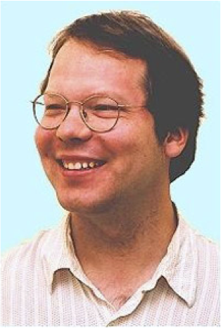
From Relational Statistics to Degrees of Belief
School of Computing Science
Simon Fraser University
Vancouver, Canada
Oliver Schulte | Hassan Khosravi | Arthur Kirkpatrick | Tianxiang Gao | Yuke Zhu
Notes:
Mention luc’s book, Henrik’s work.
Add Sajjad
Advertise database repository.
relationallearning.net, Wannes Meert

Slide 2

Overview
Structure and Parameter Learning
Bayesian Network Model for Relational Frequencies
New Log-linear Model
Model-based
Relational Classifier
Dependency Network
Relational Outlier Detection

Slide 3

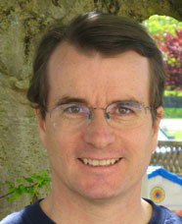
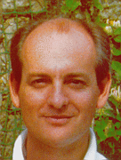
Relational Data and Logic
Lise Getoor
David Poole
Stuart Russsell
Notes:
There are different formalism for describing relational data and relational models. I follow the approach developed by Poole, Russell Getoor. My learning algorithm work for others as well. Basically, for any formalism basedon first-order logic. I’m also trying to show that we are in review mode.

Slide 4
Database Management Systems
Maintain data in linked tables.
Structured Query Language (SQL) allows fast data retrieval.
  E.g., find all movie ratings > 4 where the user is a woman.
Multi-billion dollar industry, $Bn 15+ in 2006.
IBM, Microsoft, Oracle, SAP, Peoplesoft.
Much interest in analysis (big data, data mining, business intelligence, predictive analytics, OLAP…)

Slide 5
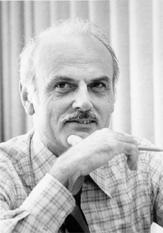
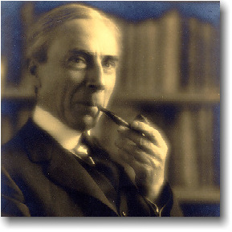
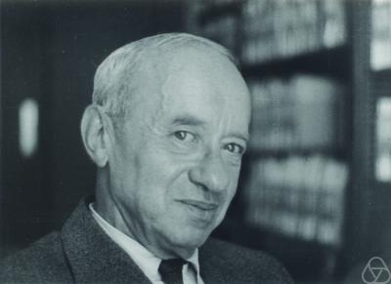
The Relational Data Model
Codd (IBM Research 1970)
The fundamental question: What kinds of information do users need to represent?
Answered by first-order predicate logic!
(Russell, Tarski).
The world consists of
  Individuals/entities.
  Relationships/links among them.

Slide 6
Entity-Relationship Diagram IMDb
Notes:
See also imdb-eer.mws from Workbench.
Note that there can be attributes of relationships as well.

Slide 7
Notes:
More realistic, still relatively small. http://www.dbis.informatik.uni-goettingen.de/Mondial/

Slide 8
Relational Data Formats
Data Format
graphical
logical
tabular
Nodes and edges in heterogenous network
(Sun and Han 2012)
Logical Facts
Knowledge Graph Triples
(Nickel et al. 2015)
Atoms
Database Tables
SQL

Slide 9
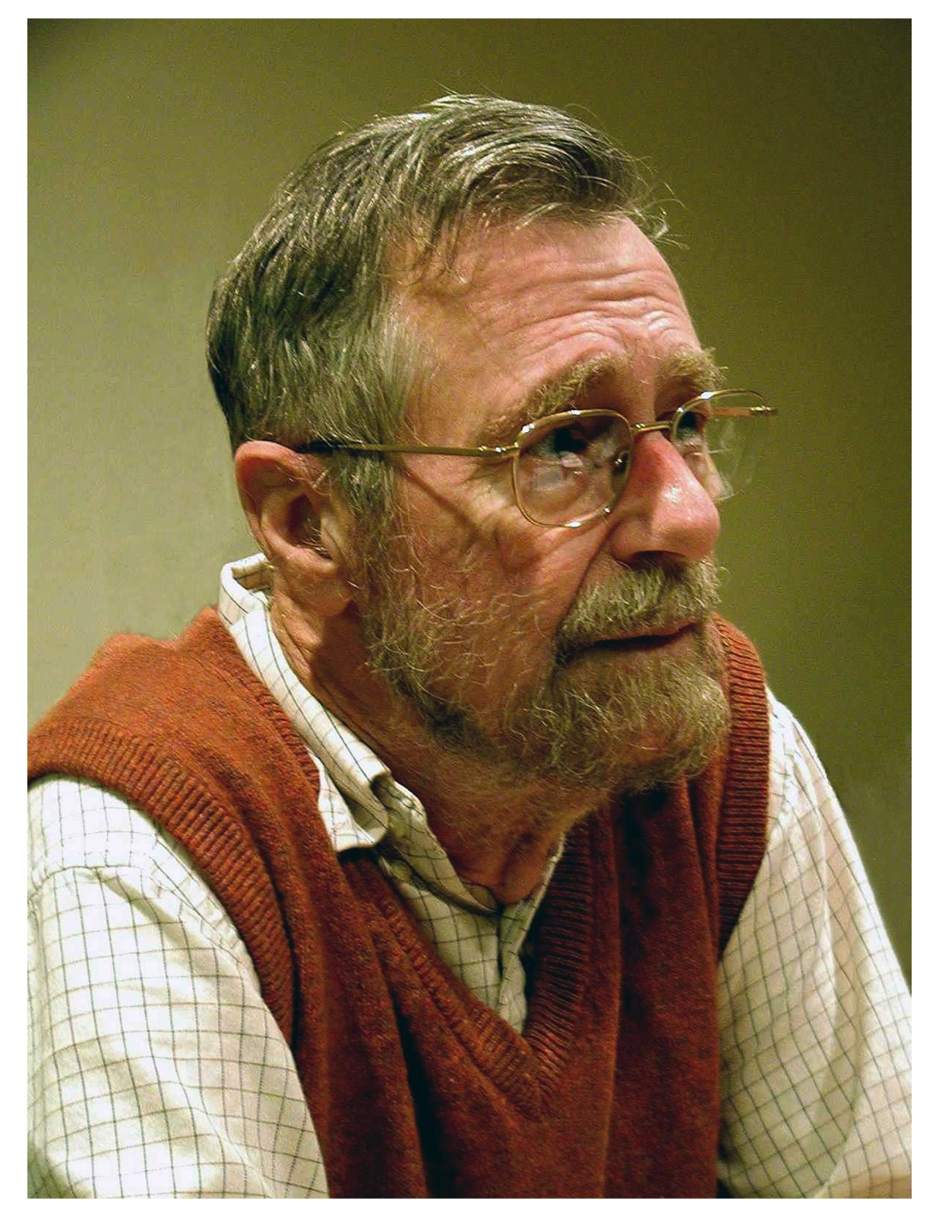
Logical Representation
Edsger Dijkstra
by Hamilton Richards
Standard in database theory.
Unify logic and probability.
Equational logic (Dijkstra and Scholten 1990) is especially similar to random variable concepts in statistics.
  Represent relational information using functions (functors) (Poole 2003).
  Single table data : All functions take 1 argument (Nickel et al. 2015).
  Relational data: Some functions take > 1 argument.
Poole, D. (2003), First-order probabilistic inference, in 'IJCAI’.
Getoor, L. & Grant, J. (2006), 'PRL: A probabilistic relational language', Machine Learning 62(1-2), 7-31.
Russell, S. & Norvig, P. (2010), Artificial Intelligence: A Modern Approach, Prentice Hall.
Ravkic, I.; Ramon, J. & Davis, J. (2015), 'Learning relational dependency networks in hybrid domains', Machine Learning.
Dijskstra & Scholten (1990), Predicate calculus and program semantics, Springer Verlag.
Notes:
Unification Listed as a major topic in Russell and Norvig’s AI textbook.
Show Russell paper, including graphic on logic and probability.
Add BLPs, deRaedt?
This is about the data. Get to pattern language next.

Slide 10

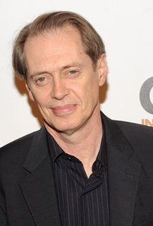

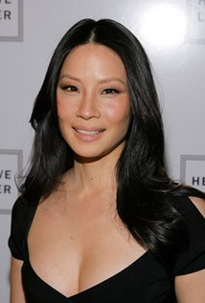


Function Representation Example
gender = Man
country = U.S.
gender = Man
country = U.S.
gender = Woman
country = U.S.
gender = Woman
country = U.S.
False
n/a
False
n/a
True
$500K
False
n/a
False
n/a
True
$5M
False
n/a
True
$2M
ActsIn
salary
genre = action
country = U.S.
genre = action
country = U.S.
Notes:
functors: gender, genre, who acts in what.
Can also add complex functions, like aggregate functions, page rank. See Kersting and deRaedt.

Slide 11
First-Order Logic
An expressive formalism for specifying relational conditions.
database theory
relational learning
First-Order Logic
Query language
Pattern Language
Notes:
Remind them that I use equational logic

Slide 12
First-Order Logic: Terms
A constant refers to an individual.
  e.g. “Fargo”
A logical variable refers to a class of individuals
  e.g. “Movie” refers to Movies.
A ground term is of the form f(a₁,..,a_{n})
  e.g. “salary(UmaThurman, Fargo)”
A first-order term is of the form f(t₁,..,t_{n}) where at least one of the t_{i} is a first-order variable.
  e.g. “salary(Actor, Movie)”.
Notes:
could also build nested terms

Slide 13
Formulas (Equational Logic)
A (conjunctive) formula is a conjunction
term₁ = value₁,...,term_{n}=value_{n}.
  ActsIn(Actor, Movie) = T, gender(Actor) = W
A ground formula contains only constants.
  ActsIn(UmaThurman, KillBill) = T, gender(UmaThurman) = W
Notes:
The value_i are constants.

Slide 14


Two Kinds of Probability
Frequencies vs. Single Event Probabilities
Joe Halpern
Fahim Bacchus

Slide 15
Frequencies/Proportions
Classical statistics aims to estimate population frequencies or proportions.
Proportion
90% of birds fly.
0% of planes have crashed because of a turbulence.
5% of Brusselians speak only Dutch at home.
51.1% of U.S. voters voted for Barack Obama.
Notes:
https://en.wikipedia.org/wiki/Brussels#French_and_Flemish_communities
http://www.bloomberg.com/news/articles/2013-01-03/final-tally-shows-obama-first-since-56-to-win-51-twice

Slide 16
Probabilities for Single Events
Bayesian statistics emphasizes assigning probabilities to single events.
  Including the values of model parameters.
Proportion | Instance
90% of birds fly. | The probability that Tweety flies is 90%.
0% of planes have crashed because of a turbulence. | The probability that Flight 3202 to Brussels crashes because of a turbulence is 0%.
5% of Brusselians speak only Dutch. | Given that Marc lives in Brussels, the probability that he speaks only Dutch is 5%.
 | The probability that the mean μ=0 for a Gaussian distribution is 0.01.
Notes:
“there is not one accidence in the history of modern aviation that has been caused by turbulence (Allen Carr).”
Can instantiate frequencies to get single probability results.
More examples: predict result of election

Slide 17
Classical Statistics: Two Kinds of Probabilities
Probability
learning
Frequency in class of events
instantiate
Degree of Belief, Uncertainty
Betting Odds
inference
Notes:
can also cite Kahnemann
it’s a pipeline!

Slide 18
Two Kinds of Relational Probabilities
P(first-order formulas)
Relational Probability
P(ground formulas)
Relational Frequency
Statistics
type 1 probability
Class-level probability
instantiate (?)
Degree of Belief
type 2 probability
Instance-level probability
inference (?)
The Halpern instantiation principle:
P(φ(X)) = p) ➔P(φ(c)) = p
where φ is a formula with free logical variable X, and c is a constant instantiating X.
Notes:
Halpern: type I,l type II probability. Getoor: kind of universally quantified.
The instantiation is difficult, this is the most fundamental difference between relational and iid data.
In iid data, frequencies and single-event probabilities come apart only for parameter values. In relational data, come apart always when there are multiple instantiations.
Probability of grounding = probability of frequency.

Slide 19
Examples of the Instantiation Principle
First-Order | Ground Instance
90% of birds fly. | The probability that Tweety flies is 90%.
P(Flies(B)) = 90% | P(Flies(tweety)) = 90%
0% of planes have crashed because of a turbulence. | The probability that Flight 3202 to Brussels crashes because of a turbulence is 0%.
P(Turbulence_Crash(Plane)) = 0%. | P(Turbulence_Crash(3202)) = 0%.
x% of Brusselians speak Dutch. | Given that Marc lives in Brussels, the probability that he speaks Dutch is x%.
P(SpeaksOnly(Person,dutch)|FromBrussels(Person)) = 5%. | P(SpeaksOnly(marc,dutch)|FromBrussels(marc)) = 5%.

Slide 20
Previous SRL Work: Different Models for Different Probabilities
Many Model Types:
Parametrized Bayes Nets
Probabilistic Relational Models,
Markov Logic Networks,
Bayes Logic Programs,
Logical Bayesian Networks, …
Relational Probability
Statistical-Relational Models
(Lise Getoor, Taskar, Koller 2001)
Model for Frequencies
Class-Level Probabilities
Model for Single Event Probabilities
Instance-Level Probabilities

Slide 21
Today: Unified Approach
Learning
Bayesian Network
new class-level semantics
statistical-relational model
Frequencies
Class-Level
instantiate
Single Event Probabilities
Instance-Level
new log-linear model
Notes:
Pipeline like in classical statistics.
“Instantiation” is difficult. This is the most profound difference between relational and nonrelational learning.

Slide 22
Relational Frequencies
Joe Halpern
Fahim Bacchus

Slide 23
Applications of Relational Frequency Modelling
First-order rule learning
(e.g., “women users like movies with women actors”).
Strategic Planning
(e.g., “increase SAT requirements to decrease student attrition”).
Query Optimization (Getoor, Taskar, Koller 2001).
Class-level queries support selectivity estimation ➔
optimal evaluation order for SQL query .

Slide 24
Relational Frequencies
Database probability of a first-order formula =
number of satisfying instantiations/
number of possible instantiations.
Examples:
  P_{D}(gender(Actor) = W) = 2/4.
  P_{D}(gender(Actor) = W, ActsIn(Actor,Movie) = T) = 2/8.

Slide 25
The Grounding Table
P(gender(Actor) = W, ActsIn(Actor,Movie) = T, genre(Movie) = Action) = 2/8
frequency = #of rows where the formula is true/# of all rows
Logical Variable
Single data table that correctly represents relational frequencies.
Schulte 2011, Riedel, Yao, McCallum (2013)
Actor | Movie | gender(Actor) | ActsIn(Actor,Movie) | genre(Movie)
Brad_Pitt | Fargo | M | F | Action
Brad_Pitt | Kill_Bill | M | F | Action
Lucy_Liu | Fargo | W | F | Action
Lucy_Liu | Kill_Bill | W | T | Action
Steve_Buscemi | Fargo | M | T | Action
Steve_Buscemi | Kill_Bill | M | F | Action
Uma_Thurman | Fargo | W | F | Action
Uma_Thurman | Kill_Bill | W | T | Action
Notes:
single data table that correctly represents relational frequencies

Slide 26
Random Selection Semantics (Terms)
Logical Random Variable
P(Movie = Fargo) = 1/2
Prob | Actor | Movie | gender(Actor) | ActsIn(Actor,Movie) | genre(Movie)
1/8 | Brad_Pitt | Fargo | M | F | Action
1/8 | Brad_Pitt | Kill_Bill | M | F | Action
1/8 | Lucy_Liu | Fargo | W | F | Action
1/8 | Lucy_Liu | Kill_Bill | W | T | Action
1/8 | Steve_Buscemi | Fargo | M | T | Action
1/8 | Steve_Buscemi | Kill_Bill | M | F | Action
1/8 | Uma_Thurman | Fargo | W | F | Action
1/8 | Uma_Thurman | Kill_Bill | W | T | Action
Notes:
single data table that correctly represents relational frequencies
Schulte, O. (2011), A tractable pseudo-likelihood function for Bayes Nets applied to relational data, in 'SIAM SDM', pp. 462-473.
Raedt, L. D. (1998), Attribute-Value Learning Versus Inductive Logic Programming: The Missing Links (Extended Abstract), in David Page, ed., 'ILP', Springer, , pp. 1-8.
Riedel, S.; Yao, L. & McCallum, A. (2013), 'Latent Relation Representations for Universal Schemas', CoRR abs/1301.4293.

Slide 27
Random Selection Semantics
Population
Population variables
First-Order Random Variables
Actors
Actor
Random Selection
from Actors.
P(Actor = brad_pitt) = 1/4.
gender(Actor)
Gender of selected actor.
P(gender(Actor) = W) = ½.
ActsIn(Actor,Movie) =
T if selected actor appears in selected movie, F otherwise
P(ActsIn(Actor,Movie) = T) = 3/8
Movies
Movie
Random Selection
from Movies.
P(Movie = fargo) = ½.
genre(Movie)
Genre of selected movie.
P(genre(Movie)=Action) = 1.
Notes:
skip this if it’s clear

Slide 28
Bayesian Networks for Relational Statistics
Statistical-Relational Models (SRMs)
Random Selection Semantics for Bayesian Networks
Bayesian Network Model for Relational Frequencies

Slide 29
Bayesian networks for relational data
A first-order Bayesian network is a Bayesian network whose nodes are first-order terms (Wang et al. 2008).
aka parametrized Bayesian network (Poole 2003, Kimmig et al. 2014).
gender(A)
genre(M)
ActsIn(A,M)
Notes:
Bayesian networks are close to rules (Kersting and deRaedt)
parametrized BNs not a frequency model
Demo.
First-order Random variables = terms.

Slide 30
Random Selection Semantics for First-Order Bayesian Networks
P(gender(Actor) = W, ActsIn(Actor,Movie) = T, genre(Movie) = Action) = 2/8
“if we randomly select an actor and a movie, the probability is 2/8 that the actor appears in the movie, the actor is a woman, and the movie is an action movie”
Demo.
gender(A)
genre(M)
ActsIn(A,M)
Notes:
These frequencies are interesting in themselves!
could also be typical or normal individuals.

Slide 31
Bayesian Networks are Excellent Estimators of Relational Frequencies
Queries Randomly Generated.
Example: P(gender(A) = W|ActsIn(A,M) = true, genre(M) = drama)?
Learn and test on entire database as in Getoor et al. 2001.

Slide 32
How to upgrade propositional Bayesian network learners to first-order logic
Structure and Parameter Learning
Bayesian Network Model for Relational Frequencies
Notes:
make overall system flow, show parts of it here.

Slide 33

How to upgrade single-table Bayesian network learners to multi-relational data
Follow Luc’s advice!
Search the space of functors/predicates, not literals. (Kersting and de Raedt 2007).
Organize search using the specialization/refinement lattice of models (Laer and de Raedt 2001).
Follow the generalization principle (Knobbe 2006):
When we apply a relational model to a single i.i.d. data table, it should give the same result as the propositional model.

Slide 34
General Structure Learning Schema
After Kimmig et al. 2014.
Initialize graph G := empty.
While not converged do
  Generate candidate graphs.
  For each candidate graph C, learn parameters θ_{C} that maximize score(C, θ, dataset).
  G := argmax_{C} score(C, θ_{C},dataset).
check convergence criterion.
lattice search
relational score
Notes:
use open Markov in Bristol

Slide 35
Scoring Bayesian Networks for Relational Data
Notes:
cite Jensen on independent instances.

Slide 36
The Random Selection Pseudo Likelihood Function
Randomly select a grounding for all first-order variables in the first-order Bayesian network.
Compute the log-likelihood for the attributes of the selected grounding.
Pseudo log-likelihood = expected log-likelihood for a random grounding.
Generalizes i.i.d. log-likelihood.
Notes:
generalizes i.i.d. case: only one first-order variable.
uses random selection semantics, instantiation principle

Slide 37
Example
gender(A)
genre(M)
ActsIn(A,M)
Prob | A | M | gender(A) | ActsIn(A,M) | genre(M) | P_{B} | ln(P_{B})
1/8 | Brad_Pitt | Fargo | M | F | Action | 3/8 | -0.98
1/8 | Brad_Pitt | Kill_Bill | M | F | Action | 3/8 | -0.98
1/8 | Lucy_Liu | Fargo | W | F | Action | 2/8 | -1.39
1/8 | Lucy_Liu | Kill_Bill | W | T | Action | 2/8 | -1.39
1/8 | Steve_Buscemi | Fargo | M | T | Action | 1/8 | -2.08
1/8 | Steve_Buscemi | Kill_Bill | M | F | Action | 3/8 | -0.98
1/8 | Uma_Thurman | Fargo | W | F | Action | 2/8 | -0.98
1/8 | Uma_Thurman | Kill_Bill | W | T | Action | 2/8 | -1.39
 |  |  |  |  |  | 0.27 geo | -1.32 arith
Notes:
implicitly uses the instantiation principle
Raedt, L. D. (1998), Attribute-Value Learning Versus Inductive Logic Programming: The Missing Links (Extended Abstract), in David Page, ed., 'ILP', Springer, , pp. 1-8.

Slide 38
Observed Frequencies Maximize Pseudo-Likelihood
Proposition The random selection pseudo log-likelihood is maximized by setting the Bayesian network parameters to the observed conditional frequencies.
gender(A)
genre(M)
P(ActsIn(A,M)=T|g(A) = M,ge(M) = Action) = ¼
...
ActsIn(A,M)

Slide 39
Equivalent Closed-Form Computation for Pseudo-Likelihood
relational joint frequency of child node value and parent state
e.g. P_{D}(ActsIn,M,Action) = 1/8
Parameter of Bayes net
e.g. P(ActsIn|M, Action) = ¼
gender(A)
genre(M)
ActsIn(A,M)
Notes:
this is a log-linear model
can extend with AIC, BIC
generalizes single-table case
can visualize as splitting the original groundings table.
can be evaluated in closed form given sufficient statistics

Slide 40
Parameter Learning
Maximum Likelihood Estimation

Slide 41
Computing Parameter Estimates
  Need to compute a contingency table with grounding counts.
  Well researched for all true relationships.
  SQL Count(*)
  Virtual Join
  Partition Function Reduction
g(A) | Acts(A,M) | ge(M) | count
M | F | Action | 3
M | F | Action | 3
W | F | Action | 2
W | T | Action | 2
M | T | Action | 1
M | F | Action | 3
W | F | Action | 2
W | T | Action | 2
Notes:
Also parametrized polynomial in number of first-order variables.

Slide 42
The Möbius Extension Theorem for negated relations
For two link types
R₁
R₂
Count(*)
Joint probabilities
R₁
R₂
Count(*)
R₁
R₂
Count(*)
R₁
R₂
Count(*)
R₁
R₂
Count(*)
R₁
Count(*)
Möbius Parameters
R₂
Count(*)
nothing
Count(*)

Slide 43

The Fast Möbius Transform
ActsIn(A,M) = R₁
HasRated(U,M) = R₂
Initial table with no false relationships
J.P. = joint probability
table with joint probabilities
R₁ | R₂ | J.P.
T | T | 0.2
* | T | 0.3
T | * | 0.4
* | * | 1
R₁ | R₂ | J.P.
T | T | 0.2
F | T | 0.1
T | * | 0.4
F | * | 0.6
R₁ | R₂ | J.P.
T | T | 0.2
F | T | 0.1
T | F | 0.2
F | F | 0.5
-
+
-
+
-
-
+
+
Notes:
ignoring attribute condition
numbers are made up
* means: nothing specified.
Let audience trace it.

Slide 44
Using Presence and Absence of Relationships
Fast Möbius Transform ➔ almost free computationally!
Allows us to find correlations with relationships.
  e.g. users who search for an item on-line also watch a video about it.
Relationship variables selected by standard data mining approaches (Qian et al 2014).
  Interesting Association Rules.
  Feature Selection Metrics.
Notes:
high transaction volume -> HasLoan.

Slide 45
Parameter Learning Time
Fast Inverse Möbius transform (IMT) vs.
Constructing complement tables using SQL.
Times are in seconds.
Möbius transform is much faster, 15-200 times.

Slide 46
Structure Learning: Lattice Search

Slide 47
Learning a Bayesian Multi-Net
Score = pseudo log-likelihood – parameter penalty
Learn a Bayesian network for each relationship chain.
Nodes and edges are propagated from shorter chains to smaller chains.
Demo.
ActsIn(A,M), HasRated(U,M)
ActsIn(A,M)
HasRated(U,M)
Actors A
Movies M
Users U
Notes:
Preserves complexity.

Slide 48
Comparison With Luc’s advice
Search in space of functions/predicates.
Generalizes i.i.d. BN learning.
Decompose specialization lattice into sublattices.
  Each sublattice corresponds to relational path.
  Lattices at the same level can be analyzed separately ➔ distributed processing.
  Results from lower levels are propagated to higher levels ➔dynamic programming style.
First-order variables only ➔ half of theta-subsumption.
Notes:
(normal in i.i.d. BN learning)
General moral: efficient implementation of theta-subsumption search
Look up Friedman et al.

Slide 49
Fast Structure Learning
Dataset | # Predicates | # tuples | RDN_Boost | MLN_Boost | Lattice
UW | 14 | 612 | 15±0.3 | 19±0.7 | 1±0.0
Mondial | 18 | 870 | 27±0.9 | 42±1.0 | 102±6.9
Hepatitis | 19 | 11,316 | 251±5.3 | 230±2.0 | 286±2.9
Mutagenesis | 11 | 24,326 | 118±6.3 | 49±1.3 | 1±0.0
MovieLens(0.1M) | 7 | 83,402 | 44±4.5 min | 31±1.87 min | 1±0.0
MovieLens(1M) | 7 | 1,010,051 | >24 hours | >24 hours | 10±0.1
Imdb(1.5M) | 17 | 1,538,400 | >24 hours | >24 hours | 549
Standard deviations are shown for cross-validation.
Units are seconds/predicate or function
Notes:
MovieLens 1M takes only 9 sec more because counting in RDBMS scales really well.
DNs are only learned for predicates for both MLN-Boost and RDN_Boost (two possible values only).
IMDB is evaluated only on unary predicates, for all methods. IMDB evaluated only on one fold.
We report the average per node.
good at finding long relationship chains.
Hepatitis has a complex schema: longer to learn single model than learn independently.
--------------------
Not available yet = not run yet.

Slide 50
From Relational Statistics to Degrees of Belief
Structure and Parameter Learning
Bayesian Network Model for Relational Frequencies
New Log-linear Model
Relational Classifier
Dependency Network

Slide 51
Predicting Ground Facts
Many relational models aim to predict specific facts, e.g.
  Will KAA Gent win the Belgian football league 2015-2016?
  Is Spectre likely to do well at the box office?
The problem: relational data feature multiple instantiations of the same pattern.
  E.g. 1,000 men give Spectre a high rating, 1,200 women give spectre a high rating.
Halpern’s project: from relational frequencies, derive a probability distribution over possible worlds (models, databases). (Halpern 1990, 1992, 2006).
Notes:
https://en.wikipedia.org/wiki/List_of_Belgian_football_champions

Slide 52
Bayesian Network Relational Classification
Classification problem: Define P(Y*=y|X*=x) for ground term Y* given values for all other terms X*.
Strictly easier than defining joint probability P(Y*=y,X*=x).
Basic idea: score labels by comparing pseudo-likelihood P(Y*=0,X*=x) to P(Y*=1,X*=x) .
Restrict pseudo-likelihood to relevant groundings that involve the target term.
Generalizes propositional Bayesian Network classification formula.
Notes:
Fine Print: in general, need to restrict to relevant groundings as well.
(cf. Kimmig et al. 2014).

Slide 53
Example
gender(sam)
genre(M)
-1.32 > -1.36: predict sam is a woman.
ActsIn(sam,M)
A | M | gender(A) | ActsIn(A,M) | genre(M) | P_{B} | ln(P_{B})
sam | Fargo | W | F | Action | 2/8 | -0.98
sam | Kill_Bill | W | T | Action | 2/8 | -1.39
 |  |  |  |  |  | -1.32 arith
A | M | gender(A) | ActsIn(A,M) | genre(M) | P_{B} | ln(P_{B})
sam | Fargo | M | F | Action | 3/8 | -0.98
sam | Kill_Bill | M | T | Action | 1/8 | -1.39
 |  |  |  |  |  | -1.36 arith
Notes:
implicitly uses the instantiation principle
Has closed form that generalizes propositional classifier.
Has random selection interpretation.
Show more complex example with entire Markov blanket.

Slide 54
Dependency Networks
aka Markov blanket networks (Hoffmann and Tresp 1998).
Defined by a local conditional distribution for each random variable Y*: P(Y*=y|X*=x).
We just showed Bayesian network ➔ dependency network.
Can compare with other dependency network learning.
Recall that this is very fast (<12 min on 1M tuples).
Finds complex dependencies
  e.g. gender(User) correlates with gender(Actor) in movies they have rated.

Slide 55
Accuracy Comparison
Leave-one-out over all unary functors.
PR = area under precision-recall curve.
CLL: conditional log-likelihood
Notes:
Arrows point in the direction of better performance.
This is for unary predicates only. For binary predicates, see paper.
Boosting method inference.

Slide 56
Model-Based Unsupervised Relational Outlier Detection

Slide 57

Model-Based Outlier Detection for I.I.D. data
ID | Attribute1 | Attribute2 | Attribute3
1 | W | rich | 10
2 | .... | ... | ...
Learning
ID | Att1 | Att2 | Att3
1000 | M | rich | 8
Attribute1
Attribute2
Attribute3
Likelihood of potential outlier
low likelihood ➔outlier

Slide 58
Model-Based Outlier Detection for Relational Data
Population Database
e.g. Premier League games
First-Order Bayesian network
Individual Profile
e.g. MU games
Pseudo likelihood of individual database
low likelihood ➔outlier
Notes:
cite Blockeel on learning from interpretations
like learning from interpretations

Slide 59
Likelihood Ratio Variant
Complete
Database
Individual Profile
Parameter
Learning
Algorithm
Parameter
Learning
Algorithm
BN Structure
Population Parameter
Values θ_{Class}
Individual Parameter
Values θ_{individual}
outlier score =
pseudo-likelihood(θ_{Class})/
pseudo-likelihood(θ_{individual})
Notes:
Further refinement: apply mutual information decomposition to log-likelihood ratio

Slide 60
Example Terms in Outlier Metrics
Striker Edin Dzeko.
Pseudo log-likelihood:
  Shoteff(dzeko,M) = hi, TackleEff(dzeko,M)= medium ➔ DribbleEff(dzeko,M) = low.
  Support=26% Confidence = 50%.
Pseudo log-likelihood
26% x ln(38%).
Pseudo Log-likelihood ratio
26% x (ln(38%)-ln(50%)).
Shoteff(P,M)
TackleEff(P,M)
DribbleEff(P,M)
P(DribbleEff(P,M) = low|
Shoteff(P,M) = hi,
TackleEff(P,M)= medium)
= 38%
Notes:
the best of both worlds: the log-liikelihood score decomposes into associations, at the same time adds all differences.

Slide 61
Interpretable (and Accurate)
Top Outliers from Selected Normal Classes:
Strikers
Midfielders
Drama

Slide 62
Summary, Review, Open Problems

Slide 63
Random Selection Semantics for First-Order Logic
First-order variables and first-order terms are viewed as random variables.
Associates relational frequency with each first-order formula.
Joe Halpern
Fahim Bacchus

Slide 64
Applying random selection to log-linear models
Graphical model ≈
Propositional log-linear model
s = w_{i} x_{i}
relational log-linear model
s = w_{i} f_{i}
E(s) from random instantiation
feature functions = frequency
Combines multiple instantiations of the same feature.
Defines relational pseudo log-likelihood score Bayes net.

Slide 65
Log-linear Models With Proportions
Frequencies are on the same scale [0,1]: addresses “ill-conditioning” (Lowd and Domingos 2007).
Surprisingly expressive: can “simulate” combining rules (Kazemi et al. 2014).
Also effective for dependency networks with hybrid data types (Ravkic, Ramon, Davis 2015).
Random selection semantics provides a theoretical foundation.

Slide 66
Learning results
Random selection pseudo-likelihood score for Bayesian networks.
Closed-form parameter estimation.
  Fast Möbius transform for computing parameters with negated relationships.
Structure Learning: Decompose the lattice of relationship chains.
Fast learning, competitive accuracy for:
  modeling relational frequencies.
  relational dependency networks.
  relational outlier detection.

Slide 67
Open Problems
Learning with constants (theta-subsumption).
Generalize model scores like AIC, BIC with positive and negative relationships.
  need to scale penalty terms as well as feature counts.
Notes:
Add neighbourhood counts as predictors (cf. Poole on relational logistic regression).

Slide 68

Thank you!
Any questions?

