Slide 1
External Storage

Slide 2
So far …
… we have been assuming that the data collections we have been manipulating were entirely stored in memory.

Slide 3
BIG Datasets
… In practice, this is not always a reasonable assumption.
What if we were asked to search records of all Canadians for a particular Canadian (search key -> lastname)?
How many records?
Problem?

Slide 4
Record for a Canadian
class Canadian
{
private:
string lastName;
string firstName;
string middleName;
string SIN;
…
};

Slide 5
BIG Datasets
What if we were asked to search records of all Canadians for a particular Canadian (search key -> lastname)?
How many records?
How much space?
35 million * 20 bytes / string * 100 strings(?) = approx 70GB
Some large databases, in which records are kept in files stored on external storage such as hard disk, cannot be read entirely into main memory.
We refer to such data as disk-bound data.

Slide 6
BIG Datasets Stay on Disk
Hence, big datasets cannot fit in memory
Need to keep them on hard disk (“on disk”)
Just read what we need at one time into memory
Challenge: memory and disk access are not created equal

Slide 7
Disk-Bound Data
Time efficiency of search for Canadian?
Important factors:
Accessing data stored in a file kept on the hard disk is extremely slow compared to accessing data in memory -> order of milliseconds (10⁻³)
In contrast, accessing data in memory is fast -> order of nanoseconds (10⁻⁹)
Given the million-to-1 ratio of disk access time versus memory access time, to search our 30M records efficiently, we will need to devise a way that minimizes the number of disk accesses performed.
Notes:
Accessing data stored in a file kept on the hard disk is extremely slow …
Access time = seek time +rotational delay (latency) + transfer time

Slide 8
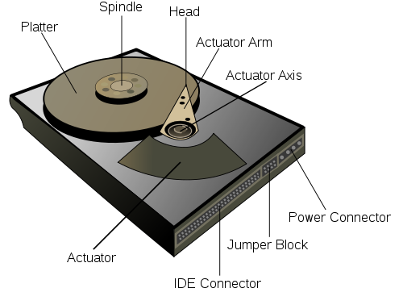
Why is Hard Disk Access Slow?

Slide 9
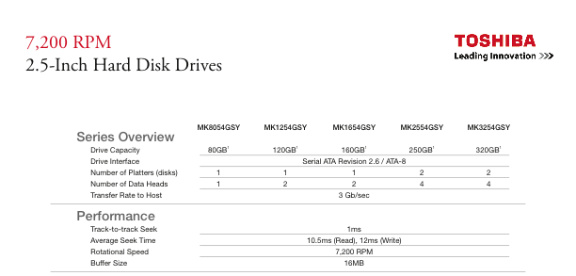
Your average PC hard drive

Slide 10
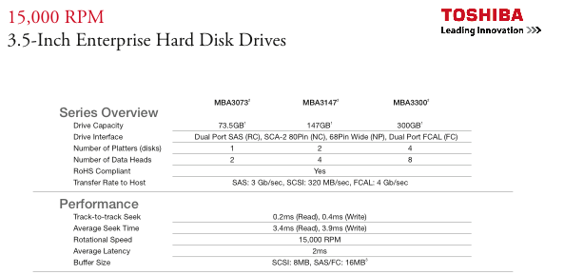
Your not-so-average hard drive

Slide 11
Aside
Solid State Drives (SSD) can be much faster than spinning disks
And much more expensive
However, still large latency compared to RAM

Slide 12
Sanity Check: Is that Slow?
What do those numbers mean?
Search in a red-black tree with 35 million records?
log n = 25
If dataset fits in memory
Hundreds of nanoseconds per search
Can handle thousands of searches per second
If dataset doesn’t
Hundreds of milliseconds per search
Can handle only a few searches per second

Slide 13
Disk Access
Most time consuming operation when elements stored in external storage (disk)
Compared to 10 milliseconds, compute time is irrelevant
How many operations can a CPU do in 10 milliseconds?
@3GHz, a lot

Slide 14
Block
Basic unit written to/read from external storage (disk)
If you’re going to read don’t just read 1 bit
Block size varies on each system
E.g. could be 8KB, could be 1MB

Slide 15
Example of blocks
Nodes of a binary tree can be located in different blocks on a disk.

Slide 16
File Access
Random access file
Linear data collection (like an array)
Sequential access file
Linear data collection (like a linked list)
Go to external_reading example

Slide 17
Back to our problem
We have records for ~30M Canadians
Assume we can’t store them in memory
So we keep them on disk
Now we want to search for one Canadian
How should we do it?

Slide 18
Search - Take #1
We could store our 30M Canadian records in a disk file which we access randomly
Assume each block on disk contains only 1 record
Time efficiency to search for that Canadian?
If our records are not sorted: linear search -> O(n)
How fast is this in seconds?
30M * milliseconds = seconds

Slide 19
Search - Take #2
We could store our 30M Canadian records in a disk file which we access randomly.
Assume each block on disk contains only 1 record
Sort the records within the disk file (A. Aaronson at beginning of file, Z. Zygmund at end)
Time efficiency to search for that Canadian
If our records are sorted: binary search -> O(log₂ n)
How fast is this in seconds?
log (30M) * milliseconds = hundreds of milliseconds

Slide 20
Better, but still not so good
Still need to do many disk accesses
Array is sorted, so log(n) disk accesses
Disk accesses are really slow
Let’s try to reduce them even further

Slide 21
Search - Take #3
Main idea: split data into two files on disk
DATA file
Holds all information about all Canadians (our 70GB of data)
INDEX file
A smaller file that tells me where to find data about each Canadian
Remember the seekg command, random access to DATA file

Slide 22
Index File
INDEX file should hold entries <key, file byte>
key is name of Canadian (or SIN)
file byte is offset into DATA file of where the record for this Canadian starts
…
<G Mori, 504>
<H Mori, 206>
<G Jensen, 7>
<R Henderson, 1083>
…
t | 6 | 4 | 2 | M | o | r | i
500 | 501 | 502 | 503 | 504 | 505 | 506 | 507
INDEX file
DATA file

Slide 23
Size of Index File
Index file will be smaller than data file
File size will be?
# Canadians * key size * file byte size
Much smaller than data file if record for each Canadian is large

Slide 24
Organization of Index File
In order to find data about an individual, need to find his entry in index file
So what should we do to the index file?
Sort it, e.g. into a tree data structure
…
<G Mori, 504>
<H Mori, 206>
<G Jensen, 7>
<R Henderson, 1083>
…
INDEX file

Slide 25
Search – Take #3 Flavour 1
Let’s assume 30 million * key size * file byte size is not “too big”
I.e. it fits in memory
Build a tree structure to store the contents of the index file in memory
Can build it / read it from disk when the program starts
Make it a balanced tree (e.g. red-black)

Slide 26
Search - Take #3 – Flavour 1
Time efficiency to search for a record will be:
O(log₂ n) comparisons (worst case) (for searching the index tree and finding the desired key, hence block #)
+ 1 disk access to fetch the block, in the data file, that contains the desired record (using block # found above)
Time efficiency to search for a particular Canadian will be: about 25 comparisons + 1 disk access
Just a few milliseconds

Slide 27
Isn’t that Index File Pretty Big?
Wait a minute, 30 million * key size * file byte size isn’t that much smaller than the data file!!
Hmm… we can use a similar trick on the index file

Slide 28
Search - Take #3 – Flavour 2
If the entire tree stored in the Index file cannot be loaded into main memory:
Each of its nodes, stored in a block, will contain as the “location of this node’s left and right subtrees” the block # of the block in the Index file containing the root of the left/right subtree.
I.e. instead of a tree in memory with child pointers, a tree in the file with child block #s

Slide 29
Search - Take #3 – Flavour 2
To perform a search:
the block containing the root of the tree is first accessed from the Index file
Tree search algorithm is performed on node contained in that block
the block # of the next tree node (block in Index file) is determined and the block containing that node is accessed
above two steps are repeated until the desired key is found or bottom of tree is reached (i.e., key not found)
if key found, the data file block containing the matching record is accessed using the block # of pair

Slide 30
Search - Take #3 – Flavour 2
Time efficiency to search for a record will be:
O(log₂ n) disk accesses (worst case)
+ 1 disk access to fetch the block, in the data file, that contains the desired record
Time efficiency to search for a particular Canadian will be: about 25 disk accesses + 1 disk access

Slide 31
Not so good (again)
Wait, 25 disk accesses sounds familiar
That was the case for good old binary search on the data file
Let’s (again) try to do better

Slide 32
Search - Take #4
How can we improve search performance?
In order to minimize the number of disk accesses, we need to minimize the number of levels in our search tree, i.e., we need to flatten our tree.
This can be achieved by increasing the number of records each node of our search tree can deal with.
A B Tree can help …

Slide 33
More Trees (M-way, B)

Slide 34
M-Way Search Tree
Definition: m-way search tree T is a tree of order m, in which each node can have at most m children
Binary search trees generalize directly to m-way search trees
Purpose of m-way search tree: Efficient search (hence retrieval)
Other names given to m-way search trees are
m-ary search trees
multiway search trees
n-way search trees
n-ary search trees

Slide 35
M-Way Search Tree
Definition: An m-way search tree T is an m-way tree (a tree of order m) such that:
T is either empty or
each non-leaf node of T has at most m children (subtrees):
T₀, T₁, …, T_{m-1}
and m – 1 key values in ascending order:
K₁ < K₂ < … < K_{m-1}
for every key value V in subtree T_{i}: (rules of construction)
V < K₁, i = 0 K_{i} < V < K_{i+1}, 1 <= i <= m-2 V > K_{m-1}, i = m-1
every subtree T_{i} is also an m-way search tree

Slide 36
Example: The following is a 3-way search tree:
16
18
4
6
17
22
26
20
24
28
30

Slide 37
Insertion into m-way Search Tree
Search for the spot where the new element is to be inserted (using its search key) until you reach an empty subtree
Insert the new element into the parent of the empty subtree, if there is room in the node.
Insert the new element into the subtree, if there is no room in its parent.

Slide 38
Insertion into an m-way Search Tree
Let’s construct the m-way search tree shown on the previous slide where m=3
To do so, we shall insert the following search keys: 18, 16, 6, 22, 26, 4, 28, 24, 20, 30, 17
Remember: the search keys (and their associated elements) are inserted in ascending sorting order in a node
Let’s begin by inserting 18:
since the m-way tree is empty, we create the first node i.e., the root and insert 18
18

Slide 39
Insertion into an m-way Search Tree
Let’s insert 16:
Search for the spot where the new element is to be inserted using its search key until you reach an empty subtree
Insert the new element into the parent of the empty subtree, in the proper sorted order, if there is room in the parent node.
18
becomes
16
18

Slide 40
Insertion into an m-way Search Tree
Let’s insert 6:
Search for the spot where the new element is to be inserted using its search key until you reach an empty subtree
Insert the new element into the empty subtree, if there is no room in its parent node.
16
18
becomes
16
18
6

Slide 41
Insertion into an m-way Search Tree
Let’s insert 22:
Search for the spot where the new element is to be inserted using its search key until you reach an empty subtree
Insert the new element into the empty subtree, if there is no room in its parent node.
16
18
becomes
16
18
6
6
22

Slide 42
Insertion into an m-way Search Tree
Let’s insert 26:
Search for the spot where the new element is to be inserted using its search key until you reach an empty subtree
Insert the new element into the parent of the empty subtree, in the proper sorted order, if there is room in the parent node.
16
18
becomes
16
18
6
22
6
22
26

Slide 43
Insertion into an m-way Search Tree
Let’s insert 4:
Search for the spot where the new element is to be inserted using its search key until you reach an empty subtree
Insert the new element into the parent of the empty subtree, in the proper sorted order, if there is room in the parent node.
16
18
becomes
16
18
6
22
26
4
6
22
26

Slide 44
Insertion into an m-way Search Tree
Let’s insert 28:
Search for the spot where the new element is to be inserted using its search key until you reach an empty subtree
Insert the new element into the empty subtree, if there is no room in its parent node.
16
18
becomes
16
18
4
6
22
26
4
6
22
26
28

Slide 45
Insertion into an m-way Search Tree
Let’s insert 24:
Search for the spot where the new element is to be inserted using its search key until you reach an empty subtree
Insert the new element into the empty subtree, if there is no room in its parent node.
16
18
becomes
16
18
4
6
22
26
4
6
22
26
28
24
28

Slide 46
Insertion into an m-way Search Tree
Let’s insert 20:
Search for the spot where the new element is to be inserted using its search key until you reach an empty subtree
Insert the new element into the empty subtree, if there is no room in its parent node.
16
18
becomes
16
18
4
6
22
26
4
6
22
26
20
24
28
24
28

Slide 47
Insertion into an m-way Search Tree
Let’s insert 30:
Search for the spot where the new element is to be inserted using its search key until you reach an empty subtree
Insert the new element into the parent of the empty subtree, in the proper sorted order, if there is room in the parent node.
16
18
becomes
16
18
4
6
22
26
4
6
22
26
20
24
28
20
24
28
30

Slide 48
Insertion into an m-way Search Tree
Let’s insert 17:
Search for the spot where the new element is to be inserted using its search key until you reach an empty subtree
Insert the new element into the empty subtree, if there is no room in its parent node.
16
18
16
18
becomes
4
6
17
22
26
4
6
22
26
20
24
28
30
20
24
28
30

Slide 49
B Trees

Slide 50
B Tree
Definition: A B Tree is a data collection that organizes its blocks (B) into an m-way search tree, and in addition
the root of a B Tree has at least 2 children (unless it is a leaf node)
and its other non-leaf nodes have at least m / 2 children.

Slide 51
B Tree
A B Tree is built from the leaves up, rather than from the root down, and so all leaf nodes in a B Tree are on the same level.
Hence, B Tree is a balanced m-way tree, just as Red-black trees are balanced binary search trees

Slide 52
B-Tree Structure
Each block contains a tree node
m-1 <key, data file block #> pairs in a node + index file block # as links to children/subtrees

Slide 53
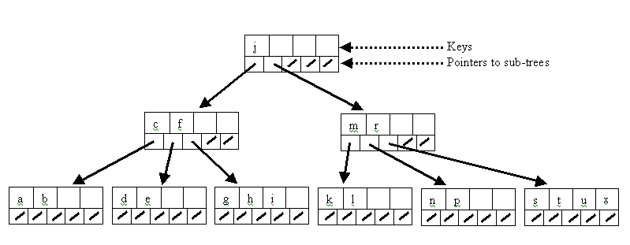
Example of B Tree
B-Tree of order 5 ( m = 5 ) in which every node (except the root and the leaves) has
at least 5 / 2 = 3 children, and
no more than 5 children
<Key, block #> pair
Children: block # in index file

Slide 54
Example: The following is a B Tree with m=4 (such B Trees are called 2-3-4 search trees)
7
12
5
9
17
20
1
3
4
8
15
16
22
23
6
10
11
18

Slide 55
Insertion into a B Tree
Let’s construct the B Tree shown on the previous slide where m=4
Actually, that B Tree is an example of a 2-3-4 search tree
To do so, we shall insert the following search keys: 12, 1, 7, 23, 20, 6, 18, 5, 4, 22, 10, 15, 8, 3 , 9, 17, 11, 16
Remember: the search keys (and their associated elements) are inserted in ascending sorting order in a node
Let’s begin by inserting 12:
since the m-way tree is empty, we create the first node i.e., the root and insert 12
12

Slide 56
Insertion into a B Tree
Insert 1:
compare each key found in the root with the key 1 and since 1 < 12, move 12 over, then insert 1
Insert 7:
compare each key found in the root with the key 7 and since 1 < 7 < 12, move 12 over, then insert 7
1
12
1
7
12

Slide 57
Insertion into a B Tree
Insert 23:
starting at the root, right away we encounter a full node so we split it as follows:
create a new node (parent) and move the middle key into it
create a sibling and move the key > 7 into it
link the subtrees to the newly formed parent node
1
7
12
7
1
12

Slide 58
Insertion into a B Tree
Insert 23 (cont’d):
starting at the root, since 7 < 23, 23 is inserted into its right subtree
considering the root of its right subtree, since its only key 12 < 23, insert 23 after 12
7
1
12
23

Slide 59
Insertion into a B Tree
7
Insert 20:
starting at the root, since 7 < 20, 20 is inserted into its right subtree
moving on to the root of its right subtree, since 12 < 20 < 23, move 23 over, then insert 20
1
12
23
7
1
12
20
23

Slide 60
Insertion into a B Tree
Let’s pick up the pace now…
Insert 6:
7
7
1
12
20
23
1
6
12
20
23

Slide 61
Insertion into a B Tree
7
Insert 18:
on our way to insert 18 we encounter a full node so we split it first:
we move its middle key into the parent node
we create a sibling and move the key > 20 into it
link the newly formed rightmost subtree to the parent node
1
6
12
20
23
7
20
1
6
12
23

Slide 62
Insertion into a B Tree
Insert 18 (cont’d):
Insert 5:
7
20
1
6
12
18
23
7
20
1
5
6
12
18
23

Slide 63
Insertion into a B Tree
Insert 4:
on our way to insert 4 we encounter a full node, so we split it first
then insert 4
7
20
1
5
6
12
18
23
5
7
20
1
6
12
18
23
5
7
20
1
4
6
12
18
23

Slide 64
Insertion into a B Tree
Insert 22:
on our way to insert 22, right away we encounter a full node so we split it first hence creating another level
5
7
20
1
4
6
12
18
23
7
5
20
1
4
6
12
18
23

Slide 65
Insertion into a B Tree
Insert 22 (cont’d):
then insert 22:
7
5
20
1
4
6
12
18
22
23

Slide 66
Insertion into a B Tree
Insert 10:
7
5
20
1
4
6
10
12
18
22
23

Slide 67
Insertion into a B Tree
Insert 15:
on our way to insert 15, we encounter a full node, so we split it first
7
5
12
20
1
4
6
10
18
22
23

Slide 68
Insertion into a B Tree
Insert 15:
then insert 15:
7
5
12
20
1
4
6
10
15
18
22
23

Slide 69
Insertion into a B Tree
Insert 8, 3, 9 and 17:
7
5
12
20
1
3
4
6
8
9
10
15
17
18
22
23

Slide 70
Insertion into a B Tree
Insert 11:
on our way to insert 11, we encounter a full node, so we split it first, then we insert 11
7
5
9
12
20
1
3
4
8
15
17
18
22
23
6
10
11

Slide 71
Insertion into a B Tree
And finally, we insert 16:
on our way to insert 16, we encounter 2 full nodes which we split before inserting 16.
7
5
9
12
20
1
3
4
8
15
17
18
22
23
6
10
11

Slide 72
Insertion into a B Tree
Insert 16 (cont’d):
7
12
5
9
20
1
3
4
8
15
17
18
22
23
6
10
11

Slide 73
Insertion into a B Tree
Insert 16 (cont’d):
7
12
5
9
17
20
1
3
4
8
15
22
23
6
10
11
18

Slide 74
Insertion into a B Tree
Insert 16 (cont’d):
Et voilà!
7
12
5
9
17
20
1
3
4
6
8
15
16
22
23
10
11
18

Slide 75
Phew
Ok, don’t worry, that won’t be on the exam
Summary: another balanced tree
But it’s not binary, it’s an m-way tree
Will have far fewer levels in it than a binary tree
Has similar balancing properties to red-black
Number of levels similar to best case log(n)

Slide 76
B Tree Search Algorithm
Access block from index file containing the root
Linearly search for key in accessed block
If found -> done!
If not found & node (block) is leaf -> not there!
Otherwise, determine which index file block # to access next based on rules of construction of m-way search tree
Access that block from index file
Repeat above step “Linearly search for key in accessed block”
If found desired key: determine its matching block # and access that block from data file

Slide 77
Search - Take #4 - B Tree
Assuming the entire Index file (B Tree) cannot be loaded into main memory.
In analyzing the search time efficiency, we need to know how many levels a B Tree (accommodating 30M records) has.
Answer:
Assuming we are using a B Tree of order 4 to store our 30M keys (and matching block #’s) and that each node of the B Tree is filled (i.e., each node contains 3 key pairs) and that every level of our B Tree is filled, then our B Tree contains:
(4^{L} – 1) key pairs, where L is the number of levels.

Slide 78
Search - Take #4 - B Tree
Hence a data collection containing 30,000,000 data records will have
log₂( 30,000,001 ) or _____ levels!
log₂4
In this example, we could increase the value of m, which would decrease the number of levels in our B Tree, hence further reduce the number of disk accesses performed during a search of our data collection containing 30M Canadians

Slide 79
Advantage of B Trees
Good for disk-bound data
When n is large, m can be set to a large number, which keeps the number of levels low
Since the number of disk accesses is proportional to the number of levels in a tree, then small # of levels translates into small number of disk accesses, and hence good time efficiency for search/insert/remove operations
In practice, commercial databases use specialized versions of these search trees where m is of the order of 100

Slide 80
External Sorting

Slide 81
Sorting
Assume we inserted our 30M Canadian records into a random access disk file.
How can we sort these records?
Let’s look at our favourite algorithms
QuickSort
HeapSort
MergeSort

Slide 82
QuickSort
Find pivot
Walk data, swapping entries greater than / less than pivot
Is this going to work well if data are stored on disk?

Slide 83
HeapSort
Heapify data
Call bubbleUp repeatedly
Remove data from heap
Is this going to work well if data are stored on disk?

Slide 84
Merge Sort
The simplest algorithm that can be used to sort disk-bound data, and one that turns out to be quite efficient, is Merge Sort.
Recall the internal Merge Sort algorithm:
divide the data collection into two sections of approx. equal size - recursively apply the algorithm to sort each of the smaller sections -> sorting is done on adjacent records - merge the sorted sections back together

Slide 85
External MergeSort example
Suppose we’re trying to sort 32 million records
Suppose disk blocks hold 1 million records
I.e. reading 1 million records is roughly as fast as reading 1
Suppose we only have enough memory to hold 3 million records in memory at a time
Let’s see how we can MergeSort under these constraints

Slide 86
External Merge Sort Algorithm
Phase 1:
Divide 32 million records into groups of 1 million
Read each 1 million into memory in turn
For each group i, sort and write back to disk as R_i (sorted)
This phase can be done under our constraint
Phase 2:
Merge sorted groups R_1,…,R_32
Let’s see why this can be done under our constraint

Slide 87
External Merging
Recall constraint: only 3 million records in memory at a time, blocks are 1 million
We need to merge up 32 sorted files R_1,…,R_32 each with 1 million records
First level merge is easy?
Merge R_1 and R_2 into R_{1,2}, R_3 and R_4, …
Each merge only requires 2 million records
What about the second level merges?
That is, merging R_{1,2} and R_{3,4}

Slide 88
Larger Merges
Suppose we are merging one sorted 8 million record file with another
Only need memory for 3 million records!
Read 1 million records (a block) from file 1
Read 1 million records (a block) from file 2
Allocate memory for 1 million records for output
Start merging
Once the output is full, write it to disk
Once a file input block is finished, read another

Slide 89
Why is this better?
QuickSort is O(n log n)
But how many disk reads will it require?
O(n log n)
External MergeSort is O(n log n)
But how many disk reads will it require?
O(n/B log n/B)
Where B is the number of records in a block

Slide 90
Summary

Slide 91
Summary
How to handle big datasets?
Big = do not fit in memory
Disk access is slow
Minimize number of disk accesses algorithms perform
Searching
Index files and data files
Can access index file from disk too if it’s too big
Sorting
Use MergeSort

Slide 92
Readings
Carrano: Ch. 14

