Slide 1
Multi-Layer Video Broadcasting with Low Channel Switching Delays
Cheng-Hsin Hsu
Joint work with Mohamed Hefeeda
Simon Fraser University, Canada

Slide 2
Mobile TV
Watch TV anywhere, and anytime
users: watch more programs
providers: higher revenues
Broadcast over cellular networks
Inefficient, because they are: (i) designed for unicast, and (ii) narrowband
Several standards for dedicated broadcast networks
DVB-H, MediaFLO, T-DMB

Slide 3
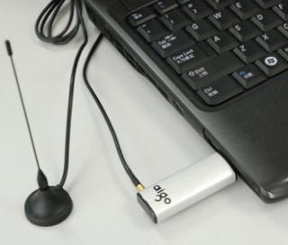
Different from Regular TV
Heterogeneity among mobile devices
Energy is critical: battery powered
In cellular phones, about 40% energy consumption is due to mobile TV chips
measurements on Nokia N96 phones
Broadcast standards dictate mechanisms to save energy

Slide 4
Energy Saving for Mobile Devices
Burst
R
Off
r
Time
This is called time slicing (in DVB-H and MediaFLO)
Base station constructs a time slicing scheme
(time, size) for bursts of individual TV channels

Slide 5
Channel Switching Delay
Burst
User switches
channel
Device gets
the video data
Time slicing increases channel switching delay
Low switching delays are important
Long delays are annoying
Users flip through too many channels

Slide 6
Problem Statement
Design a time slicing scheme to support heterogeneous mobile devices, such that
Each mobile device has an energy consumption proportional to its received video quality
Channel switching delays on all mobile devices are bounded by , which is a system parameter
But, how to support heterogeneous devices?
For example, devices with different display resolutions?

Slide 7
Support Heterogeneous Devices
Multi-version: encode each video into several versions, and concurrently broadcast them
Simple, but not efficient
Spectrum is expensive
Multi-layer: encode each video into a scalable stream consists of several layers, and broadcast each layer only once
Bandwidth efficient, but challenging in mobile TV broadcast networks

Slide 8
Mobile TV Base Station and Frame Format
Video
Server
IP/MPE
frames
RF
signal
IP pkts
IP
Encapsulator
Modulator
App. Data Table
191 Columns
R-S Data Table
64 Columns
MPE Frame
P. 2
FEC Bytes Computed
Row-by-Row
Packet 1
P. 3
256, 512, 768, or
1024 Rows
Padding
P. 3
P. 2

Slide 9
An Illustrative Example: Challenge
Picture 1
Layer 1
Picture 3
Layer 1
Picture 2
Layer 2
FEC Bytes Computed
Row-by-Row
Picture 2
Layer 1
Padding
Picture 3
Layer 2
Picture 1
Layer 2
Picture 3
Layer 1
OK for devices that receive both layers
BAD for devices that only receive the base layer
Higher energy consumption

Slide 10
Our Solution: Layer-Aware Transmission
Base station properly organizes the video data while broadcasting
Mobile devices that only receive the base layer can skip the enhancement layer
reduce energy consumption

Slide 11
Layer Aware Time Slicing Scheme (LATS)
Channel 1
Layer 1
Channel 2
Layer 1
Channel 3
Layer 1
Channel 1
Layer 2
Channel 2
Layer 2
Channel 3
Layer 2
Channel 1
Layer 1
Rate
Time
Burst time for layer c of channel s is:
where b is burst size, R is network bandwidth

Slide 12
Performance of LATS
Lemma 1, 2:
Devices that receive c layers achieve
energy saving:
Smaller c values result in higher energy saving
a worst case channel switching delay:
Independent to c values, but…

Slide 13
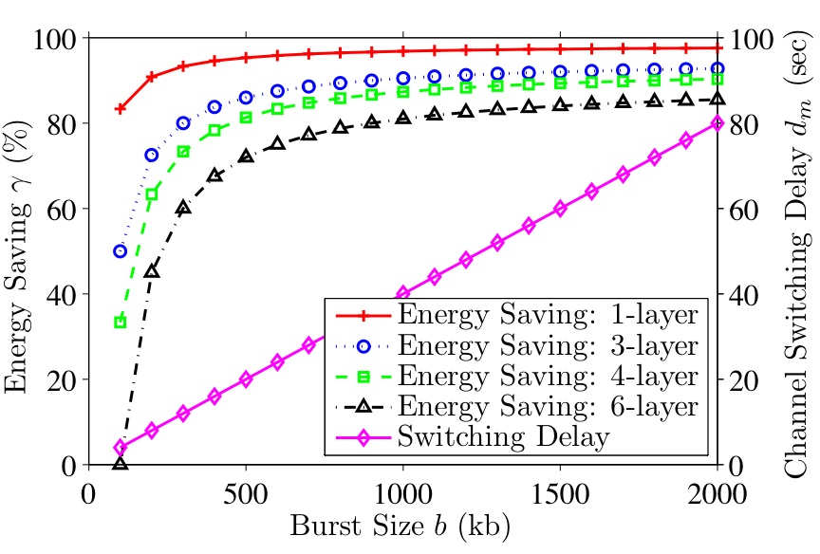
Problem of LATS
May incur high
switching
delays
Delays are reduced by choosing a smaller b
b = 200 kb ➔ 7.5 sec delay ➔ 40% energy saving
Can we do better?

Slide 14
LATS with Delay Bound (LATSB)
Optimized
for
Low Delays
Bootstrap
Bursts
Optimized
for High
Energy saving
Normal
Bursts
Time
Our Idea: inserting frequent and short bootstrap bursts between two LATS bursts
Bootstrap bursts carries base layers

Slide 15
Performance of LATSB
Lemma 3:
Devices that receive c layers achieve
energy saving (with normal bursts):
Smaller c values result in higher energy saving
a worst case channel switching delay:
Independent to c values, and…

Slide 16
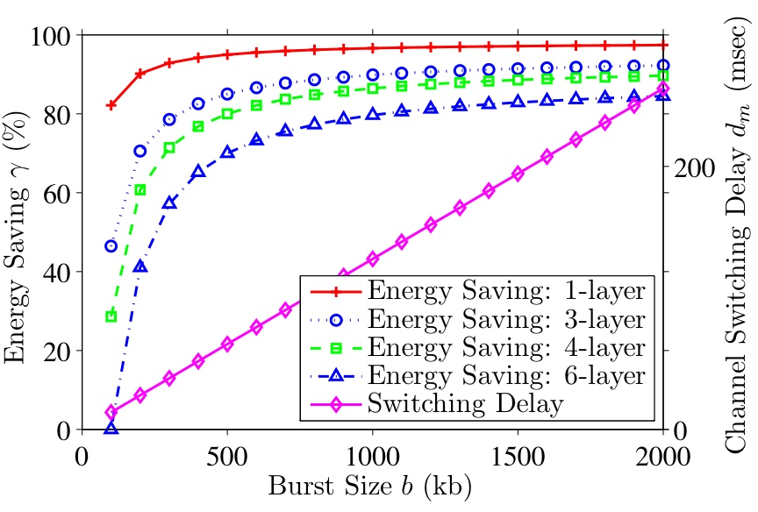
Low Switching Delays of LATSB
Let b = 1500 kb, LATSB reduces delay from 60 sec (LATS) to less than 200 msec

Slide 17
Empirical Evaluation
Implement LATS and LATSB schemes in a real base station
Encode each video into an SVC stream with four layers
Each layer has a bit rate of 192 kbps
Broadcast four TV channels
Emulate a million mobile devices, and randomly generate channel switching events
On average, 60 sec per channel watch time

Slide 18
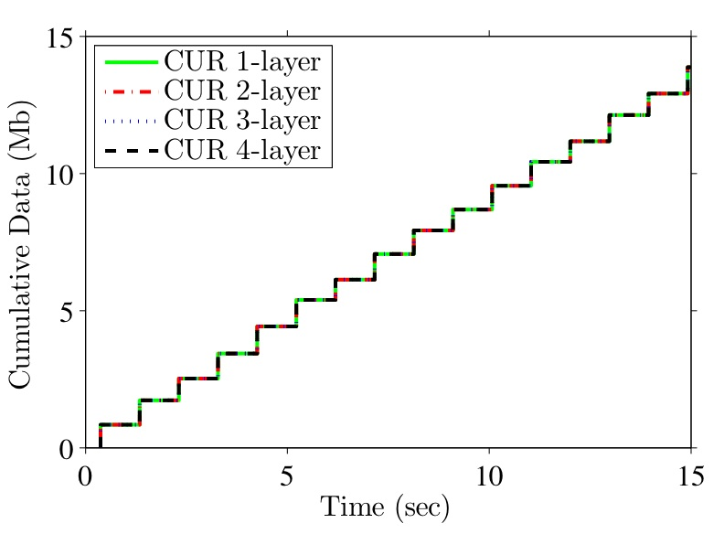
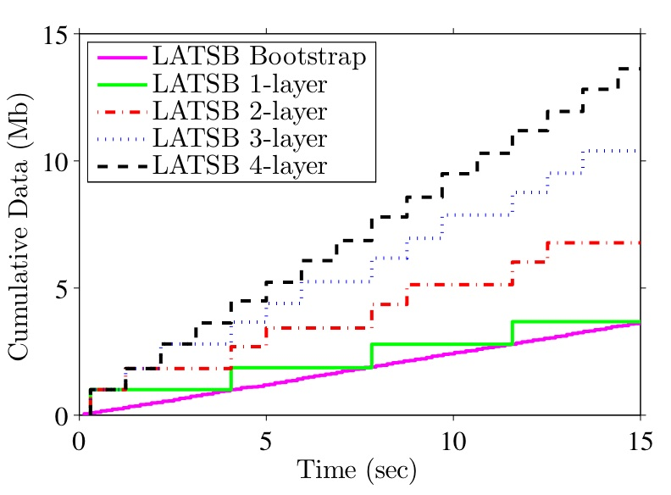
Cumulative Received Data
Current: always receive complete streams
LATS, LATSB: devices may opt for partial streams

Slide 19
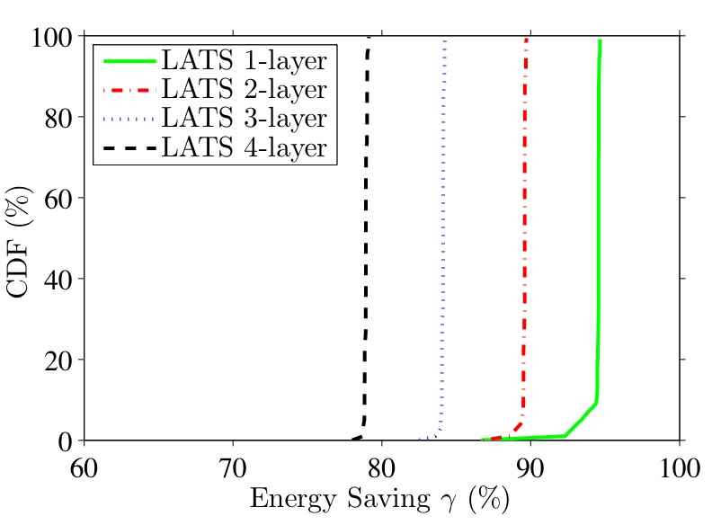
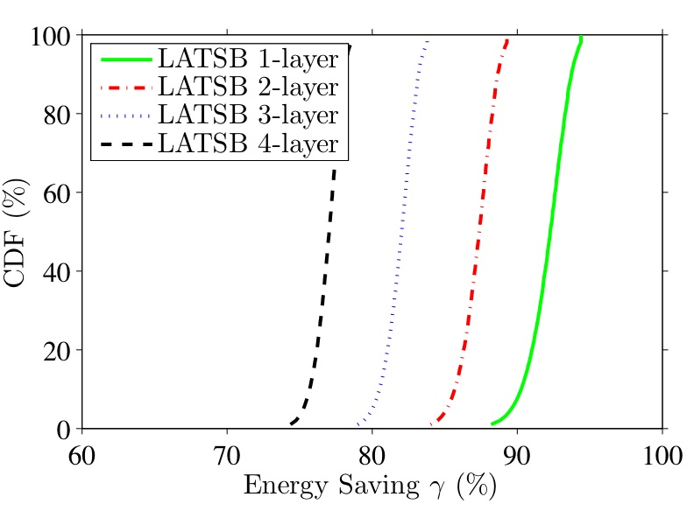
Energy Saving
LATS, LATSB enable a range of energy saving: up to 95%

Slide 20
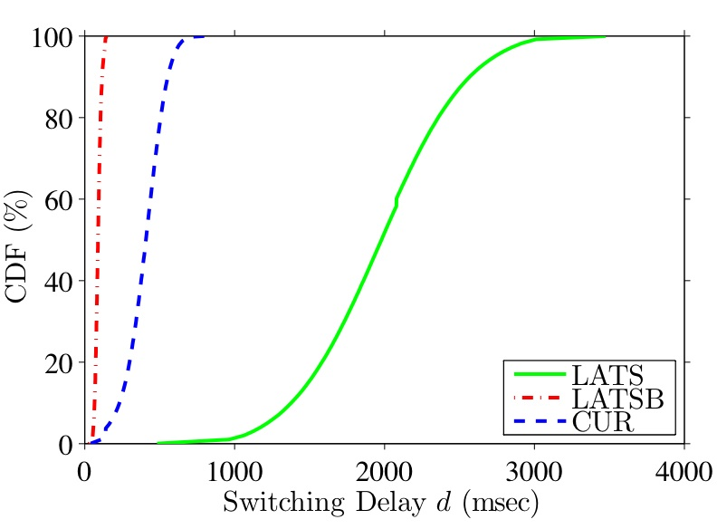
Channel Switching Delay
LATSB significantly reduces the switching delays

Slide 21
Conclusion
Studied the problem of broadcasting TV channels to mobile devices with diverse resources
Proposed and analyzed two time slicing schemes
Implemented them in a real mobile TV base station
Empirically showed that
LATS, LATSB support heterogeneous mobile devices
LATS, LATSB achieve high energy saving
LATSB achieves low channel switching delay

Slide 22
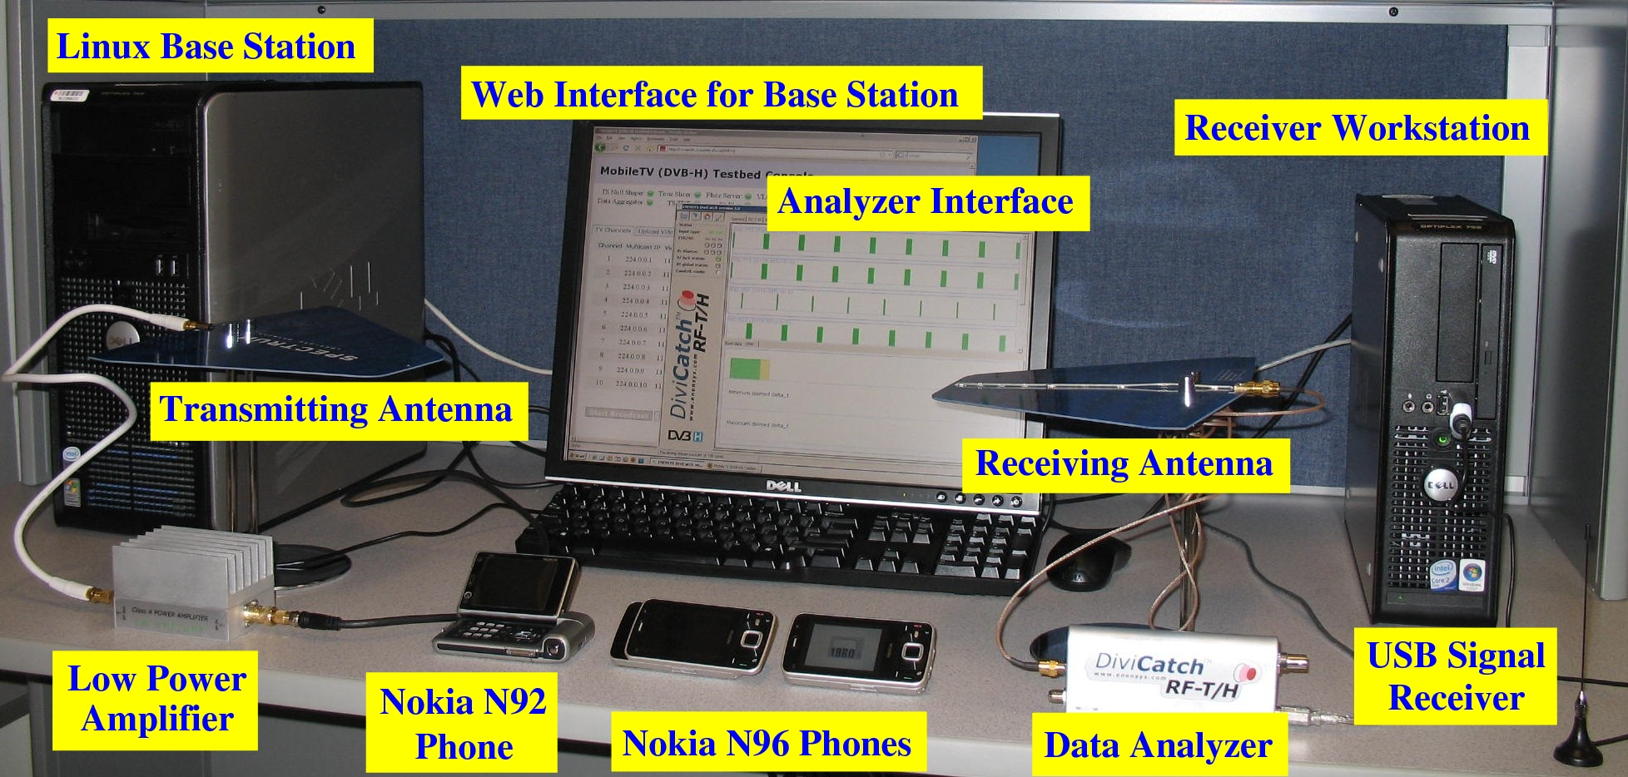
Questions?
More details can be found online at
http://nsl.cs.sfu.ca

Slide 23
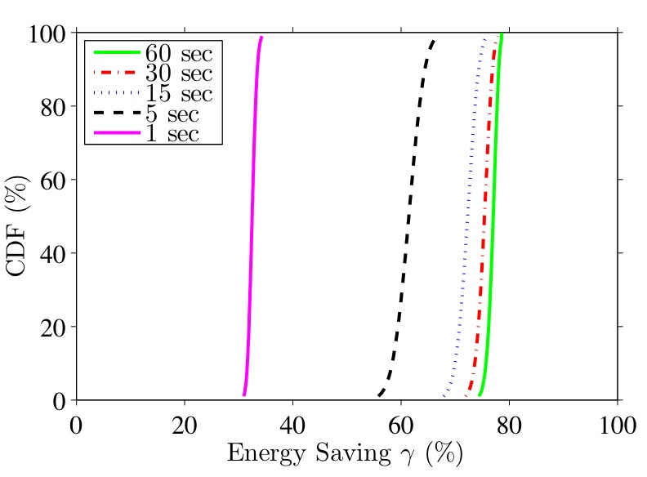
Implication of Average Watch Time on LATSB
Curves shown for devices receiving all layers
Energy saving is > 70% except extreme cases

