Slide 1
School of Computing Science
Simon Fraser University, Canada
Analysis of Multimedia Authentication Schemes
Mohamed Hefeeda
(Joint work with Kianoosh Mokhtarian)
12 May 2009

Slide 2
Motivations
Increasing demand for multimedia services
Content often transported over open and insecure networks (Internet)
Many applications need to ensure authenticity of content
  Videos for surveillance, documentary, political debates, etc
Numerous authentication schemes exist
  Merits and shortcomings against each other not clear
No comprehensive analysis/comparison in literature
Notes:
Secure delivery: ensuring the authenticity of the content, detection of any tampering by an attacker.
More motivation: attackers may tamper with the multimedia data by removing, inserting, or modifying portions of the data. Tampering attacks may be performed for commercial, political, or even personal purposes.
There are various schemes and various requirements by multimedia applications. Which one to choose to secure the delivery in our service?

Slide 3
Our Work
Define common performance metrics/scenarios
Analytically analyze all schemes
Conduct simulation and quantitative comparisons
Recommendations for choosing appropriate scheme for a target environment
Insights for further research

Slide 4
Outline
Performance Metrics
(Brief) Overview of Authentication Schemes
Analysis Results
  Detailed derivations are given in the paper
Conclusions and Recommendations

Slide 5
Performance Metrics
Computation cost
  Limited capacity receivers
Communication overhead
  Limited bandwidth
Tolerance against packet losses
  Bursty & random
Receiver buffer size required
  Memory constraints
Streaming delay
  Live streaming
Notes:
We numerically analyze these metrics based on analytic formulas, and we also implemented the authentication schemes in a simulator for further evaluation, especially the loss tolerance. The parameters for the simulation are also chosen carefully to mimic realistic settings!
We will also briefly discuss the reasons behind advantages/disadvantages revealed.
Old (or if we remove scalable part):
We analyze single-layer media streams, and do not analyze scalable streams that can be received and decoded partially.
Scalable streams not widely used yet.
Nonscalable streams provide higher coding efficiency and are used in most of today’s streaming application.

Slide 6
Authentication Schemes for Videos
Present basic ideas of most important schemes
Only representative sample
  See our paper for details
Notes:
We numerically analyze these metrics based on analytic formulas, and we also implemented the authentication schemes in a simulator for further evaluation, especially the loss tolerance. The parameters for the simulation are also chosen carefully to mimic realistic settings!
We will also briefly discuss the reasons behind advantages/disadvantages revealed.
Old (or if we remove scalable part):
We analyze single-layer media streams, and do not analyze scalable streams that can be received and decoded partially.
Scalable streams not widely used yet.
Nonscalable streams provide higher coding efficiency and are used in most of today’s streaming application.

Slide 7
Hash Chaining [Gennaro 97]
No receiver buffer required
Delay: duration of a block (sender side) + zero (receiver side)
No loss tolerance
Notes:
The stream is divided into blocks of packets, as with other schemes.
The hash of each packet is embedded in its preceding packet.
Due to the collision-free property of the ash function, the hash of the first packet serves as the block digest.
Other performance metrics are analyzed later, compared against other schemes.

Slide 8
Hash Chaining: with Loss Tolerance
Attach hash of packet to multiple other packets
Choose other packets carefully
Hashes of a block form Directed Acyclic Graph (DAG)
  Packet is verifiable if it has path to signature packet
Notes:
According to the way the hashes are replicated in packets, a block can be modeled as a Directed Acyclic Graph (DAG), where each edge …
The signature packet: the packet whose hash is signed.
Hash chaining: any loss breaks the chain.

Slide 9
Butterfly Hash Chaining [Zhishou 07]
Improved loss tolerance
Delay: duration of block (sender side) + zero (receiver side)
Notes:
A receiver buffer of size of a complete block is needed anyways, even though it is going to be filled rarely.

Slide 10
Tree Chaining [Wong 99]
Based on Merkle hash tree
Each packet carries all info needed for its verification
  Complete loss tolerance
No receiver buffer required
Delay: duration of a
block (sender side) +
zero (receiver side)

Slide 11
SAIDA: Signature Amortization using Information Dispersal Algorithm [Park 03]
Disperse auth info over n packets such that any m suffice to verify block
  m: determines overhead—loss tolerance tradeoff
Receiver buffer: m packets
Delay: 2 times duration of block (sender + receiver side)
Notes:
Overhead~tolerance: tradeoff between communication overhead and loss tolerance

Slide 12
SAIDA Improvements
eSAIDA (enhanced SAIDA) [Park 04]
  To reduce comm overhead, one hash for each pair of packets
    If packet is lost, its couple cannot be verified
  A packet’s hash is put in its couple with probability s
    s (input): determines overhead—loss tolerance tradeoff
cSAIDA (communication overhead-reduced SAIDA) [Pannetrat 03]
  A systematic FEC coding, keeping parity symbols only
  An additional FEC coding
Delay and receiver buffer of both: as in SAIDA

Slide 13
TFDP: Tree-based Forward Digest Protocol [Habib 05]
For streaming pre-encoded videos
Similar to SAIDA, but block digests are not signed
  Hash tree over block digests, root is signed
  One signature for the whole stream
Receiver buffer: nearly a complete block
Delay: not relevant!

Slide 14
Sample of our Results
Analytic and numerical analysis
Simulation analysis
Notes:
We use realistic parameter values from measurement studies and RFC recommendations.
Loss of bursty and random pattern: bursty is common in Internet (router congestions), random is common in wireless and also when the media file is transmitted with interleaved packetization, which is a common practice in streaming applications to neutralize the bursty pattern of losses and change it to random.
Scheme-specific parameters: in augmented hash chaining and butterfly hash graph chaining, there are a few input parameters that govern tradeoffs. The values we use are obtained by a local search, to get the best out of the scheme.
For further details see the paper.

Slide 15
Computation Cost
Complete Table is given in the paper
 | num signature verif per block | num 512-bit hash operations per block
Hash Chaining | 1
Tree Chaining | 1
SAIDA | 1
n: block size
l: packet size
s_{hash}: hash size
Notes:
Other schemes not shown:
chaining variants are similar to hash chaining, SAIDA variants are similar to SAIDA with minor things (hash values) more.
The dominant cost is signature, which is 1 per block.

Slide 16
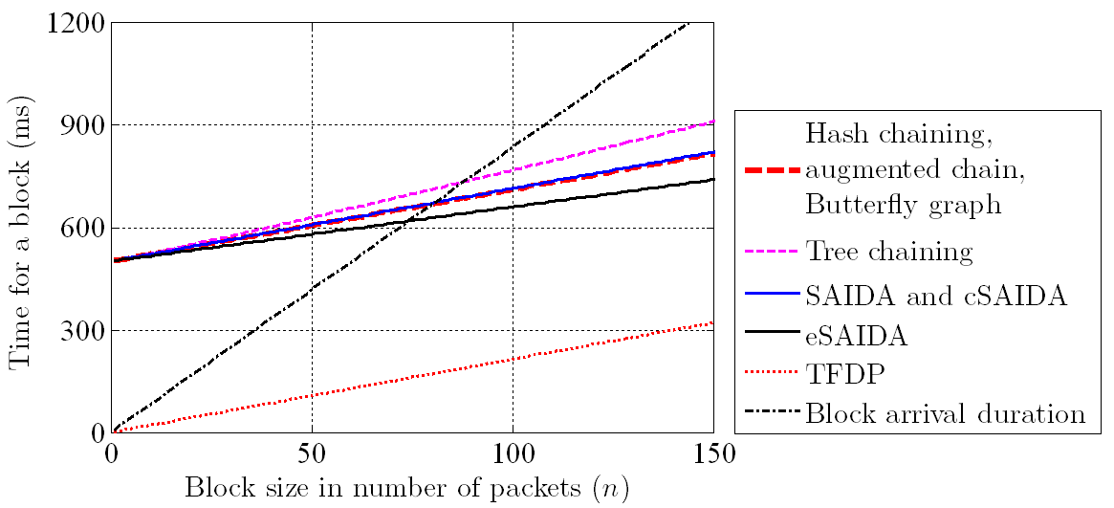
Computation Cost
Time to verify block on limited-capability device ➔ Lower bound on block size
Notes:
according to some measurement studies on the performance of cryptographic primitives on limited-capability cellular phones, we estimate an upper bound on the time it takes to verify a block, as a function of block size (n).
We assume only 10% of CPU is available for authentication purposes, and the rest is already consumed by video decoding and so.
Notice the TFDP curve: it calculates one digital signature for the whole stream and is this computationally efficient. But it is applicable for offline streaming only.
How we use this figure:
1) We also plot the duration of a block. Clearly, the time it takes to verify (using 10% CPU) must not exceed the block arrival duration, or some receivers cannot verify the stream at all! Thus the block size has to be larger than a certain lower bound (roughly the same for all schemes). For example, (with considering a safety margin) 100 packets are needed for each block.
2) Schemes all have almost the same cost, since the dominant cost of all is one digital signature verification per block (except TFDP).

Slide 17
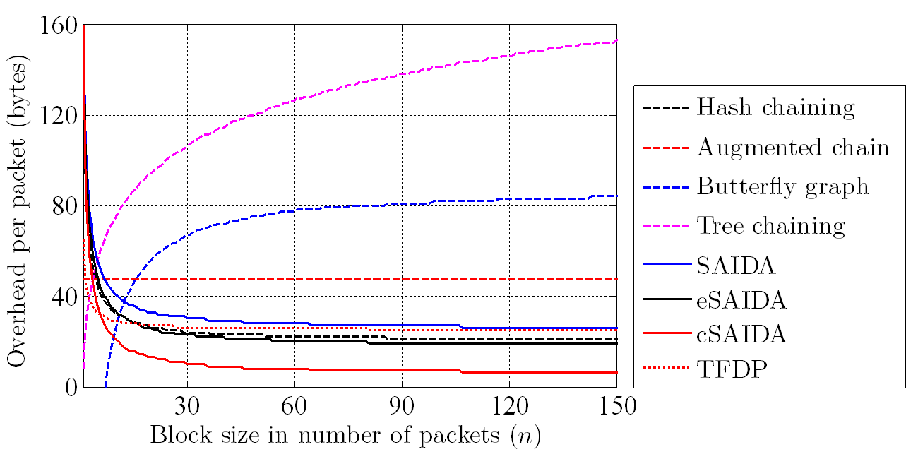
Communication Overhead
cSAIDA is the most efficient, Tree Chaining the least
Notes:
FEC factor is 1.25 for those schemes using FEC (SAIDA variants and TFDP).
cSAIDA is the most outperforming. (maybe a quick recall on its difference with SAIDA).
Tree chaining is the most different one: higher than all and a significant overhead, since the communication overhead of a packet increases logarithmically with the block size, and does not stabilize like others. For SAIDA and its variants and TFDP, it is I proportion of 1/n.
That the curve of Augmented Chain is constant is because the number of copies of the signature is in proportion to block size (1/16 of n).

Slide 18
Delay and Buffer Requirements
With a block size of 100 packets:
 | Buffer required (pkts) | Delay (seconds)
Hash Chaining | 1 | 3-4
Augmented Chaining | n | 3-4
Butterfly Chaining | n | 3-4
Tree Chaining | 1 | 3-4
SAIDA | n | 6-7
eSAIDA | n | 6-7
cSAIDA | n | 6-7
TFDP | n | Not relevant

Slide 19
Simulation Results
Realistic parameter values from measurement studies
Loss models
  Bursty: Internet (router congestions)
  Random: wireless networks and when interleaved packetization is used
Best parameters are chosen for each scheme
Notes:
We use realistic parameter values from measurement studies and RFC recommendations.
Loss of bursty and random pattern: bursty is common in Internet (router congestions), random is common in wireless and also when the media file is transmitted with interleaved packetization, which is a common practice in streaming applications to neutralize the bursty pattern of losses and change it to random.
Scheme-specific parameters: in augmented hash chaining and butterfly hash graph chaining, there are a few input parameters that govern tradeoffs. The values we use are obtained by a local search, to get the best out of the scheme.
For further details see the paper.

Slide 20
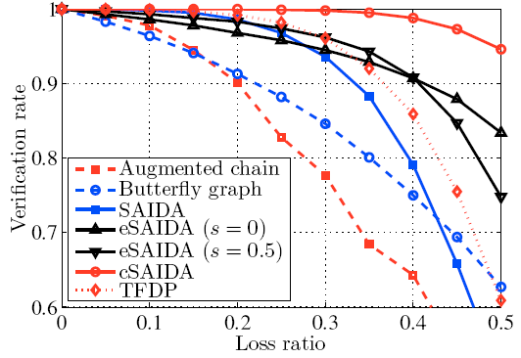
Simulation: Loss Resilience (Bursty Loss)
cSAIDA is the most efficient
Notes:
This is different from loss tolerance of the streaming application (such as error concealment).
Tree chaining not shown (always 100% verification rate), and hash chaining not shown (no resilience).
Overhead is fixed to 40 B/pkt : Parameters of the schemes are selected accordingly: FEC factor, num copies of signature pkt.
cSAIDA dominates: example: 99% verification rate under bursty loss of ratio 40%, 100% under random loss. Why?
cSAIDA’s low communication overhead allows us to designate a larger FEC factor for it compared to other schemes (either FEC-based or signature-replication-based) when the overhead is fixed to 40 bytes per packet for all schemes.

Slide 21
Conclusions
Conducted analytical and simulation comparisons among most authentication schemes for video streams
Our Findings …
Minimal computation cost
  TFDP; for on-demand streaming only
  Live streaming: all schemes almost the same
Minimal communication overhead
  cSAIDA
Notes:
This shows a basic selection based on criteria. The analysis helps making the best choice for combinations of criteria, such as loss pattern and so.

Slide 22
Conclusions (cont’d)
Minimal delay
  Hash/Augmented/Butterfly/Tree Chaining
Maximal loss tolerance
  Tree Chaining: high overhead, no buffering, low delay
  cSAIDA: low overhead, but requires buffering one block, and incurs twice the delay of Tree Chaining
Minimal buffering (memory) requirement
  Hash Chaining; reliable data transfer only
  Tree Chaining; fully loss tolerant

Slide 23
Thank You!
Questions??
More info at:
  http://nsl.cs.sfu.ca/

