Slide 1
Trie-Join : Efficient Trie-based String Similarity Joins with Edit Distance Constraints
Jiannan Wang (Tsinghua, China) Guoliang Li (Tsinghua, China)
Jianhua Feng (Tsinghua, China)

Slide 2
Outline
Motivation
Preliminaries
Trie-based Framework
Trie-based Algorithms
Pruning Techniques
Support Data Update
Experiment
Conclusion

Slide 3
Real-world Data is Rather Dirty！☹
Microsoft Academic Search
Kenneth De Jong
Kenneth Dejong
PK
http://academic.research.microsoft.com/Author/2037349.aspx
http://academic.research.microsoft.com/Author/3054641.aspx

Slide 4
Real-world Data is Rather Dirty！☹
DBLP Complete Search
Typo in “author”
Typo in “title”
Argyrios Zymnis
Argyris Zymnis
relaxed
related

Slide 5
Similarity Joins
The similarity join is an essential operation for data integration and cleaning
Perform a similarity join on Name attribute (find all record pairs whose Name attributes are similar)
Output: (2037349, 3054641), …
Id | Name | Univ.
2037349 | Kenneth De Jong | George …
… | … | …
3054641 | Kenneth Dejong | George …
… | … | …
R

Slide 6
Outline
Motivation
Preliminaries
Trie-based Framework
Trie-based Algorithms
Pruning Techniques
Support Data Update
Experiment
Conclusion

Slide 7
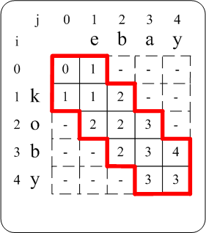
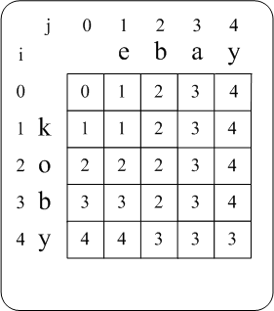
Similarity Evaluation
We use edit distance to quantify the string similarity
ED(r,s) is the minimum number of single-character edit operations (i.e., insertion, deletion, and substitution) needed to transform r to s
For example: ED(“kobe”, “ebey”)=3
1. kobe → obe (delete ‘k’ at the beginning)
2. obe → ebe (substitute ‘o' with ‘e')
3. ebe → ebey (insert ‘y' at the end)
Dynamic Programming
Given an edit-distance threshold τ , we say r and s are similar if ED(r, s) ≤ τ
Verify ED(r, s) ≤ 1
Compute ED(r, s)

Slide 8
Problem Formulation
For example: Suppose R=S.
------------------------------------------------------------
Input: S = {“bag”, “ebay”, “bay”, “kobe”, “koby”, “beagy”}
τ = 1
Output: {<“kobe”, “koby”>, <“ebay”, “bay”>, <“bag”, “bay”>}
String Similarity Join
-----------------------------------------------
Input: two sets of strings R and S
an edit-distance threshold τ
Output: <r, s> ∈ R×S s.t. ED(r, s) ≤ τ
Naïve Solution
Enumerate all pairs <r, s> ∈ R×S and verify ED(r, s) ≤ τ
---------------------------------------------------------------------------
|R|×|S| verifications are rather expensive!!
For |R|=|S|=1m, it needs 10¹² verifications.

Slide 9
Prior Work
Signature-based methods
Basic idea
ED(r, s) ≤ τ Sig(r) ∩Sig(s) ≠ φ
Framework
Filter pairs <r, s> s.t. Sig(r) ∩Sig(s) = φ
Verify the survived pairs
Disadvantages
Large index
Inverted index for signatures is large
Low efficiency for short strings
Can not select high-quality signatures for short strings
As least one parameter need to be tuned
E.g. tune the parameter q for q-gram signatures

Slide 10
Outline
Motivation
Preliminaries
Trie-based Framework
Trie-based Algorithms
Pruning Techniques
Support Data Update
Experiment
Conclusion

Slide 11
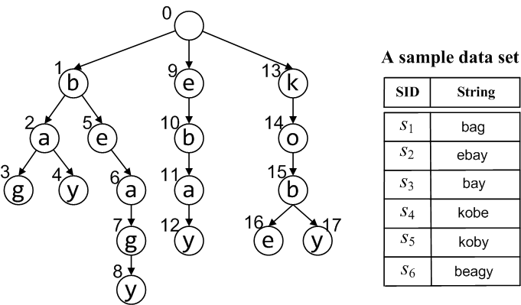
Trie Index
Trie is a tree structure, in which
Each path from the root to a leaf represents a string in the data set
Every node on the path has a label of a character in the string
Node 2 / Node “ba” /
String “ba”

Slide 12
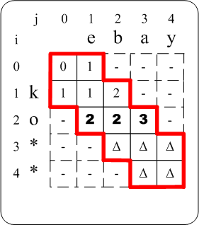
Subtrie Pruning
Observation I
Subtrie Pruning
×
Verify ED(r, s) ≤ 1
Verify ED(r, s) ≤ 1
Whatever * is, Δ (≥2) is larger than τ =1.
Given τ =1 , all strings starting with “ko” can not be similar with “ebay”.
Given τ =1 , for the string “ebay”, we can prune the subtrie rooted at “ko”.

Slide 13
Computing Active-Node Set
Active Node
Node u is an active node of string s if ED(u, s) ≤ τ.
E.g. Node “bay” is an active node of string “ebay”, but node “ko” is not.
Active-Node Set
For a string s, As is a set consisting of all the active nodes in the trie.
0
1
Incremental algorithm (www’09)
9
13
b
e
k
2
5
A“ko”={13,14,15}
10
14
a
e
b
o
3
4
6
11
15
g
y
a
a
b
7
12
16
17
A“kob”={14,15,16,17}
g
y
e
y
8
y

Slide 14
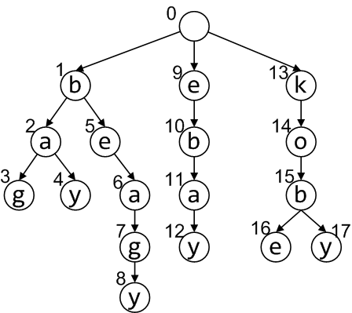
Trie-Search Algorithm
Observation II
Share prefix “eb”. ☺
Should we do subtrie pruning on S!
R
Trie T
S
bag
bay
beagy
ebay
kobe
koby
…
ebags
ebay
ebey
ebook
…
… ,
A“ebags”={} ,
A“ebay”={4,11,12} ,
A“ebey”={12} ,
A“ebooks”={} ,
…
<“ebay”, 4>, <“ebay”, 12>
<“ebey”, 12>

Slide 15
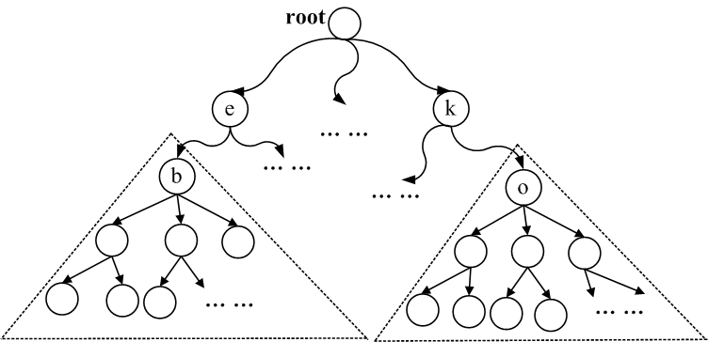
Dual Subtrie Pruning
Construct a trie for stings in both R and S
Do subtrie pruning for strings in both R and S
For example:
Given τ =1 , all strings starting with “ko” can not be similar with the strings starting with “eb”

Slide 16
Outline
Motivation
Preliminaries
Trie-based Framework
Trie-based Algorithms
Pruning Techniques
Support Data Update
Experiment
Conclusion

Slide 17
Trie-Traverse
We focus on self-join, that is R = S
Algorithm Description
Construct a trie index T for all strings in S (R)
Traverse the trie T in pre-order
Compute the active-node set of each visited node incrementally
When reaching a leaf node, find leaf nodes in its active-node set and output the similar string pairs
Benefits of pre-order trie traversal
Compute active-node sets incrementally
Discard active-node sets of the nodes whose descendants have been visited

Slide 18
Illustration of Trie-Traverse
Consider τ = 1 and S = {“bag”, “ebay”, “bay”, “kobe”, “koby”, “beagy”}.
0
{0,1,9,13}
Depth ≤ τ
1
9
{0,1,2,5,9,10,13}
13
b
e
k
2
5
{1,2,3,4,5,6,11}
10
14
a
e
b
o
3
4
6
11
15
{2,3,4,7}
g
y
a
a
b
Output: <3,4>
{2,3,4,12}
7
12
16
17
Output: <4,12>
g
y
e
y
8
y

Slide 19
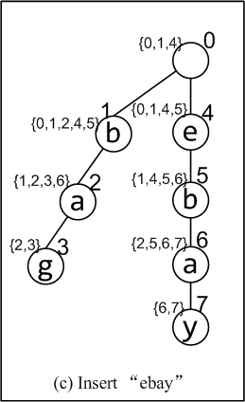
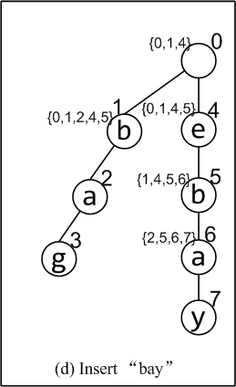
Trie-Dynamic
Basic idea: utilize active-node symmetry property
Illustration of Trie-Dynamic
Trie-Dynamic maintains the active-node sets of all trie nodes that involve large space!!
Consider τ = 1 and S = {“bag”, “ebay”, “bay”, “kobe”, “koby”, “beagy”}.
{0,1}
b
{1,2,3,6,8}
{1,2,3,6}
a
{2,3,8}
8
{2,3}
y
{2,3,7,8}
{6,7,8}
{6,7}

Slide 20
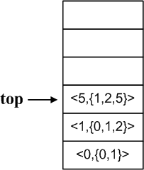
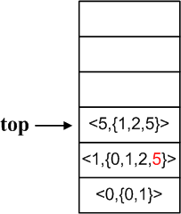
Trie-PathStack
Motivation
Trie-Traverse uses little memory space but involves unnecessary active-node computation
Trie-Dynamic avoids repeated active-node computation but involves large memory space
Basic Idea
Virtual partial subtrie
Runtime stack from current node to root node (τ = 1)
Virtual Partial Subtrie
0
1
9
b
e
13
k
2
5
10
14
a
e
b
o
3
4
6
11
15
g
y
a
a
b
7
12
16
17
g
y
e
y
8
y

Slide 21
Bi-Trie-PathStack
Motivation
It is expensive to compute active-node sets for large edit-distance thresholds
Basic Idea
Consider a string r = “arnold schwarzeneger” and τ = 5.
If a string s is similar to r within τ=5 (i.e. ed(r, s) ≤5), then
either r’s first part “arnold sch” is similar to a prefix of s within 5/2=2
or r’s second part “warzeneger” is similar to a suffix of s within 5/2=2.
Algorithm
Perform Trie-PathStack twice within the half threshold
Verify the survived pairs
“arnold sch” “warzeneger”

Slide 22
Outline
Motivation
Preliminaries
Trie-based Framework
Trie-based algorithms
Pruning Techniques
Support Data Update
Experiment
Conclusion

Slide 23
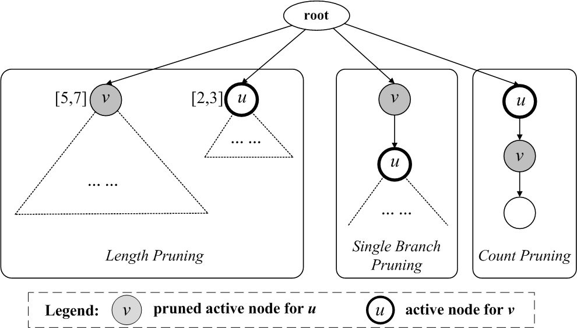
Pruning Techniques
τ=1
Length pruning
Prune v from Au if the difference of v’s range and u’s range is larger than τ
Single-branch pruning
Prune v from Au if u is the only child node of v
Count pruning
Prune v from Au if there’s only one string have both u and v as prefixes

Slide 24
Outline
Motivation
Preliminaries
Trie-based Framework
Trie-based algorithms
Pruning Techniques
Support Data Update
Experiment
Conclusion

Slide 25
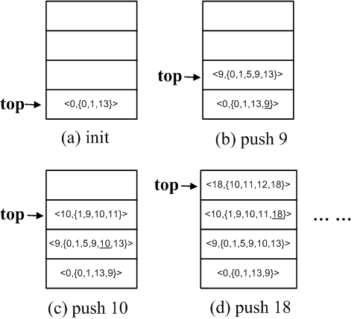
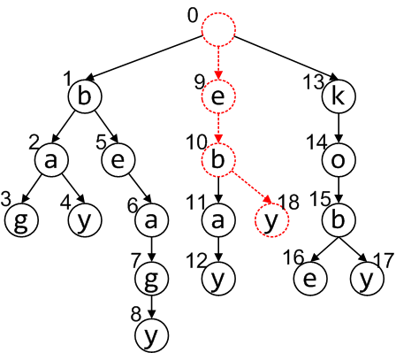
Support Data Update
Incremental Similarity Join
Input: a set of strings S, a set of strings ΔS, an edit-distance threshold τ
Output: <r ∈ ΔS, s ∈ S∪ΔS > s.t ED(r, s) ≤ τ
Illustration of incremental similarity join
Consider τ = 1 and S = {“bag”, “ebay”, “bay”, “kobe”, “koby”, “beagy”} and ΔS = {“eby”}.

Slide 26
Outline
Motivation
Preliminaries
Trie-based Framework
Trie-based algorithms
Pruning Techniques
Support Data Update
Experiment
Conclusion

Slide 27
Experiment Setup
Data sets
English Dict: English words from the Aspell spellchecker for Cygwin
DBLP Author: Author names from DBLP dataset
AOL Query Log: Queries from AOL dataset
Existing algorithms
All-Pairs-Ed[www’07]
Ed-Join [vldb’08]
Part-Enum [vldb’06]
Environment
C++ , GCC 4.2.3, Ubuntu
Intel Core 2 Quad X5450 3.00GHz processor and 4 GB memory

Slide 28
Comparison of Four Trie-Based Algorithms
Our trie-join algorithms outperform Trie-Search by 1~2 orders of magnitude
Trie-PathStack performs the best

Slide 29
Trie-PathStack VS Ed-Join, All-Pairs-Ed, Part-Enum
Index Size (MB)
3~5 times smaller

Slide 30
Trie-PathStack VS Ed-Join, All-Pairs-Ed, Part-Enum
Efficiency (Log-Scale)
Trie-PathStack performs the best
Existing methods need to tune parameters

Slide 31
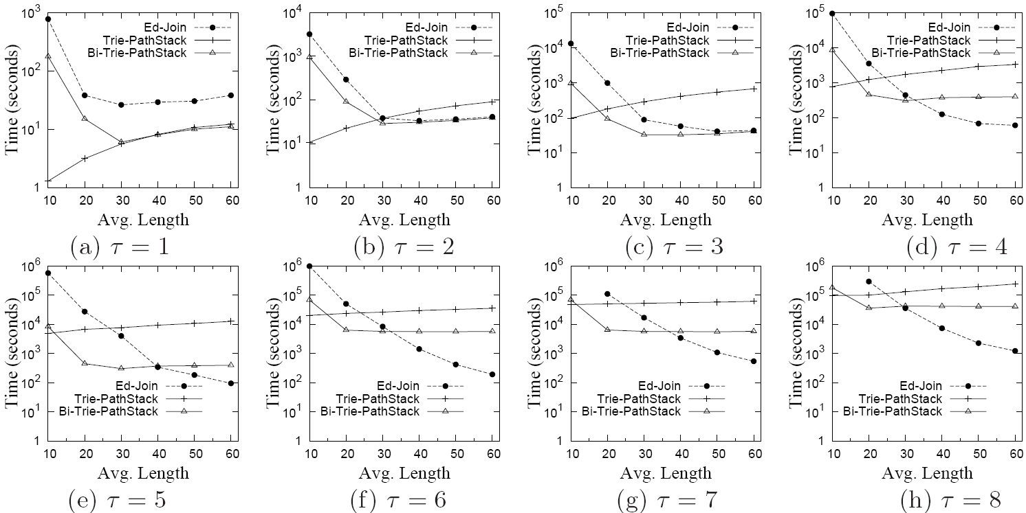
Algorithm Selection
Trie-based algorithms VS Ed-Join

Slide 32
Trie-based algorithms outperform Ed-Join for all string lengths (τ ≤ 3)

Slide 33
Trie-based algorithms outperform Ed-Join for short strings (avg. len ≤ 30 and τ >3)

Slide 34
Ed-Join outperforms Trie-based algorithms for long strings (avg. len >30 and τ >3)

Slide 35
Outline
Motivation
Preliminaries
Trie-based Framework
Trie-based algorithms
Pruning Techniques
Support Data Update
Experiment
Conclusion

Slide 36
Conclusion
Trie-based similarity-join framework
Trie-based algorithms
Pruning techniques
Trie-based algorithms have many advantages
small index
no need to tune parameters
efficient for short strings
support dynamic data update
Trie-based algorithms significantly outperform state-of-the-art methods on data sets with short strings (Avg. Length ≤ 30)

Slide 37
Reference
[1] Arasu et al. Efficient exact set-similarity joins. VLDB 2006.
[2] Bayardo et al. Scaling up all pairs similarity search. WWW 2007.
[3] Chaudhuri et al. A primitive operator for similarity joins in data cleaning. ICDE 2006.
[4] Gravano et al. Approximate string joins in a database (almost) for free. VLDB 2001.
[5] Sarawagi et al. Efficient set joins on similarity predicates. SIGMOD 2004.
[6] Xiao et al. Ed-join: an efficient algorithm for similarity joins with edit distance constraints. PVLDB 2008.
[7] Ji et al. Efficient interactive fuzzy keyword search. WWW 2009.
[8] Chaudhuri et al. Extending autocompletion to tolerate errors. SIGMOD 2009.

Slide 38
Thanks!
Q&A
http://dbgroup.cs.tsinghua.edu.cn/wangjn/projects/triejoin/

