Slide 1
Fast-Join : An Efficient Method for Fuzzy Token Matching based String Similarity Join
Jiannan Wang (Tsinghua, China) Guoliang Li (Tsinghua, China)
Jianhua Feng (Tsinghua, China)

Slide 2
Outline
Introduction
Fuzzy-Token Similarity
String Similarity Join using Fuzzy-Token Similarity
Signature Scheme for token sets
Signature Scheme for tokens
Experiment
Conclusion

Slide 3
Background
String Similarity Join
Find similar string pairs between two string sets
An essential operation in many applications
Card # | Name | Addr | Phn
1234**** | Jeffery Ullman | CS Dept. Stanford, CA | 111-1111
1018**** | Marvin Minsky | CS Dept. , MIT, MA | 222-2222
… | … | … | …
Jeffery Ullman
Jeffrey Ullman
Perform a similarity join on name attribute
Card # | Name | Email | Tel
1205**** | David Patterson | Patterson@ucb.com | 999-9999
0101**** | Jeffrey Ullman | ullman@stanford.com | (650)111-1111
… | … | … | …

Slide 4
Background
String Similarity Join
Find similar string pairs between two string sets
An essential operation in many applications
Perform a self similarity join on query attribute
User Id | Query | Timestamp
1018**** | ICDE 2011 Hanover | 2011-01-15 10:12:10
1234**** | NBA All Stars 2011 | 2011-01-15 11:05:06
2823**** | ICDE Hannover | 2011-01-15 11:10:10
6345**** | weather Hanover | 2011-01-15 12:34:10
… | … | …

Slide 5
Motivation
Existing Similarity Metrics
Token-based
Similarity
Hybrid Similarity
Character-based
Similarity
Dice,
Cosine,
Jaccard,
…
Edit Distance,
Edit Similarity,
…
GED [SIGMOD 03]
S1 = “nba mcgrady”, S2 = “macgrady nba”
Jaccard(S1, S2) = 1/3
GED(S1, S2) = 0
ED(S1, S2) = 8

Slide 6
Outline
Introduction
Fuzzy-Token Similarity
String Similarity Join using Fuzzy-Token Similarity
Signature Scheme for token sets
Signature Scheme for tokens
Experiment
Conclusion

Slide 7
Token-based Similarity
Dice similarity
Cosine similarity
Jaccard similarity
$$Dice\left(T_{1},T_{2}\right)=\frac{2∙\left|T_{1}∩T_{2}\right|}{\left|T_{1}\right|+\left|T_{2}\right|}$$
Example
T₁ = {nba, mcgrady}
T₂ = {macgrady, nba}
$$Cosine\left(T_{1},T_{2}\right)=\frac{\left|T_{1}∩T_{2}\right|}{\sqrt{\left|T_{1}\right|∙\left|T_{2}\right|}}$$
|T₁ ∩ T₂| =1
$$Jaccard\left(T_{1},T_{2}\right)=\frac{1}{3}$$
☹
$$Jaccard\left(T_{1},T_{2}\right)=\frac{\left|T_{1}∩T_{2}\right|}{\left|T_{1}|+|T_{2}\right|−\left|T_{1}∩T_{2}\right|}$$
Exactly matched token pairs, i.e. T₁ ∩ T₂

Slide 8
Fuzzy Overlap ( T₁ ${\tilde{∩}}_{δ}$T₂ )
(Quantify token similarity)
？
$$1+0.875=1.875$$
Better than |T₁ ∩ T₂|=1
Weighted Bipartite Graph
T₁
T₂
nba
Edge weight: Edit Similarity
$$NED\left(t_{i},t_{j}\right)=1−\frac{ED\left(t_{i},t_{j}\right)}{\max\left(\left|t_{i}\right|, \left|t_{j}\right|\right)}$$
0.125
1
macgrady
wnba
0.125
Remove dissimilar edges
$$NED\left(t_{i},t_{j}\right)<δ$$
0.75
nba
0.875
Fuzzy Overlap: Maximum Weighted Matching
0.143
mcgrady

Slide 9
Fuzzy-Token Similarity
Fuzzy-Dice similarity
Fuzzy-Cosine similarity
Fuzzy-Jaccard similarity
$${FDice}_{δ}\left(T_{1},T_{2}\right)=\frac{2∙\left|T_{1}{\tilde{∩}}_{δ}T_{2}\right|}{\left|T_{1}\right|+\left|T_{2}\right|}$$
Example
T₁ = {nba, mcgrady}
T₂ = {macgrady, nba}
☺
$${Cosine}_{δ}\left(T_{1},T_{2}\right)=\frac{\left|T_{1}{\tilde{∩}}_{δ}T_{2}\right|}{\sqrt{\left|T_{1}\right|∙\left|T_{2}\right|}}$$
|T₁ ${\tilde{∩}}_{0.7}$T₂| =1.875
${FJaccard}_{0.7}\left(T_{1},T_{2}\right)=$0.882
$${FJaccard}_{δ}\left(T_{1},T_{2}\right)=\frac{\left|T_{1}{\tilde{∩}}_{δ}T_{2}\right|}{\left|T_{1}|+|T_{2}\right|−\left|T_{1}{\tilde{∩}}_{δ}T_{2}\right|}$$
Fuzzy matched token pairs, i.e. T₁ ${\tilde{∩}}_{δ}$T₂

Slide 10
Comparison with Existing Similarities
Non-metric space
Triangle inequality does not hold
E.g. T₁ = {abc}, T₂= {abcd}, T₃= {bcd}
Subsume token-based similarity
${|T}_{1}{\tilde{∩}}_{δ=1}T_{2}|=\left|T_{1}∩T_{2}\right|$
Subsume edit similarity
Let $T_{1}=\left\{s_{1}\right\}$ and$T_{2}=\left\{s_{2}\right\}$,
then ${|T}_{1}{\tilde{∩}}_{δ=0}T_{2}|=NED(s1,s2)$

Slide 11
Outline
Introduction
Fuzzy-Token Similarity
String Similarity Join using Fuzzy-Token Similarity
Signature Scheme for token sets
Signature Scheme for tokens
Experiment
Conclusion

Slide 12
String Similarity Join using Fuzzy-Token Similarity
s₁ | “kobe and trancy”
s₂ | “trcy macgrady mvp”
… | …
s'₁ | “kobe bryant age”
s'₂ | “mvp tracy mcgrady”
… | …
Tokenization
T₁ | {kobe, and, trancy}
T₂ | {trcy, macgrady, mvp}
… | …
T’₁ | {kobe, bryant, age}
T’₂ | {mvp, tracy, mcgrady}
… | …
Similarity Join
($τ=0.8$ , ${FJaccard}_{0.75}$)
Naive Solution
Enumerating N² pairs
Quite Expensive！！！
$${FJaccard}_{0.75}\left(T2,T′2\right)≥0.8$$
(s₂, s’₂), …

Slide 13
Using Existing Methods
A signature-based method
Signature schemes
T → $Sig(T)$, T’ → $Sig(T’)$ such that
The filter step
Inverted index
The refine step
Maximum weight matching ($O({|V|}^{2}|E|)$)
If T and T’ are similar, then $Sig\left(T\right) and Sig(T’)$ have overlaps
Challenges
Subsume many similarity metrics
Overlap → Fuzzy Overlap (|T ${\tilde{∩}}_{δ}$ T’|≥ c)
T1 = {trcy, macgrady}, T2 = {tracy, mcgrady}

Slide 14
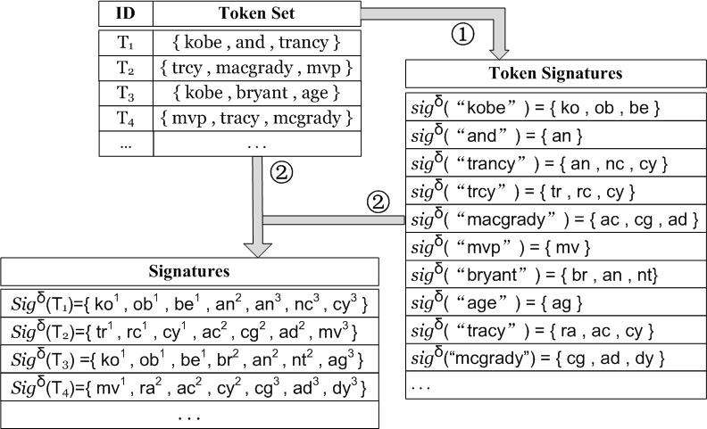
Our Signature Scheme
Similar token pairs have overlaps
E.g. sig(“kobe”) $∩$sig(“tracy”) = {}
sig(“trcy”) $∩$sig(“tracy”) = {cy}
T1 = {kobe, and, trancy}
sig(“kobe”) = {ko, ob, be}
sig(“and”) = {an}
sig(“trancy”) = {an, nc, cy}
Sig(T₁)= sig(“kobe”) $⨄$
sig(“and”)$⨄$sig(“trancy”)
$$Sig\left(T\right)$$
$$=⨄_{t∈T}sig(t)$$
The superscript denotes which
token generates the signature

Slide 15
Outline
Introduction
Fuzzy-Token Similarity
String Similarity Join using Fuzzy-Token Similarity
Signature Scheme for Token Sets
Signature Scheme for Tokens
Experiment
Conclusion

Slide 16
Prefix Filtering Signature Scheme
Basic Idea
If T and T’ are similar, then $\left|Sig\left(\text{T}\right)∩Sig\left(\text{T}′\right)\right|≥$ c
Signature Scheme
Global order over all signatures
Remove$\left\lceil c−1\right\rceil$largest signatures
Candidates : {(T₁,T₂),(T₁,T₃),(T₁,T₄),(T₂,T₄)}
E.g. Sig_{p}(T₁) $∩$Sig_{p}(T₂) = {cy}
Sig_{p}(T₂) $∩$Sig_{p}(T₃) = {}
Alphabetical
Order
Remove 2 largest signatures

Slide 17
Token Sensitive Signature Scheme
Basic Idea
If T and T’ are similar, then $Sig\left(\text{T}\right)∩Sig\left(\text{T}′\right)$ are generated from at least $\left\lceil c\right\rceil$ tokens
For Example
Sig(T₁)={an², an³, be¹ , cy³, ko¹ , nc³, ob¹}
Sig(T₃) ={ag³, an², be¹, br², ko¹ , ob¹, nt²}
$\left\lceil c\right\rceil$ = $\left\lceil 2.4\right\rceil$ = 3
As an², be¹, ko¹ , ob¹ are generated from only 2 tokens, filter (T₁, T₃)
Token Sensitive
Yes!
Prefix Filtering
No!
Signature Scheme
Global order over all signatures
Remove the maximal number of signatures that are generated from at most $\left\lceil c−1\right\rceil$ tokens

Slide 18
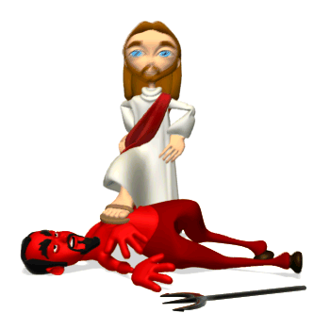
Token Sensitive Signature Scheme (Cont’d)
Candidates : {(T₁,T₂),(T₁,T₃),(T₁,T₄),(T₂,T₄)}
Alphabetical
Order
Candidates : {(T2,T4)}
Delete the maximal number of largest signatures that contain 2 tokens

Slide 19
Outline
Introduction
Fuzzy-Token Similarity
String Similarity Join using Fuzzy-Token Similarity
Signature Scheme for token sets
Signature Scheme for tokens
Experiment
Conclusion

Slide 20
Partition-NED Signature Scheme
Basic Idea
Partition t and t’ into substrings s.t. if $NED(t, t’)≥δ$, then they share a substring with one edit error
Overview
Partition t’
Pigeonhole principle
Partition t
Enumerate all possible |t’ | s.t. $NED\left(t, t’\right)≥δ$
Partition t based on the substrings of t’ and the upper-bound of $ED\left(t, t’\right)$, i.e. $(1−δ)∙max(\left|t\right|, |t′|)$

Slide 21
Partition t’
$$t^{′}[1:4]$$
$$t^{′}[5:8]$$
$$t^{′}[9:12]$$
Consider $δ =0.8$
Upper bound of edit distance
$NED\left(t’, t\right)≥0.8 ⟹ED\left(t’, t\right) ≤ \left\lfloor \frac{1−δ}{δ} \left|t^{′}\right|\right\rfloor =4$
Divide t’ into $\left\lceil \frac{4+1}{2}\right\rceil =3$ paritions
Pigeonhole Principle: $t′[1:4]$or $t′[5:8]$or $t′[9:12]$have one edit operator

Slide 22
Partition t
$t′[1:4]$ has one edit operator
$t′[9:12]$ has one edit operator

Slide 23
Partition t (Cont’d)
$$ED\left(t’, t\right) ≤ \left\lfloor (1−δ)∙max(\left|t^{′}\right|, \left|t\right|)\right\rfloor =3$$
-3
-2
$t′[5:8]$ has one edit operator
2

Slide 24
Punning Techniques
Reduce substrings
from 21 to 8

Slide 25
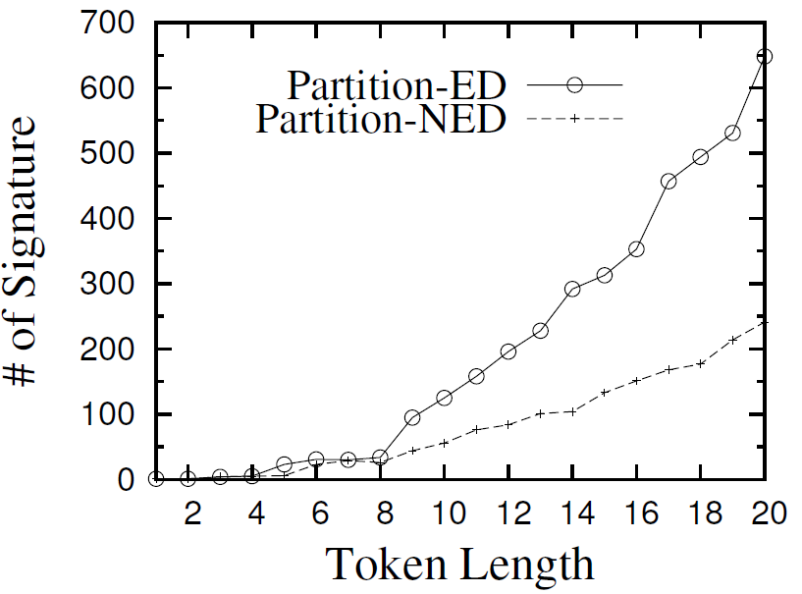
Comparison with Partition-ED (SIGMOD 09)
Superior to Partition-ED for Edit Similarity
Partition-ED generates many redundant signatures
Neglect that shorter t’ corresponds to smaller upper-bound of $ED\left(t, t’\right)$

Slide 26
Outline
Introduction
Fuzzy-Token Similarity
String Similarity Join using Fuzzy-Token Similarity
Signature Scheme for token sets
Signature Scheme for tokens
Experiment
Conclusion

Slide 27
Experiment Setup
Data sets
DBLP Author: Author names from DBLP dataset
AOL Query Log: Queries from AOL dataset
Environment
C++ , GCC 4.2.3, Ubuntu
Intel Core 2 Quad X5450 3.00GHz processor and 4 GB memory

Slide 28
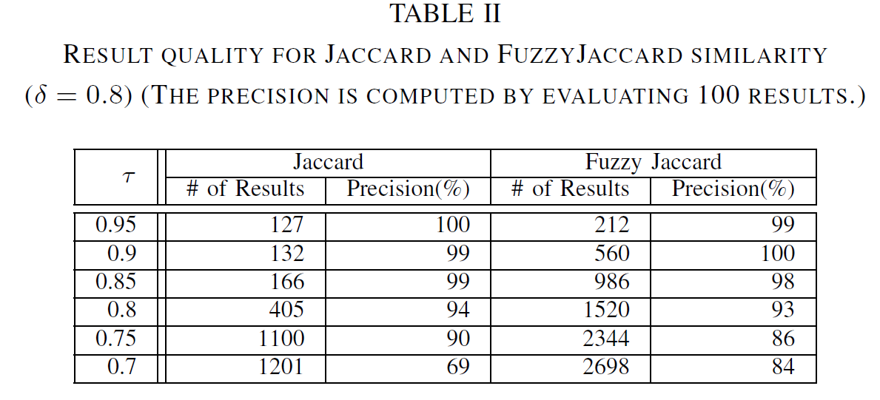
Result Quality

Slide 29
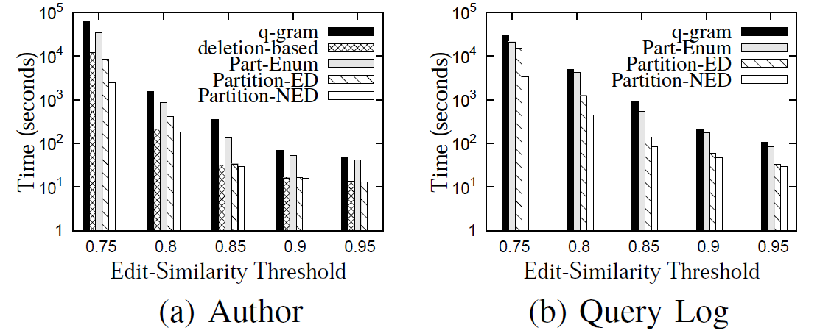
Evaluation on Different Signature Schemes for Tokens
$τ=0.8$

Slide 30
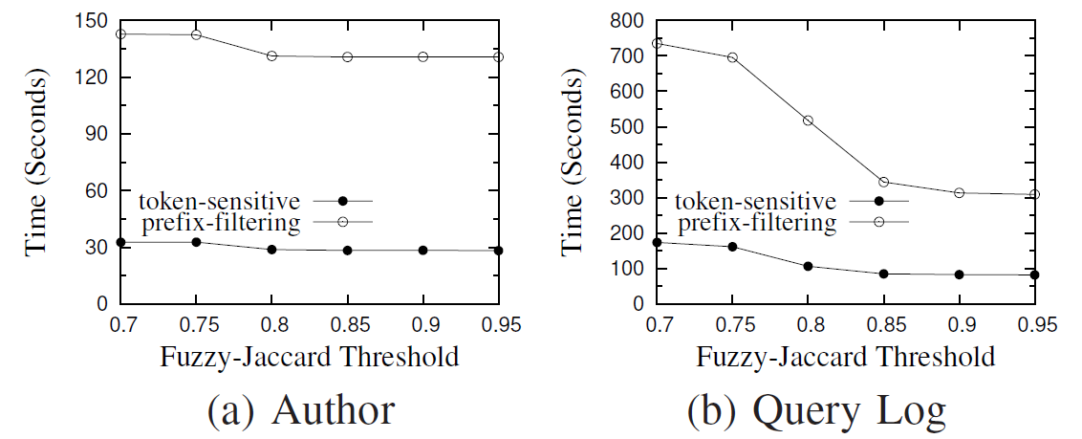
Evaluation on Different Signature Schemes for Token Sets
$δ=0.85$

Slide 31
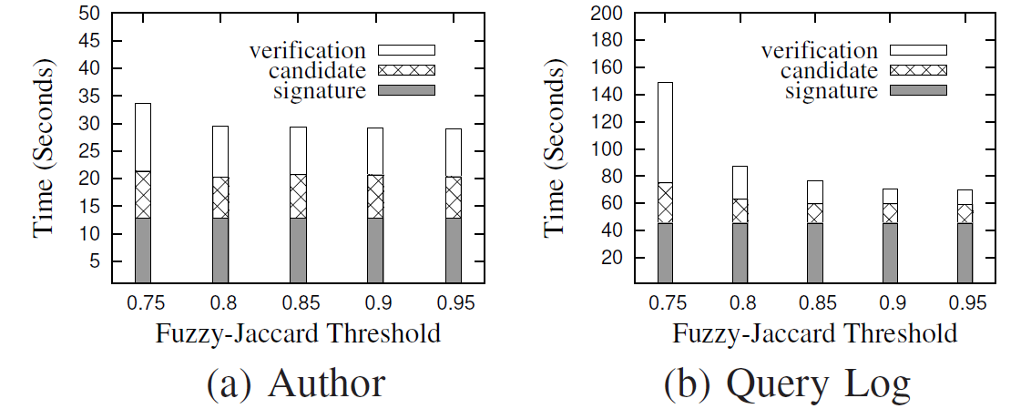
Put Everything Together
$δ=0.85$

Slide 32
Outline
Introduction
Fuzzy-Token Similarity
String Similarity Join using Fuzzy-Token Similarity
Signature Scheme for Token Sets
Signature Scheme for Tokens
Experiment
Conclusion

Slide 33
Conclusion
Fuzzy-token similarity
Hybrid similarity
Subsume many well-known similarities
High result quality
String similarity join using fuzzy-token similarity
Signature-based framework
Token-sensitive signature scheme
Partition-NED signature scheme
Achieve higher performance than the state-of-the-art methods both theoretically and experimentally

Slide 34
Thanks!
Q&A
http://dbgroup.cs.tsinghua.edu.cn/wangjn/projects/fastjoin/

