Slide 1
Homework 6

Slide 2
Homework 6
Lhs: Selecting m-subset of balls from a set of 2m distinct balls: C(2m,m)
Rhs: Let A(k) denote the number of ways of selecting k-subset of white balls from a set of m white balls and selecting (m-k)-subset of black balls from a set of m black balls.
A(k) = C(m,k) $×$C(m, m-k) = C(m,k)²
Therefore, Rhs = $\sum_{k=0}^{m}{A(k)}$ = $\sum_{k=0}^{m}{C\left(m,k\right)2}$

Slide 3
Place one red ball in each box and a white ball in each box.
-- r - n red balls and w - n white balls left. (assuming r, w > n)
Answer: C(r-n+n-1, n-1) x C(w-n+n-1, n-1).

Slide 4
(a) (m+n)-permutation with non-distinct object: $\frac{\left(m+n\right)!}{m!n!}$
(b) Valid sequences are 00100010001001; 10000001001001; …. ( m = 10 and n = 4)
Let us first place 4 1s:
1 1 1 1

Slide 5
(a) (m+n)-permutation with non-distinct object: $\frac{\left(m+n\right)!}{m!n!}$
(b) Valid sequences are 00100010001001; 10000001001001; …. ( m = 10 and n = 4)
Let us first place 4 1s:
1 1 1 1

Slide 6
(a) (m+n)-permutation with non-distinct object: $\frac{\left(m+n\right)!}{m!n!}$
(b) Valid sequences are 00100010001001; 10000001001001; …. ( m = 10 and n = 4)
Let us first place 4 1s:
1 1 1 1. results in 5 gaps.
Let x_{i} denote the i^{th} gap.
Need to separate the consecutive 1s by placing 0s in gaps. We have ten 0s.
Thus our answer is the number of integer solutions to
x₁ + x₂ + x₃ + x₄ + x₅ = 10 where x₁ $≥$ 0; x₂ $≥$ 2, x₃ $≥$ 2, x₄ $≥$ 2, x₅ $≥$ 0
The answer is C(10-6+5-1,5-1).
In general, if there are m 0s and n 1s, the # of ways is C(m-2(n-1)+(n+1)-1,(n+1)-1).
Note that if m < 2n, the answer is zero. There is no such sequence.

Slide 7
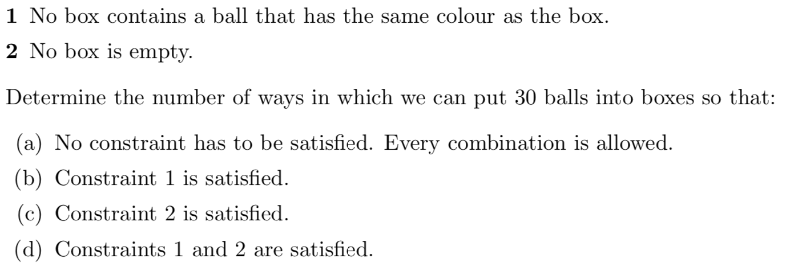

Slide 8
(a) We cannot place all 30 balls in three boxes. The balls are not indistinguishable.
First place 10 red balls,
then 10 blue balls
followed by 10 green balls.
Ans: C(10+3-1,3-1) x C(10+3-1,3-1) x C(10+3-1,3-1)

Slide 9
(b) We solve it in the same way as in problem (a).
When distributing 10 red balls, we have only two boxes to place the red balls.
We cannot place red balls in red box.
The answer is, therefore, C(10 + 2 − 1, 2 − 1)³.

Slide 10
(c) Problem (a) compute the number of ways {C(12,2)³} without any restriction.
Subtract the invalid ones:
of the type (0,*,*), (*,0,*), (*,*,0), (0,0,*), (*,0,0), (0,*,0)
Ans: C(12,2)³ – 3 x C(10+2-1,2-1)³ +3

Slide 11
(d) Problem (b) compute the number of ways {C(11,1)³} with type 1 restriction.
We have to eliminate the invalid ones of the types
(0,*,*), (*,0,*), (*,*,0), (0,0,*), (*,0,0), (0,*,0)
For the type (0,*,*), the red balls can go to two boxes,
but blue balls (also the green balls) can go to one box only.
The number of invalid ones of type (0,*,*) is C(10+2-1,2-1) x C(10+1-1,1-1)².
There is no invalid one of the type (0,0,*).
Ans: C(12,1)³ – 3 x C(10+2-1,2-1) x C(10+1-1,1-1)².

Slide 12
1
2
3
4
5
(a). n(n-1)⁴

Slide 13
1
2
3
4
5
(b). # of ways = n(n-1)(n-1)(n-1)(n-2) is wrong if the color for room 4 is the same as the color of room 1.
Two subproblems: A = # of ways of coloring four rooms with 1 and 4 are colored the same;
B = # of ways of coloring four rooms with 1 and 4 are colored differently.
A = n(n-1)(n-2) ; Note that if rooms 1 and 4 are colored red, rooms 2 and 3 can’t use red.
B=n(n-1)(n--1)(n-1) – A
Ans: C = A x (n-1) + B x (n-2)

Slide 14
1
2
3
4
5
(c). Ans: $\frac{C}{5}$

