Slide 1
Set Theory
Chapter 3

Slide 2
Sets in applications
Many pieces of software need to maintain sets of items. For example, a database is a large set of pieces of information.
A university maintains a set of all the students enrolled.
An airline maintains a set of all past and future flights.
One of the most basic types of operations a programmer might perform on a set of data is to ask whether a particular item is an element of that set.
Discrete math is primarily concerned with mathematical operations on sets.

Slide 3
Sets (3.1)
A set is an unordered collection of objects.
the students in this class
the chairs in this room
The objects in a set are called the elements, items or members of the set.
A set is said to contain its elements.

Slide 4
Sets
The notation a ∈ A denotes that a is an element of the set A.
If a is not a member of A, write a ∉ A

Slide 5
Describing a Set: Roster Method
S = {a,b,c,d}
Order not important
S = {a,b,c,d} = {b,c,a,d}

Slide 6
Describing a Set: Roster Method
Elipses (…) may be used to describe a set without listing all of the members when the pattern is clear.
S = {a,b,c,d, ……,z }

Slide 7
Roster Method
Set of all vowels in the English alphabet:
V = {a,e,i,o,u}
Set of all odd positive integers less than 10:
O = {1,3,5,7,9}
Set of all positive integers less than 100:
S = {1,2,3,……..,99}
Set of all integers less than 0:
S = {…., -3,-2,-1}

Slide 8
Some Important Sets
N = natural numbers = {0,1,2,3….}
Z = integers = {…,-3,-2,-1,0,1,2,3,…}
Z⁺ = positive integers = {1,2,3,…..} = {x ε Z | x > 0}
Q = set of rational numbers
Q⁺ = set of positive rational numbers
R = set of real numbers
Φ, {} = empty set (null set)

Slide 9
Interval Notation
[a,b] = {x | a ≤ x ≤ b}
[a,b) = {x | a ≤ x < b}
(a,b] = {x | a < x ≤ b}
(a,b) = {x | a < x < b}
closed interval [a,b]
open interval (a,b)

Slide 10
Representation of a set
A set-builder notation is used to describe sets that are too complex to enumerate them.
Suppose E={…., -6, -4, -2, 0, 2, 4, 6, ….}
Set-builder notation
E={n : n is an even integer} or
E={n | n is an even integer}
Other examples
A = {x : x is an integer |x| < 4} = {-3, -2, -1, 0, 1, 2, 3}
The rational numbers: Q={x : x = m/n, m,n ∈ Z, n ≠ 0}

Slide 11
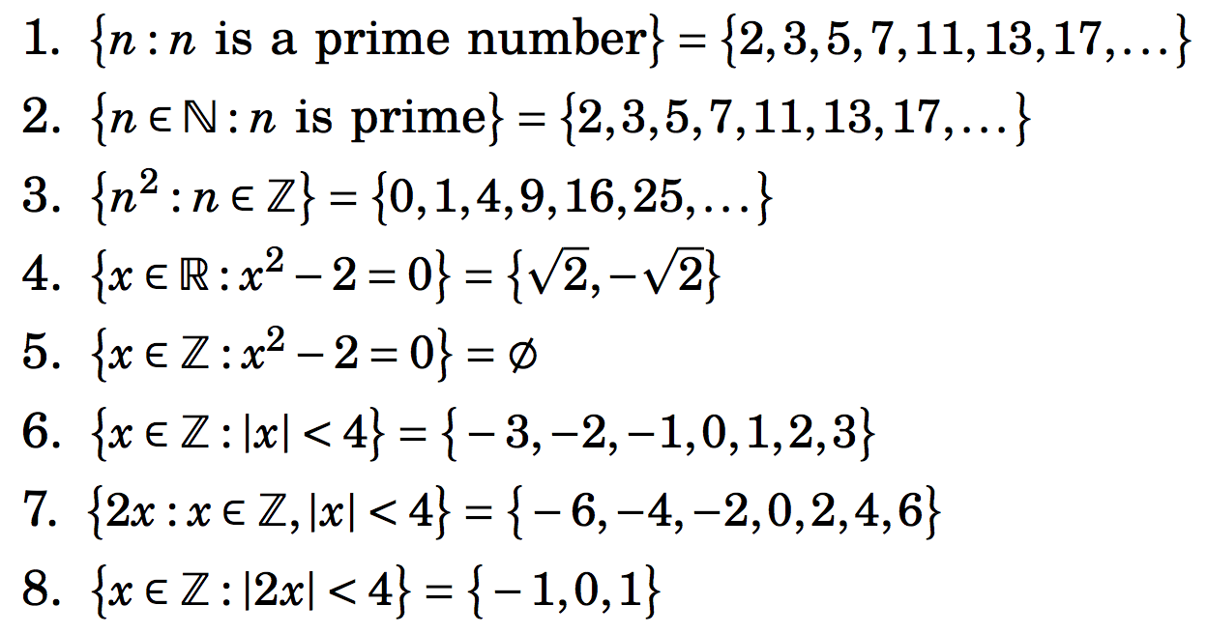
Some illustrations of set-builder notation

Slide 12
Conceptually:
Conceptually, a set is like a bag containing objects. This bag can contain another bag containing other objects.
Example: A= {1, {1}, {2}, {1,2}}
How many elements are in A?
1 ∈ A? 2 ∈ A? {2} ∈ A? {{2}} ∈ A?

Slide 13
Universal set
The set containing all the elements mentioned in a particular context.
Set of real numbers
Set of rational numbers
Usually denoted by U

Slide 14
Venn diagrams
Sets are often represented pictorially with Venn diagram.
A rectangle is used to denote the universal set.
Oval shapes are usually used to denote sets within U.

Slide 15
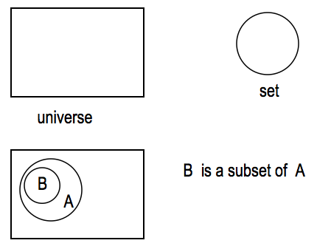
Venn Diagram
It is often used to visualize the various relations between the sets.

Slide 16
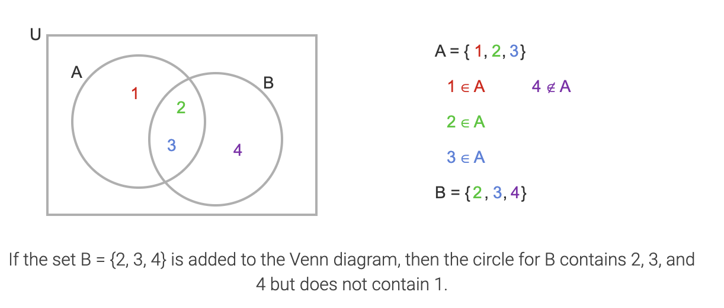
Venn diagrams

Slide 17
Set of sets (3.2)
The set A = {{1,2}, Φ, {1,2,3},{1}} has four elements: {1,2}, Φ, {1,2,3}, {1}}.
The empty set Φ is not the same as Φ.
The cardinality of {Φ} is one.

Slide 18
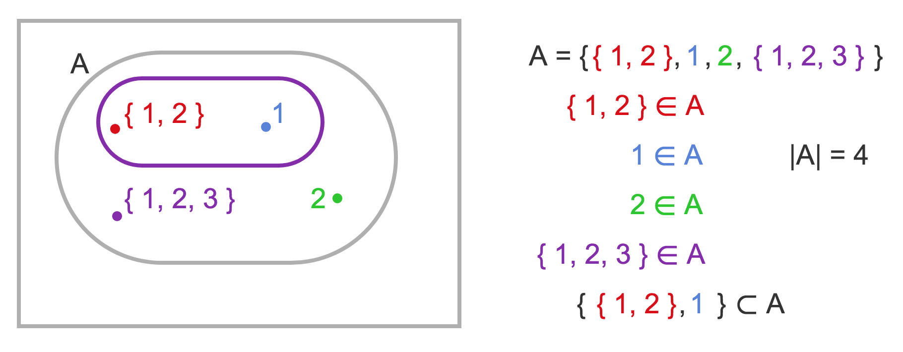
Set of sets

Slide 19
Power set
Given a set A, the power set of A, P(A), is the set of all subsets of A.
Examples
Let A={a,b,c}, P(A)={∅,{a},{b},{c},{a,b},{b,c},{a,c},{a,b,c}}
Let A={{a,b},c}, P(A)={∅,{{a,b}},{c},{{a,b},c}}
Note: the empty set ∅ and the set itself are always elements of the power set.

Slide 20
Power set
The power set is a fundamental combinatorial object useful when considering all possible combinations of elements of a set
Fact: Let S be a set such that |S|=n, then
|P(S)| = 2^{n}
Some intuition?

Slide 21
Power set
For B={1,2,3,4}

Slide 22
Cardinality of a set
Cardinality of a set A, denoted by |A|:
It is the number of elements in the set
A set with finite number of elements is called a finite set.
A set with infinite number of elements is called an infinite set.
Sets N, Z, Q, R are all infinite.
Empty set has no element, denoted by ∅
How many elements does the set {∅} contain?

Slide 23
Cardinality of a set
Cardinality of a set A, denoted by |A|:
It is the number of elements in the set
A set with finite number of elements is called a finite set.
A set with infinite number of elements is called an infinite set.
Sets N, Z, Q, R are all infinite.
Empty set has no element, denoted by ∅
How many elements does the set {∅} contain? One

Slide 24
Equality of Sets, Subsets
If B is a subset of A, every element of B is an element of A. We write B ⊆ A.
Two sets are equal if they have the same elements.
To show that two sets are equal, it is sufficient to show separately that
A ⊆ B and
B ⊆ A

Slide 25
Equality of Sets, Subsets (contd.)
Z⁺ is N, the set of natural numbers
Q⁺ is the set of all positive rational numbers

Slide 26
Subsets (contd.)
A set B is a proper subset of a set A, if it is a subset A and is not equal to A ( ).
If A is a subset of B and B is a subset of C, A is a subset of C. (Transitive relation)
Note that if A has at least one element, ∅ is a proper subset of A.

Slide 27
Set of sets
Let X={1, {1}, {1.2}, 2, {3}, 4}. Which statements are true?
2 ∈ X
{2} ∈ X
3 ∈ X
{1,2} ∈ X
{2,3} ⊆ X
{1, 2} ⊆ X
{2, 4} ⊆ X

Slide 28
Section 3.3
Set Operations
Union
Intersection
Complementation
Difference

Slide 29
Union
Definition: Let A and B be sets. The union of the sets A and B, denoted by A ∪ B, is the set:
Example: What is {1,2,3} ∪ {3, 4, 5}?
Solution: {1,2,3,4,5}
Venn Diagram for A ∪ B
U
A
B

Slide 30
Operations on Sets
Let A and B be two arbitrary sets. Let U be the universal set, (i.e. A ⊆ U and B ⊆ U).
Union: A ∪ B = {x: x ∈ A or x ∈ B}
Intersection: A ∩ B = {x: x ∈ A and x ∈ B}
Difference: A – B = { x: x ∈ A and x ∉ B}
Symmetric Difference:
A △ B = {x: (x ∈ A and x ∉ B) or (x ∉ A and x ∈ B)}
= (A – B) ∪ (B – A)
Complement: U – A = {x : x ∉ A}

Slide 31
Review Question
Example: U = {0,1,2,3,4,5,6,7,8,9,10} A = {1,2,3,4,5}, B ={4,5,6,7,8}
A ∪ B
Solution: {1,2,3,4,5,6,7,8}
A ∩ B
Solution: {4,5}
Ā
Solution: {0,6,7,8,9,10}
Solution: {0,1,2,3,9,10}
A – B
Solution: {1,2,3}
B – A
Solution: {6,7,8}

Slide 32
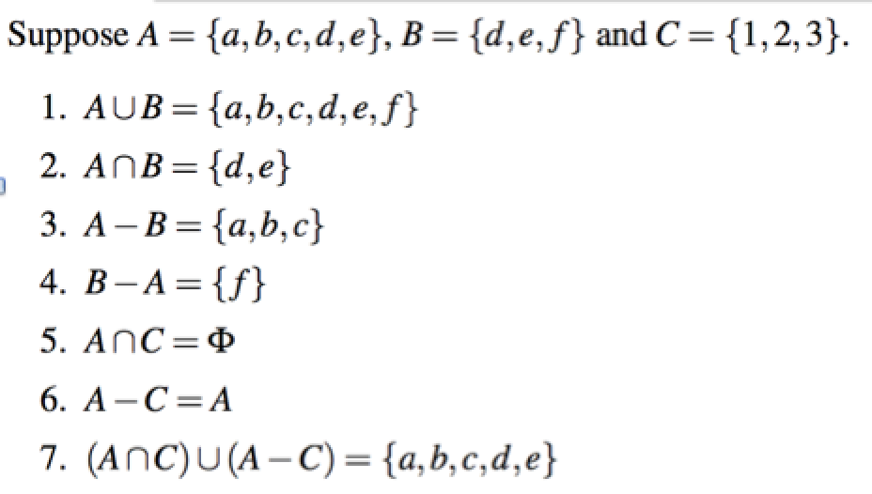
Operations on Sets

Slide 33
Operations on Sets
A={(x,x²) : x ∈ R} B={(x,ax + b) : x ∈ R and a,b ∈ R}
R
R
R

Slide 34
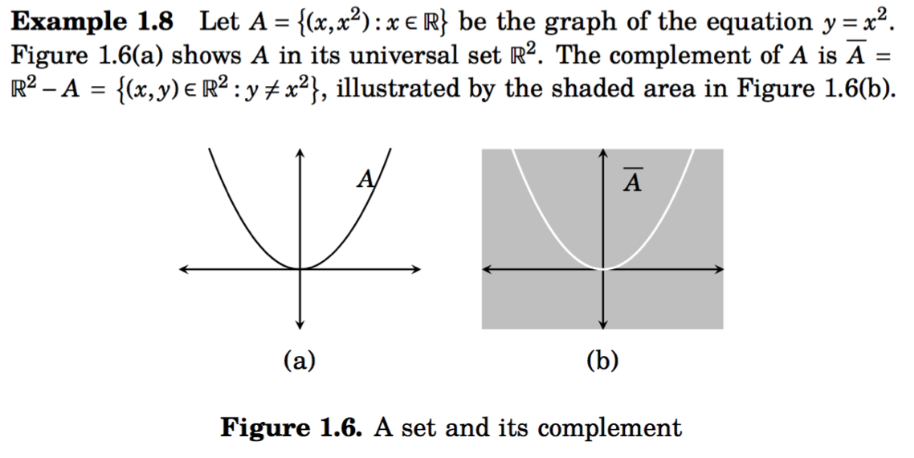
Operations on Sets
R
R

Slide 35
Special notation
Intersection and union of a long sequence of sets A₁, A₂, ..., A_{n}.

Slide 36
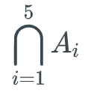
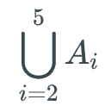
Exercise 3.3.2
For i ∈ Z⁺, A_{i} is the set of all positive integer multiples of i.
A₁={1, 2, 3, …}
A₂={2, 4, 6, 8, …}
A₃={ 3, 6, 9, 12, ….}
A₄={4, 8, 12, 16, …}
A₆={5,10, 15, 20, …}
What are and ?

Slide 37
Exercise 3.3.2
For i ∈ Z⁺, A_{i} is the set of all positive integer multiples of i.
A₁={1, 2, 3, …}
A₂={2, 4, 6, 8, …}
A₃={ 3, 6, 9, 12, ….}
A₄={4, 8, 12, 16, …}
A₆={5,10, 15, 20, …}
What are and. ?
= {1, 2, 3, ….} and
= {x: x =60 k for all positive integer k} = {60, 120, 180, …}

Slide 38
Venn Diagram
It is often used to visualize the various relations between the sets.

Slide 39
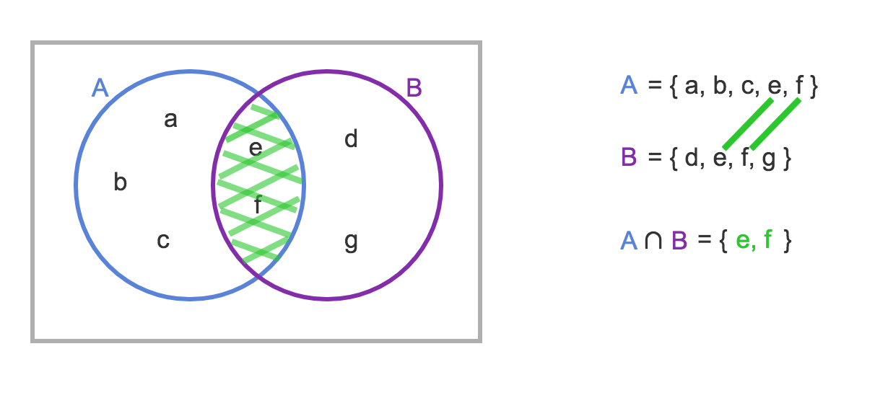
Intersection
The intersection of sets A and B, denoted by A B, is the set that contains those elements in both A and B.

Slide 40
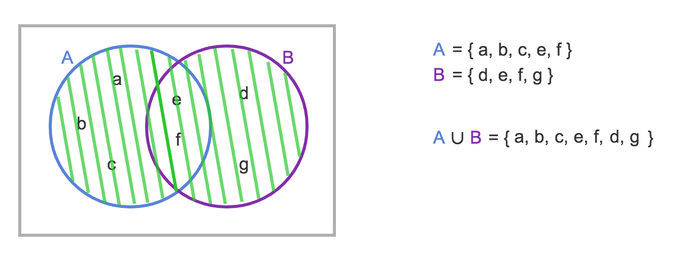
Union
The union of sets A and B, denoted by A B, is the set that contains those elements that are in either A or B.

Slide 41
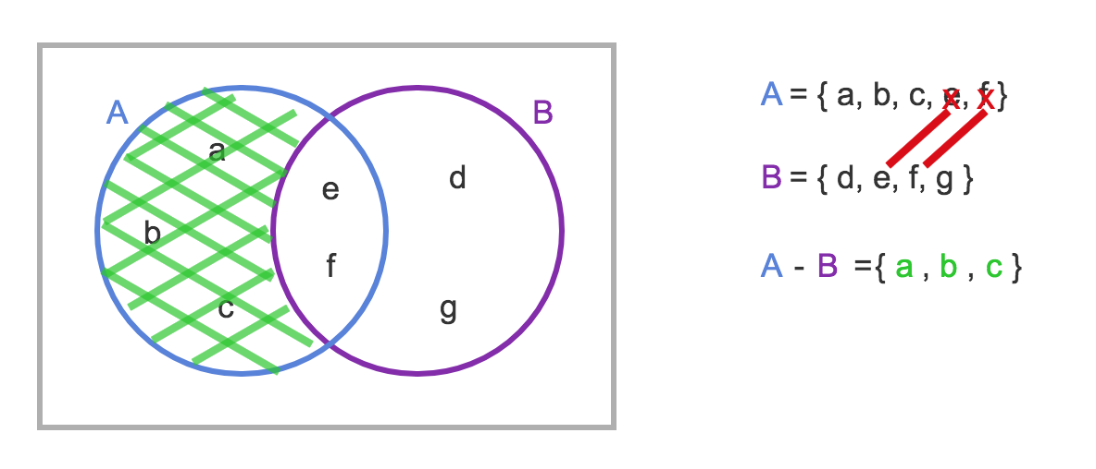
Set Difference
Definition: The difference of two sets A and B, denoted A−B, is the set containing those elements that are in A but not in B
B – A = { d , g }

Slide 42
Set Difference
Definition: The difference of two sets A and B, denoted A−B, is the set containing those elements that are in A but not in B
B – A = { d , g }
Note that A - B ≠ B - A

Slide 43
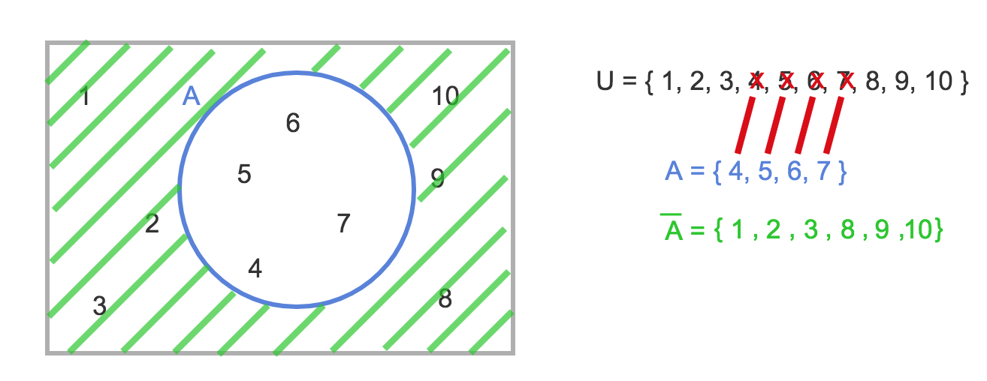
Set Complement
Definition: The complement of a set A, denoted A, consists of all elements not in A. That is the difference of the universal set U and A.
A = {x | x ∉ A }

Slide 44
Symmetric Difference
The difference operation is not commutative since it is not necessarily the case that A - B = B - A.
By contrast the symmetric difference is commutative.
The symmetric difference between two sets, A and B, denoted A Δ B, is the set of elements that are a member of exactly one of A and B, but not both.
An alternative definition of the symmetric difference operation is:

Slide 45
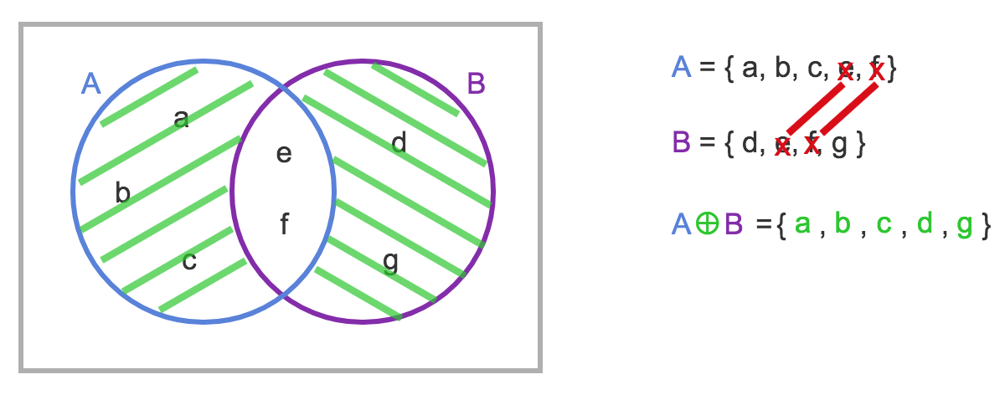
Symmetric Difference
Δ
A ⊕ B =.

Slide 46
Disjoint Sets
Definition: Two sets are said to be disjoint if their intersection is the empty set: A ∩ B = ∅
U
A
B

Slide 47
Disjoint Sets
Definition: Two sets are said to be disjoint if their intersection is the empty set: A ∩ B = ∅
U
A
B
If A and B are disjoint, A B = A ⊕ B.

Slide 48
Set identities (3.5)
Set identities are basic laws on how set operations work
Many have already been introduced on previous slides
Just like logical equivalences!
Replace U with ∨
Replace ∩ with ∧
Replace ∅ with F
Replace U with T

Slide 49
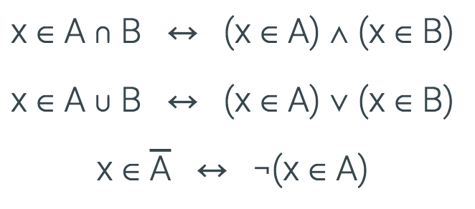
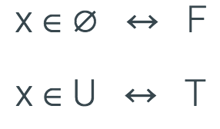
Set identities
The set operations intersection, union and complement are defined in terms of logical operations.
All the elements are assumed to be contained in a universal set U.

Slide 50
Set identities: De Morgan again
These should look very familiar…

Slide 51
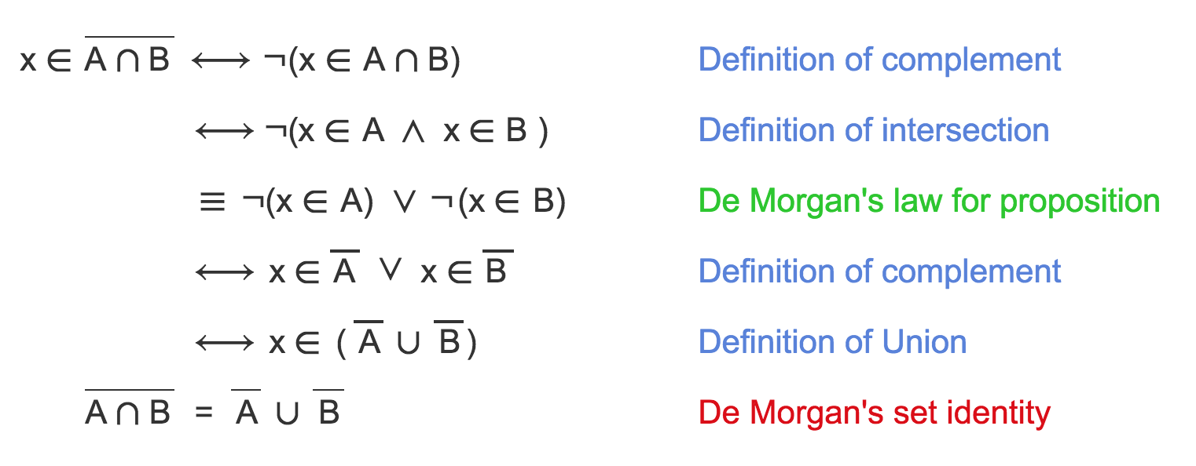
Deriving De Morgan's set identity using logic
x represents an arbitrary element.

Slide 52
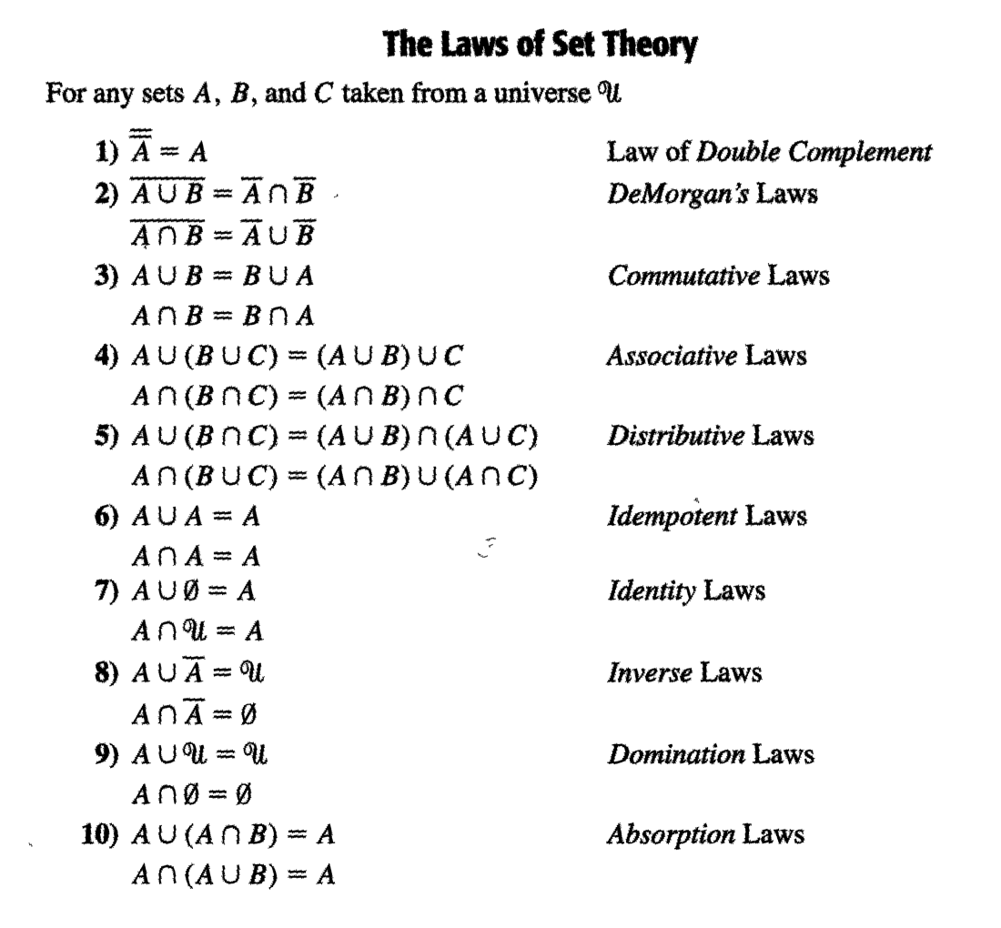

Slide 53
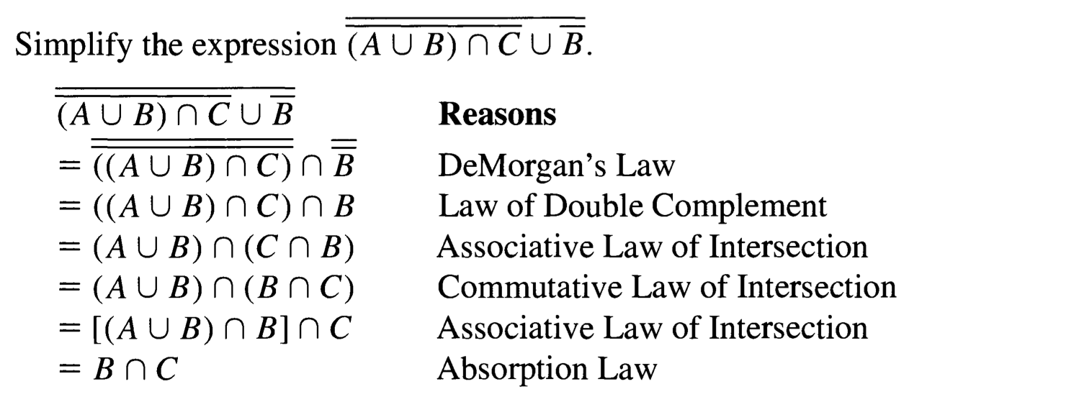
Example 3.20

Slide 54
Example 3.20

Slide 55
Example 3.20
The steps and reasons for simplifying the following statement is very similar.

Slide 56
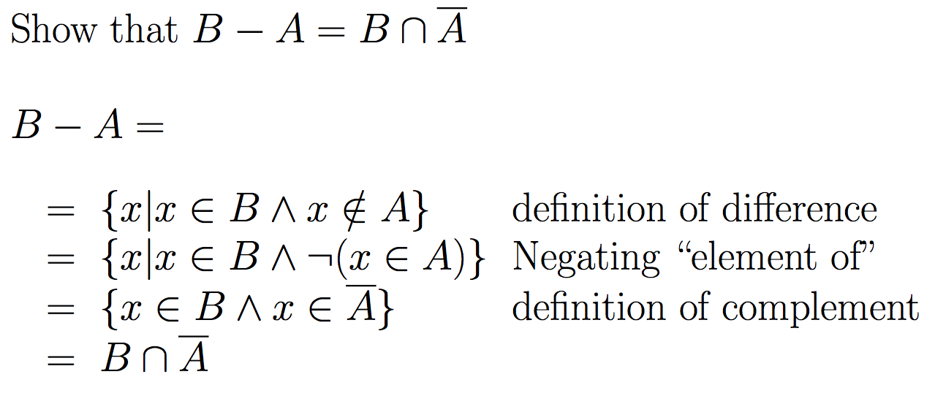

Slide 57
Proof by using basic set identities
Prove that A∩B=B-(B-A)
Definition of difference
Definition of difference
DeMorgan’s law
Complementation law
Distributive law
Complement law
Identity law
Commutative law

Slide 58
What is a membership table ?
Membership tables show all the combinations of sets an element can belong to
1 means the element belongs, 0 means it does not
Consider the following membership table:
The top row is all elements that belong to both sets A and B
Thus, these elements are in the union and intersection, but not the difference

Slide 59
What is a membership table ?
Membership tables show all the combinations of sets an element can belong to
1 means the element belongs, 0 means it does not
Consider the following membership table:
The second row is all elements that belong to set A but not set B
Thus, these elements are in the union and difference, but not the intersection

Slide 60
What is a membership table ?
Membership tables show all the combinations of sets an element can belong to
1 means the element belongs, 0 means it does not
Consider the following membership table:
The third row is all elements that belong to set B but not set A
Thus, these elements are in the union, but not the intersection or difference

Slide 61
What is a membership table ?
Membership tables show all the combinations of sets an element can belong to
1 means the element belongs, 0 means it does not
Consider the following membership table:
The bottom row is all elements that belong to neither set A or set B
Thus, these elements are neither the union, the intersection, nor difference

Slide 62
Proof by membership tables
The following membership table shows that A∩B=B-(B-A)
Because the two indicated columns have the same values, the two expressions are identical
This is similar to Boolean logic!

Slide 63
Proof by set builder notation and logical equivalences
First, translate both sides of the set identity into set builder notation
Then massage one side (or both) to make it identical to the other
Do this using logical equivalences

Slide 64
Proof by set builder notation and logical equivalences
Original statement
Definition of difference
Negating “element of”
Definition of difference
DeMorgan’s Law
Distributive Law
Negating “element of”
Negation Law
Identity Law
Definition of intersection

Slide 65
Proof by showing each set is a subset of the other
Definition: If two sets A and B are equal,
A ⊆ B and B ⊆ A.
We can prove A∩B=B-(B-A) by showing that
A∩B ⊆ B-(B-A), and
B-(B-A) ⊆ A∩B
If any element of A∩B is also an element of B-(B-A), then A∩B ⊆ B-(B-A).
If any element of B-(B-A) is also an element of A∩B, then B-(B-A) ⊆ A∩B.

Slide 66
Proof by showing each set is a subset of the other
Assume that x∈B-(B-A)
By definition of difference, we know that x∈B and x∉B-A

Slide 67
Proof by showing each set is a subset of the other
Assume that x∈B-(B-A)
By definition of difference, we know that x∈B and x∉B-A
Consider x∉B-A
If x∈B-A, then (by definition of difference) x∈B and x∉A
Since x∉B-A, then only one of the inverses has to be true (DeMorgan’s law): x∉B or x∈A

Slide 68
Proof by showing each set is a subset of the other
Assume that x∈B-(B-A)
By definition of difference, we know that x∈B and x∉B-A
Consider x∉B-A
If x∈B-A, then (by definition of difference) x∈B and x∉A
Since x∉B-A, then only one of the inverses has to be true (DeMorgan’s law): x∉B or x∈A
So we have that x∈B and (x∉B or x∈A)
It cannot be the case where x∈B and x∉B
Thus, x∈B and x∈A
This is the definition of intersection
Therefore, if x∈B-(B-A), x∈A∩B

Slide 69
Proof by showing each set is a subset of the other
Assume that x∈B-(B-A)
By definition of difference, we know that x∈B and x∉B-A
Consider x∉B-A
If x∈B-A, then (by definition of difference) x∈B and x∉A
Since x∉B-A, then only one of the inverses has to be true (DeMorgan’s law): x∉B or x∈A
So we have that x∈B and (x∉B or x∈A)
It cannot be the case where x∈B and x∉B
Thus, x∈B and x∈A
This is the definition of intersection
Therefore, if x∈B-(B-A), x∈A∩B
Thus, if x∈B-(B-A) then x∈A∩B
Therefore, B – (B-A) ⊆ A∩B

Slide 70
Proof by showing each set is a subset of the other
Assume that x∈A∩B
By definition of intersection, x∈A and x∈B
Thus, we know that x∉B-A
B-A includes all the elements in B that are also not in A not include any of the elements of A (by definition of difference)

Slide 71
Proof by showing each set is a subset of the other
Assume that x∈A∩B
By definition of intersection, x∈A and x∈B
Thus, we know that x∉B-A
B-A includes all the elements in B that are also not in A (by definition of difference)
Consider B-(B-A)
We know that x∉B-A
We also know that if x∈A∩B then x∈B (by definition of intersection)
Thus, if x∈B and x∉B-A, we can restate that (using the definition of difference) as x∈B-(B-A)S

Slide 72
Proof by showing each set is a subset of the other
Assume that x∈A∩B
By definition of intersection, x∈A and x∈B
Thus, we know that x∉B-A
B-A includes all the elements in B that are also not in A not include any of the elements of A (by definition of difference)
Consider B-(B-A)
We know that x∉B-A
We also know that if x∈A∩B then x∈B (by definition of intersection)
Thus, if x∈B and x∉B-A, we can restate that (using the definition of difference) as x∈B-(B-A)
Thus, if x∈A∩B then x∈B-(B-A)
Therefore, A∩B ⊆ B - (B-A).
This completes the proof of A∩B = B - (B-A).

Slide 73
Subset problems
Let A, B, and C be sets. Show that:
(AUB) ⊆ (AUBUC)
(A∩B∩C) ⊆ (A∩B)
(A-B)-C ⊆ A-C
(A-C) ∩ (C-B) = ∅

Slide 74
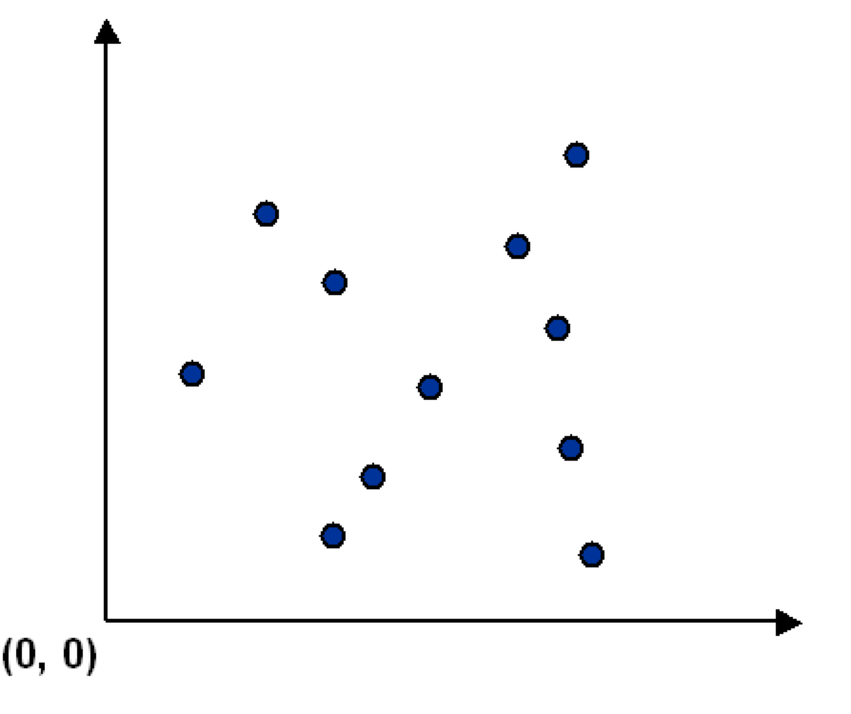
Ordered collection of objects (3.6)
Sometimes we need to consider ordered collection of objects.
Consider a set S of points in the plane.
y
x

Slide 75
Ordered collection of objects
Sometimes we need to consider ordered collection of objects.
Consider a set S of points in the plane.
y
p_{i} =(x_{i},y_{i}) is the x-y coordinate of the i^{th} point.
S={(x₁,y₁), (x₂,y₂), ……, (x_{m},y_{m})} represents a set of m ordered objects.
Each object is an ordered collection of two elements.
S = {p₁,p₂, …, p_{m}} is also fine.
x

Slide 76
Tuples
An ordered n-tuple is a sequence of n objects {a₁, a_{2, …,} a_{n}}.
First component is a₁
Second component is a₂
...
N-th component is a_{n}
An ordered pair: 2-tuple (a,b)
An ordered triple: 3-tuple. (a,b,c)
(1,1,1) is valid but {1,1,1} = {1} when it is unordered.

Slide 77
Tuples
Two n-tuples are equal if and only if corresponding pairs of elements are equal:
(a₁, a₂, …, a_{n}) = (b₁, b₂, …, b_{n}) iff
a₁ = b₁, a₂= b₂, …, a_{n} = b_{n}
(2, 1) $≠$(1, 2), but {2, 1} = {1, 2}
Think of tuples as book chapters and sections
(1,1): Chapter 1, section 1
(1,2,5). Chapter 1, section 2, sub-section 5

Slide 78
Cartesian products
For two sets, A and B, the Cartesian product of A and B, denoted A x B, is the set of all ordered pairs in which the first entry is in A and the second entry is in B.
That is A x B = { (a, b) : a ∈ A and b ∈ B }
Example: A = {1, 2}, B = {a, b, c}
A x B = { (1, a), (1, b), (1, c), (2, a), (2, b), (2, c)}
Is A x B the same as B x A? NO

Slide 79
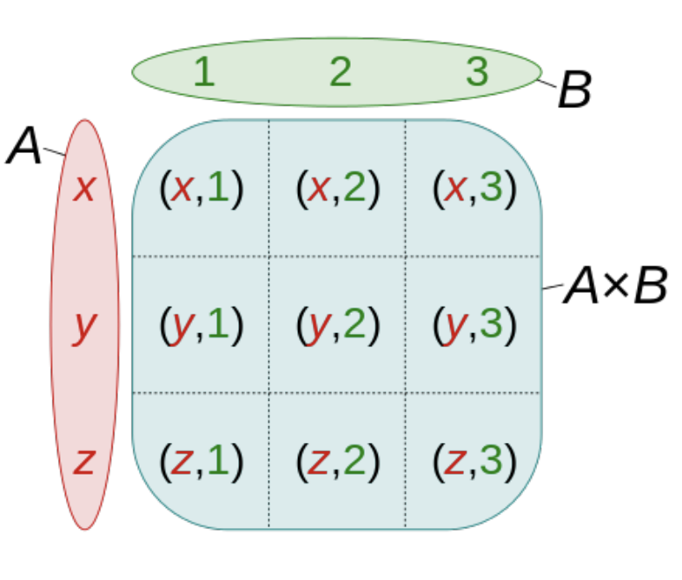
Cartesian products
Cartesian product of the sets
A = {x, y, z} and
B = {1, 2, 3}

Slide 80
Cartesian products
Fact: |A x B| = |A| * |B|
Example: A = {1, 2}, B = {a, b, c} A x B = { (1, a), (1, b), (1, c), (2, a), (2, b), (2, c)}

Slide 81
Cartesian products
The cartesian product of sets A₁,…,A_{n} is the set of n-tuples (a₁,a₂,…,a_{n}), where a_{i} $ε$ A_{i} for i=1, 2, …, n.
Denoted by A₁ $×$ A₂ $×$… $×$ A_{n}
Example:
A={0, 1}, B={2, 3}, C={4, 5, 6}
What is A x B x C? What is |A x B x C|?

Slide 82
Cartesian products of a set with itself
Given a set A we can look at A x A (denoted A²), and more generally A x A x ... x A denoted as A^{k}.
Example:
if A = {0, 1}, then A^{k} is the set of all ordered k-tuples whose entries are bits (0 or 1).
{0, 1}³ = { (0, 0, 0), (0, 0, 1), (0, 1, 0), (0, 1, 1), (1, 0, 0), (1, 0, 1), (1, 1, 0), (1, 1, 1) }
k times

Slide 83
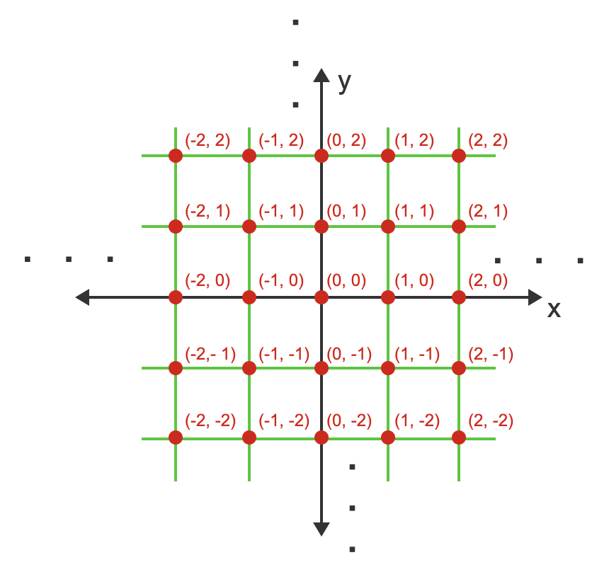
Z² = Z x Z is the set of all integer points in the plane

Slide 84
R² = R x R is the set of all points in the plane

Slide 85
Strings
If A is a set of symbols, then members of A^{k} can be written without commas/parentheses.
For example:
If A = {0, 1} then we can express A² as {00, 01, 10, 11}.
A sequence of characters is called a string.
The set of characters used in a set of strings is called the alphabet for the set of strings.
The length of a string is the number of characters in the string.
For example, the length of the string 110011 is 6.

Slide 86
Strings
A binary string is a string whose alphabet is {0, 1}.
A bit is a character in a binary string.
A string of length n is also called an n-bit string.
The set of binary strings of length n is denoted as {0,1}^{n}.
An example of a binary string of length 7 (or 7-bit string) is: 0010110.
The empty string is the unique string whose length is 0 and is usually denoted by the symbol λ.
Since {0, 1}⁰ is the set of all binary strings of length 0,
{0, 1}⁰ = {λ}.

Slide 87
Strings
If s and t are two strings, then the concatenation of s and t (denoted st) is a longer string obtained by putting s and t together.
s = 010 and t = 11, then st = 01011.
t = 11, t0 = 110 (concatenating a single symbol)

Slide 88
Example 3.6.2
Define the sets X and Y as: X = {*, +, $} and Y = {52, 67}. Use the definitions for X and Y to answer the questions.
(a) Write the set X × Y using roster notation.
(b) Give an element of X⁴. Express your
answer as a 4-tuple, not as a string.
(c) Give an element of X × X × Y × Y × X.
Express your answer as a 5-tuple, not as a string.

Slide 89
Example 3.6.2
Define the sets X and Y as: X = {*, +, $} and Y = {52, 67}. Use the definitions for X and Y to answer the questions.
(a) Write the set X × Y using roster notation.
{ (*, 52), (*, 67), (+, 52), (+, 67), ($, 52), ($, 67) }
(b) Give an element of X⁴. Express your answer as a
4-tuple, not as a string.
For example: (*, *, $, +)
(c) Give an element of X × X × Y × Y × X.
Express your answer as a 5-tuple, not as a string.
For example: ($, $, 67, 67, *)

Slide 90
Example 3.6.8 Proving set identities with cartesian products.
Use the following three definitions and the laws of logic to prove the two identities given below.
Definition of Cartesian product: (x,y) ∈ A × B ↔ (x ∈ A) ∧ (y ∈ B)
Definition of intersection: x ∈ A ∩ B ↔ (x ∈ A) ∧ (x ∈ B)
Definition of union: x ∈ A ∪ B ↔ (x ∈ A) ∨ (x ∈ B)
Show that A × (B ∪ C) = (A × B) ∪ (A × C)

Slide 91
Show that A × (B ∪ C) = (A × B) ∪ (A × C)
(x,y) ∈ A × (B ∪ C) ↔ (x ∈ A) ∧ (y ∈ (B ∪ C))
(by the definition of Cartesian product)
↔ (x ∈ A) ∧ ((y ∈ B) ∨ (y ∈ C))
(by the definition of union)
↔ ((x ∈ A) ∧ (y ∈ B)) ∨ ((x ∈ A) ∧ (y ∈ C))
(by the distributive law)
↔ ((x ,y) ∈ A × B) ∨ ((x ,y) ∈ A × C)
(by the definition of Cartesian product)
↔ ((x ,y) ∈ (A × B) ∪ (A × C)
(by the definition of union)

Slide 92
Partitions (3.7)
Two sets, A and B, are said to be disjoint if their intersection is empty (A ∩ B = ∅).
A sequence of sets, A₁, A₂, ..., A_{n}, is pairwise disjoint if every pair of distinct sets in the sequence is disjoint.
(i.e., A_{i} ∩ A_{j} = ∅ for any i and j in the range from 1 through n where i ≠ j).

Slide 93
Partitions (3.7)
A partition of a non-empty set A is a collection of non-empty subsets of A such that each element of A is in exactly one of the subsets. A₁, A₂, ...,A_{n} is a partition for a non-empty set A if all of the following conditions hold:
For all i, A_{i} ⊆ A.
For all i, A_{i} ≠ ∅
A₁, A₂, ...,A_{n} are pairwise disjoint.
A = A₁ ∪ A₂ ∪ ... ∪ A_{n}

Slide 94
Example 3.7.4(a) Recognizing partitions – sets of strings
Suppose that every student at a university is assigned a unique 8-digit ID number.
A_{i} : the set students whose ID number begins with the digit i.
Assume that for each digit, i, there is at least one student whose ID starts with i.
Do the sets A₀, …, A₉ form a partition of the set of currently enrolled students?

Slide 95
Example 3.7.4(a) Recognizing partitions – sets of strings
Suppose that every student at a university is assigned a unique 8-digit ID number.
A_{i} : the set students whose ID number begins with the digit i.
Assume that for each digit, i, there is at least one student whose ID starts with i.
Do the sets A₀, …, A₉ form a partition of the set of currently enrolled students?
Yes.
If i ≠ j, then A_{i} ∩ A_{j} = ∅.
An ID number can not begin with digit i and digit j if i ≠ j.
Also is the set of all students because each ID number has to start with some digit.

Slide 96
Example 3.7.4(b) Recognizing partitions – sets of strings
Let A be the set of words in the Oxford English Dictionary (OED).
For each positive integer j, define A_{j} to be the set of all words with j letters in the OED.
For example, the word "discrete" is an element of A₈ because the word "discrete" has 8 letters.
The longest word in the OED is "pneumonoultramicroscopicsilicovolcanoconiosis" which has 45 letters.
Do the sets A₁, …, A₄₅ form a partition of the set of words in the OED?

Slide 97
Example 3.7.4(b) Recognizing partitions – sets of strings
Let A be the set of words in the Oxford English Dictionary (OED).
For each positive integer j, define A_{j} to be the set of all words with j letters in the OED.
For example, the word "discrete" is an element of A₈ because the word "discrete" has 8 letters.
The longest word in the OED is "pneumonoultramicroscopicsilicovolcanoconiosis" which has 45 letters.
Do the sets A₁, …, A₄₅ form a partition of the set of words in the OED?
Yes
If i ≠ j, then A_{i} ∩ A_{j} = ∅. A word can not have both i letters and j letters if i ≠ j.
Also is the set of all words in the OED because the number of letters in every word is in the range from 1 through 45.

