Slide 1
Relations (Chapter 6.5 – 6.6)

Slide 2
Posets (6.5)
Definition: A set A (domain) together with a partial order relation R is called a partial ordered set or poset and is denoted by (A,R).
Example: Suppose R is the relation `divides’. We can show that (N, R) ((N,|)) is a poset.
We often use the symbol for a partial order.

Slide 3
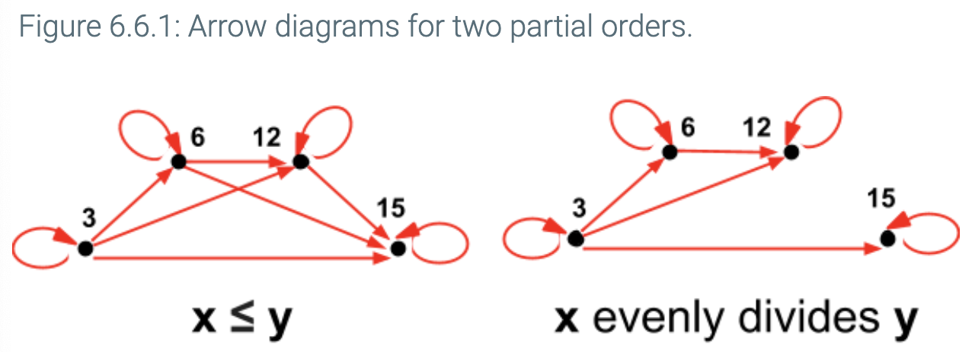

Slide 4
Comparability and total orders of a poset (S,R)
Definition: The elements a and b of a poset (S,R) are called comparable if either (a,b) ∈ R or (b,a) ∈ R. Note that both cannot belong to R since R is antisymmetric. When a and b are elements that neither (a,b) ∈ R nor (b,a) ∈ R, a and b are called incomparable.
Example: Consider the poset (Z,R) where Z is the set of integers and R indicates the relationship `divide’.
3 and 6 are comparable
3 and 5 are not comparable.

Slide 5
Comparability and total orders of a poset (S,R)
Definition: If (S,R) is a poset, and every two elements a and b of S are comparable, (S,R) is called a totally ordered set, and R is called a total order.
Example: (Z, ≤) is a totally ordered set.

Slide 6
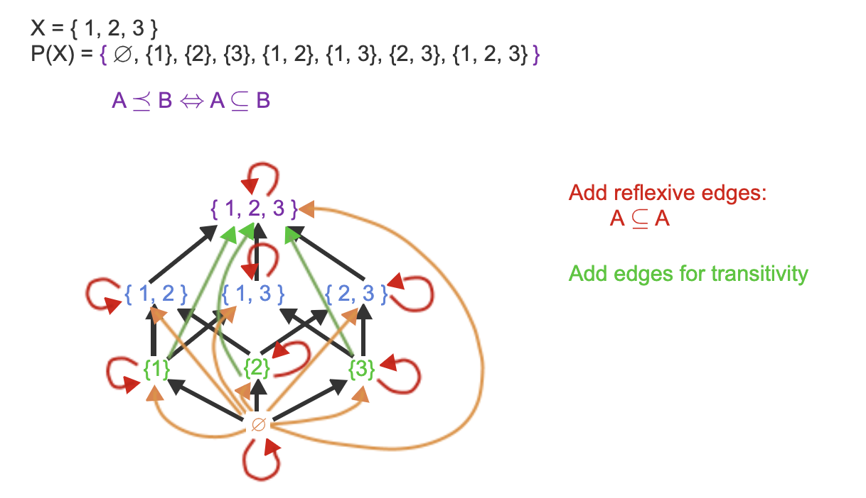
Partial order defined on a power set.

Slide 7
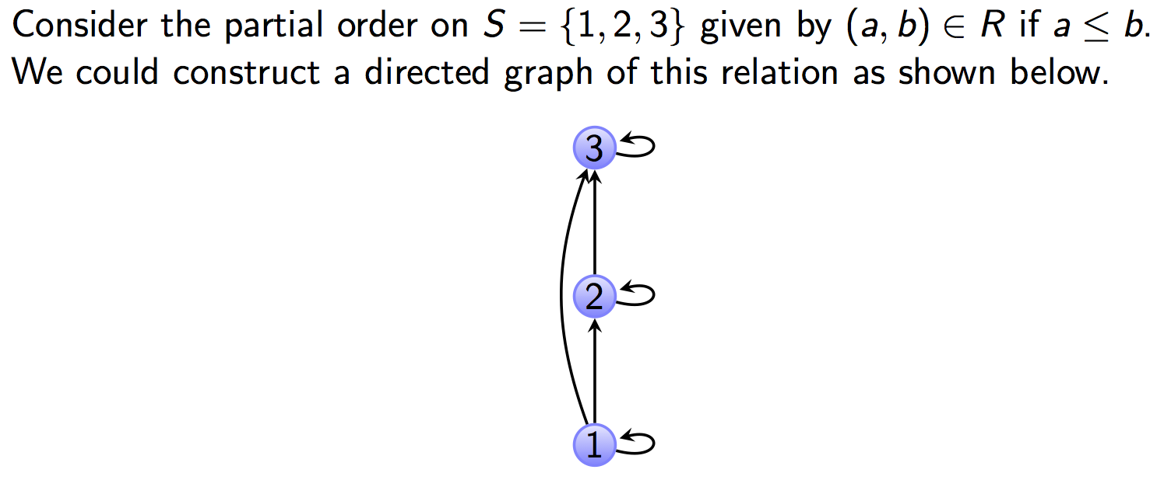
Hasse Diagram to represent posets.

Slide 8
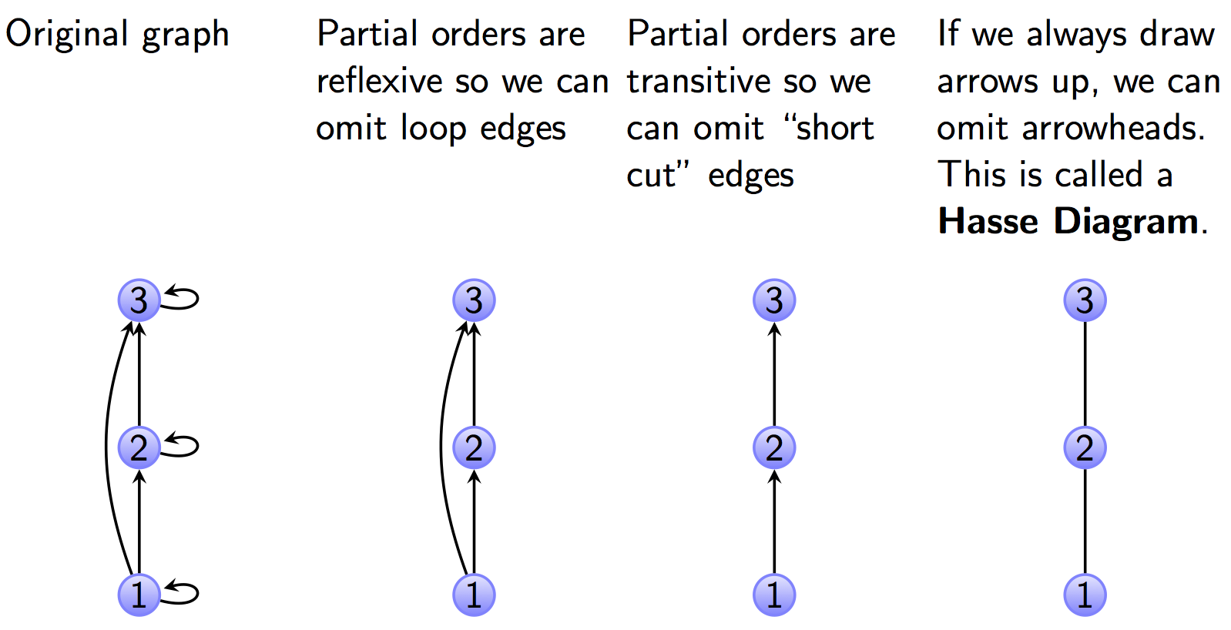
Hasse Diagram to represent posets.

Slide 9
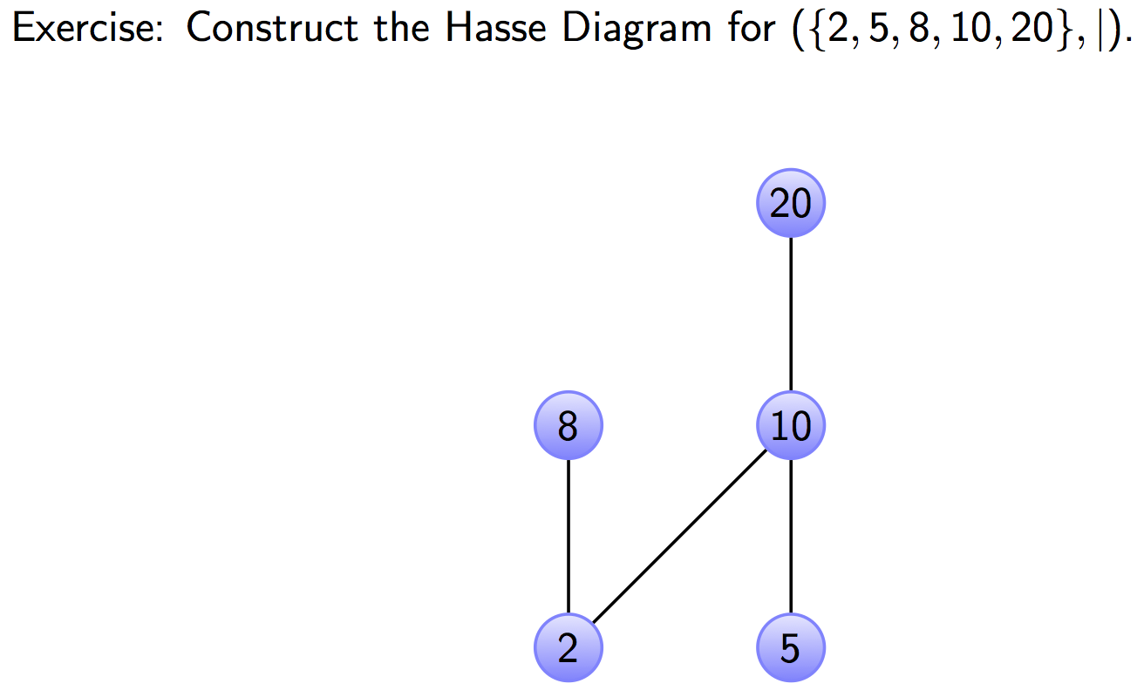
Hasse Diagram Example

Slide 10
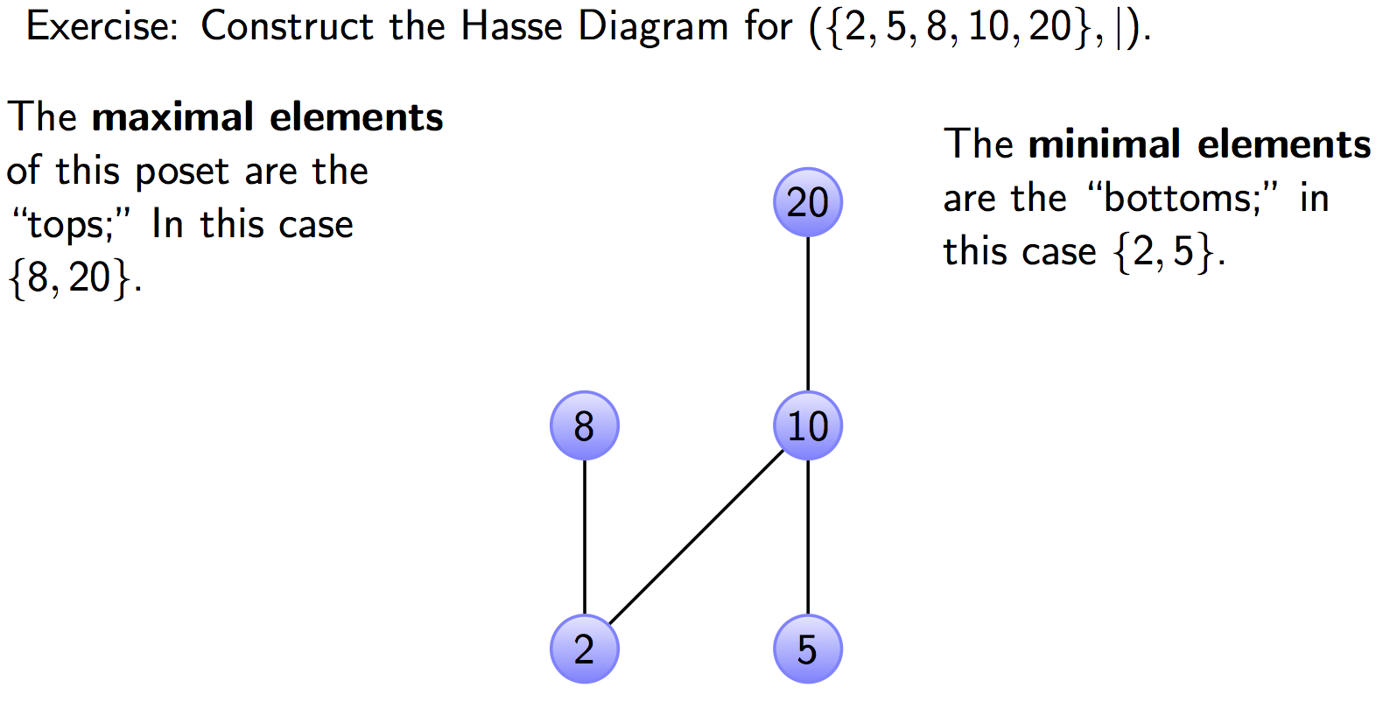
Hasse Diagram Example

Slide 11
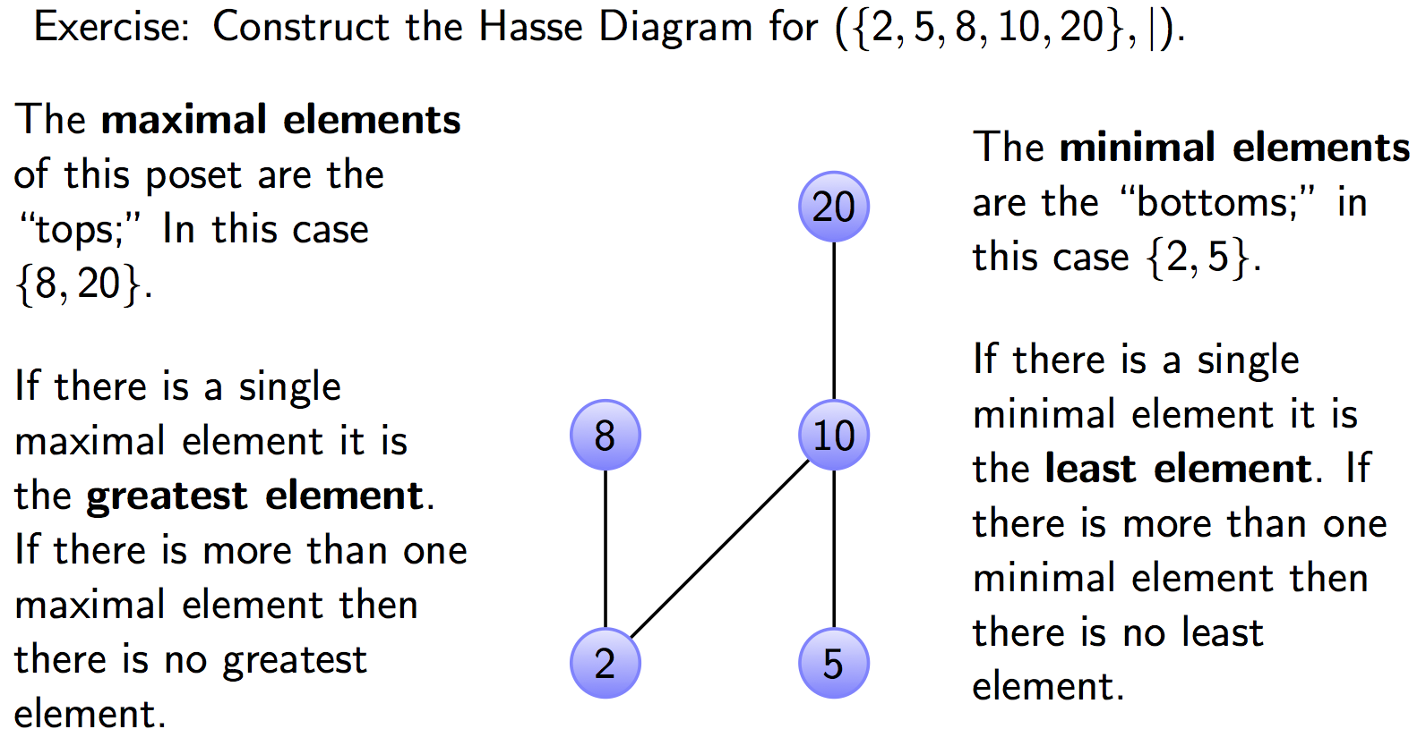
Hasse Diagram Example

Slide 14
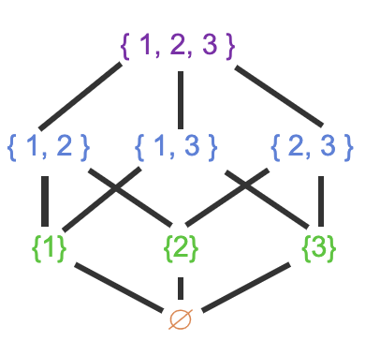
Partial order defined on a power set.
Greatest element
Least element

Slide 16
An application

Slide 17
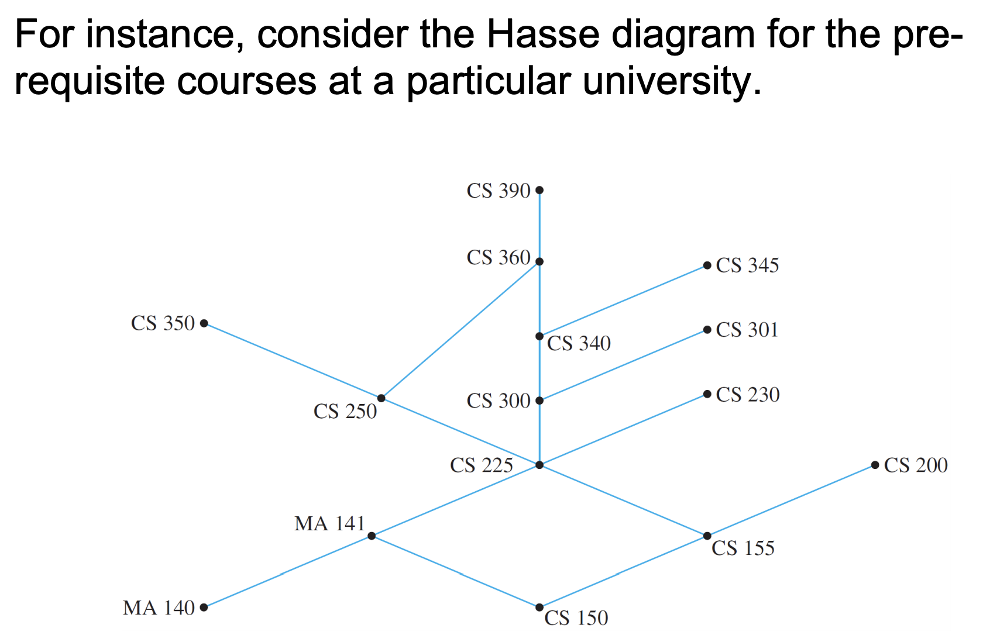
An application

Slide 18
An application

Slide 19
An application

Slide 20
Practice problems:
Show that (P(A), ⊆) is a poset. Draw the Hasse diagram of (P({a,b,c}, ⊆). Determine the greatest and the least elements of the poset.
Suppose R is defined as: R = {(a,b) | a, b ∈ Z and a+b is even}.
Is (Z, R) a poset?
Consider the `divides’ relation on the set A = (1,2,2², 2³, …., 2^{n}}.
Prove that this relation is a total order on A.
Draw the Hasse diagram for this relation when n=3.

Slide 21
Equivalence Relation (6.6)
Consider the set of people
Now consider a R relation such that (a,b)∈R if a and b are siblings.
Clearly this relation is
Reflexive
Symmetric, and
Transitive
Such as relation is called an equivalence relation
Definition: A relation on a set A (domain) is an equivalence relation if it is reflexive, symmetric, and transitive

Slide 22
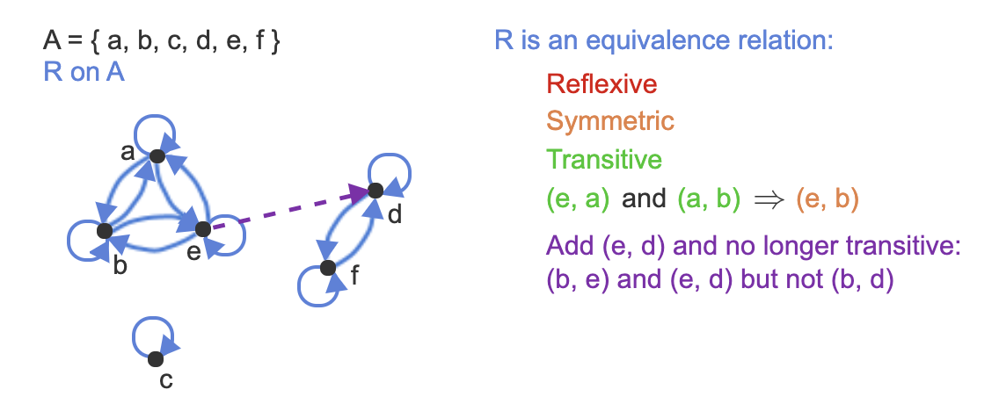
Equivalence relation example

Slide 23
Equivalence Relations: Example 1
Example: Let R={ (a,b) | a,b∈R and a≤b}
Is R reflexive?
Is it transitive?
Is it symmetric?
No, it is not. 4 is related to 5 (4 ≤ 5) but 5 is not related to 4
Thus R is not an equivalence relation

Slide 24
Equivalence Class (1)
Definition: Let R be an equivalence relation on a set A and let a ∈A. The set of all elements in A that are related to a is called the equivalence class of a. We denote this set [a]_{R} or just [a] if it is clear what R is.
[a]_{R} = { s | (a,s)∈R, s∈A}

Slide 26
Equivalence Relations: Example 2
Example: Let R={ (a,b) | a,b∈Z and a=b}
Is R reflexive?
Is it transitive?
Is it symmetric?
What are the equivalence classes that partition Z?

Slide 27
Equivalence Relations: Example 3
Example: For (x,y),(u,v) ∈R², we define
R={ ((x,y),(u,v)) | (x²+y²=u²+v²}
Show that R is an equivalence relation.
What are the equivalence classes that R defines (i.e., what are the partitions of R²)?

Slide 28
Equivalence Relations: Example 3
Example: For (x,y),(u,v) ∈R², we define
R={ ((x,y),(u,v)) | x²+y²=u²+v²}
Two points are related if they lie on a circle with the center at the origin.
Show that R is an equivalence relation.
What are the equivalence classes that R defines (i.e., what are the partitions of R²)?
(concentric circles with the center at the origin)

Slide 29
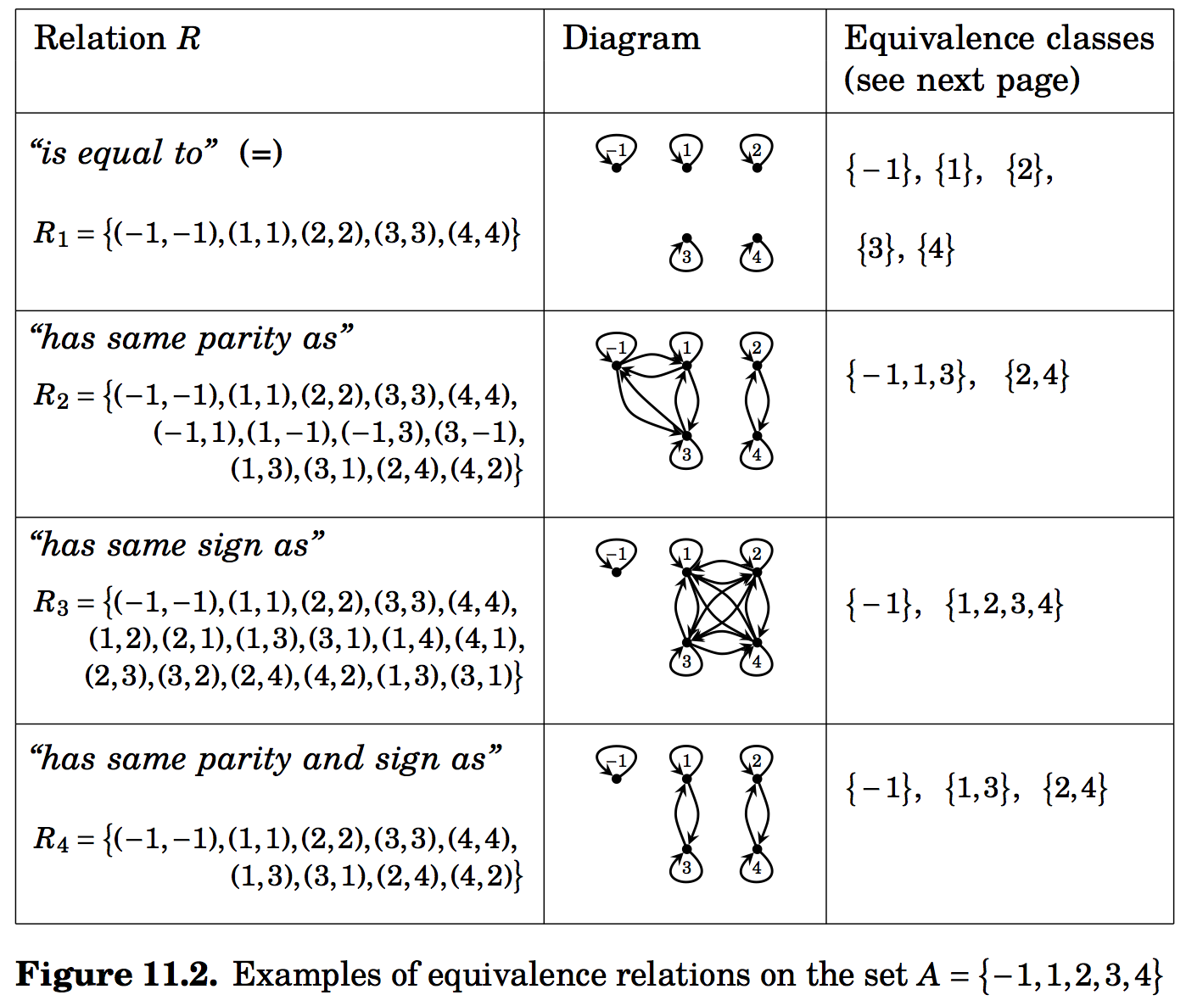
Equivalence relation on set A={-1,1,2,3,4}

Slide 30
Equivalence Class (2)
The elements in [a]_{R} are called representatives of the equivalence class
Theorem: Let R be an equivalence class on a set A. The following statements are equivalent
aRb (i.e. (a,b) ∈ R)
[a]=[b]
[a] ∩ [b] ≠∅
Proof: We first show that (1) ⇒ (2)

Slide 31
Equivalence Class (3)
We will prove that [a] = [b] by showing that [a] ⊆ [b] and [b] ⊆ [a].
Suppose c ∈ [a].
Thus (a,c) ∈ R.
Because (a,b) ∈ R, and R is symmetric, therefore (b,a) ∈ R.
Thus (b,a) ∈ R and (a, c) ∈ R, and R is transitive, therefore (b,c) ∈ R.
Because of the symmetric property of R, (c,b) ∈ R as well.
This implies that c ∈ [b].
Therefore [a] ⊆ [b].
The proof for [b] ⊆ [a] is similar.
Hence [a] = [b] .

Slide 32
Equivalence Class (4)
(2) ⇒ (3): [a] = [b] ⇒ [a] ∩ [b] ≠ ∅
Let a, b ∈ A such that [a] = [b]. Since a ∈ [a], we know that it also belongs to [b].
This means that a ∈ [a] ∩ [b].
This implies [a] ∩ [b] ≠ ∅

Slide 33
Equivalence Class (5)
(3) ⇒ (1): [a] ∩ [b] ≠ ∅ ⇒ (a,b) ∈ R.
Let c ∈ [a] ∩ [b] . c exists since [a] ∩ [b] is non-empty.
Therefore, c ∈ [a] and c ∈ [b] Since a ∈ [a], we know that it also belongs to [b].
Thus (c,a) ∈ R and (c,b) ∈ R.
R is symmetry: (a,c) ∈ R and (b,c) ∈ R.
R is transitive: (a,b) ∈ R.

Slide 34
Partitions Partitions (1)
Equivalence classes partition the set A into disjoint, non-empty subsets A₁, A₂, …, A_{k}
A partition of a set A satisfies the properties
∪^{k}_{i=1}A_{i}=A
A_{i} ∩ A_{j} = ∅ for i≠j
A_{i} ≠ ∅ for all i

Slide 35
Partitions (2)
Example: Let R be a relation such that (a,b)∈R if a and b live in the same province/ territories , then R is an equivalence relation that partitions the set of people who live in Canada into 13 equivalence classes

Slide 36
Partitions (2)
Theorem:
Let R be an equivalence relation on a set S. Then the equivalence classes of R form a partition of S.
Conversely, given a partition A_{i} of the set S, there is a equivalence relation R that has the set A_{i} as its equivalence classes.

Slide 37
Partitions: Visual Interpretation
Example: Let A={1,2,3,4,5,6,7} and R be an equivalence relation that partitions A into A₁={1,2}, A₂={3,4,5,6} and A₃={7}
Draw the 0-1 matrix
Draw the digraph

