Slide 1
Relations (Chapter 6.1-6.4)
A few slides have been taken from the sites
http://cse.unl.edu/~choueiry/S13-235/
and
http://www.math-cs.gordon.edu/courses/mat231/notes.html

Slide 2
Outline of Chapter 6
Binary Relations (6.1)
Properties of relations(6.2)
Equivalence relations
Relations between sets
Partial Orders
Hasse Diagrams

Slide 3
Introduction to binary relations
Binary relation
Mathematically, a binary relation between two sets A and B is a subset R of A×B.
Arrow diagram
In an arrow diagram of a relation R on sets A and B, the elements of A are listed on the left, the elements of B are listed on the right, and
there is an arrow from a∈A to b∈B if aRb.

Slide 4
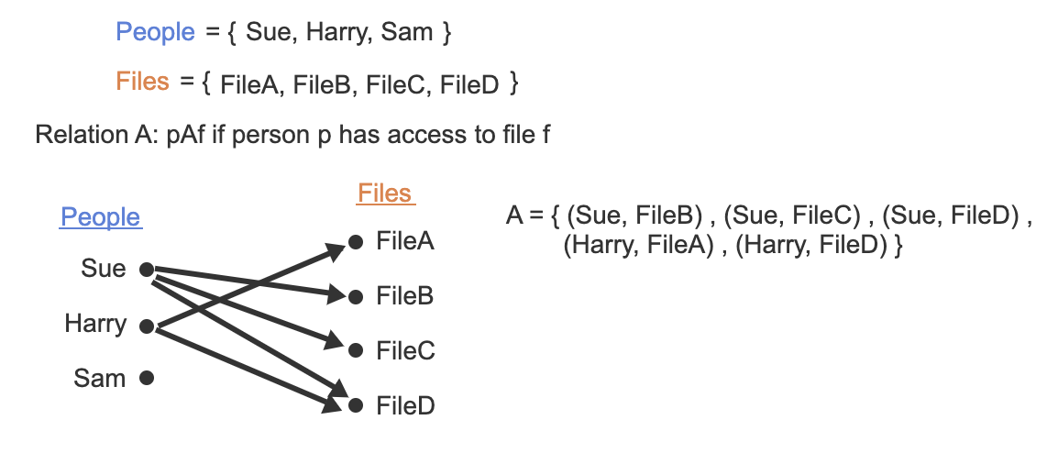
Arrow diagram of a relation
The relation A is a subset of People x Files cartesian product.

Slide 5
Arrow diagram of a relation
Any function is a relation, but a relation may or may not be a function.

Slide 6
Relation of a set
Defn: A relation R on a set A is a subset R ⊆ A x A. We often abbreviate the statement (x,y) ∈ R as xRy. The statement (x,y) ∉ R is abbreviated as
A is called the domain of the relation.

Slide 7
Relations
Suppose A = {1,2,3,4,5,6}
Consider the set L = { (x,y): x, y ∈ A and x < y}
L = {(1,2), (1,3), (1,4), (1,5), (1,6), (2,3), (2,4), (2,5), (2,6), (3,4), (3,5), (3,6), (4,5), (4,6), (5,6)}

Slide 8
Relations
Suppose A = {1,2,3,4,5,6}
Consider the set L = { (x,y): x, y ∈ A and x < y}
L = {(1,2), (1,3), (1,4), (1,5), (1,6), (2,3), (2,4), (2,5), (2,6), (3,4), (3,5), (3,6), (4,5), (4,6), (5,6)}
Consider the set D={(x,y): x,y ∈ A and x|y}

Slide 9
Relations
Suppose A = {1,2,3,4,5,6}
Consider the set L = { (x,y): x, y ∈ A and x < y}
L = {(1,2), (1,3), (1,4), (1,5), (1,6), (2,3), (2,4), (2,5), (2,6), (3,4), (3,5), (3,6), (4,5), (4,6), (5,6)}
Consider the set D={(x,y): x,y ∈ A and x|y}
D={(1,1), (1,2), (1,3), (1,4), (1,5), (1,6), (2,2), (2,4) (2,6), (3,3), (3,6), (4,4), (5,5), (6,6)}

Slide 10
Relation of a set

Slide 11
Examples of Relations
We have seen that < relation on A = {1,2,3,4,5,6} is given by
L = {(1,2), (1,3), (1,4), (1,5), (1,6), (2,3), (2,4), (2,5), (2,6), (3,4), (3,5), (3,6), (4,5), (4,6), (5,6)}
We have also seen that | relation on A = {1,2,3,4,5,6} is given by
D={(1,1), (1,2), (1,3), (1,4), (1,5), (1,6), (2,2), (2,4) (2,6), (3,3), (3,6), (4,4), (5,5), (6,6)}
L ∩ D = {(1,2), (1,3), (1,4), (1,5), (1,6), (2,4), (2,6), (3,6)}.
L ∩ D ={(x,y): : x, y ∈ A and x < y and x|y}
Note that L ∩ D is a relation.

Slide 12
Representing Relations
There are multiple ways to represent relations.
We have already seen that relations can be enumerated, i.e. they are listed as sets.

Slide 13
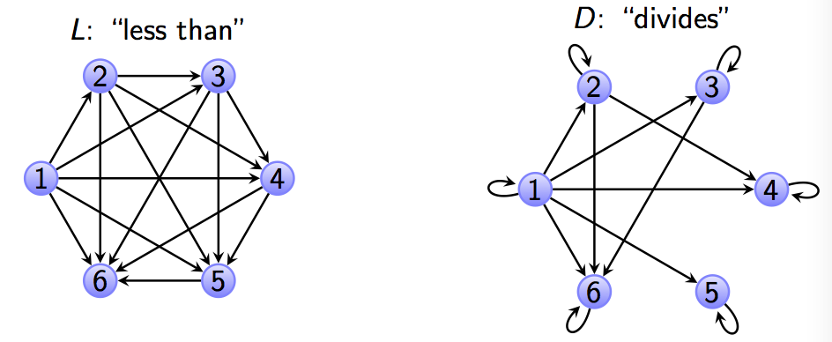
Representing Relations
There are multiple ways to represent relations.
We have already seen that relations can be enumerated, i.e. they are listed as sets.
A directed graph can represent a relation R on A. Each node (vertex) in the graph represents an element of A and an arrow from vertex x to vertex y indicates (x,y) ∈ R. For example, using set A and relations L and D from the previous slides, we have

Slide 14
Representing Relations
A relation R on A = {a₁, a₂, …, a_{m}} can be represented by the zero-one matrix M_{R} = [m_{ij}] with
m_{ij} = 1 if (a_{i}, a_{j}) ∈ R, and
m_{ij} = 0 if (a_{i}, a_{j}) ∉ R.
Note that for creating this matrix we first need to determine the elements that represent the rows. This mapping is arbitrary.

Slide 15
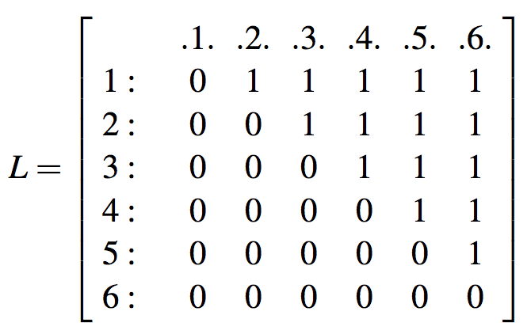
Representing Relations
Consider the relation L considered earlier.
L = {(1,2), (1,3), (1,4), (1,5), (1,6), (2,3), (2,4), (2,5), (2,6), (3,4), (3,5), (3,6), (4,5), (4,6), (5,6)}

Slide 16
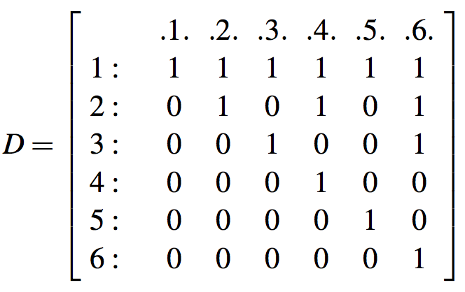
Representing Relations
Consider the relation D considered earlier.
D={(1,1), (1,2), (1,3), (1,4), (1,5), (1,6), (2,2), (2,4) (2,6), (3,3), (3,6), (4,4), (5,5), (6,6)}

Slide 17
Relations
Suppose A = {1,2,3,4,5,6}
Consider the set L = { (x,y): x, y ∈ A and x < y}
L can also be written as L={(x,y): (x,y) ∈ A x A and x < y}.

Slide 18
Relations
Suppose A = {1,2,3,4,5,6}
Consider the set L = { (x,y): x, y ∈ A and x < y}
L = {(1,2), (1,3), (1,4), (1,5), (1,6), (2,3), (2,4), (2,5), (2,6), (3,4), (3,5), (3,6), (4,5), (4,6), (5,6)}

Slide 19
Relations
Suppose A = {1,2,3,4,5,6}
Consider the set L = { (x,y): x, y ∈ A and x < y}
L = {(1,2), (1,3), (1,4), (1,5), (1,6), (2,3), (2,4), (2,5), (2,6), (3,4), (3,5), (3,6), (4,5), (4,6), (5,6)}
Consider the set D={(x,y): x,y ∈ A and x|y}

Slide 20
Relations
Suppose A = {1,2,3,4,5,6}
Consider the set L = { (x,y): x, y ∈ A and x < y}
L = {(1,2), (1,3), (1,4), (1,5), (1,6), (2,3), (2,4), (2,5), (2,6), (3,4), (3,5), (3,6), (4,5), (4,6), (5,6)}
Consider the set D={(x,y): x,y ∈ A and x|y}
D={(1,1), (1,2), (1,3), (1,4), (1,5), (1,6), (2,2), (2,4) (2,6), (3,3), (3,6), (4,4), (5,5), (6,6)}

Slide 21
Relations
Suppose A = {1,2,3,4,5,6}
Consider the set L = { (x,y): x, y ∈ A and x < y}
L = {(1,2), (1,3), (1,4), (1,5), (1,6), (2,3), (2,4), (2,5), (2,6), (3,4), (3,5), (3,6), (4,5), (4,6), (5,6)}
Consider the set D={(x,y): x,y ∈ A and x|y}
D={(1,1), (1,2), (1,3), (1,4), (1,5), (1,6), (2,2), (2,4) (2,6), (3,3), (3,6), (4,4), (5,5), (6,6)}
The symbol < is usually used to denote the relationship between the elements of A.
Similarly, the symbol | is generally used to denote the relationship between the elements of A.
L, D ⊆ A x A.

Slide 22
Relations
Binary relations R defined on a set A
R ⊆ A x A : n = 2
R ⊆ R x R : real plane
R ⊆ R⁺ x R⁺: Interior of the first quadrant
(a,b) ∈ R is an element of R.
In the text infix notation aRb is also used.

Slide 23
Relations as Subsets
Question : Suppose we have relations on {1,2} given by R = {(1,1), (2,2)}, S = {(1,1),(1,2)}. Find:
The union R ∪S
The intersection R ∩ S
The symmetric difference R ⊕S
The difference R-S
The complement of R

Slide 24
Relations as Subsets
Answer: (R = {(1,1),(2,2)}, S = {(1,1),(1,2)})
R ∪S = {(1,1),(1,2),(2,2)}
R ∩S = {(1,1)}
R ⊕S = {(1,2),(2,2)}.
R-S = {(2,2)}.
R = {(1,2),(2,1)}

Slide 25
Questions:
Q.6: Congruence modulo 5 is a relation on set N (set of positive integers). Let R be the relation.
R = {(a,b) | a, b ∈ N and a ≡ b (mod 5)}
R = { (0,0), (0,5), (0,10), (1,6), (1,11), …}
Q

Slide 26
Properties of Binary Relations (6.2)
Let R be a binary relation on A (i.e. R ⊆ A x A)
R is reflexive if for every a ∈ A, (a,a) ∈ R.
R is anti-reflexive if for every a ∈ A, (a,a) $∉$ R
R is symmetric if (a,b) ∈ R, (b,a) ∈ R.
R is transitive if (a,b) ∈ R, (b,c) ∈ R, then (a,c) ∈ R.
R is antisymmetric if (a,b) ∈ R and (b,a) ∈ R, a = b.
.

Slide 27
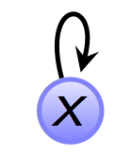
Properties of Relations in Graphs
How do each of the properties of relations show up in graphs of relations?
The graph of a reflexive relation will have a loop edge at each node.

Slide 28
Properties of Relations in Graphs
How do each of the properties of relations show up in graphs of relations?
The graph of a reflexive relation will have a loop edge at each node.
The graph of a symmetric relation will not have an edge from x to y unless there is also an edge from y to x.

Slide 29
Properties of Relations in Graphs
The graph of an antisymmetric relation will not have any symmetric pairings. If there is an edge from x to y, there cannot be an edge from y to x.
For A={1,2,3,4,5,6}, R={(1,1), (2,2), (3,3), (4,4), (5,5), (6,6)} is a relation which is reflexive, symmetric and antisymmetric.
A graph is symmetric if there is no antisymmetric edge. Similarly, a graph is antisymmetric if there is no symmetric edge.

Slide 30
Properties of Relations in Graphs
The graph of a transitive relation will have an edge from x to z whenever there is an edge from x to y and an edge from y to z.

Slide 31
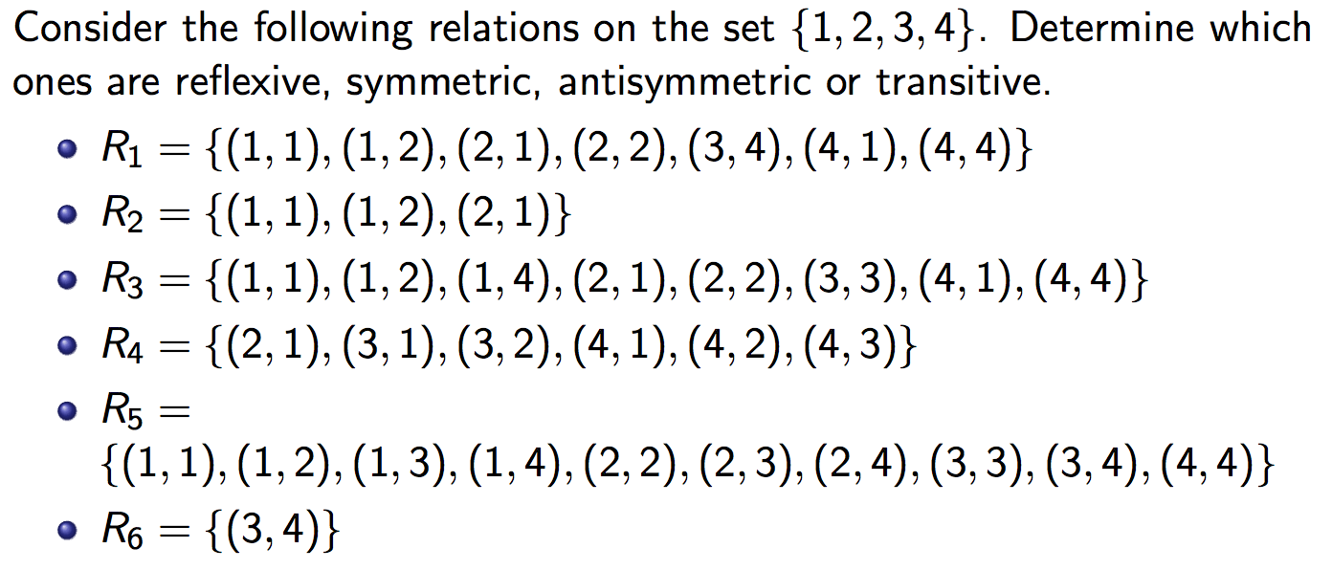
Examples

Slide 32
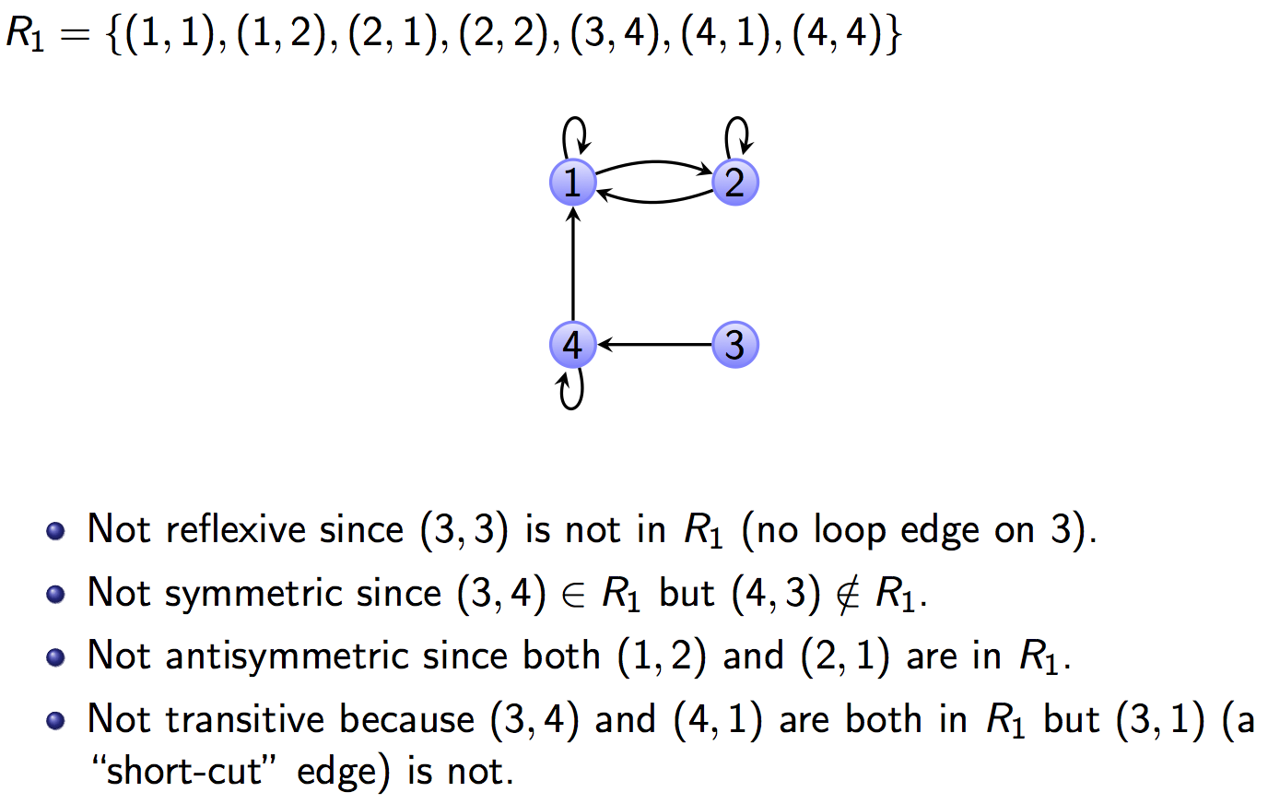
R₁

Slide 33
R₂

Slide 34
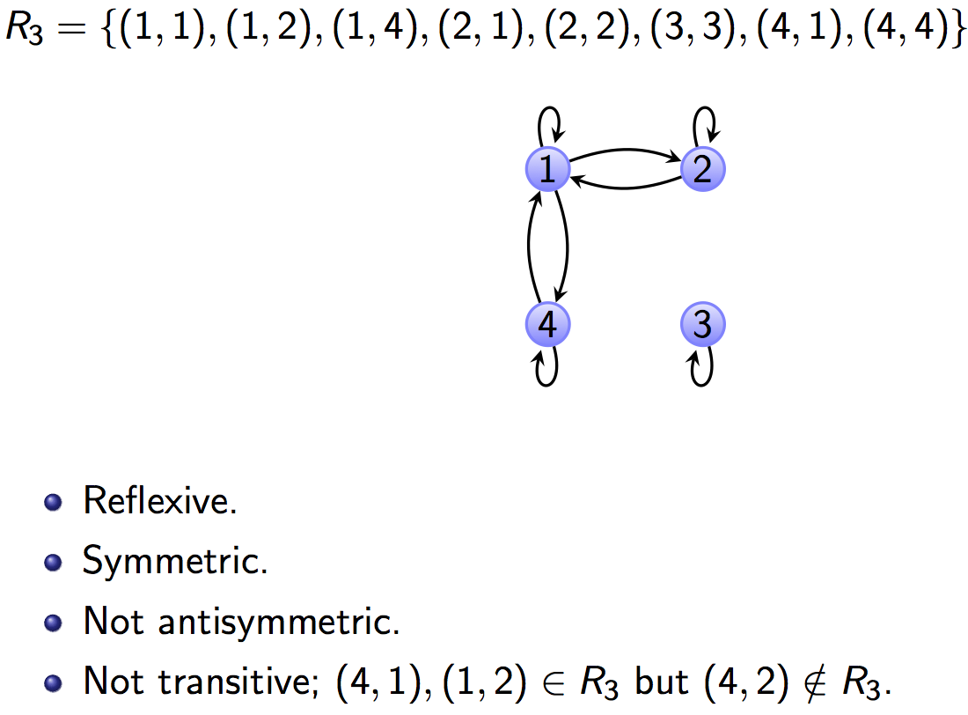
R₃

Slide 35
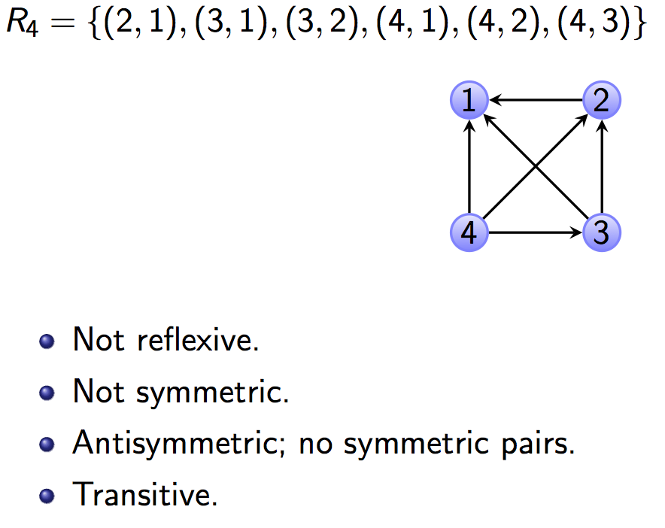
R₄

Slide 36
R₅

Slide 37
R₅
This is the “less than or equal to” relation on A={1,2,3,4}

Slide 38
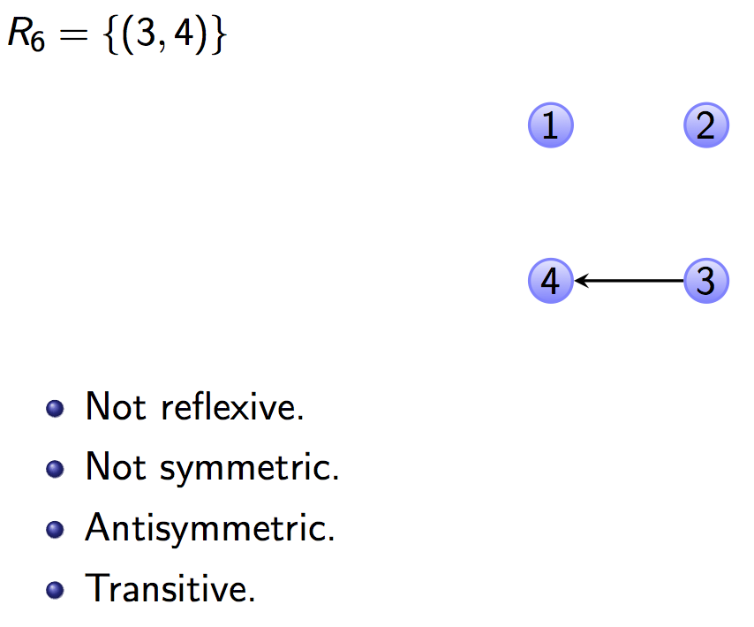
R₆

Slide 39
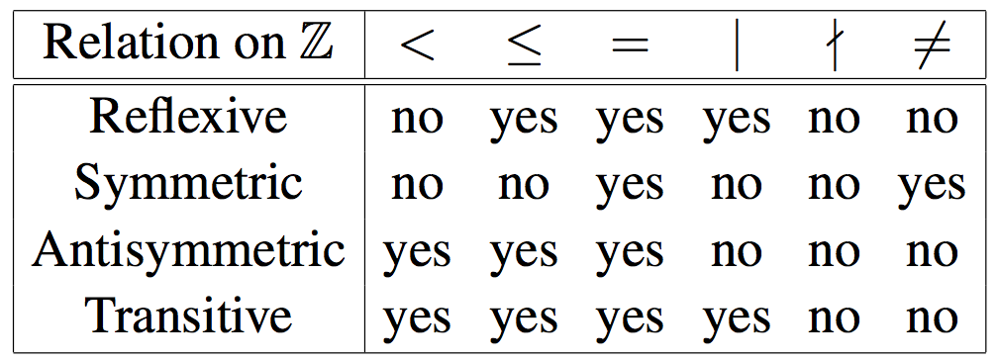
Examine the following table:

Slide 40
Visualizing the Properties
A: Reflexive. Upper-Left corner to Lower-Right corner diagonal is all 1’s. EG:
M_{R} =
Q: How about if R is symmetric?

Slide 41
Visualizing the Properties
A: A symmetric matrix. i.e., flipping across diagonal does not change matrix. EG:
M_{R} =
Notes:
Official name for “flipping across diagonal” is transposing

Slide 42
Visualizing the Properties
Not symmetric
This matrix is also antisymmetric
Notes:
Official name for “flipping across diagonal” is transposing

Slide 43
Directed graphs, paths, and cycles (6.3)
Directed graph
A directed graph (or digraph, for short) consists of a pair (V, E). V is a set of vertices, and E, a set of directed edges, is a subset of V × V. .
Vertex
An individual element of V is called a vertex
Tail, head
The vertex u is the tail of the edge (u,v).
The vertex v is the head of the edge (u,v).

Slide 44
Directed graphs, paths, and cycles (6.3)
Self-loop
If the head and the tail of an edge are the same vertex, the edge is called a self-loop.
Here (d,d) is a self-loop.

Slide 45
Directed graphs, paths, and cycles (6.3)
Self-loop
If the head and the tail of an edge are the same vertex, the edge is called a self-loop.
In-degree
The in-degree of a vertex is the number of edges pointing into it.
Here (d,d) is a self-loop.

Slide 46
Directed graphs, paths, and cycles (6.3)
Self-loop
If the head and the tail of an edge are the same vertex, the edge is called a self-loop.
In-degree
The in-degree of a vertex is the number of edges pointing into it.
Out-degree
The out-degree of a vertex is the number of edges pointing out of it.
Here (d,d) is a self-loop.

Slide 47
Directed graphs

Slide 48
A walk in a directed graph
A walk from v₀ to v_{m} in a directed graph G is a sequence of alternating vertices and edges that starts and ends with a vertex.
⟨v₀,(v₀,v₁),v₁,(v₁,v₂),v₂,...,v_{m−1},(v_{m−1},v_{m}),v_{m}⟩
Each edge in the sequence appears after its tail and before its head: …,v_{i−1},(v_{i−1},v_{i}),v_{i},…

Slide 49
A walk in a directed graph
A walk from v₀ to v_{m} in a directed graph G is a sequence of alternating vertices and edges that starts and ends with a vertex.
⟨v₀,(v₀,v₁),v₁,(v₁,v₂),v₂,...,v_{m−1},(v_{m−1},v_{m}),v_{m}⟩
Each edge in the sequence appears after its tail and before its head: …,v_{i−1},(v_{i−1},v_{i}),v_{i},…
The length of a walk is m, the number of edges in the walk.
An open walk is a walk in which the first and last vertices are not the same.
A closed walk is a walk in which the first and last vertices are the same.

Slide 51
A few more definitions
Trail
A trail is an open walk in which no edge occurs more than once.
Circuit
A circuit is a closed walk in which no edge occurs more than once.
Path
A path is a trail in which no vertex occurs more than once.
Cycle
A cycle is a circuit of length at least 1 in which no vertex occurs more than once, except the first and last vertices which are the same.

Slide 52
Example

Slide 53
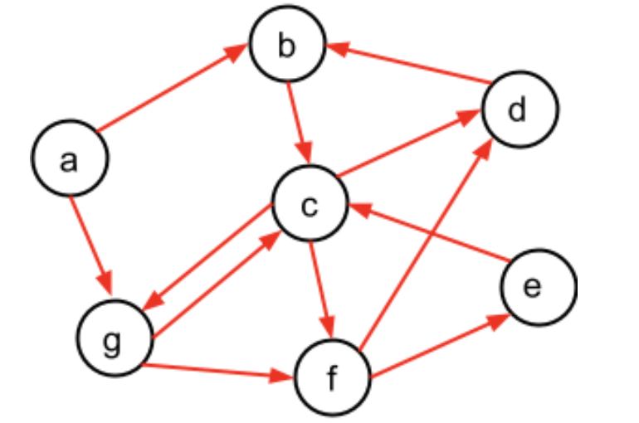
Graph definitions
In-degree of a vertex; out-degree of a vertex; head of an edge; tail of an edge; Self-loops; walk in the graph; trail; circuit; path; cycle

Slide 54
Compositions of relations (6.4)
Composition
The composition of relations R and S on set A is another relation on A, denoted S ο R.
The pair (a, c) ∈ S ο R if and only if there is a b ∈ A such that (a, b) ∈ R and (b, c) ∈ S.
The domain of each relation is the same.

Slide 55
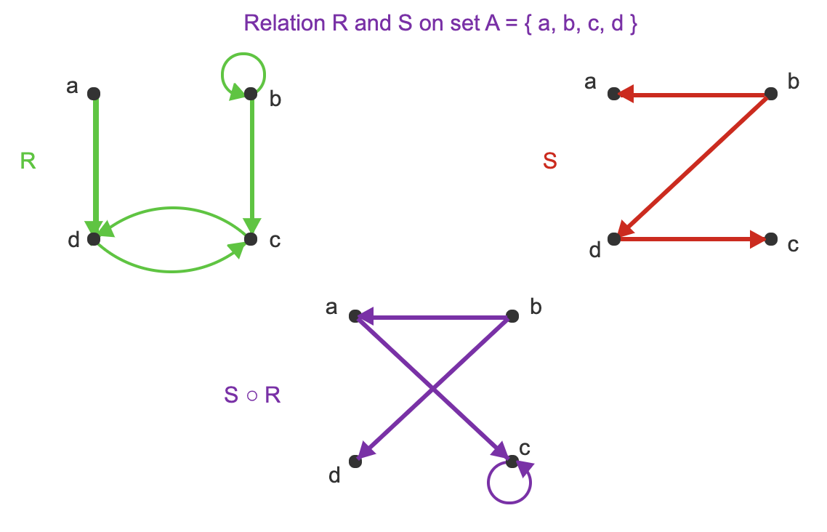
R and S are relations on set A.
(a, c) ∈ S ∘ R because there is a vertex d such that (a,d) ∈ R and (d,c) ∈ S.
Since (c,d) ∈ R and (d,c) ∈ S, (c,c) ∈ S ∘ R.
Since (b,b) ∈ R and (b,d) ∈ S, (b,d) ∈ S ∘ R.
Since (b,b) ∈ R and (b,a) ∈ S, (b,a) ∈ S ∘ R.

