Slide 1
Proofs (Chapter 2)
Used some materials from
Book of Proof by
Richard H. Hammack
https://www.people.vcu.edu › ~rhammack › BookOfProof › BookOfProof

Slide 2
Proofs
A proof of a mathematical statement is logical argument which establishes the truth of a statement.
We will cover a variety of methods of proofs.
There are terms which we should know while proving things.

Slide 3
Mathematical definitions
Even integer
An integer x is even if there is an integer k such that x = 2k
Odd integer
An integer x is odd if there is an integer k such that x = 2k+1.
The parity of an integer is whether the number is odd or even.
If two numbers are both even or both odd, then the two numbers have the same parity.
If one number is odd and the other is even, then the two numbers have opposite parity.

Slide 4
Mathematical definitions
Rational
A number r is rational if there exist integers x and y such that y ≠ 0 and r = x/y.
The numbers .25, .3274, , are rational numbers
Irrational
A number is irrational if it is not rational.
$π$, $\sqrt{3}, …are irrationals$
Real
Consists of all rational and irrational numbers.

Slide 5
Mathematical definitions
Divides
An integer x divides an integer y if and only if x ≠ 0 and y = kx, for some integer k.
The fact that x divides y is denoted x|y. If x does not divide y, then that fact is denoted x∤y.
If x divides y, then y is said to be a multiple of x, and x is a factor or divisor of y.
What are the positive divisors of -1, 7, 75, -30?

Slide 6
Mathematical definitions
Prime
An integer n is prime if and only if n > 1, and for every positive integer m, if m divides n, then m = 1 or m = n.
2, 3, 5, 7, 11, 13, 17,19, 23, … are prime number.

Slide 7
Mathematical definitions
Composite
An integer n is composite if and only if n > 1, and there is an integer m such that 1 < m < n and m divides n.
Label each number as a prime, a composite or neither
1, 2, 21, 56328, sqrt(2)

Slide 8
Mathematical definitions
at least
x ≥ c if and only if x = c or x > c. We say that x is at least c or x is greater than or equal to c.
greater than or equal to :
at most
X ≤ c if and only if x = c or x < c. We say that x is at most c or x is less than or equal to c.
less than or equal to
Positive : x > 0
Negative : x < 0
Non-negative : x ≥ 0
Non-positive : x ≤ 0

Slide 9
Process of writing Proofs
One of the hardest parts of writing proofs is knowing where to start.
A proof can be any sequence of logical steps.
which steps will lead to the proof?
Fortunately, many proofs follow one of a relatively small number of patterns.
Following one of the common patterns helps give the proof structure and some direction.

Slide 10
Proofs by exhaustion
If the domain of an open statement is small, it may be easiest to prove the statement by checking each element individually.
This kind of proof is called proof by exhaustion.

Slide 11
Example
For every positive integer n less than 3, (n+1)² ≥ 3^{n}.
p(n): (n+1)² ≥ 3^{n}
The domain of n is S= {1,2}
We can check that p(1) is true, p(2) is true.
Therefore, ∀ n ∈ S, p(n) is true.
However, when S = {1,2,3}, the above claim is not true since p(3) is false.

Slide 12
Counterexamples
It is possible to disprove a claim by example as well.
A counterexample is an assignment of values to variables that shows a statement is false.

Slide 13
Counterexample
If x is a real number and x< 1, the x² < x.
x = 2 is not a counterexample.
x = -1 is a counterexample.

Slide 14
Find a counterexample:
Every month of a year has 30 or 31 days.
Every positive integer can be expressed as the sum of the squares of two integers.
Every real number has a multiplicative inverse.
x is a multiplicative inverse of y if xy = 1.

Slide 15
Counterexamples
Claim: If n is an integer greater than 1, then (1.1)^{n} < n¹⁰.
domain S = {2, 3, 4, …..}
p(n): (1.1)^{n} < n¹⁰.
The claim: ∀n ∈ S, p(n) is true.
p(2) is true.
p(100) is true since (1.1)¹⁰⁰=13780.61

Slide 16
Counterexamples
Claim: If n is an integer greater than 1, then (1.1)^{n} < n¹⁰.
domain S = {2, 3, 4, …..}
p(n): (1.1)^{n} < n¹⁰.
The claim: ∀n ∈ S, p(n) is true.
p(2) is true.
p(100) is true since (1.1)¹⁰⁰=13780.61
P(685) is true, but P(686) is not true.
n=686 is a counterexample for the statement (claim)

Slide 17
Terminology
A primary endeavor in mathematics is proving theorems.
A theorem is a statement that can be shown to be true (via a proof).
A proof is a sequence of statements that form an argument.
Axioms or postulates are statements taken to be self evident or assumed to be true.

Slide 18
Rule for Universal Specification
Suppose ∀x p(x) is true.
We can say that for an arbitrary element c of the universe, p(c) is true.
Suppose ∀x ∀y p(x,y) is true.
We can say that for arbitrary c and d of the universe, p(c,d) is true.

Slide 19
Rule for Universal Generalization
Suppose p(c) is true for an arbitrary element of the universe.
We can claim that ∀x p(x) is true.
Suppose for arbitrary elements c and d of the universe, p(c,d) is true.
We can claim that ∀x ∀y p(x,y) is true.

Slide 20
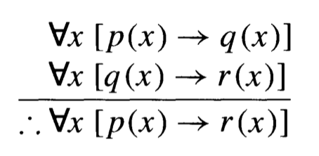
Example
Let p(x), q(x) and r(x) be open statements that are defined for a given universe. The following argument is valid.

Slide 22
Convention: We will often use x instead of c to denote an arbitrary element of the universe.

Slide 23
Best Practices and common errors in proofs
Allowed assumptions in proofs.
The rules of algebra.
For example if x, y, and z are real numbers and x = y, then x+z = y+z.
The set of integers is closed under addition, multiplication, and subtraction.
In other words, sums, products, and differences of integers are also integers.
Every integer is either even or odd.
This fact is proven elsewhere in the material.
If x is an integer, there is no integer between x and x+1.
In particular, there is no integer between 0 and 1.
The relative order of any two real numbers.
For example 1/2 < 1 or 4.2 ≥ 3.7.
The square of any real number is greater than or equal to 0.
This fact is proven in a later exercise.

Slide 24
Euclidean Geometry
Points and lines are our universe.
Axiom: Given two points, there is exactly one line.
Theorem: If the two sides of a triangle are equal, the angles opposite them are equal.
Corollary: If a triangle is equilateral, it is equiangular.

Slide 25
Common Keywords
Thus and therefore
a statement that follows from previous statements
n is a positive integer. Thus (or Therefore) n ≥ 1.
Let
Let x be an integer. Introduce a new variable.
Suppose
can also be used to introduce a new variable.
Since
Since x > 0 and y > z, then xy > xz.
Using facts that appeared earlier.
By definition
a fact that is known because of a definition
By assumption
a fact is known because of an assumption
In other words
useful when rephrasing a statement
We must show that the average of x and y is positive. In other words, we must show that (x+y)/2 > 0.
Gives and yields
Multiplying both sides of the inequality x > y by 2, gives 2x > 2y.
Substituting m = 2k into m² yields (2k)²

Slide 26
Direct Proofs
We are interested in proving an implication:
p → q, i.e. if p, then q.

Slide 27
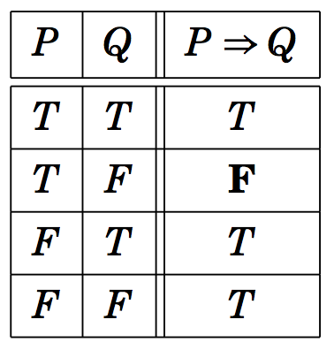
Direct Proofs
We are interested in proving an implication:
P → Q, i.e. if P, then Q.
Consider the truth table of P → Q:
Our goal is to show that this conditional statement P → Q is true.
→

Slide 28
Direct Proofs
We are interested in proving an implication:
P → Q, i.e. if P, then Q.
Consider the truth table of P → Q:
Our goal is to show that this conditional statement P → Q is true.
Since P → Q is true, if P is false. Therefore, we need to show that P → Q is true when P is true.
P → Q

Slide 29
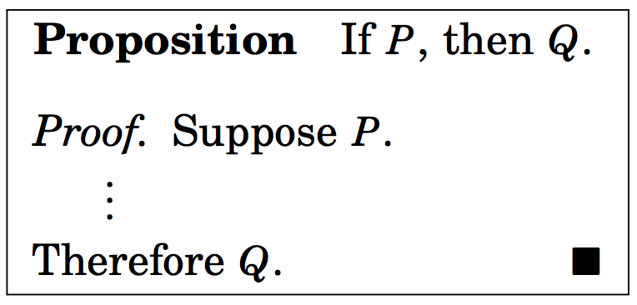
Direct Proof of P → Q
Outline of direct proof
We use the rules of inference, axioms, definitions, and logical equivalences to prove Q.

Slide 30
Direct Proofs

Slide 31
Problem:
Consider the following hypotheses (premises)
More I study, more I know
More I know, more I forget
More I forget, less I know.
Conclusion: Everyone who studies more knows less.
s(x): x studies more; m(x): x knows more;
f(x) : x forgets more ; l(x): x knows less
In symbols
∀x, [(s(x) → m(x)) ∧ (m(x) → f(x)) ∧ (f(x) → l(x)) → (s(x) → l(x)]

Slide 32
Problem (contd.):
Conclusion: Everyone who studies more knows less.
s(x): x studies more; m(x): x knows more;
f(x) : x forgets more ; l(x): x knows less
In symbols
∀x, [(s(x) → m(x)) ∧ (m(x) → f(x)) ∧ (f(x) → l(x)) → (s(x) → l(x)]
Direct Proof: Let c be an arbitrary element of the universe
(population). We need to show that s(c) → l(c).
s(c) is true.

Slide 33
Problem (contd.):
Conclusion: Everyone who studies more knows less.
s(x): x studies more; m(x): x knows more;
f(x) : x forgets more ; l(x): x knows less
In symbols
∀x, [(s(x) → m(x)) ∧ (m(x) → f(x)) ∧ (f(x) → l(x)) → (s(x) → l(x)]
Direct Proof: Let c be an arbitrary element of the universe
(population). We need to show that s(c) → l(c).
s(c) is true.
s(c) → m(c); m(c) → f(c); f(c) → l(c)

Slide 34
Problem (contd.):
Conclusion: Everyone who studies more knows less.
s(x): x studies more; m(x): x knows more;
f(x) : x forgets more ; l(x): x knows less
In symbols
∀x, [(s(x) → m(x)) ∧ (m(x) → f(x)) ∧ (f(x) → l(x)) → (s(x) → l(x)]
Direct Proof: Let c be an arbitrary element of the universe
(population). We need to show that s(c) → l(c).
s(c) is true.
s(c) → m(c); m(c) → f(c); f(c) → l(c)
s(c) → l(c) by the transitivity (syllogism)

Slide 35
Problem (contd.):
Conclusion: Everyone who studies more knows less.
s(x): x studies more; m(x): x knows more;
f(x) : x forgets more ; l(x): x knows less
In symbols
∀x, [(s(x) → m(x)) ∧ (m(x) → f(x)) ∧ (f(x) → l(x)) → (s(x) → l(x)]
Direct Proof: Let c be an arbitrary element of the universe
(population). We need to show that s(c) → l(c).
s(c) is true.
s(c) → m(c); m(c) → f(c); f(c) → l(c)
s(c) → l(c) by the transitivity
∀x (s(x) → l(x)) Universal generalization

Slide 36
Proposition: ∀x, if x is odd, x² is odd.

Slide 37
Proposition: ∀x, if x is odd, x² is odd.
We have the starting structure for an arbitrary element x of the universe:
indicates the end of the proof

Slide 38
Proposition: ∀x, if x is odd, x² is odd.
Using the definition of odd numbers we get

Slide 39
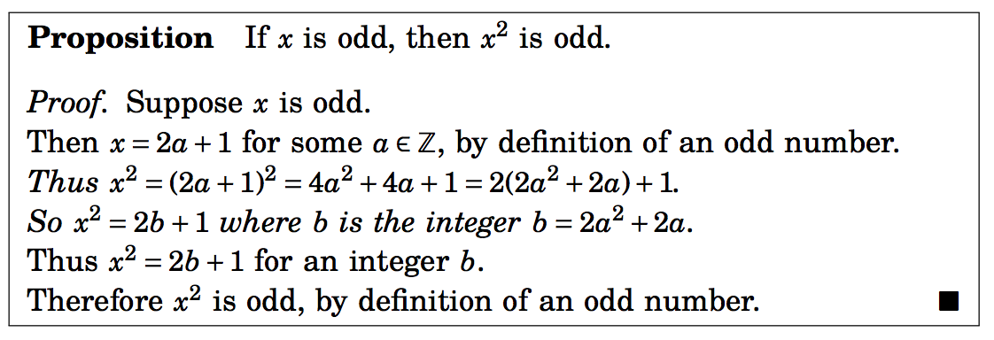
Proposition: ∀x, if x is odd, x² is odd.
We are almost there:

Slide 40
Proposition: ∀x, if x is odd, x² is odd.
P(x) = x is odd; Q(x) = x² is odd.
The above proof can also be written as follows (x is an arbitrary element of the universe):
P(x): x is odd → (x=2a+1)
(x=2a+1) → (x² =2(2a²+2a) +1)
(x²=2b +1) → Q(x): x² is odd
Thus P(x) → Q(x) is true for an arbitrary x.

Slide 41
Show that 1+2+3+ …+ n =n(n+1)/2
We assume that n ∈ N.
We write
x = 1 + 2 + … + n.

Slide 42
Show that 1+2+3+ …+ n =n(n+1)/2
We assume that n ∈ N.
We write
x = 1 + 2 + … + n.
→ x = n + (n-1) + … + 1. (Commutative property)

Slide 43
Show that 1+2+3+ …+ n =n(n+1)/2
We assume that n ∈ N.
We write
x = 1 + 2 + … + n.
→ x = n + (n-1) + … + 1. (Commutative property)
→ 2x = n(n+1) (adding them together)
→ x = n(n+1)/2

Slide 44
Example 1
Suppose x, y are integers. If x and y are odd, xy is odd.
Assume x and y are odd integers.
Then x=2a + 1, and y=2b+1 for some integers a and b.

Slide 45
Example 1
Suppose x, y are integers. If x and y are odd, xy is odd.
Assume x and y are odd integers.
Then x=2a + 1, and y=2b+1 for some integers a and b.
As a result xy = (2a+1).(2b+1)=4ab + 2a +2b +1 = 2(2ab+a+b) +1 =2t+1 where t is an integer.
Therefore, if x and y are odd integers, xy is odd.
This completes the proof.

Slide 46
Example 2
Suppose a,b,c are integers. If a|b and a|c, the a|(b+c).
by definitions, a|b implies b=ad for some integer d.
Similarly a|c imples c= af for some integer f.

Slide 47
Example 2
Suppose a,b,c are integers. If a|b and a|c, the a|(b+c).
by definitions, a|b implies b=ad for some integer d.
Similarly a|c imples c= af for some integer f.
We can now write b + c =a(f+d) = a.t, for some integer t. Therefore, by definition, a | (b+c).

Slide 48
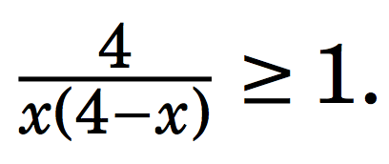
Example 3
If x ∈ R, and 0 < x < 4,

Slide 49
Example 3
If x ∈ R, and 0 < x < 4,
We can rewrite the above equation as 4 ≥ x(4-x). This is only possible if x(4-x) > 0. This is true since 0 < x < 4.

Slide 50
Example 3
If x ∈ R, and 0 < x < 4,
We can rewrite the above equation as 4 ≥ x(4-x). This is only possible if x(4-x) > 0. This is true since 0 < x < 4.
Upon further simplification we get (x-2)² ≥ 0.
Thus the above statement is true.

Slide 51
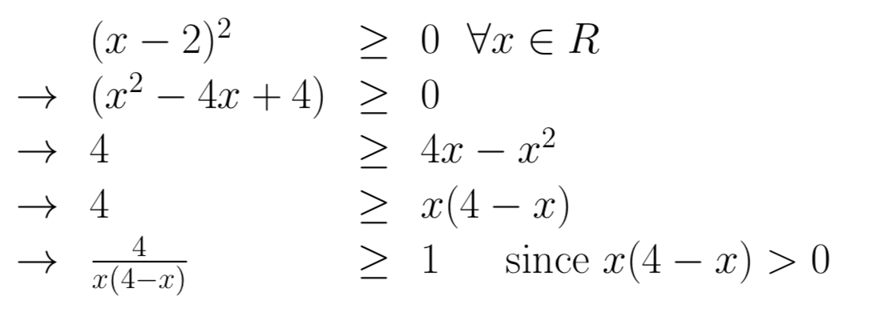
Example 3
If x ∈ R, and 0 < x < 4,

Slide 52
Direct Proof of P → Q
Outline of direct proof
We use the rules of inference, axioms, definitions, and logical equivalences to prove Q.

Slide 53
p → (q → r) and (p → q) → r are logically equivalent?
We can use the truth table approach.

Slide 54
Contrapositive Proof
We use the fact that P → Q and ¬Q → ¬P are logically equivalent.
The expression ¬Q → ¬P is called the contrapositive form of P → Q .

Slide 55
Contrapositive Proof
We use the fact that P → Q and ¬Q → ¬P are logically equivalent.
The expression ¬Q → ¬P is called the contrapositive form of P → Q .
In order to prove P → Q is true, it suffices to instead prove that ¬Q → ¬P is true.
In order to use direct proof to show ¬Q → ¬P is true, we would assume that ¬Q is true, and use this to deduce that ¬P is true.

Slide 56
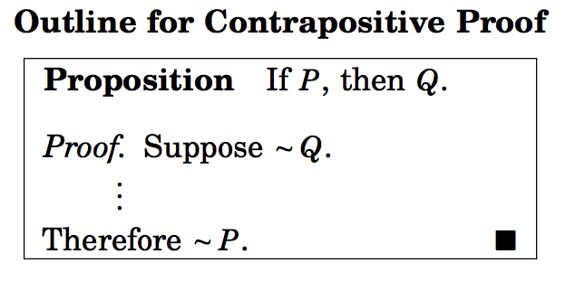

Slide 58
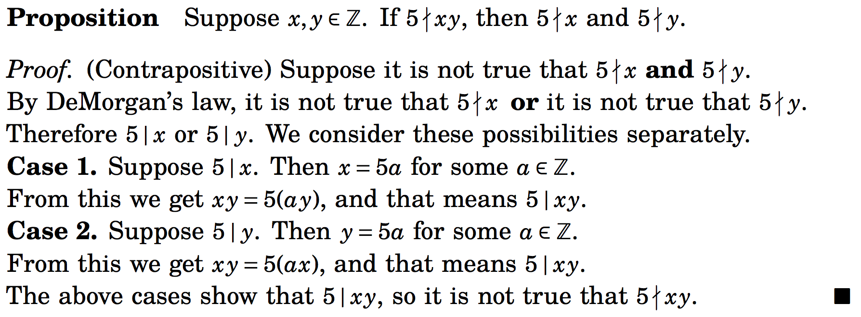
Example

Slide 59
Example
Suppose x, y are integers. If x²(y+3) is even, the x is even or y is odd.
The equivalent contrapositive statement is:
if x is odd and y is even, x²(y+3) is odd.

Slide 60
Theorem: For every positive real number r, if r is irrational, $\sqrt{r}$ is also irrational.
Contrapositive equivalent:
If $\sqrt{r}$ is not irrational (i.e. rational), r is also rational.

Slide 61
Theorem: For every positive real number r, if r is irrational, $\sqrt{r}$ is also irrational.
Contrapositive equivalent:
If $\sqrt{r}$is not irrational (i.e. rational), r is also rational.
Let $\sqrt{r}$= a/b where a and b are integers and b is non-zero
Equivalent to r = a²/b²= c/d where c and d are integers. This implies that r is also rational.

Slide 62
Proofs by contrapositive of conditional statements with multiple hypotheses
Conditional statement: p ∧ q → r
Equivalent Contrapositive : ¬r → ¬p ∨ ¬q
The direct proof of the contrapositive statement needs to show that
if ¬r is true (i.e. r is false), then ¬p ∨ ¬q is true.
This is equivalent to showing that
if r is false and ¬p is false (p is true), then ¬q is true (q is false).
(Another equivalent statement)
if r is false and q is true, then p is false.

Slide 63
Prove the contrapositive of if x is rational and y is irrational, then x + y is irrational.
p: x is rational; q: y is irrational; r: (x+y) is irrational
Contrapositive statement:
If r is false and p is true, then q is false.
If (x+y) is rational and x is rational, then y is rational
Alternate contrapositive statement
If r is false and q is true, then p is false
If (x+y) is rational and y is irrational, then x is irrational.

Slide 64
Proofs by contrapositive of conditional statements with multiple hypotheses
Conditional statement: p ∧ q ∧ r ∧ s → t
Equivalent Contrapositive : ¬t → ¬p ∨ ¬q ∨ ¬r ∨ ¬s
The direct proof of the contrapositive statement needs to show that
if ¬t is true, then ¬p ∨ ¬q ∨ ¬r ∨ ¬s is true.
This is equivalent to showing that
if ¬t is true, ¬p is false, ¬q is false, ¬r is false, then ¬s is true.

Slide 65
Proof by Contradiction
This method is not just limited to conditional statements.
Show that the number is irrational. (Note: A number is irrational if it cannot be expressed as where a and b are integers, and b is non-zero.)
A proof by contradiction is sometimes called an indirect proof.

Slide 66
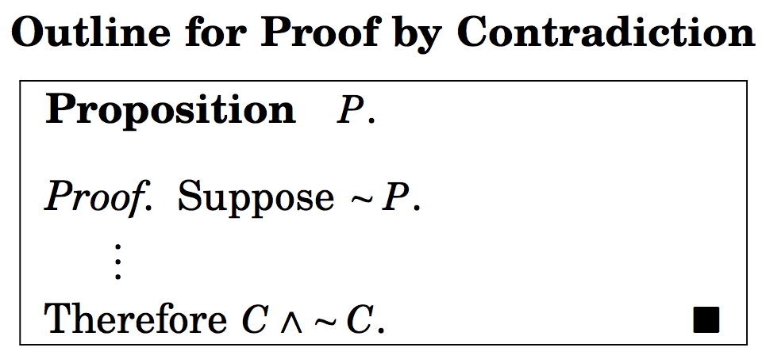
Proof by Contradiction
C is some statement.

Slide 67
Proof by Contradiction
¬P → (C ∧ ¬C)
Showing inconsistency
C is some statement.

Slide 69
Show that the number is irrational.
Suppose ¬P : is rational.

Slide 70
Show that the number is irrational.
Suppose ¬ P : is rational.
Then by definition = where a and b are integers and a and non-zero b have no common factors.

Slide 71
Show that the number is irrational.
Suppose ¬ P : is rational.
Then by definition = where a and b are integers and a and non-zero b have no common factors.
Squaring we get 2b² = a². This implies that a is even. Therefore, a=2k, for some k.

Slide 72
Show that the number is irrational.
Suppose ¬ P : is rational.
Then by definition = where a and b are integers and a and non-zero b have no common factors.
Squaring we get 2b² = a². This implies that a is even. Therefore, a=2k, for some k.
We can write 2b² = 4k^{2,} i.e. b² = 2k² .
Hence b is also even.

Slide 73
Show that the number is irrational.
Suppose ¬ P : is rational.
Then by definition = where a and b are integers and a and non-zero b have no common factors.
Squaring we get 2b² = a². This implies that a is even. Therefore, a=2k, for some k.
We can write 2b² = 4k^{2,} i.e. b² = 2k² .
Hence b is also even.
This means that a and b have 2 as a common factor.
We arrive at a contradiction.
¬ P → F
P is true.

Slide 74
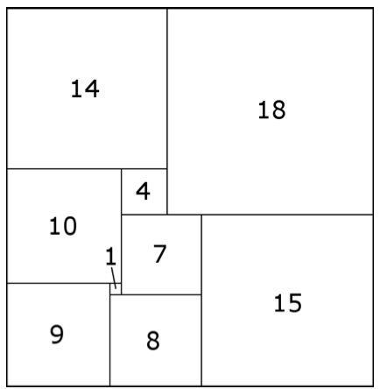
Arrangement of squares
Consider a 32 x 33 rectangle partitioned into nine squares:
Claim: Smallest square in the partition must always lie in the middle.

Slide 75
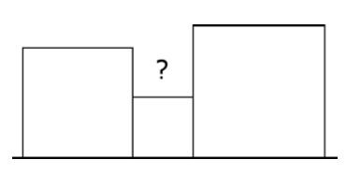
Proof by Contradiction.
Suppose it is possible to place the smallest square on the boundary.

Slide 76
Proof by Contradiction.
Suppose it is possible to place the smallest square on the boundary.
Observe that the squares immediately adjacent to the smallest square are larger.

Slide 77
Proof by Contradiction.
Suppose it is possible to place the smallest square on the boundary.
Observe that the squares immediately adjacent to the smallest square are larger.
The area marked ? cannot be covered by larger size squares.

Slide 78
Proof by Contradiction.
Suppose it is possible to place the smallest square on the boundary.
Observe that the squares immediately adjacent to the smallest square are larger.
The area marked ? cannot be covered by larger size squares.
The starting assumption leads to a contradiction.
The starting assumption is wrong.
Therefore, the smallest square must appear in the middle of the configuration of squares.

Slide 79
Proofs by contrapositive of conditional statements with multiple hypotheses
Conditional statement: p ∧ q ∧ r ∧ s → t
Equivalent Contrapositive : ¬t → ¬p ∨ ¬q ∨ ¬r ∨ ¬s
The direct proof of the contrapositive statement needs to show that
if ¬t is true, then ¬p ∨ ¬q ∨ ¬r ∨ ¬s is true.
This is equivalent to showing that
if ¬t is true, ¬p is false, ¬q is false, ¬r is false, then ¬s is true.

Slide 80
There are infinitely many primes.

Slide 81
There are infinitely many primes.
Suppose there are finite number of primes, and they are, say, p₁, p₂, ….., p_{n}.
Let p_{n} is the largest prime number in the list.

Slide 82
There are infinitely many primes.
Suppose there are finite number of primes, and they are, say, p₁, p₂, ….., p_{n}.
Let p_{n} is the largest prime number in the list.
Consider the number a = p₁x p₂x …..x p_{n} + 1.

Slide 83
There are infinitely many primes.
Suppose there are finite number of primes, and they are, say, p₁, p₂, ….., p_{n}.
Let p_{n} is the largest prime number in the list.
Consider the number a = p₁x p₂x …..x p_{n} + 1.
Since a is not divisible by p_{i} for any p_{i}, a is also a prime number.

Slide 84
There are infinitely many primes.
Suppose there are finite number of primes, and they are, say, p₁, p₂, ….., p_{n}.
Let p_{n} is the largest prime number in the list.
Consider the number a = p₁x p₂x …..x p_{n} + 1.
Since a is not divisible by p_{i} for any i, a is also a prime number.
Thus a is a prime number larger that p_{n}.
The starting assumption leads to a contradiction.
This proves that there are infinitely many prime.

Slide 85
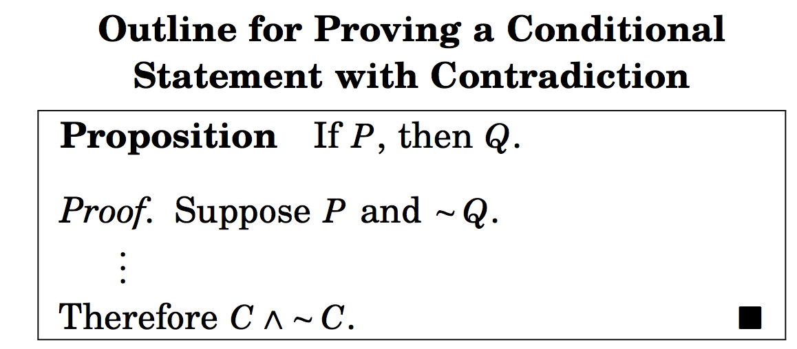
Proving conditional statements by contradiction

Slide 86
Proving conditional statements by contradiction
P ∧ ¬Q → F

Slide 87
Example
Let x and y be real numbers. If 5x+25y = 1723, then x or y is not an integer.

Slide 88
Example
Let x and y be real numbers. If 5x+25y = 1723, then x or y is not an integer.
Here P(x,y): 5x + 25 y =1723;
Q(x,y): (x is not an integer) ∨ (y is not an integer)

Slide 89
Example
Let x and y be real numbers. If 5x+25y = 1723, then x or y is not an integer.
Here P(x,y): 5x + 25 y =1723;
Q(x,y): (x is not an integer) ∨ (y is not an integer)
Suppose ∀x,y (P(x,y) ∧¬ Q(x,y))
¬ Q(x,y) : x and y are integers.

Slide 90
Example
Let x and y be real numbers. If 5x+25y = 1723, then x or y is not an integer.
Here P(x,y): 5x + 25 y =1723;
Q(x,y): (x is not an integer) ∨ (y is not an integer)
Suppose ∀x,y (P(x,y) ∧¬ Q(x,y))
¬ Q(x,y) : x and y are integers.
Note that 5x + 25 y =1723 is 5(x+5y) =1723.
Since x+5y is an integer, therefore 5 divides 1723, a contradiction.

Slide 91
Example
Consider the statement: For all nonnegative real numbers a, b, and c, if a² + b² = c², then a + b ≥ c.
Exercise

Slide 92
Proof by cases
Sometimes it is easier to prove a theorem by
breaking it down into cases and
proving each case separately.
It is a direct method of proving statements like p₁ ∨ p₂ ∨ …. ∨ p_{n} → q is equivalent to proving (p₁ → q) ∧ (p₂ → q) ∧ (p₃ → q) ∧ …. ∧ (p_{n} → q).

Slide 93
Example
For any two reals x and y, show that|x+y| ≤ |x| + |y|.
Proof by cases:

Slide 94
Example
For any two reals x and y, show that|x+y| ≤ |x| + |y|.
Proof by cases:
(Case 1) x ≥ 0, y ≥ 0
Theorem is true since (x+y) = x + y.

Slide 95
Example
For any two reals x and y, show that|x+y| ≤ |x| + |y|.
Proof by cases:
(Case 1) x ≥ 0, y ≥ 0
Theorem is true since (x+y) = x + y.
(Case 2) x < 0, y ≥ 0
Theorem is true since |x+y| < max{|x|,|y|} < |x| + |y|

Slide 96
Example
For any two reals x and y, show that|x+y| ≤ |x| + |y|.
Proof by cases:
(Case 1) x ≥ 0, y ≥ 0
Theorem is true since (x+y) = x + y.
(Case 2) x < 0, y ≥ 0
Theorem is true since |x+y| < max {|x|,|y|} < |x| + |y|
(Case 3) x ≥ 0, y < 0
Very similar to the second case
(Case 4) x < 0, y < 0
In this case |x+y| = |x| + |y|.

Slide 97
Example
Problem:
Let n ∈ Z (integer). Prove that 9n²+3n-2 is even.

Slide 98
Example
Problem: Let n ∈ Z. Prove that 9n²+3n-2 is even.
Proof by cases:
Case 1: n is even, i.e. n = 2k, k an integer
9n²+3n-2 = 9.4.k² + 3.2k – 2 = 2(18k²+3k -1) = 2t, t an integer (even)
Case 2: n is odd, i.e. n = 2k+1, k an integer
9n²+3n-2 = 9(2k+1)² +3(2k +1) -2
= 9(4k² + 4k +1) + 6k +1
= 2(18 k² +21 k +5) : even
∀n, 9n²+3n -2 is even.

Slide 99
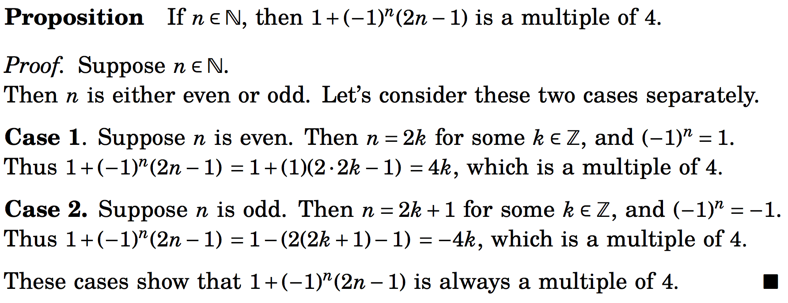
Proof by cases
In proving a statement is true, we sometimes have to examine multiple case before showing the statement is true in all possible scenarios.

Slide 100
Theorem
Consider a group of six people. Each pair of people are either friends or enemies with each other. Then there are three people in the group who are all mutual friends or all mutual enemies.
Listen to the video whose link is given by the Zybooks (section 2.7)

Slide 101
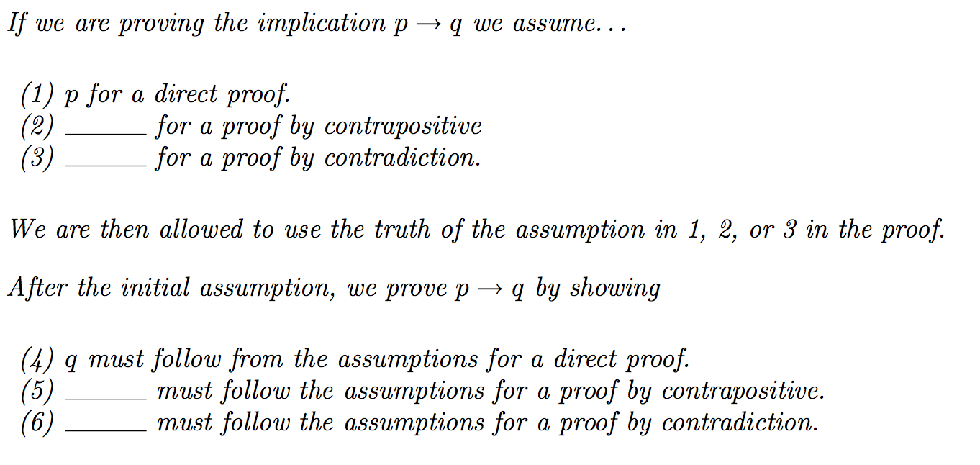
Fill in the blanks

