Slide 1
Latex Basics
Source:
https://www.tug.org/twg/mactex/tutorials/ltxprimer-1.0.pdf

Slide 2
What is latex?
LATEX (pronounced LAY-tek or LAH-tek) is a tool used to create professional-looking documents.
Invented by Donald Knuth in 70’s, one of the founding members of computer science.
LATEX is used all over the world for scientific documents, books, as well as many other forms of publishing.
Due to the huge number of open source packages available (more on this later), the possibilities with LATEX are endless.
These packages allow users to do even more with LATEX, such as add footnotes, draw schematics, create tables etc.

Slide 3
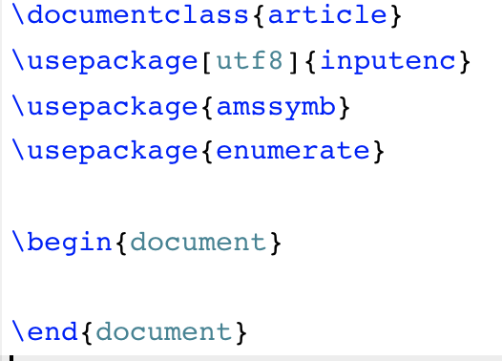
The Basics
Document Class
\documentclass[options]{class}
options = a4paper, 11pt, 12pt, 10pt, twocolumn, landscape,...
class = article, report, book,...
Packages
\usepackage{package name}
amssymb = math symbols
enumerate = making enumerate list versatile

Slide 4
Body of Text
Start with \begin{document}
End with \end{document}
Typesetting Text
\\ or \newline and \newpage
Quotations
Bold \textbf{……………} or \bf{…………}
Italics \emph{…………} or \textit{………} or \it{…………}
Underline \underline{…………}

Slide 5
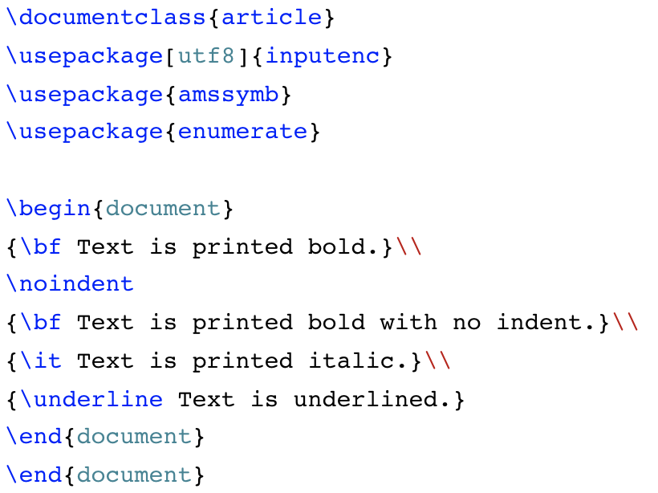

Slide 6
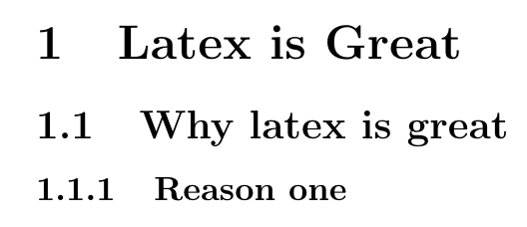
Format
Sections
\section{Latex is great}
\subsection{Why Latex is Great}
\subsubsection{Reason one}

Slide 7
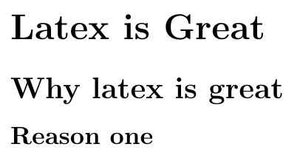
Format
Sections
\section*{Latex is great}
\subsection*{Why Latex is Great}
\subsubsection*{Reason one}

Slide 8
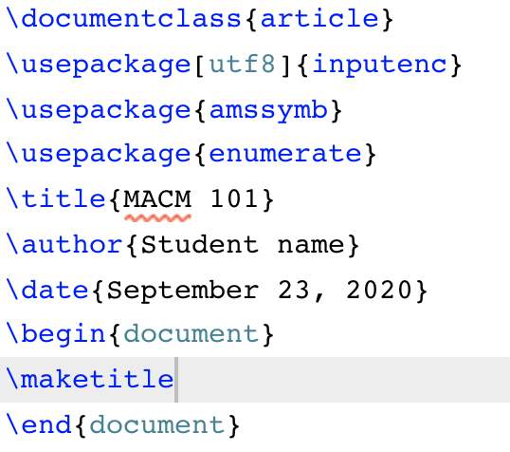
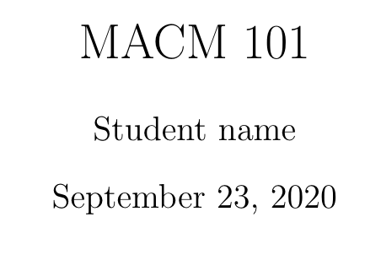
Format
Titles, Authors and others

Slide 9
Latex special characters
special characters: # $ %. & ~ _. ^ \ { }
~ (tilde) unbreakable space; use it when you need a blank space.
$ (dollar sign) used in math mode.
_ (underscore) for subscripts in math mode.
^ (hat) for superscripts in math mode.
\ (backslash) starting commands.
{} (curly brackets) to group and separate commands from its surroundings. Must appear in pairs.

Slide 10
Latex special characters
special characters: # $ %. & ~ _. ^ \ { }
To use these characters in the text we write

Slide 11
Text positioning
\begin{center}
Certificate
\end{center}
\begin{flushright}
text1
\end{flushright}
\begin{flushleft}
text2
\end{flushleft}

Slide 12
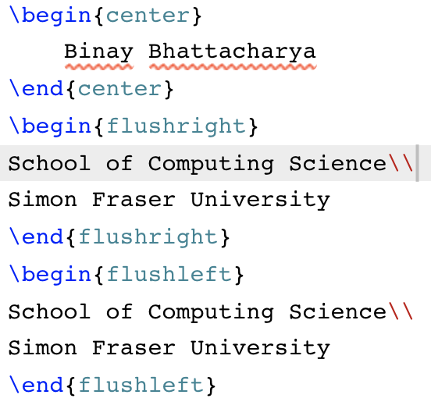

Slide 13
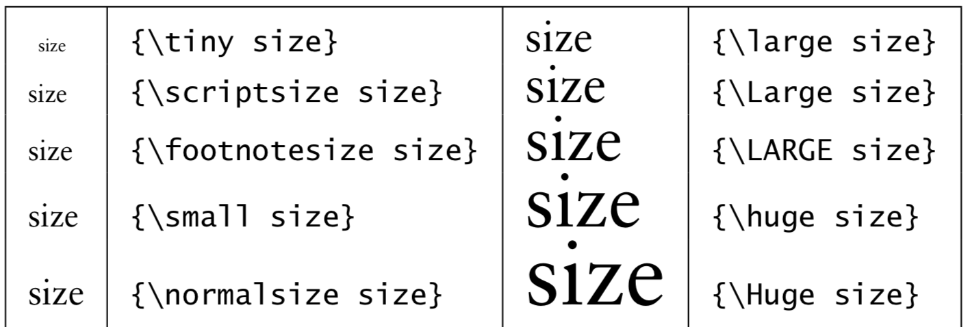
Type size
Traditionally, type size is measured in (printer) points. The default type that TEX produces is of 10 pt size.
Various declarations

Slide 14
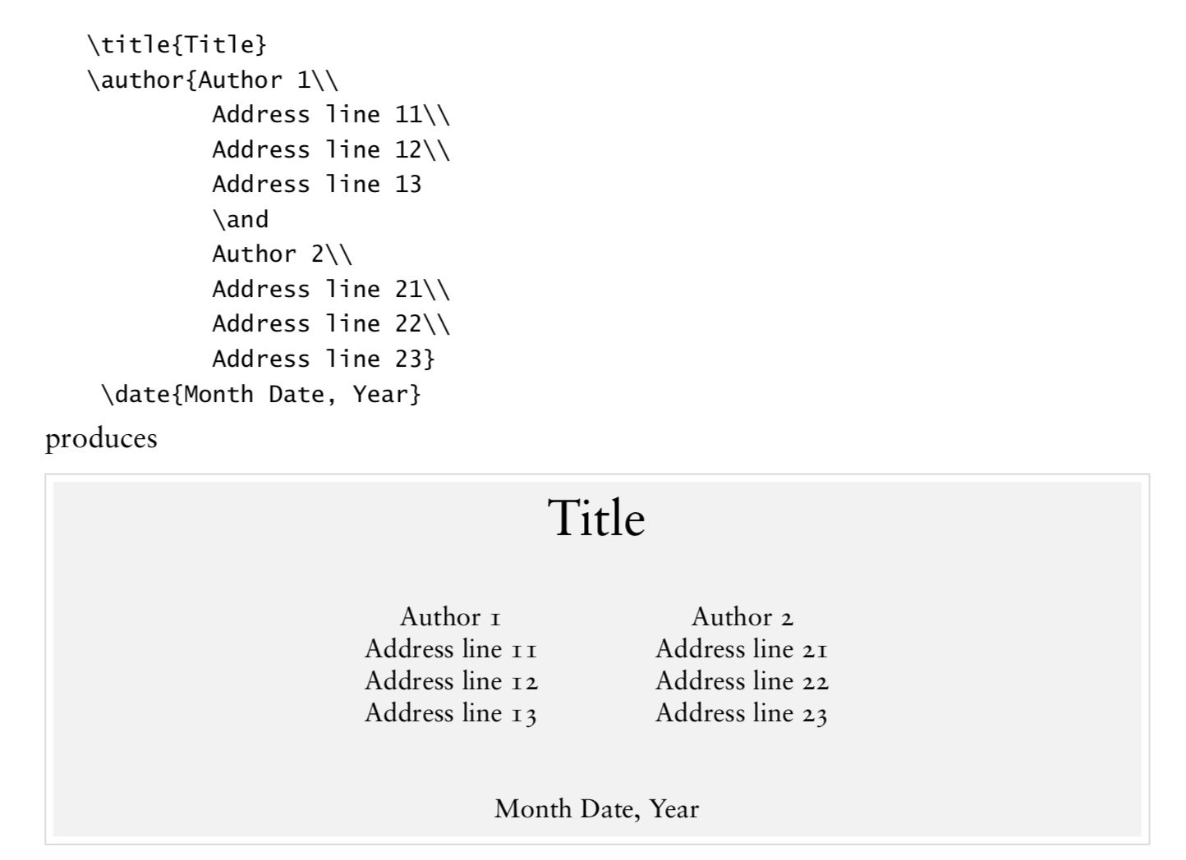

Slide 15
Replace \and by \\
Author 1
.
.
Author 2
date
.

Slide 16
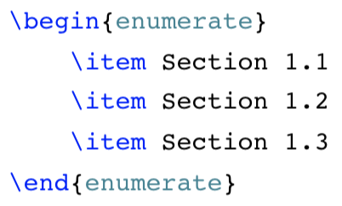
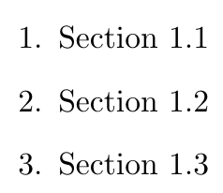
Making Lists
Very important environment.
There are different kind of lists.
Ordered lists

Slide 17
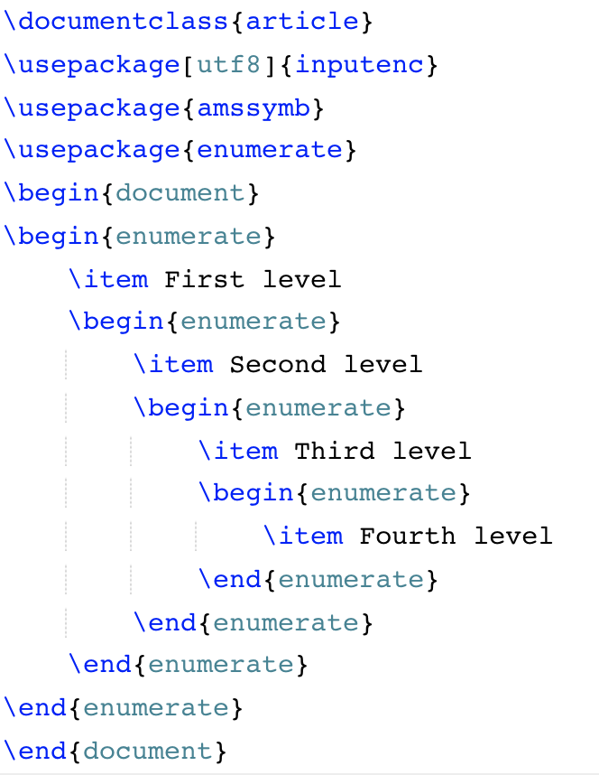
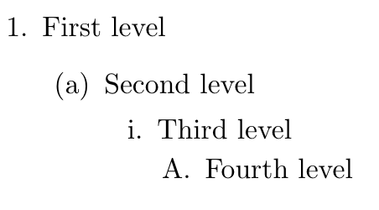
Multi-levels

Slide 18
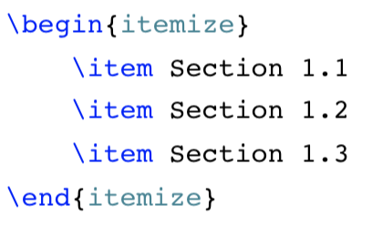
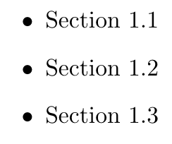
Making Lists
There are different kind of lists.
Unordered lists

Slide 19
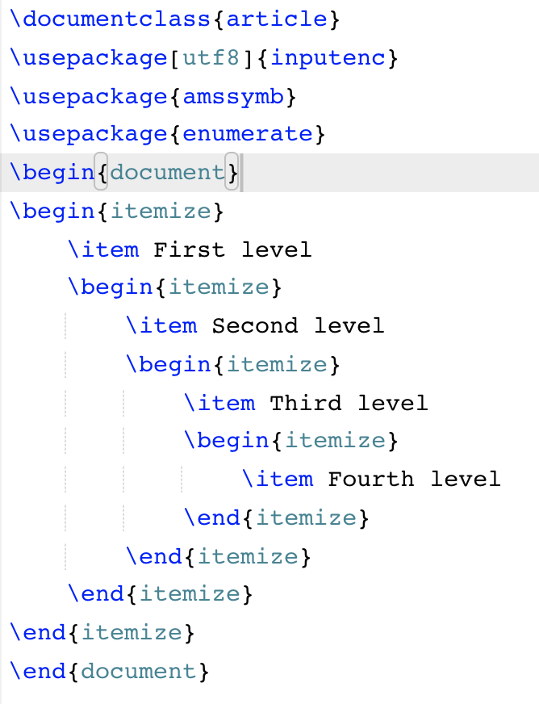
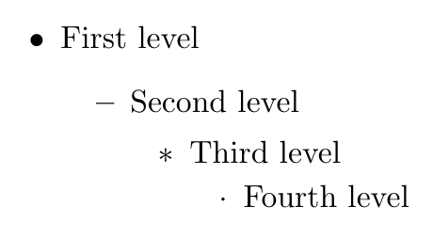
Multi-levels

Slide 20
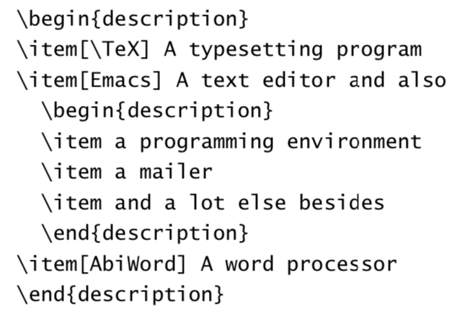
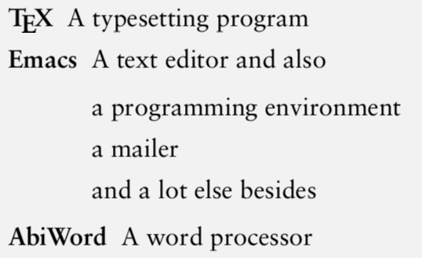
Making Lists
There is a third type list available which is used in typesetting lists like

Slide 21
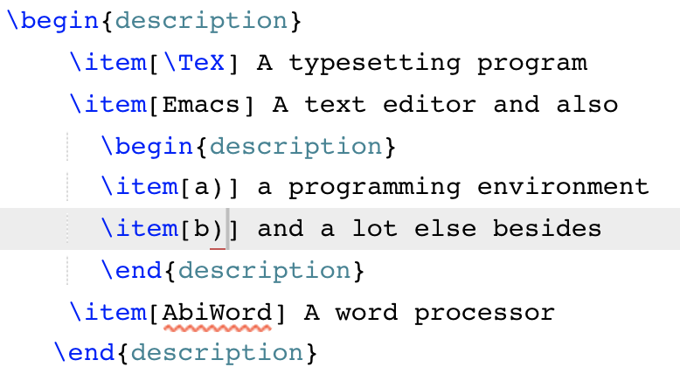
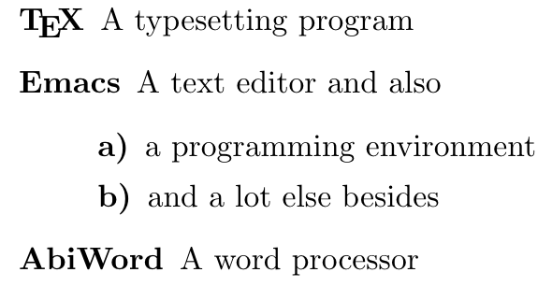
Making Lists
There is a third type list available which is used in typesetting lists like

Slide 22
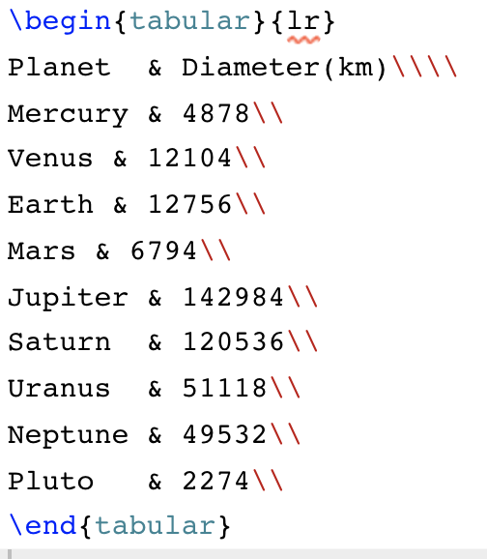
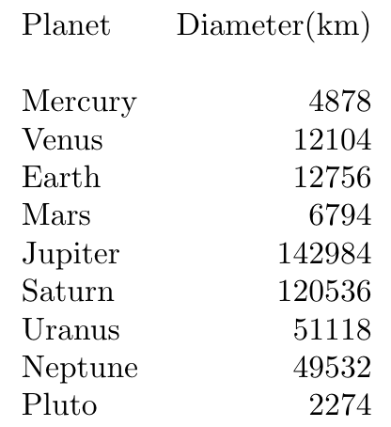
Tables
One can format text into columns and rows is to use the tabular environment.

Slide 23
Tables
\\ : line feed; \\\\: two lines feed;
{lr}: Tow columns in the table- first column left adjusted and the second column is right adjusted.
& : Separating the first and the second column
One can format text into columns and rows is to use the tabular environment.

Slide 24
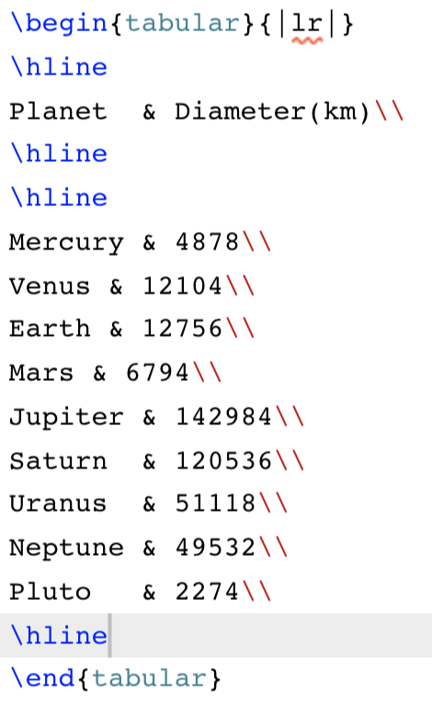
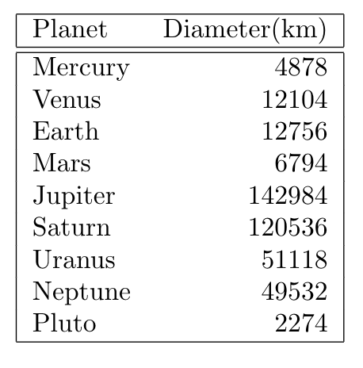

Slide 25
Adding math to latex
One of the main advantages of LATEX is the ease at which mathematical expressions can be written.
To put your expression in math mode use delimiters $ …. $
For equation x² + y² = 10, we write in latex $x^2 + y^2=10$.
For ∀x p(x) ≡ p(a₁) ∧ p(a₂) ∧ … ∧p(a_{n}), we write in latex
$\forall x p(x) \equiv p(a_1) \wedge p(a_2) \wedge \ldots \wedge p(a_n)$
The equation representing a straight line in the Cartesian plane is of the form $ax+by+c=0$, where $a$, $b$, $c$ are constants.

Slide 26
Adding math to latex

Slide 27
Subscripts and superscripts

Slide 28
Some examples

Slide 29
Some examples
\quad produces thick spaces
$$ … $$ produces output in a new line.

Slide 30
Math Symbols

Slide 31
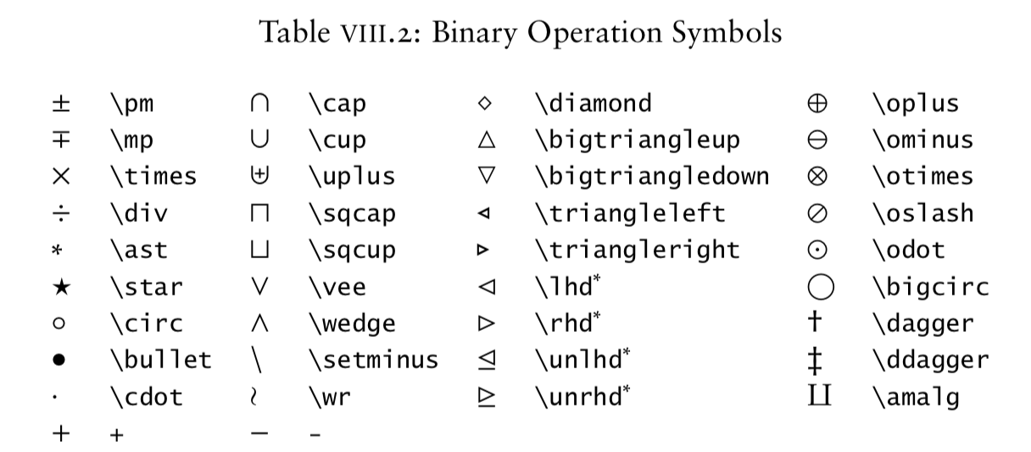
Math Symbols

Slide 32
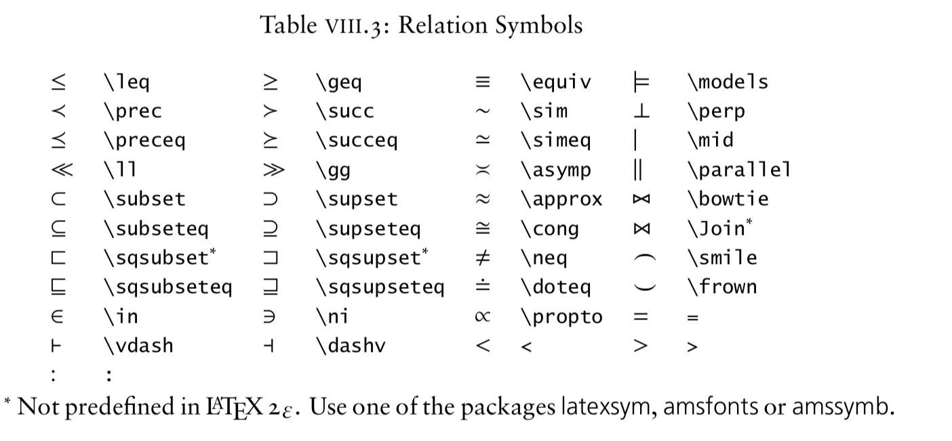
Math Symbols

Slide 33
Math Symbols

