Slide 1
Discrete Mathematics MACM 101
Fall 2020

Slide 2
Acknowledgement
Used some slides prepared by Prof. Sandy Irani, the author of MACM 101 textbook.

Slide 3
Course Instructors
Instructor: Prof. Binay Bhattacharya
Teaching Assistants:
?
?
?

Slide 4
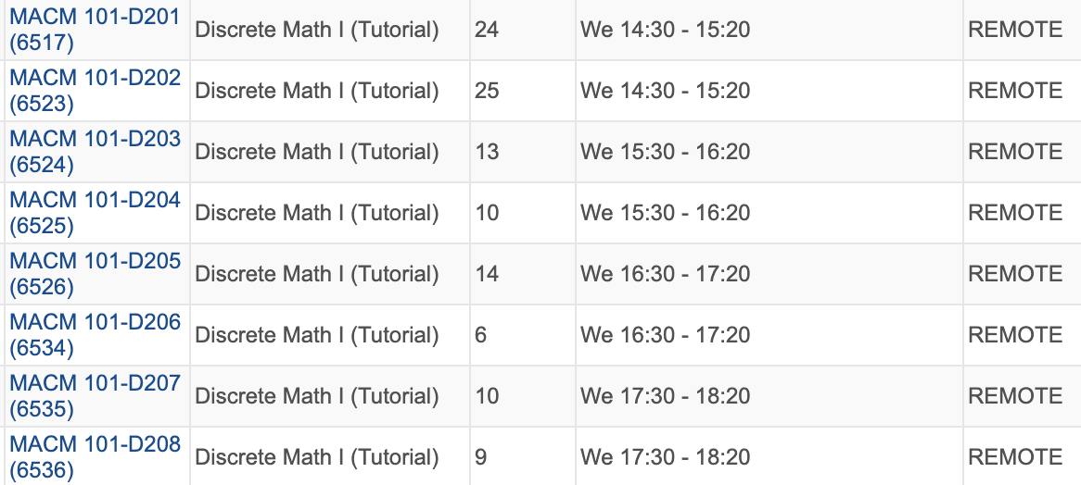
Course Meeting Times
Lectures: MWF 12:30 – 1:20
Delivered remotely using Zoom
Tutorials (More later once TAs are assigned)

Slide 5
Course Meeting Times
Lectures: MWF 12:30 – 1:20
Delivered remotely using Zoom
Tutorials (More later once TAs are assigned)
Led by TAs (Remotely)
No new materials are presented
Question and answer format
No tutorials this week.

Slide 6
Course Web Page
www.cs.sfu.ca/~binay/2020/macm101
Office hours, contact info
Course administration
Schedule
Topics
Reading assignments
Homeworks
Test schedule
All the hand-outs/announcements

Slide 7
Text (zyBook)
Web-based, interactive text
Subscription for the quarter ($48)
zyBooks.com to sign up.
zyBook code: SFUMACM101BhattacharyaFall2020
Click Subscribe
Required for the course:
Data on activities is recorded and counts for a small portion of course credit.
You get credit if you eventually get the question correct.

Slide 8
Text (zyBook)
Two types of interactive activities:
Participation activities (labeled with ”P”)
Due at the time the reading is due (generally before the class)
Shorter and easier
Reinforce/teach concepts

Slide 9
Text (zyBook)
Two types of interactive activities (contd):
Challenging activities (labeled with ”C”)
Due at the time the homework is due.
More challenging.
Test mastery.
Will be explicitly listed in homework assignment.

Slide 10
Text (zyBook)
Student activities automatically time stamped
Your progress visible on your dashboard.
Sep 11 and 14 reading is due Monday, Sep 14 at 12 noon.
After the first two weeks, most often, the reading for each lecture is due 12 noon on the day of the lecture.

Slide 11
Text (zyBook)
Provide feedback:
Technical issues with your subscription:
support@zyBooks.com
Small bugs in the test
“Feedback” buttons in the text
support@zyBooks.com
Technical problems that prevent understanding the material
support@zyBooks.com
cc me: binay@cs.sfu.ca

Slide 12
Schedule
1

Slide 13
Homework
Homework consists of two parts:
Electronic: challenge activities in your zyBook
Written: exercises handed out
Both parts are due at 12:15PM
No late homework is accepted
Solutions will be made visible in text after due date.

Slide 14
Coursys
You will hand in written homework through Coursys system (as it stands now). You will be notified if there is a change.
Coursys can be found at https://coursys.sfu.ca/
Everyone enrolled in the class has been added and has an account.
You need to upload a pdf file with your written homework to Coursys for grading.
Coursys will maintain all your scores in various activities.

Slide 15
Course Grades
Homework: 15%
Reading: 5%
4 Tests: 40%
Final exam: 40%

Slide 16
Tests
Each test has two parts: One electronic part and the other written part.
The written part exam will be taken in the form of take-home exam. More details later.
All tests are mandatory.

Slide 17
Questions on Grading
After each test or HW score is posted, the questions on grading should first go to the person who graded it.
By e-mail.
Talk to me about the unresolved grading questions.

Slide 18
Lecture slides
All lecture slides will be posted on the course webpage (www.cs.sfu.ca/~binay/2020/macm101)
After each lecture, I will post the contents of the slides generated from the lecture.
Posted slides are not a complete record of what happened in the class.
You are responsible for whatever is said in the lecture.

Slide 19
Canvas (https://canvas.sfu.ca/)
Online forum
All questions related to course content should be posted on Canvas (not asked by email)
Instructors can add their own solution.
The TAs and I will check Canvas at least once a day.

Slide 20
Questions
The best way to get questions answered:
Discussion section of Canvas
My office hours (Remote)
TA office hours (Remote)

Slide 21
Office Hours
Highly under-utilized resource
Office hours are not ”study hall”.
How these interactions get evolved is anybody’s guess. We will improvise as we go.

Slide 22
Academic Honesty
It is important, specially in this remote setting.
Read the school policy.
Write up your homework solutions on your own.
If needed, I will meet students one on one to check the authenticity of the answers.

Slide 23
What is discrete mathematics?
Discrete mathematics is the mathematics of computing

Slide 24
What is MACM 101 about?
Continuous Math vs Discrete Math
Discrete mathematics is the mathematics of computing
Why is it computer science?
Mathematical techniques for Discrete Math

Slide 25
Continuous vs Discrete
Continuous Mathematics
Objects vary continuously
Example: analog wristwatch: from analog perspective, between 10:30 am to 10:31 am there are infinitely many possible times
Differential equations
Sine, cosine functions

Slide 26
Continuous vs Discrete
Discrete Mathematics
Objects vary in a discrete way
Example: digital wristwatch: from analog perspective, between 10:30 am to 10:31 am there are infinitely finitely many possible times. A digital watch does not show split seconds.
Integers --- core of discrete mathematics
Computer science – computers are discrete.

Slide 27
What is MACM 101 about?
Why is it computer science?

Slide 28
Number Theory: RSA and Public-key Cryptography
Alice and Bob have never met but they would like to
exchange a message. Eve would like to eavesdrop.
E.g. between you and the Bank of Montreal.
They could come up with a good encryption algorithm and exchange the encryption key – but how to do it without
Eve getting it? (If Eve gets it, all security
is lost.)
CS folks found the solution:
public key encryption. Quite remarkable
that is feasible.

Slide 29
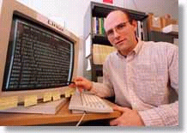
Automated Proofs:
EQP - Robbin’s Algebras are all Boolean
A mathematical conjecture (Robbins conjecture) unsolved for decades.
First non-trivial mathematical theorem proved automatically.
The Robbins problem was to determine whether one particular set of rules is powerful enough to capture all of the laws of Boolean algebra. One way to state the Robbins problem in mathematical terms is:
Can the equation not(not(P))=P be derived from the following three equations?
[1] P or Q = Q or P,
[2] (P or Q) or R = P or (Q or R),
[3] not(not(P or Q) or not(P or not(Q))) = P.
[An Argonne lab program] has come up with a major mathematical
proof that would have been called creative if a human had thought of it.
New York Times, December, 1996

Slide 30
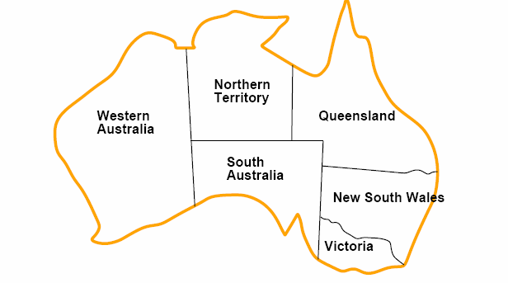
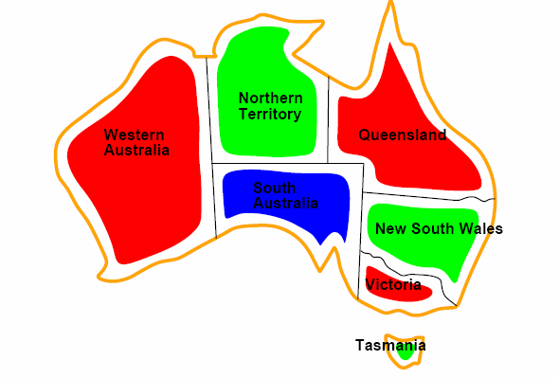
Coloring a Map
How to color this map so that no two
adjacent regions have the same color?

Slide 31
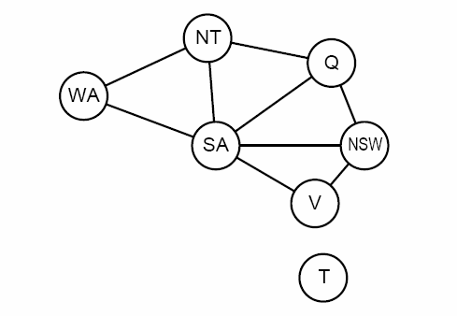
Graph representation
Coloring the nodes of the graph:
What’s the minimum number of colors such that any two nodes
connected by an edge have different colors?

Slide 32
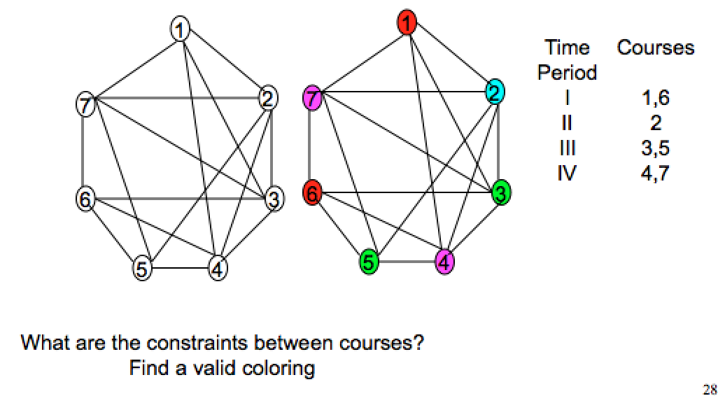
Scheduling Final Exams

Slide 33
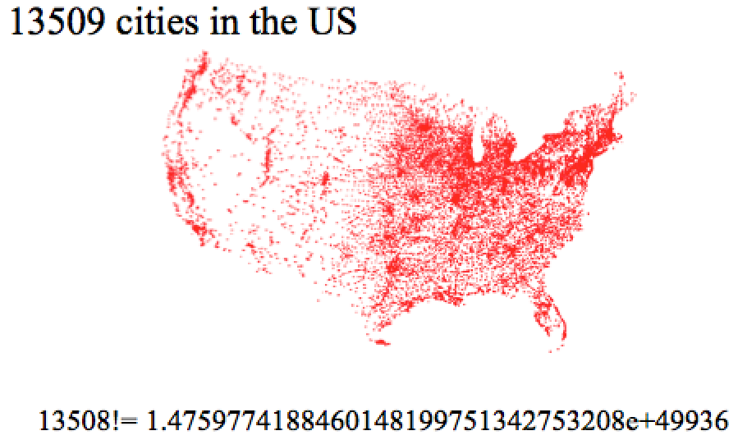
Traveling Salesman Problem

Slide 34
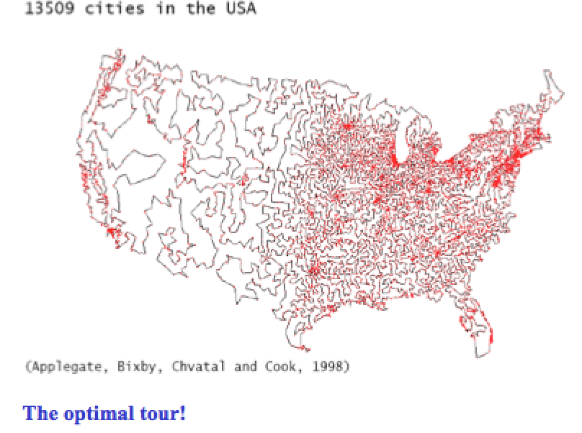
Traveling Salesman Problem

Slide 35
Probability and Chances
Importance of concepts from probability is rapidly increasing in CS:
Randomized algorithms
primality testing; Google’s PageRank, “just” a random walk on the web!)
in computation, having a few random bits really helps!
Machine Learning / Data Mining:
find statistical regularities in large amounts of data.
Natural language understanding
dealing with the ambiguity of language

Slide 36
Goals of MACM 101
Introduce students to a range of mathematical tools from discrete mathematics that are key in computer science.
How to write statements correctly.
How to read and write theorems.
Areas:
Counting
Logic
Set Theory
Mathematical Induction
Relations
Functions
Introduction to Graphs

Slide 37
Goals of MACM 101
Introduce students to a range of mathematical tools from discrete mathematics that are key in computer science.
How to write statements correctly.
How to read and write theorems.
Areas:
Counting
Logic
Set Theory
Mathematical Induction
Relations
Functions
Introduction to Graphs
Note: Learning to do proofs from
watching the slides is like trying to
learn to play tennis from watching
it on TV! So, do exercises!

Slide 39
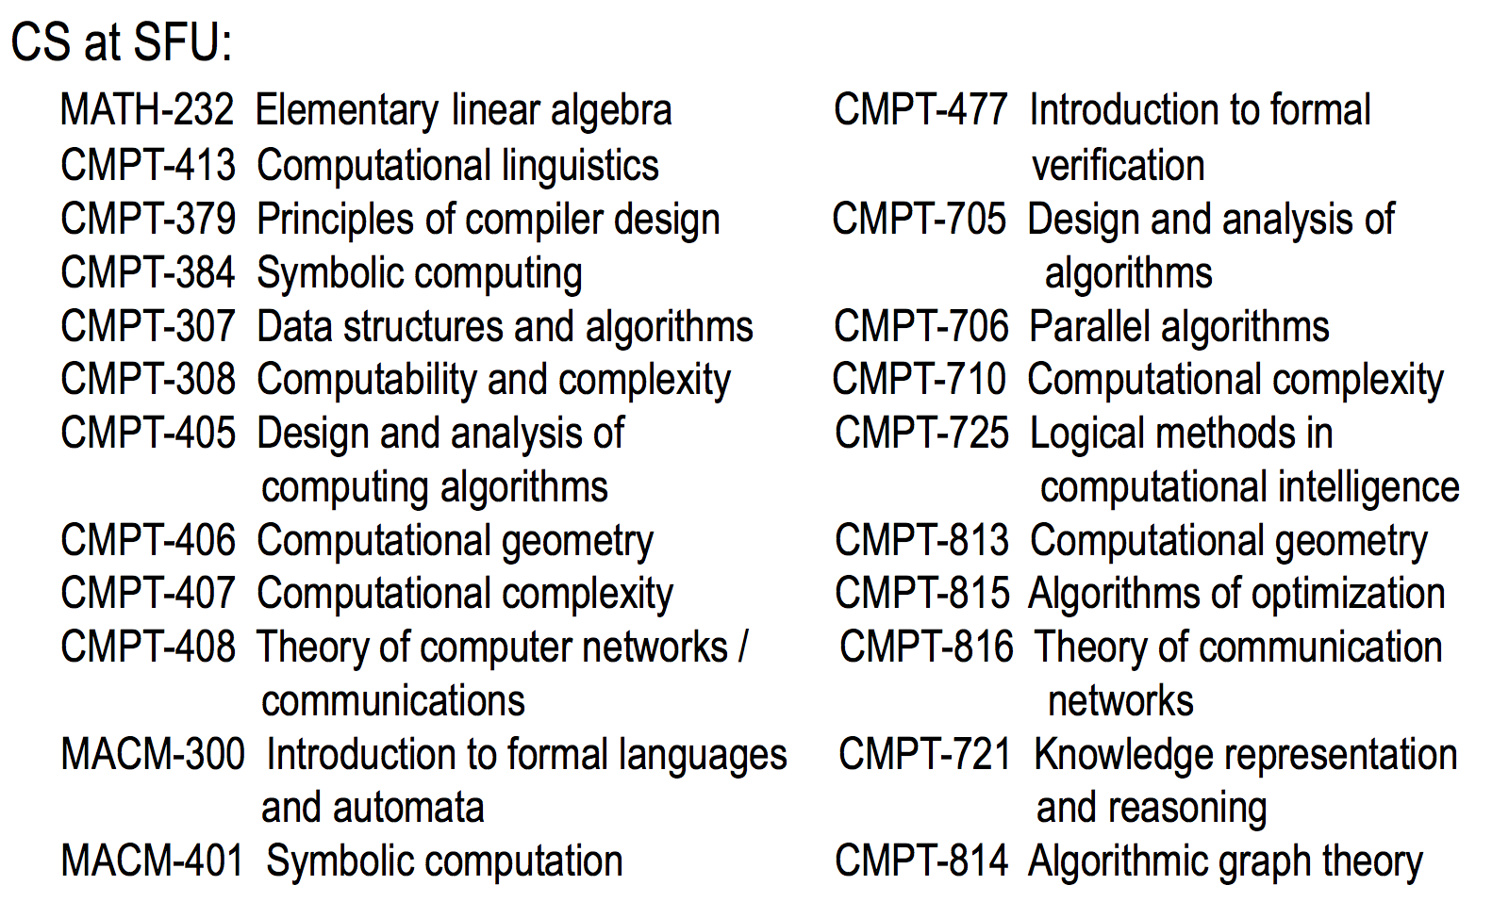

Slide 40
Acknowledgement
Taken some slides from Prof. Bart Selman:
www.cs.cornell.edu/courses/cs2800/

