Slide 1
Induction (Chapter 7.6)
Some slides have been taken from the sites
http://cse.unl.edu/~choueiry/S13-235/

Slide 2
Open statement S(n): (1+x)^{n} $≥$ 1+nx for all n $≥$ 1 and any x > -1

Slide 3
Open statement S(n): (1+x)^{n} $≥$ 1+nx for all n $≥$ 1 and any x > -1
Basis : S(1) is true.
Inductive hypothesis: S(k) is true for any k $≥$ 1.

Slide 4
Open statement S(n): (1+x)^{n} $≥$ 1+nx for all n $≥$ 1 and any x > -1
Basis : S(1) is true.
Inductive hypothesis: S(k) is true for any k $≥$ 1.
Inductive step: Showing that S(k+1) is true.
i.e. to show that (1+x)^{(k+1)} $≥$ 1+(k+1)x for all n $≥$ 1 and any x > -1
(1+x)^{(k+1)}= (1+x)^{k}(1+x) $≥$ (1 + kx)(1+x) (using inductive hypothesis)
(1+kx)(1+x) = 1+x+kx + kx² = 1+(k+1)x + kx² $≥$ (1+(k+1)x), since kx² $≥$ 0.
S(k+1) is true.

Slide 5
Open statement S(n): (1+x)^{n} $≥$ 1+nx for all n $≥$ 1 and any x > -1
Basis : S(1) is true.
Inductive hypothesis: S(k) is true for any k $≥$ 1.
Inductive step: Showing that S(k+1) is true.
i.e. to show that (1+x)^{(k+1)} $≥$ 1+(k+1)x for all n $≥$ 1 and any x > -1
(1+x)^{(k+1)}= (1+x)^{k}(1+x) $≥$ (1 + kx)(1+x) (using inductive hypothesis)
(1+kx)(1+x) = 1+x+kx + kx² = 1+(k+1)x + kx² $≥$ 1 + (1+(k+1)x), since kx² $≥$ 0.
S(k+1) is true.
Thus S(1) ∧ (S(k) → S(k+1)) → ∀ n $≥$ 1, S(n).

Slide 6
Z⁺
S(n)
S(1)
S(k) → S(k+1))
S(n)
Z⁺
S(n)
S(1)
S(a-1)
S(a-1) → S(a)

Slide 7
Example
Show that any number larger than 43 can be written as the sum of nonnegative multiples of 6, 9, or 20.
i.e n = 6 t₁ + 9 t₂ + 20 t₃, where t₁, t₂, t₃ ≥ 0, n ≥ 44.

Slide 8
Example
Show that any number larger than 43 can be written as the sum of nonnegative multiples of 6, 9, or 20.
i.e n = 6 t₁ + 9 t₂ + 20 t₃, where t₁, t₂, t₃ ≥ 0, n ≥ 44.
Consider n=1,2,3,….
We notice that only the numbers 6, 9, 12, 15, 18, 20, 21, 24, 26, 27, 29, 30, 32, 33, 36, 38, 39, 40, 42 (less than 43) can be expressed as the sum of the multiples of 6, 9 and 20.
However, 43 is not expressible as the sum of 6, 9, and 20.

Slide 9
Example
Show that any number larger than 43 can be written as the sum of nonnegative multiples of 6, 9, or 20.
i.e n = 6 t₁ + 9 t₂ + 20 t₃, where t₁, t₂, t₃ ≥ 0, n ≥ 44.
Consider n=1,2,3,….
We notice that only the numbers 6, 9, 12, 15, 18, 20, 21, 24, 26, 27, 29, 30, 32, 33, 36, 38, 39, 40, 42 (less than 43) can be expressed as the sum of 6 and 9.
However, 43 is not expressible as the sum of 6, 9, and 20.
Claim any number greater than or equal to 44 can be expressed as
S(n): n = 6 t₁ + 9 t₂ + 20 t₃, where t₁, t₂, t₃ ≥ 0, n ≥ 44.

Slide 10
Example (contd.)
We can show that S(44), S(45), S(46), S(47), S(48), S(49) are true.
We now show that
(S(44) ∧ S(45) ∧ .... ∧ S(k)) → S(k + 1), k ≥ 49.

Slide 11
Example (contd.)
We can show that S(44), S(45), S(46), S(47), S(48), S(49) are true.
We now show that
(S(44) ∧ S(45) ∧ .... ∧ S(k)) ⇒ S(k + 1), k ≥ 49.
Consider m= (k+1)-6.
Since k ≥ 49, m ≥ 44.
We assumed (induction hypothesis) that S(m) is true.
i.e. m = 6 t’₁ + 9 t’₂ + 20 t’₃, where t’₁, t’₂, t’₃ ≥ 0.
Hence m+6 = k+1 = 6 (t’₁+1) + 9 t’₂ + 20 t’_{3.}
Therefore, S(k+1) is true. This means that
S(44) → S(50), S(45) → S(51), S(46) → S(52), S(47) → S(53), …,
completing the induction.
By the principle of strong induction, ∀n∈Z⁺ S(n), n ≥ 44 is true.

Slide 12
Principle of Strong Mathematical Induction
Sometimes mathematical induction is not enough.
In order to prove that S(n) is true for all positive integer n ≥ n₀, we complete two steps:
Basis step: We verify that S(n₀), S(n₀+1), ..., S(n₁) are true.
Inductive step: We show that conditional statement (S(n₀) ∧ S(n₀+1) ∧ .... ∧ S(k)) → S(k + 1) for all positive integers k ≥ n₁.
It follows by the principle of strong mathematical induction that every S(n), n≥ n₀ is true.
Symbolically
[(S(n₀)∧S(n₀+1)∧ ... ∧S(n₁) ∧ S(n₁+1) ∧ …∧ S(k) → S(k+1), k ≥ n₁]
→ ∀(n≥ n₀) S(n)

Slide 13
Example
Any integer n > 11 can be written in the form n=4a + 5b for a, b ∈ Z.
Try at home.

Slide 14
Example
Any integer n > 11 can be written in the form n=4a + 5b for a, b ∈ Z.
S(n): n = 4a +5b (open statement)
Show that S(n) is true for all n >= 12.
Base cases: Show that S(12), S(13), S(14), S(15) are true.
For any k >= 15, k + 1 = ((k+1) – 4) + 4.
(k+1) – 4 >= 12.
Since S((k+1)-4) is true (inductive hypothesis) , S(k+1) is also true.

Slide 15
Steps to doing an inductive proof
State the theorem, which is the proposition S(n)

Slide 16
Steps to doing an inductive proof
State the theorem, which is the proposition S(n)
Show that S(base case) is true. There could be more than one base case.

Slide 17
Steps to doing an inductive proof
State the theorem, which is the proposition S(n)
Show that S(base case) is true. There could be more than one base case.
State the inductive hypothesis (S(k), S(k-1), … are true)
State what must be proven (substitute k+1 for n)

Slide 18
Steps to doing an inductive proof
State the theorem, which is the proposition S(n)
Show that S(base case) is true. There could be more than one base case.
State the inductive hypothesis (S(k), S(k-1), … are true)
State what must be proven (substitute k+1 for n)
State that you are beginning your proof of the inductive step, and proceed to manipulate the inductive hypothesis (which we assume is true) to find a link between the inductive hypothesis and the statement to be proven. Always state explicitly where you are invoking the inductive hypothesis.

Slide 19
Steps to doing an inductive proof
State the theorem, which is the proposition S(n)
Show that S(base case) is true. There could be more than one base case.
State the inductive hypothesis (S(k), S(k-1), … are true)
State what must be proven (substitute k+1 for n)
State that you are beginning your proof of the inductive step, and proceed to manipulate the inductive hypothesis (which we assume is true) to find a link between the inductive hypothesis and the statement to be proven. Always state explicitly where you are invoking the inductive hypothesis.
Always finish your proof with something like: S(k+1) is true when S(k) is true, S(k-1) is true, etc., and therefore, S(n) is true for all n ≥ base case.

Slide 20
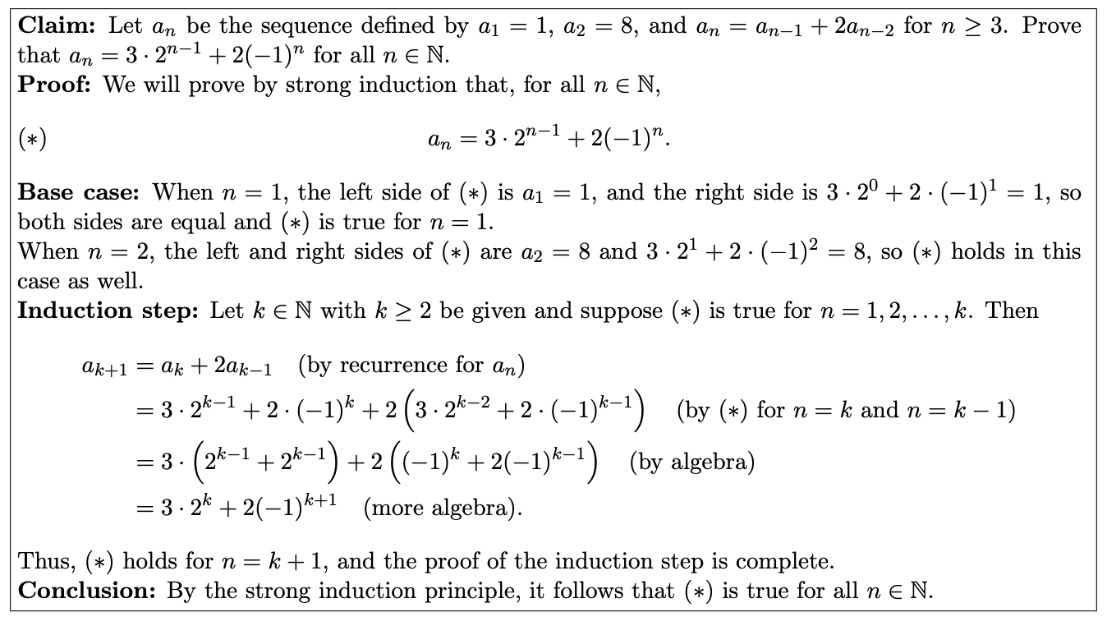
Problem

Slide 21
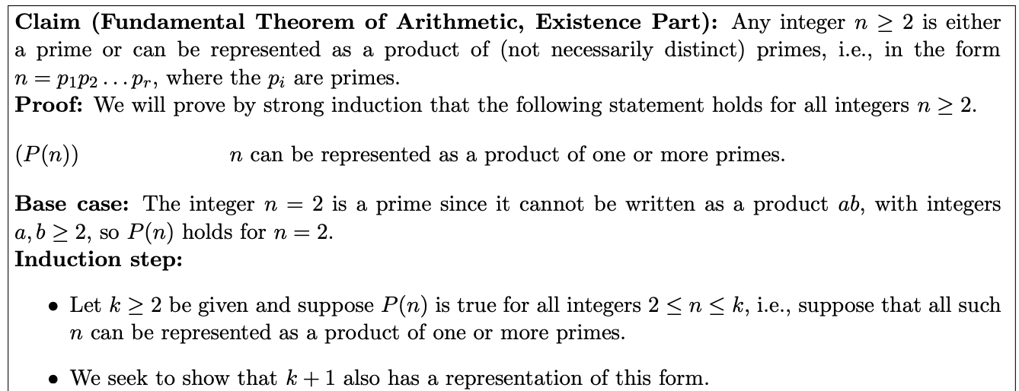
Fundamental Theorem of Arithmetic

Slide 22
Fundamental Theorem of Arithmetic

Slide 24
Fibonacci Number

Slide 25
Fibonacci Number
Proposition: Prove that
F₁ + F₂ + … + F_{n} = F_{n+2} -1 for n ≥ 2

Slide 26
Number of diagonals in a convex polygon with n vertices.
n = 3; # of diagonal =0
n = 5; # of diagonal = 5

Slide 27
Number of diagonals in a convex polygon with n vertices is n(n-3)/2.
S(n) : n ≥ 3 vertex convex polygon realizes N(n) = n(n-3)/2 diagonals.
Proof by Induction.
Basis: S(3) is true, since a triangle realizes N(3 )= 0 diagonal.
Inductive Hypothesis: S(k) is true for any k ≥ 3, N(k) = k(k-3)/2.
Show that S(k+1) is also true.
Consider a convex polygon P with k+1 vertices p₁, p₂, …, p_{k+1}.
N(k+1) = N(k) + ((k – 2) + 1)
= k(k-3)/2 + k-1
= (k+1)((k+1)-3)/2 (details in the class)
Using the principle of strong induction, ∀ n ≥ 3, S(n) is true.

Slide 28
N(6) = 6(6-3)/2

Slide 29
N(6) = 6(6-3)/2 = 9
N(7) = N(6) + (7-3) +1
= 7(7-3)/2
p₇

Slide 30
N(6) = 6(6-3)/2 = 9
N(7) = N(6) + (7-3) +1
= 7(7-3)/2
p₇

Slide 31
False Theorem
H_{k}
k
H_{k+1}
k
H_{k}. H_{k+1}
What is wrong?

Slide 32
False Theorem
H_{k}
k
H_{k+1}
k
H_{k}. H_{k+1}
What is wrong?
Inductive step cannot be applied for P(2)

Slide 33
http://web.stanford.edu/class/archive/cs/cs103/cs103.1164/fall1516/lectures/13/Small13.pdf

Slide 35
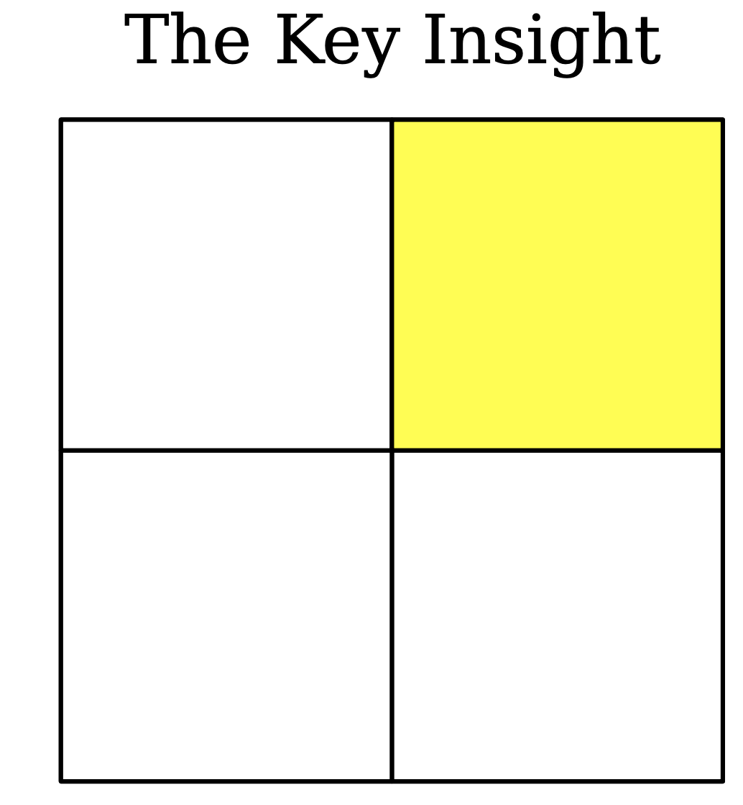

Slide 36
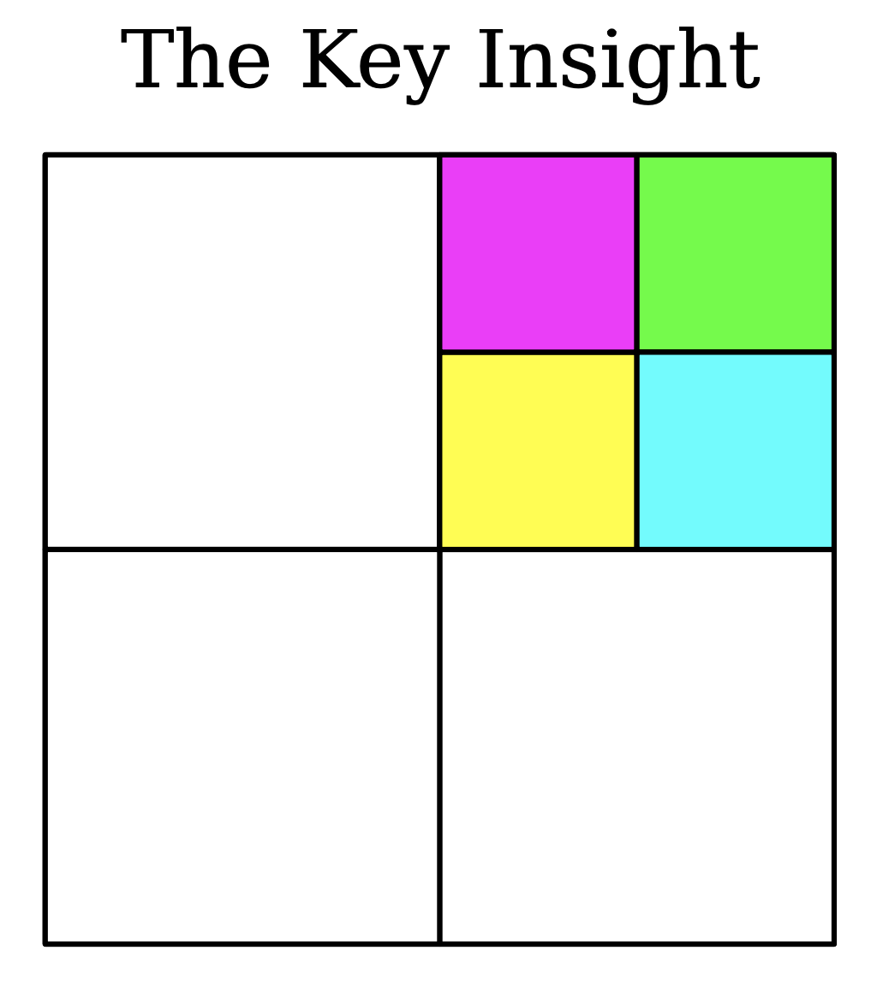

Slide 37
Key Insight
If a square can be subdivided into n squares, it can also be subdivided into n+3 squares.

Slide 38
The following is true for the first few values of n.

Slide 39
The following is true for the first few values of n.

Slide 40
The following is true for the first few values of n.

Slide 42
Inductive step.
Assume that for some k $≥$, P(k) is true.
We need to show that P(k+1) is true.
Since P(k+1 – 3) is true (due to inductive hypothesis), and k – 2 $≥$ 6, we replace an arbitrary square from the solution for n = k – 2 by 4 squares.
Effective increase of the number of squares is 3.
This results in a solution when n = k – 2 +3= k+1.
Therefore, P(k+1) is true.

Slide 44
