Slide 1
Induction-first (Chapter 7.1- 7.5)
Some slides have been taken from the sites
http://cse.unl.edu/~choueiry/S13-235/

Slide 2
Motivation
How can we prove the following proposition?
∀x∈A S(x)
For a finite set A={a₁,a₂,…,a_{n}}, we can prove that S(x) holds for each element because of the equivalence
S(a₁)∧S(a₂)∧…∧S(a_{n})
For an infinite set, we can try to use universal generalization
Another, more sophisticated way is to use induction

Slide 3
Sequences
Well known sequences
Arithmetic sequence
1, 4, 7, 10, 14, ……….
Geometric sequence
1, 3, 9, 27, ……..
Fibonacci sequence
1, 1, 2, 3, 5, 8, ….....

Slide 4
Arithmetic sequence
General form: <a, (a+d), (a+2d), …..>
a is the initial value and d is the common difference
a = 1 and d=3 realize the sequence <1, 4, 7, ….>
a = 3, d=3 realize the sequence <3, 7, 10, …>

Slide 5
Arithmetic sequence
General form: <a, (a+d), (a+2d), …..>
Let S(n) denote the n^{th} term of the sequence; n is called the index.
We can define a function S: {1, 2, 3, …..} → Z such that S(n) = a + (n-1) d, for given a and d.
The is denoted by {S(n)} or { S_{n} }.
S(1) is the initial term

Slide 6
Geometric sequence
General form: <a, ar, ar², ar³…..>
a is the initial value and r is the common ratio
a = 1 and r=3 realize the sequence <1, 3, 3², ….>
a = 3, r=3 realize the sequence <3, 3.3¹, 3.3², ….>

Slide 7
Geometric sequence
General form: <a, ar, ar², ar³…..>
Let S(n) denote the n^{th} term of the sequence; n is called the index of the term.
We can define a function S: {1, 2, 3, …..} → Z such that S(n) = a. r^{(n-1)}, for given a and r.
The is sequence is denoted by {S(n)} or { S_{n} }.
S(1) is the initial term

Slide 8
Fibonacci sequence
Form: <1, 1, 2, 3, 5, …..>
1 is the initial value
Let S(n) denote the n^{th} term of the sequence; n is called the index of the term.
We can define a function S: {1, 2, 3, …..} → Z such that S(n) =
The is sequence is denoted by {S(n)} or { S_{n} }.
S(1) is the initial term

Slide 9
More definitions: our sequence is {a_{n}}
increasing
A sequence is increasing if for every two consecutive indices, k and k + 1, in the domain, a_{k} < a_{k+1}.
non-decreasing
A sequence is non-decreasing if for every two consecutive indices, k and k + 1, in the domain, a_{k} ≤ a_{k+1}..

Slide 10
More definitions: our sequence is {a_{n}}
decreasing
A sequence is decreasing if for every two consecutive indices, k and k + 1, in the domain, a_{k} > a_{k+1}.
non-increasing
A sequence is non-increasing if for every two consecutive indices, k and k + 1, in the domain, a_{k} ≥ a_{k+1}.

Slide 11
Problem 7.1.2 of the text
Do it in the class

Slide 12
Recurrence relation
recurrence relation
A rule that defines a term a_{n} as a function of previous terms in the sequence is called a recurrence relation.
Arithmetic sequence: <t, t+d, t+2d, …., t+(n-1)d, …>
Let the sequence be {a_{n}}.
a_{n} = t + (n-1)d; a_{n-1}= t + (n-2)d
a_{n} = a_{n-1} + d is the recurrence relation of {a_{n}}, n $≥2$.
a₁ = t (initial value)

Slide 13
Geometric sequence {S_{n}}, n $≥1$
Geometric sequence: <a, ar, a+r², …., ar^{n-1}, …>
Let the sequence be {a_{n}}.
S_{n} = ar^{n-1}; S_{n-1}= ar^{n-2}
S_{n} = r S_{n-1} is the recurrence relation of {S_{n}}, n $≥2$.
S₁ = a (initial value)

Slide 14
Fibonacci sequence {F_{n}}
The sequence is <1, 1, 2, 3, 5, 8, ….>
Let the sequence be {F_{n}}.
F_{n} = F_{n-1} + F_{n-2} is the recurrence relation of {F_{n}}, for n $≥3$.
F₁ = 1; F₂ = 1 (initial values)
In the text, the recurrence relation for Fibonacci sequence is given by
F_{n} = F_{n-1} + F_{n-2} for n $≥$2
F₀ = 0; F₁ = 1 (initial values)
The sequence it generates is <0, 1, 1, 2, 3, 5, 8, ……>
The value of the 0th term is 0.

Slide 15
Example 7.2.3: Outstanding balance on a car loan.
An individual takes out a $20,000 car loan.
The annual interest rate for the loan is 3%.
The person wishes to make a monthly payment of $500.
Define a_{n} to be the amount of outstanding debt after n months.
Since the interest rate describes the annual interest, the percentage increase each month is actually 3% / 12 = 0.25%.
Thus, the multiplicative factor increase each month is 1.0025.

Slide 16
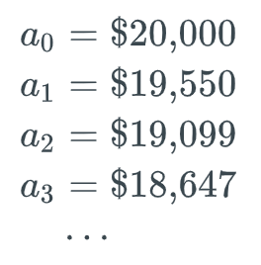
Example 7.2.3: Outstanding balance on a car loan.
The recurrence relation for {a_{n}} is:
Few initial values:

Slide 17
Summation
Summation notation
Summation notation is used to express the sum of terms in a numerical sequence.
Index, lower limit, upper limit
In the summation.
the variable i is called the index of the summation.
The variable s is the lower limit, and
the variable t is the upper limit of the summation.
= a_{s} + a_{s+1} + ….. + a_{t} is the expanded form.

Slide 18
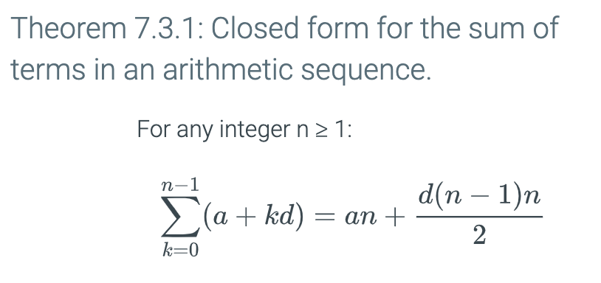
Closed form
A closed form for a sum is a mathematical expression that expresses the value of the sum without summation notation.

Slide 19
Closed form
A closed form for a sum is a mathematical expression that expresses the value of the sum without summation notation.

Slide 20
Change of variables in summations.
We have seen that

Slide 21
Change of variables in summations.
We have seen that
Therefore,

Slide 22
Change of variables in summations.
We have seen that
Therefore,
Let j = i -1; j = 0 when i = 1, and j = n- 1 when i = n.
We then get

Slide 23
Principle of Mathematical Induction
To prove that a statement S(n) is true for all positive integers n (i.e. n ∈ Z⁺) , we perform two steps:
Basis step: We verify that S(1) is true.
Inductive step: We show that the conditional statement
S(k) → S(k+1) is true ∀k ∈ Z⁺
Symbolically, the statement
(S(1) ∧ ∀(k ≥ 1) (S(k) ⇒ S(k+1))) → ∀(n ∈ Z⁺) S(n)

Slide 24
Principle of Mathematical Induction
How do we do this?
S(1) is usually an easy property to show.
To prove the conditional statement, we assume that S(k) is true (it is called inductive hypothesis) and show that under this condition S(k+1) is also true.

Slide 25
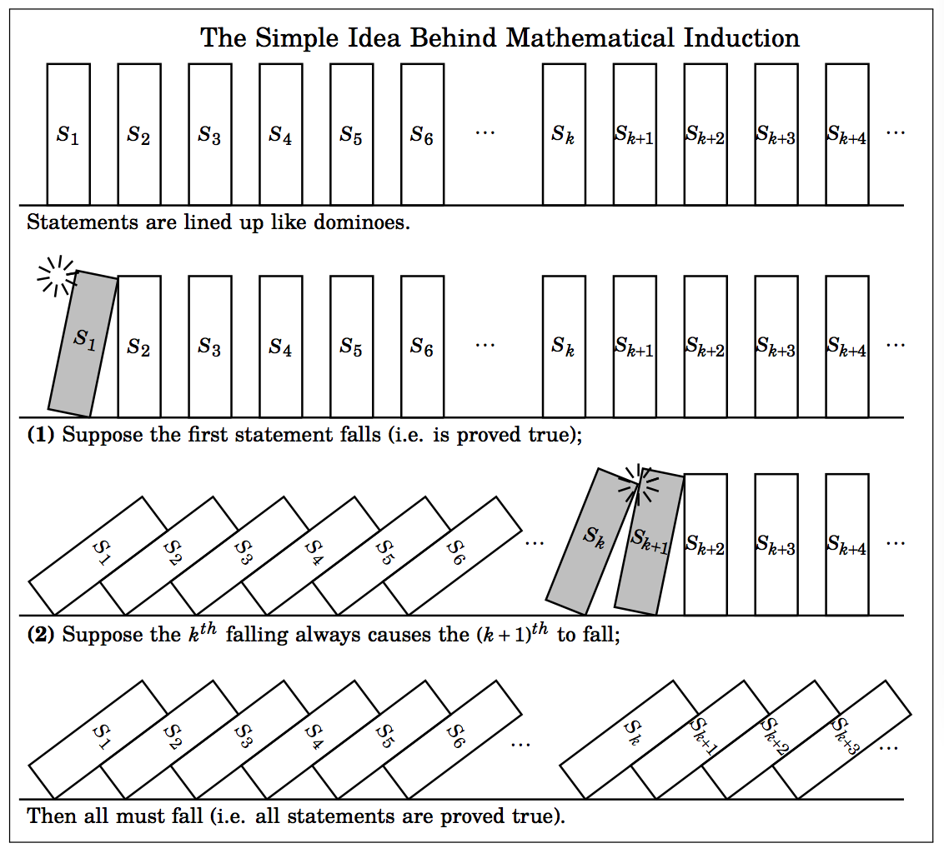
Mathematical Induction
It is a powerful proof techniques.

Slide 26
Mathematical Induction
It is a powerful proof techniques.
The Domino Effect
Show that all dominos fall.
Basis Step: The first domino falls.
Inductive step: Whenever a domino falls, its next neighbor will also fall.

Slide 27
Mathematical Induction
Two components of inductive proof.
The base case establishes that the theorem is true for the first value in the sequence.
The inductive step establishes that if the theorem is true for k, then the theorem also holds for k + 1.

Slide 28
→

Slide 29
Another View
To look at it in another way, assume that the statements
S(1)
S(k) → S(k+1)
are true. We can now use a form of universal generalization as follows:

Slide 30
Another View
To look at it in another way, assume that the statements
(1) S(1)
(2) S(k) → S(k+1)
are true. We can now use a form of universal generalization as follows.
Say we choose an element c of Z⁺. c is finite. We wish to establish that S(c) is true. If c=1, then we are done.

Slide 31
Another View
To look at it in another way, assume that the statements
(1) S(1)
(2) S(k) → S(k+1)
are true. We can now use a form of universal generalization as follows.
Say we choose an element c of N. c is finite. We wish to establish that S(c) is true. If c=1, then we are done.
Z⁺.
Otherwise, we apply (2) above to get
S(1) → S(2), S(2) → S(3), S(3) → S(4), …, S(c-1) → S(c)
via a finite number of steps (c-1) we get that S(c) is true.

Slide 32
Another View
To look at it in another way, assume that the statements
(1) S(1)
(2) S(k) → S(k+1)
are true. We can now use a form of universal generalization as follows.
Say we choose an element c of N. c is finite. We wish to establish that S(c) is true. If c=1, then we are done.
Z⁺.
Z⁺.
Otherwise, we apply (2) above to get
S(1) → S(2), S(2) → S(3), S(3) → S(4), …, S(c-1) → S(c)
via a finite number of steps (c-1) we get that S(c) is true.
Because c is arbitrary, the universal generalization is established and
∀n ∈ Z⁺ S(n)

Slide 33
Example 1
Prove that for any integer n≥1, 2^{2n}-1 is divisible by 3.
Define S(n) to be the statement 3 | (2^{2n}-1).

Slide 34
Example 1
Prove that for any integer n≥1, 2^{2n}-1 is divisible by 3
Define S(n) to be the statement 3 | (2^{2n}-1)
We note that for the basis case n=1, we do have S(1)
2^{2∙1}-1 = 3 is divisible by 3.

Slide 35
Example 1
Prove that for any integer n≥1, 2^{2n}-1 is divisible by 3
Define S(n) to be the statement 3 | (2^{2n}-1)
We note that for the basis case n=1 we do have P(1)
2^{2∙1}-1 = 3 is divisible by 3
Next we assume that S(k) holds. That is, there exists some integer t such that
2^{2k}-1 = 3t. (Inductive hypothesis)

Slide 36
Example 1
Prove that for any integer n≥1, 2^{2n}-1 is divisible by 3
Define S(n) to be the statement 3 | (2^{2n}-1)
We note that for the basis case n=1 we do have S(1)
2^{2∙1}-1 = 3 is divisible by 3
Next we assume that S(k) holds. That is, there exists some integer t such that
2^{2k}-1 = 3t. (Inductive hypothesis)
We must prove that S(k+1) holds. That is, 2^{2(k+1)}-1 is divisible by 3.

Slide 37
Example 1 (contd.)
Note that: 2^{2(k+1)} – 1 = 2²2^{2k} -1=4.2^{2k} -1

Slide 38
Example 1 (contd.)
Note that: 2^{2(k+1)} – 1 = 2²2^{2k} -1=4.2^{2k} -1
The inductive hypothesis: 2^{2k} – 1 = 3t ⇒ 2^{2k} = 3t+1

Slide 39
Example 1 (contd.)
Note that: 2^{2(k+1)} – 1 = 2²2^{2k} -1=4.2^{2k} -1
The inductive hypothesis: 2^{2k} – 1 = 3t ⇒ 2^{2k} = 3t+1
Thus: 2^{2(k+1)} – 1 = 4∙2^{2k} -1 = 4(3t+1)-1
= 12t+4-1
= 12t+3
= 3(4t+1), a multiple of 3

Slide 40
Example 1 (contd.)
Note that: 2^{2(k+1)} – 1 = 2²2^{2k} -1=4.2^{2k} -1
The inductive hypothesis: 2^{2k} – 1 = 3t ⇒ 2^{2k} = 3t+1
Thus: 2^{2(k+1)} – 1 = 4∙2^{2k} -1 = 4(3t+1)-1
= 12t+4-1
= 12t+3
= 3(4t+1), a multiple of 3
We conclude, by the principle of mathematical induction, for any integer n≥1, 2^{2n}-1 is divisible by 3.

Slide 41
Example 2 (page 154)
Open Statement S(n) = S_{n} : 1 + 3 + 5 +…..+ (2n-1) = n^{2 .}
→
The rest of the details will be shown in the class.
Notes:
Will use direct proof.

Slide 42
Example 2 (page 154)
Open Statement S(n) = S_{n} : 1 + 3 + 5 +…..+ (2n-1) = n^{2 .}
S₁ is true.
→
The rest of the details will be shown in the class.
Notes:
Will use direct proof.

Slide 43
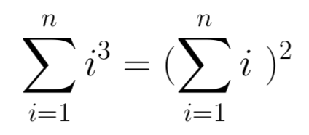
Example 3: Summation
Show that for all n ≥ 1.
The basis case is trivial: for n =1, 1³ = 1²
The inductive hypothesis assumes that for some n≥1 we have Σ_{i=1} ^{k} (i³) = (Σ_{i=1}^{k} i)²
We now consider the summation for (k+1): Σ_{i=1}^{k+1} (i³)
= (Σ_{i=1}^{k} i)² + (k+1)³
= ( k(k+1)/2 )² + (k+1)³
= ( k²(k+1)² + 4(k+1)³ ) /2²
= (k+1)² (k² + 4(k+1) ) /2²
= (k+1)² ( k² +4k+4 ) /2²
= (k+1)² ( k+2)² /2²
= ((k+1)(k+2) / 2) ²
Thus, by the PMI, the equality holds

Slide 44
→

Slide 45
Examples
n

Slide 46
Z⁺
S(n)
S(1)
S(k) → S(k+1))
S(n)
Z⁺
S(n)
S(1)
S(a-1)
S(a-1) → S(a)

Slide 49
Example
Show that any number larger than 43 can be written as the sum of nonnegative multiples of 6, 9, or 20.
i.e n = 6 t₁ + 9 t₂ + 20 t₃, where t₁, t₂, t₃ ≥ 0, n ≥ 44.

Slide 50
Example
Show that any number larger than 43 can be written as the sum of nonnegative multiples of 6, 9, or 20.
i.e n = 6 t₁ + 9 t₂ + 20 t₃, where t₁, t₂, t₃ ≥ 0, n ≥ 44.
Consider n=1,2,3,….
We notice that only the numbers 6, 9, 12, 15, 18, 20, 21, 24, 26, 27, 29, 30, 32, 33, 36, 38, 39, 40, 42 (less than 43) can be expressed as the sum of 6 and 9.
However, 43 is not expressible as the sum of 6, 9, and 20.

Slide 51
Example
Show that any number larger than 43 can be written as the sum of nonnegative multiples of 6, 9, or 20.
i.e n = 6 t₁ + 9 t₂ + 20 t₃, where t₁, t₂, t₃ ≥ 0, n ≥ 44.
Consider n=1,2,3,….
We notice that only the numbers 6, 9, 12, 15, 18, 20, 21, 24, 26, 27, 29, 30, 32, 33, 36, 38, 39, 40, 42 (less than 43) can be expressed as the sum of 6 and 9.
However, 43 is not expressible as the sum of 6, 9, and 20.
Claim any number greater than or equal to 44 can be expressed as
S(n): n = 6 t₁ + 9 t₂ + 20 t₃, where t₁, t₂, t₃ ≥ 0, n ≥ 44.

