Slide 1
InclusionExclusion 9.1

Slide 2
Standard Inclusion-Exclusion
Inclusion-Exclusion principle:
U
A
B
A-A∩B
A∩B
B-A∩B

Slide 3
Inclusion-Exclusion-Inclusion
“Inclusion-Exclusion-Inclusion” principle:
B
U
A
A-(B∪C)
A∩B
-A∩B∩C
B-(A∪C)
A∩B∩C
A∩C
-A∩B∩C
B∩C
-A∩B∩C
C-(A∪B)
C

Slide 4
Inclusion-Exclusion-Inclusion
A
B
1
4
2
7
6
5
3
C

Slide 5
Inclusion-Exclusion-Inclusion
Q: How many numbers between 1 and 1000 are divisible by 3, 5, or 7.

Slide 6
Inclusion-Exclusion-Inclusion
Use the formula that the number of positive integers up to N which are divisible by d is ⎣N/d⎦.
Use the fact that for relatively prime a, b (i.e a and b have no common divisors) both numbers divide x iff their product ab divides x.

Slide 7
Inclusion-Exclusion-Inclusion
Use the formula that the number of positive integers up to N which are divisible by d is ⎣N/d⎦.
Use the fact that for relatively prime a, b (i.e a and b have no common divisors) both numbers divide x iff their product ab divides x.
42 is divisible by 3 and 7.
Since 3 and 7 are relatively prime, 3x7 divides 42.
12 is divisible by 2 and 4, but 2x4 does not divide 12 (since 2 and 4 are not relatively prime)

Slide 8
Inclusion-Exclusion-Inclusion
Use the formula that the number of positive integers up to N which are divisible by d is ⎣N/d⎦.
Use the fact that for relatively prime a, b (i.e a and b have no common divisors) both numbers divide x iff their product ab divides x.
Total = ⎣1000/3⎦ + ⎣1000/5⎦ + ⎣1000/7⎦ - ⎣1000/15⎦ - ⎣1000/21⎦ - ⎣1000/35⎦ + ⎣1000/105⎦
= 333 + 200 + 142 - 66 - 47 - 28 + 9
= 543

Slide 9
Inclusion-Exclusion Principle
Using induction, could prove:
THM: General Inclusion-Exclusion Principle:
union =
all terms
all pairs
all triples
…
+/- total intersection
n+1

Slide 10
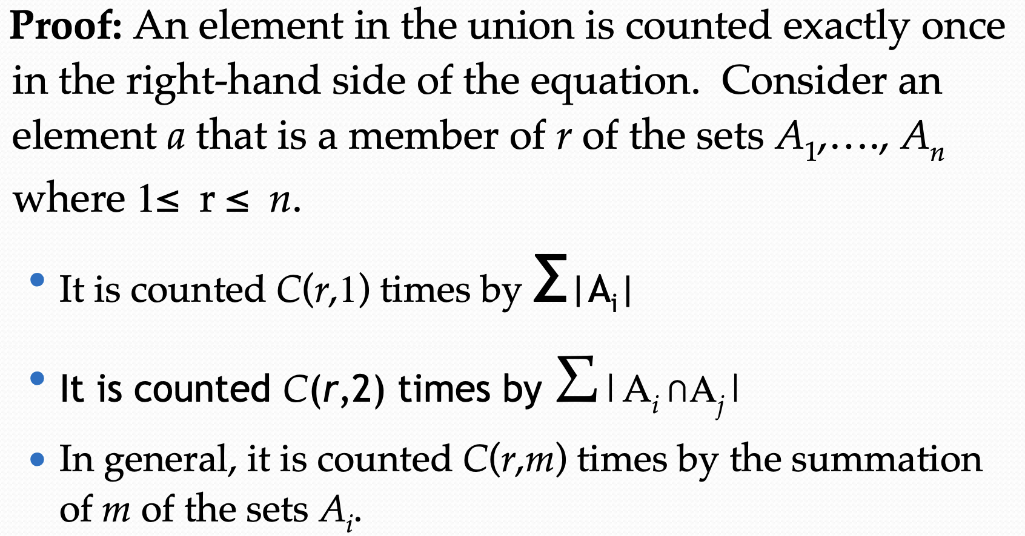

Slide 11
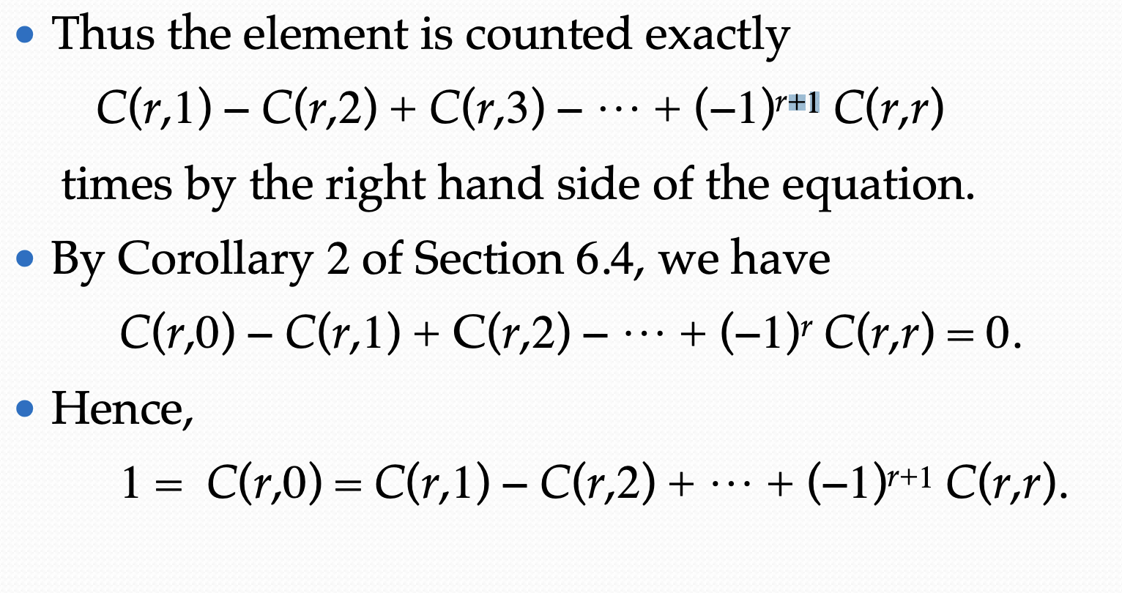
Plugging x=1 and y=-1 in (x+y)^{r}= C(r,0)x^{r}y⁰ + C(r,1)x^{r-1}y¹+C(r,2)x^{r-2}y²+ ...+ (-1)^{r}x⁰y^{r}

Slide 12
Deragement
Permutation of {1,2,3}: (1,2,3), (1,3,2), (2,1,3), (2,3,1), (3,1,2), (3,2,1)
In combinatorial mathematics, a derangement is a permutation of the elements of a set, such that no element appears in its original position.
Derangement of {1,2,3}: (2,3,1),(3,1,2)
Given n distinct objects, determine the number of derangement.

Slide 13
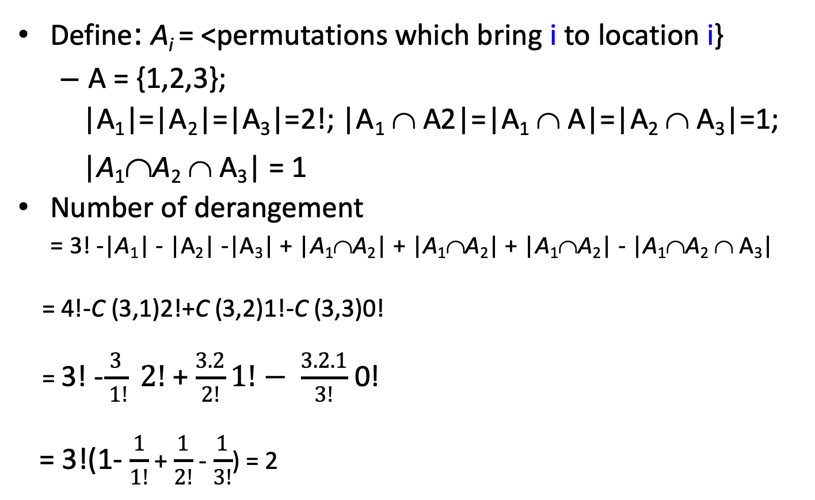
Counting Derangements
Define: A_{i} = <permutations which bring i to location i}
  A = {1,2,3};
  |A₁|=|A₂|=|A₃|=2!; |A₁ ∩ A2|=|A₁ ∩ A|=|A₂ ∩ A₃|=1;
  |A₁∩A₂ ∩ A₃| = 1
Number of derangement
= 3! -|A₁| - |A₂| -|A₃| + |A₁∩A₂| + |A₁∩A₂| + |A₁∩A₂| - |A₁∩A₂ ∩ A₃|
= 4!-C (3,1)2!+C (3,2)1!-C (3,3)0!
= 3! -$\frac{3}{ 1!} 2!$+ $\frac{3.2}{2!}1!− \frac{3.2.1}{3!}$ 0!
= 3!(1- $\frac{1}{1!}$ + $\frac{1}{2!}$ - $\frac{1}{3!}$) = 2

Slide 14
Counting Derangements
General Formula
Theorem:
The number of derangements of a set with n elements is given by:

Slide 15
Examples
Compute the number of solutions to x1+x2+x3=11
where x1,x2,x3 non-negative integers and x1 <=3, x2<=4, x3<=6.
P1: x1 > 3
P2: x2 > 4
P3: x3 > 6
The solution must have none of the properties P1,P2,P3.
→The solution of a problem x1+x2+x3=11 with constraints x1 > 3 is solved as
follows:
7 more balls
4 balls in
basket x1
already.
Total number of ways:
C(7+3-1,3-1)=36
x1 x2 x3
Therefore: N-N(P1)-N(P2)-N(P3)+N(P1,P2)+N(P2,P3)+N(P1,P3)-N(P1,P2,P3)
C(11+3-1,7) – C(7+3-1,7) – C(6+3-1,6) −C(5+3-1,5)+…. – 0.

