Slide 1
Functions
Chapter 4.1– 4.6

Slide 2
Acknowledgement
I have used materials from the following sources:
Textbook
Lecture notes slides prepared by Prof. Bulatov.
http://cse.unl.edu/~choueiry/S13-235/
http://www.math-cs.gordon.edu/courses/mat231/notes.html

Slide 3
Outline
Functions
Floor and ceiling functions
Properties of functions
Inverse Functions
Composition of Functions
Logarithm and exponential functions

Slide 4
Definitions of Functions
A function maps (associates) elements from one set A to another set B.
Many functions are mathematical functions such as absolute function, sine function, cosine function, floor function, ceiling function

Slide 5
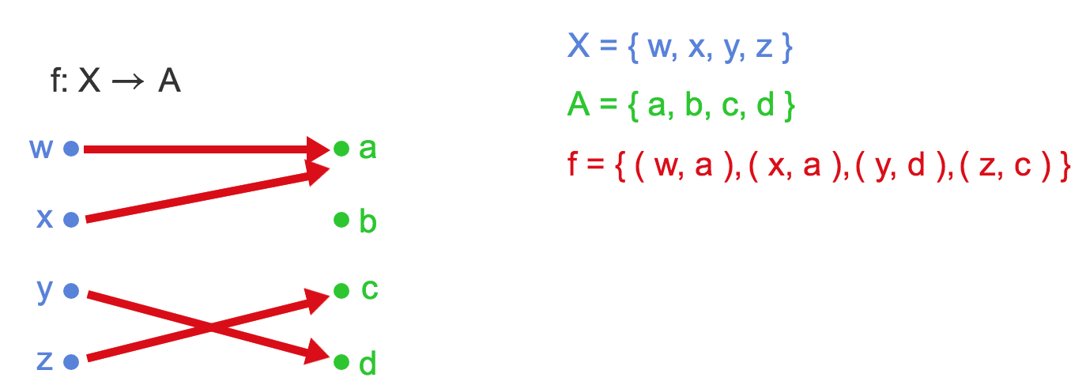
Visually …

Slide 6
Visually …
f is a function
f maps each element of X to an element of A.
a = f(w), c = f(z) …
f is a subset of Cartesian product set X $×$ A.

Slide 7
Function; Domain; Codomain
Definition:
A function f from the non-empty set X into a nonempty set Y is a subset f of the Cartesian product X x Y such that for every x ∈ X there is exactly one y ∈ Y for which (x, y) ∈ f.
The set X is called the domain and the set Y is called the codomain (target) of f.
We write f : X → A. We write f(x) = y when f maps x to y.

Slide 8
Function; Domain; Codomain
Definition:
A function f from the non-empty set X into a nonempty set Y is a subset f of the Cartesian product X x Y such that for every x ∈ X there is exactly one y ∈ Y for which (x, y) ∈ f.
The set X is called the domain and the set Y is called the codomain (target) of f.
We write f : X → A. We write f(x) = y when f maps x to y.
The assertion “every element of X appears in one and only one ordered pair in f” means that no two ordered pairs in f have the same first element. It also implies that every element of X appears in some ordered pair in f.
In this case we say f is well-defined.

Slide 9
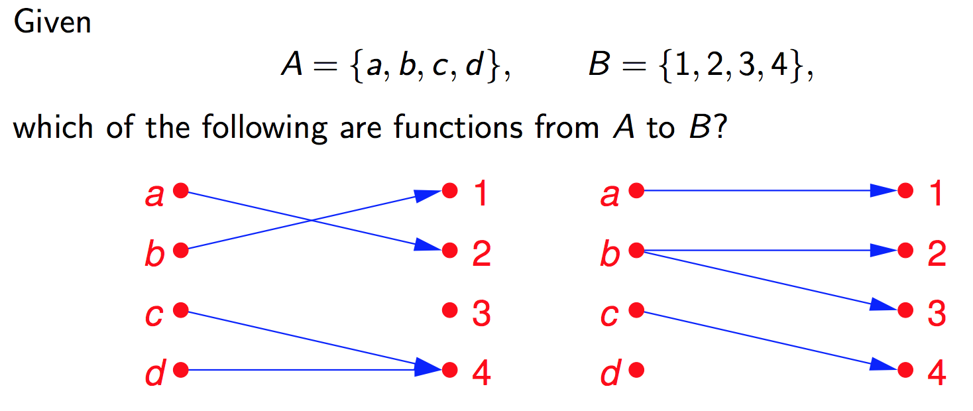
Example
A B A B

Slide 10
Example
A B A B
The diagram on the left is a function. The domain of the function is A; the codomain (target) of the function is B.
The one on the right is not a function. The domain is not A. Moreover b is assigned (mapped) to two different elements of B.

Slide 11
Terminology
Let f: X → Y and f(x)=y. Then we use the following terminology:
X is the domain of f
Y is the codomain (target) of f
y is the image of x
x is the preimage (antecedent) of y
The range of f is the set of all images of elements of X
Range of f = { y: (x, y) ∈ f, for some x ∈ X }

Slide 12
Function: Visualization
Range
Preimage
Image, f(x)=y
f
x
y
X
Y
Domain
Codomain (Target)
A function, f: X → Y

Slide 13
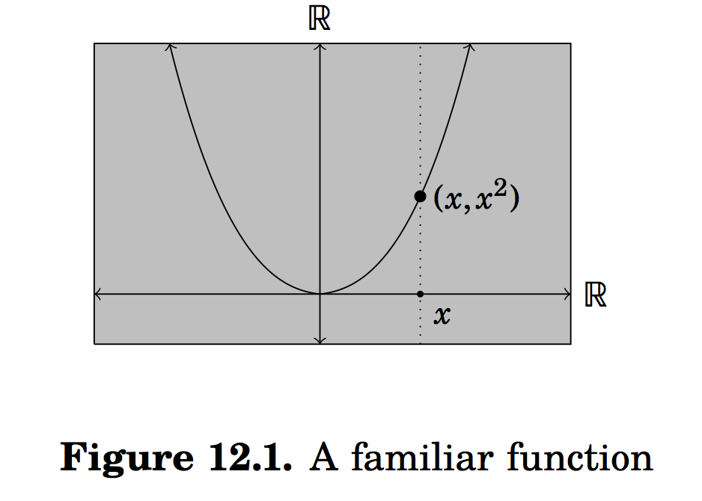
Functions
The concept of relations between the sets plays a big role here.
Consider the function f(x) = x², where x ∈ R.

Slide 14
Functions
The concept of relations between the sets plays a big role here.
Consider the function f(x) = x², where x ∈ R.
The points on the curve are related.
T={(x,x²): x ∈ R} ⊆ R x R.
T is a function

Slide 15
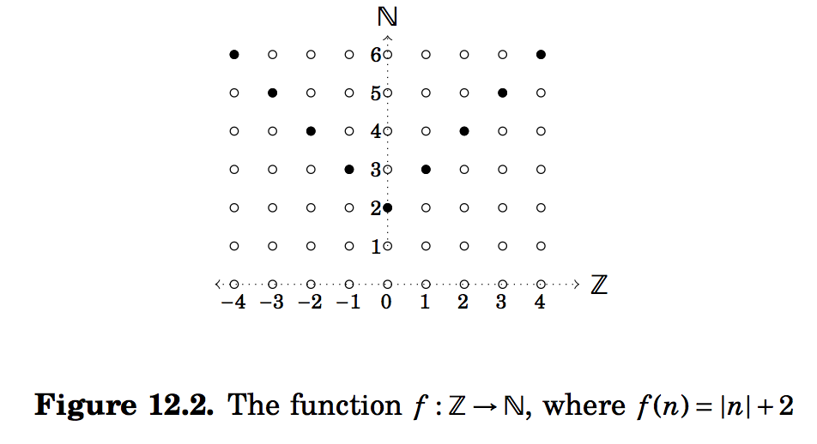
Another example of a function
Here f= {(n,|n|+2): n ∈ N} ⊆ Z x N.

Slide 16
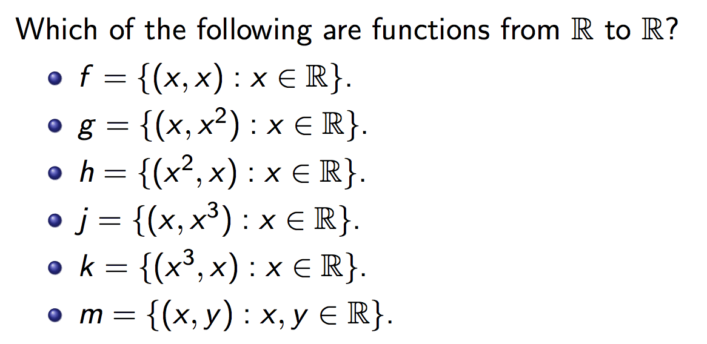
Example

Slide 17
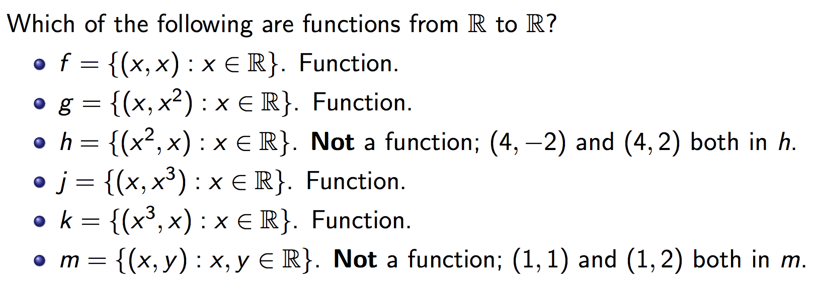
Example

Slide 18
More Definitions (2)
Definition: Let f: A→ B and S ⊆A. The image of the set S is the subset of B that consists of all the images of the elements of S. We denote the image of S by f(S), so that
f(S)={ f(s) | ∀ s ∈ S }
Note there that the image of S is a set and not an element.

Slide 19
Image of a set: Example
Let:
A = {a₁,a₂,a₃,a₄,a₅}
B = {b₁,b₂,b₃,b₄,b₅}
f={(a₁,b₂), (a₂,b₃), (a₃,b₃), (a₄,b₁), (a₅,b₄)}
S={a₁,a₃}
f(S) = {b₂, b₃}
Draw a diagram for f.
What is the:
Domain, codomain, range of f?
Image of S, f(S)?

Slide 20
Function Equality
Two functions, f and g, are equal if f and g have the same domain and target, and f(x) = g(x) for every element x in the domain.
The notation f = g is used to denote the fact that functions f and g are equal.

Slide 21
Exercise 4.1.6 Are f and g equal?
f: Z → Z, where f(x) = x². g: Z → Z, where g(x) = |x|².
f: Z → Z, where f(x) = x³. g: Z → Z, where g(x) = |x|³.
f: Z × Z → Z, where f(x,y) = |x + y|. g: Z × Z → Z, where g(x,y) = |x| +| y|.
f: R × R → R, where f(x,y) = x^{y}. g: R × R → R, where g(x,y) = y^{x}.
B = {0, 1} f: B × B → B × B, where f(x,y) = (1-y, 1-x) g: B × B → B × B, where g(x,y) = (x,y)

Slide 22
Exercise 4.1.6 Are f and g equal?
f: Z → Z, where f(x) = x². g: Z → Z, where g(x) = |x|².
f = g.
f: Z → Z, where f(x) = x³.
g: Z → Z, where g(x) = |x|³.
f ≠ g. For example, f(-2) = -8, and g(-2) = 8.
f: Z × Z → Z, where f(x,y) = |x + y|. g: Z × Z → Z, where g(x,y) = |x| +| y|.
f ≠ g. For example, f(-2,2) = 0, and g(-2,2) = 4.
f: R × R → R, where f(x,y) = x^{y}. g: R × R → R, where g(x,y) = y^{x}.
f ≠ g. For example, f(-2,2) = 4, and g(-2,2) = 1/4.
B = {0, 1} f: B × B → B × B, where f(x,y) = (1-y, 1-x) g: B × B → B × B, where g(x,y) = (x,y)
f ≠ g. For example, f(0,0) = (1,1), and g(0,0) = (0,0).

Slide 23
Important Functions: Floor & Ceiling
Definitions:
The floor function, denoted ⎣x⎦, is a function R→Z. Its values is the largest integer that is less than or equal to x
The ceiling function, denoted ⎡x⎤, is a function R→Z. Its values is the smallest integer that is greater than or equal to x .

Slide 24
Important Functions: Floor
y
3
2
1
x
-5
-4
-3
-2
-1
1
2
3
4
5
-1
-2
-3

Slide 25
Important Functions: Ceiling
3
2
1
x
-5
-4
-3
-2
-1
1
2
3
4
5
-1
-2
-3

Slide 26
Problem
For any integer n, show that ⎣$\frac{n}{2}$⎦ + ⎡ $\frac{n}{2}$⎤ = n.
Proof by cases: n is even, and n is odd.
When n is even, n =2k, for some integer k.
In this case: ⎣$\frac{n}{2}$⎦ = k, and ⎡ $\frac{n}{2}$⎤ = k.
Therefore, ⎣$\frac{n}{2}$⎦ + ⎡ $\frac{n}{2}$⎤ = 2k = n.
When n is odd, n = 2k +1 for some integer k.
In this case: ⎣$\frac{n}{2}$⎦ = k, and ⎡ $\frac{n}{2}$⎤ = k+1
Therefore, ⎣$\frac{n}{2}$⎦ + ⎡ $\frac{n}{2}$⎤ = 2k +1 = n.

Slide 27
Injective (one-to-one) and Surjective (onto) functions
In the literature
injective and one-to-one mean the same
surjective and onto mean the same
bijective and one-to-one correspondence mean the same.

Slide 28
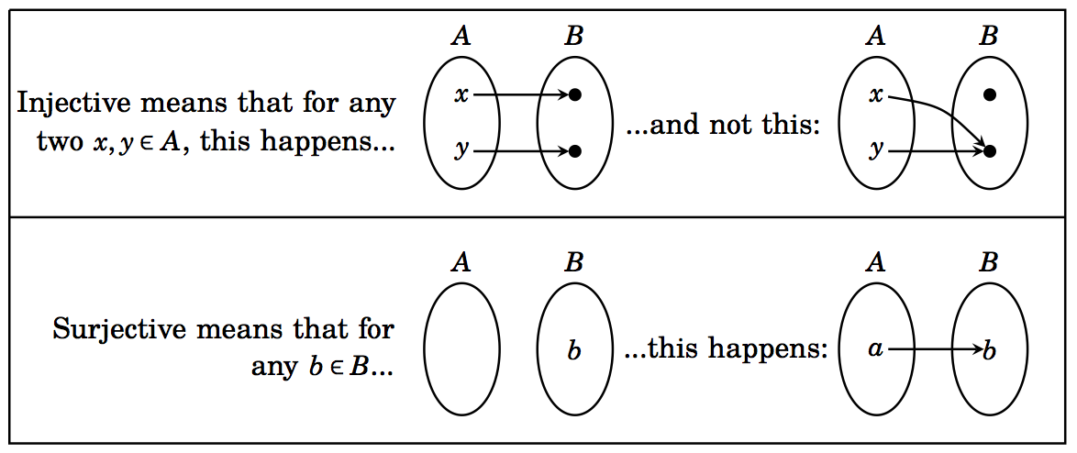
Section 12.2 (Injective and Surjective functions)
Definitions:

Slide 29
Example
Consider the following functions on the students in macm class. Under what conditions is the function one-to-one if it assigns to a student his or her
cell phone number
student id
final grade in the class
home town

Slide 30
Example
Consider the following functions on the students in macm class. Under what conditions is the function one-to-one if it assigns to a student his or her
cell phone number one-to-one
student id one-to-one
final grade in the class generally not one-to-one unless each student gets a unique grade
home town one-to-one if each student comes from a different town

Slide 31
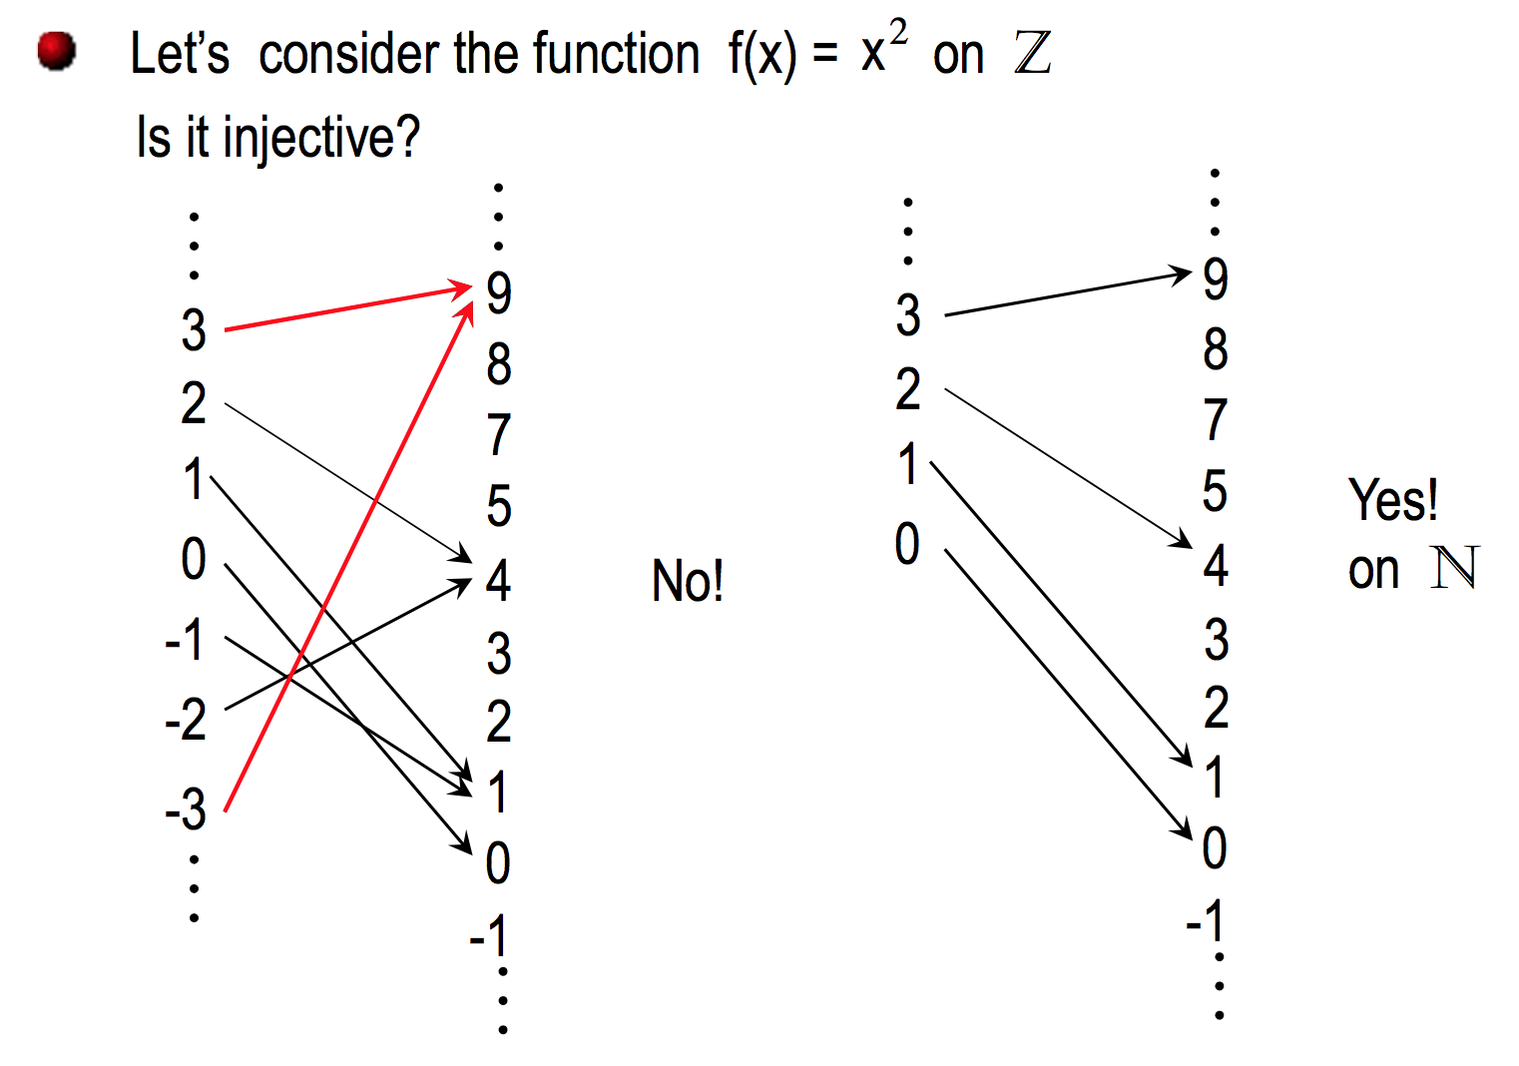

Slide 32
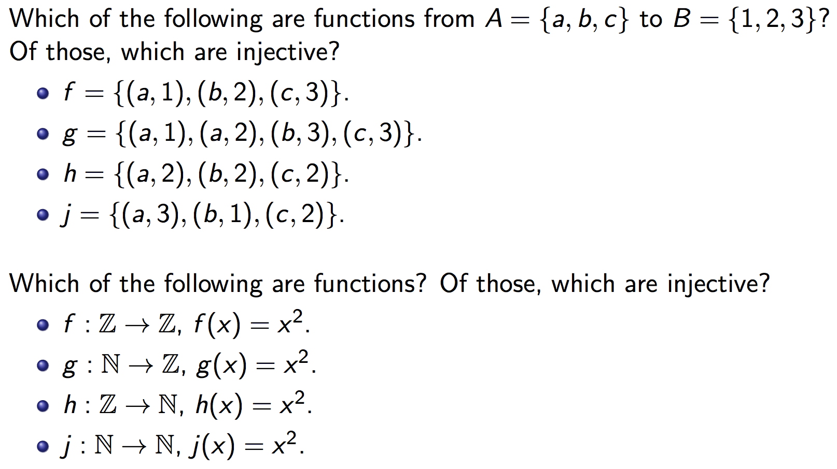
Injective functions One-to-one functions

Slide 33
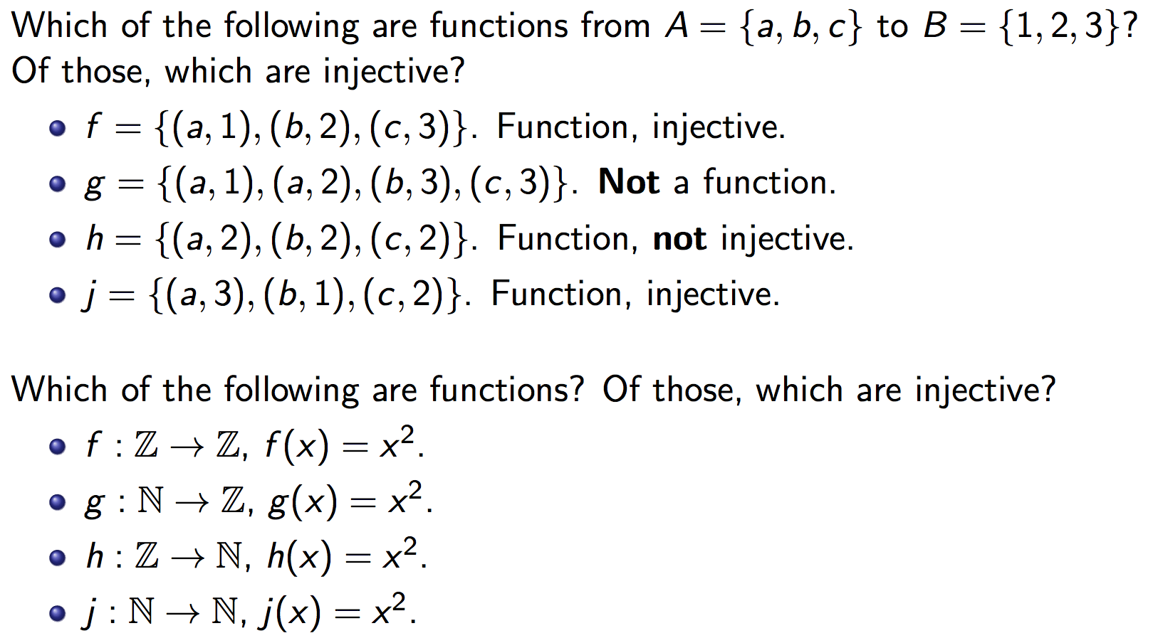
Injective functions One-to-one functions

Slide 34
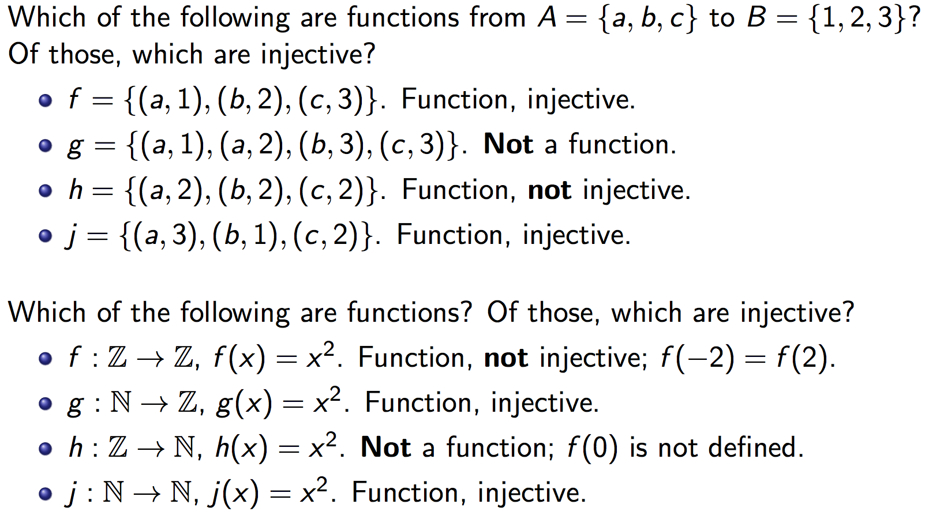
Injective functions One-to-one functions

Slide 35
How to show a function f: A→ B is injective (one-to-one)?
∀ x,y ∈ A [{(x ≠ y) (f(x) ≠ f(y))} ≡ {(f(x) = f(y)) (x=y)}]
Contrapositive

Slide 36
Recall:

Slide 37
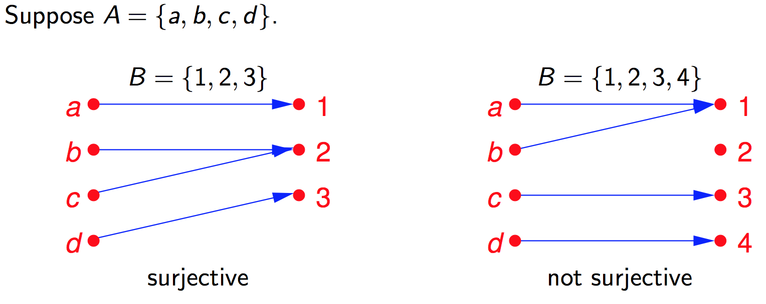
Surjective functions Onto functions range(f) = codomain(f)
range(f) ≠ codomain(f)

Slide 38
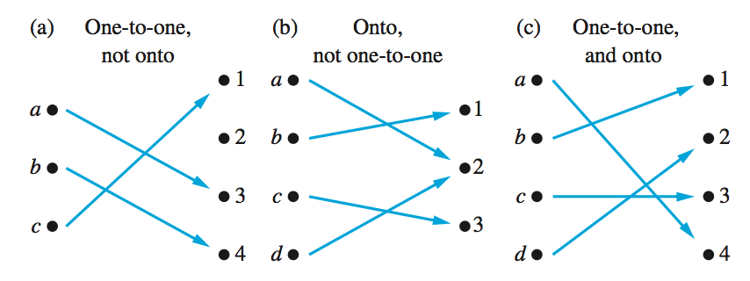
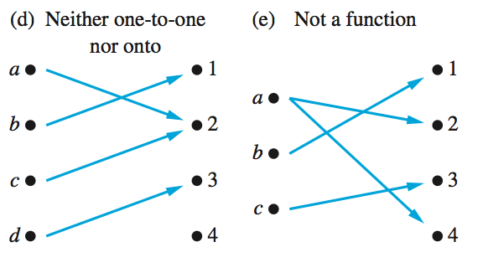
Examples of different types of functions

Slide 39
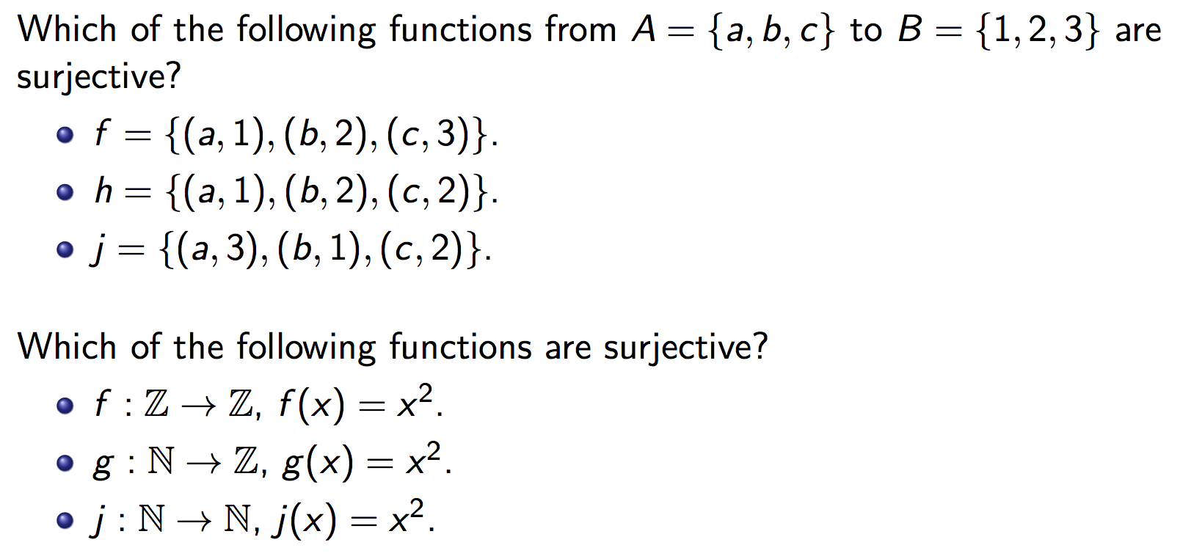
Surjective functions Onto functions

Slide 40
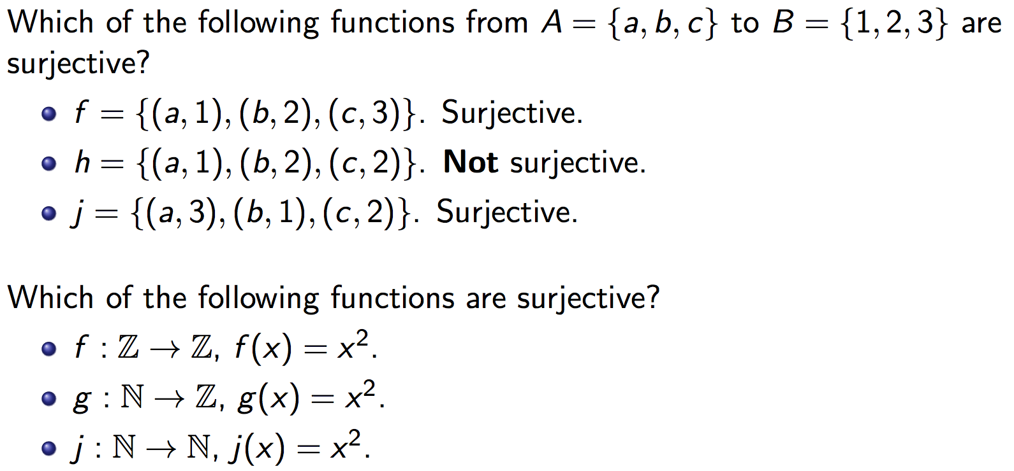
Surjective functions Onto functions

Slide 41
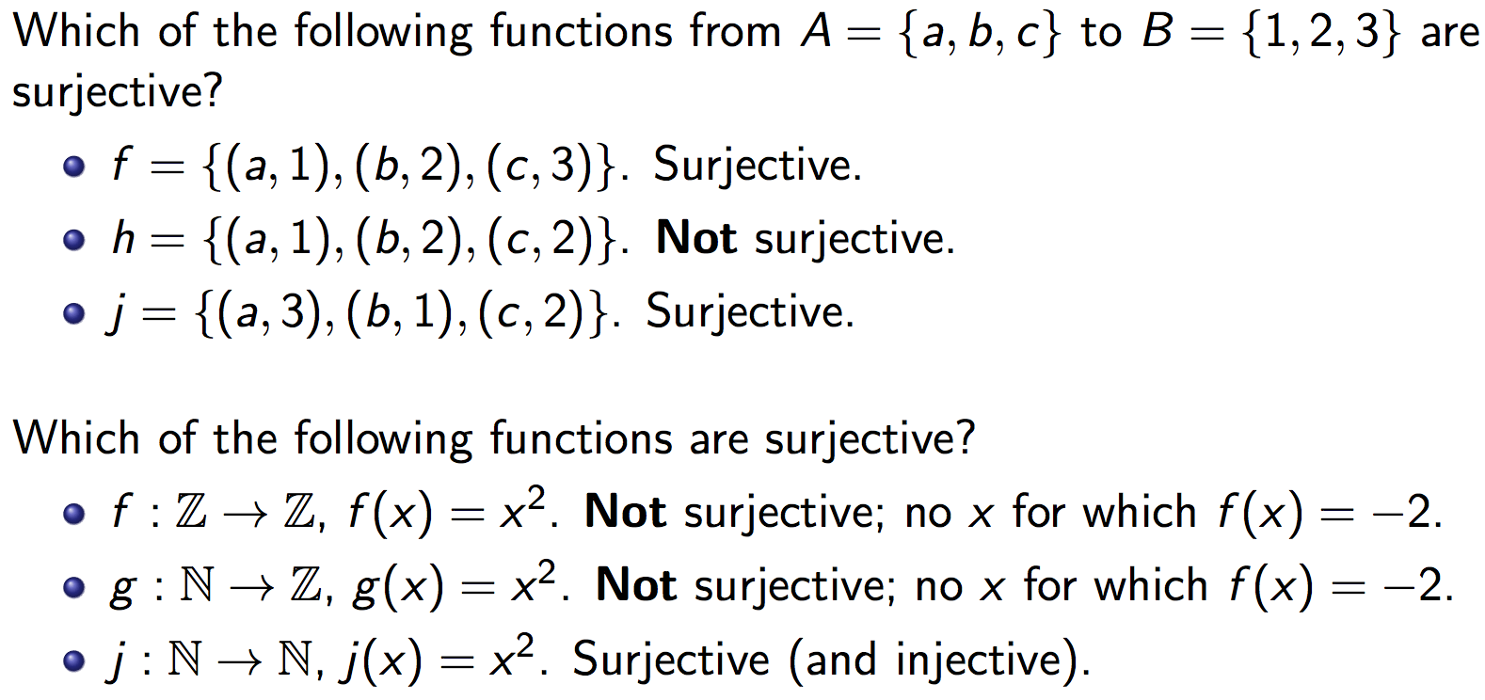
Surjective functions Onto functions
Not surjective (but injective)

Slide 42
How to show a function f: A→ B is injective?
∀ x,y ∈ A [{(x ≠ y) (f(x) ≠ f(y))} ≡ {(f(x) = f(y)) (x=y)}]

Slide 43
How to show a function f: A→ B is surjective (onto)?
∀ b ∈ B [∃a ∈ A (f(a) = b)]
We are assuming that f is a function.

Slide 46
Examples of different types of correspondences

Slide 47
Exercise 1
Let f:Z→Z be defined by
f(x)=2x-3
What is the domain, codomain, range of f?
Is f one-to-one (injective)?
Is f onto (surjective)?
Clearly, domain(f)=Z.
To see what the range is, note that:
b∈ range(f) b=2a-3, for some a ∈ Z
b=2(a-2)+1
b is odd

Slide 48
Exercise 1 (cont’d)
Thus, the range is the set of all odd integers
Since the range and the codomain are different (i.e., range(f) ≠ Z), we can conclude that f is not onto (surjective)
However, f is one-to-one injective. (Contrapositive approach)
For x, y ∈ Z , we can write
f(x) = f(y) ⇒ 2x - 3 = 2y - 3 ⇒ x = y. QED

Slide 49
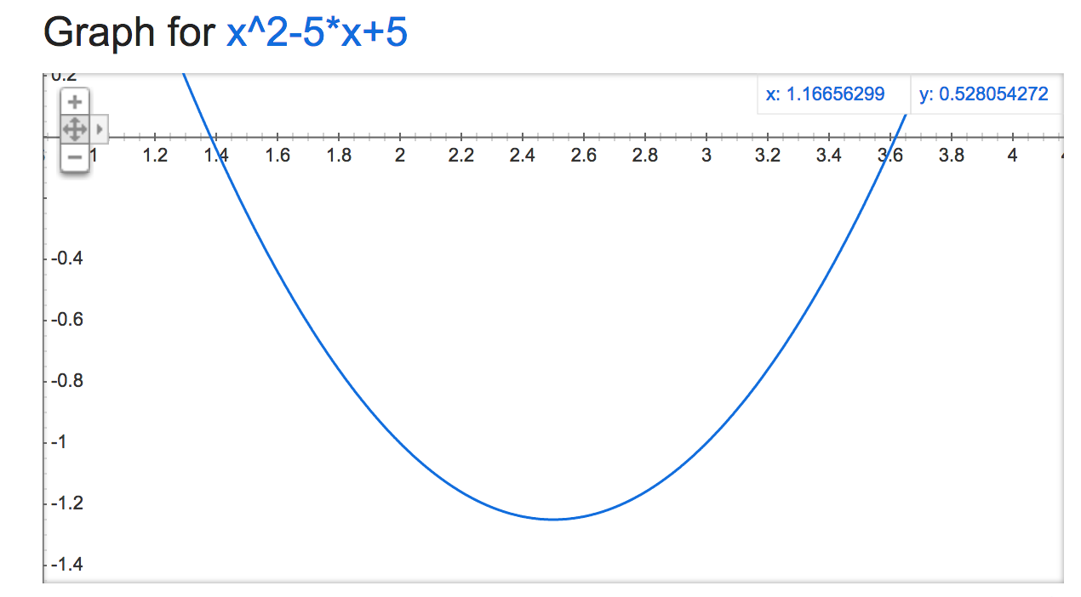
Exercise 3
Let f:Z→Z be defined by
f(x) = x² - 5x + 5
Is this function
One-to-one?
Onto?

Slide 50
Exercise 3: Answer
It is not one-to-one (injective)
f(x₁)=f(x₂) ⇒ x₁²-5x₁+5=x₂² - 5x₂+5 ⇒ x₁² - 5x₁ = x₂² - 5x₂
⇒ x₁² - x₂² = 5x₁ - 5x₂ ⇒ (x₁ - x₂)(x₁ + x₂) = 5(x₁ - x₂)
⇒ (x₁ + x₂) = 5 if x₁ ≠ x₂
Many x₁,x₂ ∈Z satisfy this equality. In particular, f(2)=f(3)=-1. Therefore, f is not one-to-one.
This proof belongs to the class of “Proof by counterexample”

Slide 51
Exercise 3: Answer
It is also not onto (surjective).
The function is a parabola with a global minimum at (5/2,-5/4). Therefore, the function fails to map to any integer less than -1
We can show that there does not exists any x ∈ Z such that f(x) = -2. (Why?)
The equation x² – 5x + 5 = -2 has imaginary roots.

Slide 52
Exercise 4
Let f:Z→Z be defined by
f(x) = 2x² + 7x
Is this function
One-to-one (injective)?
Onto (surjective)?
Again, this is a parabola, it cannot be onto.

Slide 53
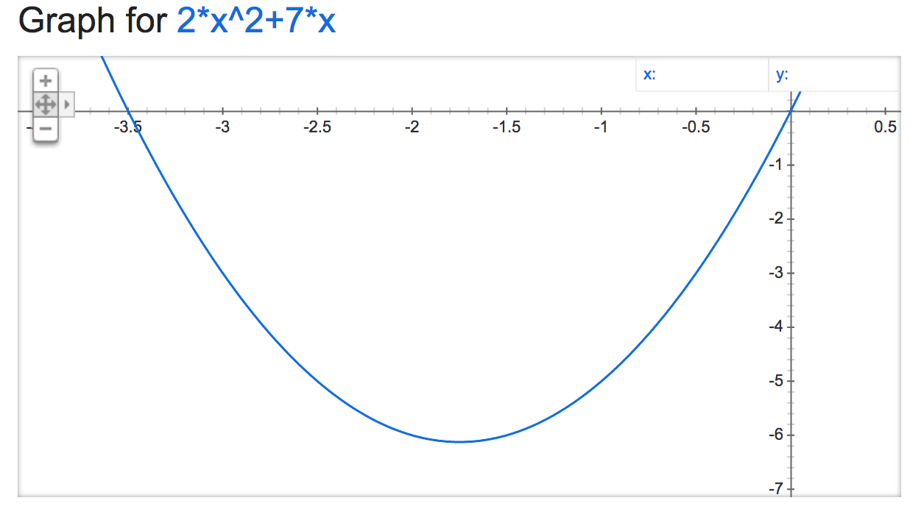

Slide 54
Exercise 4: Answer
f(x) is one-to-one! Indeed:
Proof by contradiction: Suppose f(x₁)=f(x₂) and x₁ ≠ x₂.
f(x₁)=f(x₂) ⇒ 2x₁²+7x₁=2x₂² + 7x₂ ⇒ 2x₁² - 2x₂² = 7x₂ - 7x₁
⇒ 2(x₁ - x₂)(x₁ + x₂) = 7(x₂ - x₁) ⇒ 2(x₁ + x₂) = -7
⇒ (x₁ + x₂) = -7/2
But -7/2 ∉ Z. Therefore we arrive at a contradiction. Therefore it must be the case that x₁ = x₂. It follows that f is a one-to-one function. QED

Slide 55
Exercise 4: Answer
f(x) is not surjective because f(x)=1 does not exist for any integer x .
2x² +7x=1 ⇒ x(2x +7)=1 the product of two integers is 1 if both integers are 1 or -1
x=1 ⇒ (2x+7)=1 ⇒ 9 =1, impossible
x=-1 ⇒ -1(-2+7)=1 ⇒ -5=1, impossible

Slide 56
Inverse of a function (4.4)
If a function f: X → Y is a bijection, then the inverse of f is obtained by exchanging the first and second entries in each pair in f.
The inverse of f is denoted by f⁻¹:
f⁻¹ = { (y, x) : (x, y) ∈ f }.

Slide 57
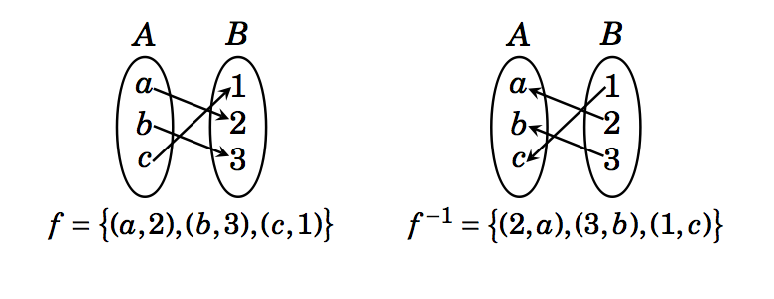

Slide 58
Definition: Suppose f : A → B is bijective. The inverse function of f is the function that assigns to each element b ∈ B, an element (preimage) a ∈ A such that f(a) = b. We denote the inverse function f⁻¹: B → A and can write
f⁻¹(b) = a when f(a) = b.
A function f : A → B has an inverse if and only if f is a bijection.

Slide 59
Example
Find the inverse of the function f : R → R defined as f(x) = x³ + 1, if it exists.
We first show that f is bijective.
f is one-to-one:
f(x) = f(y) implies (x³ + 1) = (y³ +1)
i.e (x-y)( x² + xy + y² ) = 0.
Since ( x² + xy + y² ) is not zero for any x ≠ y, therefore f(x) = f(y) implies x = y.
Therefore, f is one-to-one.

Slide 60
Example
Find the inverse of the function f : R → R defined as f(x) = x³ + 1, if it exists.
We first show that f is bijective.
f is one-to-one:
We now show that f is onto.
For any y of R, we need to find x such that f(x) = y.
i.e. find x such that x³ + 1 = y, i.e x = (y-1)^{1/3}.
Thus we see that f((y-1)^{1/3})= y for any y.
Therefore, f is onto.
Thus f is bijective

Slide 61
Example
Find the inverse of the function f : R → R defined as f(x) = x³ + 1, if it exists.
We now find f⁻¹(x).
We are interested in computing y such that f⁻¹(x) =y.
i.e. computing y such that f(y) = x.
i.e. computing y such that y³ + 1 = x.
i.e. y = (x – 1)^{1/3}.
Thus f ⁻¹ (x) = (x – 1)^{1/3}.
Note that f ⁻¹(f(x)) = f(f ⁻¹ (x))= x.

Slide 62
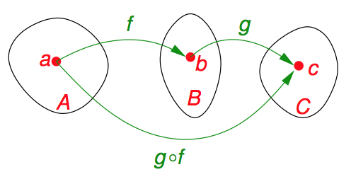
Composition (Section 4.5)
Definition:
Suppose f : A → B and g : B → C are functions with the property that the codomain(f ) equals the domain(g).
The composition of f and g is another function, denoted as g ^{ο} f and defined as follows: If x ∈ A, then g ^{ο} f (x) = g(f(x)). This function g(f(x)) sends (maps) elements of A to elements of C, so g ^{ο} f: A → C.

Slide 63
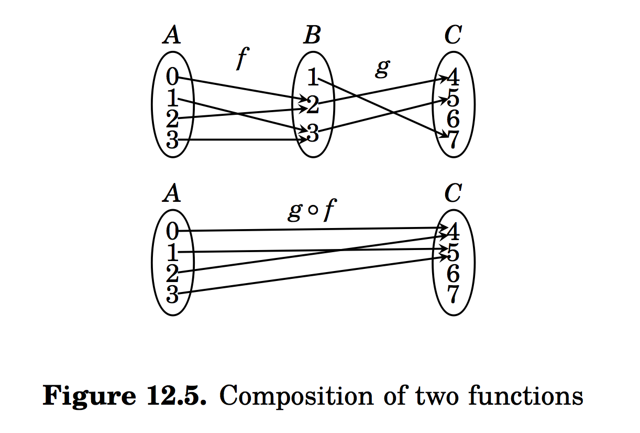

Slide 64
Composition: Example 1
Let f, g be two functions on R→R defined by
f(x) = 2x – 3
g(x) = x² + 1
What are f ^{ο} g and g ^{ο} f?

Slide 65
Composition: Example 1 (cont’d)
Given f(x) = 2x – 3 and g(x) = x² + 1
(f ^{ο} g)(x) = f(g(x)) = f(x²+1) = 2(x²+1)-3
= 2x² - 1
(g ^{ο} f)(x) = g(f(x)) = g(2x-3) = (2x-3)² +1
= 4x² - 12x + 10
Thus the composition of functions is not commutative.

Slide 66
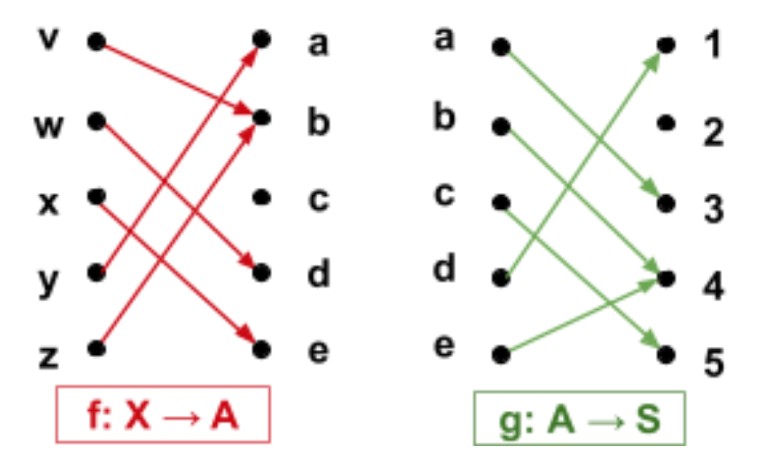
Function composition from arrow diagrams
Given:
What is the domain and codomain of g o f?
Give the arrow diagram of g o f.
What is the range of g o f?

Slide 67
Composition: Injection and Surjection
Theorem:
Suppose f: A → B and g: B → C. If both f and g are injective then g ^{ο} f is injective. If both f and g are surjective, g ^{ο} f is also surjective.

Slide 68
_{Proof of:} Suppose f: A → B and g: B → C. If both f and g are injective then g ο f is injective.
Here both f and g are injective.
To see that g ^{ο} f is injective, we must show that g(f(x)) = g(f(y)) implies x = y.
Suppose g(f(x)) = g(f(y)).
Since g is injective, f(x) = f(y).
Since f(x) = f(y), and f is injective, x = y.
Hence g(f(x)) = g(f(y)) implies x = y.
Therefore, g ^{ο} f is injective.

Slide 69
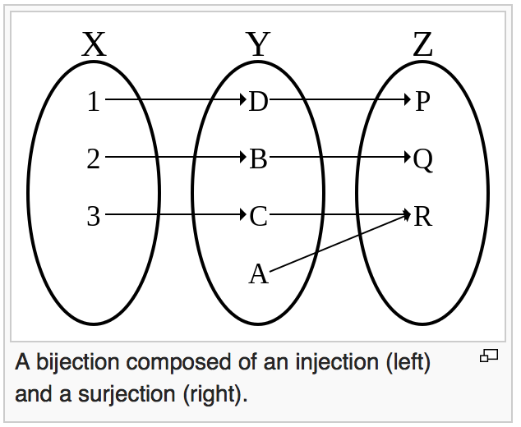
Conversely,
Suppose f : X → Y and g: Y → Z.
If the composition g ^{ο} f of two functions is bijective, we can only say that f is injective and g is surjective.

Slide 70
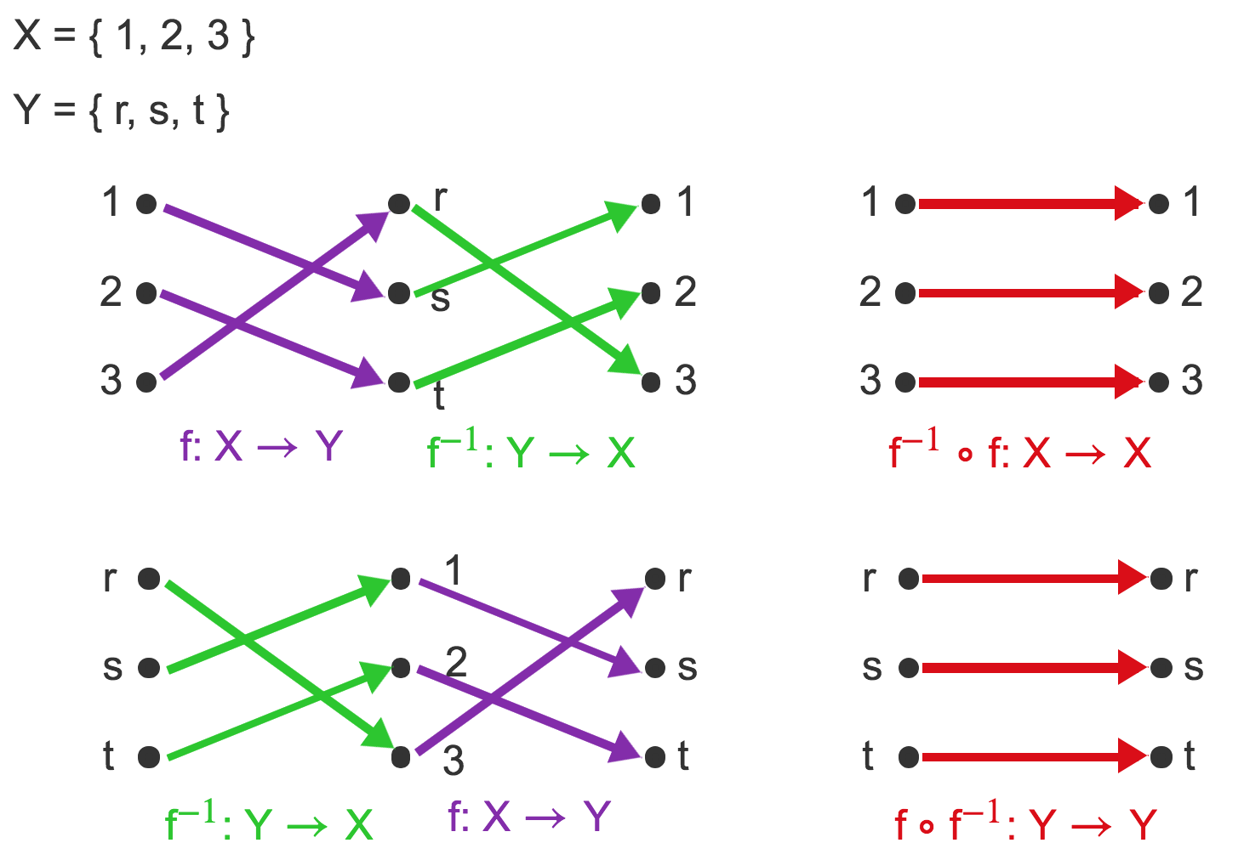
Composition of a function and its inverse

Slide 71
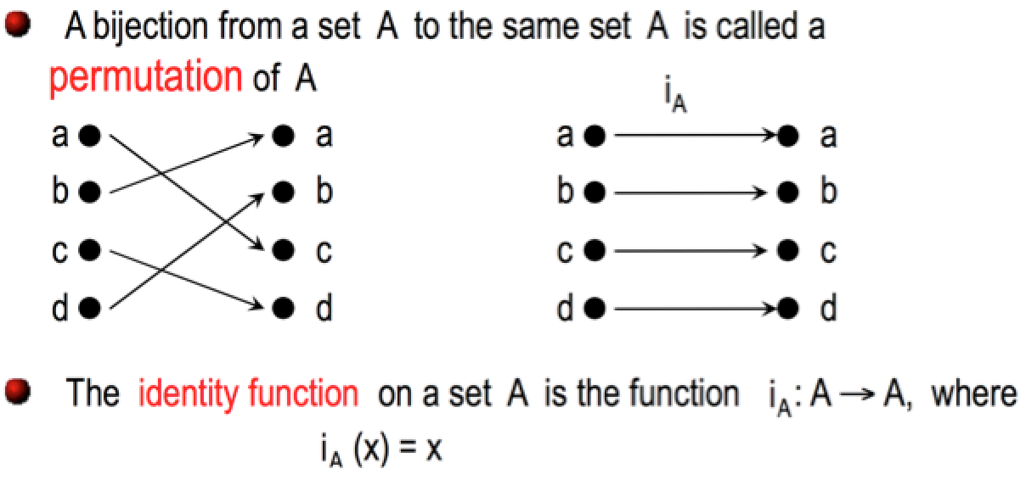
Permutation Functions

Slide 72
f ⁻¹ o f = {(a,a), (b,b), (c,c)}
f o f ⁻¹ = {(1,1), (2,2), (3,3)}

Slide 73
Important Functions: Absolute Value
Definition: The absolute value function, denoted |x|, f : R→ {y ∈R | y ≥ 0}. Its value is defined by
x if x ≥ 0
|x| =
-x if x ≤ 0

Slide 74
Important Function: Factorial
The factorial function gives us the number of permutations (that is, uniquely ordered arrangements) of a collection of n objects
Definition: The factorial function, denoted n!, is a function N→N⁺. Its value is the product of the n positive integers
n! = Π_{i=1} ^{i=n} i = 1⋅2⋅3⋅…⋅(n-1)⋅n

Slide 75
Logarithms and exponents
Exponential function
The exponential function exp_{b}:R → R⁺ is defined as
exp_{b}(x)=b^{x}
where b is a positive real number and b ≠ 1.
Base of the exponent
The parameter b is called the base of the exponent in the expression b^{x}.
Exponent
The input x to the function b^{x} is called the exponent.

Slide 76
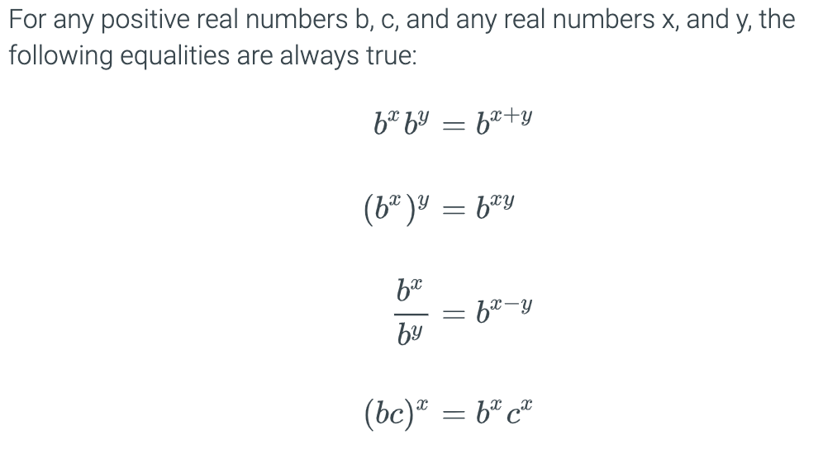
Properties of exponents

Slide 77
Logarithm function
The logarithm function is the inverse of the exponential function.

Slide 78
Logarithm function
The logarithm function is the inverse of the exponential function.
The parameter b is called the base of the logarithm in the expression log_{b} y.

Slide 79
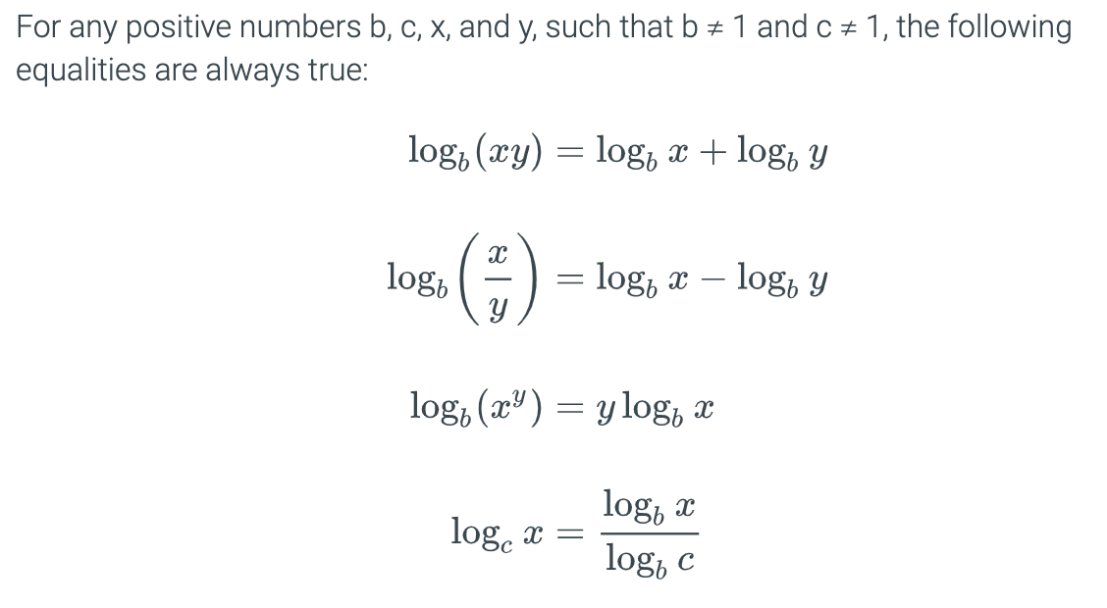
Properties of logarithms

Slide 80
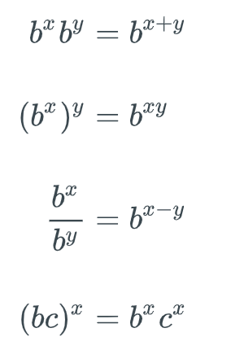
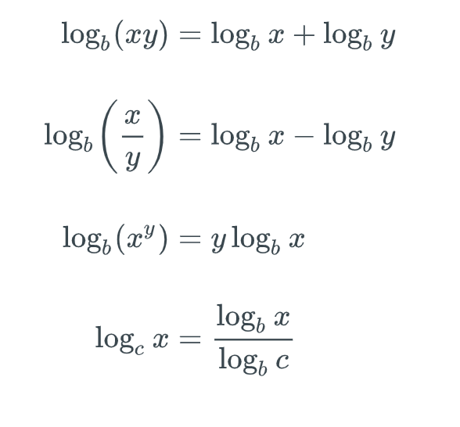

Slide 81
Exercise 4.6.2
For each expression, give an equivalent expression that is of the form log₅(*), where * is an expression with numbers and possibly the variable k.
log₅ k + log₅ 2
2·log₅ k
log₅ k - log₅ 7
(log₃ k)/(log₃ 5)
(log₃ (k²))/(log₃ 25)

Slide 82
Summary
Definitions & terminology
function, domain, codomain or target, image, preimage , range, image of a set
Properties
One-to-one (injective), onto (surjective), one-to-one correspondence (bijective)
Operators
Composition
Inverse functions
Important functions
identity, absolute value, floor, ceiling, factorial, logarithm and exponents

