Slide 1
Counting 8.10 - 8.12

Slide 2
Permutation with identical objects

Slide 3
The expansion of (x+y+z)^{n}
What is the coefficient of x^{i}y^{j}z^{k} where i+j+k = n?

Slide 4
The expansion of (x+y+z)^{n}
What is the coefficient of x^{i}y^{j}z^{k} where i+j+k = n?
(x+y+z)^{n}=(x+y+z).(x+y+z). … (x+y+z) (there are n terms)
The coefficient of x^{i}y^{j}z^{k} is the number of ways to select i terms for x; j terms for y and k terms for z.

Slide 5
The expansion of (x+y+z)^{n}
What is the coefficient of x^{i}y^{j}z^{k} where i+j+k = n?
(x+y+z)^{n}=(x+y+z).(x+y+z). … (x+y+z) (there are n terms)
The coefficient of x^{i}y^{j}z^{k} is the number of ways to select i terms for x; j terms for y and k terms for z.
Coefficient of x^{i}y^{j}z^{k} = number of n permutations with three object where object 1 is repeated i times, object 2 is repeated j times and object 3 is repeated k times.
Coefficient of x^{i}y^{j}z^{k} = $\frac{n!}{i!j!k!}$

Slide 6
Natural question
How many terms are there in the expansion of (x+y+z)^{r}?
How many terms of the type x^{i}y^{j}z^{k} are there where i+j+k =r?
(r,0,0),(0,r,0), (0,0,r), (r-1,1,0)….. are integral solutions of i+j+k = r, where i,j and k are nonnegative.
This is nothing but r-combination, with three (=n) distinct objects.
Ans: C(r+n-1,n-1).

Slide 7
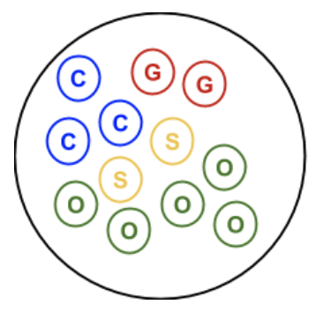
Counting multisets
Multisets
A multiset is a collection that can have multiple instances of the same kind of item.

Slide 8
Combinations with repetitions (Counting multisets)
Example: Consider a set A = {a,b,c,d}. We select two objects from A.
We now consider the following four cases.

Slide 9
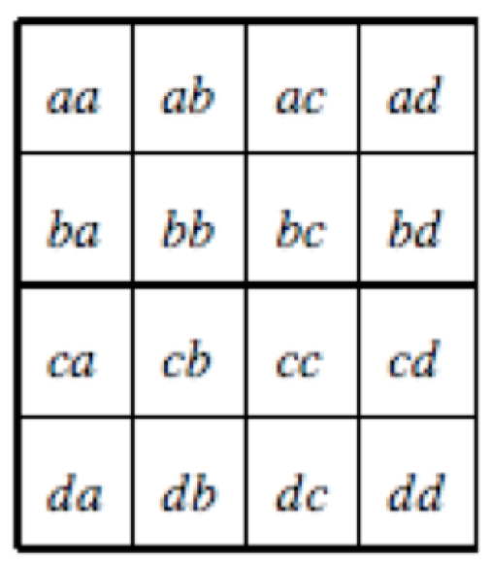
Given set of objects = {a,b,c,d}
2-permutations with repetitions: 4² = 16 possible cases.

Slide 10
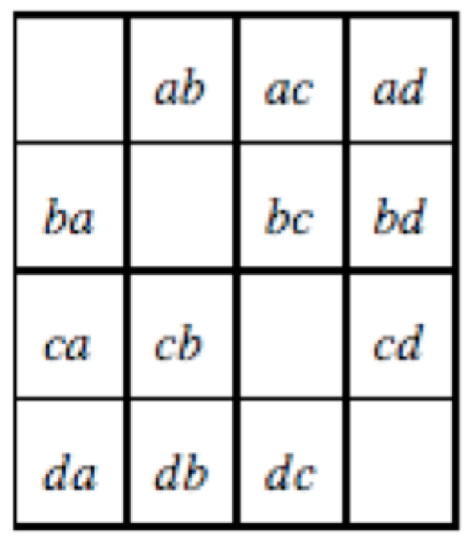
2-permutations without repetitions: P(4,2) = 12 possible cases.

Slide 11
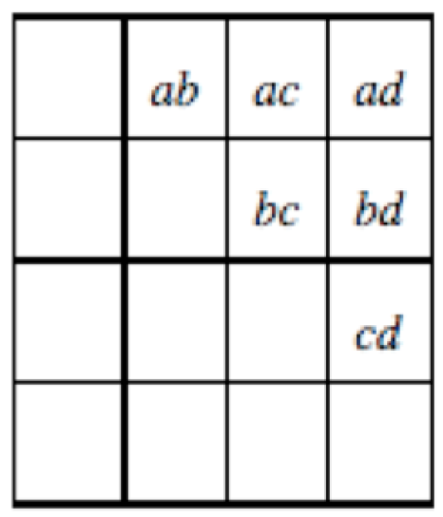
2-combinations without repetitions: C(4,2) = 6 possible cases.

Slide 12
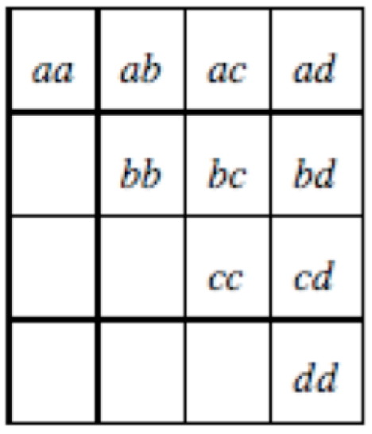
2-combinations with repetitions: C(5,3) = 10 possible cases.

Slide 13
2-combinations with repetitions: C(5,3) = 10 possible cases.
Note that combinations with repetitions do not correspond to subsets of a set.

Slide 14
Combinations with repetitions
Example: Consider a set A = {a,b,c,d}. We select two 10 objects from A with repetitions.
aaaabbbbbd (order is not important)
selected a four times;
selected b five times and
selected d one time

Slide 15
Combinations with repetitions
Example: Consider a set A = {a,b,c,d}. We select two 10 objects from A with repetitions.
aaaabbbbbd (order is not important)
selected a four times;
selected b five times and
selected d one time
bbbaaacccd (another combination)

Slide 16
Combinations with repetitions
Example: Consider a set A = {a,b,c,d}. We select two 10 objects from A with repetitions.
aaaabbbbbd (order is not important)
selected a four times;
selected b five times and
selected d one time
bbbaaacccd (another combination)
a b c d
x x x x | x x x x x | | x
a b c d
x x x | x x x | x x x | x

Slide 17
Combinations with repetitions
Example: Consider a set A = {a,b,c,d}. We select two 10 (r) objects from A (n=|A|) with repetitions.
aaaabbbbbd (order is not important)
selected a four times;
selected b five times and
selected d one time
bbbaaacccd (another combination)
another combination
a b c d
x x x x | x x x x x | x |
a b c d
x x x | x x x | x x x | x |
a b c d
| x | x x x x x | x x x x

Slide 18
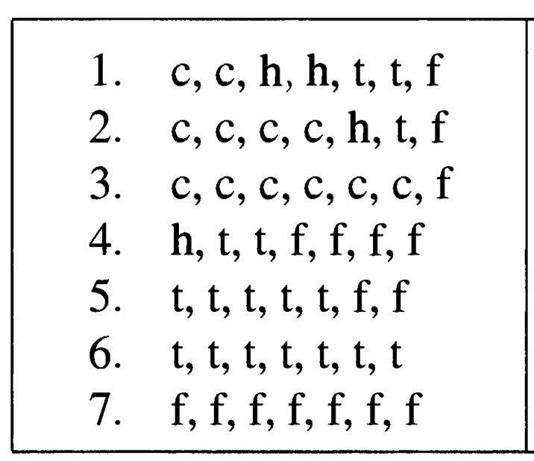
Example
Seven students where each of them has one item from: cheeseburger, hot dog, taco and fish sandwich. How many different purchases are possible?
Some possible purchases:

Slide 19
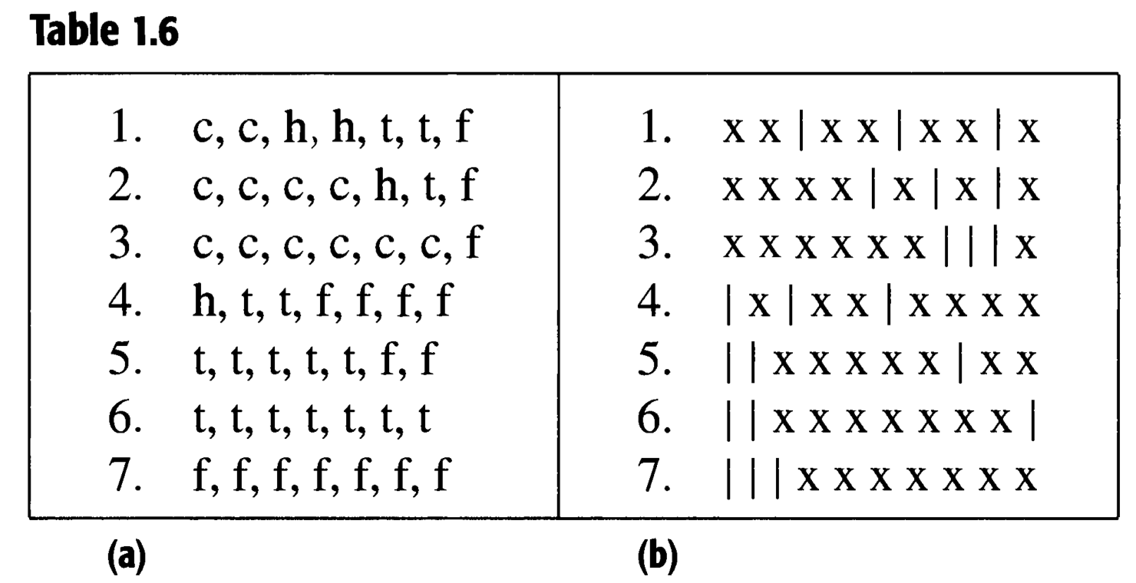
Example
Equivalent bar notation
Thus we have to arrange 7 x’s and (n-1) bars( | ).
This is an arrangement of 10 objects using seven x and three |.
This is
This is the same as

Slide 20
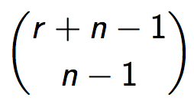
Theorem:
The number of r-combinations with repetition allowed, that can be selected from a set of size n is

Slide 21
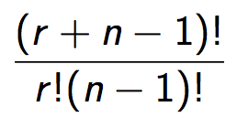
Proof:
1st
2nd
3rd
….
nth
XX
X
XXX
r X’s and n-1 boundaries.
These can be arranged in any order.
The number of ways this can be done is
C(r+n-1,r) = C(r+n-1,n-1) =
Thus the number of r-combinations with repetitions allowed is

Slide 22
Example
I want to buy 5 cans of soft drink.
The possible drinks that are available are coke, sprite and pepsi, where there are unlimited number of each.
In how many ways can I choose the 5 cans?
Answer:
This is same as the number of 5-combinations, with repetition allowed, from a set of size 3.
(since I need to select 5 cans from a set of size 3 with repetition allowed)
Using the theorem, this can be done in C(5+3-1,3-1) ways.

Slide 23
Example
How many integral solutions of equation
x₁+x₂+x₃=20,
where x₁,x₂,x₃ ≥ 0
are there?
(3,4,13) is a solution;
(4,3,13) is also a solution;
(0,0,20) is a solution

Slide 24
Example
How many integral solutions of equation
x₁+x₂+x₃=20,
where x₁,x₂,x₃ ≥ 0
are there?
Answer:
Note that we can consider x₁, x₂, x₃ as different types.
Choosing x_{i}=t, would mean that we are taking t copies of x_{i}.
This is same as the number of 20-combinations, with repetition allowed, from a set of objects of size 3.
Using the theorem, this can be done in C(20+3-1, 3-1) ways.

Slide 25
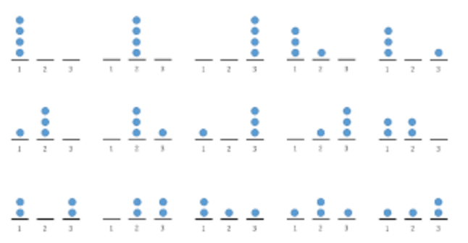
Another view
Equivalent: How many ways can you place r indistinguishable balls in n distinguishable boxes?
Ans: = C(r+n-1,n-1)

Slide 26
Permutations and combinations with and without repetitions. n = Number of distinct objects r = number of objects to be selected

Slide 27
Example
A doughnut shop has plain doughnuts, cherry doughnuts, chocolate doughnuts, almond doughnuts, apple doughnuts, broccoli doughnuts. How many ways are there to choose:
a dozen doughnuts?

Slide 28
Example
A doughnut shop has plain doughnuts, cherry doughnuts, chocolate doughnuts, almond doughnuts, apple doughnuts, broccoli doughnuts. How many ways are there to choose:
a dozen doughnuts?
12 indistinguishable balls and 6 bins
Ans: C(12+6-1,6-1) = C(17,5) = C(17, 12)

Slide 29
Example
A doughnut shop has plain doughnuts, cherry doughnuts, chocolate doughnuts, almond doughnuts, apple doughnuts, broccoli doughnuts. How many ways are there to choose:
(b) three dozen doughnuts?

Slide 30
Example
A doughnut shop has plain doughnuts, cherry doughnuts, chocolate doughnuts, almond doughnuts, apple doughnuts, broccoli doughnuts. How many ways are there to choose:
(b) three dozen doughnuts? 36 doughnut
36 indistinguishable balls and 6 bins
Ans: C(36+6-1,6-1) = C(41,5) = C(41,36)

Slide 31
Example
A doughnut shop has plain doughnuts, cherry doughnuts, chocolate doughnuts, almond doughnuts, apple doughnuts, broccoli doughnuts. How many ways are there to choose:
(c) two dozen doughnuts with at least two of each kind?

Slide 32
Example
A doughnut shop has plain doughnuts, cherry doughnuts, chocolate doughnuts, almond doughnuts, apple doughnuts, broccoli doughnuts. How many ways are there to choose:
(c) two dozen doughnuts with at least two of each kind?
Pick first two of each kind . Thus the answer is the number of ways of choosing the remaining dozen.
Ans: C(12+6-1,6-1) = C(17,5) = C(17, 12)

Slide 33
Example
A doughnut shop has plain doughnuts, cherry doughnuts, chocolate doughnuts, almond doughnuts, apple doughnuts, broccoli doughnuts. How many ways are there to choose:
(d) two dozen doughnuts with no more than two broccoli doughnuts?

Slide 34
Example
A doughnut shop has plain doughnuts, cherry doughnuts, chocolate doughnuts, almond doughnuts, apple doughnuts, broccoli doughnuts. How many ways are there to choose:
(d) two dozen doughnuts with no more than two broccoli doughnuts?
We will add up three cases: no broccoli doughnut, exactly one broccoli doughnut, exactly two broccoli doughnuts.
These numbers are: C(24 +5 -1, 5-1) (0 broccoli doughnut);
C(23 +5-1, 5-1) (1 broccoli doughnut); C(22+5-1,5-1) (2 broccoli doughnuts)

Slide 35
Example
A doughnut shop has plain doughnuts, cherry doughnuts, chocolate doughnuts, almond doughnuts, apple doughnuts, broccoli doughnuts. How many ways are there to choose:
(e) two dozen doughnuts at least five chocolate doughnuts and at least three almond doughnuts?

Slide 36
Example
A doughnut shop has plain doughnuts, cherry doughnuts, chocolate doughnuts, almond doughnuts, apple doughnuts, broccoli doughnuts. How many ways are there to choose:
(e) two dozen doughnuts at least five chocolate doughnuts and at least three almond doughnuts?
We have already chosen the first 8, so need to select the remaining 16. There are C(16+6-1,6-1) ways to do this.

Slide 37
Example
A doughnut shop has plain doughnuts, cherry doughnuts, chocolate doughnuts, almond doughnuts, apple doughnuts, broccoli doughnuts. How many ways are there to choose:
(e) two dozen doughnuts with at least one plain, at least two cherry, at least three chocolate, at least one almond, at least two apple, no more than three broccoli doughnuts?

Slide 38
Example
A doughnut shop has plain doughnuts, cherry doughnuts, chocolate doughnuts, almond doughnuts, apple doughnuts, broccoli doughnuts. How many ways are there to choose:
(e) two dozen doughnuts with at least one plain, at least two cherry, at least three chocolate, at least one almond, at least two apple, no more than three broccoli doughnuts?
We have already chosen the first nine doughnuts. We need determine the ways to distribute 15 doughnuts without choosing more than 3 broccoli doughnuts. The answer is
C(15+5-1,5-1) + C(14+5-1,5-1) + C(13+5-1,5-1) + C(12+5-1, 5-1).

Slide 39
Example
How many terms are there in the expansion of (w + x + y + z)¹⁰⁰?

Slide 40
Example
How many terms are there in the expansion of (w + x + y + z)¹⁰⁰?
each term of in the expansion of (w + x + y + z)¹⁰⁰ is of the form wª x^{b} y^{c} z^{d} where a +b + c + d =100 where a, b, c, d are nonnegative integers.
Therefore, the answer is C(100+4 -1, 4 – 1).

Slide 41
Review
Given n distinct objects, select r objects where repetitions are allowed. How many ways can you select r objects.
Equivalent: Given n distinct objects in a bag, select r objects with replacement. How many ways can you select r objects.
Equivalent: Given r Xs and n-1 bars (|), how many ways can you select a list of size (r+n-1) involving Xs and |s?

Slide 42
Review
Given n distinct objects, select r objects where repetitions are allowed. How many ways can you select r objects.
Equivalent: Given n distinct objects in a bag, select r objects with replacement. How many ways can you select r objects.
Equivalent: Given r Xs and n-1 bars (|), how many ways can you select a list of size (r+n-1) involving Xs and |s?
Ans: C(r+n-1,n-1)

Slide 43
Review
Equivalent: How many ways can you place r indistinguishable balls in n distinguishable boxes?

Slide 44
Review
Equivalent: How many ways can you place r indistinguishable balls in n distinguishable boxes?
Ans: = C(r+n-1,n-1)

Slide 45
Review
Determine the number of integral solutions to
x₁ + x₂+ ….. + x_{n} = r
where x₁ ≥ 0, x₂ ≥ 0, ……, x_{n} ≥ 0.

Slide 46
Review
Determine the number of integral solutions to
x₁ + x₂+ ….. + x_{n} = r
where x₁ ≥ 0, x₂ ≥ 0, ……, x_{n} ≥ 0.
Ans: C(r+n-1,n-1)

Slide 47
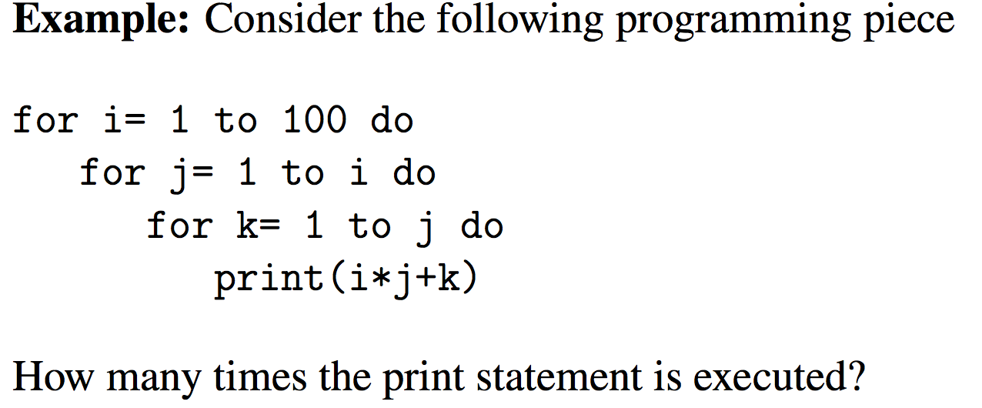

Slide 48
Given any three values n₁, n₂, n₃ ≤ 100, we can assign the largest value as i, the least value as k, and the remaining one as j.
There is a direct correspondence between the number of printing lines with the number of 3-combinations with repetitions from a set of 100 distinct objects.
This is equivalent to selecting three integers from the set {1,2, …, 100} with repetitions. (Here balls = 3; bins = 100)
The answer is C(3+100-1,100-1) = C(102,99).

Slide 49
Problem
Determine all possible ways to write number n as a sum of positive integers. For n = 4,
4, 3+1, 1+3, 2+2, 2+1+1, 1+2+1, 1+1+2, 1+1+1+1
note that we are treating 2+1+1 and 1+2+1 to be different.

Slide 50
Problem
Determine all possible ways to write number n as a sum of positive integers. For n = 4,
4, 3+1, 1+3, 2+2, 2+1+1, 1+2+1, 1+1+2, 1+1+1+1
note that we are treating 2+1+1 and 1+2+1 to be different.
How many to write number n using two summands?
for n=7, the possible ways are: 1+6, 2+5, 3+4, 5+2, 6+1
Let x represent the first term and y represent the second term.
Therefore, for two summands, the answer is the number of integral solutions to x + y = n, x ≥ 1 and y ≥ 1. (C((n-2) + 2 -1, 2-1))

Slide 51
Problem
Determine all possible ways to write number n as a sum of positive integers. For n = 4,
4, 3+1, 1+3, 2+2, 2+1+1, 1+2+1, 1+1+2, 1+1+1+1
note that we are treating 2+1+1 and 1+2+1 to be different.
How many to write number n using two summands?
for n=7, the possible ways are: 1+6, 2+5, 3+4, 5+2, 6+1
Let x represent the first term and y represent the second term.
Therefore, for two summands the answer is the number of integral solutions to x + y = n, x ≥ 1 and y ≥ 1. (C((n-2) + 2 -1, 2-1))
(3 summands) The answer is the number of integral solutions to x + y + z = n, x ≥ 1, y ≥ 1 and z ≥ 1 . (C((n-3) + 3 -1, 3-1)).

Slide 52
Balls in Boxes
Many problems can be formulated as a balls in boxes problem.
Suppose we have r balls which are to be placed in n boxes.
Balls are distinguishable (distinct) or not?
Boxes are distinguishable (distinct) or not?
Boxes have limited capacity or infinite capacity?
Boxes are required to be non-empty?

Slide 53
Balls in Boxes
We will only consider the cases where Boxes are distinguishable. The question when boxes are indistinguishable is hard.
Case I: r distinguishable balls are to be placed in n distinguishable boxes with infinite capacity.
We can divide the job into r tasks.
T_{i}: place the i-th ball. (i=1 to r)
T_{i} can be done in n ways (one can select any of the boxes).
Using the multiplication rule, number of ways to do the job is
n^{r}.

Slide 54
Balls in Boxes
Case II: r indistinguishable balls are to be placed in n distinguishable boxes with infinite capacity.
1st
2nd
3rd
….
n th
XX
X
XXX
Choosing r-combination from a set of size n with repetition allowed.
This can be done in C(r+n-1,n-1) ways by the theorem done earlier.

Slide 55
Balls in Boxes
Case III: r distinguishable balls are to be placed in n distinguishable boxes with capacity =1.
n < r → 0 ways
n ≥ r → P(n,r) ways

Slide 56
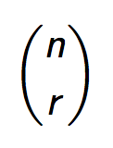
Balls in Boxes
Case IV: r indistinguishable balls are to be placed in n distinguishable boxes with capacity =1.
n < r → 0 ways
n ≥ r → ways

Slide 57
Balls in Boxes: non-empty boxes.
Case V: r indistinguishable balls are to be placed in n distinguishable boxes, with unlimited capacity such that each box is non-empty.
r < n: 0 ways.
r ≥ n
Give one ball to each box.
Now distribute the remaining r-n balls in n boxes, without the non-empty constraint.

Slide 58
Balls in Boxes: non-empty boxes.
Case VI: r indistinguishable balls are to be placed in n distinguishable boxes, with capacity = 1, such that each box is non-empty.
If r = n: 1 way.
If r ≠ n : 0 way.

Slide 59
It is important to recognize the equivalence of the following
The number of integer solutions of the equation
x₁ + x₂ + … + x_{n} = r where x_{i} ≥ 0 for all 1 ≤ i ≤ n.
The number of choices, with repetitions, of size r from a collection of n objects.
The number of choices of distributing r indistinguishable balls to n bins with no restriction (i.e. a bin can get no ball).
The number of ways of placing r indistinguishable balls in n distinct bins.
Total number of integral solutions = C(r+n-1, n-1)

Slide 60
Example
A doughnut shop has plain doughnuts, cherry doughnuts, chocolate doughnuts, almond doughnuts, apple doughnuts, broccoli doughnuts. How many ways are there to choose:
(e) two dozen doughnuts with at least one plain, at least two cherry, at least three chocolate, at least one almond, at least two apple, no more than three broccoli doughnuts?
x₁ = # of plain; x₂ = # of cherry; x₃ = # of chocolate; x₄ = # of almond; x₅ = # apple; x₆ = # of broccoli
Problem: Number of integral solutions to
x₁+ x₂ + x₃ + x₄ + x₅ + x₆ = 24; x₁ ≥ 1, x₂≥ 2, x₃ ≥ 3, x₄ ≥ 1, x₅ ≥ 2, x₆ ≤ 3.

Slide 61
Example
Problem: Number of integral solutions to
x₁+ x₂ + x₃ + x₄ + x₅ + x₆ = 24; x₁ ≥ 1, x₂≥ 2, x₃ ≥ 3, x₄ ≥ 1, x₅ ≥ 2, x₆ ≤ 3.
We solve the problem when x₆ = 0, when x₆ = 1, when x₆ = 2, and when x₆ = 3.

Slide 62
Example
Problem: Number of integral solutions to
x₁+ x₂ + x₃ + x₄ + x₅ + x₆ = 24; x₁ ≥ 1, x₂≥ 2, x₃ ≥ 3, x₄ ≥ 1, x₅ ≥ 2, x₆ ≤ 3.
We solve the problem when x₆ = 0, when x₆ = 1, when x₆ = 2, and when x₆ = 3.
When x₆ = 2 :
x₁+ x₂ + x₃ + x₄ + x₅ = 22; x₁ ≥ 1, x₂≥ 2, x₃ ≥ 3, x₄ ≥ 1, x₅ ≥ 2.
Not in standard form. All x_{i} must be at least zero.

Slide 63
Example
Problem: Number of integral solutions to
x₁+ x₂ + x₃ + x₄ + x₅ + x₆ = 24; x₁ ≥ 1, x₂≥ 2, x₃ ≥ 3, x₄ ≥ 1, x₅ ≥ 2, x₆ ≤ 3.
We solve the problem when x₆ = 0, when x₆ = 1, when x₆ = 2, and when x₆ = 3.
When x₆ = 2 :
x₁+ x₂ + x₃ + x₄ + x₅ = 22; x₁ ≥ 1, x₂≥ 2, x₃ ≥ 3, x₄ ≥ 1, x₅ ≥ 2.
set x₁ = y₁ +1; x₂ = y₂ +2; x₃ = y₃ +3; x₄ = y₄ +1; x₅ = y₅ +2
Problem becomes:
(y₁+1)+ (y₂ + 2) + (y₃ +3) + (y₄ +1) + (y₅+1) = 22; y₁, y₂, y₃, y₄, y₅ ≥ 0.
y₁+ y₂ + y₃ + y₄ + y₅ = 14; y₁, y₂, y₃, y₄, y₅ ≥ 0.

Slide 64
Example
Problem: Number of integral solutions to
x₁+ x₂ + x₃ + x₄ + x₅ + x₆ = 24; x₁ ≥ 1, x₂≥ 2, x₃ ≥ 3, x₄ ≥ 1, x₅ ≥ 2, x₆ ≤ 3.
We solve the problem when x₆ = 0, when x₆ = 1, when x₆ = 2, when x₆ = 3.
When x₆ = 2 :
x₁+ x₂ + x₃ + x₄ + x₅ = 22; x₁ ≥ 1, x₂≥ 2, x₃ ≥ 3, x₄ ≥ 1, x₅ ≥ 2.
set x₁ = y₁ +1; x₂ = y₂ +2; x₃ = y₃ +3; x₄ = y₄ +1; x₅ = y₅ +2
Problem becomes:
(y₁+1)+ (y₂ + 2) + (y₃ +3) + (y₄ +1) + (y₅+1) = 22; y₁, y₂, y₃, y₄, y₅ ≥ 0.
y₁+ y₂ + y₃ + y₄ + y₅ = 14; y₁, y₂, y₃, y₄, y₅ ≥ 0.
Ans: C(14+5-1,5-1)

Slide 65
Subtraction method
Problem: Number of integral solutions to
x₁+ x₂ + x₃ + x₄ + x₅ + x₆ = 24; x₁ ≥ 1, x₂≥ 2, x₃ ≥ 3, x₄ ≥ 1, x₅ ≥ 2, x₆ ≤ 3.
Solution
Compute the number of integral solutions (A) to
x₁+ x₂ + x₃ + x₄ + x₅ + x₆ = 24; x₁ ≥ 1, x₂≥ 2, x₃≥ 3, x₄≥ 1, x₅ ≥ 2, x₆ ≥ 0
Compute the number of integral solutions (B) to
x₁+ x₂ + x₃ + x₄ + x₅ + x₆ = 24; x₁ ≥ 1, x₂≥ 2, x₃≥ 3, x₄≥ 1, x₅ ≥ 2, x₆ ≥ 4
The answer to the original problem: A – B.

Slide 66
Another variation
Number of integral solutions to
y₁+ y₂ + y₃ + y₄ + y₅ ≤ 14; y₁, y₂, y₃, y₄, y₅ ≥ 0.
Answer is the sum of the integral solutions to
y₁+ y₂ + y₃ + y₄ + y₅ = 14; y₁, y₂, y₃, y₄, y₅ ≥ 0, and
y₁+ y₂ + y₃ + y₄ + y₅ = 13; y₁, y₂, y₃, y₄, y₅ ≥ 0, and
y₁+ y₂ + y₃ + y₄ + y₅ = 12; y₁, y₂, y₃, y₄, y₅ ≥ 0, and
…
…
y₁+ y₂ + y₃ + y₄ + y₅ = 0 ; y₁, y₂, y₃, y₄, y₅ ≥ 0.

Slide 67
Another variation
Number of integral solutions to
y₁+ y₂ + y₃ + y₄ + y₅ ≤ 14; y₁, y₂, y₃, y₄, y₅ ≥ 0.
Answer is the sum of the integral solutions to
y₁+ y₂ + y₃ + y₄ + y₅ = 14; y₁, y₂, y₃, y₄, y₅ ≥ 0, and
y₁+ y₂ + y₃ + y₄ + y₅ = 13; y₁, y₂, y₃, y₄, y₅ ≥ 0, and
y₁+ y₂ + y₃ + y₄ + y₅ = 12; y₁, y₂, y₃, y₄, y₅ ≥ 0, and
…
…
y₁+ y₂ + y₃ + y₄ + y₅ = 0 ; y₁, y₂, y₃, y₄, y₅ ≥ 0.
Same as the number of integral solutions to
y₁+ y₂ + y₃ + y₄ + y₅ + s = 14; y₁, y₂, y₃, y₄, y₅, s ≥ 0

Slide 71
This one is surprisingly difficult. Realizes Stirling numbers of the second kind.

