Slide 1
Chapter 8.4 – 8.9

Slide 2
Section 8.4 (Permutations)
Given a collection of n distinct (distinguishable) objects, any arrangements of these objects in a linear order is called a permutations.

Slide 3
Permutations
Let a, b, c be three distinct objects.
  abc is a permutation
  abc, acb, bac, bca, cab,cba are the six permutations of thee object.
  The permutations are like list arrangements. (a,b,c), (a,c,a), (b,a,c), (b,c,a), (c,a,b), (c,b,a)

Slide 4
Permutations
Two key words we should be looking in the case of permutations or arrangements.
  distinct (distinguishable) objects
  order is important

Slide 5
Permutations
Definition: A permutation of a set of distinct objects is an ordered arrangement of these objects. An ordered arrangement of r elements of a set is called an r-permutation.

Slide 6
Permutations
Example: Let S = {1,2,3}.
  The ordered arrangement (3,1,2) is a permutation of S.
  The ordered arrangement (3,2) is a 2-permutation of S.
The number of r-permuations of a set with n elements is denoted by P(n,r).
  The 2-permutations of S = {1,2,3} are (1,2); (1,3); (2,1); (2,3); (3,1); and (3,2). Hence, P(3,2) = 6.

Slide 7
Formula for the Number of Permutations
Theorem 1: If n is a positive integer and r is an integer with 1 ≤ r ≤ n, then there are
P(n, r) = n(n − 1)(n − 2) ∙∙∙ (n − r + 1)
r-permutations of a set with n distinct elements.

Slide 8
Formula for the Number of Permutations
Theorem 1: If n is a positive integer and r is an integer with 1 ≤ r ≤ n, then there are
P(n, r) = n(n − 1)(n − 2) ∙∙∙ (n − r + 1)
r-permutations of a set with n distinct elements.
Proof: Use the product rule. The first element can be chosen in n ways. The second in n − 1 ways, and so on until there are (n − ( r − 1)) ways to choose the last element.
Note that P(n,0) = 1, since there is only one way to order zero elements.

Slide 9
Factorial
For any positive integer n, n! means:
  n(n-1)(n-2) ……. 3.2.1
0! is defined as equal to one.
Examples: 4! = 4.3.2.1 = 24.
Examples: 3.5! = 3.(5!)
Note that P(n,n) = n!

Slide 10
Example
Compute how many 7-digit numbers can be made from the digits 1,2,3,4,5,6,7 if there is no repetition and the odd digits must appear in an unbroken sequence. (3571264, 2413576 are valid, but not 7234615)
Ans:

Slide 11
Solution
Compute how many 7-digit numbers can be made from the digits 1,2,3,4,5,6,7 if there is no repetition and the odd digits must appear in an unbroken sequence. (3571264, 2413576 are ok, but not 7234615)
Ans:
  There are 4 odd digits. There are 4! length-4 lists of odd integers without repetition.
  The 7-digit valid number can be visualized as a list of length 4 using symbols 2, 4, 6, and a length-4 list of odd integers. There are 4! different such lists.
  The total number of valid 7-digit sequence is (4!)².

Slide 12
Solving Counting Problems by Counting Permutations
Example: How many ways are there to select a first-prize winner, a second prize winner, and a third-prize winner from 100 different people who have entered a contest?
Solution:
P(100,3) = 100 ∙ 99 ∙ 98 = 970,200

Slide 13
Solving Counting Problems by Counting Permutations
Example: Suppose that a saleswoman has to visit eight different cities. She must begin her trip in a specified city, but she can visit the other seven cities in any order she wishes. How many possible orders can the saleswoman use when visiting these cities?
Solution: The first city is chosen, and the rest are ordered arbitrarily. Hence the orders are:
7! = 7 ∙ 6 ∙ 5 ∙ 4 ∙ 3 ∙ 2 ∙ 1 = 5040
If she wants to find the tour with the shortest path that visits all the cities, she must consider 5040 paths!

Slide 14
Solving Counting Problems by Counting Permutations
Example: How many permutations of the letters ABCDEFGH contain the string ABC ?
Solution: count the permutations of six objects,
ABC, D, E, F, G, and H.
6! = 6 ∙ 5 ∙ 4 ∙ 3 ∙ 2 ∙ 1 = 720

Slide 15
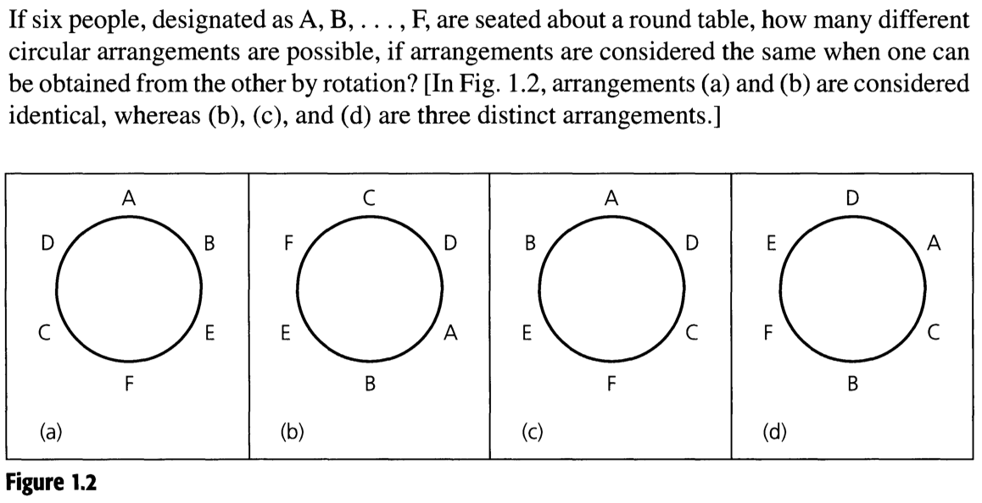
Example 1.16
ABEFCD; BEFCDA; EFCDAB; FCDABE; CDABEF, DABEFC are circularly identical (linearly not so).
Fix the starting object (say A). The remaining five objects are linearly ordered.
Ans:

Slide 16
Example 1.16
ABEFCD; BEFCDA; EFCDAB; FCDABE; CDABEF, DABEFC are circularly identical (linearly not so).
Fix the starting object (say A). The remaining five objects are linearly ordered.
Ans: 5! i.e. 5.4.3.2.1

Slide 17
P(n,r)
P(n,r) is the number of r-permutations (arrangements of r objects) of a given set of n distinct objects.
P(n,r) = n(n-1)(n-2)……….(n-(r-1))
= n(n-1)(n-2)……….(n-r+1)

Slide 18
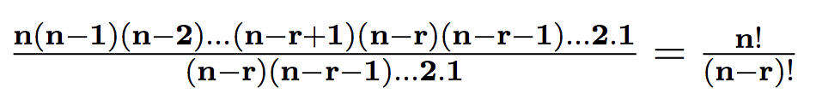
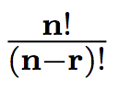
Permutation P(n,r)
We can rewrite P(n,r) =n.(n-1).(n-2). …. (n-r+1) as
P(n,r) =
Thus P(n,r) =

Slide 19
Combinations
How many committees of three students can be formed from a group of four students?
Solution: To answer this question, we need only to find the number of subsets with three elements from the set containing four elements. As is easily seen, there are four such subsets. Note that order in which these students are chosen does not matter.

Slide 20
Counting Subsets
In counting the number of length-k lists from a set of n possible objects, the order of the objects were very important.
What happens when the order is not important?
Now we select size-k subsets from a set of n possible objects.
How many such size-k subsets are there?

Slide 21
Counting Subsets
Suppose A = {a,b,c,d,e}
Size-2 subsets of A are: {a,b}, {a,c}, {a,d}, {a,e}, {b,c}, {b,d}, {b,e}, {c,d}, {c,e}, {d,e}.
Observe length-2 lists: (a,b), (b,a), (a,c), (c,a), (a,d), (d,a),(a,e), (e,a), (b,c), (c,b), (b,d), (d,b), (b,e), (e,b), (c,d), (d,c), (c,e), (e,c), (d,e), (e,d)

Slide 22
Counting Subsets
Suppose A = {a,b,c,d,e}
Size-2 subsets of A are: {a,b}, {a,c}, {a,d}, {a,e}, {b,c}, {b,d}, {b,e}, {c,d}, {c,e}, {d,e}.
Observe length-2 lists: (a,b), (b,a), (a,c), (c,a), (a,d), (d,a),(a,e), (e,a), (b,c), (c,b), (b,d), (d,b), (b,e), (e,b), (c,d), (d,c), (c,e), (e,c), (d,e), (e,d)
There is definitely some connection between the number of size-k subsets and the number of length-k lists.

Slide 23
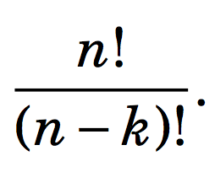
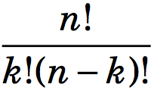
Counting Subsets
Consider a size-k subset {a₁,a₂, …, a_{k}}.
This size-k subsets generate k! length-k lists using the k symbols a₁,a₂, …, a_{k}.
These k! lists are present in length-k lists using n symbols.
Thus every size-k subset realizes k! length-k lists.
Therefore,
  number of size-k subsets x k! = number of length-k lists
  number of size-k subsets = C(n,k) =

Slide 24

Counting Subsets
In the text, C(n,k) is written as .
is read as ``n choose k’’
C(n,k) denotes the number of subsets that can be made by choosing k elements from a set of n elements.

Slide 25
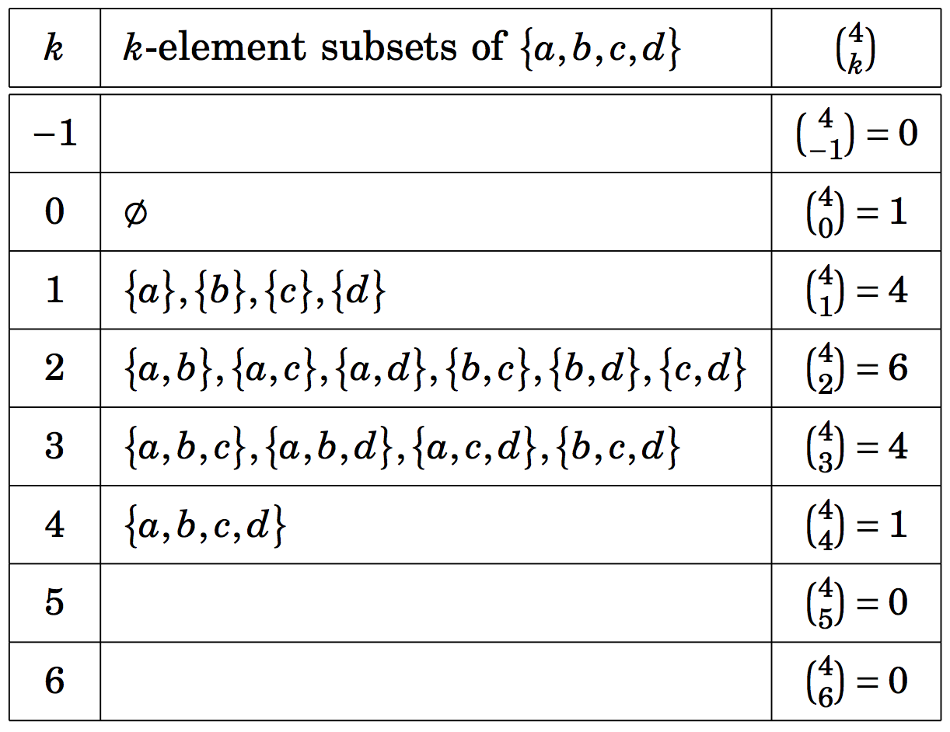
Counting Subsets

Slide 26
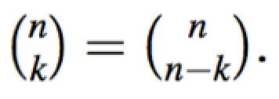
Example
Show that for any integer k, k <= n,

Slide 27
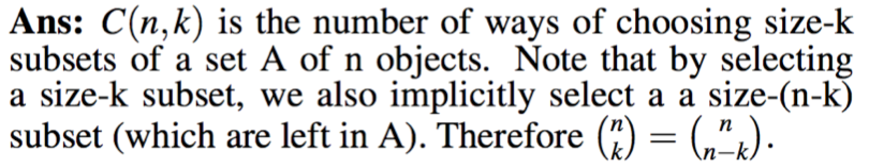
Example
Show that for any integer k, k <= n,

Slide 28
Example
How many 5-card hands are there in which two of the cards are clubs and three are hearts?
Ans: Note that order is not important.
How many ways can we select two club cards?
How many ways can we select three hearts?

Slide 29


Example
How many 5-card hands are there in which two of the cards are clubs and three are hearts?
Ans: Note that order is not important.
How many ways can we select two club cards?
The answer is: C(13,2) = =
How many ways can we select three hearts?

Slide 30
Example
How many 5-card hands are there in which two of the cards are clubs and three are hearts?
Ans: Note that order is not important.
How many ways can we select two club cards?
The answer is: C(13,2) = =
How many ways can we select three hearts?
The answer is: C(13,3)

Slide 31

Example
How many 5-card hands are there in which two of the cards are clubs and three are hearts?
Ans: Note that order is not important.
How many ways can we select two club cards?
The answer is: C(13,2) = =
How many ways can we select three hearts?
The answer is: C(13,3)
Total number = C(13,2). C(13,3) =

Slide 32
Example
In how many ways a gambler draw five cards from a standard deck and get
  (a) a flush (five card of the same suit)?
  (b) four aces?
  (c) four of a kind?
  (d) three aces and two jacks?
  (e) three aces and a pair?
  (f) a full house (three of a kind and a pair)?
  (g) thee of a kind?
  (h) two pairs?

Slide 33
Example
In how many ways a gambler draw five cards from a standard deck and get
  (a) a flush (five card of the same suit)? C(4,1).C(13,5)
  (b) four aces?
  (c) four of a kind?
  (d) three aces and two jacks?
  (e) three aces and a pair?
  (f) a full house (three of a kind and a pair)?
  (g) three of a kind?
  (h) two pairs?

Slide 34
Example
In how many ways a gambler draw five cards from a standard deck and get
  (a) a flush (five card of the same suit)? C(4,1).C(13,5)
  (b) four aces? C(4,4).C(48,1)
  (c) four of a kind?
  (d) three aces and two jacks?
  (e) three aces and a pair?
  (f) a full house (three of a kind and a pair)?
  (g) three of a kind?
  (h) two pairs?

Slide 35
Example
In how many ways a gambler draw five cards from a standard deck and get
  (a) a flush (five card of the same suit)? C(4,1).C(13,5)
  (b) four aces? C(4,4).C(48,1)
  (c) four of a kind? C(13,1).C(48,1)
  (d) three aces and two jacks?
  (e) three aces and a pair?
  (f) a full house (three of a kind and a pair)?
  (g) three of a kind?
  (h) two pairs?

Slide 36
Example
In how many ways a gambler draw five cards from a standard deck and get
  (a) a flush (five card of the same suit)? C(4,1).C(13,5)
  (b) four aces? C(4,4).C(48,1)
  (c) four of a kind? C(13,1).C(48,1)
  (d) three aces and two jacks? C(4,3).C(4,2)
  (e) three aces and a pair?
  (f) a full house (three of a kind and a pair)?
  (g) three of a kind?
  (h) two pairs?

Slide 37
Example
In how many ways a gambler draw five cards from a standard deck and get
  (a) a flush (five card of the same suit)? C(4,1).C(13,5)
  (b) four aces? C(4,4).C(48,1)
  (c) four of a kind? C(13,1).C(48,1)
  (d) three aces and two jacks? C(4,3).C(4,2)
  (e) three aces and a pair? C(4,3).C(12,1).C(4,2)
  (f) a full house (three of a kind and a pair)?
  (g) three of a kind?
  (h) two pairs?

Slide 38
Example
In how many ways a gambler draw five cards from a standard deck and get
  (a) a flush (five card of the same suit)? C(4,1).C(13,5)
  (b) four aces? C(4,4).C(48,1)
  (c) four of a kind? C(13,1).C(48,1)
  (d) three aces and two jacks? C(4,3).C(4,2)
  (e) three aces and a pair? C(4,3).C(12,1).C(4,2)
  (f) a full house (three of a kind and a pair)? C(13,1).C(4,3).C(12,1).C(4,2)
  (g) three of a kind?
  (h) two pairs?

Slide 39
Example
In how many ways a gambler draw five cards from a standard deck and get
  (a) a flush (five card of the same suit)? C(4,1).C(13,5)
  (b) four aces? C(4,4).C(48,1)
  (c) four of a kind? C(13,1).C(48,1)
  (d) three aces and two jacks? C(4,3).C(4,2)
  (e) three aces and a pair? C(4,3).C(12,1).C(4,2)
  (f) a full house (three of a kind and a pair)? C(13,1).C(4,3).C(12,1).C(4,2)
  (g) three of a kind? C(13,1).C(4,3).C(12,2).C(4,1).C(4,1)
  (h) two pairs?

Slide 40
Example
In how many ways a gambler draw five cards from a standard deck and get
  (a) a flush (five card of the same suit)? C(4,1).C(13,5)
  (b) four aces? C(4,4).C(48,1)
  (c) four of a kind? C(13,1).C(48,1)
  (d) three aces and two jacks? C(4,3).C(4,2)
  (e) three aces and a pair? C(4,3).C(12,1).C(4,2)
  (f) a full house (three of a kind and a pair)? C(13,1).C(4,3).C(12,1).C(4,2)
  (g) three of a kind? C(13,1).C(4,3).C(12,2).C(4,1).C(4,1)
  (h) two pairs? C(13,2).C(4,2).C(4,2).C(44,1)

Slide 41
Example
The problem concerns lists made from the symbols A,B,C,D,E,F,G,H,I.
  How many length-5 lists can be made if repetition is not allowed and the list is in alphabetical order? (Example: BDEFI or ABCGH, but not BACGH)
  How many length-5 lists can be made if repetition is not allowed and the list is not alphabetical order.

Slide 42
Example
The problem concerns lists made from the symbols A,B,C,D,E,F,G,H,I.
  How many length-5 lists can be made if repetition is not allowed and the list is in alphabetical order? (Example: BDEFI or ABCGH, but not BACGH)
    Observe that size-5 subset realizes one length-5 list in alphabetical order, and one length-5 list realizes one size-5 subset. Therefore, the number od length-5 alphabetically ordered list is the same as the number of size-5 subsets. Hence the number is C(9,5).
  How many length-5 lists can be made if repetition is not allowed and the list is not alphabetical order.

Slide 43
Example
The problem concerns lists made from the symbols A,B,C,D,E,F,G,H,I.
  How many length-5 lists can be made if repetition is not allowed and the list is in alphabetical order? (Example: BDEFI or ABCGH, but not BACGH)
    Observe that size-5 subset realizes one length-5 list in alphabetical order, and one length-5 list realizes one size-5 subset. Therefore, the number od length-5 alphabetically ordered list is the same as the number of size-5 subsets. Hence the number is C(9,5).
  How many length-5 lists can be made if repetition is not allowed and the list is not alphabetical order.
    Ans: 9x8x7x6x5 – C(9,5).

Slide 44
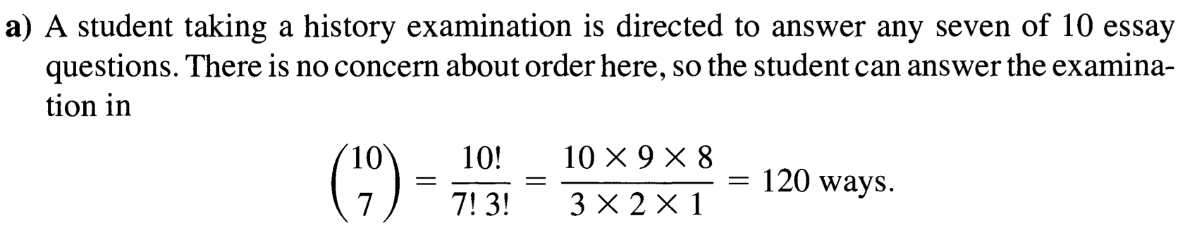
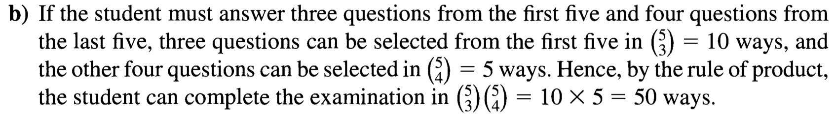
Example

Slide 45
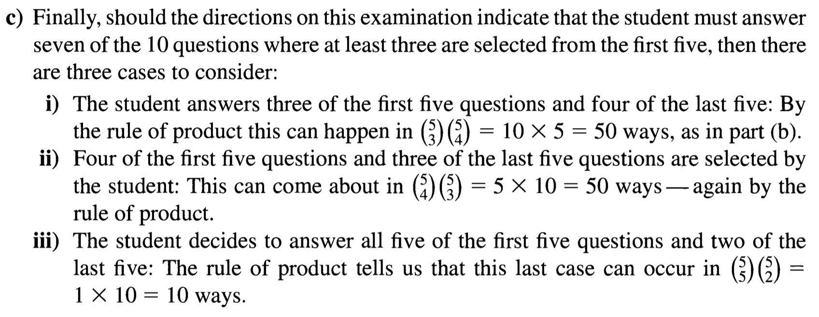
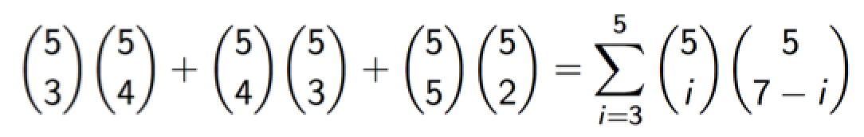
Example

Slide 46
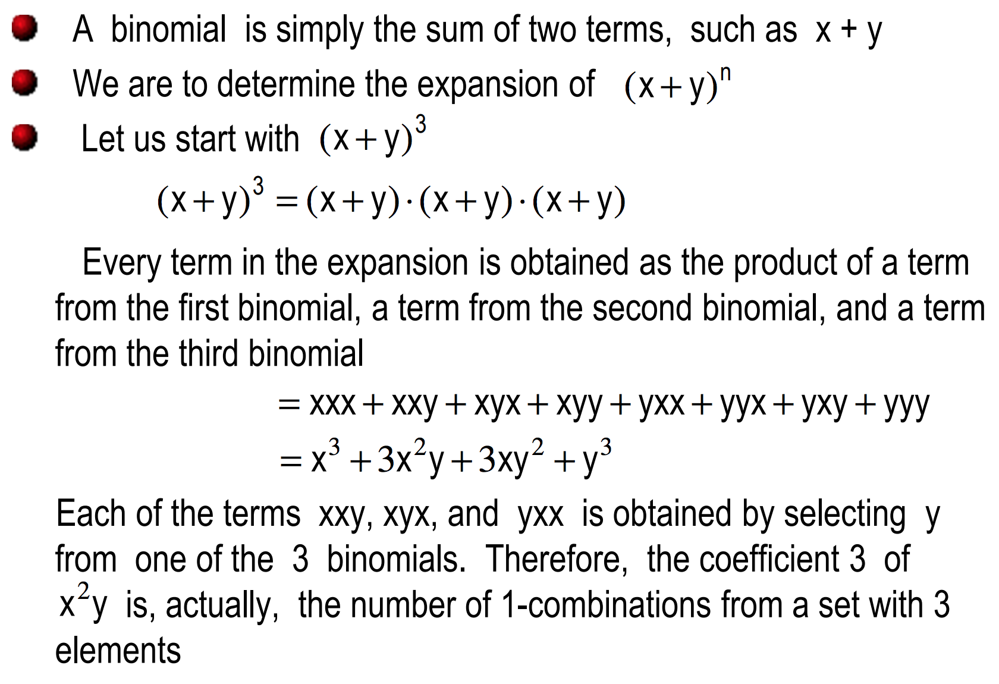
A binomial

Slide 47
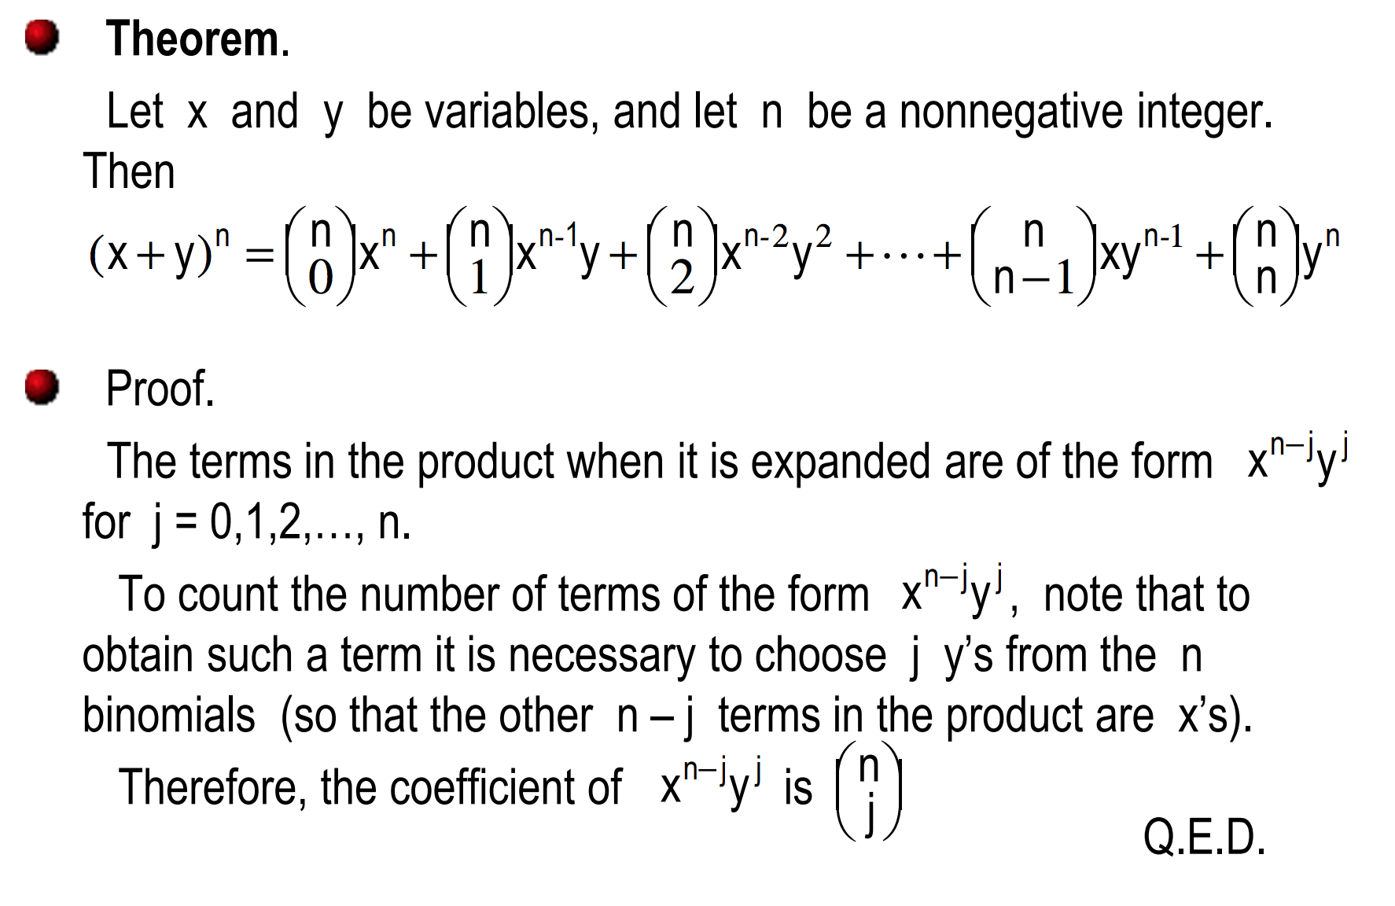
The binomial Theorem

Slide 48
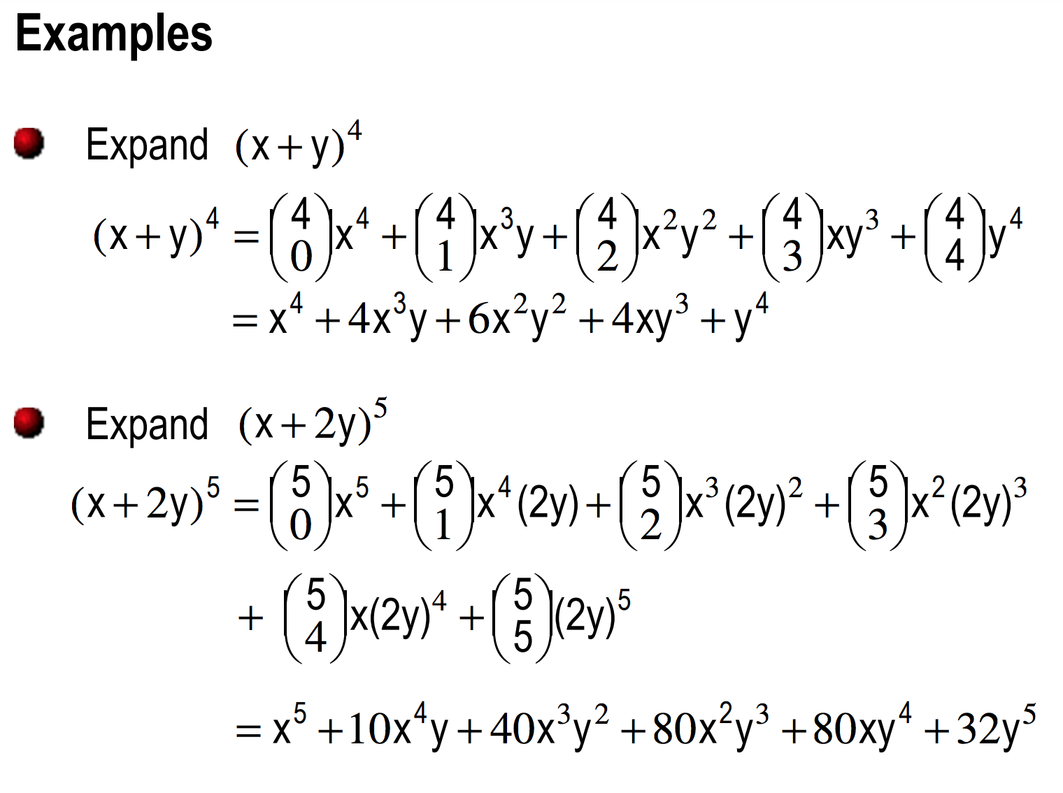

Slide 49
Binomial Theorem
(Example)
Use the binomial theorem to find the coefficient of x⁶y³ in (3x-2y)⁹.
  We can write (3x – 2y)⁹ as (a + b)⁹ where a = 3x and b = -2y. Now the coefficient of a⁶b³ is C(9,6).
  Now C(9,6).a⁶b³ = C(9,6) (3x)⁶ (-2y)³ = - C(9,6)3⁶ 2³ x⁶y³.

Slide 50
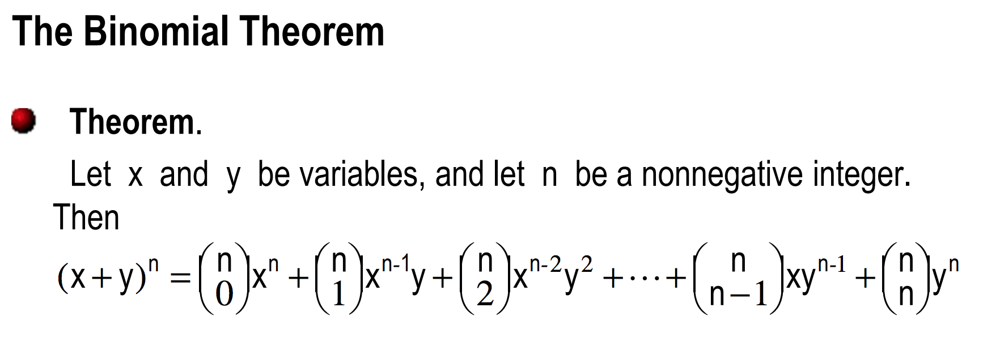
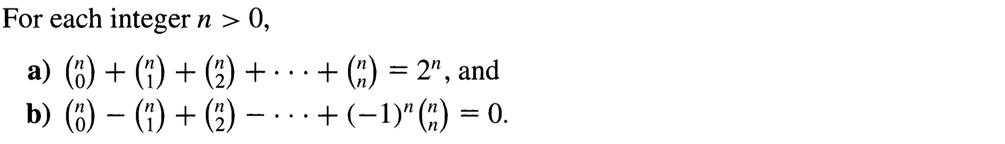
For (a), set x = y = 1.
For (b), set x = 1, and y = -1.

Slide 51
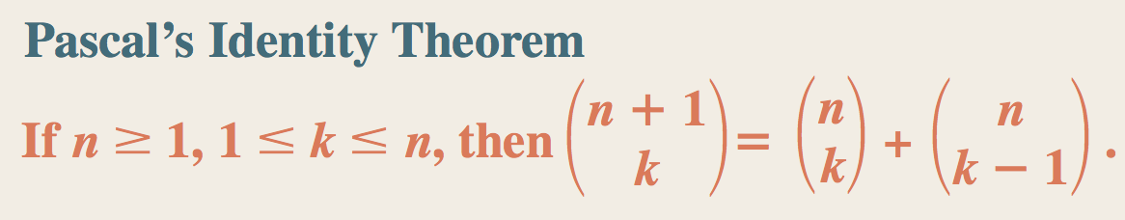
Note that k is at least 1 and k cannot be greater than n.

Slide 52
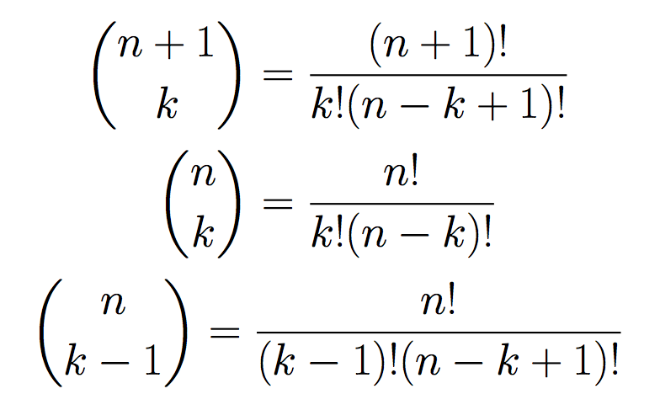
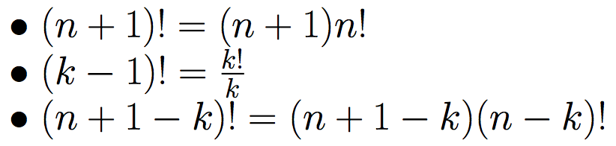
Proof 1 By definition
Important identity

Slide 53
Proof 2: Combinatorial
For any integers 1 ≤ k ≤ n,
C(n+1,k) = C(n,k-1) + C(n,k)
It says that number of size-k subset of a set with n+1 elements is equal to the sum of the number of size-(k-1) subset of a set of n elements and the number of size-k subset of a set of n elements.
Consider a set with n+1 elements.
A={0,1,2, …,n).
All subsets of A of size k
= All subsets of size k with element 0 in it
+ All subsets of size k with no element 0.
C(n+1,k) = C(n,k-1) + C(n,k).

Slide 54
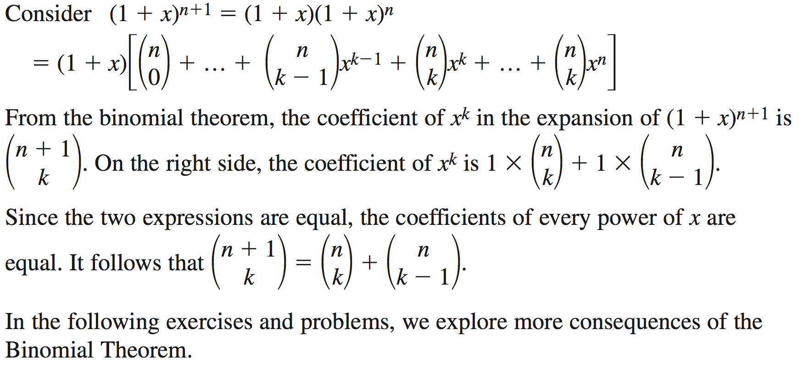
Proof 3: Combinatorial

Slide 55
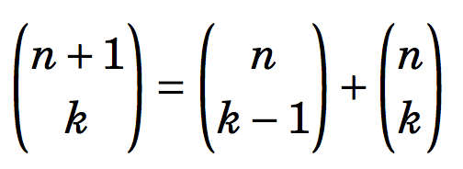
Pascal’s Triangle
We will focus on the pattern based on one equation (identity)
for any integers 1 ≤ n ≤ k.
For any integers 1 ≤ n ≤ k,
C(n+1,k) = C(n,k-1) + C(n,k)

Slide 56
Pascal’s Triangle
For any integers 1 ≤ k ≤ n,
C(n+1,k) = C(n,k-1) + C(n,k)
It says that number of size-k subset of a set with n+1 elements is equal to the sum of the number of size-(k-1) subset of a set of n elements and the number of size-k subset of a set of n elements.
Consider a set with n+1 elements.
A={0,1,2, …,n).
All subsets of A of size k
= All subsets of size k with element 0 in it
+ All subsets of size k with no element 0.
C(n+1,k) = C(n,k-1) + C(n,k).

Slide 57
Pascal’s Triangle and the Binomial Theorem
For any integers 1 ≤ k ≤ n,
C(n+1,k) = C(n,k-1) + C(n,k)
It says that number of size-k subset of a set with n+1 elements is equal to the sum of the number of size-(k-1) subset of a set of n elements and the number of size-k subset of a set of n elements.
Consider a set with n+1 elements.
A={0,1,2, …,n).
All subsets of A of size k
= All subsets of size k with element 0 in it
+ All subsets of size k with no element 0.
C(n+1,k) = C(n,k-1) + C(n,k).
Note that k is at least 1 and k cannot be greater than n.

Slide 58
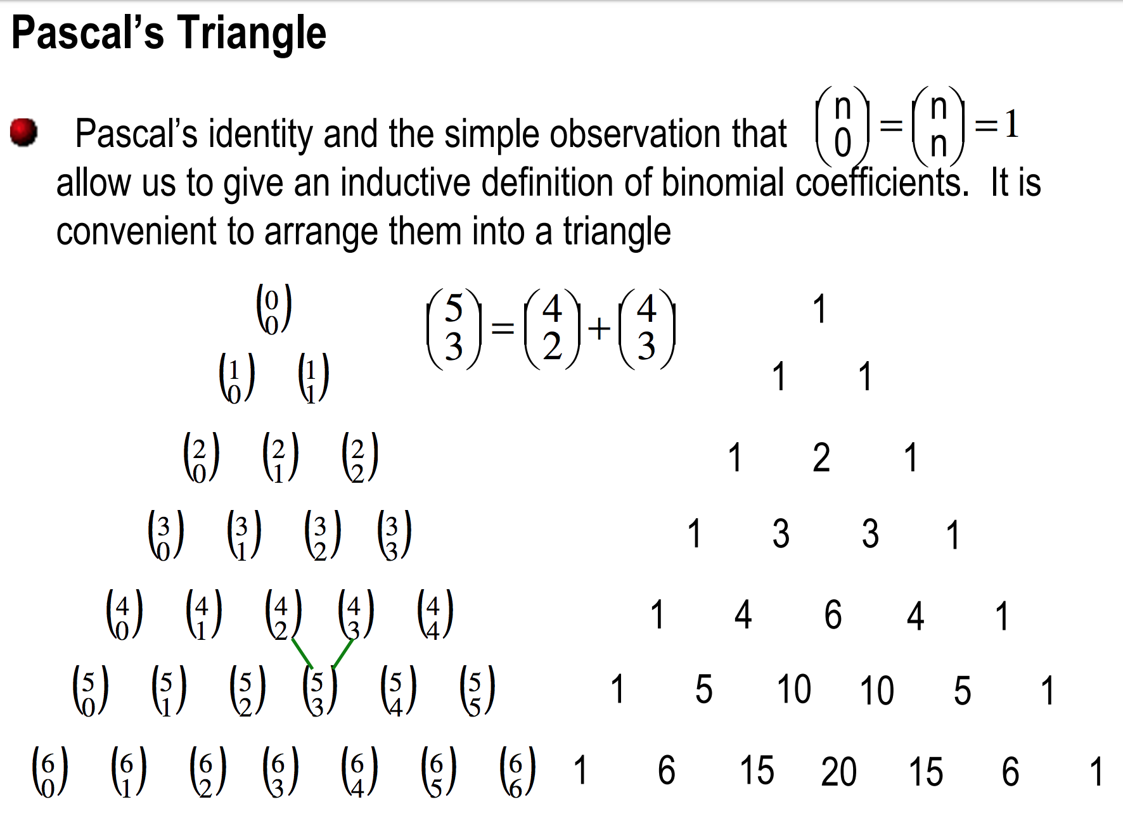

Slide 59
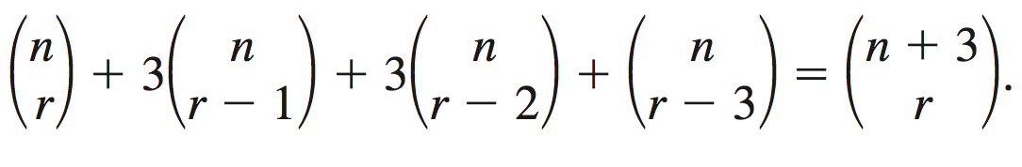
Consequences of the Binomial Theorem
Write the binomial expansion of (x +2y)⁵ and (x – 2y)⁵.
How many terms are there in the expansion of (a +b)^{n}?
Determine the sum of the coefficients in the expansion of (1-4x)⁵.
In the expansion of (1-x)^{n}, the coefficient of x² is 15. Determine the value of n.
What is the middle term in the expansion of (x – 2x²)8?
Show that

Slide 60
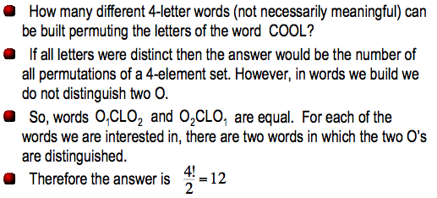
Permutations with Repetitions

Slide 61
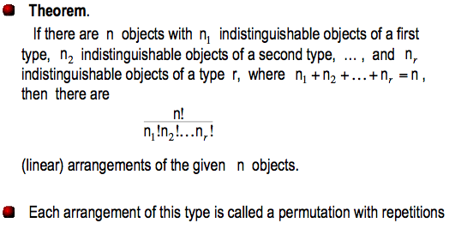
Permutations with Repetitions

Slide 62
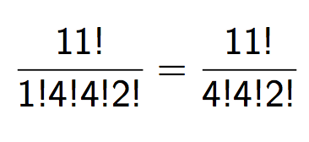
Permutations with Repetitions
How many ways can we permute the letters of MISSISSIPPI?
There are 11 characters.
  M one time
  I four times
  S four times
  P two time
Number of different arrangements:

Slide 63
Question 34 (page 14)
How many distinct 4-digit integers can one make for the digits 1, 3, 3, 7, 7, 8?
First attempt:
  Make the digits distinct: 1, 3₁, 3₂, 7₁, 7₂, 8
  Number of 4-permutations is P(6,4) since the digits are all distinct.
  Factor in the duplicates: P(6,4)/(2! x 2!) = 90.
The correct answer is 102.

Slide 64
Correct Answer
We break the solution into many cases:
  (no 7’s: 1, 3, 3, 8)
  (one 7 and 3: 1, 3, 7, 8)
  (one 7 and two 3’s: 1, 3, 3, 7)
  (one 7 and two 3’s: 3, 3, 7, 8)
  (two 7’s and no 3’s: 1, 7, 7, 8)
  (two 7’s and one 3: 1, 3, 7, 7)
  (two 7’s and one 3: 3, 7, 7, 8)
  (two 7’s and two 3’s: 3, 3, 7, 7)

Slide 65
Correct Answer
We break the solution into many cases:
  (no 7’s: 1, 3, 3, 8) 4!/2
  (one 7 and 3: 1, 3, 7, 8) 4!
  (one 7 and two 3’s: 1, 3, 3, 7) 4!/2!
  (one 7 and two 3’s: 3, 3, 7, 8) 4!/2!
  (two 7’s and no 3’s: 1, 7, 7, 8) 4!/2!
  (two 7’s and one 3: 1, 3, 7, 7) 4!/2!
  (two 7’s and one 3: 3, 7, 7, 8) 4!/2!
  (two 7’s and two 3’s: 3, 3, 7, 7) 4!/(2!2!)
Total number = 102

Slide 66
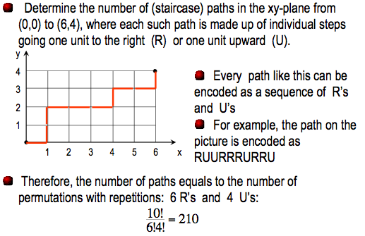
Example

