Slide 1
Rules of Inference
Section 1.11 – 1.13
Some slides are taken from
http://www.cs.sfu.ca/CourseCentral/101.MACM/abulatov/

Slide 2
Rules are used to distinguish between valid and invalid arguments.
An argument is a sequence of propositions, called hypotheses, followed by a final proposition, called the conclusion.

Slide 3
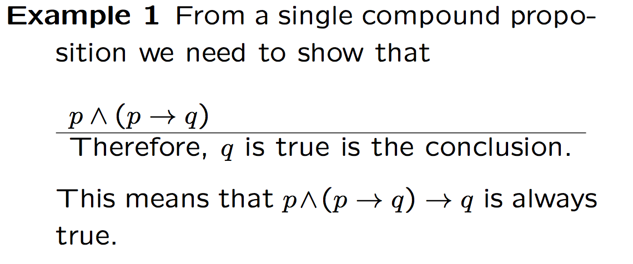
hypotheses

Slide 5
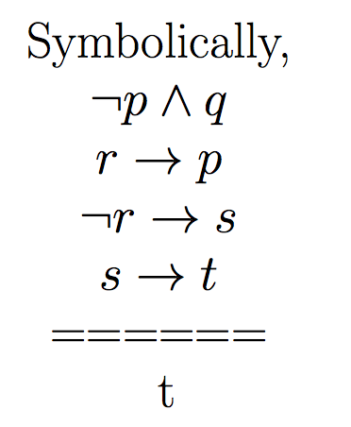
hypotheses
conclusion.

Slide 6
Logic Inference

Slide 7
Using a truth table to establish the validity of an argument

Slide 8
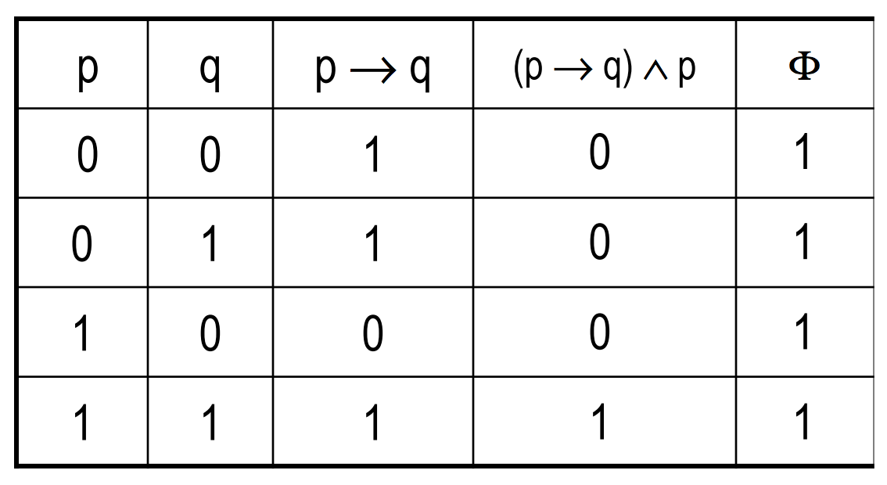

Slide 9
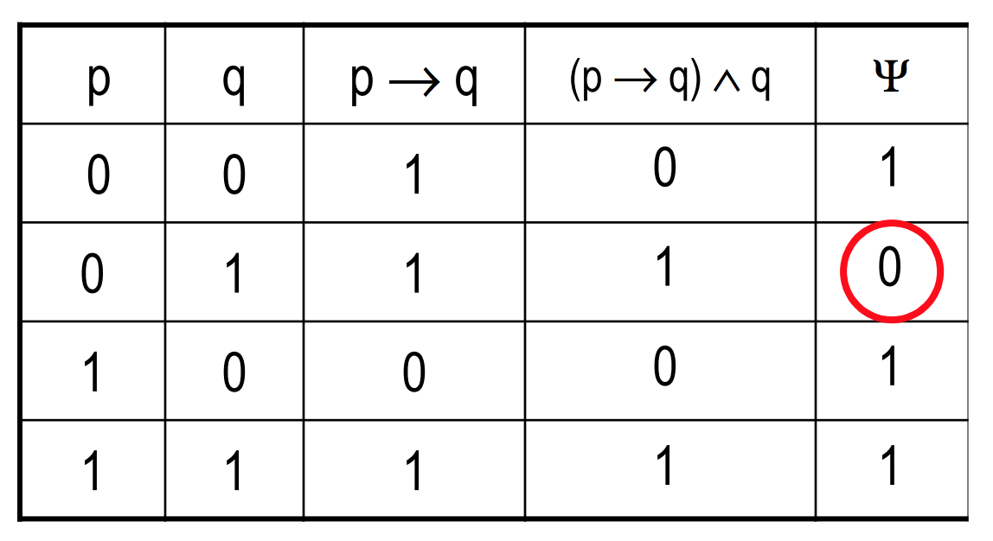

Slide 10
Example

Slide 11
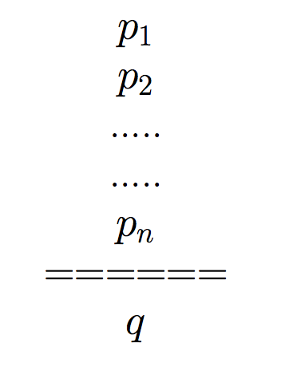
General definition of inference
Premises/ hypotheses
Conclusion

Slide 14
p: the number is divisible by 8
q: the number is divisible by 4

Slide 17
p: the number is divisible by 8
q: the number is divisible by 4
r: the number is divisible by 2

Slide 18
p: the number is divisible by 8
q: the number is divisible by 4

Slide 21
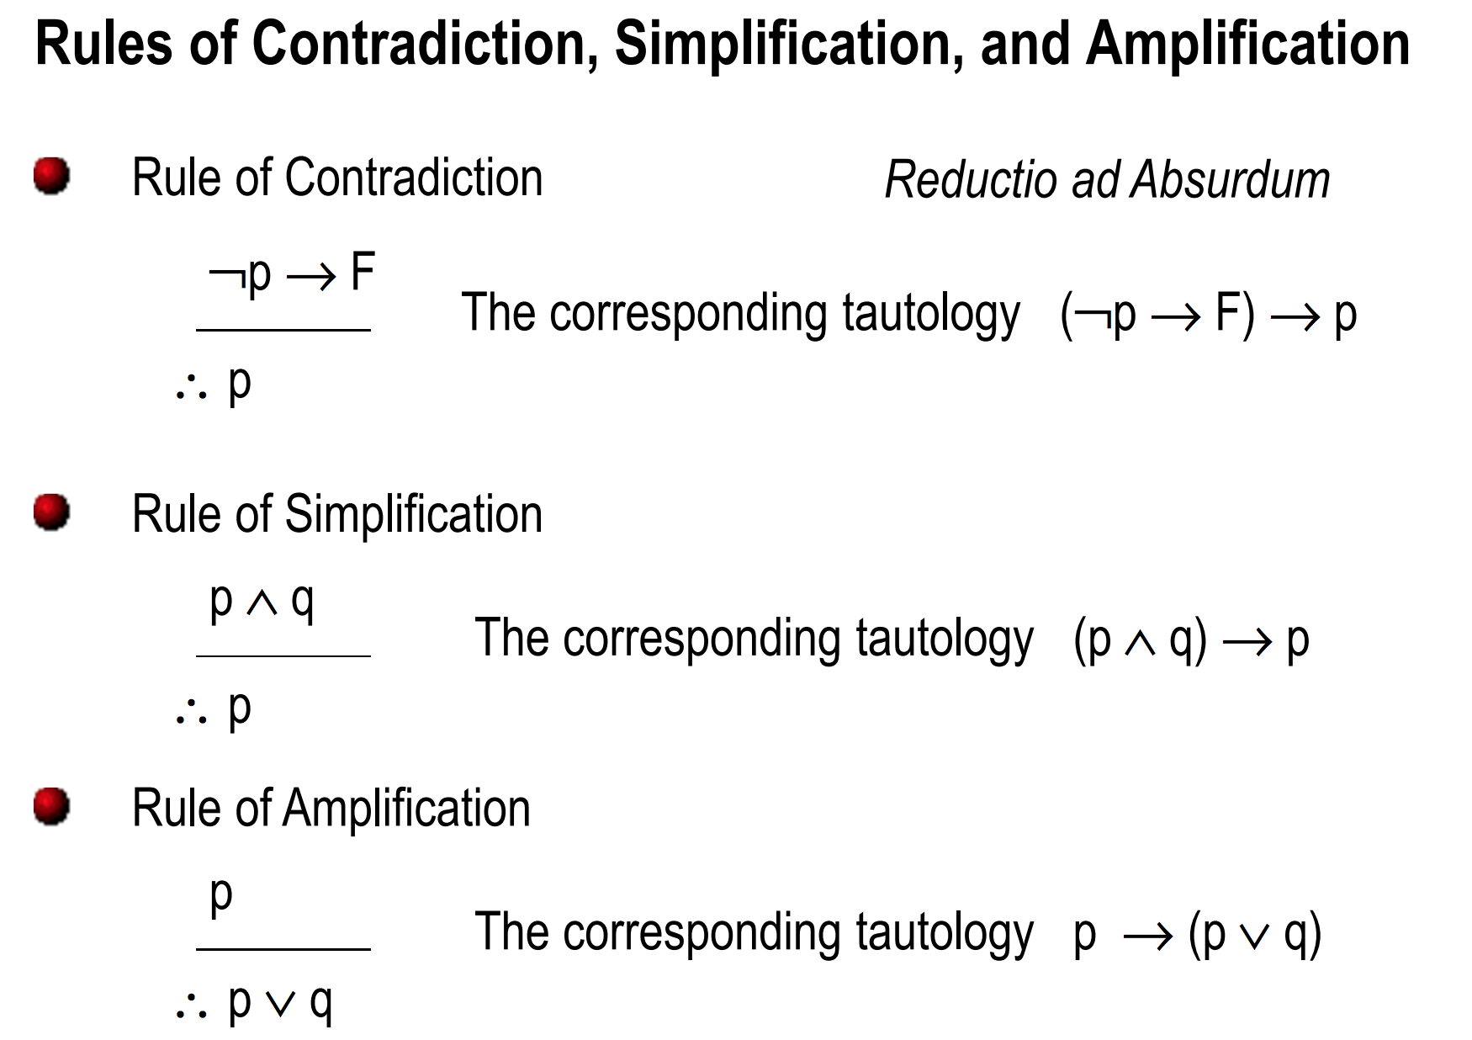
(Addition)

Slide 22
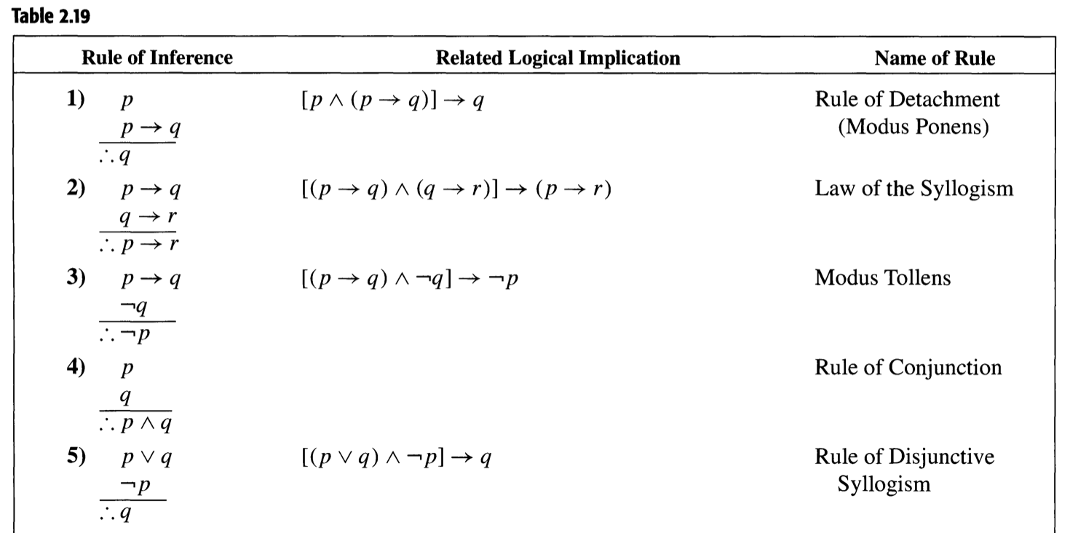
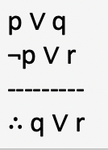
Hypothetical syllogism
Resolution

Slide 23
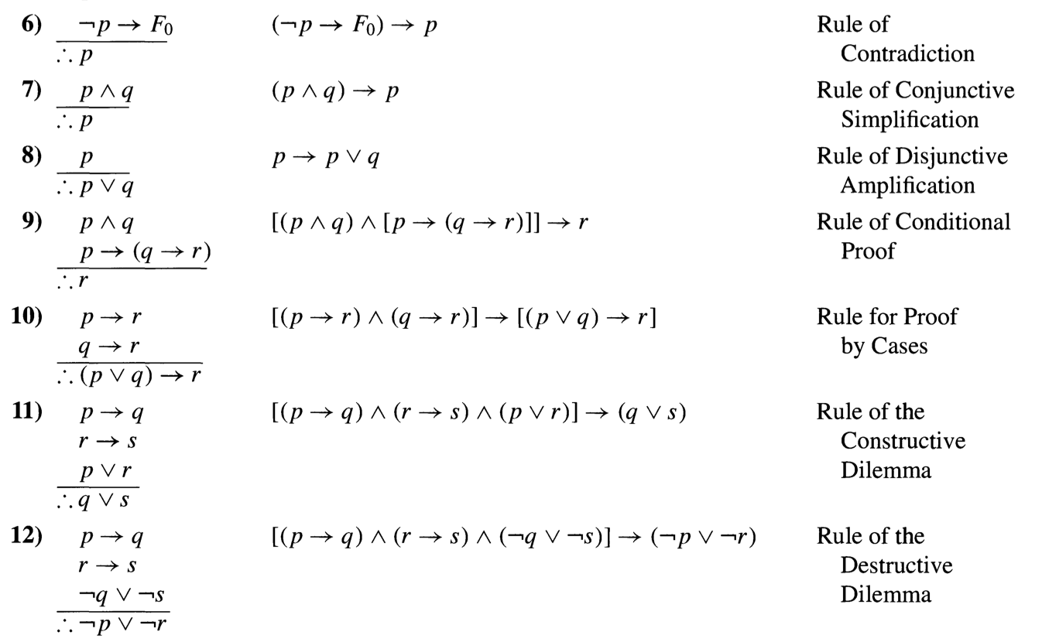
Addition

Slide 24
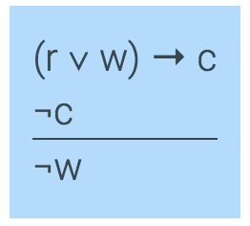
An example
Here is an argument expressed in English:
If it is raining or windy or both, the game will be cancelled
The game will not be cancelled.
_________________________________________
Therefore, it is not windy
w: it is windy; r: It is raining;
c: The game will be cancelled
Formulation in logic:

Slide 25
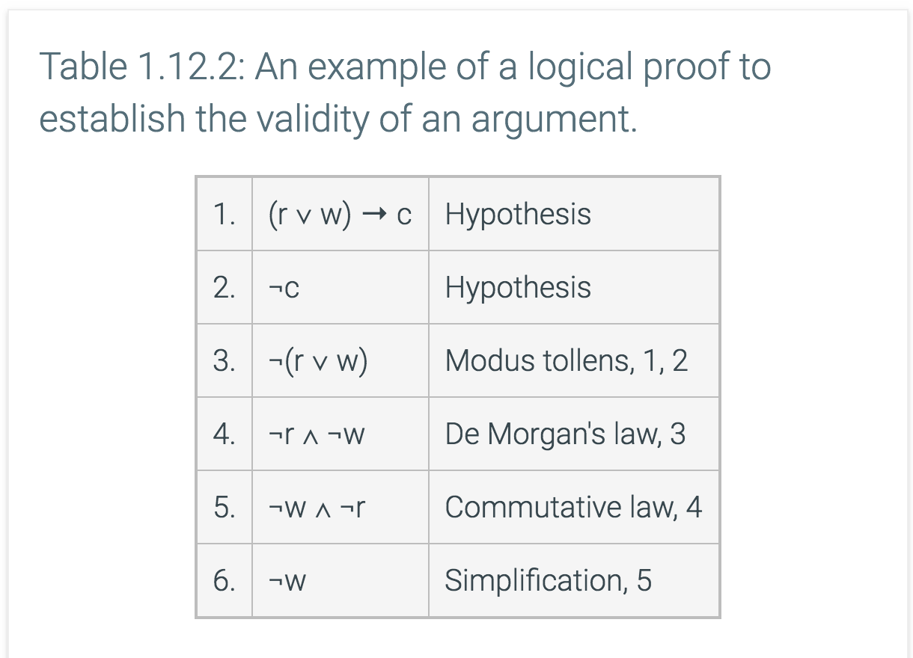

Slide 26
hypotheses
conclusion.

Slide 28
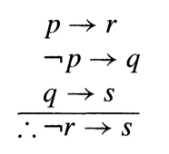
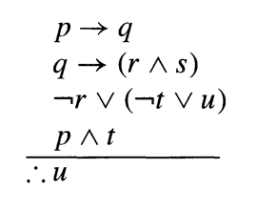
Show the validity of the following arguments:

Slide 29
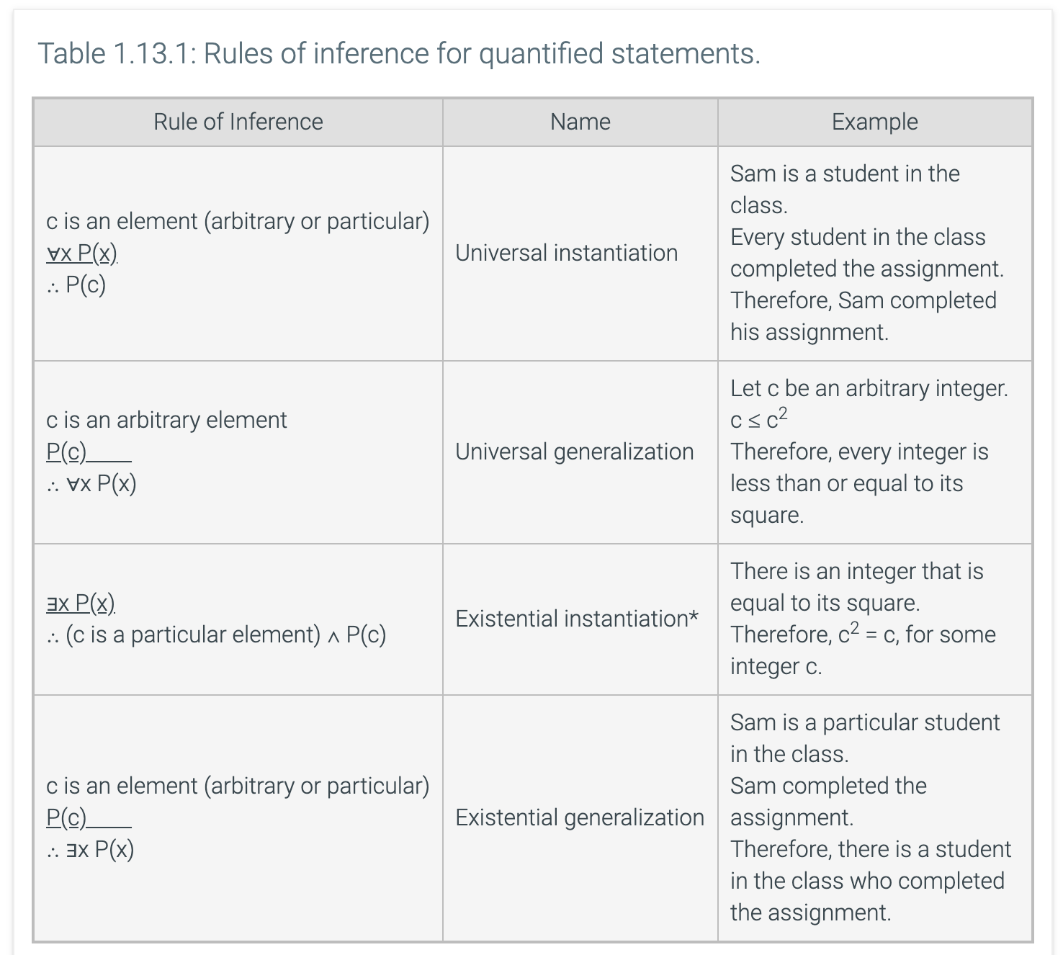

Slide 30
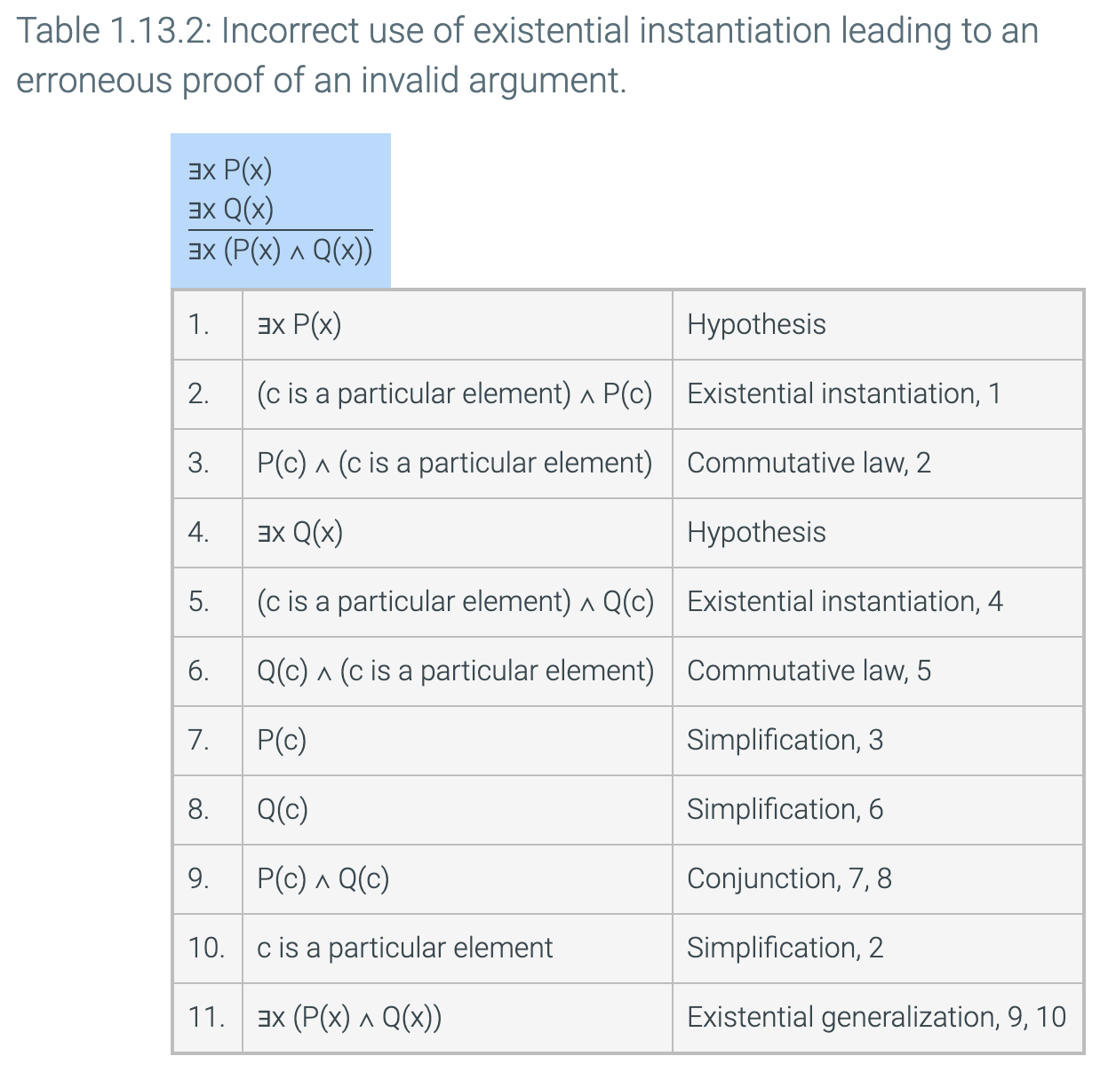

Slide 31
