Slide 1
Logic (Section 1.6 – 1.8)
(First order Logic)

Slide 2
1.6 Predicates and quantifiers
Many mathematical statements contain variables.

Slide 3
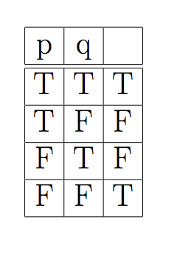
Find the proposition whose Truth Table column is give.

Slide 4
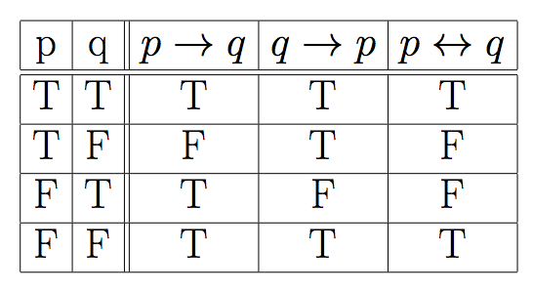
Another form

Slide 5
Predicate Logic (Propositional Function)
Propositional statements are not powerful enough to capture wide range of statements.
Consider the statement:
For every n ∈ Z, 2n is even
Consider the sentences
y has four sides
x has black hair
x+2 is an even integer
The above sentences involve variables.

Slide 6
Open sentences
A sentence whose truth value depends on the value of one or more variables is called an open sentence (predicate).
Examples of open statements
p(y) (read as “p of y”): y has four sides
p(x): x has black hair
p(x): x+2 is an even integer
Mother(x): propositional function with one variable.
Friend(x,y): function with two variables. (2-tuple)
P(x₁, x₂, …, x_{n}): function with n variables. (n-tuple)
An open statement p(x) is a proposition when x is assigned a value.

Slide 7
Domain (Universe of Discourse)
Intuitively, domain (universe) of a variable x in a propositional function is the set of values x can take.
The domain of all variables in the following predicates is the set of positive integers.
P(x): x is a prime number
L(x,y): x < y
S(x,y,z) : x²+y² ≥ z²
Is P(11) true?
Is L(4,4) true?
Is S(3,4,5) true?

Slide 8
Domain (Universe of Discourse)
Intuitively, domain (universe) of a variable x in a propositional function is the set of values x can take.
p(y): y has four sides.
Universe: set of polygons
p(x): x has black hair
Universe: humans
p(x): x + 2 is an even integer
Universe: set of integers

Slide 9
Quantifiers
We can use ∧, ∨, ¬, , , to deconstruct many English sentence to an equivalent symbolic form.

Slide 10
Quantifiers (Section 1.7)
We can use ∧, ∨, ¬, , to deconstruct many English sentence to an equivalent symbolic form.
These symbols are not enough.
For every n ∈ Z, 2n is even.

Slide 11
Quantifiers
These symbols are not enough.
For every n ∈ Z, 2n is even. (Z is the set of all integers)
For all n ∈ Z, 2n is even.
Consider the open statement p(x): x is an even integer. Since the universe is Z, the above proposition can be written as
[...∧ p(2.(-2)) ∧ p(2.(-1)) ∧ p(2(0)) ∧ p(2(1)) ∧ …].
This is not much of help.

Slide 12
Universal Quantifier: ∀ (for all)
∀ x p(x): a proposition which is true if p(x) is true for all values of x of the universe of discourse.
Consider : For every n ∈ Z, 2n is even. (Z is the set of all integers)
Let p(x): x is even be an open statement.
The domain of x is Z.
For every n ∈ Z, 2n is even can be written as ∀ x ∈ Z, p(2x).

Slide 13
Universal Quantifier: ∀ (for all)
∀ x p(x): a proposition which is true if p(x) is true for all values of x of the universe of discourse.
Consider : For every n ∈ Z, 2n is even. (Z is the set of all integers)
Let p(x): x is even be an open statement.
The domain of x is Z.
For every n ∈ Z, 2n is even can be written as ∀ x ∈ Z, p(2x).

Slide 14
Universal Quantifier: ∀ (for all)
∀ x p(x): a proposition which is true if p(x) is true for all values of x of the universe of discourse.
If the Universe is finite, say {a₁, a₂, …, a_{n}}, then
∀ x p(x) p(a₁) ∧ p(a₂) ∧ … ∧p(a_{n}) .
≡

Slide 15
Examples : universal quantifiers
Let p(x): x takes macm 101; q(x): x is a CS student.
Express the statements:
Every CS student must take macm101

Slide 16
Examples : universal quantifiers
Let p(x): x takes macm 101; q(x): x is a CS student.
Express the statements:
Every CS student must take macm101
∀ x (q(x) p(x))

Slide 17
Examples : universal quantifiers
Let p(x): x takes macm 101; q(x): x is a CS student.
Express the statements:
Every CS student must take macm101
∀ x (q(x) p(x))
Everybody must take macm101 or be a non CS student.

Slide 18
Examples : universal quantifiers
Let p(x): x takes macm 101; q(x): x is a CS student.
Express the statements:
Every CS student must take macm101
∀ x (q(x) p(x))
Everybody must take macm101 or be a non CS student.
∀ x (p(x) ∨ ¬q(x))

Slide 19
Examples : universal quantifiers
Express the statement
‘for every x and every y, x+y>10’
Answer:
Let P(x,y) be the statement x+y>10
Where the domain for x, y is the set of integers
The statement is: ∀x ∀y P(x,y)
Shorthand: ∀x,y P(x,y)

Slide 20
Existential Quantifier: ∃ (there exists)
∃ x p(x): a proposition which is true if p(x) is true for at least one value of x of domain.
Consider : There is an integer that is not even.
Let p(x): x is not even be an open statement.
The above proposition can be written as ∃ x ∈ Z, p(x).
If the Universe is finite, say {a₁, a₂, …, a_{n}}, then
∃ x p(x) p(a₁) ∨ p(a₂) ∨ …∨ p(a_{n}) .
≡

Slide 21
Existential Quantifier: ∃ (there exists)
Example: What is the truth value of ∃x p(x) where p(x) is the statement ``x² > 10”? Suppose the universe of discourse is set of positive number not exceeding 4, i.e. the set {1,2,3,4}
Ans:

Slide 22
Existential Quantifier: ∃ (there exists)
Example: What is the truth value of ∃x p(x) where p(x) is the statement ``x² > 10”? Suppose the universe of discourse is set of positive number not exceeding 4, i.e. the set {1,2,3,4}
Ans:
In our case ∃x p(x) p(1) ∨ p(2) ∨ p(3) ∨ p(4).
Since p(4) is true, ∃x p(x) is true.
≡

Slide 23
Existential Quantifier: ∃ (there exists)
Example: What is the truth value of ∃x p(x) where p(x) is the statement ``x² > 10”? Suppose the universe of discourse is set of positive number not exceeding 4, i.e. the set {1,2,3,4}
Ans:
In our case ∃x p(x) p(1) ∨ p(2) ∨ p(3) ∨ p(4).
Since p(4) is true, ∃x p(x) is true.
≡
If the domain of x is {1,2,3}, ∃x p(x) is false.

Slide 25
What we know:
p is a proposition either true or false.
p(x) is an open statement where x is a free variable defined over a domain.
When x has a value, i.e. x is bound, then p(x) is a proposition.
∀ x p(x): a proposition which is true if p(x) is true for all values of x of the domain.
∃ x p(x): a proposition which is true if p(x) is true for at least one value of x of the domain.

Slide 26
Quantifiers: Truth values
The truth table for the quantified statements.

Slide 27
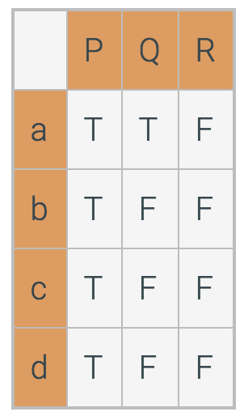
Truth values for quantified statements for a given set of predicates.
P, Q, and R are quantified statements.
The domain for this problem is {a, b, c, d}.
Consider the truth table:
Which statements are true?
∀x P(x)?
∃ x P(x)?
∀x Q(x)?
∃ x Q(x)?
∀x R(x)?
∃ x R(x)?

Slide 28
Example:
p(x): x > 0; q(x): x² ≥ 0; r(x): (x-4)(x+1) = 0 s(x): x² – 3 >0.

Slide 29
Example:
p(x): x > 0; q(x): x² ≥ 0; r(x): (x-4)(x+1) = 0 s(x): x² – 3 >0.

Slide 30
Precedence of Quantifiers
The quantifiers ∀ and ∃ have higher precedence than all logical connectives.
∀x (p(x) ∧ q(x)) is the conjunction of p(x) and q(x).

Slide 31
Precedence of Quantifiers
For example, ∀x P(x) ∨ Q(x) means (∀x P(x))∨ Q(x)
∀x (P(x) ∨ Q(x)) means something different.
Unfortunately, often people write ∀x P(x) ∨ Q(x) when they mean ∀ x (P(x) ∨ Q(x)).

Slide 32
Problems
Let p(x,y): xy =0; Universe is R.
∀x ∀y p(x,y) ∀y ∀x p(x,y) (?)
∀x ∃y p(x,y) ∃y ∀x p(x,y) (?)
Let q(x,y): x+y = 0; Universe is R
∃y ∀x q(x,y)
∀x ∃y q(x,y)
≡
≡

Slide 33
Problems
Let p(x,y): xy =0; Universe is R.
∀x ∀y p(x,y) ∀y ∀x p(x,y) (?)
∀x ∃y p(x,y) ∃y ∀x p(x,y) (?)
Let q(x,y): x+y = 0; Universe is R
∃y ∀x q(x,y)
∀x ∃y q(x,y)
≡
(T)
≡
(T)
(F)
(T)

Slide 34
Translating English to Symbolic Logic
Goldbach’s conjecture: Every even integer greater than 2 is the sum of two prime numbers.
Let P = { 2, 3, 5, 7, …} be the set of primes;
Let S= {4,6,8,10, …} be the set of even integers > 2.
∀x ∈ S, ∃p, q ∈ P, x = p + q.

Slide 35
Translating English to Symbolic Logic
Goldbach’s conjecture: Every even integer greater than 2 is the sum of two prime numbers.
Let P = { 2, 3, 5, 7, …} be the set of primes;
Let S= {4,6,8,10, …} be the set of even integers > 2.
∀x ∈ S, ∃p, q ∈ P, x = p + q.
We can also write the conjecture as
(x ∈ S) ∃p, q ∈ P, x = p + q.

Slide 36
Translating English to Symbolic Logic
Goldbach’s conjecture: Every even integer greater than 2 is the sum of two prime numbers.
Let P = { 2, 3, 5, 7, …} be the set of primes;
Let S= {4,6,8,10, …} be the set of even integers > 2.
∀x ∈ S, ∃p, q ∈ P, x = p + q.
We can also write the conjecture as
(x ∈ S) ∃p, q ∈ P, x = p + q.
Every universally quantified statement can be expressed as a conditional statement.

Slide 37
Translating English to Symbolic Logic
Every universally quantified statement can be expressed as a conditional statement.
The following statements mean the same thing.
∀x ∈ S, Q(x)
(x ∈ S) Q(x)
Sometimes a theorem will be expressed as a universally quantified statement, but it will be more convenient to think of it as a conditional statement.

Slide 38
Translating English to Symbolic Logic
Every universally quantified statement can be expressed as a conditional statement.
The following statements mean the same thing.
∀x ∈ S, Q(x)
(x ∈ S) Q(x)
Sometimes a theorem will be expressed as a universally quantified statement, but it will be more convenient to think of it as a conditional statement.
We should be able to switch between the two forms

Slide 39
Translating English to Symbolic Logic
If somebody is female and is a parent, this person is someone’s mother
f(x): x is female
p(x): x is a parent
m(x,y): x is the mother of y

Slide 40
Translating English to Symbolic Logic
If somebody is female and is a parent, this person is someone’s mother
f(x): x is female
p(x): x is a parent
m(x,y): x is the mother of y
∀x (f(x) ∧ p(x) ∃ y, m(x,y))

Slide 41
Translating English to Symbolic Logic
For every prime number p there is another prime number q with q > p.
The universe is the set of positive integers (N)
f(x): x ∈ N is a prime.
g(x,y): x > y, x, y ∈ N.

Slide 42
Translating English to Symbolic Logic
For every prime number p there is another prime number q with q > p.
f(x): x ∈ N is a prime.
g(x,y): x > y, x, y ∈ N.
∀p∈ N, f(p) ∃ q∈ N, (f(q) ∧ g(q, p))
∀p∈ N, ( f(p) ∧ (∃ q∈ N, (f(q) ∧ g(q, p))))

Slide 43
Translating English to Symbolic Logic
For every prime number p there is another prime number q with q > p.
f(x): x ∈ N is a prime.
g(x,y): x > y, x, y ∈ N.
∀p, f(p) ∃ q, (f(q) ∧ g(q, p))
∀p, ( f(p) ∧ (∃ q (f(q) ∧ g(q, p))))

Slide 44
Translating English to Symbolic Logic
P(x): x is a person; T(y): time is y; F(x,y): you can fool x in time y.
You can fool some of the people all of the time

Slide 45
Translating English to Symbolic Logic
P(x): x is a person; T(y): time is y; F(x,y): you can fool x in time y.
You can fool some of the people all of the time
∃p (∀t (P(p) ∧ (T(t) F(p,t))))

Slide 46
Translating English to Symbolic Logic
P(x): x is a person; T(y): time is y; F(x,y): you can fool x in time y.
You can fool some of the people all of the time
∃p (∀t (P(p) ∧ (T(t) F(p,t))))
You can fool all of the people some of the time

Slide 47
Translating English to Symbolic Logic
P(x): x is a person; T(y): time is y; F(x,y): you can fool x in time y.
You can fool some of the people all of the time
∃p (∀t (P(p) ∧ (T(t) F(p,t))))
You can fool all of the people some of the time
∃t (∀p (P(p) ∧ (T(t) F(p,t))))

Slide 48
Translating English to Symbolic Logic
P(x): x is a person; T(y): time is y; F(x,y): you can fool x in time y.
You can fool some of the people all of the time
∃p (∀t (P(p) ∧ (T(t) F(p,t))))
You can fool all of the people some of the time
∃t (∀p (P(p) ∧ (T(t) F(p,t))))
You can fool all of the people all of the time

Slide 49
Translating English to Symbolic Logic
P(x): x is a person; T(y): time is y; F(x,y): you can fool x in time y.
You can fool some of the people all of the time
∃p (∀t (P(p) ∧ (T(t) F(p,t))))
You can fool all of the people some of the time
∃t (∀p (P(p) ∧ (T(t) F(p,t))))
You can fool all of the people all of the time
∀p ∀t (P(p) ∧ (T(t) F(p,t))))

Slide 51
Negation
We can use negation with quantified expressions as we used them with propositions
Let P(x) be a predicate. Then the followings hold:
¬(∀x P(x)) ≡ ∃x ¬P(x)
(∃x P(x)) ≡ ∀x ¬P(x)
This is essentially the quantified version of De Morgan’s Law.

Slide 52
De Morgan’s law for quantified statements (Section 1.8)
If the domain for the variable x is the set of all birds and the predicate F(x) is "x can fly", then the statement ¬∀x F(x) is equivalent to:
"Not every bird can fly."
which is logically equivalent to the statement:
"There exists a bird that cannot fly."

Slide 53
Negating Quantified Expressions
Consider ∀x J(x)
“Every student in cs 225 has taken a course in Java.”
Here J(x) is “x has taken a course in Java” and
the domain is students in cs 225.
Negating the original statement gives “It is not the case that every student in cs 225 has taken Java.” This implies that “There is a student in cs 225 who has not taken Java.”
Symbolically ¬∀x J(x) and ∃x ¬J(x) are equivalent

Slide 54
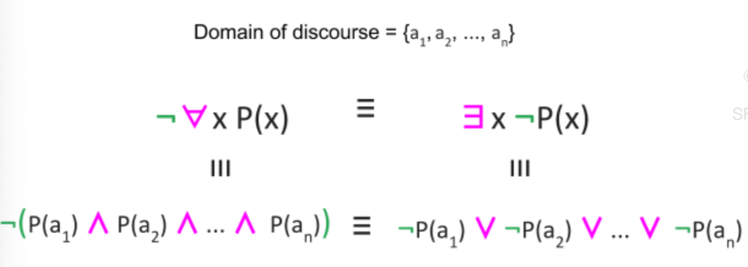
De Morgan’s law

Slide 55
Negation: Truth
Truth Values of Negated Quantifiers
Statement | True when… | False when...
¬∃x P(x) ≡ ∀x ¬P(x) | P(x) is false for every x | There is an x for which P(x) is true
¬∀x P(x) ≡ ∃x ¬P(x) | There is an x for which P(x) is false | P(x) is true for every x

Slide 56
Negation: Example
Rewrite the following expression, pushing negation inward:
¬ ∀x (∃ y ∀z P(x,y,z) ∧ ∃ z ∀y P(x,y,z))
Answer:
∃x (∀y ∃z ¬P(x,y,z) ∨ ∀z ∃y ¬P(x,y,z))

Slide 57
Example
p(x): x is odd; q(x): x² – 1 is odd.
∀x (p(x) q(x))
¬ [∀x (p(x) q(x))]
∃x [ ¬(p(x) q(x))]
∃x [ ¬ (¬ p(x) ∨ q(x))]
∃x [ p(x) ∧ ¬ q(x) ]

Slide 58
Example
p(x): x is odd; q(x): x² – 1 is odd.
∀x (p(x) q(x)) True
¬ [∀x (p(x) q(x))]
∃x [ ¬(p(x) q(x))]
∃x [ ¬ (¬ p(x) ∨ q(x))]
∃x [ p(x) ∧ ¬ q(x) ] False

Slide 59
Definition:

Slide 60
Nested quantifiers (1.9)
If an open statement (predicate) has more than one variable, each variable must be bound by a separate quantifier.
A logical expression with more than one quantifier that bind different variables in the same predicate is said to have nested quantifiers.

Slide 61
Nested quantifiers (1.9)
If an open statement (predicate) has more than one variable, each variable must be bound by a separate quantifier.
A logical expression with more than one quantifier that bind different variables in the same predicate is said to have nested quantifiers.

Slide 62
Nested quantifiers of the same type
Domain: real set R
Let p(x,y): xy = 0;
∀x ∀y p(x,y) ∀y ∀x p(x,y) (?)
∀x ∃y p(x,y) ∃y ∀x p(x,y) (?)
Let q(x,y): x+y = 0;
∃y ∀x q(x,y)
∀x ∃y q(x,y)
≡
≡

Slide 63
Nested quantifiers of the same type
Domain: real set R
Let p(x,y): xy = 0;
∀x ∀y p(x,y) ∀y ∀x p(x,y) (?)
∀x ∃y p(x,y) ∃y ∀x p(x,y) (?)
Let q(x,y): x+y = 0;
∃y ∀x q(x,y)
∀x ∃y q(x,y)
≡
(T)
≡
(T)
(F)
(T)

Slide 64
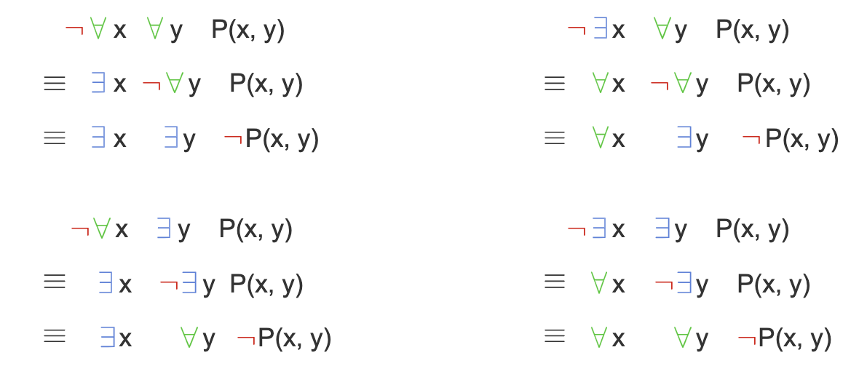
De Morgan’s law for nested quantifiers

Slide 65
Expressing uniqueness in quantified statements (Section 1.10)

Slide 66
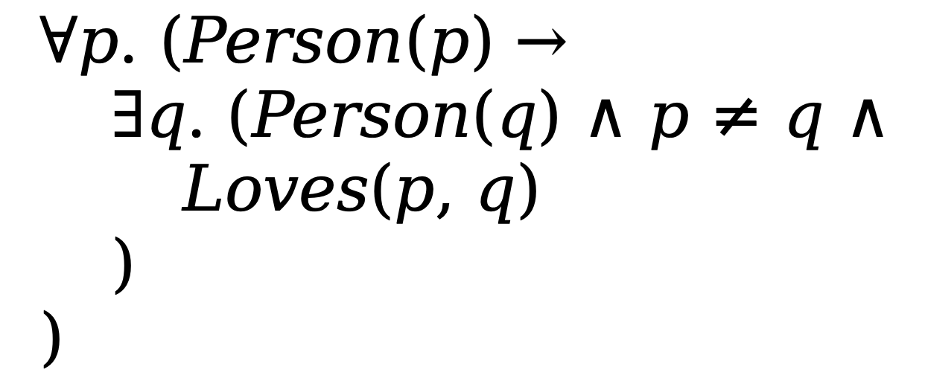
Expressing uniqueness in quantified statements

Slide 67
Example 1.10.8
Domain: a group of students
N(x, y): person x nominated person y for a position. It is possible that x=y.
W(x): person x is a new member.
O(x): person x is currently an officer.

Slide 68
Example 1.10.8
Domain: a group of students
N(x, y): person x nominated person y for a position. It is possible that x=y.
W(x): person x is a new member.
O(x): person x is currently an officer.
All the new members nominated all the officers.
Equivalent statement : ∀x ∀y ( (W(x) ∧ O(y)) → N(x, y) )
One of the current officers did not nominate anyone.
Equivalent statement : ∃x ∀y ( O(x) ∧ ¬N(x, y))

Slide 69
Example 1.10.8
Domain: a group of students
N(x, y): person x nominated person y for a position. It is possible that x=y.
W(x): person x is a new member.
O(x): person x is currently an officer.
Everyone nominated someone.
Equivalent statement : ∀x ∃y N(x, y)
Someone nominated everyone.
Equivalent statement : ∃x ∀y N(x, y)

Slide 70
Example 1.10.8
Domain: a group of students
N(x, y): person x nominated person y for a position. It is possible that x=y.
W(x): person x is a new member.
O(x): person x is currently an officer.
Everyone nominated someone other than themselves.
Equivalent statement : ∀x ∃y (x ≠ y ∧ N(x, y))
Exactly one person nominated Sam.
Equivalent statement : ∃x ∀y (N(x, Sam) ∧ (x ≠ y → ¬N(y, Sam)))

Slide 73
Comments
Whenever you see a quantifier, ask what is the universe of discourse.
Should know the precedence rules. It is better to eliminate confusion by using the parentheses.
The order of quantifiers matters a lot. Most often ∀x ∃y q(x,y) is not equal to ∃x ∀y q(x,y).
De Morgan’s laws for quantifiers are very useful. It is important to be comfortable with De Morgan’s laws.
You don’t need to memorize the laws of logic. Just convince yourself that they are correct.
One way to show logical equivalence is through truth tables, at least when they do not have quantifiers over variables.

