Slide 1
Logic (Chapter 1)
Sections 1.1 – 1.5

Slide 2
Chapter 1 (Logic)
Propositions and logical operations (1.1)
Evaluating compound propositions (1.2)
Conditional statements (1.3)
Logical equivalence (1.4)
Laws of propositional logic (1.5)
Predicates and quantifiers (1.6)
Quantified statements (1.7)
De Morgan’s law of quantified statements (1.8)
Nested quantifiers (1.9, 1.10)
Logical reasoning (1.11)
Roles of inference (1.12, 1.13)

Slide 3
Logic
Logic is the study of formal reasoning (arguments).
A statement in logic always has a well defined meaning (no room for confusion).
Logic is important in mathematics for proving theorems.
Used for designing electronic circuitry.
Logic is everywhere.

Slide 4
Examples of Propositions.

Slide 5
Logic and Arguments
Here are some examples of the arguments:
If it is snowing, then it is cold outside.
It is snowing
--------------------------------------------------
Therefore, it is cold outside
If it is snowing, then it is cold outside.
It is cold outside
--------------------------------------------------
Therefore, it is snowing.

Slide 6
Logic and Arguments
Here are some examples of the arguments:
Either you are a Canucks fan or a Maple Leafs fan.
You are not a Maple Leafs fan
-----------------------------------------------------------------
Therefore, you are a Canucks fan.
Either you are neither a Canucks fan nor a Maple Leafs fan.
You are a Maple Leafs fan
-----------------------------------------------------------------
Therefore, you are not a Canucks fan.

Slide 7
Logic and Arguments
Here are some examples of the arguments:
All humans are green
Some green things are edible
-----------------------------------------------------------------
Therefore, some humans are edible
All humans are green.
Some green things are not edible
-----------------------------------------------------------------
Therefore, some humans are not green

Slide 8
Logic and Arguments
Some of these arguments are valid, and some are not valid.
one of the tasks of logic is to provide a precise mathematical theory of validity of arguments.

Slide 9
Logic
(Propositional ) Logic is a system based on statements (also called propositions).
The most basic element in logic is a proposition.

Slide 10
Logic
A statement is a (declarative) sentence that is either true or false (not both).
We say that the truth value of a proposition is either true (T) or false (F).
Corresponds to 1 and 0 in digital circuits
We usually denote a proposition by a letter: p, q, r, s, …

Slide 11
Consider a sentence: The sun rises in the east
Is it a statement?
What is the truth value
of the proposition?

Slide 12
Consider a sentence: The sun rises in the east
Is it a statement? YES
What is the truth value
of the proposition? TRUE

Slide 13
Consider a sentence: {0,2,3} ∩ N = Φ
Is it a statement?
What is the truth value
of the proposition?

Slide 14
Consider a sentence: {0,2,3} ∩ N = Φ
Is it a statement? YES
What is the truth value
of the proposition? False

Slide 15
Consider a sentence: y > 21
Is it a statement?
What is the truth value
of the proposition?

Slide 16
Consider a sentence: y > 21
Is it a statement? No
What is the truth value
of the proposition? Its truth value
depends on unspecified y.
This statement is called an
open statement.

Slide 17
Consider a sentence: Please do not fall asleep.
Is it a statement?
What is the truth value
of the proposition?

Slide 18
Consider a sentence: Please do not fall asleep.
Is it a statement? No
What is the truth value It is neither true nor false
of the proposition
English statements are not in general propositions

Slide 19
Sentences that are not statements with similar expressions that are statements

Slide 20
Consider a sentence:
Every even integer greater than 2 is a sum of two prime numbers.
Goldbach conjecture
Is it a statement?
What is the truth value
of the proposition?

Slide 21
Consider a sentence:
Every even integer greater than 2 is a sum of two prime numbers.
Goldbach conjecture
Is it a statement? Yes
What is the truth value
of the proposition? Probably true

Slide 22
Consider a sentence:
Either x is a multiple of 7 or it is not
Is it a statement?
What is the truth value
of the proposition?

Slide 23
Consider a sentence:
Either x is a multiple of 7 or it is not
Is it a statement? Yes
What is the truth value
of the proposition? True since it is true
for all x.

Slide 24
Compound Proposition
A compound proposition is created by connecting individual propositions with logical operations.

Slide 25
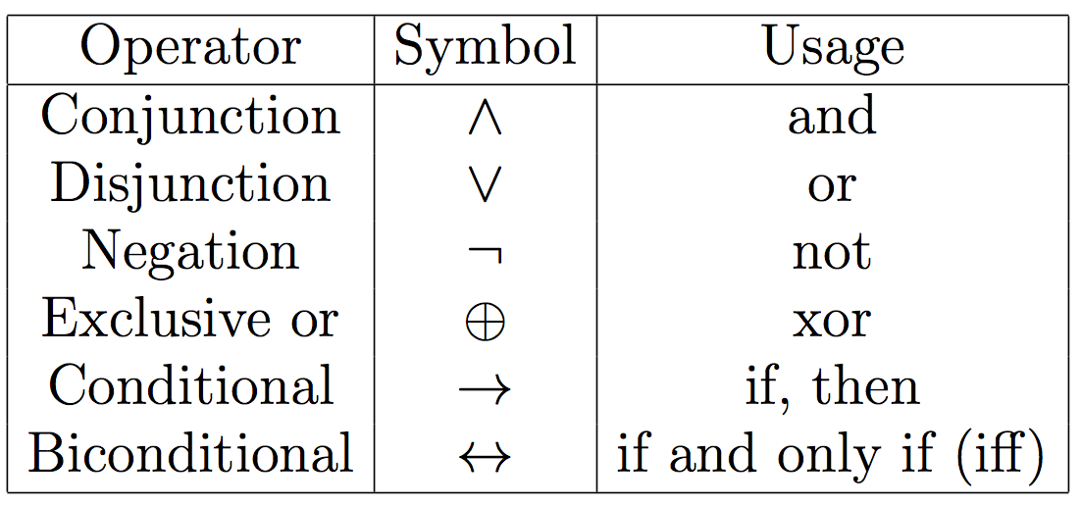
Logical Connectives (Operators)
Combining statements to make compound statements.
p, q, r, s, … represent statements/propositions.
Following connectives are considered now.

Slide 26
Logical Connective: Logical And ( )
The logical conjunction AND is true only when both of the propositions are true. It is also called a conjunction
Examples
It is raining and it is warm
(2+3=5) and (1<2).

Slide 27
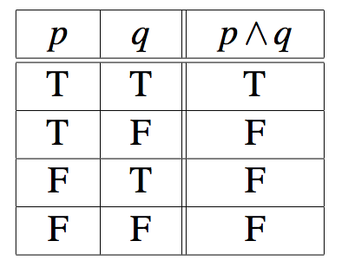
Logical Connective: Logical And ( )
Truth table
p ∧ q is true when both p and q are true.
A truth table shows the truth value of a compound proposition for every possible combination of truth values for the variables contained in the compound proposition.
Every row in the truth table shows a particular truth value for each variable, along with the compound proposition's corresponding truth value.

Slide 28
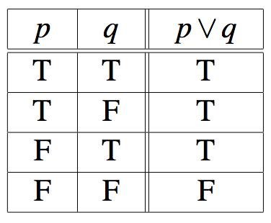
Logical Connective: Logical OR( )
The logical disjunction, or logical OR, is true if one or both of the propositions are true. This is also known as ‘inclusive OR’
Examples
It is raining or it is the second lecture
(2+2=5) ∨ (1<2)
Truth table
p v q is true when either p or q is true.
It is also known as inclusive ‘or’.

Slide 29
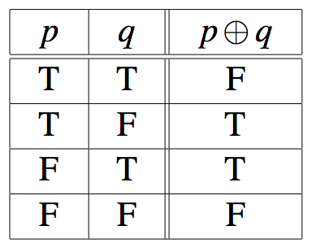
Logical Connective: Exclusive Or ( )
The exclusive OR, or XOR, of two propositions is true when exactly one of the propositions is true and the other one is false
Example
The circuit is either ON or OFF but not both
Let ab<0, then either a<0 or b<0 but not both
Truth table

Slide 30
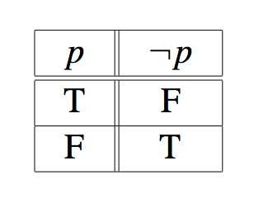
Logical Connective: Negation ( )
¬p, the negation of a proposition p, is also a proposition
p: Today is Monday
Examples:
Today is not Monday
It is not the case that today is Monday, etc.
Truth table

Slide 31
Examples
Express each statement or open statement in one of the forms: p ∧ q, p ∨ q, or ¬p.
Today is cold but it is not cloudy
x ∈ A – B
At least one of the numbers x and y equals 0.

Slide 32
Exercise 1.2.2: Translating English statements into logic.
Express each statement in logic using the variables:
p: It is windy q: It is cold r: It is raining
It is windy and cold. p ∧ q
It is windy but not cold. p ∧ ¬q
It is not true that it is windy or cold. ¬(p ∨ q)
It is raining and it is windy or cold. r ∧ (p ∨ q)
It is raining and windy or it is cold. (r ∧ p) ∨ q
It is raining and windy but it is not cold. r ∧ p ∧ ¬q

Slide 33
Exercise 1.2.9: Boolean expression to express a condition on the input variables.
Give a logical expression with variables p, q, r that is true if p and q are false and r is true and is otherwise false.
¬p ∧ ¬q ∧ r

Slide 34
Conditional Statements
The conditional operation is denoted with the symbol →.
The proposition p → q is read "if p then q".

Slide 35
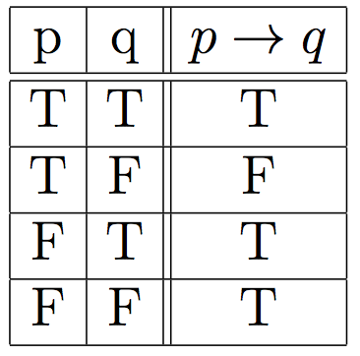
Logical Connective: Implication ( )
Definition: Let p and q be two propositions. The implication p→q is the proposition that is false when p is true and q is false and true otherwise
p is called the hypothesis, premise
q is called the conclusion, consequence
Truth table

Slide 37
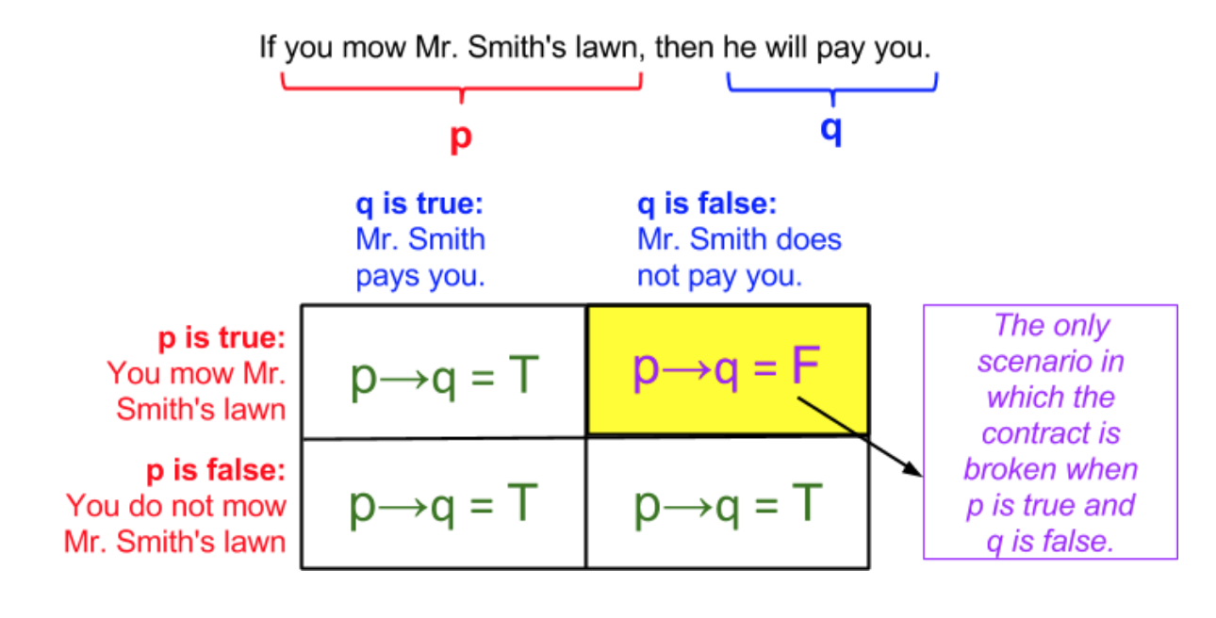
A conditional statement illustrated

Slide 38
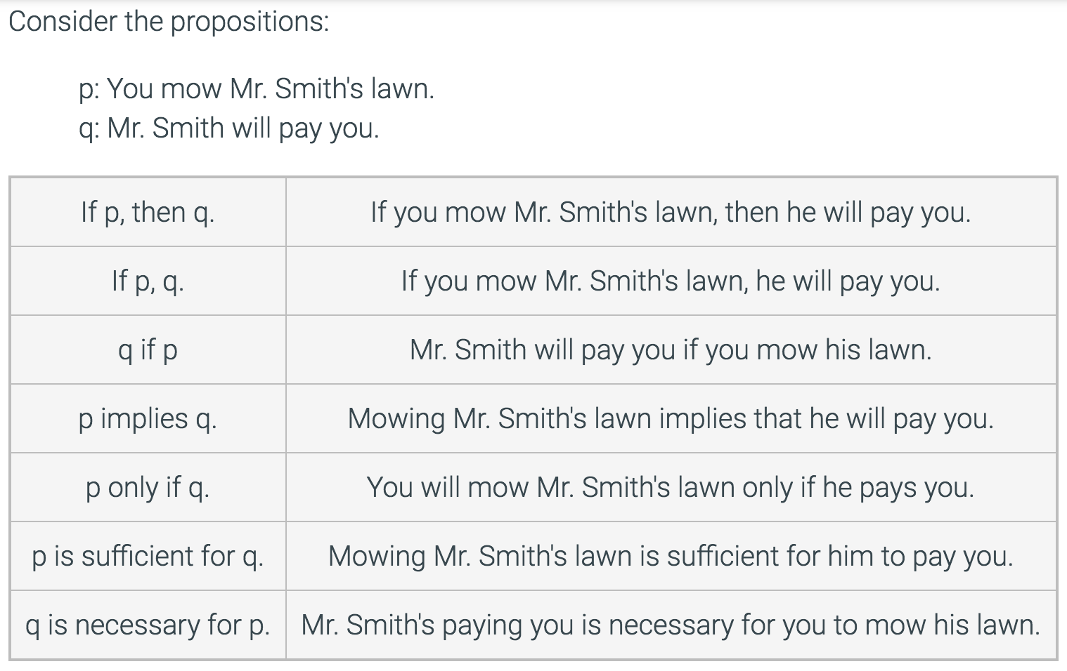
English expressions of the conditional operation

Slide 39
Logical Connective: Implication ( )
Consider the statements:
you pass the exam → you pass the course
Equivalent statements:
Passing the exam is sufficient for passing the course.
For you to pass this course, it is sufficient that you pass the exam.

Slide 40
Exercise: Which of the following implications is true?
If -1 is a positive number, then 2+2=5

Slide 41
Exercise: Which of the following implications is true?
If -1 is a positive number, then 2+2=5
True. The premise is obviously false, thus no matter what the conclusion is, the implication holds.

Slide 42
Exercise: Which of the following implications is true?
If -1 is a positive number, then 2+2=5
If -1 is a positive number, then 2+2=4
True. The premise is obviously false, thus no matter what the conclusion is, the implication holds.
True. Same as above.

Slide 43
Exercise: Which of the following implications is true?
If -1 is a positive number, then 2+2=5
If -1 is a positive number, then 2+2=4
If you get an 100% on your Midterm 1, then you will have an A⁺.
True. The premise is obviously false, thus no matter what the conclusion is, the implication holds.
True. Same as above.

Slide 44
Exercise: Which of the following implications is true?
If -1 is a positive number, then 2+2=5
If -1 is a positive number, then 2+2=4
If you get an 100% on your Midterm 1, then you will have an A⁺.
True. The premise is obviously false, thus no matter what the conclusion is, the implication holds.
True. Same as above.
False. Your grades homework, quizzes, Midterm 2, and Final, if they are bad, would prevent you from having an A⁺.

Slide 45
Note that logical (material) implication does not assume any casual connection.
`If black is white, then we live in Antartic’
`If pigs fly, then Paris is in France.

Slide 46
Exercises
To take discrete mathematics, you must have taken calculus or a course in computer science.
When you buy a new car from Acme Motor Company, you get $2000 back in cash or a 2% car loan.
School is closed if more than 2 feet of snow falls and if the wind chill is below -80.

Slide 47
Exercises
To take discrete mathematics, you must have taken calculus or a course in computer science.
Propositions
- p: take discrete math
- q: you have taken calculus
- r : you have taken a course in CS

Slide 48
Exercises
When you buy a new car from Acme Motor Company, you get $2000 back in cash or a 2% car loan.
Propositions
- p: you buy a car
- q: you you get $2000 back
- r : you get 2% car loan

Slide 49
Exercises
School is closed if more than 2 feet of snow falls and if the wind chill is below -80.
Propositions
- p: School is closed
- q: 2 feet of snow falls
- r : wind chill is below -80

Slide 50
Converse
The converse of p → q is q → p.

Slide 51
Contrapositive
The contrapositive of p → q is ¬q → ¬p.

Slide 52
Inverse
The inverse of p → q is ¬p → ¬q.

Slide 53
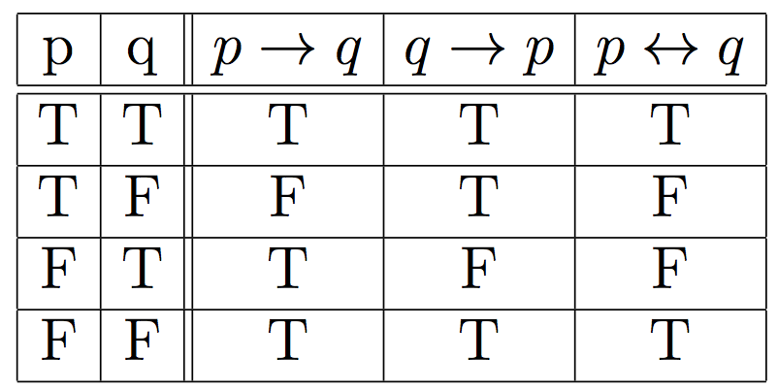
Logical Connective: Biconditional ( )
↔
Definition: The biconditional p ↔ q is the proposition that is true when p and q have the same truth values. It is false otherwise.
Note that it is equivalent to (p → q) ∧ (q → p)
Truth table

Slide 54
Logical Connective: Biconditional (↔)
The biconditional p ↔ q can be equivalently read as
p if and only if q
p is a necessary and sufficient condition for q
if p then q, and conversely
p iff q
Examples
x>0 if and only if x² is positive
The alarm goes off iff a burglar breaks in

Slide 56
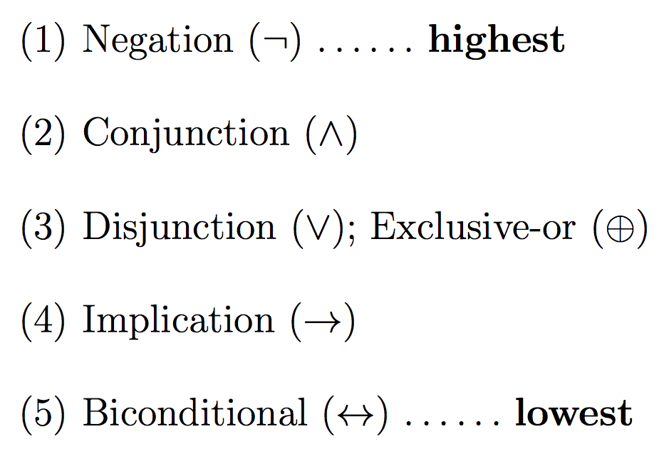
Precedence of Logical Operators
As in arithmetic, an ordering is imposed on the use of logical operators in compound propositions
However, it is preferable to use parentheses to disambiguate operators and facilitate readability
¬ p ∨ q ∧ ¬ r ≡ (¬p) ∨ (q ∧ (¬r))
To avoid unnecessary parenthesis, the following precedence hold:

Slide 57
Examples
Express the following sentence in the form If P, then Q.
We will order pizza today if there are 100 students in the class.
We will order pizza today only if there are 100 students in the class.
You can use the lab if you are a cs major or not a freshman.
An integer is by 8 only if it is divisible by 4.

Slide 58
Examples
Express the following sentence in the form If P, then Q.
We will order pizza today if there are 100 students in the class.
(If there are 100 students, then we will order pizza today)
We will order pizza today only if there are 100 students in the class.
You can use the lab if you are a cs major or not a freshman.
An integer is divisible by 8 only if it is divisible by 4.

Slide 59
Examples
Express the following sentence in the form If P, then Q.
We will order pizza today if there are 100 students in the class.
(If there are 100 students, then we will order pizza today)
We will order pizza today only if there are 100 students in the class.
(If we order pizza today, there are 100 students in the class)
You can use the lab if you are a cs major or not a freshman.
An integer is divisible by 8 only if it is divisible by 4.

Slide 60
Examples
Express the following sentence in the form If P, then Q.
We will order pizza today if there are 100 students in the class.
(If there are 100 students, then we will order pizza today)
We will order pizza today only if there are 100 students in the class.
(If we order pizza today, there are 100 students in the class)
You can use the lab if you are a cs major or not a freshman.
(if you are a cs major or not a freshman, then you can use the lab.)
An integer is divisible by 8 only if it is divisible by 4.

Slide 61
Examples
Express the following sentence in the form If P, then Q.
We will order pizza today if there are 100 students in the class.
(If there are 100 students, then we will order pizza today)
We will order pizza today only if there are 100 students in the class.
(If we order pizza today, there are 100 students in the class)
You can use the lab if you are a cs major or not a freshman.
(if you are a cs major or not a freshman, then you can use the lab.)
An integer is divisible by 8 only if it is divisible by 4.
(If an integer is divisible by 8, then it is divisible by 4.)

Slide 62
Truth Tables
Logical operators/connectives are defined by truth tables:
Negation truth table (unary):
Binary truth tables:
p | ¬p
F T | T F
p | q | p∧q | p∨q | p ⊕q | p →q | p ↔ q
T T F F | T F T F | T F F F | T T T F | F T T F | T F T T | T F F T

Slide 63
Logical Equivalence
Tautology
A compound proposition is a tautology if the proposition is always true, regardless of the truth value of the individual propositions that occur in it.
Contradiction
A compound proposition is a contradiction if the proposition is always false, regardless of the truth value of the individual propositions that occur in it.

Slide 64
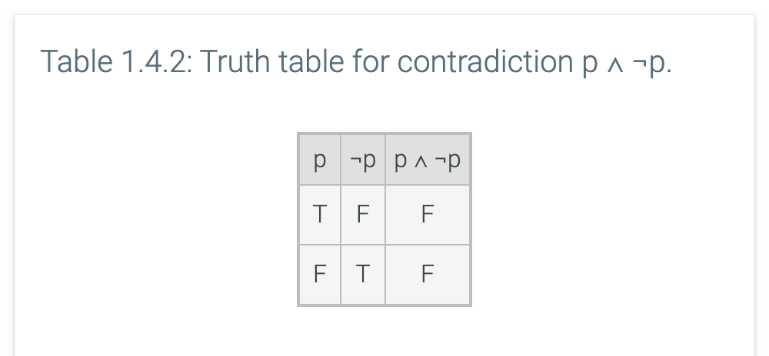

Slide 65
Logical Equivalence
Definition: Two statements s₁ and s₂ are logically equivalent, s₁ ≡ s₂, if their truth tables are the same
i.e. s₁ is true (respectively, false) if and only if the statement s₂ is true (respectively, false).

Slide 68
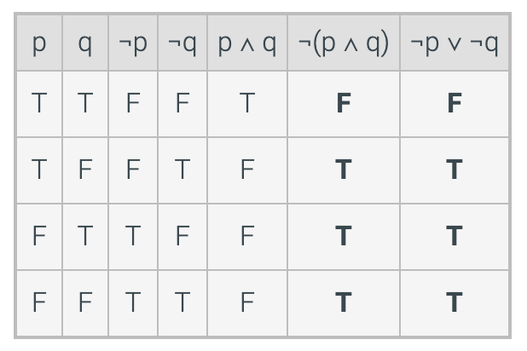
Truth table to show: ¬p ∨ ¬q ≡ ¬(p ∧ q).

Slide 69
Example
True or False:
≡

Slide 70
Example
Show that
≡

Slide 71
Exercise 1.4.5: Logical equivalence of two English statements.
Define the following propositions:
j: Sally got the job.
l: Sally was late for her interview
r: Sally updated her resume.
Express each pair of sentences using logical expressions. Then prove whether the two expressions are logically equivalent.

Slide 72
Exercise 1.4.5: Logical equivalence of two English statements.
Express each pair of sentences using logical expressions. Then prove whether the two expressions are logically equivalent.
If Sally did not get the job, then she was late for her interview or did not update her resume.
If Sally updated her resume and did not get the
job, then she was late for her interview.
Solution:
¬j → (l ∨ ¬r) (r ∧ ¬j) → l

Slide 73
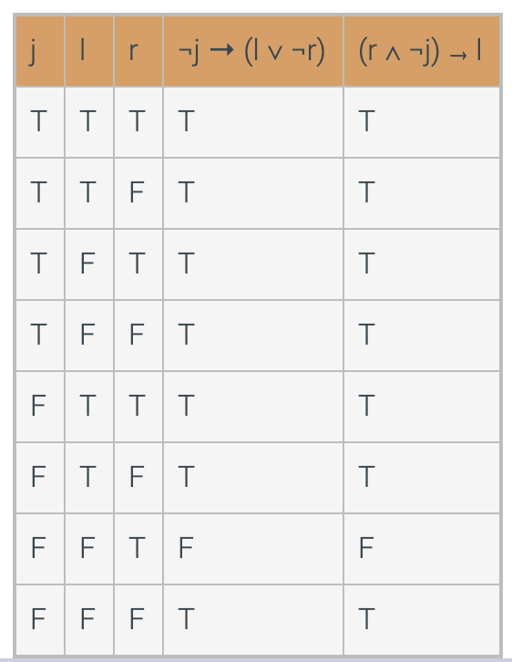
Solution (cntd.)
Logically Equivalent

Slide 74
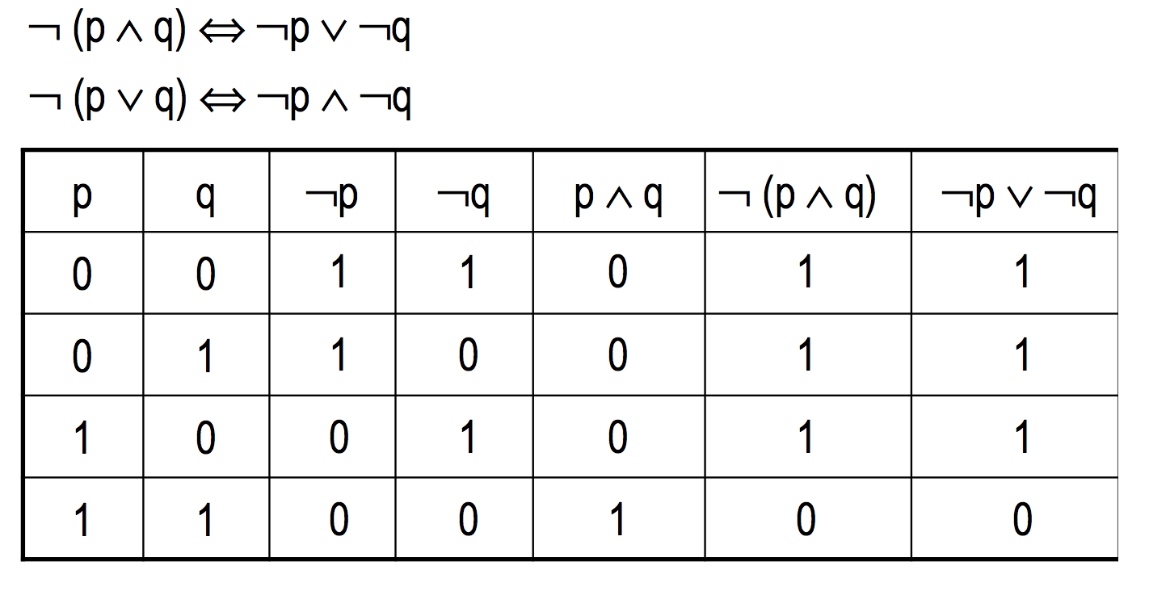
DeMorgan’s Law
De Morgan's laws are logical equivalences that show how to correctly distribute a negation operation inside a parenthesized expression.
≡
≡
1 : T
0 : F

Slide 75
Laws of propositional logic
If two propositions are logically equivalent, then one can be substituted for the other within a more complex proposition.
For example p → q ≡ ¬p ∨ q.
Therefore, (p ∨ r) ∧ (¬p ∨ q) ≡ (p ∨ r) ∧ (p → q).
The compound proposition after the substitution is logically equivalent to the compound proposition before the substitution.

Slide 76
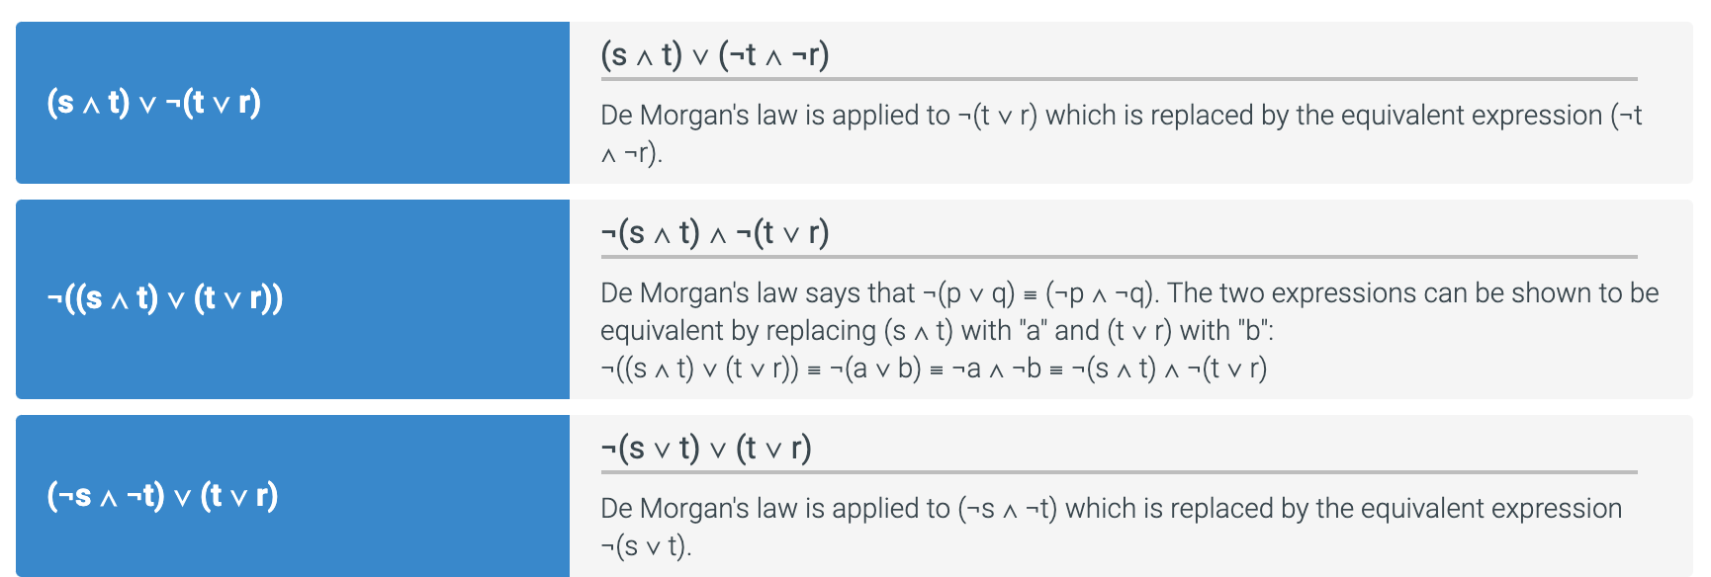
The following logical propositions are matched using the logical equivalence ¬(p ∨ q) ≡ ¬p ∧ ¬q (DeMorgan’s law)

Slide 77
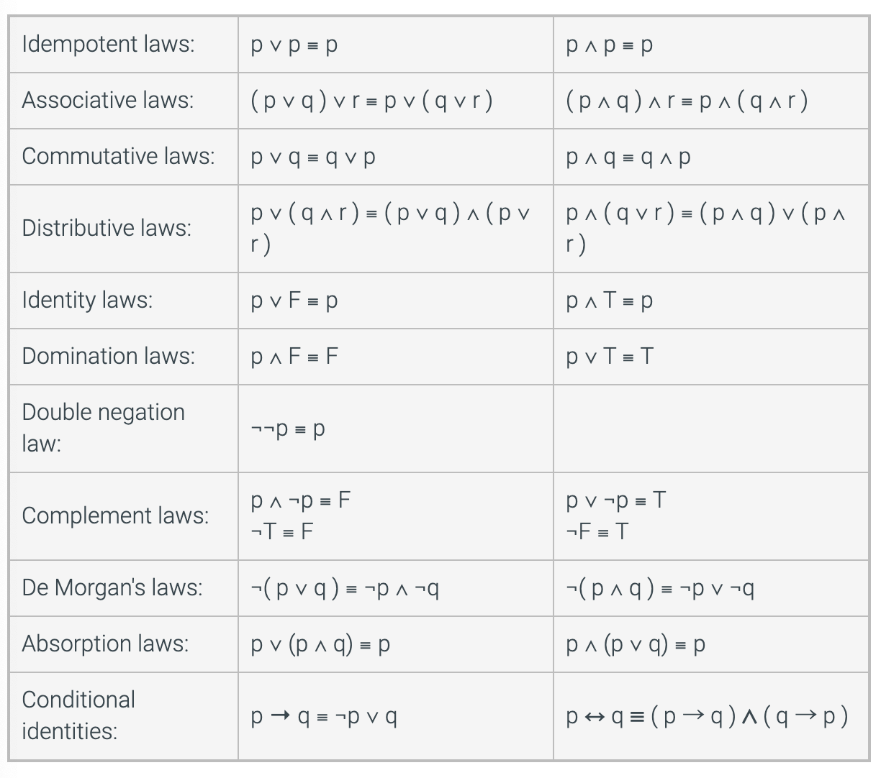
Laws of Propositional logic (Table 1.5 of the text)

Slide 78
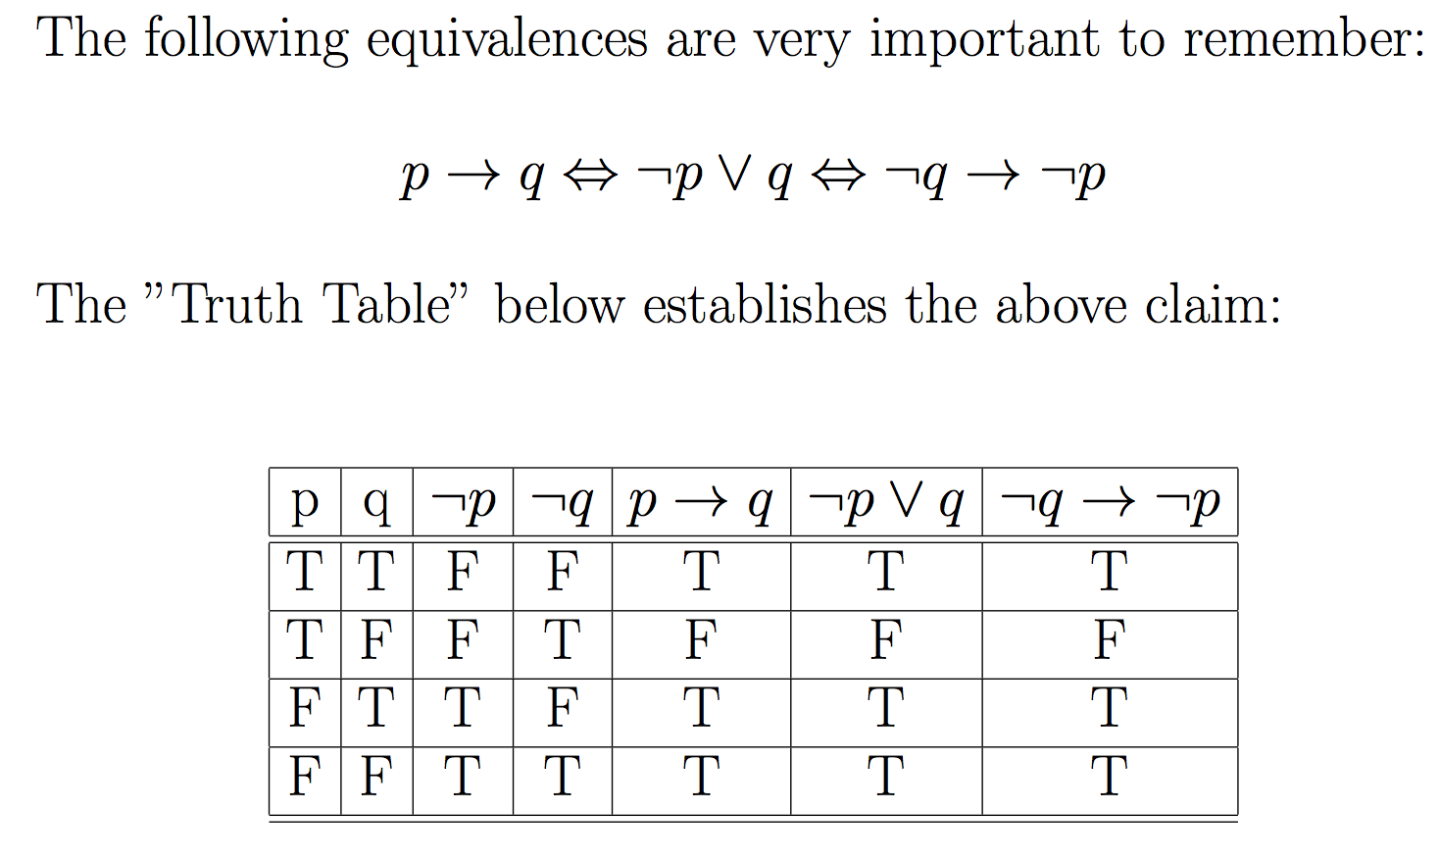
p implies q (p→q)
≡
≡

Slide 79
Examples
Express the following sentence in the form If p, then q and if not q, not p .
We will order pizza today if there are at least 100 students in the class.
(If there are at least 100 students, then we will order pizza today)
(if we don’t order any pizza today, there are less than 100 students

Slide 80
Examples
Express the following sentence in the form If p, then q and if not q, not p .
We will order pizza today if there are at least 100 students in the class.
(If there are at least 100 students, then we will order pizza today)
(if we don’t order any pizza today, there are less than 100 students
We will order pizza today only if there are at least 100 students in the class.
(If we order pizza today, there are at least 100 students in the class.)
(if there are less than 100 students in the class, we don’t order pizza today.)

Slide 81
Examples
Express the following sentence in the form If p, then q and if not q, not p .
You can use the lab if you are a cs major or not a freshman.
(if you are a cs major or not a freshman, then you can use the lab.)
(If you cannot use the lab, you are not a cs major and a freshman)

Slide 82
Examples
Express the following sentence in the form If p, then q and if not q, not p .
You can use the lab if you are a cs major or not a freshman.
(if you are a cs major or not a freshman, then you can use the lab.)
(If you cannot use the lab, you are not a cs major and a freshman)
An integer is divisible by 8 only if it is divisible by 4.
(If an integer is divisible by 8, then it is divisible by 4.)
(if an integer is not divisible by 4, it is not divisible by 8.)

Slide 83
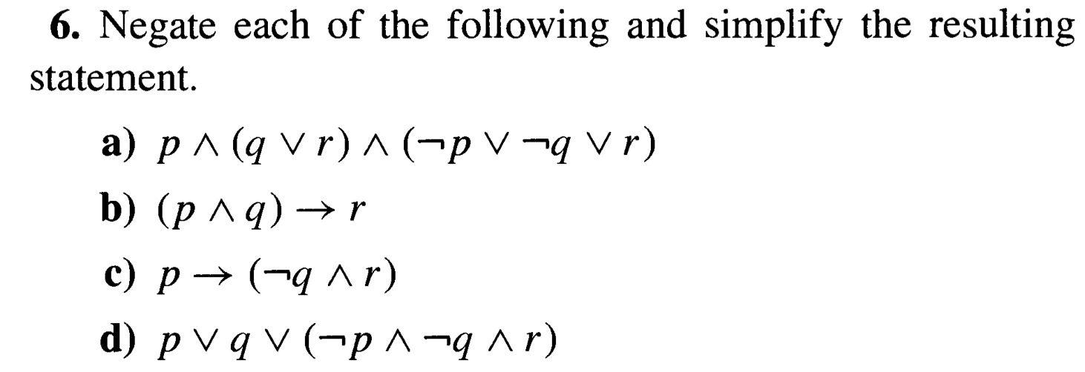

Slide 84
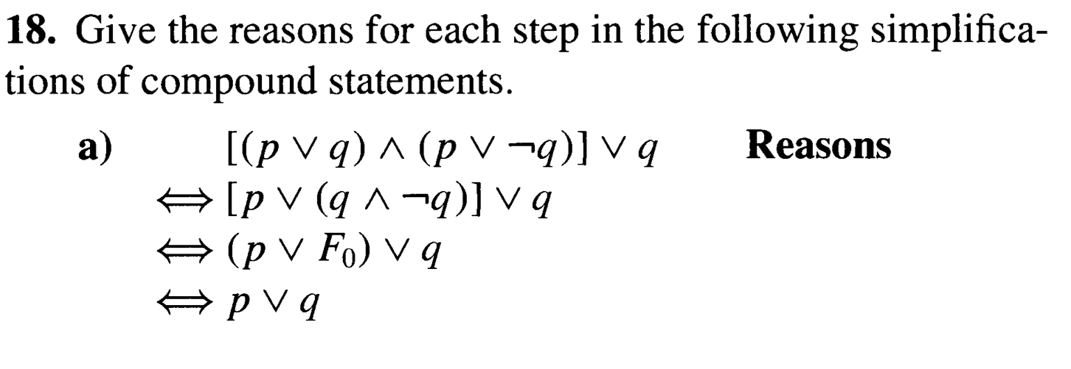
≡
≡
≡

Slide 85
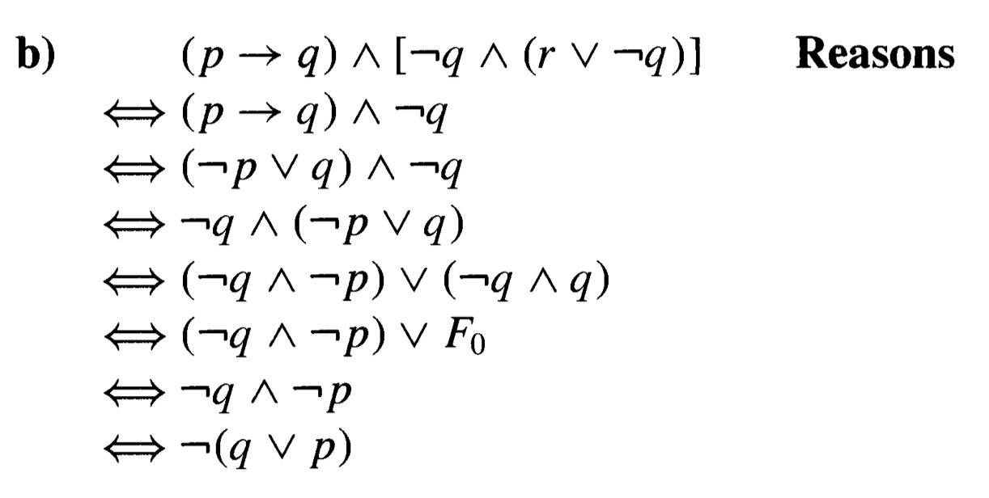
≡
≡
≡
≡
≡
≡
≡

Slide 86
≡
≡
≡

Slide 90
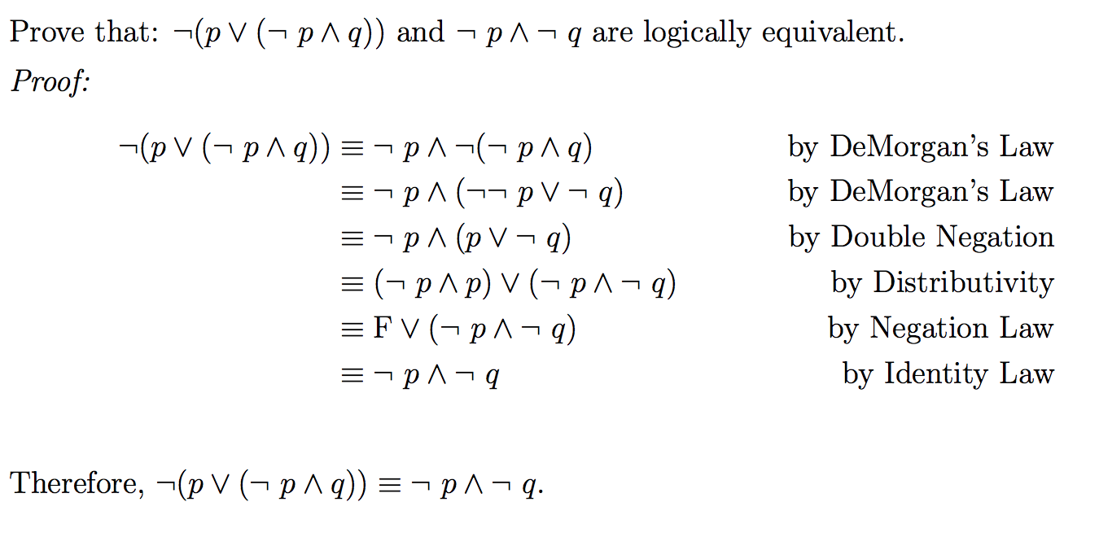

Slide 92
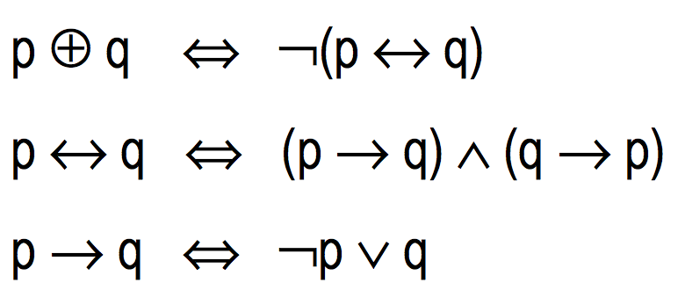
Expressing connectives
We have seen that connectives can be expressed through others:
≡
≡
≡

Slide 93
Theorem
Every compound statement is logically equivalent to a statement that uses only conjunction, disjunction, and negation.

