Slide 1
Topics Covered- Oct 12 onwards 2019
MACM 101

Slide 2
Set Theory
Sections 3.1, 3.2, 3.3

Slide 3
Set Theory
A set is an unordered collection of objects.
The objects in a set are called elements.
One way to describe a set is to list its elements {0, 1, 2, 3, 4, 5, 6, 7, 8, 9} – the set of digits
(a, b, ...., x, y, z} – the alphabet set
A set can be element of another set
{{a,b, ...}, {0,1,2, ...., 9}, ... ,{α, β, ....}, ....} – set of all alphabets

Slide 4
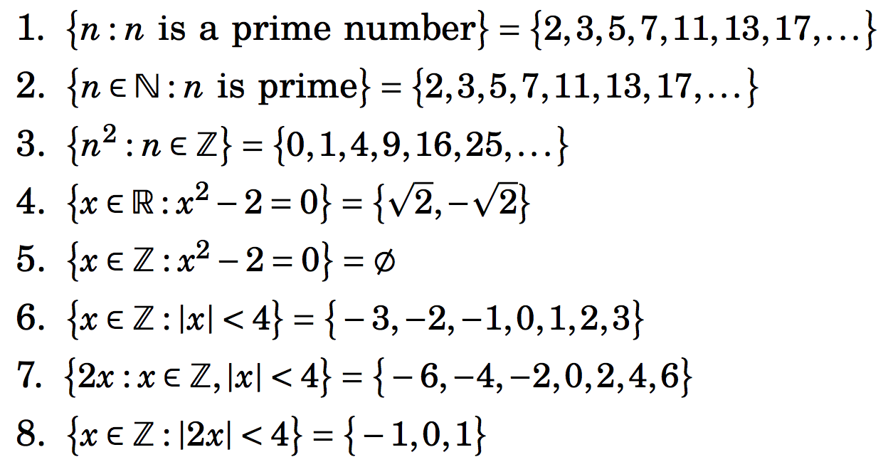
Some illustrations of set-builder notation

Slide 5
Special sets

Slide 6
Universe

Slide 7
Equality of Sets, Subsets
Two sets are equal if they have the same elements.
If B is a subset of A, every element of B is an element of A. We write

Slide 8
Power set of a set
Given a set A, the power set of A, P(A), is the set of all subsets of A.
Theorem: If A is finite, |P(A)| = 2^{|A|}.

Slide 9
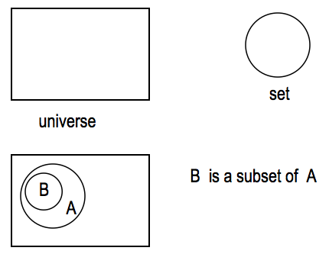
Venn Diagram
It is often used to visualize the various relations between the sets.

Slide 10
Sets and Logic

Slide 11
Laws of Set Theory

Slide 12
More Laws of Set Theory

Slide 13
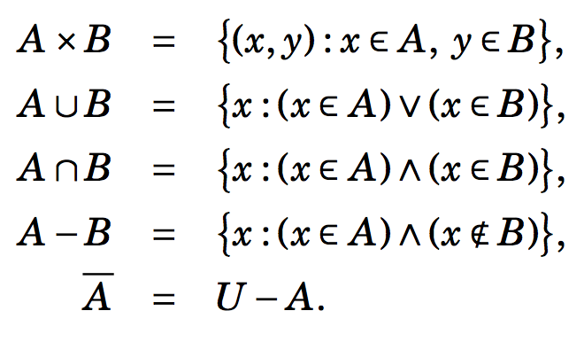
Proof involving sets
Some important definitions; Let A and B be sets.

Slide 14
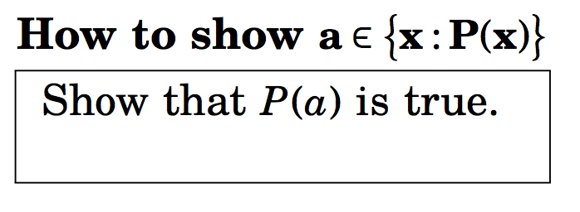
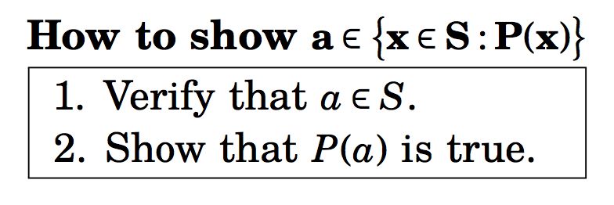
Proof involving sets

Slide 15
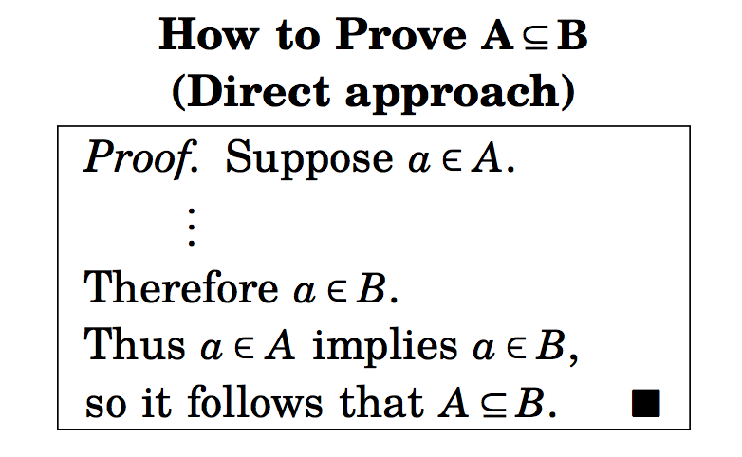
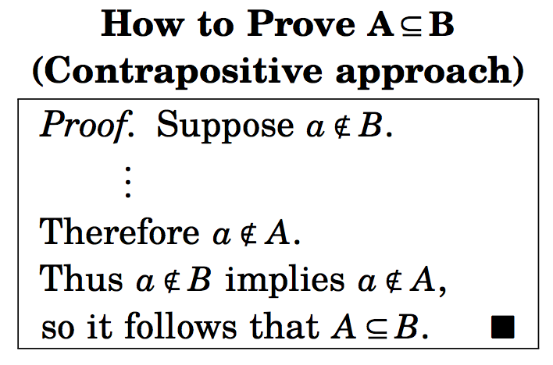
Proof involving sets

Slide 16
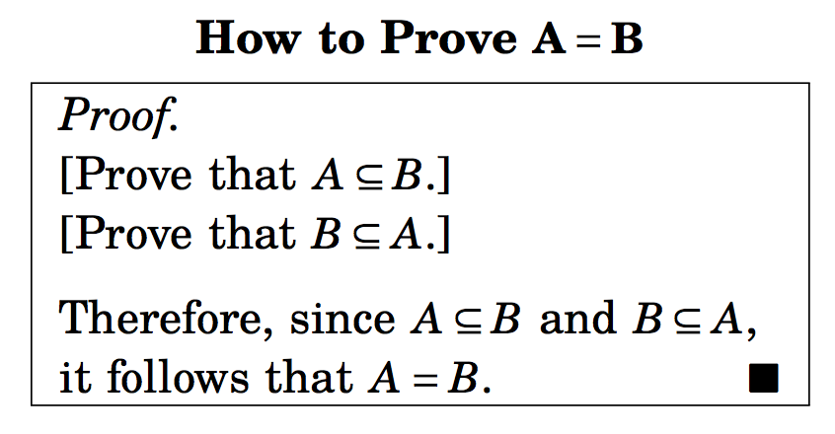
Proof involving sets

Slide 17
Probability Theory
Section 3.4 and 3.5

Slide 18
Sample space
Experiment: tossing a coin, rolling a die, selecting subjects from a group at random
The set of all possible outcomes of an experiment is called a sample space.
Under the assumption of equal likelihood, let S be the sample space for an experiment E. Each subset of S, including empty set, is called an event. Each element of S determines an outcome, so if |S| =n and a ε S, A ⊆ S, then
Pr({a}) = Pr(a) = |{a}|/|S| = 1/n
Pr(A) = |A|/n

Slide 19
Axioms of Probability
Let S be the sample space for an experiment E. If A and B are any events – that is Φ ⊆ A, B ⊆ S, then
Pr(A) ≥ 0
Pr(S)=1
if A, B are disjoint (or, mutually disjoint) the Pr(A ∪ B) = Pr(A) + Pr(B).
The Rule of Complement: Pr(A)=1-Pr(A)

Slide 20
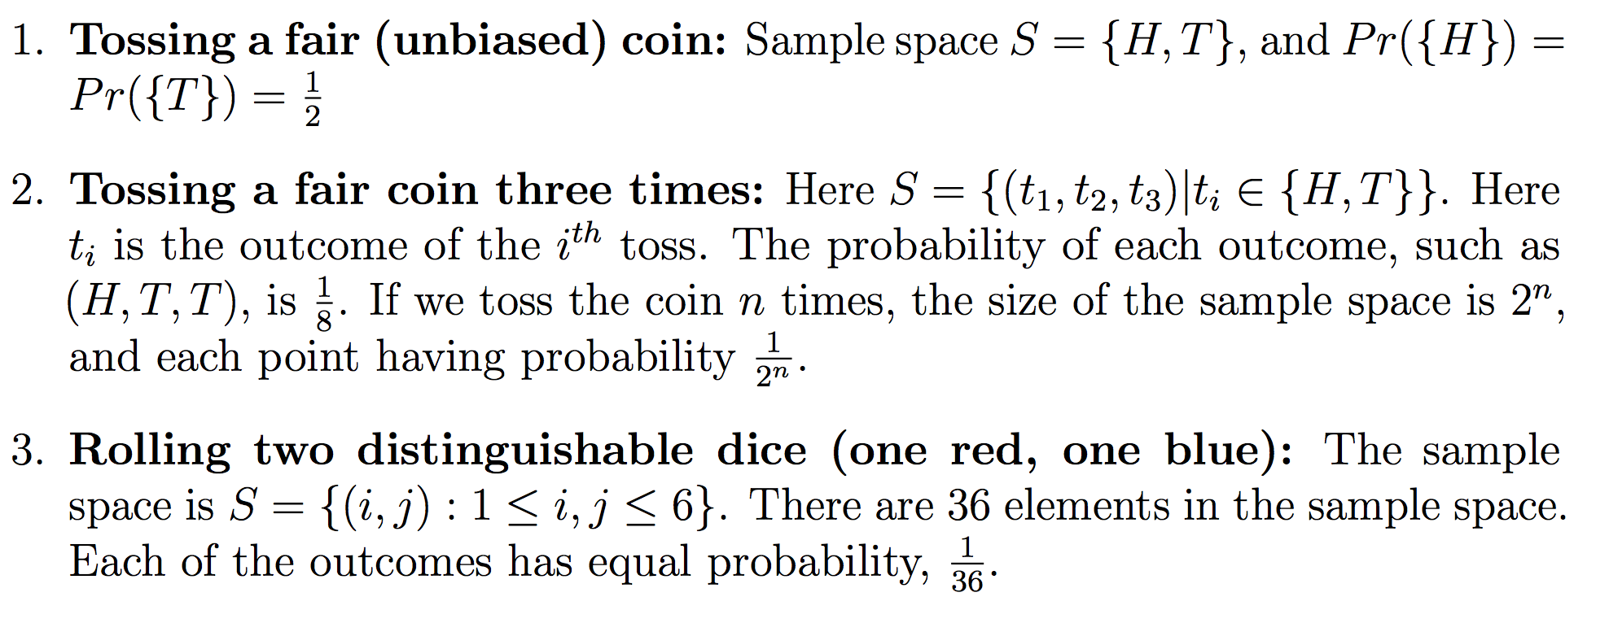
Examples of sample space

Slide 21
Examples of sample space

Slide 22
Mathematical Induction
Section 4.1

Slide 23
Mathematical Induction (section 4.1)
Mathematical induction is a rigorous method that proves statements with absolute certainty.

Slide 24
Principle of Mathematical Induction
Let S(n) denote a mathematical statement for all positive integers n. In order to prove S(n) is true for all positive integers n, we complete two steps:
Basis step: We verify that S(1) is true.
Inductive step: We show that, given any integer k ≥ 1, conditional statement S(k) → S(k + 1) is true
It follows by mathematical induction that every S(n) is true.
Symbolically
(S(1)^ ∀(k ≥ 1) (S(k) → S(k+1))) → ∀(n ≥ 1) S(n)

Slide 25
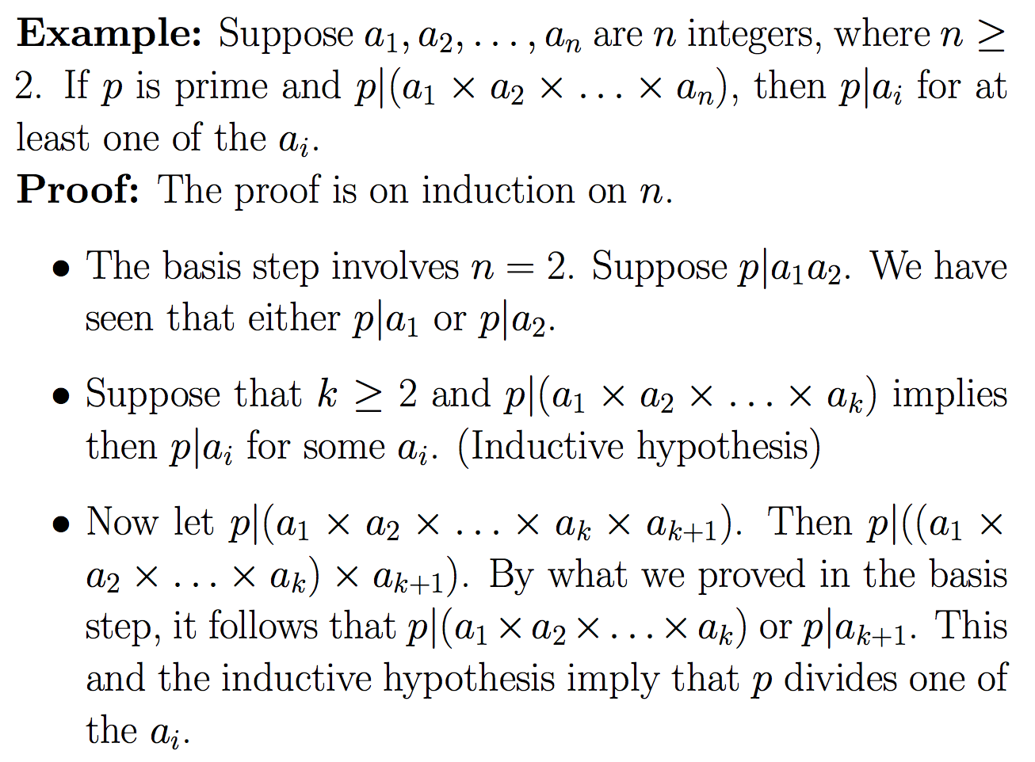

Slide 26
Principle of Strong Mathematical Induction
Sometimes mathematical induction is not enough.
In order to prove that S(n) is true for all positive integer n ≥ n₀, we complete two steps:
Basis step: We verify that S(n₀), S(n₀+1), ..., S(n₁) are true.
Inductive step: We show that conditional statement (S(n₀)^ S(n₀+1)^ ....^ S(k)) → S(k + 1) for all positive integers k ≥ n₁.
It follows by mathematical induction that every S(n), n≥ n₀ is true.
Symbolically
(S(n₀)^ S(n₀+1)^ ...^S(n₁)^ ∀k(S(n₁+1)^ …^ S(k)) → ∀(n≥ n₀) S(n)

Slide 27
The Well-Ordering Principle
The proofs of principle of induction and proof of strong induction use the well-ordering principle.
(Principle)
Every non-empty subset of N, set of nonnegative integers, contains a smallest element. ( We often express this by saying that N is well-ordered.
Note that sets of all integers, rational numbers, real numbers do not have this property. (Why?)

Slide 28
Why Induction Works

Slide 29
Summation

Slide 30
More Summation

Slide 31
Problems
Show that 43 is the largest number you cannot write as the sum of 6, 9 or 20.
Show that p(x): x=3a+8b for all x ≥ 14 is true.
Show that 3|(5^{2n} -1) for all non-negative integers n.

Slide 32
Class notes on Chapter 4 and 5
Topics covered:
Recursive definition
Properties of Integers
Functions: injective, surjective and bijective

Slide 33
Recursive Definitions
Recursively defined sequence
Consider the Fibonacci sequence:
{F_{n}} = 1, 1, 2, 3, 5, ….
Here F₁=1, F₂=1, F₃=2, …..
Recursive Definition of {F_{n}}
Initialization: F₁ = 1, F₂=2
Recursion F_{n} = F_{n-1} + F_{n-2}, n >= 3

Slide 34
Recursive Definitions (contd.)
Recursively defined functions
Consider the factorial function:
n! = 1.2.3. ….(n-2)(n-1)n
Here 0!=0, 1!=1, 2!=2
Recursive Definition of n!
Initialization: 1! = 1
Recursion n! = n.(n-1)!, n >= 2

Slide 35
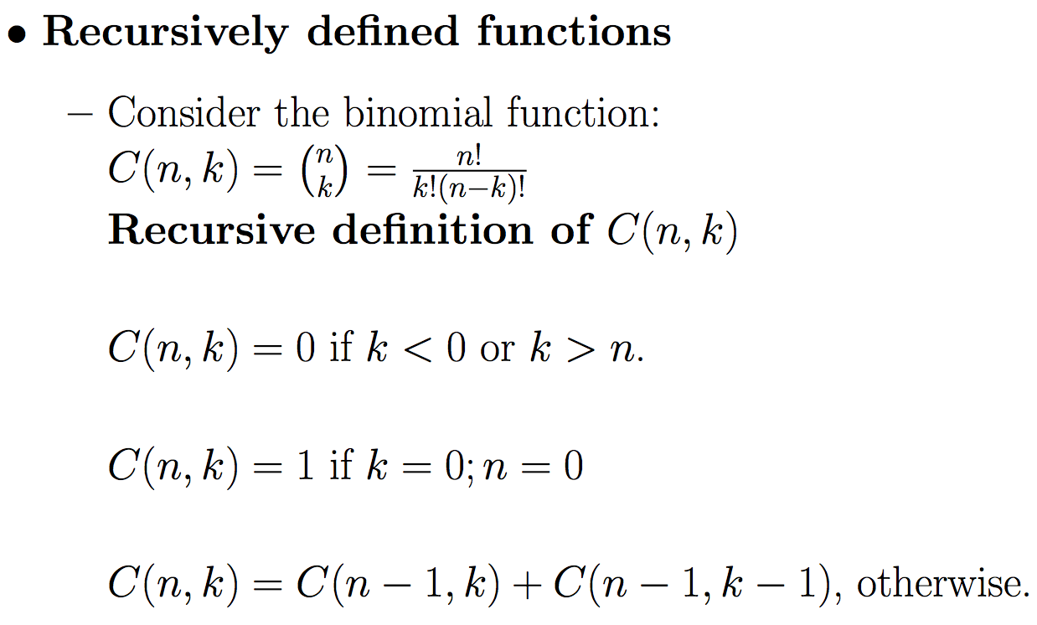
Recursive Definitions (contd.)

Slide 36
Recursive Definitions (contd.)
Recursively defined mathematical notations
Consider the sum
A(n) = a₁+a₂+ …. +a_{n}
Here A(1) = a₁, A(2) = a₂
Recursive Definition of A(n)
Initialization: A(1) = a₁
Recursion A(n)= A(n-1) + a_{n}, n ≥ 2
Similar definitions can be described for the product
P(n) = a₁a₂…..a_{n} where P(1) = a_{1.}

Slide 37
Recursive Definitions (contd.)
Recursively defined sets (defining the elements of a set recursively)
Consider the set S of prices (cents) payable using quarters and dimes.
Recursive Definition of S
Initialization: 0 ε S
Recursion If x ε S, x+10 ε S and x+25 ε S.
Note that only the distinct elements of S are kept.
Recursive defn. of +ve and –ve powers of 2
Initialization: 1 ε T
IF x ε T, 2x ε T and x/2 ε T.

Slide 38
Recursive Definitions (contd.)
Recursively defined sets (defining the elements of a set recursively)
Consider the power set of A.

Slide 39
Recursive Definitions (contd.)
Recursively defined character strings
Defn: A string is a finite sequence of 0 (null string) or more letters of alphabet Σ.
For binary strings the alphabet set Σ = {0,1}.
Defining binary strings B recursively:
Initialization: {} ε B
IF u ε B, u || ’0’ ε B and u || ’1’ ε B.
Here || indicates concatenation.

Slide 40
Recursive Definitions
Factorial
Fibonacci sequence
Binomial Coefficients “n-choose-k ”
Addition of non-negative integers
Summation Notation
Product Notation

Slide 41
Applications of Recursions
Example: Find the recurrence for the number of n digit binary sequences with no pair of consecutive 1’s.
Let A(n) denote the number of n digit binary sequences with no pair of consecutive 1s.
To write A(n) we condition on the last digit. If it is 0, the number of such sequence is A(n-1). If it is 1, the penultimate digit must be 0, and the number of such sequences sought is A(n-2).
Thus A(n) = A(n-1)+A(n-2) (inductive step)
Basis step: A(1) = 2; A(2) = 3

Slide 42
Integer and Modular Arithmetic
4.3, 4.4, 4.5

Slide 43
Divisors
Let a, b, c are integers such that c = ab.
a and b are called divisors of c
a|c ∧ b|c
105 = 15∙7 implies 15|105 and 7|105

Slide 44
Divisor Theorem
Theorem: Let a, b, and c be integers. Then
a|b ∧ a|c implies a|(b+c)
a|b implies a|bc
a|b ∧ b|c implies a|c

Slide 45
Prime numbers
A number n ≥ 2 is prime if and only if it is divisible by only 1 and itself.
A number which is not a prime is called composite.
15 is composite
23 is prime

Slide 46
Fundamental Theorem of Arithmetic
Theorem: Any number n ≥ 2 is expressible as a unique product one or more primes.
100 = 2∙2∙5∙5 = 2².5²
29338848000 = 2⁸3⁵5³7³11¹

Slide 47
How many divisors?
How many positive divisors does n have?
when n= 100, the divisors are
1, 2, 4, 5, 10, 20, 25, 50, 100
n = 2²5²
Divisors are :
2⁰5⁰, 2⁰5¹,2⁰5²; 2¹5⁰, 2¹5¹,2¹5²; 2²5⁰, 2²5¹,2²5²

Slide 48
How many divisors?
How many positive divisors does n have?
Write n in its unique prime factorization pªq^{b}…s^{d} where p,q, …., s are prime.
Any divisor of n has the form p^{x}q^{y}… s^{z} where 0 ≤ x ≤ a, 0 ≤ y ≤ b, …., 0 ≤ z ≤ d.
The total number of divisors of n is (a+1)(b+1)…(d+1).
x can assume (a+1) different values, y can assume (b+1) different values, and so on. The product rule is then applied.

Slide 49
How many divisors?
How many divisors of n are perfect squares?
A number is a perfect square if and only if each of the exponents in its prime factorization is even.
Any perfect square divisor of n has the form p^{2x} q^{2y}… s^{2z} where 0 ≤ 2x ≤ a, 0 ≤ 2y ≤ b, ….,0 ≤ 2z ≤ d.
The total number of divisors of n is (floor(a/2)+1)(floor(b/2)+1)…(floor(d/2)+1).

Slide 50
GCD
Definition:
Let a, b ∈ Z where a ≥ b, and b ≠ 0. Then c ∈ Z⁺ is called a greatest common divisor of a,b if
(a) c|a and c|b
(b) for any common divisor d of a and b, we have d|c.
gcd(24,18) = 6

Slide 51
Finding the Greatest Common Divisor Using Prime Factorizations
Example: 120 = 2³ ∙3 ∙5 500 = 2² ∙5³
gcd(120,500) = 2^{min(3,2)} ∙3^{min(1,0)} ∙5^{min(1,3)}
=2² ∙3⁰ ∙5¹ = 20

Slide 52
Least Common Multiple
Definition: The least common multiple of the positive integers a and b is the smallest positive integer that is divisible by both a and b. It is denoted by lcm(a,b).
lcm(6,10) = 30.

Slide 53
lcm and gcd
lcm(2³3⁵7², 2⁴3³)
= 2^{max(3,4)} 3^{max(5,3)} 7^{max(2,0)}
= 2⁴ 3⁵ 7²
gcd(2³3⁵7², 2⁴3³)
= 2^{min(3,4)} 3^{min(5,3)} 7^{min(2,0)}
= 2³ 3³
2⁴3⁵7² x 2³3³ = 2⁷ 3⁸ 7²

Slide 54
Least Common Multiple
The greatest common divisor and the least common multiple of two integers are related by:
Theorem: Let a and b be positive integers. Then
ab = gcd(a,b) ∙lcm(a,b)

Slide 55
Prime factorization of products and quotients
p₁, p₂, …, p_{n} are primes.
a(i)s and b(i)s are positive integers.
x = p₁^{a(1)}p₂^{a(2)}……..p_{n}^{a(n)}
y = p₁^{b(1)}p₂^{b(2)}……..p_{n}^{b(n)}
x.y = p₁^{a(1)+b(1)}p₂^{a(2)+b(2)}……..p_{n}^{a(n)+b(n)}
y|x = p₁^{a(1) - b(1)}p₂^{a(2) - b(2)}……..p_{n}^{a(n) - b(n)}

Slide 56
Euclidean Algorithm
Example: Find gcd(287,91):
287 = 91 ∙ 3 + 14
91 = 14 ∙ 6 + 7
14 = 7 ∙ 2 + 0
gcd(287, 91) = gcd(91, 14) = gcd(14, 7) = 7
Divide 287 by 91
Divide 91 by 14
Divide 14 by 7
Stopping condition

Slide 57
Example
Find d = gcd(821,123)
821 =123 ∙ 6 + 83 ………… (1)
123 = 83 ∙ 1 + 40 …………. (2)
83 = 40 ∙ 2 + 3 …………. (3)
40 = 3 ∙ 13 + 1 …………. (4)

Slide 58
Example
d = gcd(821,123) = 1 (i.e. 821 and 123 are relatively prime)
We can find integers u and v such that 1 = 821u +123v.
821 =123 ∙ 6 + 83 ………… (1)
123 = 83 ∙ 1 + 40 …………. (2)
83 = 40 ∙ 2 + 3 …………. (3)
40 = 3 ∙ 13 + 1 …………. (4)

Slide 59
Example
Find d = gcd(821,123) = 1
We can find integers u and v such that d = 821u +123v.
821 =123 × 6 + 83 ………… (1)
123 = 83 × 1 + 40 …………. (2)
83 = 40 × 2 + 3 …………. (3)
40 = 3 × 13 + 1 …………. (4)
Now we can write
1 = 40 − 3×13 (from (4))
1 = 40 − (83 - 40×2) × 13 (using (3))
1 = 40 × 27 − 83 × 13
1 = (123 – 83 × 1) × 27 − 83 × 13 (from (2))
1 = 123 × 27 − 83 × 40
1 = 123 × 27 − (821 – 123×6) × 40 (from (1))
1 = 123 × 267 − 821×∙ 40
Thus we have u = -40 and v = 267.

Slide 60
Example
Find d = gcd(821,123) = 1
We can find integers u and v such that d = 821u +123v.
821 =123 × 6 + 83 ………… (1)
123 = 83 × 1 + 40 …………. (2)
83 = 40 × 2 + 3 …………. (3)
40 = 3 × 13 + 1 …………. (4)
Now we can write
1 = 40 − 3×13 (from (4))
1 = 40 − (83 - 40×2) × 13 (using (3))
1 = 40 × 27 − 83 × 13
1 = (123 – 83 × 1) × 27 − 83 × 13 (from (2))
1 = 123 × 27 − 83 × 40
1 = 123 × 27 − (821 – 123×6) × 40 (from (1))
1 = 123 × 267 − 821×∙ 40
Thus we have u = -40 and v = 267.
The gcd of 821 and123 can be expressed as a linear combination of 821 and 123.

Slide 61
Example 4.37
Griffin has two unmarked containers. One container holds 17 litres and the other holds 55 litres. Explain how Griffin can use his two containers to measure exactly one litre.
gcd(55,17) = 1.
1 = 13 (17) – 4 (55)
Rest is easy
How about measuring 3 litres?
Can it be done?
Yes, since gcd(17,55) divides 3.

Slide 62
Example 4.37
Griffin has two unmarked containers. One container holds 17 litres and the other holds 55 litres. Explain how Griffin can use his two containers to measure exactly one litre.
gcd(55,17) = 1.
1 = 13 (17) – 4 (55)
Rest is easy
How about measuring 3 litres?
Can it be done?
Yes, since gcd(17,55) divides 3.
3 = 39 (17) – 12(55)

Slide 63
Example 4.38
Brian 6 minutes on an average to help a student debug a Java code, and takes 10 minutes on an average to debug a C++ program. If he works continuously for 104 minutes, and doesn’t waste any time, how many programs can he debug in each language?
We seek integers x,y ≥ 0 where 6x + 10y =104.
Can this be done?

Slide 64
Theorem 4.8
If a, b, c are positive integers, the Diophantine equation ax + by = c has an integer solution x = x₀, y = y₀ if and only if gcd(a,b) divides c.

Slide 65
Cartesian Product (sections 5.1)
Let A and B are sets; A x B = {(a,b) | a ε A and b ε B};
(a,b) are ordered pairs, also known as 2-tuple.
The universes of A and B could be different.
R x R = {(x,y)| x,y ε R} is the two-dimensional real plane.

Slide 66
Relations as Subsets
A: Siblinghood. A = {people}
Because relations are just subsets, all the usual set theoretic operations are defined between relations which belong to the same Cartesian product.
Q: Consider two subsets of {1,2} × {1,2} given by
R = {(1,1), (2,2)}, S = {(1,1),(1,2)}.
Find:
The union R ∪S
The intersection R ∩ S
The symmetric difference R ⊕S
The difference R-S
The complement of R

Slide 67
A: R = {(1,1),(2,2)}, S = {(1,1),(1,2)}
R ∪S = {(1,1),(1,2),(2,2)}
R ∩S = {(1,1)}
R ⊕S = {(1,2),(2,2)}.
R-S = {(2,2)}.
R = {(1,2),(2,1)}
Notes:
In principle could represent Google’s database as a subset of {words} X {url’s} but for efficiency’s sake, Google has to use a more sophisticated data structure.

Slide 68
Functions (5.1,5.2,5.3)
For non-empty sets A and B, a function (mapping) f from A to B (f: A → B) is a relation f (a subset of AxB) from A to B in which every element a ε A, the relation f contains exactly one pair of the form (a,b). The element (a,b) ε f is abbreviated as f(a) = b.
A is the domain of f
B is the codomain of f
if f(a) = b, b is the image of a; a is the preimage of b
f is treated as a set
The range of f is the set {f(a): a ε A} = {b|(a,b) ε f}. The range is the set of all possible “output values” for f.

Slide 69
Example
• f(a) = z
• the image of d is z
• the domain of f is A = {a, b, c, d}
• the codomain is B = {x, y, z}
• f(A) = {y, z}
• the preimage of y is b
• the preimages of z are a, c and d
• f({c,d}) = {z}
The range of f is {y,z}
A
B
a
x
b
y
c
z
d

Slide 70
Functions
f: A→ B means
all a ε A have an image b ε B
some b ε B may not have a preimage a ε V
some b ε B may have more than one preimages a ε B
f(A) denotes the subset X ⊆ B such that for any x ε X, there exists an element a ε A such that f(a) = x, and for any y ε B-X, there does not exist any a ε A such that f(a) = y.
X is called the range of f.

Slide 71
Functions
Three things:
A function can be viewed as sending (mapping) elements from one set A to another set B.
Such a function can be regarded as a relation from A → B.
For every input value a (of A), there is exactly one output value f(a). (Vertical line test)

Slide 72
Some useful functions
floor functions: real R → integer Z
floor(x) = greatest integer ≤ x
= ⎣x⎦
ceiling functions: real R → integer Z
ceiling(x) = least integer ≥ x
= ⎡x⎤
⎣3.5⎦ = 3; ⎣π⎦ = 3; ⎣-3.5⎦ = - 4
⎡3.5⎤ = 4; ⎡π⎤ = 4; ⎡-3.5⎤ = -3

Slide 73
Some examples
g: Z x Z → Z which is defined as
g((m,n)) = 6m – 9n.
Note that g = {6m-9n| (m,n) ε Z x Z}
Domain is Z x Z
Codomain is Z
Range is { 3x : x ε Z} (why?)
A = {p,q,r,s}; B = {0,1,2};
f = {(p,0), (q,1), (r,2), (s,2)}
f is a function with domain A, codomain B and range B.

Slide 74
Equality of functions
Two functions f:A → B and g:C → D are equal if A=C, B=D and f(x)=g(x) for all x ε A.
Caution: f:Z → N and g:Z → Z, f(x) = |x| +2, and g(x) = |x| +2 are technically not equal.

Slide 75
Injective (one-to-one) Surjective (onto) functions
A function f: A → B is:
Injective (one-to-one) if for every x,y ε A, x ≠ y, f(x) ≠ f(y). Equivalently:
Surjective (onto) if for every b ε B, there is an element a ε such that f(a) = b.
Bijective (one-to-one and onto) if f is injective and bijective.

Slide 76
one-to-one (injective) functions
f: Z⁺ → Z⁺ where f(a) = a² is one-to-one
f: Z → Z⁺ where f(a) = a² is not one-to-one
floor and ceiling function is not one-to-one.

Slide 77
onto (surjective) functions
f:Z → Z, f(x) = x + 1 is onto.
⎣.⎦: R → Z is onto, but not one-to-one
⎡.⎤: R → Z is onto, but not one-to-one

Slide 78
one-to-one and onto (bijection)
f: R → R, f(x) = x + 1 is one-to-one correspondence
f: [0,1] → [0,1/3], f(x) = x/3 is one-to-one and onto.
f: R → R⁺, f(x) = x² is not one-to-one, but onto.
f: R → R, f(x) = x³ is injective and surjective.

Slide 79
How to show a function f: A → B is injective?
Direct approach:
Consider arbitrary x,y ε A; x ≠ y
…. Reduction steps with the goal to show that
f(x) ≠ f(y)
Contraposition approach:
Suppose x,y ε A; f(x) = f(y)
….. Reduction steps with the goal to show that x=y.
Often contrapositive approach is easy when f is an algebraic function

Slide 80
How to show a function f: A → B is surjective?
f is surjective if for all b ε B, there exists a ε A such that f(a) = b. That is
f is surjective if
Contrapositive approach:
not ( ) → f is not surjective
i.e. → f is not surjective

Slide 81
How to show a function f: A → B is surjective?
f: R – {0} → R – {0}, f(x) = 1/x +1. Is it surjective?
Let b ε B be an arbitrary element. Let f(x) = b for some x ε A. This means that
1/x + 1 = b
i.e. x = 1/(b-1). Now x is not defined if b=1. Therefore f, as defined above, is not an onto function.
Show that g : Z x Z → Z x Z, g(m,n)=(m+n,m+2n)
is bijective.

Slide 82
Section 5.6 Composition and inverse function

Slide 83
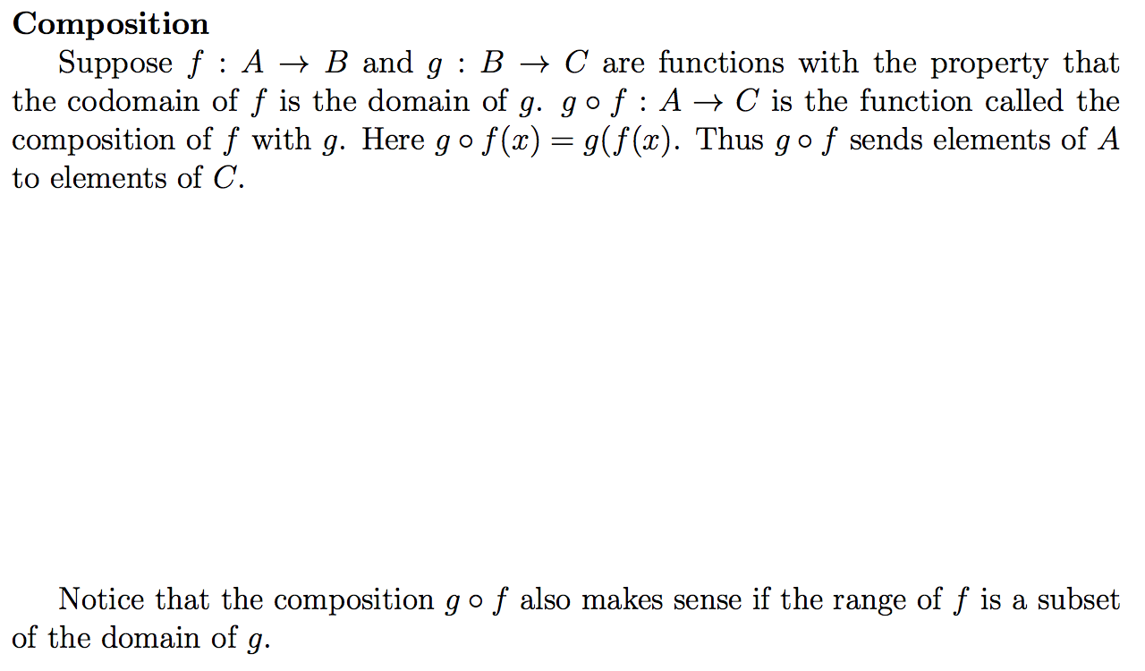
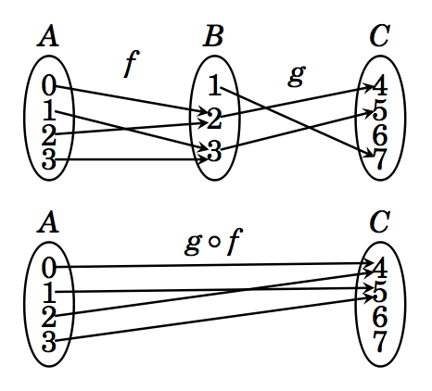
Composition functions

Slide 84
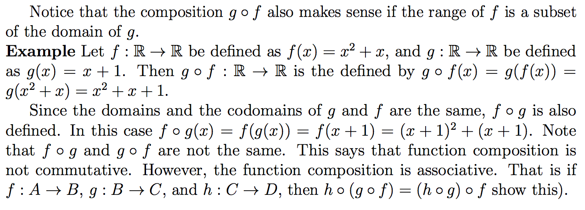
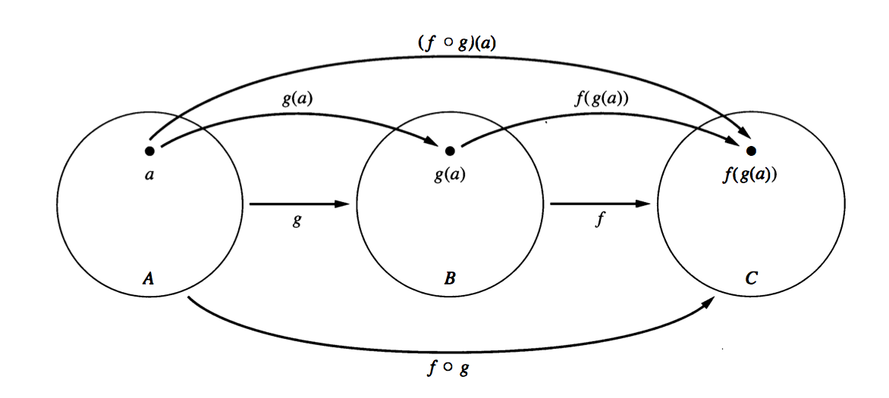
Composition functions (contd)
A diagram of compositions of two functions. There is a nice diagram in the text, page 281.

Slide 85
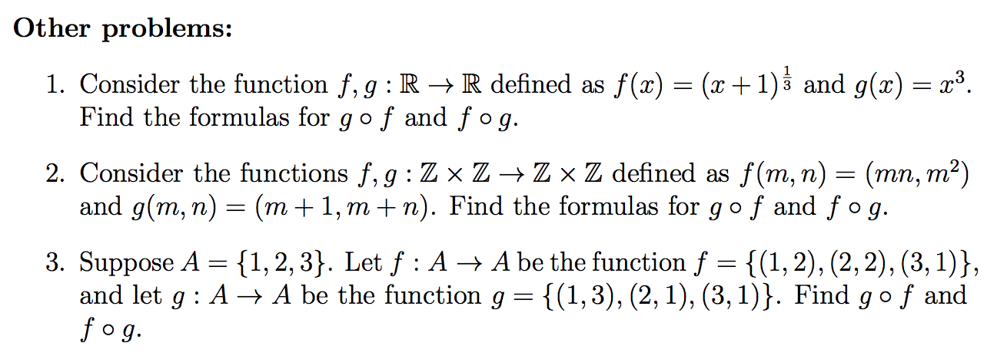
Composition functions (contd)
Problems from the text: Section 5.6: 3, 4, 7

Slide 86
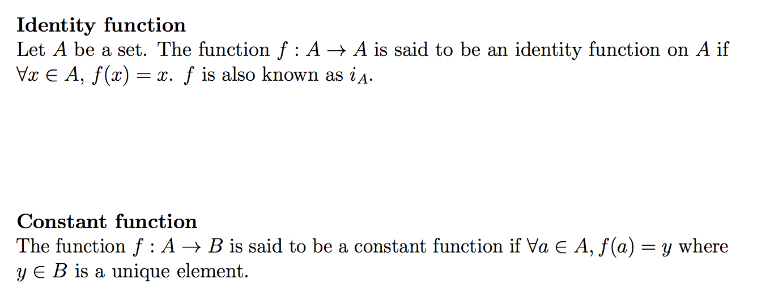
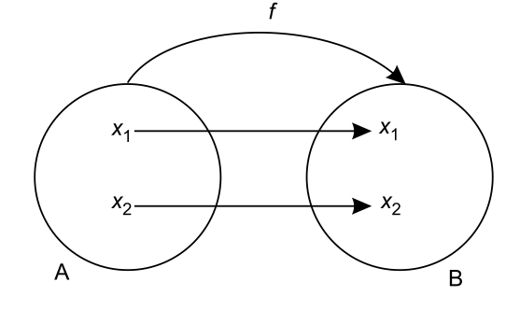
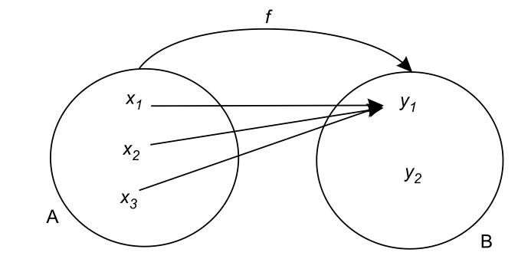
Important functions
A

Slide 87
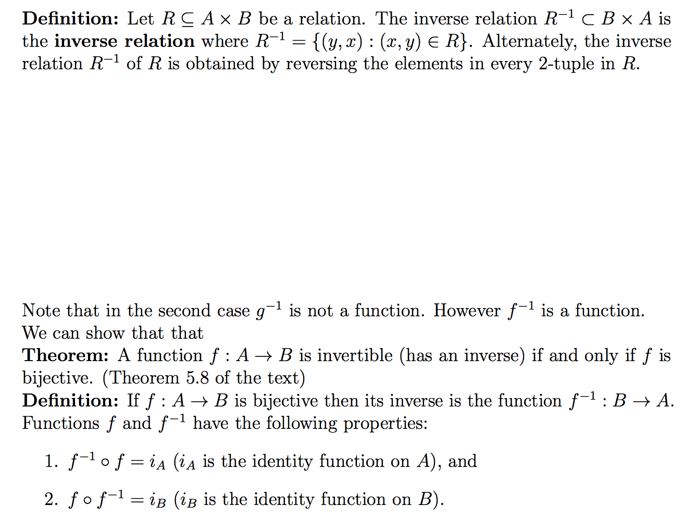
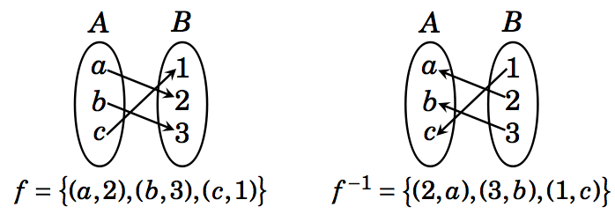
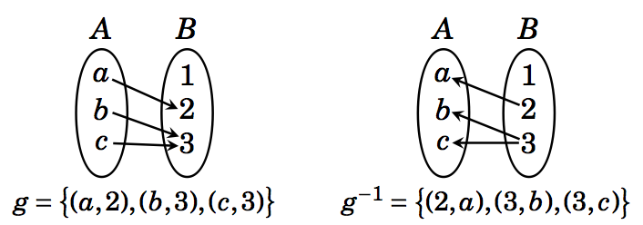
Inverse functions

Slide 88
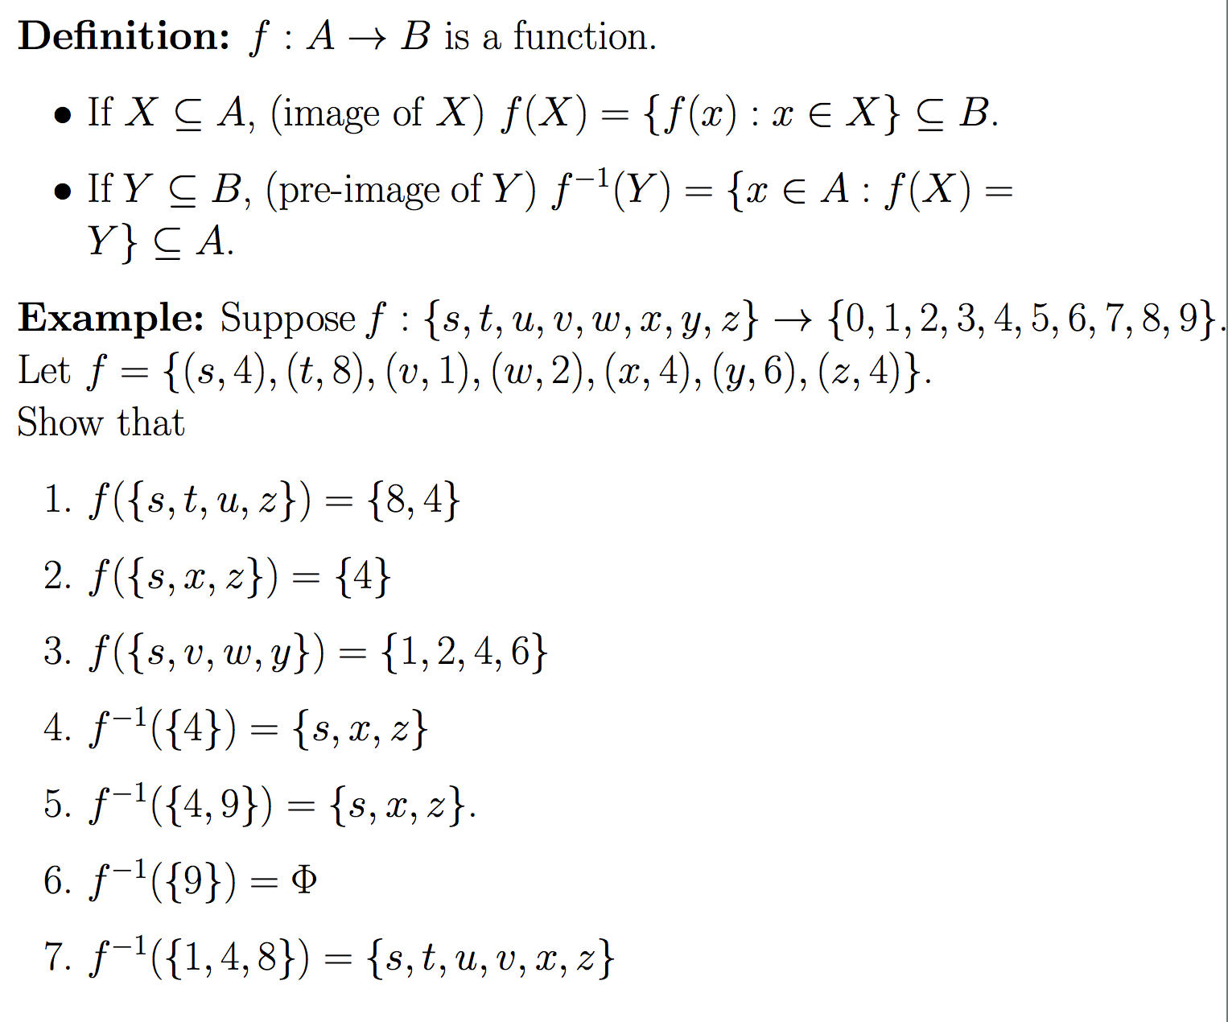

Slide 89
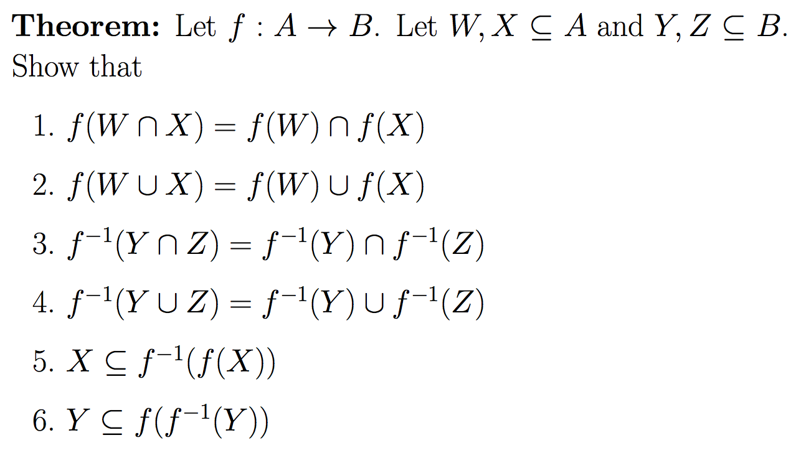

Slide 90
