Slide 1
Set Theory – Part I
Chapter 3.1, 3.2, 3.3

Slide 2
Sets in applications
Many pieces of software need to maintain sets of items. For example, a database is a large set of pieces of information.
A university maintains a set of all the students enrolled.
An airline maintains a set of all past and future flights.
One of the most basic types of operations a programmer might perform on a set of data is to ask whether a particular item is an element of that set.
Discrete math is primarily concerned with mathematical operations on sets.

Slide 3
Sets
A set is an unordered collection of objects.
the students in this class
the chairs in this room
The objects in a set are called the elements, items or members of the set.
A set is said to contain its elements.

Slide 4
Sets
The notation a ∈ A denotes that a is an element of the set A.
If a is not a member of A, write a ∉ A

Slide 5
Describing a Set: Roster Method
S = {a,b,c,d}
Order not important
S = {a,b,c,d} = {b,c,a,d}

Slide 6
Describing a Set: Roster Method
Elipses (…) may be used to describe a set without listing all of the members when the pattern is clear.
S = {a,b,c,d, ……,z }

Slide 7
Roster Method
Set of all vowels in the English alphabet:
V = {a,e,i,o,u}
Set of all odd positive integers less than 10:
O = {1,3,5,7,9}
Set of all positive integers less than 100:
S = {1,2,3,……..,99}
Set of all integers less than 0:
S = {…., -3,-2,-1}

Slide 8
Some Important Sets
N = natural numbers = {0,1,2,3….}
Z = integers = {…,-3,-2,-1,0,1,2,3,…}
Z⁺ = positive integers = {1,2,3,…..} = {x ε Z | x > 0}
Q = set of rational numbers
Q⁺ = set of positive rational numbers
R = set of real numbers
Φ, {} = empty set (null set)

Slide 9
Interval Notation
[a,b] = {x | a ≤ x ≤ b}
[a,b) = {x | a ≤ x < b}
(a,b] = {x | a < x ≤ b}
(a,b) = {x | a < x < b}
closed interval [a,b]
open interval (a,b)

Slide 10
Representation of a set
A set-builder notation is used to describe sets that are too complex to enumerate them.
Suppose E={…., -6, -4, -2, 0, 2, 4, 6, ….}
Set-builder notation
E={n : n is an even integer} or
E={n | n is an even integer}
Other examples
A = {x : x is an integer |x| < 4} = {-3, -2, -1, 0, 1, 2, 3}
The rational numbers: Q={x : x = m/n, m,n ∈ Z, n ≠ 0}

Slide 11
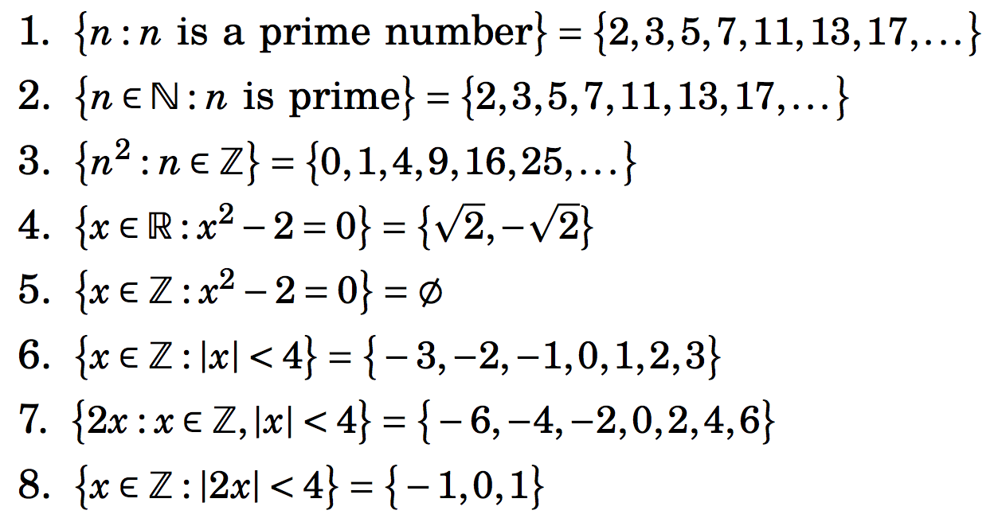
Some illustrations of set-builder notation

Slide 12
Conceptually:
Conceptually, a set is like a bag containing objects. This bag can contain another bag containing other objects.
Example: A= {1, {1}, {2}, {1,2}}
How many elements are in A?
1 ∈ A? 2 ∈ A? {2} ∈ A? {{2}} ∈ A?

Slide 13
Set of sets
The set A = {{1,2}, Φ, {1,2,3},{1}} has four elements: {1,2}, Φ, {1,2,3}, {1}}.
The empty set Φ is not the same as Φ.
The cardinality of {Φ} is one.

Slide 14
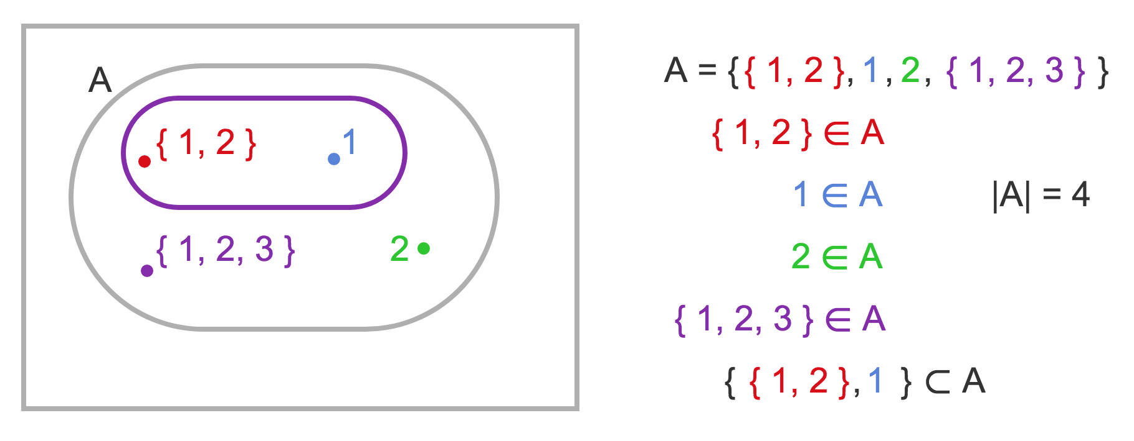
Set of sets

Slide 15
Equality of Sets, Subsets
If B is a subset of A, every element of B is an element of A. We write B ⊆ A.
Two sets are equal if they have the same elements.
To show that two sets are equal, it is sufficient to show separately that
A ⊆ B and
B ⊆ A

Slide 16
Equality of Sets, Subsets (contd.)
Z⁺ is N, the set of natural numbers
Q⁺ is the set of all positive rational numbers

Slide 17
Subsets (contd.)
A set B is a proper subset of a set A, if it is a subset A and is not equal to A ( ).
If A is a subset of B and B is a subset of C, A is a subset of C. (Transitive relation)
Note that if A has at least one element, ∅ is a proper subset of A.

Slide 18
Cardinality of a set
Cardinality of a set A, denoted by |A|:
It is the number of elements in the set
A set with finite number of elements is called a finite set.
A set with infinite number of elements is called an infinite set.
Sets N, Z, Q, R are all infinite.
Empty set has no element, denoted by ∅
How many elements does the set {∅} contain?

Slide 19
Power set
Given a set A, the power set of A, P(A), is the set of all subsets of A.
Examples
Let A={a,b,c}, P(A)={∅,{a},{b},{c},{a,b},{b,c},{a,c},{a,b,c}}
Let A={{a,b},c}, P(A)={∅,{{a,b}},{c},{{a,b},c}}
Note: the empty set ∅ and the set itself are always elements of the power set.

Slide 20
Power set
The power set is a fundamental combinatorial object useful when considering all possible combinations of elements of a set
Fact: Let S be a set such that |S|=n, then
|P(S)| = 2^{n}
Some intuition?

Slide 21
Power set
For B={1,2,3,4}

Slide 22
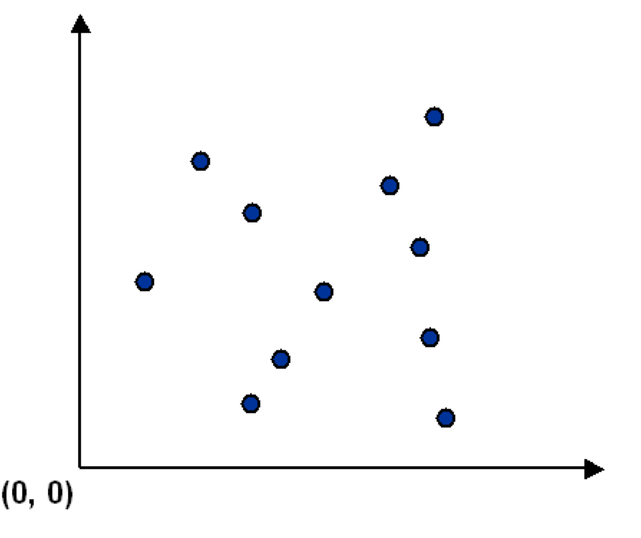
Ordered collection of objects
Sometimes we need to consider ordered collection of objects.
Consider a set S of points in the plane.
y
x

Slide 23
Ordered collection of objects
Sometimes we need to consider ordered collection of objects.
Consider a set S of points in the plane.
y
p_{i} =(x_{i},y_{i}) is the x-y coordinate of the i^{th} point.
S={(x₁,y₁), (x₂,y₂), ……, (x_{m},y_{m})} represents a set of m ordered objects.
Each object is an ordered collection of two elements.
S = {p₁,p₂, …, p_{m}} is also fine.
x

Slide 24
Set of sets
Let X={1, {1}, {1.2}, 2, {3}, 4}. Which statements are true?
2 ∈ X
{2} ∈ X
3 ∈ X
{1,2} ∈ X
{2,3} ⊆ X
{1, 2} ⊆ X
{2, 4} ⊆ X

Slide 25
Section Summary
Set Operations
Union
Intersection
Complementation
Difference

Slide 26
Union
Definition: Let A and B be sets. The union of the sets A and B, denoted by A ∪ B, is the set:
Example: What is {1,2,3} ∪ {3, 4, 5}?
Solution: {1,2,3,4,5}
Venn Diagram for A ∪ B
U
A
B

Slide 27
Operations on Sets
Let A and B be two arbitrary sets. Let U be the universal set, (i.e. A ⊆ U and B ⊆ U).
Union: A ∪ B = {x: x ∈ A or x ∈ B}
Intersection: A ∩ B = {x: x ∈ A and x ∈ B}
Difference: A – B = { x: x ∈ A and x ∉ B}
Symmetric Difference:
A △ B = {x: (x ∈ A and x ∉ B) or (x ∉ A and x ∈ B)}
= (A – B) ∪ (B – A)
Complement: U – A = {x : x ∉ A}

Slide 28
Review Question
Example: U = {0,1,2,3,4,5,6,7,8,9,10} A = {1,2,3,4,5}, B ={4,5,6,7,8}
A ∪ B
Solution: {1,2,3,4,5,6,7,8}
A ∩ B
Solution: {4,5}
Ā
Solution: {0,6,7,8,9,10}
Solution: {0,1,2,3,9,10}
A – B
Solution: {1,2,3}
B – A
Solution: {6,7,8}

Slide 29
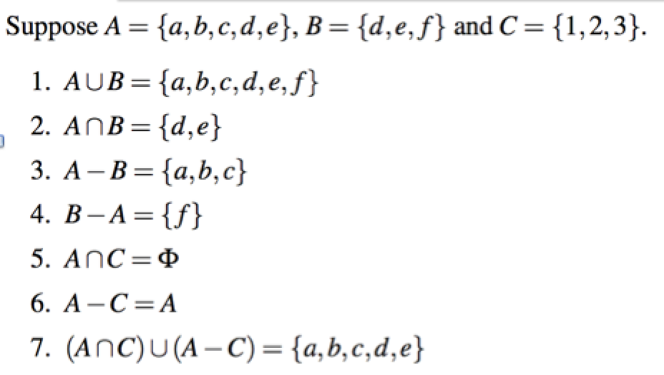
Operations on Sets

Slide 30
Operations on Sets
A={(x,x²) : x ∈ R} B={(x,ax + b) : x ∈ R and a,b ∈ R}
R
R
R

Slide 31
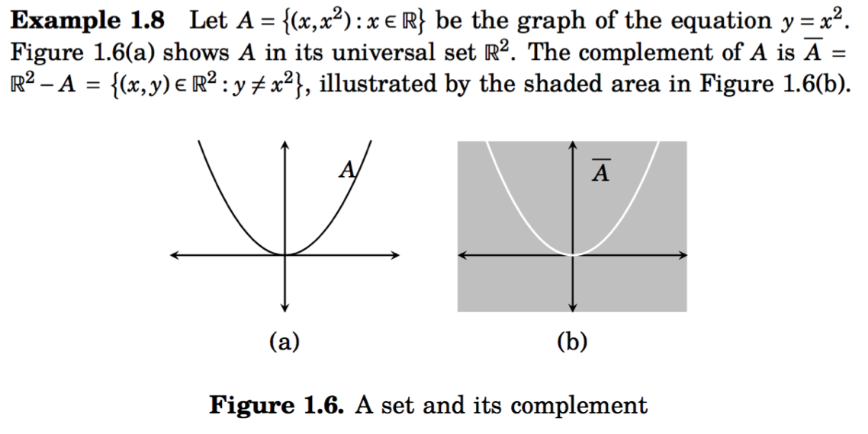
Operations on Sets
R
R

Slide 32
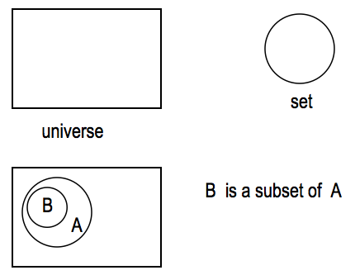
Venn Diagram
It is often used to visualize the various relations between the sets.

Slide 33
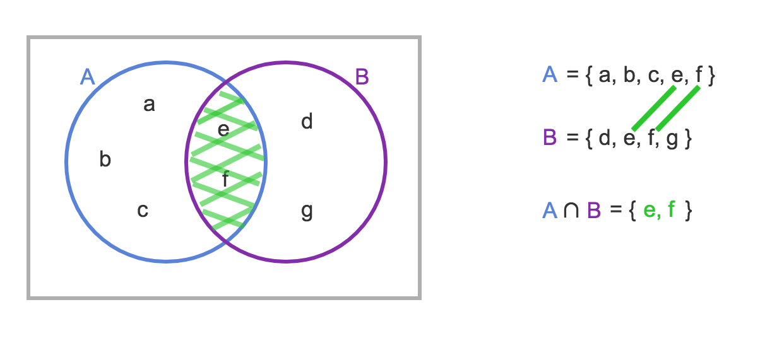
Intersection
The intersection of sets A and B, denoted by A B, is the set that contains those elements in both A and B.

Slide 34
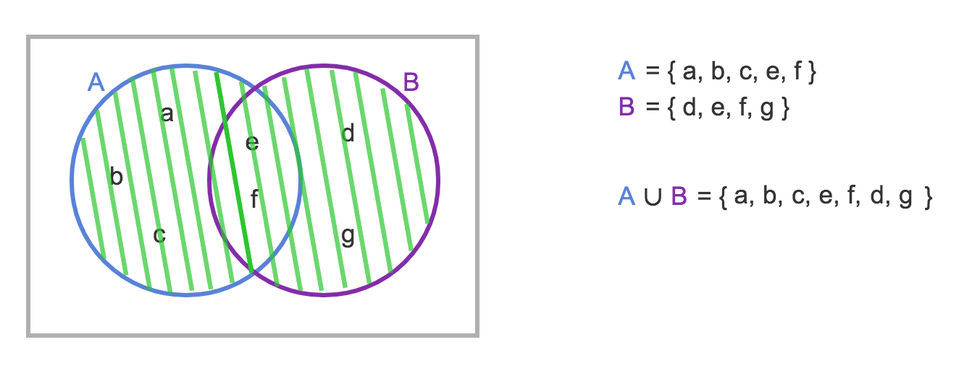
Union
The union of sets A and B, denoted by A B, is the set that contains those elements that are in either A or B.

Slide 35
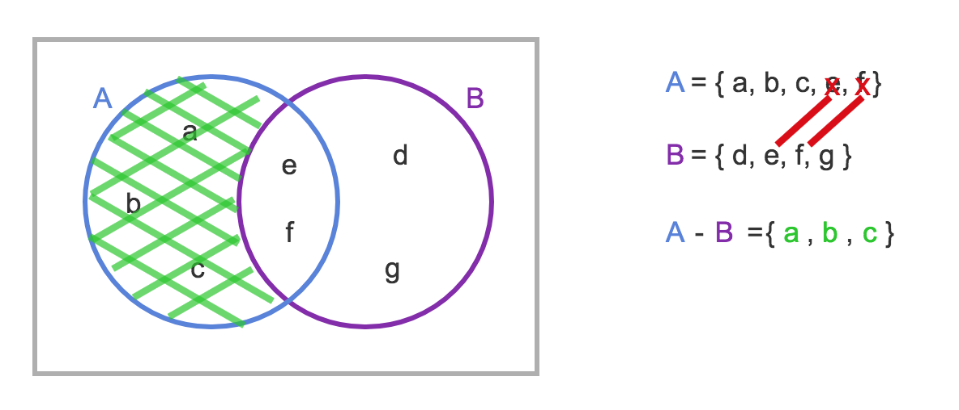
Set Difference
Definition: The difference of two sets A and B, denoted A−B, is the set containing those elements that are in A but not in B
B – A = { d , g }

Slide 36
Set Difference
Definition: The difference of two sets A and B, denoted A−B, is the set containing those elements that are in A but not in B
B – A = { d , g }
Note that A - B ≠ B - A

Slide 37
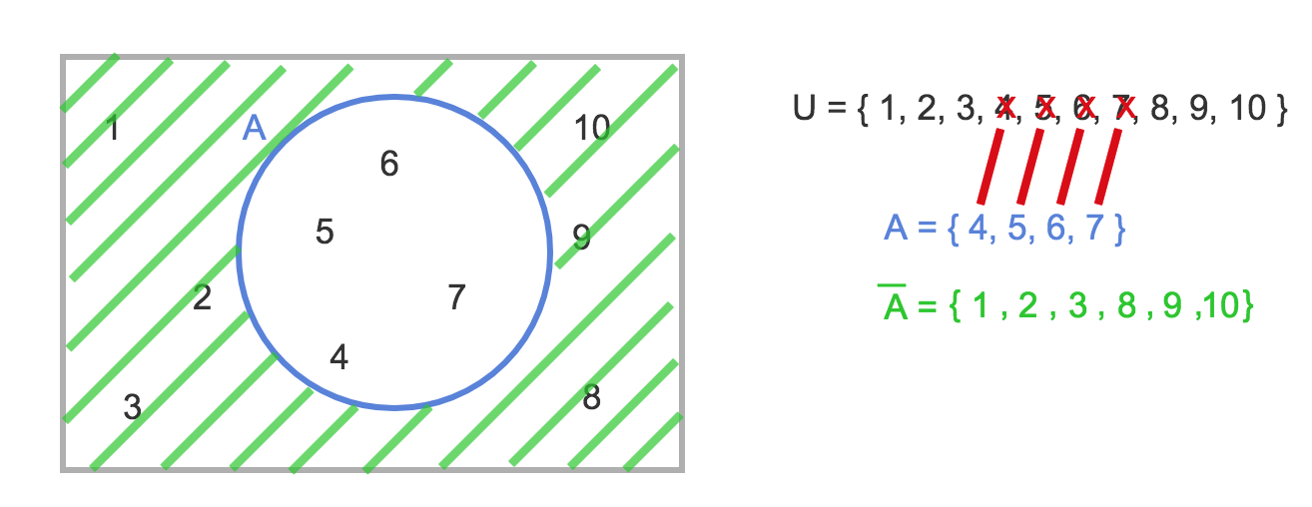
Set Complement
Definition: The complement of a set A, denoted A, consists of all elements not in A. That is the difference of the universal set U and A.
A = {x | x ∉ A }

Slide 38
Symmetric Difference
The difference operation is not commutative since it is not necessarily the case that A - B = B - A.
By contrast the symmetric difference is commutative.
The symmetric difference between two sets, A and B, denoted A Δ B, is the set of elements that are a member of exactly one of A and B, but not both.
An alternative definition of the symmetric difference operation is:

Slide 39
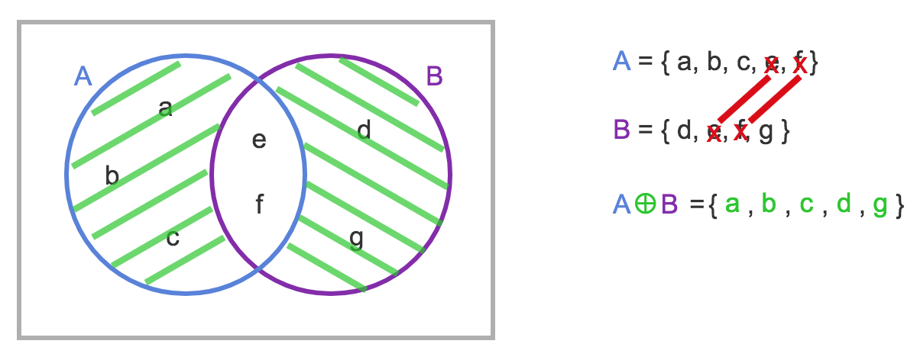
Symmetric Difference
Δ
A Δ B =

Slide 40
Disjoint Sets
Definition: Two sets are said to be disjoint if their intersection is the empty set: A ∩ B = ∅
U
A
B

Slide 41
Disjoint Sets
Definition: Two sets are said to be disjoint if their intersection is the empty set: A ∩ B = ∅
U
A
B
If A and B are disjoint, A B = A Δ B.

Slide 42
Set identities
Set identities are basic laws on how set operations work
Many have already been introduced on previous slides
Just like logical equivalences!
Replace U with ∨
Replace ∩ with ∧
Replace ∅ with F
Replace U with T

Slide 43
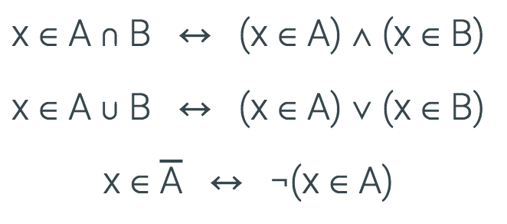
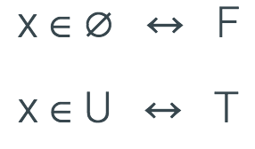
Set identities
The set operations intersection, union and complement are defined in terms of logical operations.
All the elements are assumed to be contained in a universal set U.

Slide 44
Set identities: DeMorgan again
These should look very familiar…

Slide 45
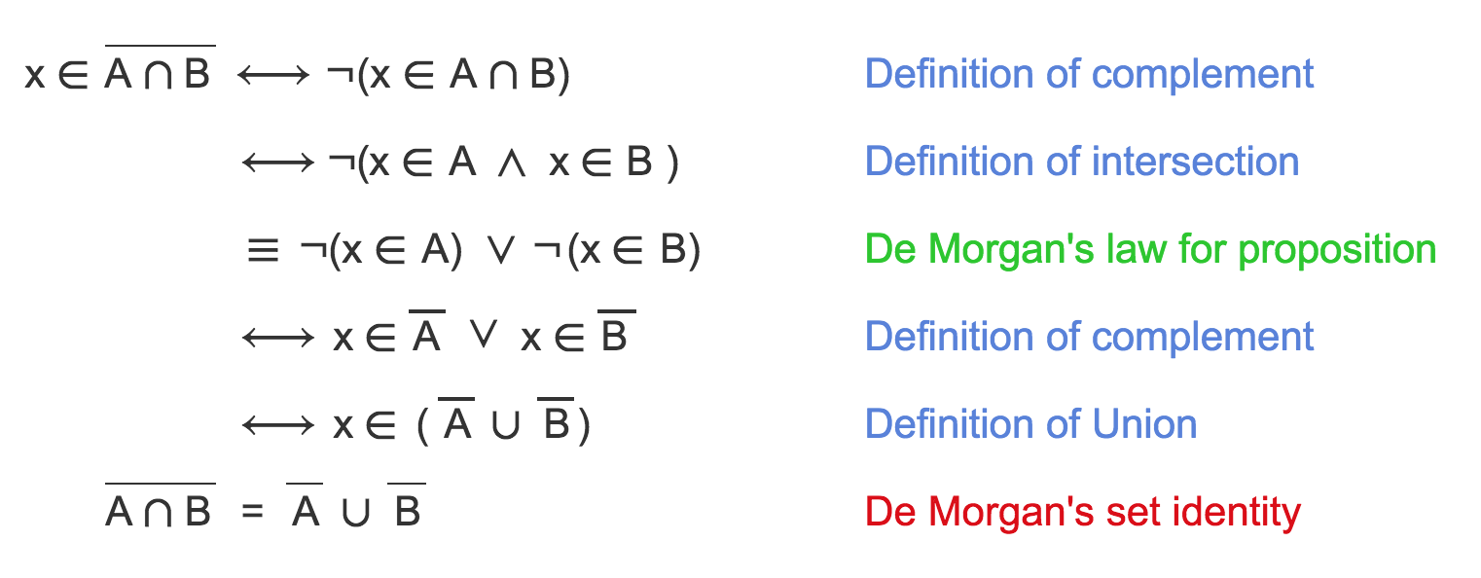
Deriving De Morgan's set identity using logic
x represents an arbitrary element.

Slide 46
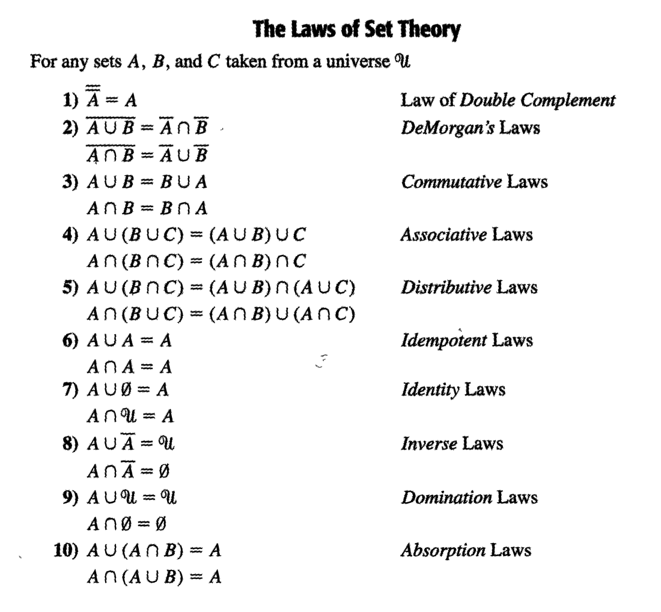

Slide 47
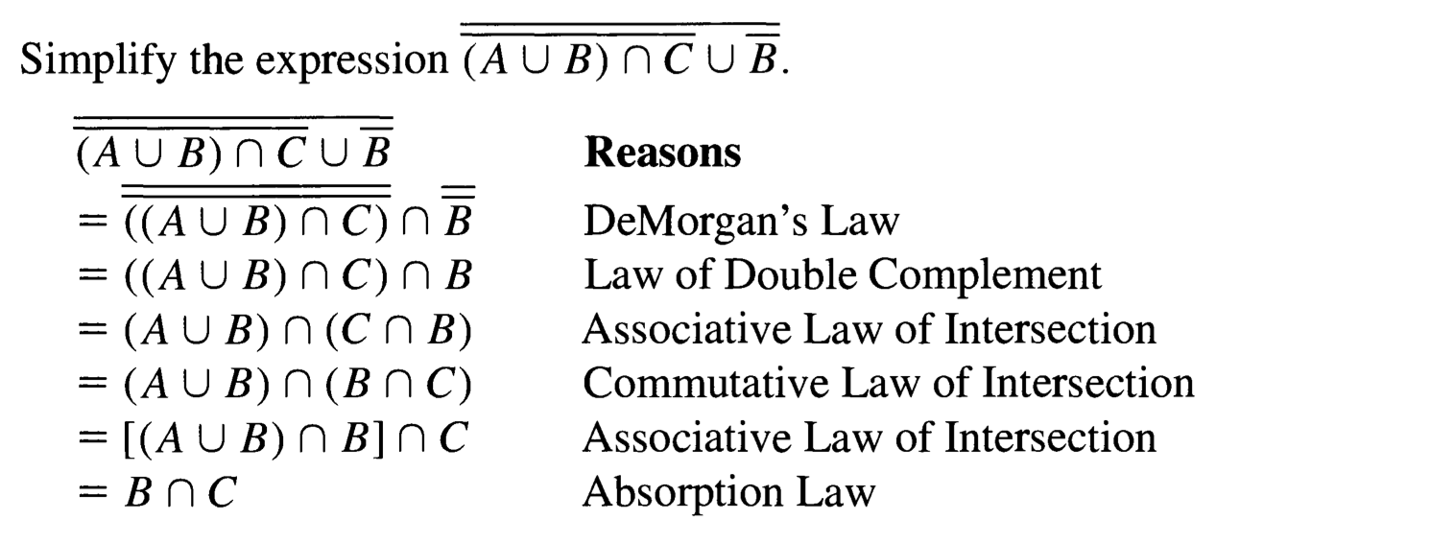
Example 3.20

Slide 48
Example 3.20

Slide 49
Example 3.20
The steps and reasons for simplifying the following statement is very similar.

Slide 50
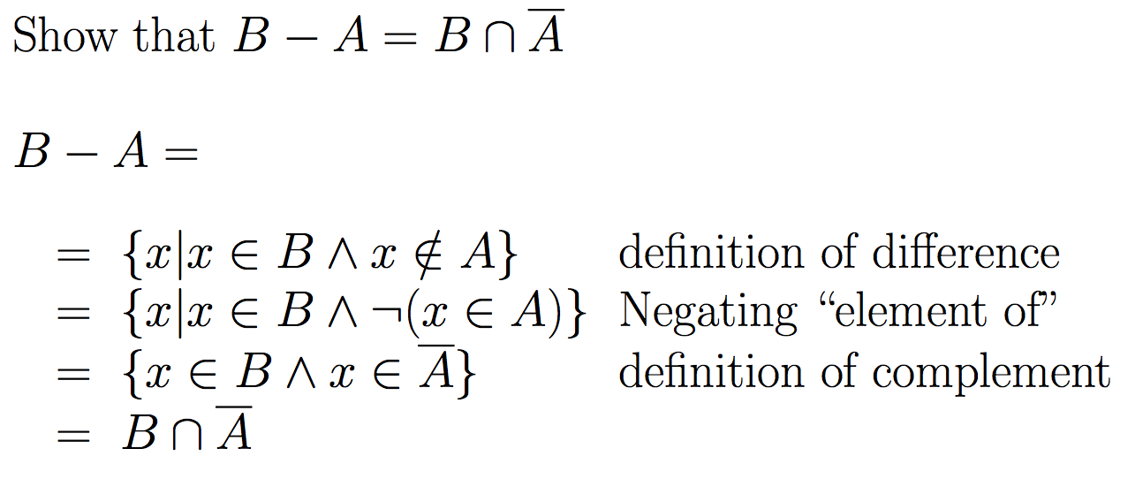

Slide 51
Proof by using basic set identities
Prove that A∩B=B-(B-A)
Definition of difference
Definition of difference
DeMorgan’s law
Complementation law
Distributive law
Complement law
Identity law
Commutative law

Slide 52
What is a membership table ?
Membership tables show all the combinations of sets an element can belong to
1 means the element belongs, 0 means it does not
Consider the following membership table:
The top row is all elements that belong to both sets A and B
Thus, these elements are in the union and intersection, but not the difference

Slide 53
What is a membership table ?
Membership tables show all the combinations of sets an element can belong to
1 means the element belongs, 0 means it does not
Consider the following membership table:
The second row is all elements that belong to set A but not set B
Thus, these elements are in the union and difference, but not the intersection

Slide 54
What is a membership table ?
Membership tables show all the combinations of sets an element can belong to
1 means the element belongs, 0 means it does not
Consider the following membership table:
The third row is all elements that belong to set B but not set A
Thus, these elements are in the union, but not the intersection or difference

Slide 55
What is a membership table ?
Membership tables show all the combinations of sets an element can belong to
1 means the element belongs, 0 means it does not
Consider the following membership table:
The bottom row is all elements that belong to neither set A or set B
Thus, these elements are neither the union, the intersection, nor difference

Slide 56
Proof by membership tables
The following membership table shows that A∩B=B-(B-A)
Because the two indicated columns have the same values, the two expressions are identical
This is similar to Boolean logic!

Slide 57
Proof by set builder notation and logical equivalences
First, translate both sides of the set identity into set builder notation
Then massage one side (or both) to make it identical to the other
Do this using logical equivalences

Slide 58
Proof by set builder notation and logical equivalences
Original statement
Definition of difference
Negating “element of”
Definition of difference
DeMorgan’s Law
Distributive Law
Negating “element of”
Negation Law
Identity Law
Definition of intersection

Slide 59
Proof by showing each set is a subset of the other
Definition: If two sets A and B are equal,
A ⊆ B and B ⊆ A.
We can prove A∩B=B-(B-A) by showing that
A∩B ⊆ B-(B-A), and
B-(B-A) ⊆ A∩B
If any element of A∩B is also an element of B-(B-A), then A∩B ⊆ B-(B-A).
If any element of B-(B-A) is also an element of A∩B, then B-(B-A) ⊆ A∩B.

Slide 60
Proof by showing each set is a subset of the other
Assume that x∈B-(B-A)
By definition of difference, we know that x∈B and x∉B-A

Slide 61
Proof by showing each set is a subset of the other
Assume that x∈B-(B-A)
By definition of difference, we know that x∈B and x∉B-A
Consider x∉B-A
If x∈B-A, then (by definition of difference) x∈B and x∉A
Since x∉B-A, then only one of the inverses has to be true (DeMorgan’s law): x∉B or x∈A

Slide 62
Proof by showing each set is a subset of the other
Assume that x∈B-(B-A)
By definition of difference, we know that x∈B and x∉B-A
Consider x∉B-A
If x∈B-A, then (by definition of difference) x∈B and x∉A
Since x∉B-A, then only one of the inverses has to be true (DeMorgan’s law): x∉B or x∈A
So we have that x∈B and (x∉B or x∈A)
It cannot be the case where x∈B and x∉B
Thus, x∈B and x∈A
This is the definition of intersection
Therefore, if x∈B-(B-A), x∈A∩B

Slide 63
Proof by showing each set is a subset of the other
Assume that x∈B-(B-A)
By definition of difference, we know that x∈B and x∉B-A
Consider x∉B-A
If x∈B-A, then (by definition of difference) x∈B and x∉A
Since x∉B-A, then only one of the inverses has to be true (DeMorgan’s law): x∉B or x∈A
So we have that x∈B and (x∉B or x∈A)
It cannot be the case where x∈B and x∉B
Thus, x∈B and x∈A
This is the definition of intersection
Therefore, if x∈B-(B-A), x∈A∩B
Thus, if x∈B-(B-A) then x∈A∩B
Therefore, B – (B-A) ⊆ A∩B

Slide 64
Proof by showing each set is a subset of the other
Assume that x∈A∩B
By definition of intersection, x∈A and x∈B
Thus, we know that x∉B-A
B-A includes all the elements in B that are also not in A not include any of the elements of A (by definition of difference)

Slide 65
Proof by showing each set is a subset of the other
Assume that x∈A∩B
By definition of intersection, x∈A and x∈B
Thus, we know that x∉B-A
B-A includes all the elements in B that are also not in A (by definition of difference)
Consider B-(B-A)
We know that x∉B-A
We also know that if x∈A∩B then x∈B (by definition of intersection)
Thus, if x∈B and x∉B-A, we can restate that (using the definition of difference) as x∈B-(B-A)S

Slide 66
Proof by showing each set is a subset of the other
Assume that x∈A∩B
By definition of intersection, x∈A and x∈B
Thus, we know that x∉B-A
B-A includes all the elements in B that are also not in A not include any of the elements of A (by definition of difference)
Consider B-(B-A)
We know that x∉B-A
We also know that if x∈A∩B then x∈B (by definition of intersection)
Thus, if x∈B and x∉B-A, we can restate that (using the definition of difference) as x∈B-(B-A)
Thus, if x∈A∩B then x∈B-(B-A)
Therefore, A∩B ⊆ B - (B-A).
This completes the proof of A∩B = B - (B-A).

Slide 67
Subset problems
Let A, B, and C be sets. Show that:
(AUB) ⊆ (AUBUC)
(A∩B∩C) ⊆ (A∩B)
(A-B)-C ⊆ A-C
(A-C) ∩ (C-B) = ∅

Slide 68
Practice Problems
Problems (Exercises 3.1) 2, 3, 4, 6, 7, 8, 15, 22
Problems (Exercises 3.2) 5, 6, 7, 8, 16, 17, 18
Problems (Exercises 3.3) 2, 3, 4, 6, 7, 10

