Slide 1
Relations (Chapter 7)
A few slides have been taken from the sites
http://cse.unl.edu/~choueiry/S13-235/
and
http://www.math-cs.gordon.edu/courses/mat231/notes.html

Slide 2
Outline of Chapter 7
Relations
Properties of relations
Equivalence relations
Relations between sets
Partial Orders
Hasse Diagrams

Slide 3
Relations
Suppose A = {1,2,3,4,5,6}
Consider the set L = { (x,y): x, y ∈ A and x < y}
L can also be written as L={(x,y): (x,y) ∈ A x A and x < y}.

Slide 4
Relations
Suppose A = {1,2,3,4,5,6}
Consider the set L = { (x,y): x, y ∈ A and x < y}
L = {(1,2), (1,3), (1,4), (1,5), (1,6), (2,3), (2,4), (2,5), (2,6), (3,4), (3,5), (3,6), (4,5), (4,6), (5,6)}

Slide 5
Relations
Suppose A = {1,2,3,4,5,6}
Consider the set L = { (x,y): x, y ∈ A and x < y}
L = {(1,2), (1,3), (1,4), (1,5), (1,6), (2,3), (2,4), (2,5), (2,6), (3,4), (3,5), (3,6), (4,5), (4,6), (5,6)}
Consider the set D={(x,y): x,y ∈ A and x|y}

Slide 6
Relations
Suppose A = {1,2,3,4,5,6}
Consider the set L = { (x,y): x, y ∈ A and x < y}
L = {(1,2), (1,3), (1,4), (1,5), (1,6), (2,3), (2,4), (2,5), (2,6), (3,4), (3,5), (3,6), (4,5), (4,6), (5,6)}
Consider the set D={(x,y): x,y ∈ A and x|y}
D={(1,1), (1,2), (1,3), (1,4), (1,5), (1,6), (2,2), (2,4) (2,6), (3,3), (3,6), (4,4), (5,5), (6,6)}

Slide 7
Relations
Suppose A = {1,2,3,4,5,6}
Consider the set L = { (x,y): x, y ∈ A and x < y}
L = {(1,2), (1,3), (1,4), (1,5), (1,6), (2,3), (2,4), (2,5), (2,6), (3,4), (3,5), (3,6), (4,5), (4,6), (5,6)}
Consider the set D={(x,y): x,y ∈ A and x|y}
D={(1,1), (1,2), (1,3), (1,4), (1,5), (1,6), (2,2), (2,4) (2,6), (3,3), (3,6), (4,4), (5,5), (6,6)}
The symbol < is usually used to denote the relationship between the elements of A.
Similarly, the symbol | is generally used to denote the relationship between the elements of A.
L, D ⊆ A x A.

Slide 8

Relation of a set
Defn: A relation R on a set A is a subset R ⊆ A x A. We often abbreviate the statement (x,y) ∈ R as xRy. The statement (x,y) ∉ R is abbreviated as

Slide 9
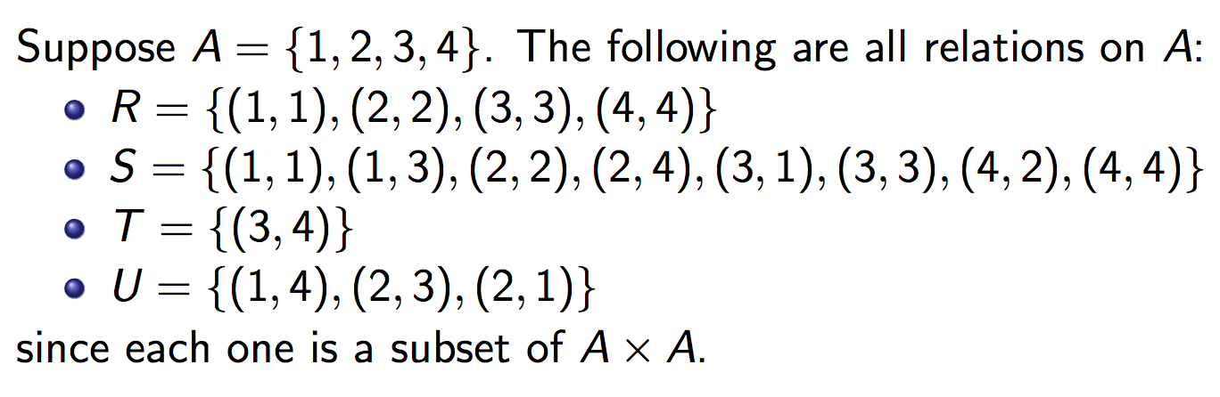
Relation of a set
Defn: A relation R on a set A is a subset R ⊆ A x A. We often abbreviate the statement (x,y) ∈ R as xRy. The statement (x,y) ∉ R is abbreviated as
Relation may or may not have meaning associated with them

Slide 10
Examples of Relations
We have seen that < relation on A = {1,2,3,4,5,6} is given by
  L = {(1,2), (1,3), (1,4), (1,5), (1,6), (2,3), (2,4), (2,5), (2,6), (3,4), (3,5), (3,6), (4,5), (4,6), (5,6)}
We have also seen that | relation on A = {1,2,3,4,5,6} is given by
  D={(1,1), (1,2), (1,3), (1,4), (1,5), (1,6), (2,2), (2,4) (2,6), (3,3), (3,6), (4,4), (5,5), (6,6)}
L ∩ D = {(1,2), (1,3), (1,4), (1,5), (1,6), (2,4), (2,6), (3,6)}.
L ∩ D ={(x,y): : x, y ∈ A and x < y and x|y}
Note that L ∩ D is a relation.

Slide 11
Relations
Binary relations R defined on a set A
R ⊆ A x A : n = 2
R ⊆ R x R : real plane
R ⊆ R⁺ x R⁺: Interior of the first quadrant
(a,b) ∈ R is an element of R.
  In the text infix notation aRb is also used.

Slide 12
Relations as Subsets
Question : Suppose we have relations on {1,2} given by R = {(1,1), (2,2)}, S = {(1,1),(1,2)}. Find:
The union R ∪S
The intersection R ∩ S
The symmetric difference R ⊕S
The difference R-S
The complement of R

Slide 13
Relations as Subsets
Answer: (R = {(1,1),(2,2)}, S = {(1,1),(1,2)})
R ∪S = {(1,1),(1,2),(2,2)}
R ∩S = {(1,1)}
R ⊕S = {(1,2),(2,2)}.
R-S = {(2,2)}.
R = {(1,2),(2,1)}

Slide 14
Representing Relations
There are multiple ways to represent relations.
  We have already seen that relations can be enumerated, i.e. they are listed as sets.

Slide 15
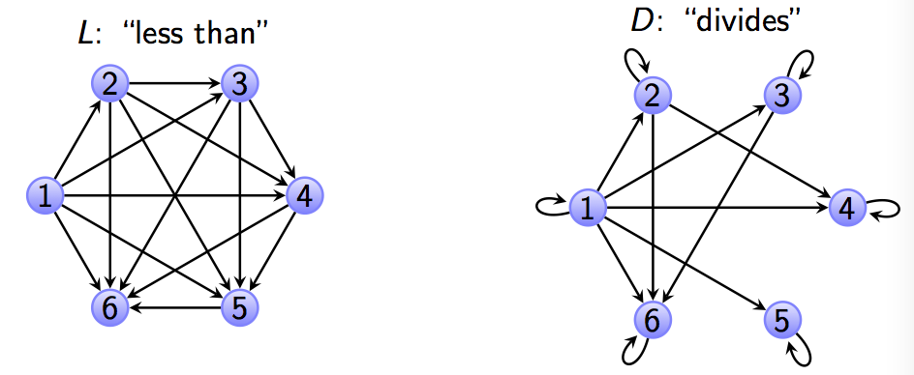
Representing Relations
There are multiple ways to represent relations.
  We have already seen that relations can be enumerated, i.e. they are listed as sets.
  A directed graph can represent a relation R on A. Each node (vertex) in the graph represents an element of A and an arrow from vertex x to vertex y indicates (x,y) ∈ R. For example, using set A and relations L and D from the previous slides, we have

Slide 16
Representing Relations
  A relation R on A = {a₁, a₂, …, a_{m}} can be represented by the zero-one matrix M_{R} = [m_{ij}] with
    m_{ij} = 1 if (a_{i}, a_{j}) ∈ R, and
    m_{ij} = 0 if (a_{i}, a_{j}) ∉ R.
    Note that for creating this matrix we first need to determine the elements that represent the rows. This mapping is arbitrary.

Slide 17
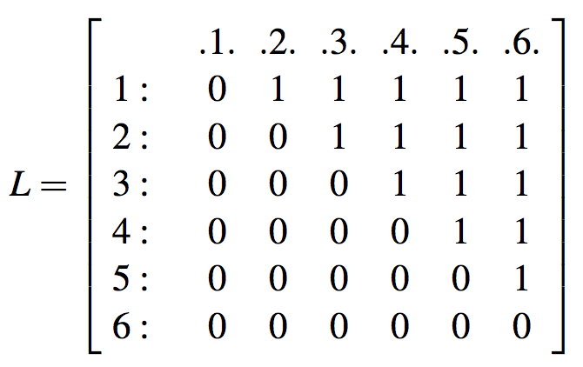
Representing Relations
  Consider the relation L considered earlier.
  L = {(1,2), (1,3), (1,4), (1,5), (1,6), (2,3), (2,4), (2,5), (2,6), (3,4), (3,5), (3,6), (4,5), (4,6), (5,6)}

Slide 18
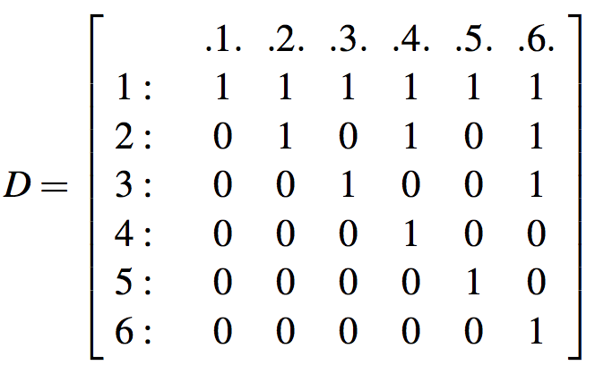
Representing Relations
  Consider the relation D considered earlier.
  D={(1,1), (1,2), (1,3), (1,4), (1,5), (1,6), (2,2), (2,4) (2,6), (3,3), (3,6), (4,4), (5,5), (6,6)}

Slide 19
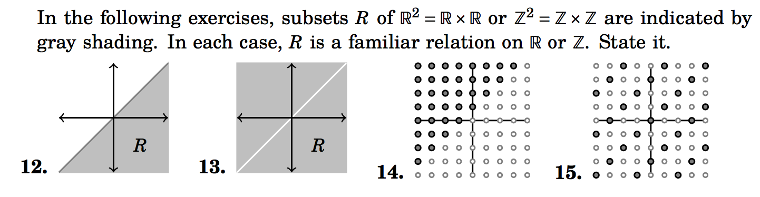
Questions:
Consider a set A with n elements. How many different relations are there on A?
Q.6: Congruence modulo 5 is a relation on set N (set of positive integers). Let R be the relation.
  R = {(a,b) | a, b ∈ N and a ≡ b (mod 5)}
  R = { (0,0), (0,5), (0,10), (1,6), (1,11), …}
Q

Slide 20
Properties of Binary Relations
Let R be a binary relation on A (i.e. R ⊆ A x A)
  R is reflexive if for all a ∈ A, (a,a) ∈ R.
  R is symmetric if (a,b) ∈ R, (b,a) ∈ R.
  R is transitive if (a,b) ∈ R, (b,c) ∈ R, then (a,c) ∈ R.
  R is antisymmetric if (a,b) ∈ R and (b,a) ∈ R, a = b.
.

Slide 21

Properties of Relations in Graphs
How do each of the properties of relations show up in graphs of relations?
The graph of a reflexive relation will have a loop edge at each node.

Slide 22
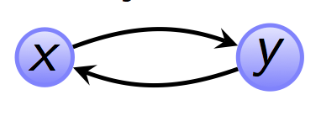
Properties of Relations in Graphs
How do each of the properties of relations show up in graphs of relations?
The graph of a reflexive relation will have a loop edge at each node.
The graph of a symmetric relation will not have an edge from x to y unless there is also an edge from y to x.

Slide 23
Properties of Relations in Graphs
The graph of an antisymmetric relation will not have any symmetric pairings. If there is an edge from x to y, there cannot be an edge from y to x.
For A={1,2,3,4,5,6}, R={(1,1), (2,2), (3,3), (4,4), (5,5), (6,6)} is a relation which is reflexive, symmetric and antisymmetric.
A graph is symmetric if there is no antisymmetric edge. Similarly, a graph is antisymmetric if there is no symmetric edge.

Slide 24
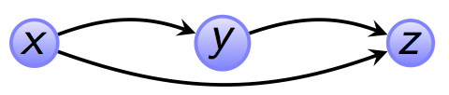
Properties of Relations in Graphs
The graph of a transitive relation will have an edge from x to z whenever there is an edge from x to y and an edge from y to z.

Slide 25
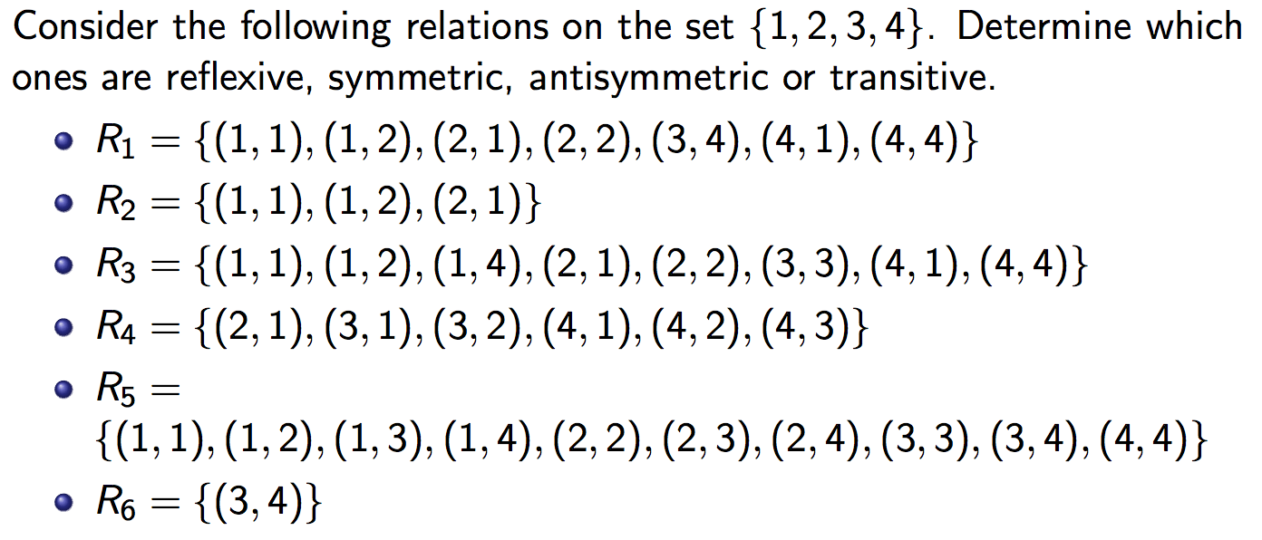
Examples

Slide 26
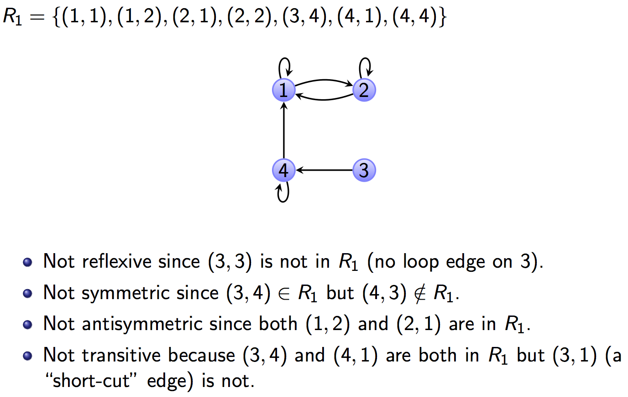
R₁

Slide 27
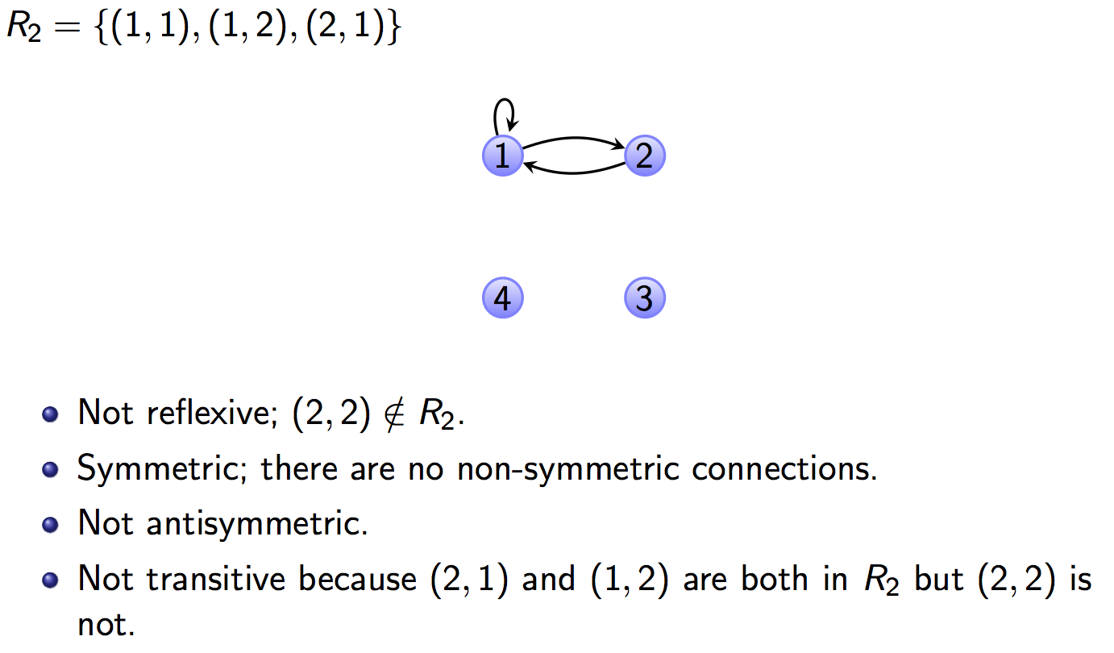
R₂

Slide 28
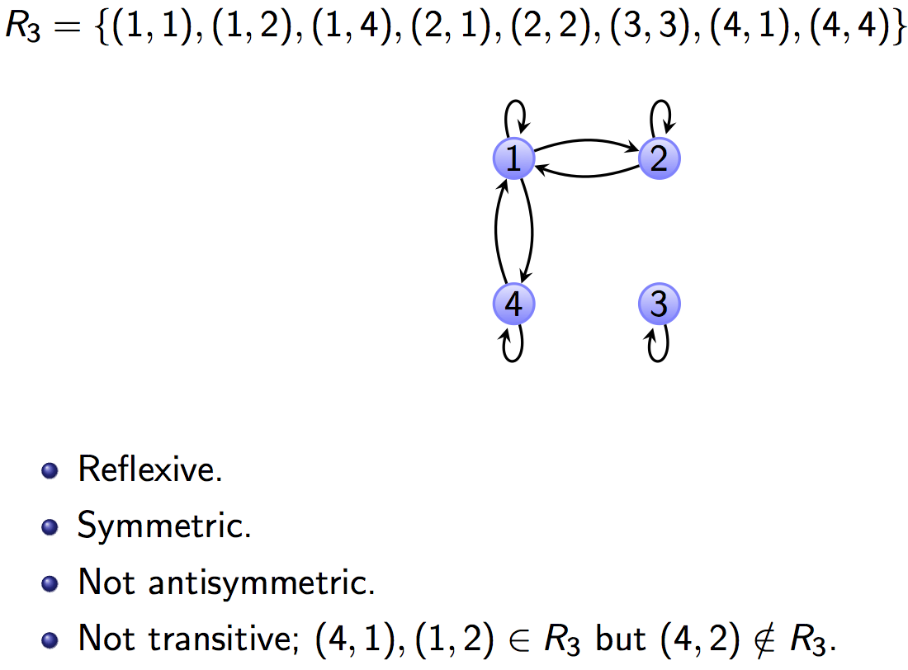
R₃

Slide 29
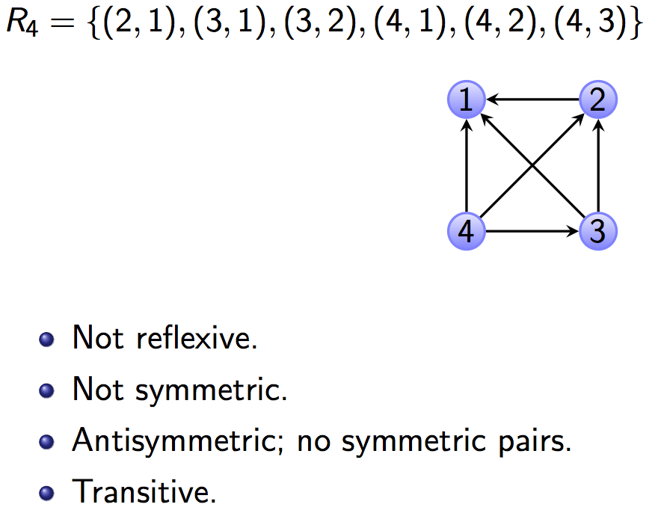
R₄

Slide 30
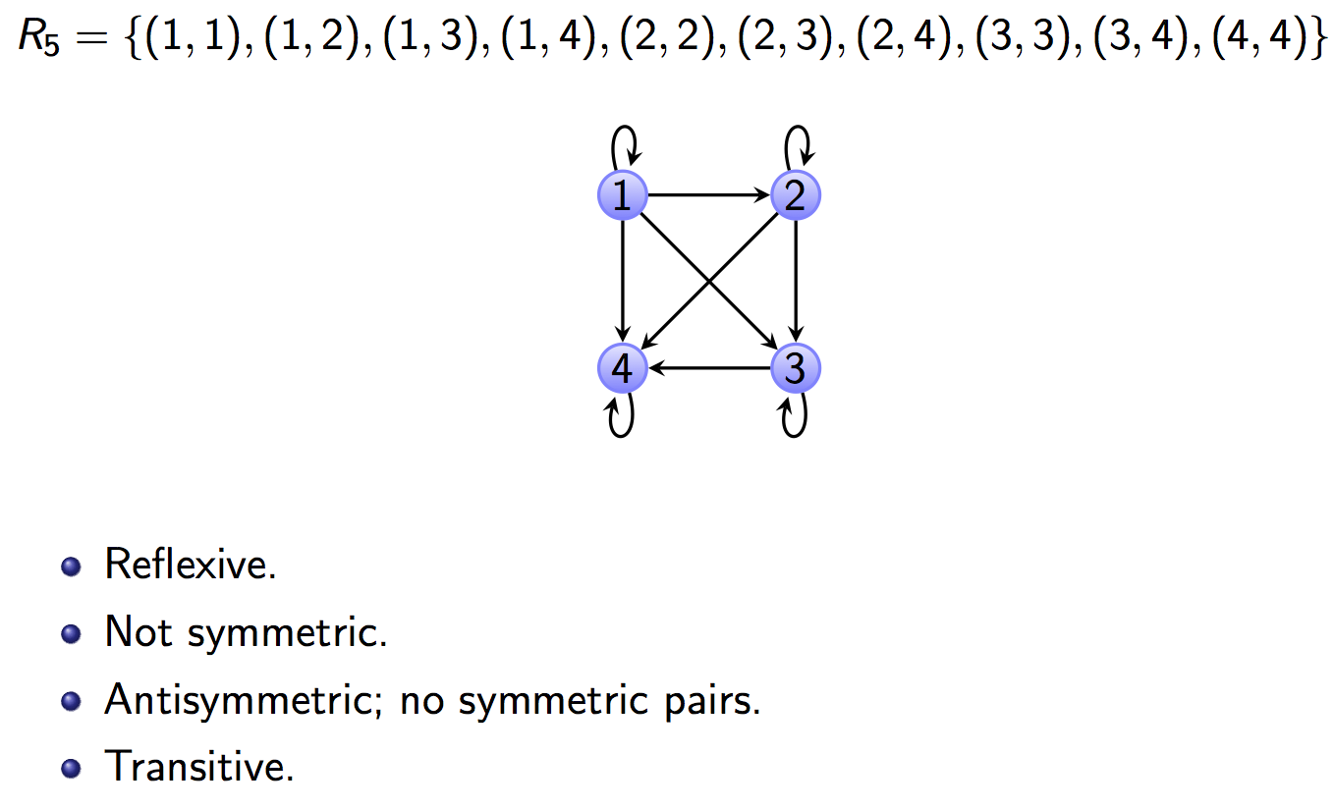
R₅

Slide 31
R₅
This is the “less than or equal to” relation on A={1,2,3,4}

Slide 32
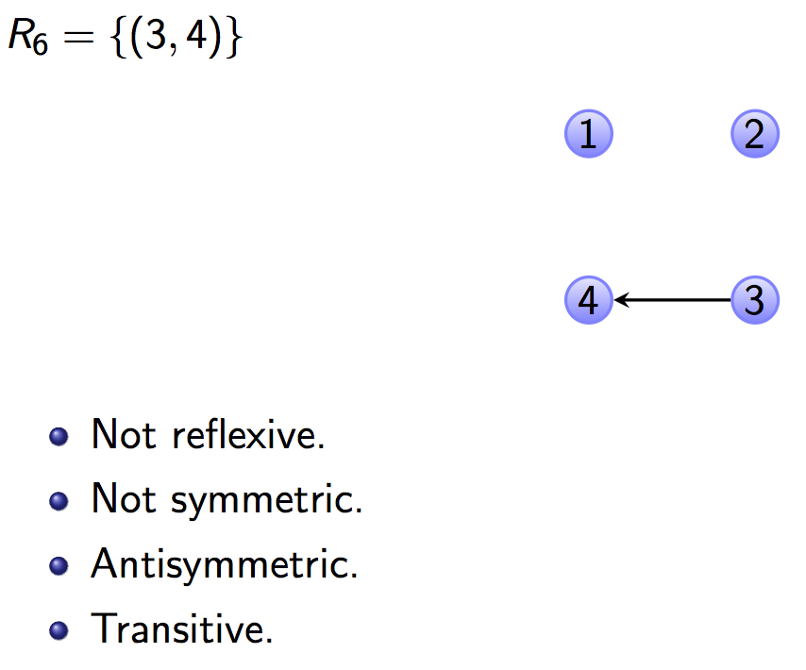
R₆

Slide 33
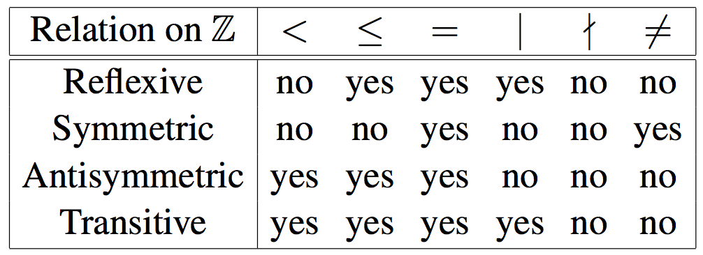
Examine the following table:

Slide 34
Visualizing the Properties
A: Reflexive. Upper-Left corner to Lower-Right corner diagonal is all 1’s. EG:
M_{R} =
Q: How about if R is symmetric?

Slide 35
Visualizing the Properties
A: A symmetric matrix. i.e., flipping across diagonal does not change matrix. EG:
M_{R} =
Notes:
Official name for “flipping across diagonal” is transposing

Slide 36
Visualizing the Properties
Not symmetric
This matrix is also antisymmetric
Notes:
Official name for “flipping across diagonal” is transposing

Slide 37
Example
Proposition Let n ∈ N. The relation ≡ (mod n) on the set Z is reflexive, symmetric and transitive.
(It will be proved in the class)

Slide 38
Counting the number of relations
Consider set A where |A|=n.
# of relations on A =
# of reflexive relations on A =
# of symmetric relations of A=
# of antisymmetric relations on A =
# of transitive relations on A = hard

Slide 39
Counting the number of relations
Consider set A where |A|=n.
# of relations on A = 2^{{n*n}}
# of reflexive relations on A = 2^{{n*n} ^{- n}}
# of symmetric relations of A= 2^{{n(n+1)/2}}
# of antisymmetric relations on A = 3^{{n(n-1)/2}}2^{n}
# of transitive relations on A = hard

Slide 40
Practice problems
Section 7.1: 5, 7, 8, 9, 10, 16
Section 7.2: 1, 12(a),(b), 16, 17, 18,, 22

Slide 41
Equivalence Relation
Consider the set of every person in the world
Now consider a R relation such that (a,b)∈R if a and b are siblings.
Clearly this relation is
  Reflexive
  Symmetric, and
  Transitive
Such as relation is called an equivalence relation
Definition: A relation on a set A is an equivalence relation if it is reflexive, symmetric, and transitive

Slide 42
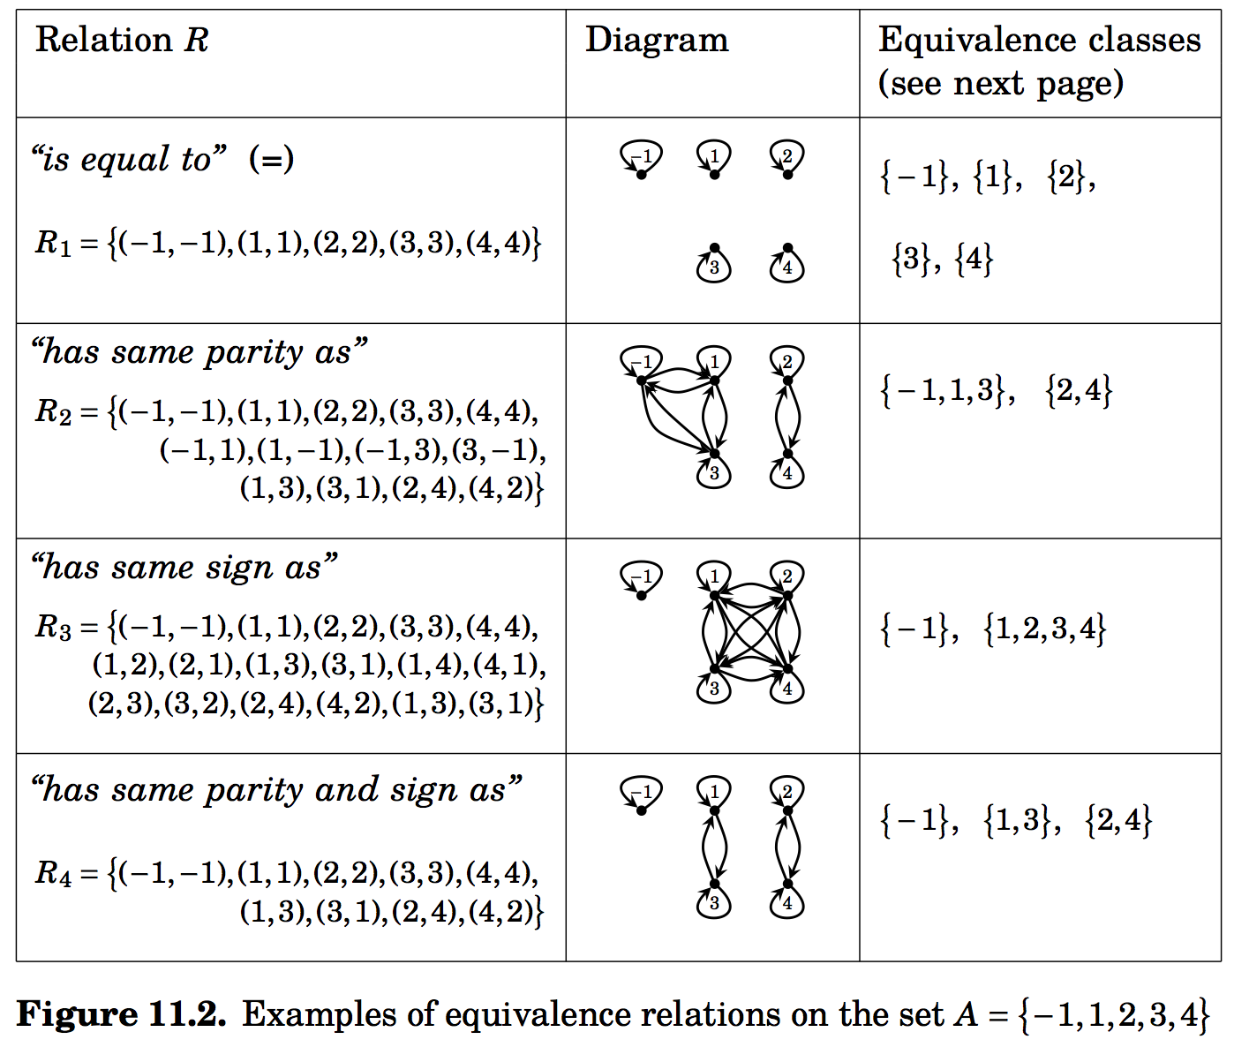
Equivalence relation on set A={-1,1,2,3,4}

Slide 43
Equivalence Relations: Example 1
Example: Let R={ (a,b) | a,b∈R and a≤b}
  Is R reflexive?
  Is it transitive?
  Is it symmetric?
No, it is not. 4 is related to 5 (4 ≤ 5) but 5 is not related to 4
Thus R is not an equivalence relation

Slide 44
Equivalence Relations: Example 2
Example: Let R={ (a,b) | a,b∈Z and a=b}
  Is R reflexive?
  Is it transitive?
  Is it symmetric?
  What are the equivalence classes that partition Z?

Slide 45
Equivalence Relations: Example 3
Example: For (x,y),(u,v) ∈R², we define
R={ ((x,y),(u,v)) | (x²+y²=u²+v²}
Show that R is an equivalence relation.
What are the equivalence classes that R defines (i.e., what are the partitions of R²)?

Slide 46
Equivalence Relations: Example 3
Example: For (x,y),(u,v) ∈R², we define
R={ ((x,y),(u,v)) | x²+y²=u²+v²}
Two points are related if they lie on a circle with the center at the origin.
Show that R is an equivalence relation.
What are the equivalence classes that R defines (i.e., what are the partitions of R²)?
(concentric circles with the center at the origin)

Slide 47
Equivalence Class (1)
Definition: Let R be an equivalence relation on a set A and let a ∈A. The set of all elements in A that are related to a is called the equivalence class of a. We denote this set [a]_{R} or just [a] if it is clear what R is.
[a]_{R} = { s | (a,s)∈R, s∈A}

Slide 48
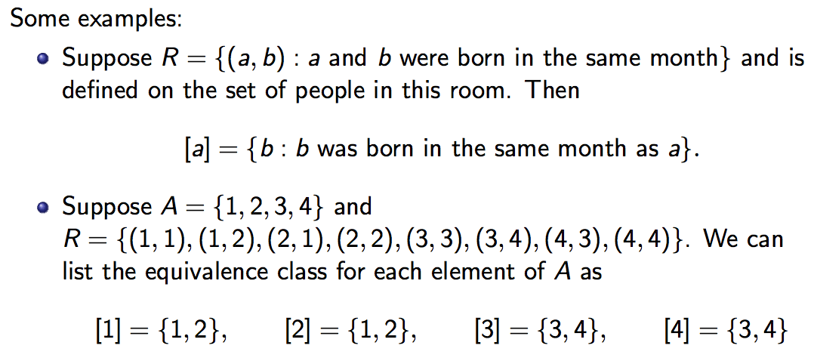

Slide 49
Equivalence relation on set A={-1,1,2,3,4}

Slide 50
Equivalence Class (2)
The elements in [a]_{R} are called representatives of the equivalence class
Theorem: Let R be an equivalence class on a set A. The following statements are equivalent
  aRb (i.e. (a,b) ∈ R)
  [a]=[b]
  [a] ∩ [b] ≠∅
Proof: We first show that (1) ⇒ (2)

Slide 51
Equivalence Class (3)
We will prove that [a] = [b] by showing that [a] ⊆ [b] and [b] ⊆ [a].
  Suppose c ∈ [a].
  Thus (a,c) ∈ R.
  Because (a,b) ∈ R, and R is symmetric, therefore (b,a) ∈ R.
  Thus (b,a) ∈ R and (a, c) ∈ R, and R is transitive, therefore (b,c) ∈ R.
  Because of the symmetric property of R, (c,b) ∈ R as well.
  This implies that c ∈ [b].
  Therefore [a] ⊆ [b].
  The proof for [b] ⊆ [a] is similar.
  Hence [a] = [b] .

Slide 52
Equivalence Class (4)
(2) ⇒ (3): [a] = [b] ⇒ [a] ∩ [b] ≠ ∅
  Let a, b ∈ A such that [a] = [b]. Since a ∈ [a], we know that it also belongs to [b].
  This means that a ∈ [a] ∩ [b].
  This implies [a] ∩ [b] ≠ ∅

Slide 53
Equivalence Class (5)
(3) ⇒ (1): [a] ∩ [b] ≠ ∅ ⇒ (a,b) ∈ R.
  Let c ∈ [a] ∩ [b] . c exists since [a] ∩ [b] is non-empty.
  Therefore, c ∈ [a] and c ∈ [b] Since a ∈ [a], we know that it also belongs to [b].
  Thus (c,a) ∈ R and (c,b) ∈ R.
  R is symmetry: (a,c) ∈ R and (b,c) ∈ R.
  R is transitive: (a,b) ∈ R.

Slide 54
Partitions
Partitions (1)
Equivalence classes partition the set A into disjoint, non-empty subsets A₁, A₂, …, A_{k}
A partition of a set A satisfies the properties
  ∪^{k}_{i=1}A_{i}=A
  A_{i} ∩ A_{j} = ∅ for i≠j
  A_{i} ≠ ∅ for all i

Slide 55
Partitions (2)
Example: Let R be a relation such that (a,b)∈R if a and b live in the same province/ territories , then R is an equivalence relation that partitions the set of people who live in Canada into 13 equivalence classes

Slide 56
Partitions (2)
Theorem:
  Let R be an equivalence relation on a set S. Then the equivalence classes of R form a partition of S.
  Conversely, given a partition A_{i} of the set S, there is a equivalence relation R that has the set A_{i} as its equivalence classes. (An example is shown in the class.)

Slide 57
Partitions: Visual Interpretation
Example: Let A={1,2,3,4,5,6,7} and R be an equivalence relation that partitions A into A₁={1,2}, A₂={3,4,5,6} and A₃={7}
  Draw the 0-1 matrix
  Draw the digraph
  (It will be shown in the class.)

Slide 58
Relations between the sets
The relations we have seen so far have been relations on a set. We can also define relations between the sets.
Definition: A real R from a set A to set B is a subset of A x B, i.e R ⊆ A x B.

Slide 59

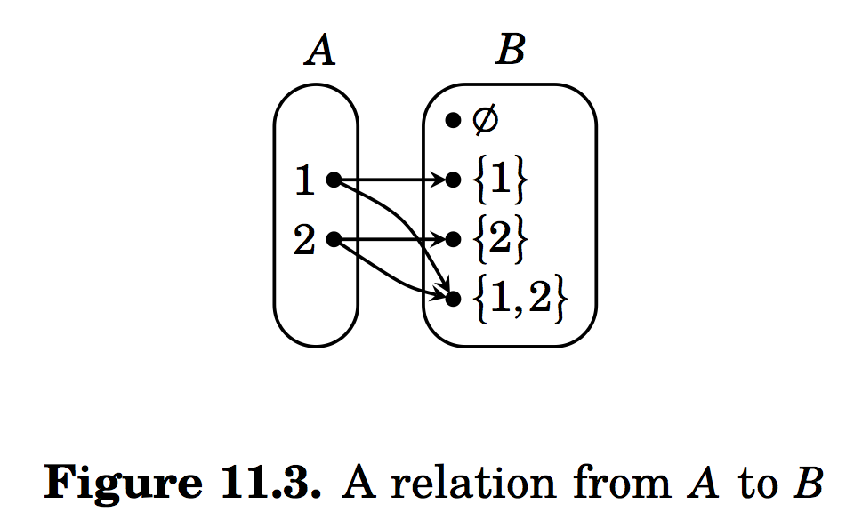
Relations between the sets
Example: Suppose A = {1,2} and
B =
Let R = {(1, {1}), (2, {2}), (1, {1,2}), (2, {1,2})} ⊆ A x B be a relation from A to B.
The relation R is the familiar relation ∈.

Slide 60
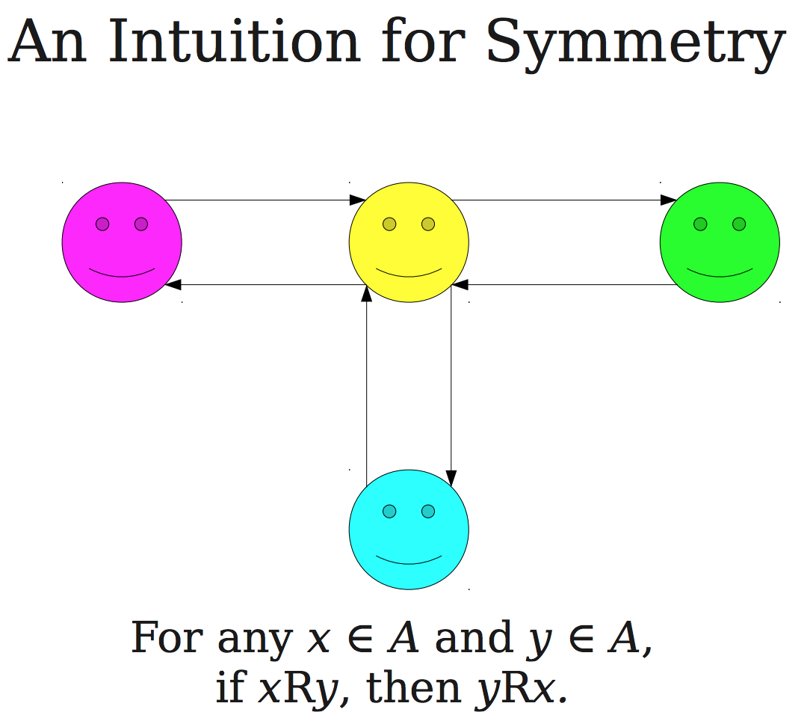

Slide 61
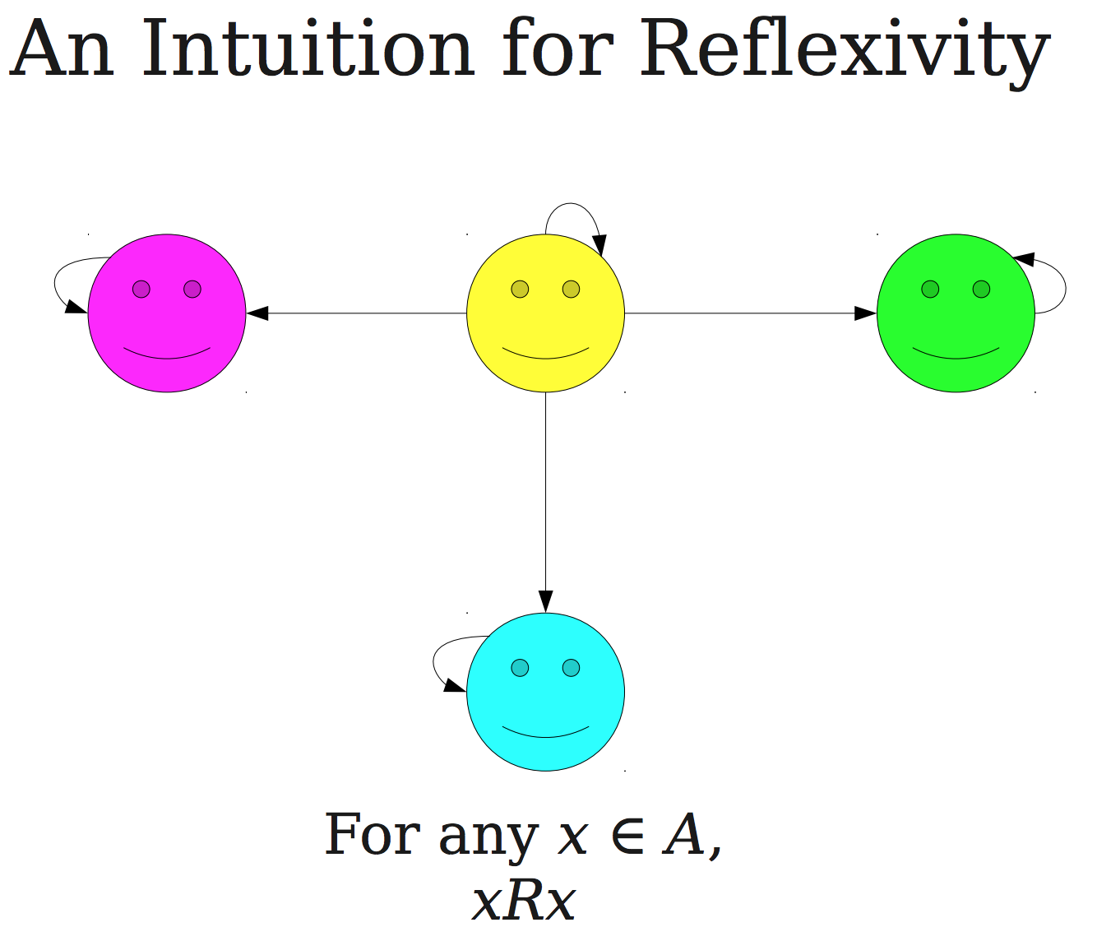

Slide 62
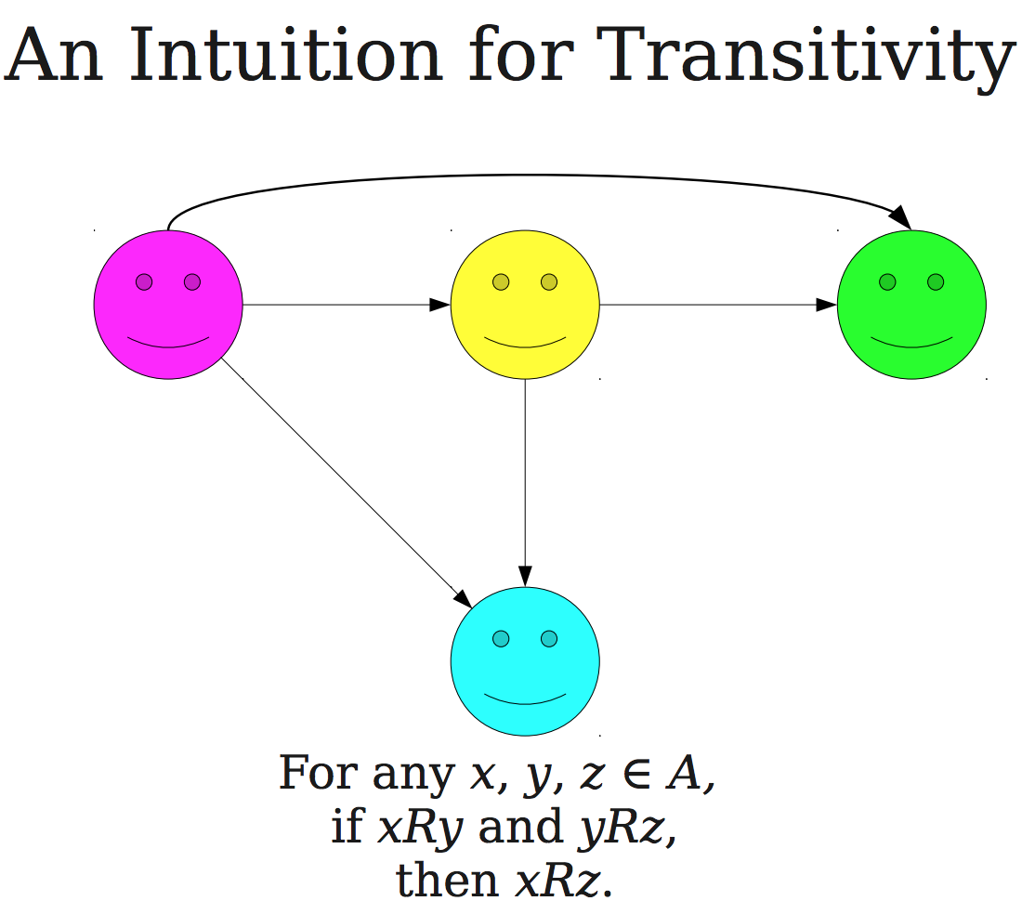

Slide 63

Partial Orders (7.3)
Definition: A relation R on a set A is a partial order if it is reflexive, antisymmetric and transitive.
Example: Let R be a relation on N such that (a,b) ∈ R if and only if a ≤ b. It can be shown that R is a partial order.
We often use the symbol for a partial order.

Slide 64
Posets
Definition: A set A together with a partial order relation R is called a partial ordered set or poset and is denoted by (A,R).
Example: Suppose R is the relation `divides’. We can show that (N, R) is a poset.

Slide 65
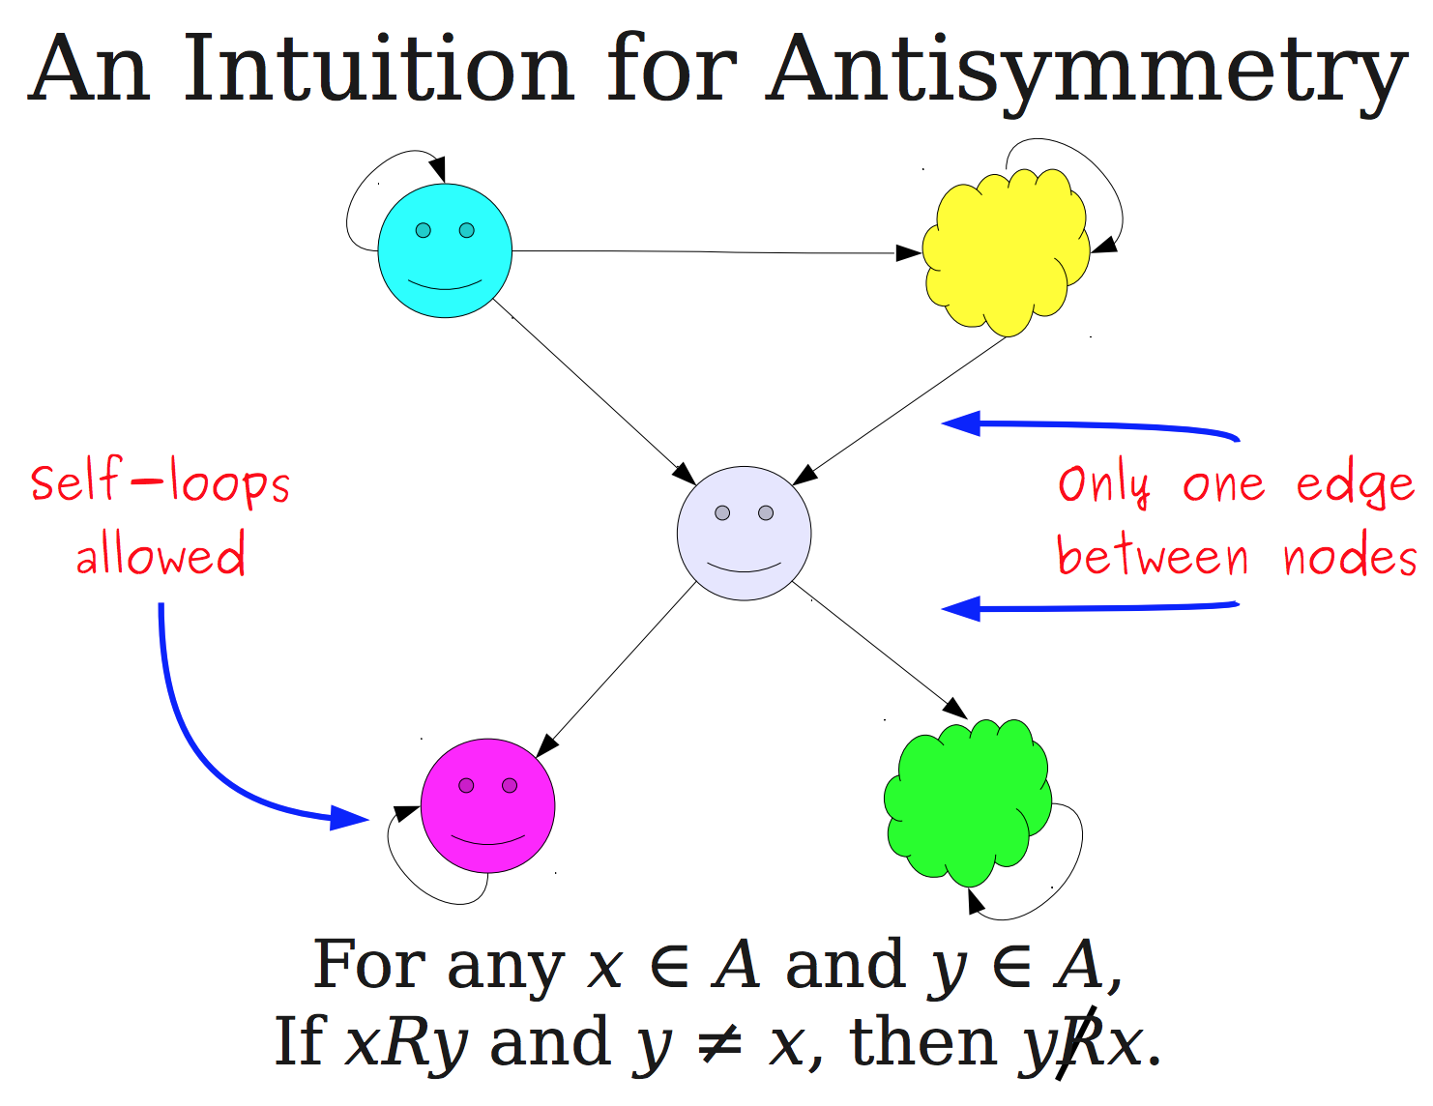

Slide 66
Comparability and total orders of a poset (S,R)
Definition: The elements a and b of a poset (S,R) are called comparable if either (a,b) ∈ R or (b,a) ∈ R. Note that both cannot belong to R since R is antisymmetric. When a and b are elements that neither (a,b) ∈ R nor (b,a) ∈ R, a and b are called incomparable.
Example: Consider the poset (Z,R) where Z is the set of integers and R indicates the relationship `divide’.
  3 and 6 are comparable
  3 and 5 are not comparable.

Slide 67
Comparability and total orders of a poset (S,R)
Definition: If (S,R) is a poset, and every two elements a and b of S are comparable, (S,R) is called a totally ordered set, and R is called a total order.
Example: (Z, ≤) is a totally ordered set.

Slide 68
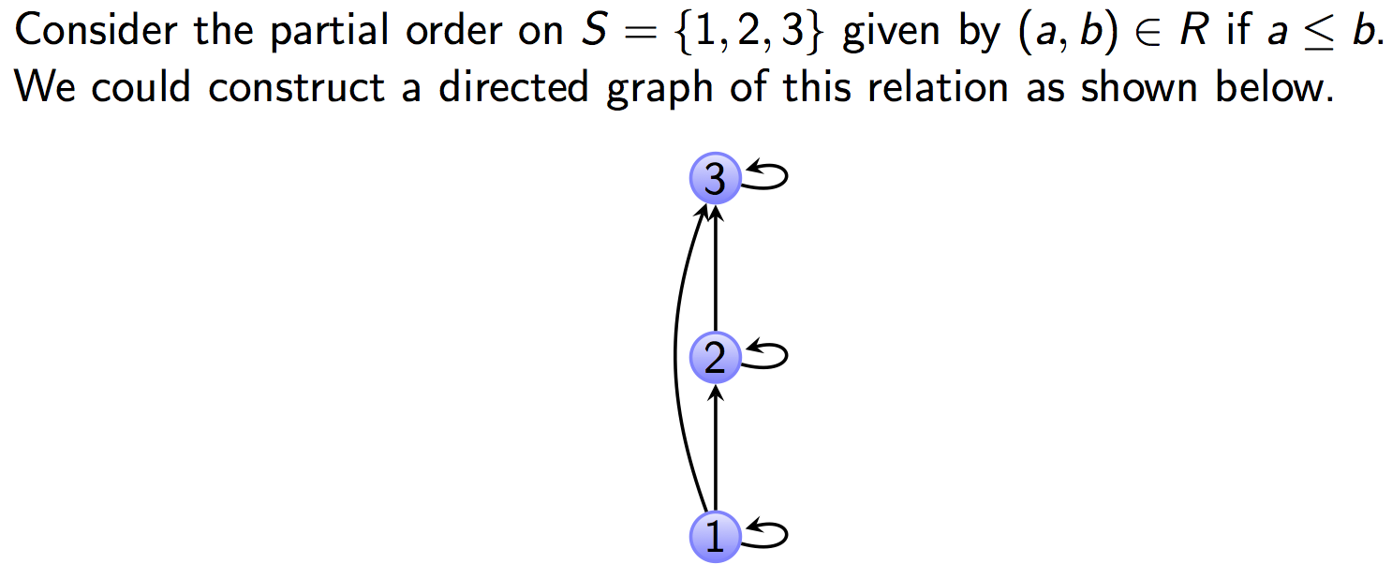
Hasse Diagram to represent posets.

Slide 69
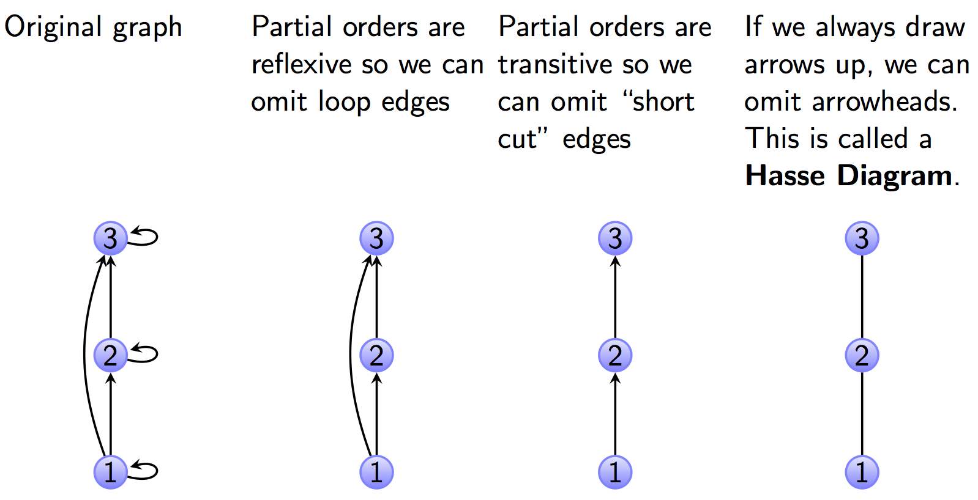
Hasse Diagram to represent posets.

Slide 70
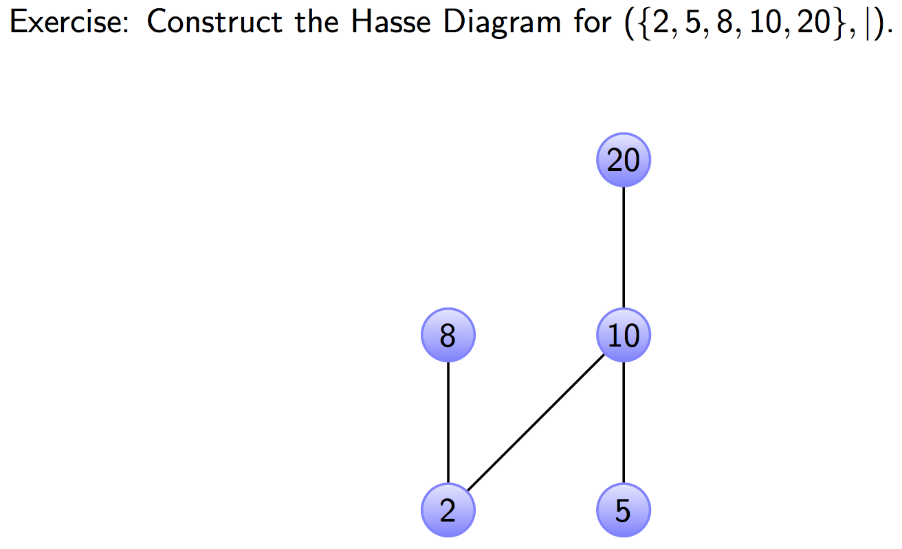
Hasse Diagram Example

Slide 71
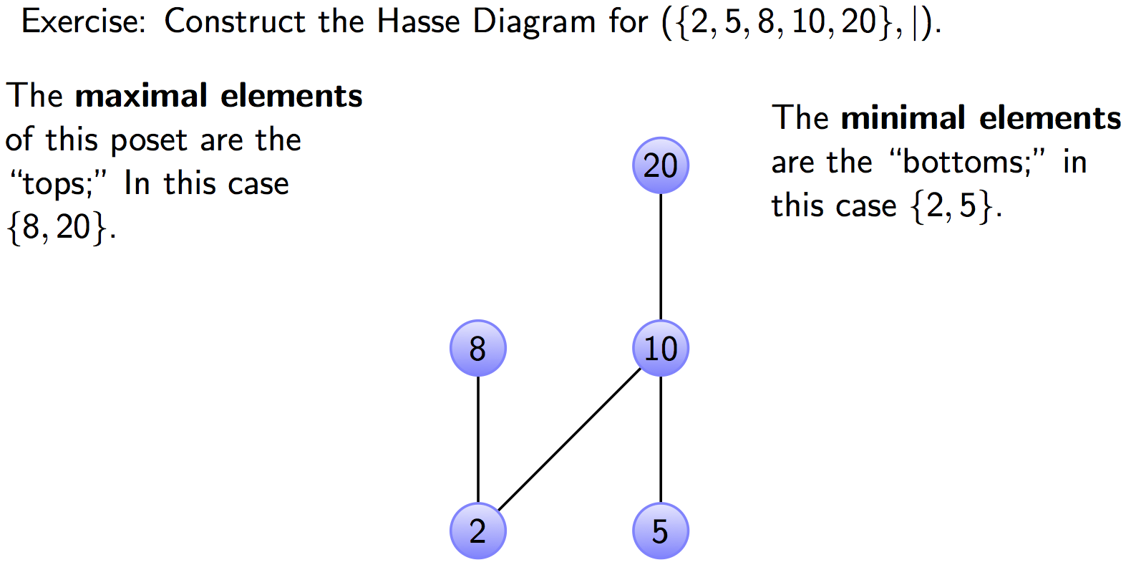
Hasse Diagram Example

Slide 72
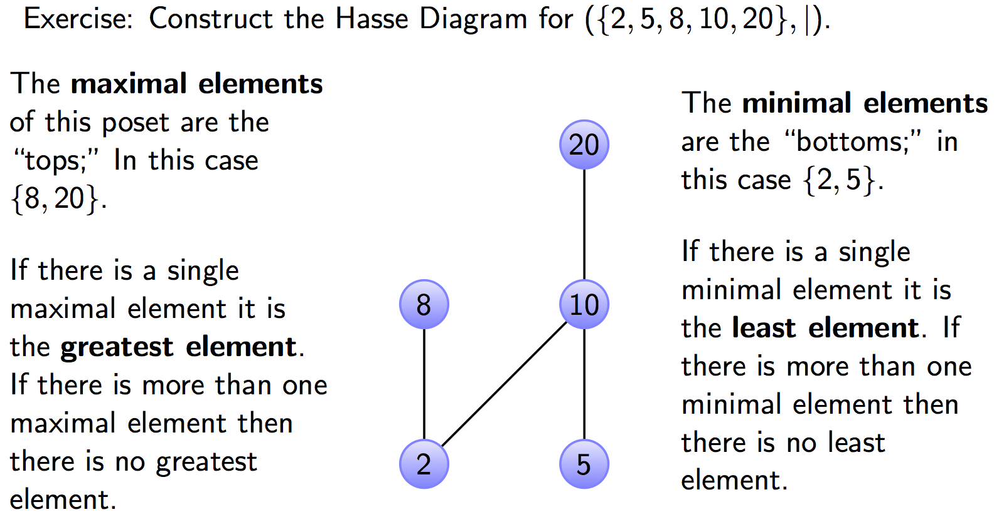
Hasse Diagram Example

Slide 73
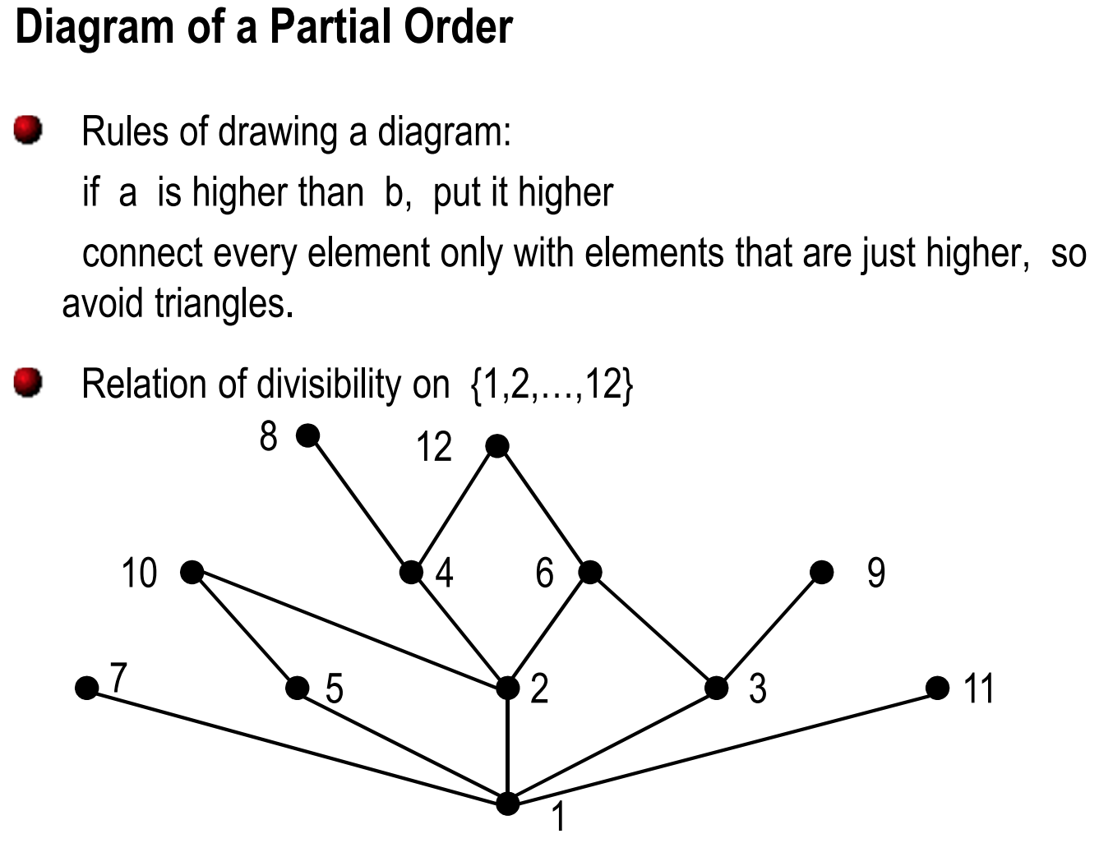

Slide 74
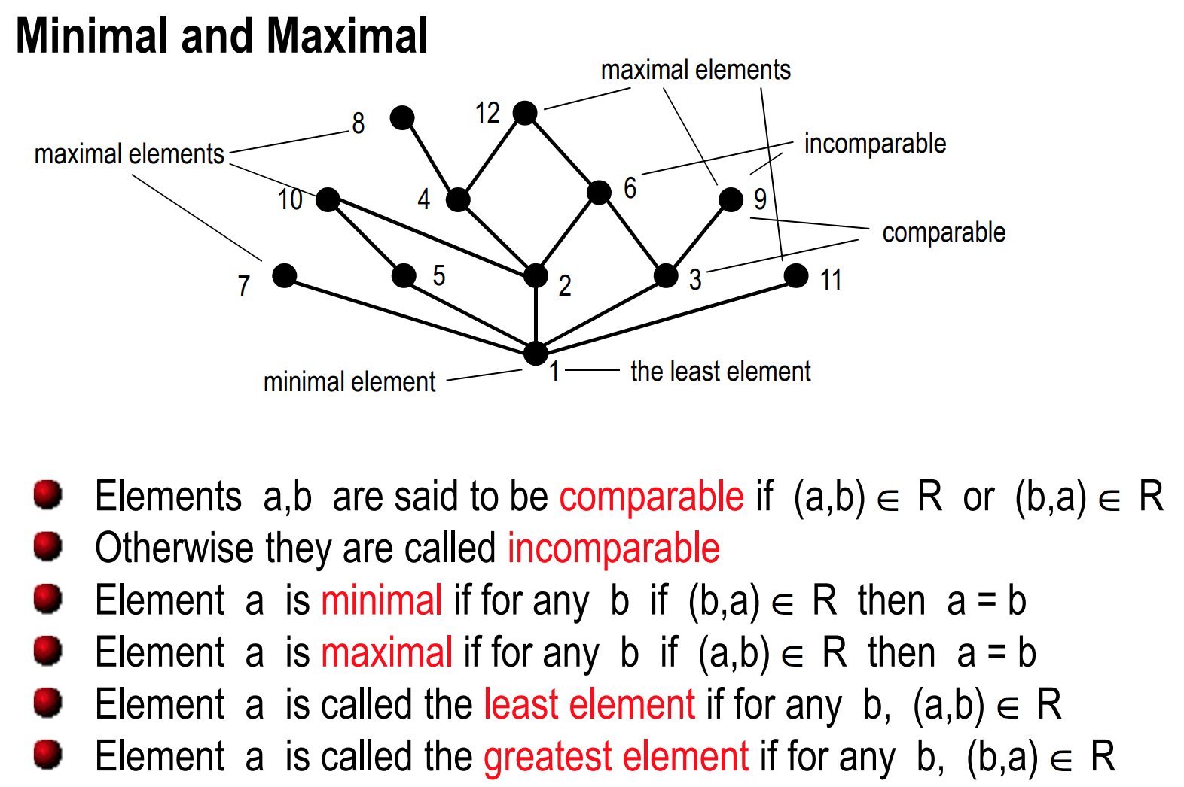

Slide 75
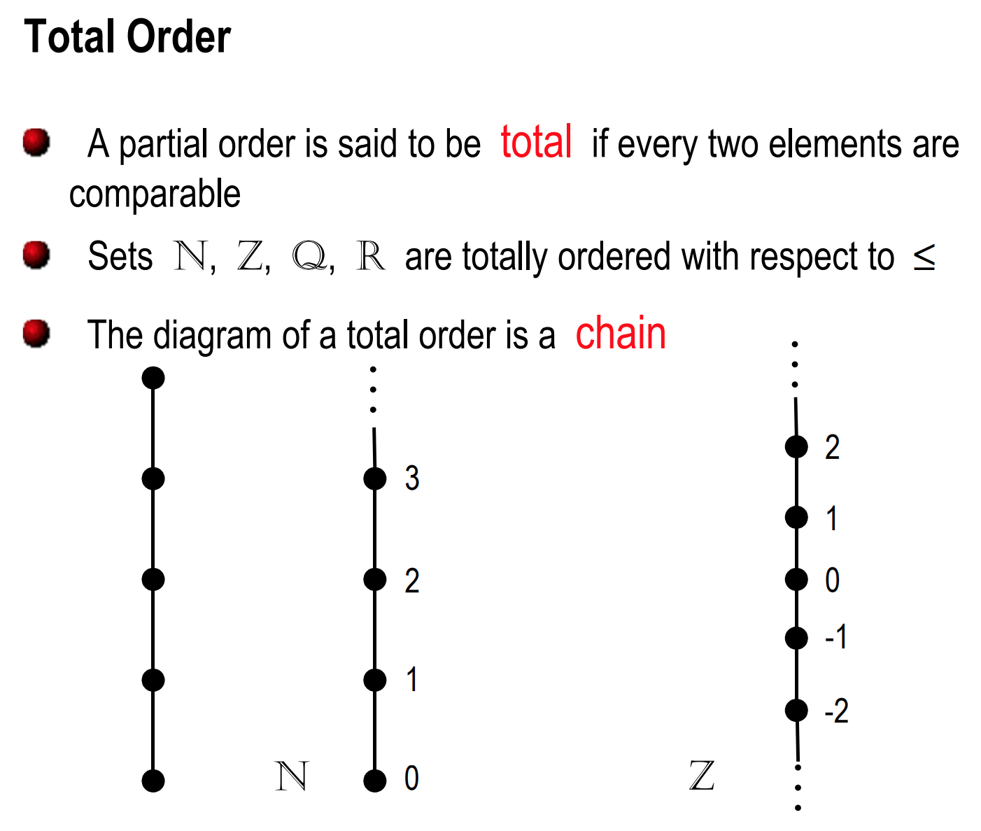

Slide 76
Counting the number of relations
Consider set A where |A|=n.
# of relations on A =
# of reflexive relations on A =
# of symmetric relations of A=
# of antisymmetric relations on A =
# of transitive relations on A = hard

Slide 77
Counting the number of relations
Consider set A where |A|=n.
# of relations on A =
# of reflexive relations on A =
# of symmetric relations of A=
# of antisymmetric relations on A =
# of transitive relations on A = hard

Slide 78
Counting the number of relations
Consider set A where |A|=n.
# of relations on A = 2^{{n*n}}
# of reflexive relations on A =
# of symmetric relations of A=
# of antisymmetric relations on A =
# of transitive relations on A = hard

Slide 79
Counting the number of relations
Consider set A where |A|=n.
# of relations on A = 2^{{n*n}}
# of reflexive relations on A = 2^{{n*n} ^{- n}}
# of symmetric relations of A=
# of antisymmetric relations on A =
# of transitive relations on A = hard

Slide 80
Counting the number of relations
Consider set A where |A|=n.
# of relations on A = 2^{{n*n}}
# of reflexive relations on A = 2^{{n*n} ^{- n}}
# of symmetric relations of A= 2^{{n(n+1)/2}}
# of antisymmetric relations on A =
# of transitive relations on A = hard

Slide 81
Counting the number of relations
Consider set A where |A|=n.
# of relations on A = 2^{{n*n}}
# of reflexive relations on A = 2^{{n*n} ^{- n}}
# of symmetric relations of A= 2^{{n(n+1)/2}}
# of antisymmetric relations on A = 3^{{n(n-1)/2}}2^{n}
# of transitive relations on A = hard

Slide 82
Practice problems:
Show that (P(A), ⊆) is a poset. Draw the Hasse diagram of (P({a,b,c}, ⊆). Determine the greatest and the least elements of the poset.
Suppose R is defined as: R = {(a,b) | a, b ∈ Z and a+b is even}.
  Is (Z, R) a poset?
Consider the `divides’ relation on the set A = (1,2,2², 2³, …., 2^{n}}.
  Prove that this relation is a total order on A.
  Draw the Hasse diagram for this relation when n=3.

Slide 83
Practice problems:
Chapter 7.3 (partial orders) 3, 4, 6, 7, 12, 13, 19, 22
Chapter 7.4: 2, 3, 4, 6, 8, 11, 13, 17

