Slide 1
Proofs
Used some materials from
Book of Proof by
Richard H. Hammack
https://www.people.vcu.edu › ~rhammack › BookOfProof › BookOfProof

Slide 2
Proofs
A proof of a mathematical statement is logical argument which establishes the truth of a statement.
We will cover a variety of methods of proofs.
There are terms which we should know while proving things.

Slide 3
Process of writing Proofs
One of the hardest parts of writing proofs is knowing where to start.
A proof can be any sequence of logical steps.
which steps will lead to the proof?
Fortunately, many proofs follow one of a relatively small number of patterns.
Following one of the common patterns helps give the proof structure and prover some direction.

Slide 4
Proofs by exhaustion
If the domain of an open statement is small, it may be easiest to prove the statement by checking each element individually.
This kind of proof is called proof by exhaustion.

Slide 5
Example
For every positive integer n less than 3, (n+1)² ≥ 3^{n}.
p(n): (n+1)² ≥ 3^{n}
The domain of n is S= {1,2}
We can check that p(1) is true p(2) is true.
Therefore, ∀ n ∈ S, p(n) is true.
However, when S = {1,2,3}, the above claim is not true since p(3) is false.

Slide 6
Counterexamples
It is possible to disprove a claim by example as well.
Claim: If n is an integer greater than 1, then (1.1)^{n} < n¹⁰.
domain S = {2, 3, 4, …..}
p(n): (1.1)^{n} < n¹⁰.
The claim: ∀n ∈ S, p(n) is true.
p(2) is true.
p(100) is true since (1.1)¹⁰⁰=13780.61
P(685) is true, but P(686) is not true.
n=686 is a counterexample for the statement (claim)

Slide 7
Counterexample
A counterexample is an assignment of values to variables that shows a statement is false.

Slide 8
Counterexample
If x is a real number and x< 1, the x² < x.
x = 2 is not a counterexample.
x = -1 is a counterexample.

Slide 9
Find a counterexample:
Every month of a year has 30 or 31 days.
Every positive integer can be expressed as the sum of the squares of two integers.
Every real number has a multiplicative inverse.
x is a multiplicative inverse of y if xy = 1.

Slide 10
Terminology
A primary endeavor in mathematics is proving theorems.
A theorem is a statement that can be shown to be true (via a proof).
A proof is a sequence of statements that form an argument.
Axioms or postulates are statements taken to be self evident or assumed to be true.

Slide 11
Theorems: Example
Theorem (Divisor theorem)
Let a, b, and c be integers. Then
If a|b and a|c then a|(b+c)
If a|b then a|bc for all integers c
If a|b and b|c, then a|c
Corollary:
If a, b, and c are integers such that a|b and a|c, then a|mb+nc whenever m and n are integers
By part 2 it follows that a|mb and a|nc.
By part 1 it follows that a|(mb+nc).
What is the assumption (axiom)?

Slide 12
Definitions
An integer n is even if n=2a for some integer a ∈ Z.
An integer n is odd if n= 2a + 1 for some integer a ∈ Z.
Two integers have the same parity if they are both even or they are both odd. Otherwise, they have opposite parity.
Other definitions…

Slide 13
Divisors
Consider three integers a, b and c, a ≠ 0, such that b = ac. In this case we say that a divides b.
We write a | b.
We also say that b is a multiple of a.

Slide 14
Divisors (Examples)
Which of the following is true?
12 | 12
13 | 0
0 |13
121 | 11
11 | 121

Slide 15
Accepted facts we will use as obvious (axioms):
In algebra, a + b = b + a
Laws of algebra
Laws of inference

Slide 16
Euclidean Geometry
Points and lines are our universe.
Axiom: Given two points, there is exactly one line.
Theorem: If the two sides of a triangle are equal, the angles opposite them are equal.
Corollary: If a triangle is equilateral, it is equiangular.

Slide 17
Equilateral
triangle

Slide 18
Prime numbers
Definition:
A number n ≥ 2, is prime if it is only divisible by 1 and itself. A number n ≥ 2 which is not a prime is called composite.
Numbers 2,3,5,7,11, … are examples of prime numbers.
18 is a composite number (divisible by a prime)

Slide 19
Rule for Universal Specification
Suppose ∀x p(x) is true.
We can say that for an arbitrary element c of the universe, p(c) is true.
Suppose ∀x ∀y p(x,y) is true.
We can say that for arbitrary c and d of the universe, p(c,d) is true.

Slide 20
Rule for Universal Generalization
Suppose p(c) is true for an arbitrary element of the universe.
We can claim that ∀x p(x) is true.
Suppose for arbitrary elements c and d of the universe, p(c,d) is true.
We can claim that ∀x ∀y p(x,y) is true.

Slide 21
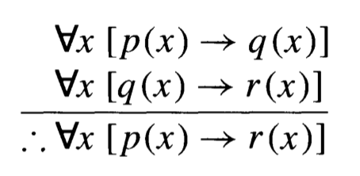
Example
Let p(x), q(x) and r(x) be open statements that are defined for a given universe. The following argument is valid.

Slide 23
Convention: We will often use x instead of c to denote an arbitrary element of the universe.

Slide 24
Direct Proofs
We are interested in proving an implication:
p → q, i.e. if p, then q.

Slide 25
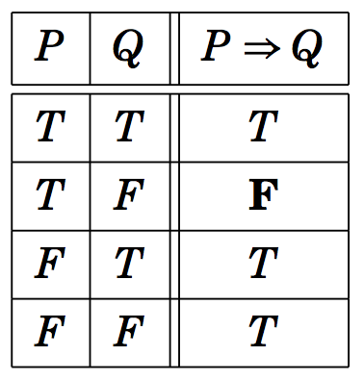
Direct Proofs
We are interested in proving an implication:
P → Q, i.e. if P, then Q.
Consider the truth table of P → Q:
Our goal is to show that this conditional statement P → Q is true.
→

Slide 26
Direct Proofs
We are interested in proving an implication:
P → Q, i.e. if P, then Q.
Consider the truth table of P → Q:
Our goal is to show that this conditional statement P → Q is true.
Since P → Q is true, if P is false. Therefore, we need to show that P → Q is true when P is true.
P → Q

Slide 27
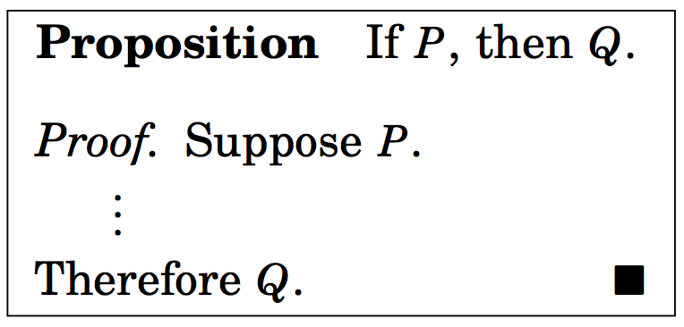
Direct Proof of P → Q
Outline of direct proof
We use the rules of inference, axioms, definitions, and logical equivalences to prove Q.

Slide 28
Direct Proofs

Slide 29
Problem:
Consider the following hypotheses (premises)
More I study, more I know
More I know, more I forget
More I forget, less I know.
Conclusion: Everyone who studies more knows less.
s(x): x studies more; m(x): x knows more;
f(x) : x forgets more ; l(x): x knows less
In symbols
∀x, [(s(x) → m(x)) ∧ (m(x) → f(x)) ∧ (f(x) → l(x)) → (s(x) → l(x)]

Slide 30
Problem (contd.):
Conclusion: Everyone who studies more knows less.
s(x): x studies more; m(x): x knows more;
f(x) : x forgets more ; l(x): x knows less
In symbols
∀x, [(s(x) → m(x)) ∧ (m(x) → f(x)) ∧ (f(x) → l(x)) → (s(x) → l(x)]
Direct Proof: Let c be an arbitrary element of the universe
(population). We need to show that s(c) → l(c).
s(c) is true.

Slide 31
Problem (contd.):
Conclusion: Everyone who studies more knows less.
s(x): x studies more; m(x): x knows more;
f(x) : x forgets more ; l(x): x knows less
In symbols
∀x, [(s(x) → m(x)) ∧ (m(x) → f(x)) ∧ (f(x) → l(x)) → (s(x) → l(x)]
Direct Proof: Let c be an arbitrary element of the universe
(population). We need to show that s(c) → l(c).
s(c) is true.
s(c) → m(c); m(c) → f(c); f(c) → l(c)

Slide 32
Problem (contd.):
Conclusion: Everyone who studies more knows less.
s(x): x studies more; m(x): x knows more;
f(x) : x forgets more ; l(x): x knows less
In symbols
∀x, [(s(x) → m(x)) ∧ (m(x) → f(x)) ∧ (f(x) → l(x)) → (s(x) → l(x)]
Direct Proof: Let c be an arbitrary element of the universe
(population). We need to show that s(c) → l(c).
s(c) is true.
s(c) → m(c); m(c) → f(c); f(c) → l(c)
s(c) → l(c) by the transitivity (syllogism)

Slide 33
Problem (contd.):
Conclusion: Everyone who studies more knows less.
s(x): x studies more; m(x): x knows more;
f(x) : x forgets more ; l(x): x knows less
In symbols
∀x, [(s(x) → m(x)) ∧ (m(x) → f(x)) ∧ (f(x) → l(x)) → (s(x) → l(x)]
Direct Proof: Let c be an arbitrary element of the universe
(population). We need to show that s(c) → l(c).
s(c) is true.
s(c) → m(c); m(c) → f(c); f(c) → l(c)
s(c) → l(c) by the transitivity
∀x (s(x) → l(x)) Universal generalization

Slide 34
Proposition: ∀x, if x is odd, x² is odd.

Slide 35
Proposition: ∀x, if x is odd, x² is odd.
We have the starting structure for an arbitrary element x of the universe:
indicates the end of the proof

Slide 36
Proposition: ∀x, if x is odd, x² is odd.
Using the definition of odd numbers we get

Slide 37
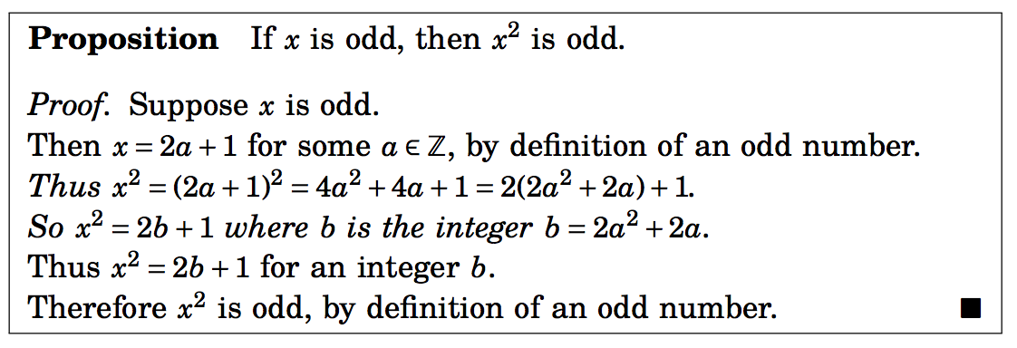
Proposition: ∀x, if x is odd, x² is odd.
We are almost there:

Slide 38
Proposition: ∀x, if x is odd, x² is odd.
P(x) = x is odd; Q(x) = x² is odd.
The above proof can also be written as follows (x is an arbitrary element of the universe):
P(x): x is odd → (x=2a+1)
(x=2a+1) → (x² =2(2a²+2a) +1)
(x²=2b +1) → Q(x): x² is odd
Thus P(x) → Q(x) is true for an arbitrary x.

Slide 39
Show that 1+2+3+ …+ n =n(n+1)/2
We assume that n ∈ N.
We write
x = 1 + 2 + … + n.

Slide 40
Show that 1+2+3+ …+ n =n(n+1)/2
We assume that n ∈ N.
We write
x = 1 + 2 + … + n.
→ x = n + (n-1) + … + 1. (Commutative property)

Slide 41
Show that 1+2+3+ …+ n =n(n+1)/2
We assume that n ∈ N.
We write
x = 1 + 2 + … + n.
→ x = n + (n-1) + … + 1. (Commutative property)
→ 2x = n(n+1) (adding them together)
→ x = n(n+1)/2

Slide 42
Example 1
Suppose x, y are integers. If x and y are odd, xy is odd.
Assume x and y are odd integers.
Then x=2a + 1, and y=2b+1 for some integers a and b.

Slide 43
Example 1
Suppose x, y are integers. If x and y are odd, xy is odd.
Assume x and y are odd integers.
Then x=2a + 1, and y=2b+1 for some integers a and b.
As a result xy = (2a+1).(2b+1)=4ab + 2a +2b +1 = 2(2ab+a+b) +1 =2t+1 where t is an integer.
Therefore, if x and y are odd integers, xy is odd.
This completes the proof.

Slide 44
Example 2
Suppose a,b,c are integers. If a|b and a|c, the a|(b+c).
by definitions, a|b implies b=ad for some integer d.
Similarly a|c imples c= af for some integer f.

Slide 45
Example 2
Suppose a,b,c are integers. If a|b and a|c, the a|(b+c).
by definitions, a|b implies b=ad for some integer d.
Similarly a|c imples c= af for some integer f.
We can now write b + c =a(f+d) = a.t, for some integer t. Therefore, by definition, a | (b+c).

Slide 46
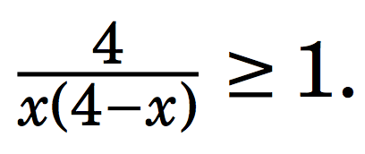
Example 3
If x ∈ R, and 0 < x < 4,

Slide 47
Example 3
If x ∈ R, and 0 < x < 4,
We can rewrite the above equation as 4 ≥ x(4-x). This is only possible if x(4-x) > 0. This is true since 0 < x < 4.

Slide 48
Example 3
If x ∈ R, and 0 < x < 4,
We can rewrite the above equation as 4 ≥ x(4-x). This is only possible if x(4-x) > 0. This is true since 0 < x < 4.
Upon further simplification we get (x-2)² ≥ 0.
Thus the above statement is true.

Slide 49
Contrapositive Proof
We use the fact that P → Q and ¬Q → ¬P are logically equivalent.
The expression ¬Q → ¬P is called the contrapositive form of P → Q .

Slide 50
Contrapositive Proof
We use the fact that P → Q and ¬Q → ¬P are logically equivalent.
The expression ¬Q → ¬P is called the contrapositive form of P → Q .
In order to prove P → Q is true, it suffices to instead prove that ¬Q → ¬P is true.
In order to use direct proof to show ¬Q → ¬P is true, we would assume that ¬Q is true, and use this to deduce that ¬P is true.

Slide 51
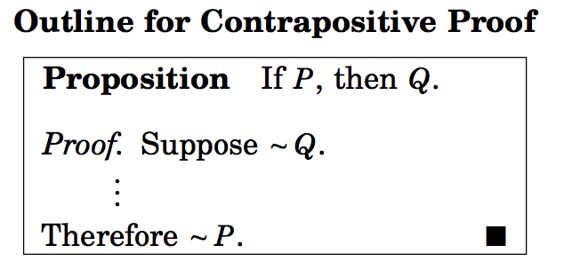

Slide 53
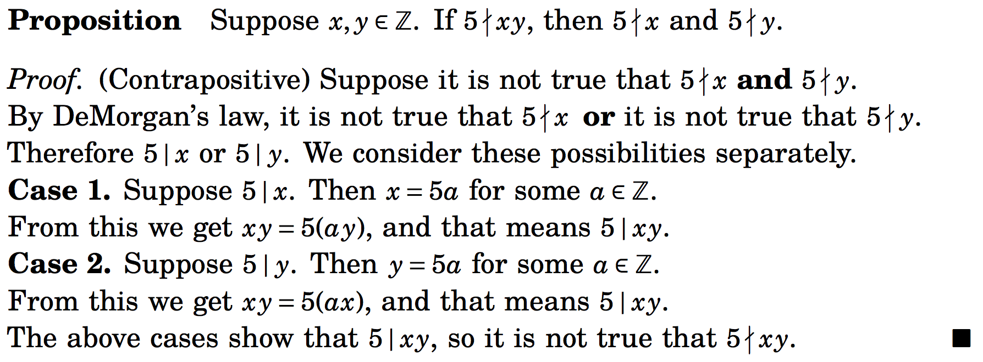
Example

Slide 54
Example
Suppose x, y are integers. If x²(y+3) is even, the x is even or y is odd.
The equivalent contrapositive statement is:
if x is odd and y is even, x²(y+3) is odd.

Slide 55
Theorem: For every positive real number r, if r is irrational, √r is also irrational.
Contrapositive equivalent:
If √r is not irrational (i.e. rational), r is also rational.

Slide 56
Theorem: For every positive real number r, if r is irrational, √r is also irrational.
Contrapositive equivalent:
If √r is not irrational (i.e. rational), r is also rational.
Let √r = a/b where a and b are integers and b is non-zero
Equivalent to r = a²/b²= c/d where c and d are integers.This implies that r is also rational.

Slide 57
Proof by Contradiction
This method is not just limited to conditional statements.
Show that the number is irrational. (Note: A number is irrational if it cannot be expressed as where a and b are integers, and b is non-zero.)

Slide 58
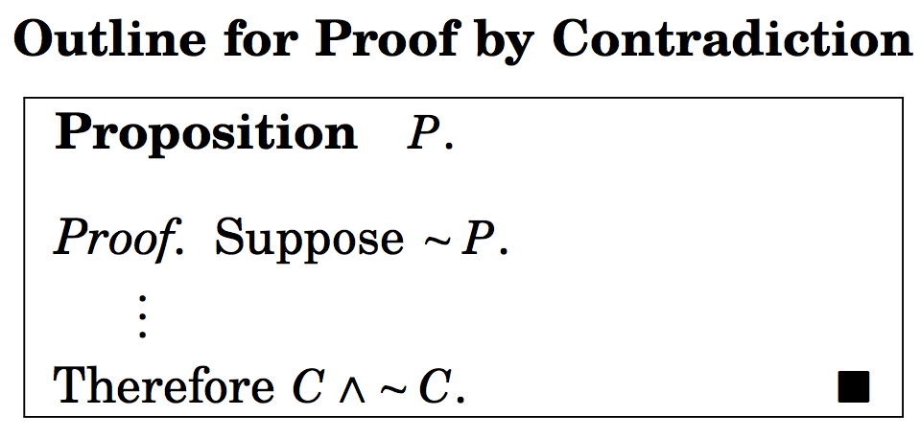
Proof by Contradiction
C is some statement.

Slide 59
Proof by Contradiction
¬P → (C ∧ ¬C)
C is some statement.

Slide 61
Show that the number is irrational.
Suppose ¬P : is rational.

Slide 62
Show that the number is irrational.
Suppose ¬ P : is rational.
Then by definition = where a and b are integers and a and non-zero b have no common factors.

Slide 63
Show that the number is irrational.
Suppose ¬ P : is rational.
Then by definition = where a and b are integers and a and non-zero b have no common factors.
Squaring we get 2b² = a². This implies that a is even. Therefore, a=2k, for some k.

Slide 64
Show that the number is irrational.
Suppose ¬ P : is rational.
Then by definition = where a and b are integers and a and non-zero b have no common factors.
Squaring we get 2b² = a². This implies that a is even. Therefore, a=2k, for some k.
We can write 2b² = 4k^{2,} i.e. b² = 2k² .
Hence b is also even.

Slide 65
Show that the number is irrational.
Suppose ¬ P : is rational.
Then by definition = where a and b are integers and a and non-zero b have no common factors.
Squaring we get 2b² = a². This implies that a is even. Therefore, a=2k, for some k.
We can write 2b² = 4k^{2,} i.e. b² = 2k² .
Hence b is also even.
This means that a and b have 2 as a common factor.
We arrive at a contradiction.
¬ P → F
P is true.

Slide 66
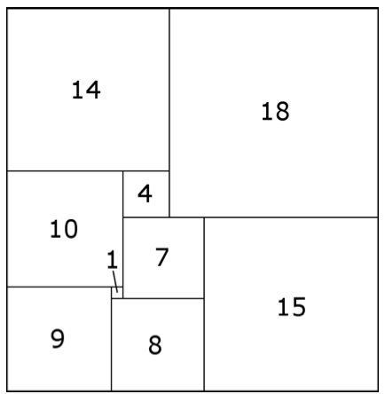
Arrangement of squares
Consider a 32 x 33 rectangle partitioned into nine squares:
Claim: Smallest square in the partition must always lie in the middle.

Slide 67
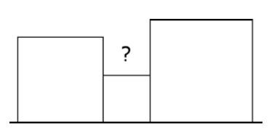
Proof by Contradiction.
Suppose it is possible to place the smallest square on the boundary.

Slide 68
Proof by Contradiction.
Suppose it is possible to place the smallest square on the boundary.
Observe that the squares immediately adjacent to the smallest square are larger.

Slide 69
Proof by Contradiction.
Suppose it is possible to place the smallest square on the boundary.
Observe that the squares immediately adjacent to the smallest square are larger.
The area marked ? cannot be covered by larger size squares.

Slide 70
Proof by Contradiction.
Suppose it is possible to place the smallest square on the boundary.
Observe that the squares immediately adjacent to the smallest square are larger.
The area marked ? cannot be covered by larger size squares.
The starting assumption leads to a contradiction.
The starting assumption is wrong.
Therefore, the smallest square must appear in the middle of the configuration of squares.

Slide 71
There are infinitely many primes.

Slide 72
There are infinitely many primes.
Suppose there are finite number of primes, and they are, say, p₁, p₂, ….., p_{n}.
Let p_{n} is the largest prime number in the list.

Slide 73
There are infinitely many primes.
Suppose there are finite number of primes, and they are, say, p₁, p₂, ….., p_{n}.
Let p_{n} is the largest prime number in the list.
Consider the number a = p₁x p₂x …..x p_{n} + 1.

Slide 74
There are infinitely many primes.
Suppose there are finite number of primes, and they are, say, p₁, p₂, ….., p_{n}.
Let p_{n} is the largest prime number in the list.
Consider the number a = p₁x p₂x …..x p_{n} + 1.
Since a is not divisible by p_{i} for any p_{i}, a is also a prime number.

Slide 75
There are infinitely many primes.
Suppose there are finite number of primes, and they are, say, p₁, p₂, ….., p_{n}.
Let p_{n} is the largest prime number in the list.
Consider the number a = p₁x p₂x …..x p_{n} + 1.
Since a is not divisible by p_{i} for any i, a is also a prime number.
Thus a is a prime number larger that p_{n}.
The starting assumption leads to a contradiction.
This proves that there are infinitely many prime.

Slide 76
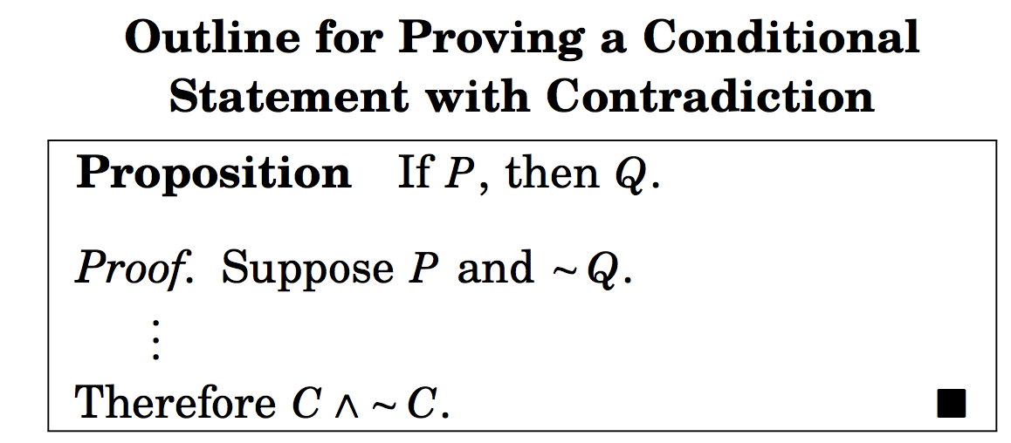
Proving conditional statements by contradiction

Slide 77
Proving conditional statements by contradiction
P ∧ ¬Q → F

Slide 78
Example
Let x and y be real numbers. If 5x+25y = 1723, then x or y is not an integer.

Slide 79
Example
Let x and y be real numbers. If 5x+25y = 1723, then x or y is not an integer.
Here P(x,y): 5x + 25 y =1723;
Q(x,y): (x is not an integer) ∨ (y is not an integer)

Slide 80
Example
Let x and y be real numbers. If 5x+25y = 1723, then x or y is not an integer.
Here P(x,y): 5x + 25 y =1723;
Q(x,y): (x is not an integer) ∨ (y is not an integer)
Suppose ∀x,y (P(x,y) ∧¬ Q(x,y))
¬ Q(x,y) : x and y are integers.

Slide 81
Example
Let x and y be real numbers. If 5x+25y = 1723, then x or y is not an integer.
Here P(x,y): 5x + 25 y =1723;
Q(x,y): (x is not an integer) ∨ (y is not an integer)
Suppose ∀x,y (P(x,y) ∧¬ Q(x,y))
¬ Q(x,y) : x and y are integers.
Note that 5x + 25 y =1723 is 5(x+5y) =1723.
Since x+5y is an integer, therefore 5 divides 1723, a contradiction.

Slide 82
Example
Consider the statement: For all nonnegative real numbers a, b, and c, if a² + b² = c², then a + b ≥ c.
Solve in the class.

Slide 83
Proof by cases
Sometimes it is easier to prove a theorem by
breaking it down into cases and
proving each case separately.
It is a direct method of proving statements like p₁ ∨ p₂ ∨ …. ∨ p_{n} → q is equivalent to proving (p₁ → q) ∧ (p₂ → q) ∧ (p₃ → q) ∧ …. ∧ (p_{n} → q).

Slide 84
Example
For any two reals x and y, show that|x+y| ≤ |x| + |y|.
Proof by cases:

Slide 85
Example
For any two reals x and y, show that|x+y| ≤ |x| + |y|.
Proof by cases:
(Case 1) x ≥ 0, y ≥ 0
Theorem is true since (x+y) = x + y.

Slide 86
Example
For any two reals x and y, show that|x+y| ≤ |x| + |y|.
Proof by cases:
(Case 1) x ≥ 0, y ≥ 0
Theorem is true since (x+y) = x + y.
(Case 2) x < 0, y ≥ 0
Theorem is true since |x+y| < max{|x|,|y|} < |x| + |y|

Slide 87
Example
For any two reals x and y, show that|x+y| ≤ |x| + |y|.
Proof by cases:
(Case 1) x ≥ 0, y ≥ 0
Theorem is true since (x+y) = x + y.
(Case 2) x < 0, y ≥ 0
Theorem is true since |x+y| < |y| < |x| + |y|
(Case 3) x ≥ 0, y < 0
Very similar to the second case
(Case 4) x < 0, y < 0
In this case |x+y| = |x| + |y|.

Slide 88
Example
Problem:
Let n ∈ Z (integer). Prove that 9n²+3n-2 is even.

Slide 89
Example
Problem: Let n ∈ Z. Prove that 9n²+3n-2 is even.
Proof by cases:
Case 1: n is even, i.e. n = 2k, k an integer
9n²+3n-2 = 9.4.k² + 3.2k – 2 = 2(18k²+3k -1) = 2t, t an integer (even)
Case 2: n is odd, i.e. n = 2k+1, k an integer
9n²+3n-2 = 9(2k+1)² +3(2k +1) -2
= 9(4k² + 4k +1) + 6k +1
= 2(18 k² +21 k +5) : even
∀n, 9n²+3n -2 is even.

Slide 90
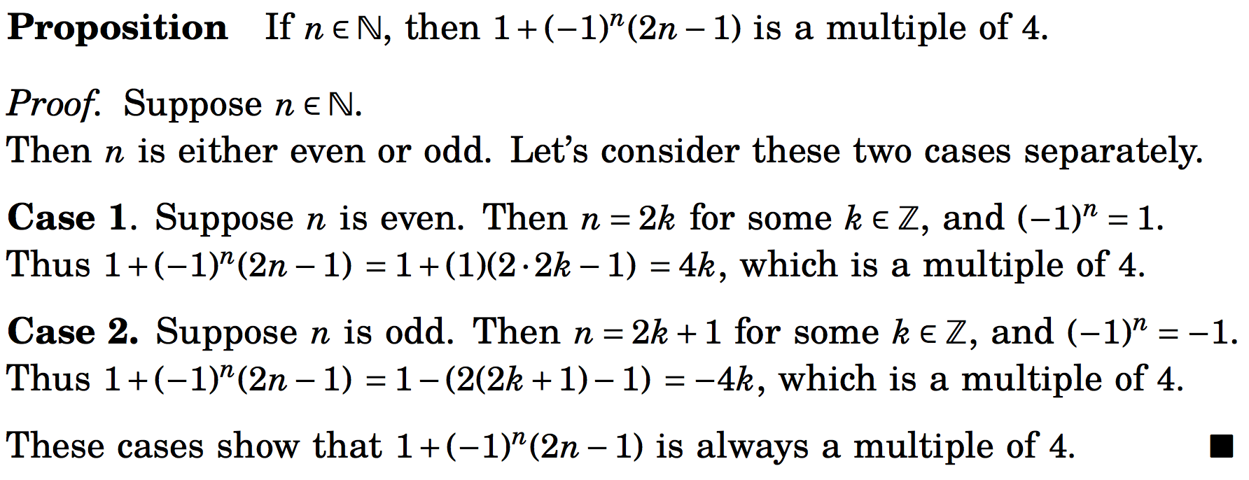
Proof by cases
In proving a statement is true, we sometimes have to examine multiple case before showing the statement is true in all possible scenarios.

Slide 91
Theorem
Consider a group of six people. Each pair of people are either friends or enemies with each other. Then there are three people in the group who are all mutual friends or all mutual enemies.
Listen to the video whose link is given by the Zybook (section 2.5)

Slide 92
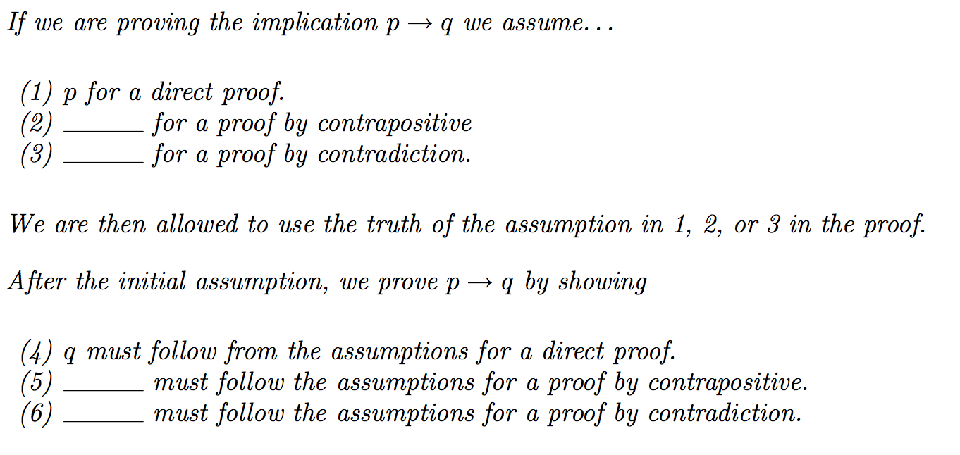
Fill in the blanks

