Slide 1
A first word on probability
Chapter 3.4

Slide 2
Acknowledgement
Some of the slides are take from Dr. Bulatov’s Lecture-Slides.

Slide 3
Use of Probabilty
One of the primary applications of counting is to calculate probabilities of random events.
Probability theory plays an important role in almost every area of science, economics, and business.
In computer science, randomization and probability are ubiquitous.

Slide 4
Cartesian Products
For sets A, B, the Cartesian product, or cross product, of A and B is denoted by A × B and equals {(a, b) | a ∈ A, b ∈ B}.
Elements of A × B are ordered pairs. For (a, b), (c, d) ∈ A × B , (a, b) = (c, d) if and only if a = c and b = d.

Slide 5
Example
Let A = {2, 3, 4}, B = {4, 5}. Then
a) A × B = {(2, 4), (2, 5), (3, 4), (3, 5), (4, 4), (4, 5)}
b) B × A = {(4, 2), (4, 3), (4, 4), (5, 2), (5, 3), (5, 4)}
c) B² = B × B = {(4, 4), (4, 5), (5, 4), (5, 5)}
d) B³ = B × B × B = {(a, b, c) | a, b, c ∈ B}; for instance, (4, 5, 5) ∈ B³

Slide 6
Cartesian Products
Properties:
If A, B are finite, it follows from the rule of product that |A × B| = |A| . |B|
Although we generally will not have A × B = B × A, we will have |A×B|=|B×A|

Slide 7
Grid
Let A = { a ε N | 0 ≤ a ≤ 10}; B = {2, 3, 4}
A x B = { (a,b), a ε A, b ε B }
= { (1,2), (1,3), (1,4), …., (10,2), (10,3), (10,4)}
4
3
2
0 1 2 3 4 5 6 7 8 9 10

Slide 8
Grid
Let A = { a ε N | 0 ≤ a ≤ 10}; B = {2, 3, 4}
A x B = { (a,b), a ε A, b ε B }
= { (1,2), (1,3), (1,4), …., (10,2), (10,3), (10,4)}
4
3
2
0 1 2 3 4 5 6 7 8 9 10
We can similarly define A x A

Slide 9
A first word on probability
Chapter 3.4

Slide 10
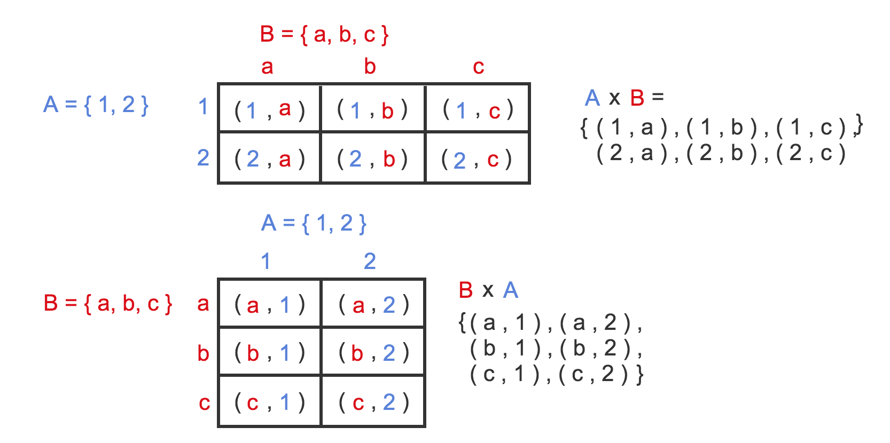
Cartesian Product (Finite Example)

Slide 11
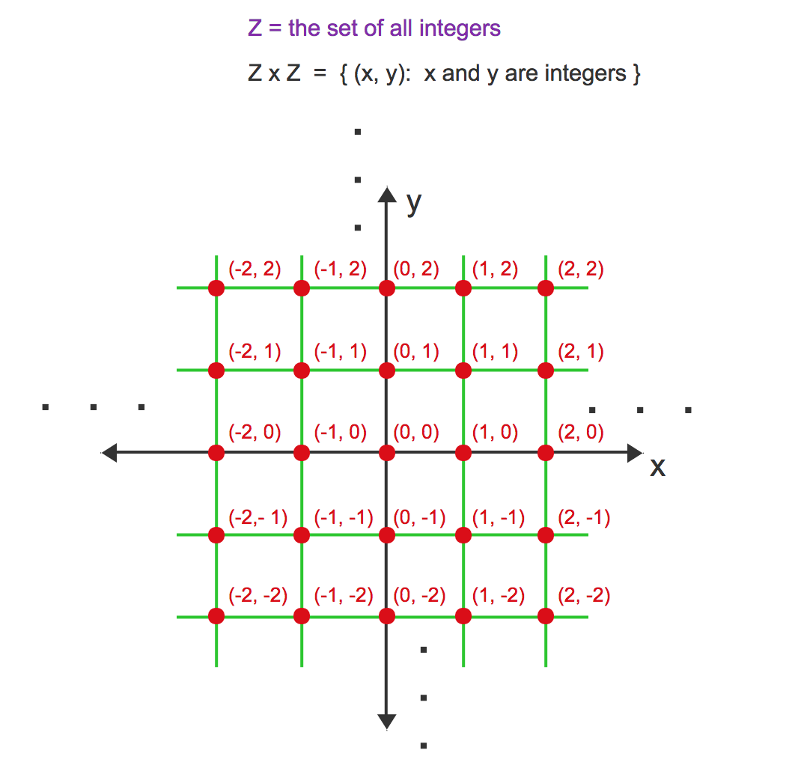
Cartesian Product (An infinite Example)

Slide 15
Example
We have a die and a coin.
When a a die is rolled, the outcome is an element of D = { 1, 2, 3, 4, 5, 6}. (sample space of the die roll)
When a coin is tossed, the outcome is an element C = {H, T} (the sample space of the coin toss)
The sample space for the experiment (E) of rolling a die followed by a coin toss is
D x C = { (1, H), (1, T), (2, H), (2, T), ……, (6, H), (6, T)}
(sample space of E)
|D x B | =12

Slide 16
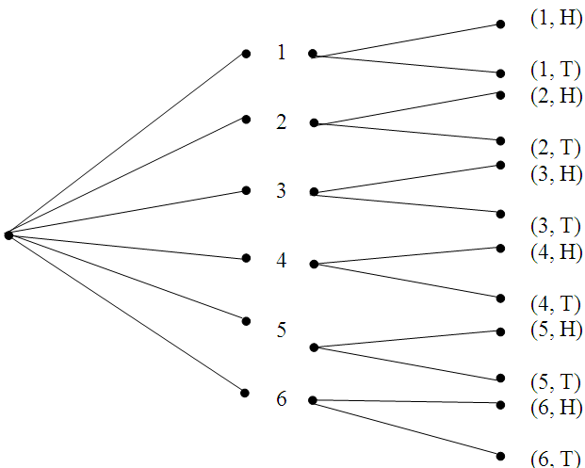
Another view of the sample space

Slide 19
Example
Consider the word WYSIWYG. If we permute the letter randomly without any bias, what is the probability of a permutation where both W’s consecutively and both Y’s appear consecutively?
There are a = 7!/(2!.2!) = 1260 different permutations of the word. Therefore, a is the size of the sample set.
When two W’s and two Y’s are both treated as one, there are 5! = 120 arrangements have both consecutive W’s and consecutive Y’s. The size of the event space E is 120.
When the letters of the word are arranged in a random manner, the probability (Pr(E)) that the arrangement has both consecutive W’s and consecutive Y’s is 120/1260 = 0.0476.
The probability of an arrangement that doesn’t have both consecutive W’s or consecutive Y’s is (1260 – 120)/1260, i.e. 1- Pr(E).

Slide 20
Crooked die

Slide 22
Example: The probability of an event where each outcome of the experiment is equally likely
A 5-card hand is dealt. What is the probability of each of the following events?
full house
three of a kind
same suit
two of a kind

Slide 23
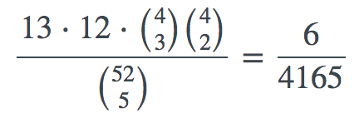
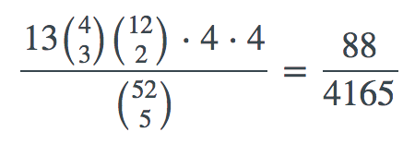
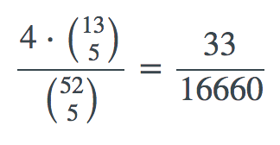
Example: The probability of an event where each outcome of the experiment is equally likely
A 5-card hand is dealt. What is the probability of each of the following events?
full house
three of a kind
same suit
two of a kind

Slide 26
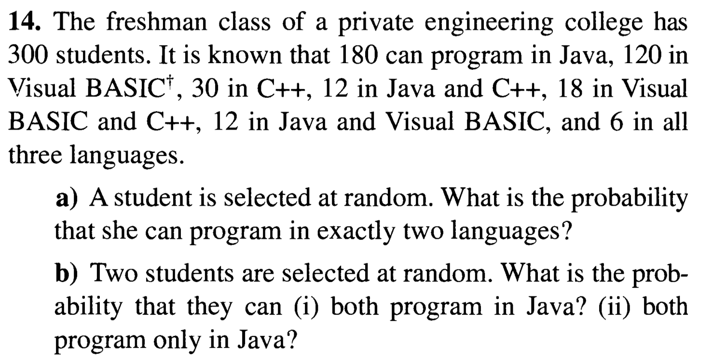

Slide 27
Practice Problem
Chapter 3.4: 1, 5, 7, 9, 15

