Slide 1
Discrete Mathematics MACM 101
Binay Bhattacharya
binay@cs.sfu.ca
Introduction

Slide 2
Overview
Course Information
Course themes, goals
Syllabus

Slide 3
Course Information
Lectures: Mon, Wed, and Fri – 12:30 pm – 1:20 pm
Lecturer: Binay Bhattacharya
Office: TASC I 8017
Phone: 778-782-3133
Email: binay@cs.sfu.ca
Course Website: www.cs.sfu.ca/~binay/2019/macm101
All the hand-outs/announcements can be found in the website.

Slide 4
Course Information

Slide 5
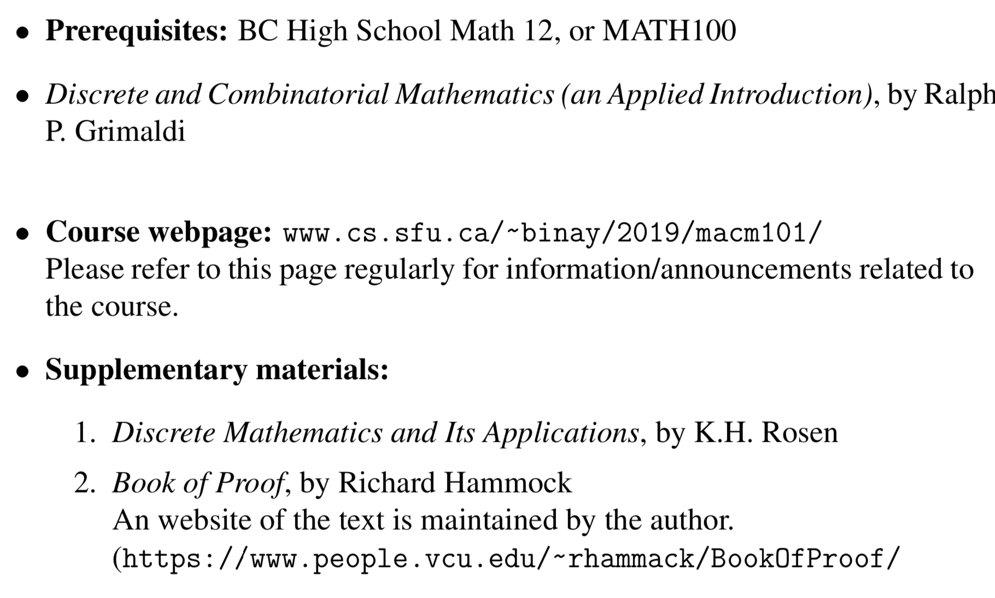
Course Information

Slide 6
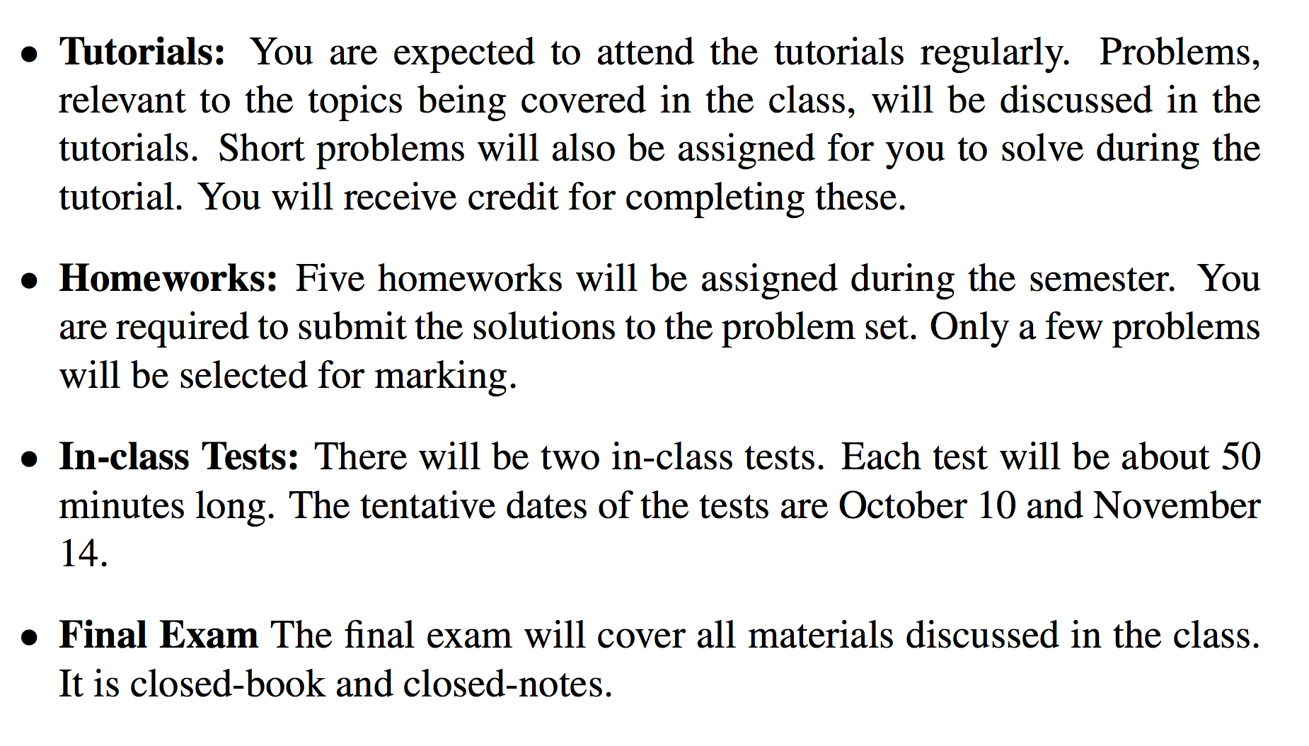
Activities

Slide 7
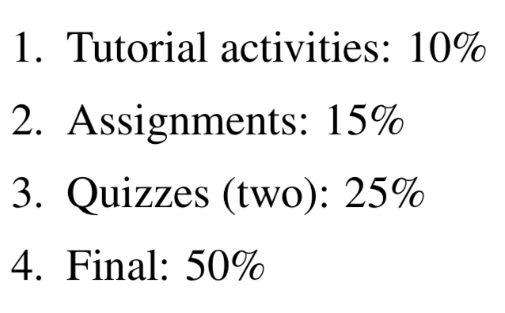
Grading

Slide 8
Other
Office hours (TBA)
feel free to stop by whenever you have a question, particularly if you are having trouble
Catching up is very difficult once you get behind
Exercises
solve as many problems as possible
lots of solved problems can be found in the lecture slides
odd numbered questions in the text are solved in the text
hints to the even-numbered questions will be provided
ask TA or the instructor for help

Slide 9
What is discrete mathematics?
Discrete mathematics is the mathematics of computing

Slide 10
What is MACM 101 about?
Continuous Math vs Discrete Math
Discrete mathematics is the mathematics of computing
Why is it computer science?
Mathematical techniques for Discrete Math

Slide 11
Continuous vs Discrete
Continuous Mathematics
Objects vary continuously
Example: analog wristwatch: from analog perspective, between 10:30 am to 10:31 am there are infinitely many possible times
Differential equations
Sine, cosine functions

Slide 12
Continuous vs Discrete
Discrete Mathematics
Objects vary in a discrete way
Example: digital wristwatch: from analog perspective, between 10:30 am to 10:31 am there are infinitely finitely many possible times. A digital watch does not show split seconds.
Integers --- core of discrete mathematics
Computer science – computers are discrete.

Slide 13
What is MACM 101 about?
Why is it computer science?

Slide 14
Number Theory: RSA and Public-key Cryptography
Alice and Bob have never met but they would like to
exchange a message. Eve would like to eavesdrop.
E.g. between you and the Bank of Montreal.
They could come up with a good encryption algorithm and exchange the encryption key – but how to do it without
Eve getting it? (If Eve gets it, all security
is lost.)
CS folks found the solution:
public key encryption. Quite remarkable
that is feasible.

Slide 15
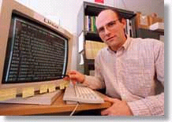
Automated Proofs:
EQP - Robbin’s Algebras are all Boolean
A mathematical conjecture (Robbins conjecture) unsolved for decades.
First non-trivial mathematical theorem proved automatically.
The Robbins problem was to determine whether one particular set of rules is powerful enough to capture all of the laws of Boolean algebra. One way to state the Robbins problem in mathematical terms is:
Can the equation not(not(P))=P be derived from the following three equations?
[1] P or Q = Q or P,
[2] (P or Q) or R = P or (Q or R),
[3] not(not(P or Q) or not(P or not(Q))) = P.
[An Argonne lab program] has come up with a major mathematical
proof that would have been called creative if a human had thought of it.
New York Times, December, 1996

Slide 16
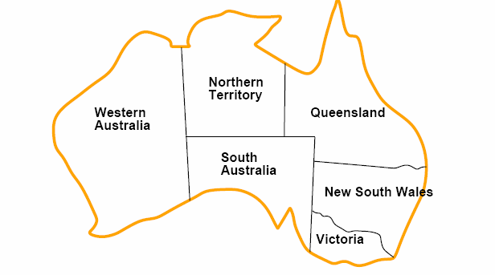
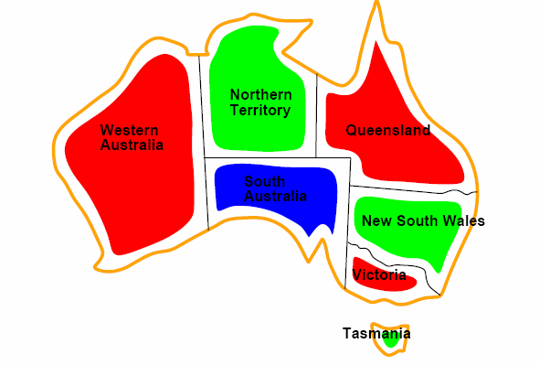
Coloring a Map
How to color this map so that no two
adjacent regions have the same color?

Slide 17
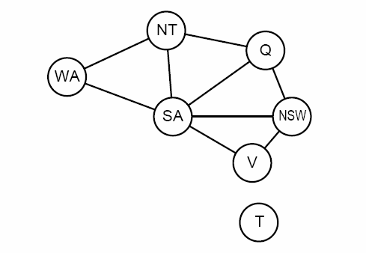
Graph representation
Coloring the nodes of the graph:
What’s the minimum number of colors such that any two nodes
connected by an edge have different colors?

Slide 18
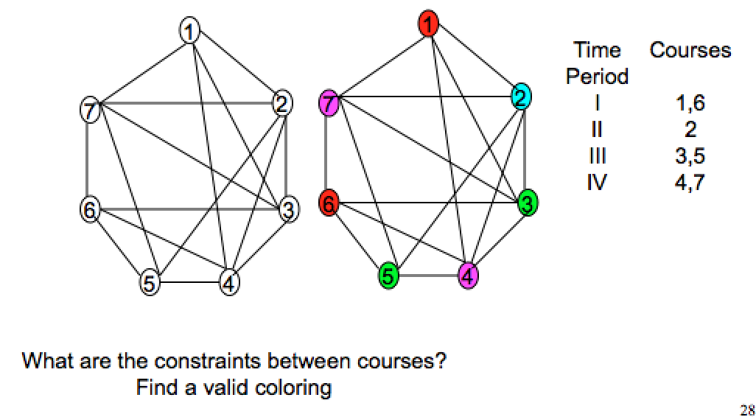
Scheduling Final Exams

Slide 19
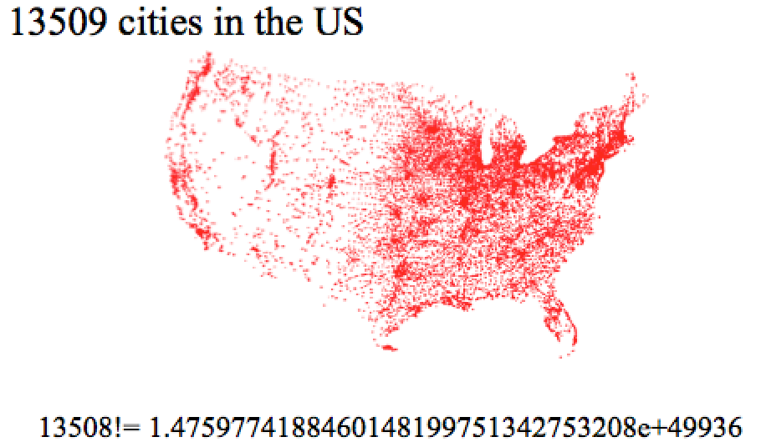
Traveling Salesman Problem

Slide 20
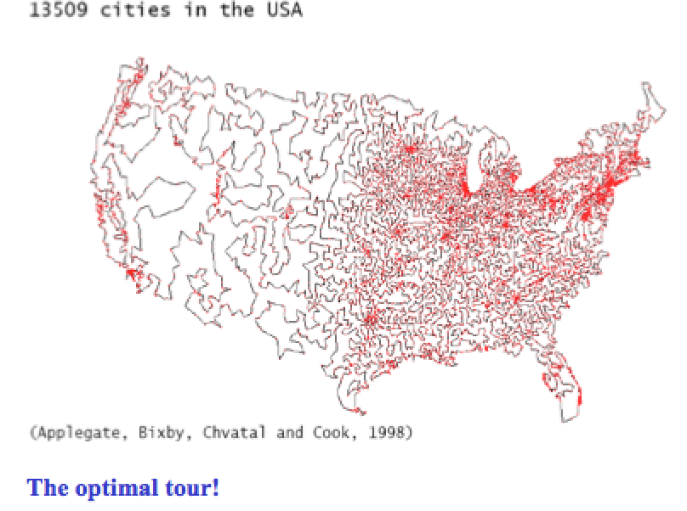
Traveling Salesman Problem

Slide 21
Probability and Chances
Importance of concepts from probability is rapidly increasing in CS:
Randomized algorithms
primality testing; Google’s PageRank, “just” a random walk on the web!)
in computation, having a few random bits really helps!
Machine Learning / Data Mining:
find statistical regularities in large amounts of data.
Natural language understanding
dealing with the ambiguity of language

Slide 22
Goals of MACM 101
Introduce students to a range of mathematical tools from discrete mathematics that are key in computer science.
How to write statements correctly.
How to read and write theorems.
Areas:
Counting
Logic
Set Theory
Mathematical Induction
Relations
Functions
Introduction to Graphs

Slide 23
Goals of MACM 101
Introduce students to a range of mathematical tools from discrete mathematics that are key in computer science.
How to write statements correctly.
How to read and write theorems.
Areas:
Counting
Logic
Set Theory
Mathematical Induction
Relations
Functions
Introduction to Graphs
Note: Learning to do proofs from
watching the slides is like trying to
learn to play tennis from watching
it on TV! So, do exercises!

Slide 25
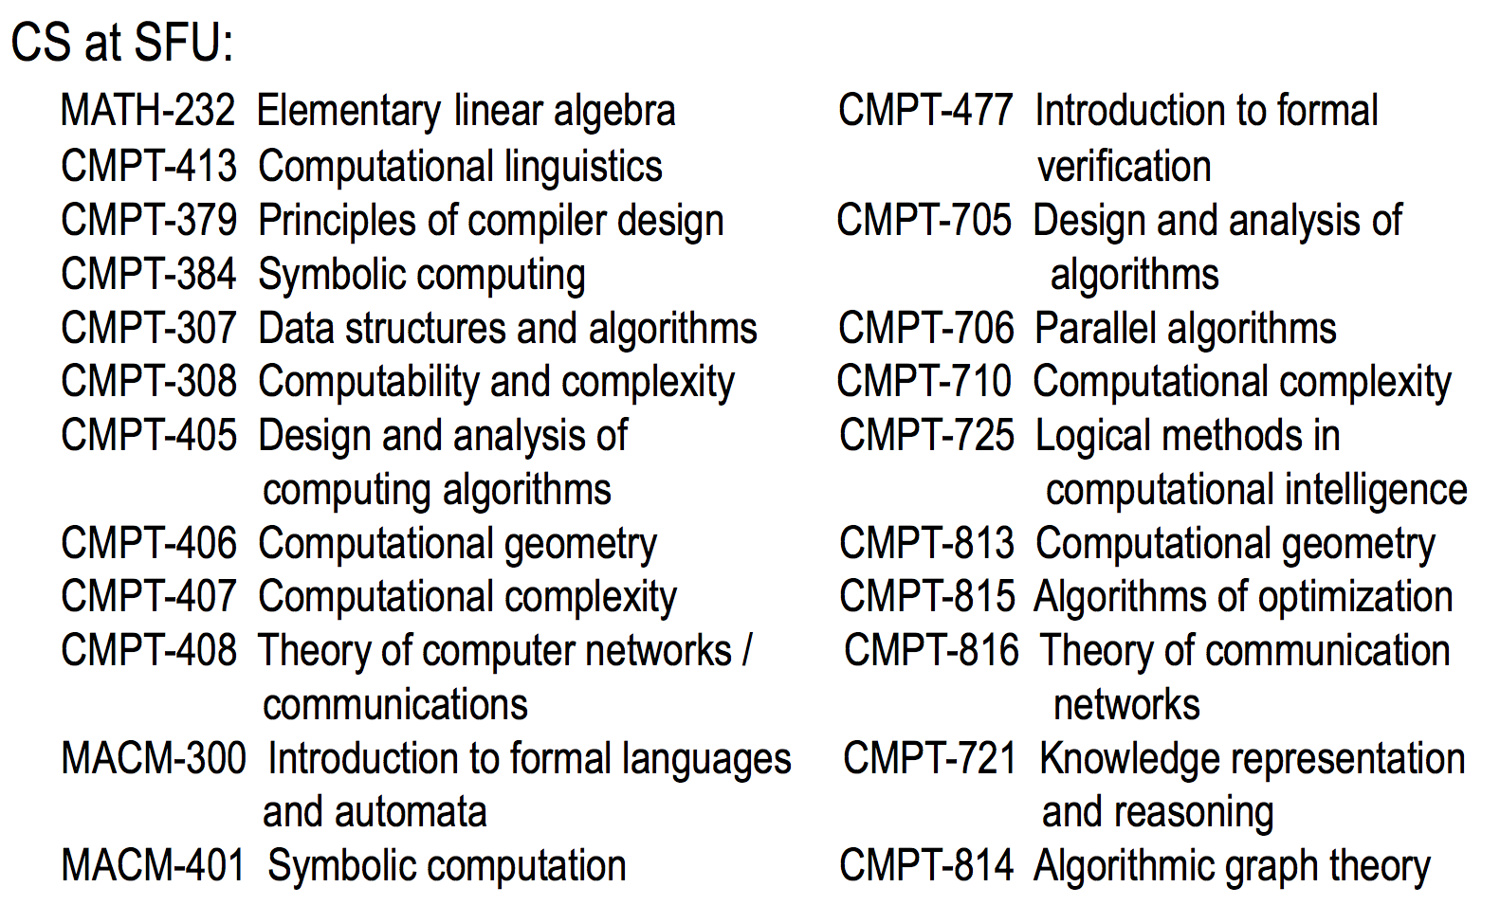

Slide 26
Acknowledgement
Taken some slides from Prof. Bart Selman slides:
www.cs.cornell.edu/courses/cs2800/

