Slide 1
Functions
Chapter 5.1– 5.6

Slide 2
Acknowledgement
I have used materials from the following sources:
Textbook
Lecture notes slides prepared by Prof. Bulatov.
http://cse.unl.edu/~choueiry/S13-235/
http://www.math-cs.gordon.edu/courses/mat231/notes.html

Slide 3
Functions
Chapter 5.1– 5.6

Slide 4
Outline
Functions
Injective (one-to-one) and Surjective (onto) Functions
Composition of Functions
Inverse Functions
Special Functions

Slide 5
Definitions of Functions
A function maps (associates) elements from one set A to another set B.
Many functions are mathematical functions such as absolute function, sine function, cosine function, floor function, ceiling function

Slide 6
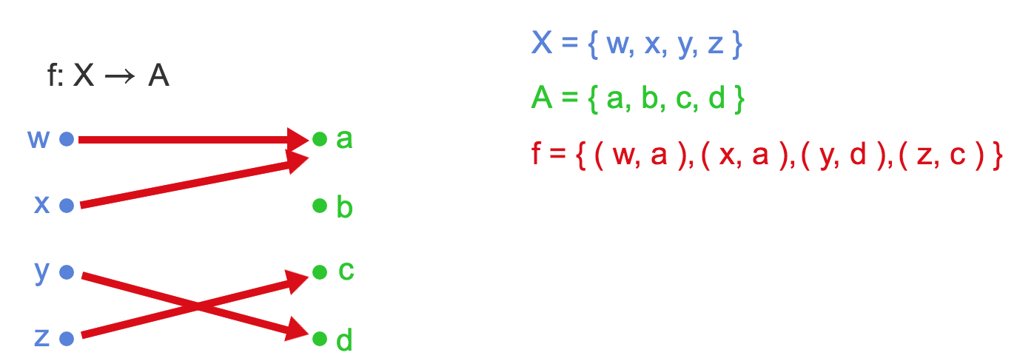
Visually …

Slide 7
Visually …
f is a function
f maps each element of X to an element of A.
a = f(w), c = f(z) …
f is a subset of X x A.

Slide 8
Function; Domain; Codomain
Definition:
A function f from the non-empty set X into a nonempty set A is a subset f of the Cartesian product X x A such that every element of X appears in one and only one ordered pair in f.
The set X is called the domain and the set A is called the codomain of f.
We write f : X → A.
The assertion “every element of X appears in one and only one ordered pair in f” means that no two ordered pairs in f have the same first element. It also implies that every element of X appears in some ordered pair in f.

Slide 9
Terminology
Let f: A → B and f(a)=b. Then we use the following terminology:
A is the domain of f
B is the co-domain of f
b is the image of a
a is the preimage (antecedent) of b
The range of f is the set of all images of elements of A

Slide 10
Function: Visualization
Range
Preimage
Image, f(a)=b
f
a
b
A
B
Domain
Co-Domain
A function, f: A → B

Slide 11
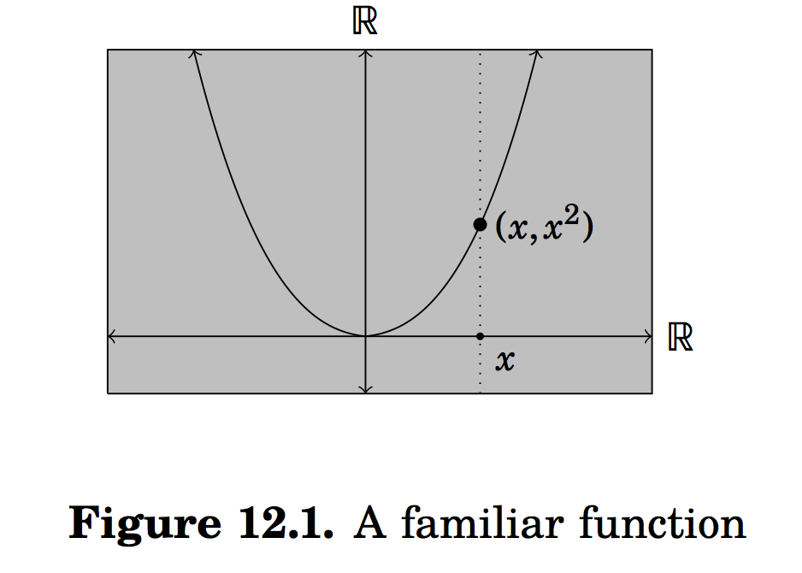
Functions
The concept of relations between the sets plays a big role here.
Consider the function f(x) = x², where x ∈ R.

Slide 12
Functions
The concept of relations between the sets plays a big role here.
Consider the function f(x) = x², where x ∈ R.
The points on the curve are related.
T={(x,x²): x ∈ R} ⊆ R x R.
T is a function

Slide 13
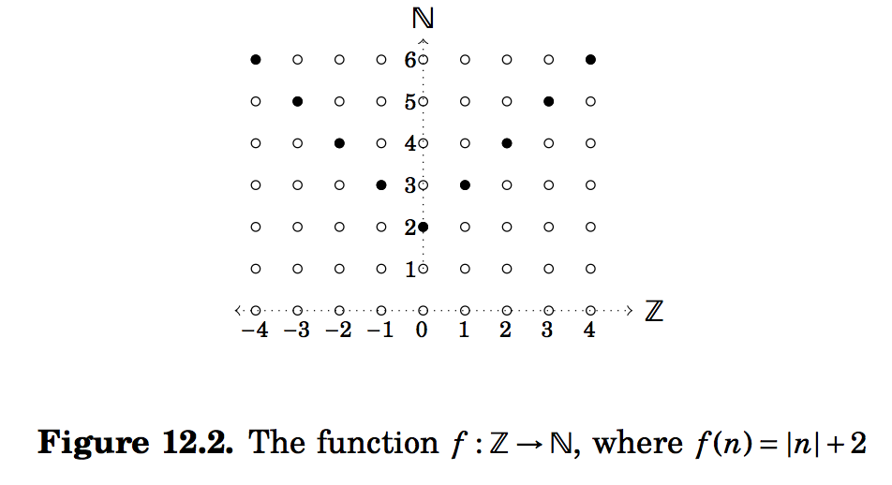
Another example of a function
Here R= {(n,|n|+2): n ∈ N} ⊆ Z x N.

Slide 14
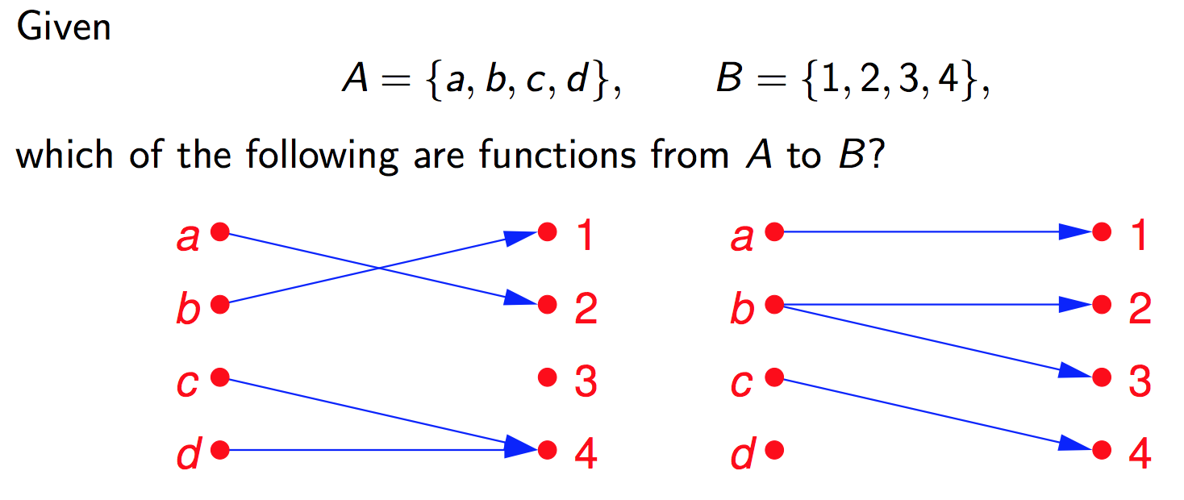
Example

Slide 15
Example
The diagram on the left is a function. The codomain is a subset of B.
The one on the right is not a function. The domain is not A. Moreover b is assigned (mapped) to two different elements of B.

Slide 16
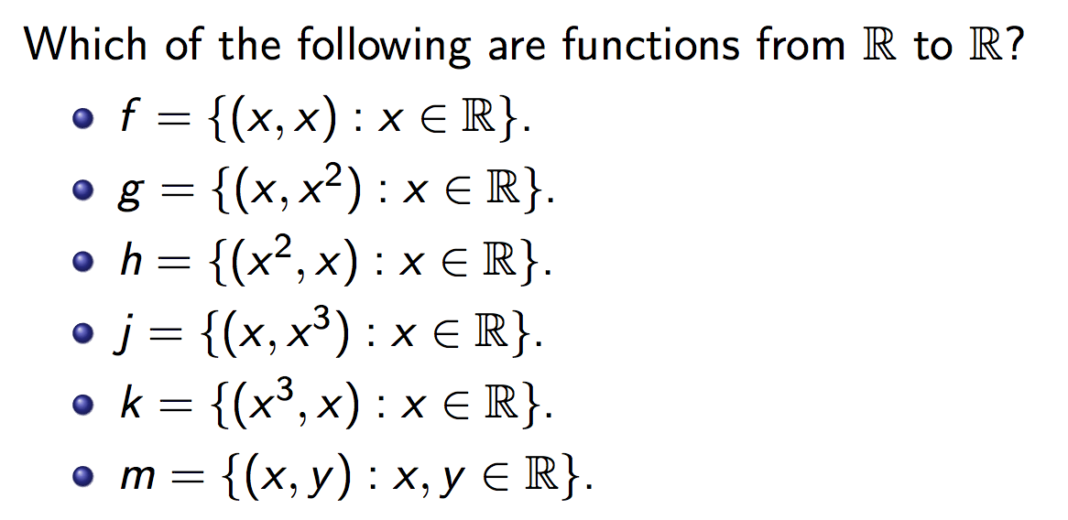
Example

Slide 17
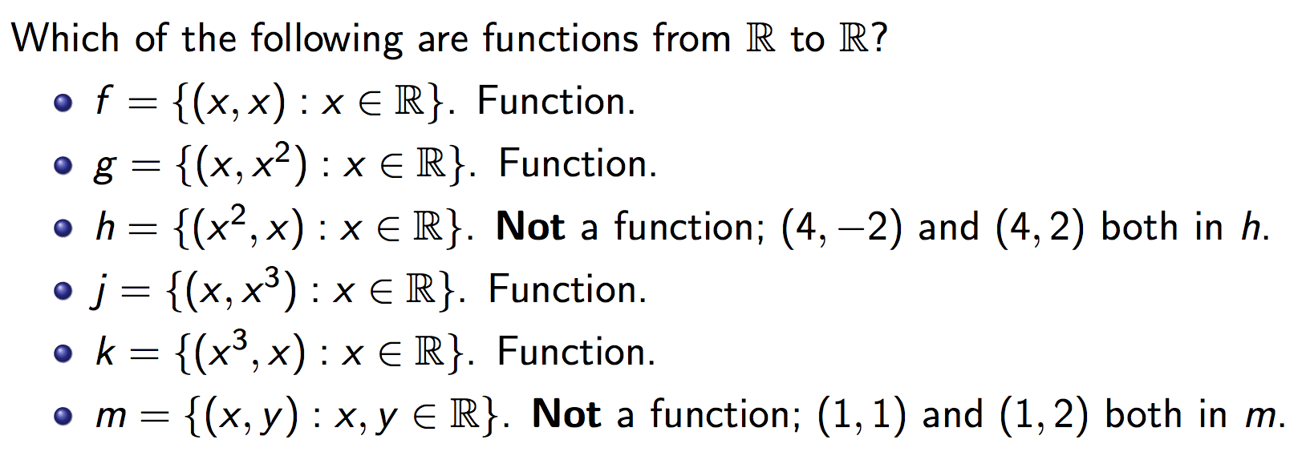
Example

Slide 18
More Definitions (2)
Definition: Let f: A→ B and S ⊆A. The image of the set S is the subset of B that consists of all the images of the elements of S. We denote the image of S by f(S), so that
f(S)={ f(s) | ∀ s ∈ S }
Note there that the image of S is a set and not an element.

Slide 19
Image of a set: Example
Let:
A = {a₁,a₂,a₃,a₄,a₅}
B = {b₁,b₂,b₃,b₄,b₅}
f={(a₁,b₂), (a₂,b₃), (a₃,b₃), (a₄,b₁), (a₅,b₄)}
S={a₁,a₃}
f(S) = {b₂, b₃}
Draw a diagram for f
What is the:
Domain, co-domain, range of f?
Image of S, f(S)?

Slide 20
Injective (one-to-one) and Surjective (onto) functions
In the literature
injective and one-to-one mean the same
surjective and onto mean the same
bijective and one-to-one correspondence mean the same.

Slide 21
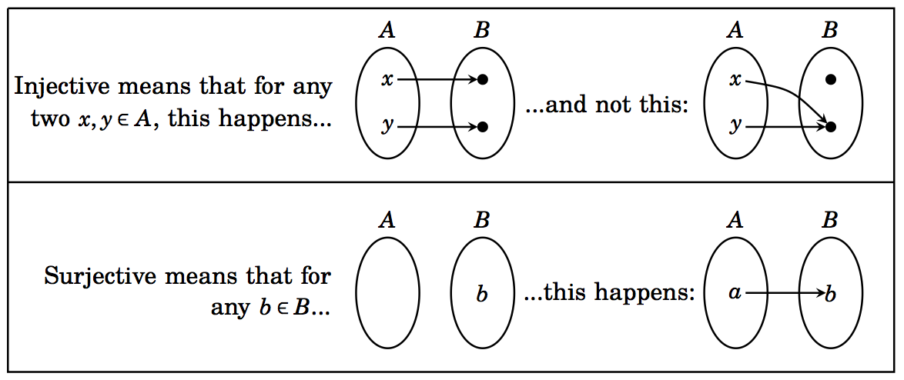
Section 12.2 (Injective and Surjective functions)
Definitions:

Slide 22
Example
Consider the following functions on the students in macm class. Under what conditions is the function one-to-one if it assigns to a student his or her
cell phone number
student id
final grade in the class
home town

Slide 23
Example
Consider the following functions on the students in macm class. Under what conditions is the function one-to-one if it assigns to a student his or her
cell phone number one-to-one
student id one-to-one
final grade in the class generally not one-to-one unless each student gets a unique grade
home town one-to-one if each student comes from a different town

Slide 24
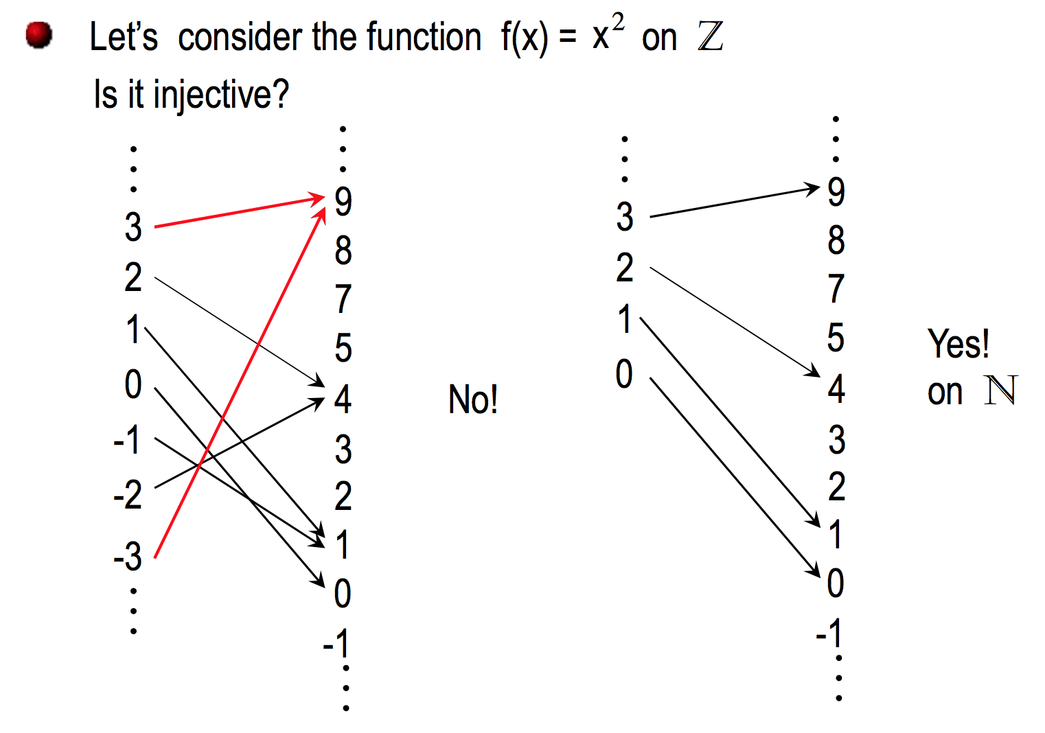

Slide 25
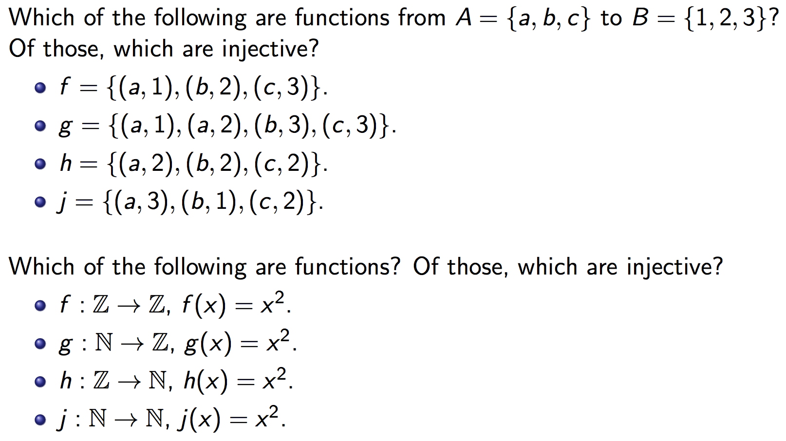
Injective functions One-to-one functions

Slide 26
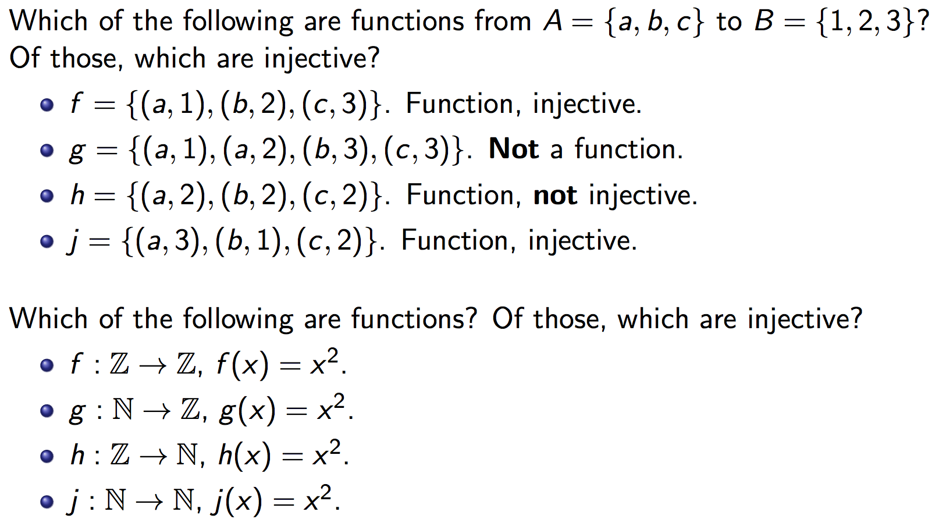
Injective functions One-to-one functions

Slide 27
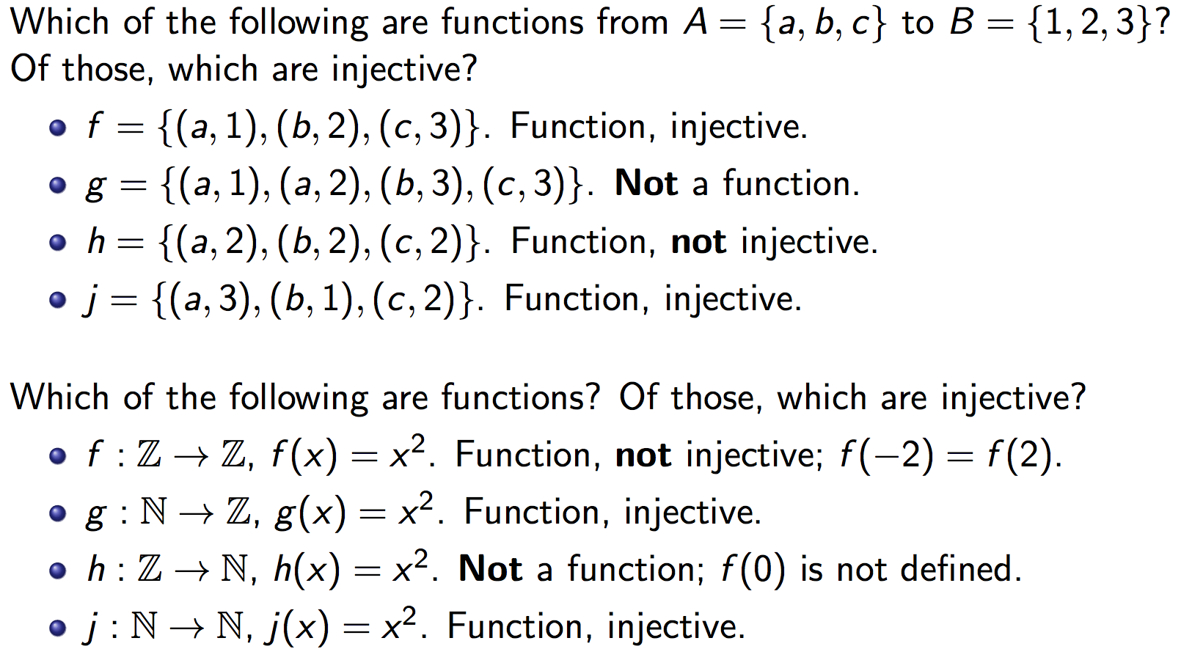
Injective functions One-to-one functions

Slide 28
How to show a function f: A→ B is injective?
∀ x,y ∈ A [{(x ≠ y) (f(x) ≠ f(y))} ≡ {(f(x) = f(y)) (x=y)}]

Slide 29
Recall:

Slide 30
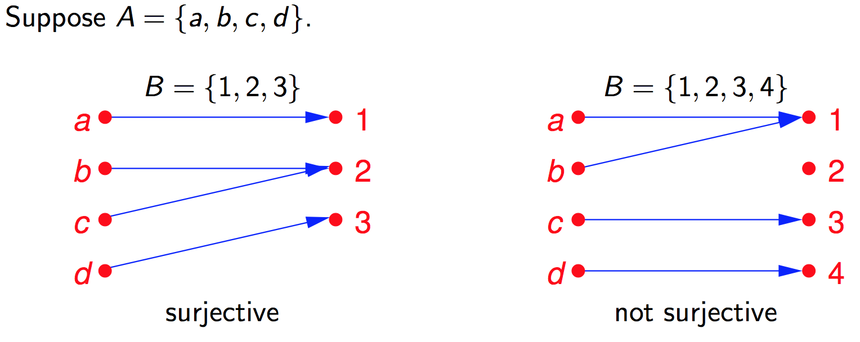
Surjective functions Onto functions range(f) = codomain(f)
range(f) ≠ codomain(f)

Slide 31
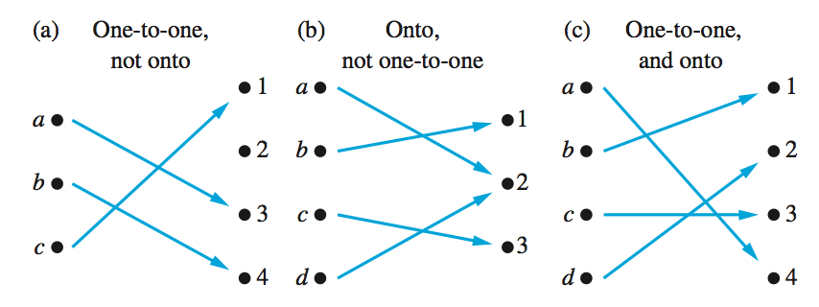
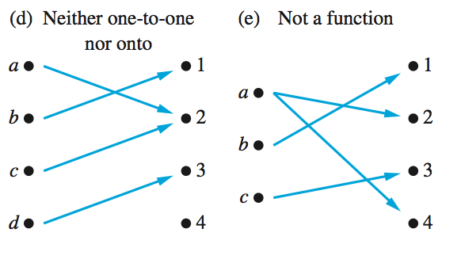
Examples of different types of functions

Slide 32
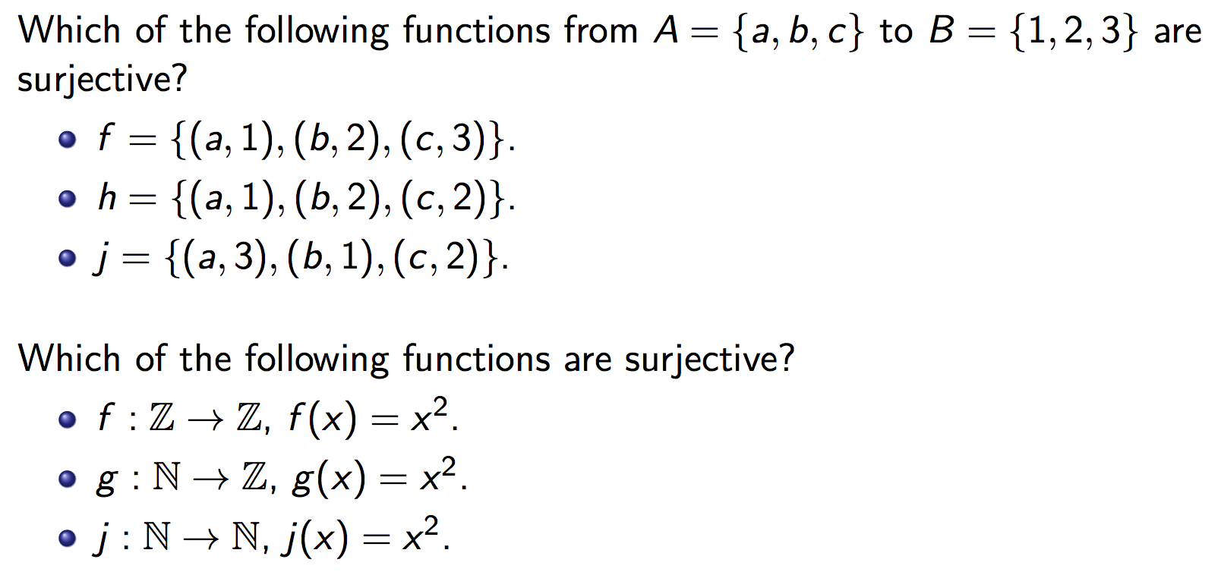
Surjective functions Onto functions

Slide 33
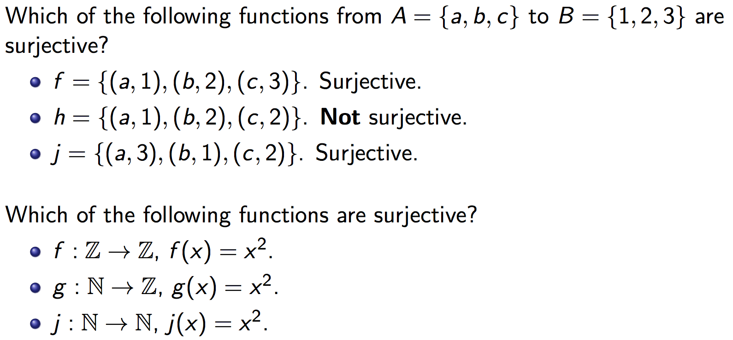
Surjective functions Onto functions

Slide 34
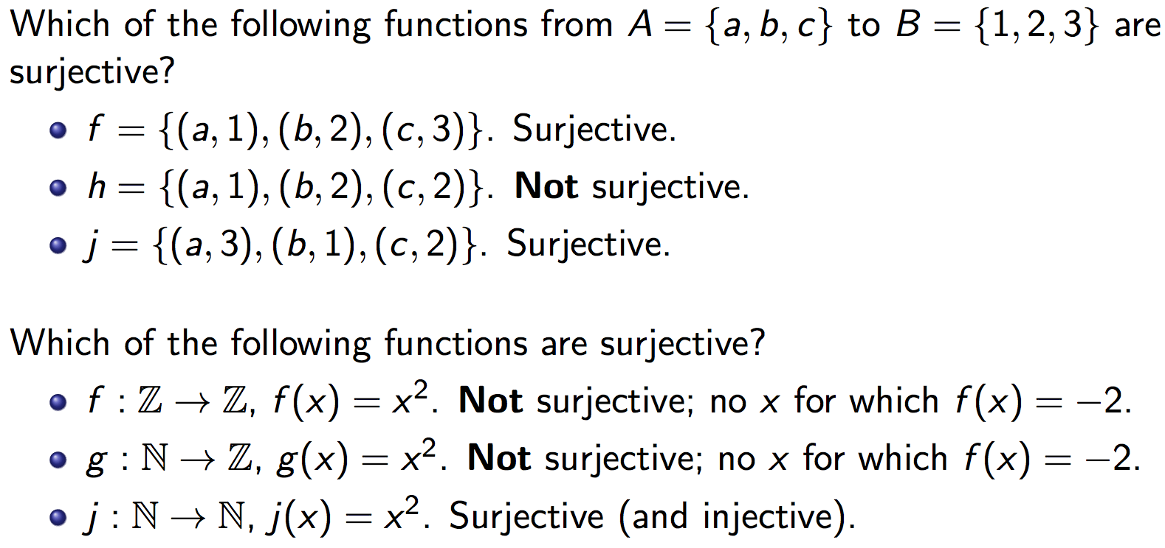
Surjective functions Onto functions
Not surjective (but injective)

Slide 35
How to show a function f: A→ B is injective?
∀ x,y ∈ A [{(x ≠ y) (f(x) ≠ f(y))} ≡ {(f(x) = f(y)) (x=y)}]

Slide 36
How to show a function f: A→ B is surjective?
∀ b ∈ B [∃a ∈ A (f(a) = b)]
We are assuming that f is a function.

Slide 39
Examples of different types of correspondences

Slide 40
Exercise 1
Let f:Z→Z be defined by
f(x)=2x-3
What is the domain, codomain, range of f?
Is f one-to-one (injective)?
Is f onto (surjective)?
Clearly, domain(f)=Z.
To see what the range is, note that:
b∈ range(f) b=2a-3, for some a ∈ Z
b=2(a-2)+1
b is odd

Slide 41
Exercise 1 (cont’d)
Thus, the range is the set of all odd integers
Since the range and the codomain are different (i.e., range(f) ≠ Z), we can conclude that f is not onto (surjective)
However, f is one-to-one injective. (Contrapositive approach)
For x, y ∈ Z , we can write
f(x) = f(y) ⇒ 2x - 3 = 2y - 3 ⇒ x = y. QED

Slide 42
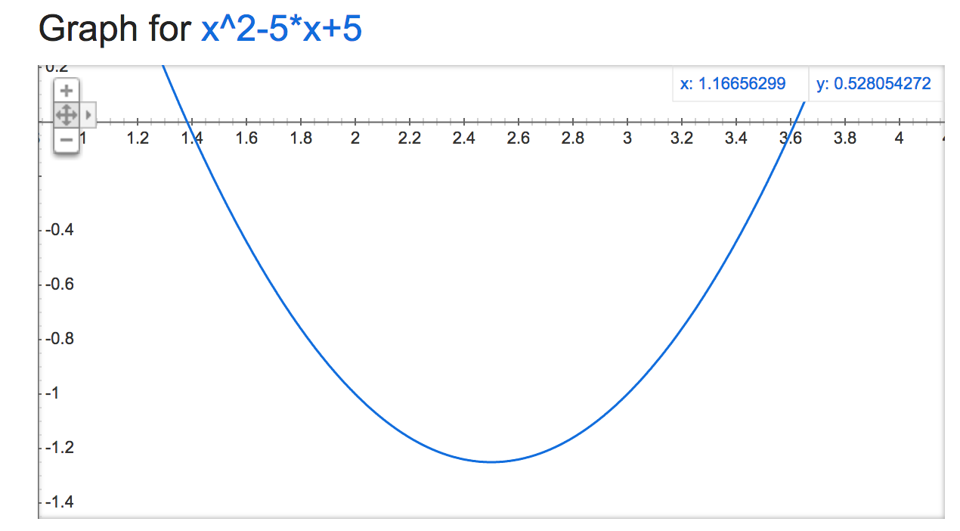
Exercise 3
Let f:Z→Z be defined by
f(x) = x² - 5x + 5
Is this function
One-to-one?
Onto?

Slide 43
Exercise 3: Answer
It is not one-to-one (injective)
f(x₁)=f(x₂) ⇒ x₁²-5x₁+5=x₂² - 5x₂+5 ⇒ x₁² - 5x₁ = x₂² - 5x₂
⇒ x₁² - x₂² = 5x₁ - 5x₂ ⇒ (x₁ - x₂)(x₁ + x₂) = 5(x₁ - x₂)
⇒ (x₁ + x₂) = 5 if x₁ ≠ x₂
Many x₁,x₂ ∈Z satisfy this equality. In particular, f(2)=f(3)=-1. Therefore, f is not one-to-one.
This proof belongs to the class of “Proof by counterexample”

Slide 44
Exercise 3: Answer
It is also not onto (surjective).
The function is a parabola with a global minimum at (5/2,-5/4). Therefore, the function fails to map to any integer less than -1
We can show that there does not exists any x ∈ Z such that f(x) = -2. (Why?)
The equation x² – 5x + 5 = -2 has imaginary roots.

Slide 45
Exercise 4
Let f:Z→Z be defined by
f(x) = 2x² + 7x
Is this function
One-to-one (injective)?
Onto (surjective)?
Again, this is a parabola, it cannot be onto.

Slide 46
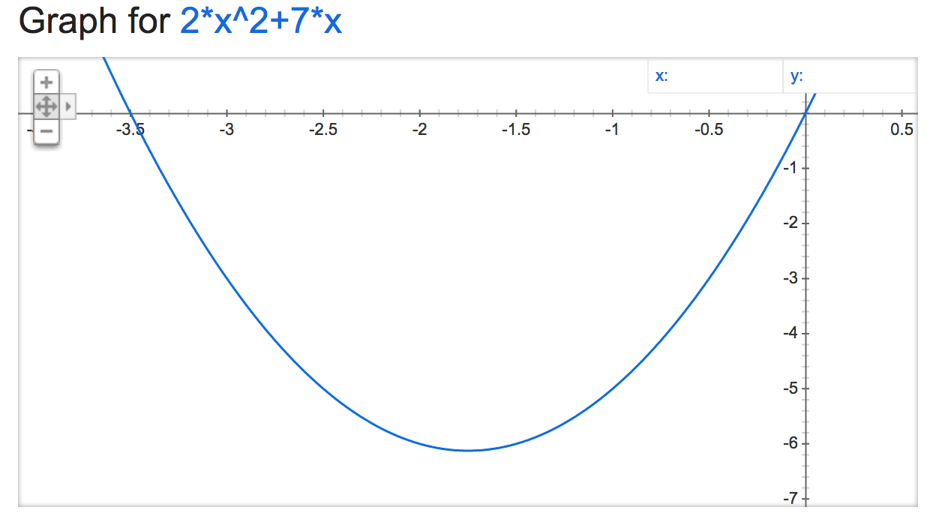

Slide 47
Exercise 4: Answer
f(x) is one-to-one! Indeed:
Proof by contradiction: Suppose f(x₁)=f(x₂) and x₁ ≠ x₂.
f(x₁)=f(x₂) ⇒ 2x₁²+7x₁=2x₂² + 7x₂ ⇒ 2x₁² - 2x₂² = 7x₂ - 7x₁
⇒ 2(x₁ - x₂)(x₁ + x₂) = 7(x₂ - x₁) ⇒ 2(x₁ + x₂) = -7
⇒ (x₁ + x₂) = -7/2
But -7/2 ∉ Z. Therefore we arrive at a contradiction. Therefore it must be the case that x₁ = x₂. It follows that f is a one-to-one function. QED

Slide 48
Exercise 4: Answer
f(x) is not surjective because f(x)=1 does not exist for any integer x .
2x² +7x=1 ⇒ x(2x +7)=1 the product of two integers is 1 if both integers are 1 or -1
x=1 ⇒ (2x+7)=1 ⇒ 9 =1, impossible
x=-1 ⇒ -1(-2+7)=1 ⇒ -5=1, impossible

Slide 49
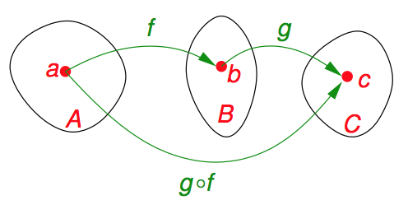
Composition (Section 5.6)
Definition:
Suppose f : A → B and g : B → C are functions with the property that the codomain(f ) equals the domain(g).
The composition of f and g is another function, denoted as g ^{ο} f and defined as follows: If x ∈ A, then g ^{ο} f (x) = g(f(x)). This function g(f(x)) sends (maps) elements of A to elements of C, so g ^{ο} f: A → C.

Slide 50
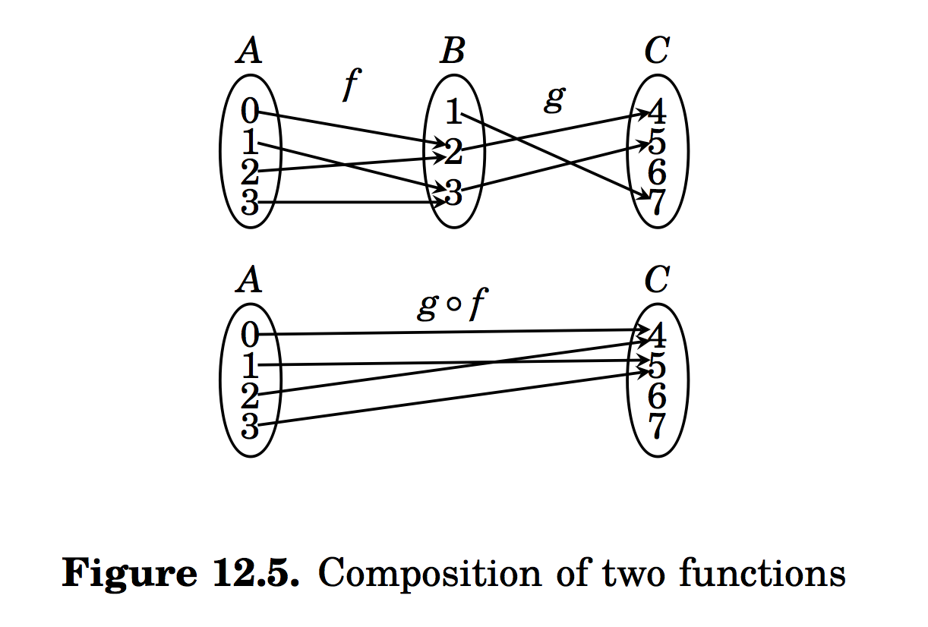

Slide 51
Composition: Example 1
Let f, g be two functions on R→R defined by
f(x) = 2x – 3
g(x) = x² + 1
What are f ^{ο} g and g ^{ο} f?

Slide 52
Composition: Example 1 (cont’d)
Given f(x) = 2x – 3 and g(x) = x² + 1
(f ^{ο} g)(x) = f(g(x)) = f(x²+1) = 2(x²+1)-3
= 2x² - 1
(g ^{ο} f)(x) = g(f(x)) = g(2x-3) = (2x-3)² +1
= 4x² - 12x + 10
Thus the composition of functions is not commutative.

Slide 53
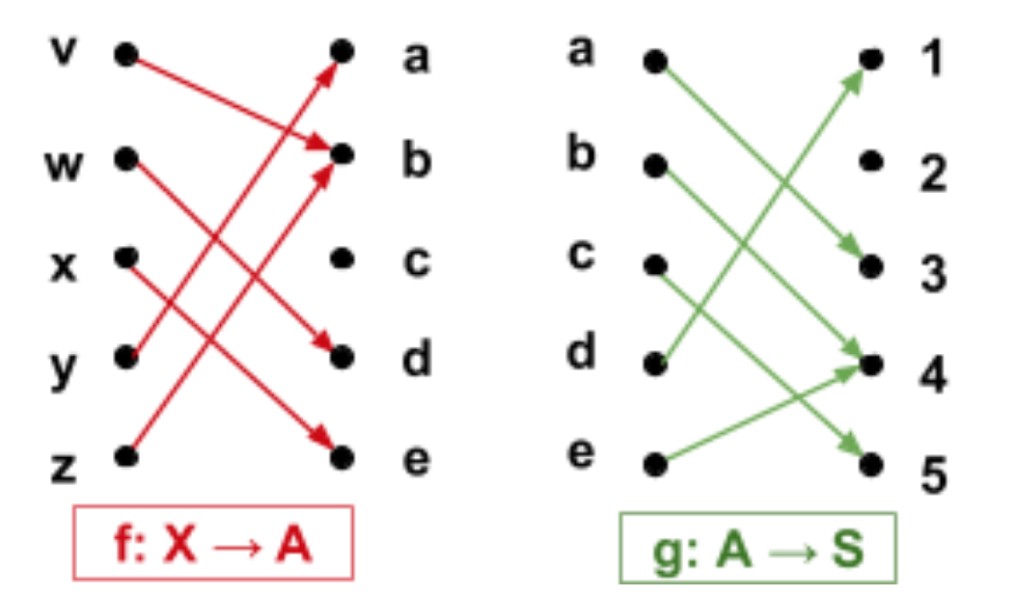
Function composition from arrow diagrams
Given:
What is the domain and codomain of g o f?
Give the arrow diagram of g o f.
What is the range of g o f?

Slide 54
Composition: Injection and Surjection
Theorem:
Suppose f: A → B and g: B → C. If both f and g are injective then g ^{ο} f is injective. If both f and g are surjective, g ^{ο} f is also surjective.

Slide 55
_{Proof of:} Suppose f: A → B and g: B → C. If both f and g are injective then g ο f is injective.
Here both f and g are injective.
To see that g ^{ο} f is injective, we must show that g(f(x)) = g(f(y)) implies x = y.
Suppose g(f(x)) = g(f(y)).
Since g is injective, f(x) = f(y).
Since f(x) = f(y), and f is injective, x = y.
Hence g(f(x)) = g(f(y)) implies x = y.
Therefore, g ^{ο} f is injective.

Slide 56
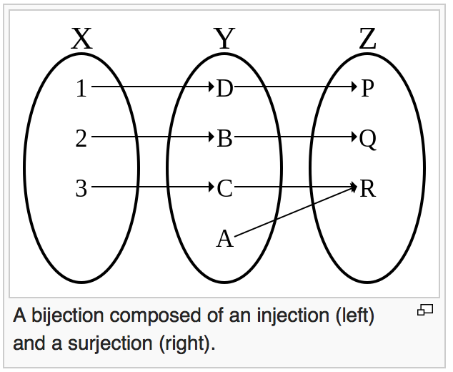
Conversely,
Suppose f : X → Y and g: Y → Z.
If the composition g ^{ο} f of two functions is bijective, we can only say that f is injective and g is surjective.

Slide 57
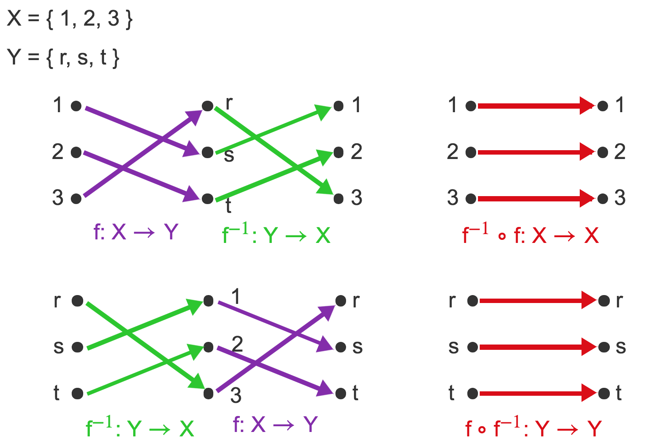
Composition of a function and its inverse

Slide 58
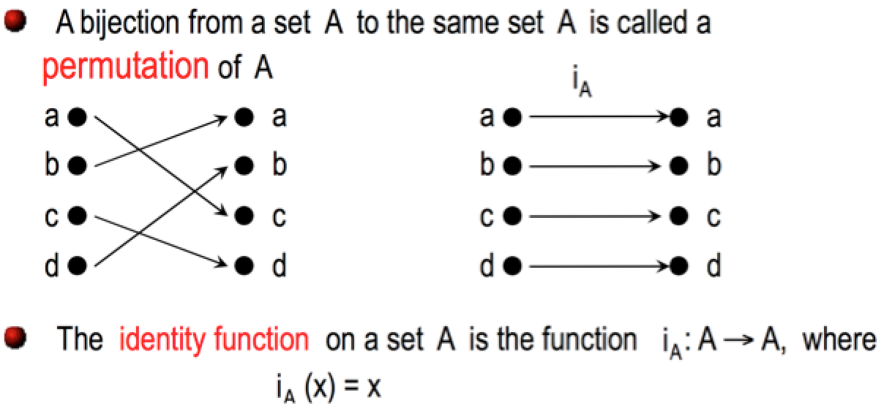
Inverse Functions

Slide 59
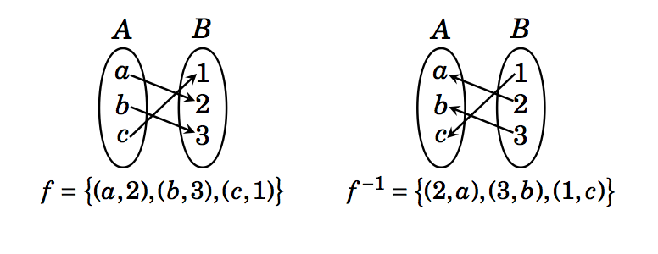
f ⁻¹ o f = {(a,a), (b,b), (c,c)}
f o f ⁻¹ = {(1,1), (2,2), (3,3)}

Slide 60
Definition: Suppose f : A → B is bijective. The inverse function of f is the function that assigns to each element b ∈ B, an element (preimage) a ∈ A such that f(a) = b. We denote the inverse function f⁻¹: B → A and can write
f⁻¹(b) = a when f(a) = b.
f⁻¹ o f = i_{A}
f o f⁻¹ = i_{B}

Slide 61
Example
Find the inverse of the function f : R → R defined as f(x) = x³ + 1, if it exists.
We first show that f is bijective.
f is one-to-one:
f(x) = f(y) implies (x³ + 1) = (y³ +1)
i.e (x-y)( x² + xy + y² ) = 0.
Since ( x² + xy + y² ) is not zero for any x ≠ y, therefore f(x) = f(y) implies x = y.
Therefore, f is one-to-one.

Slide 62
Example
Find the inverse of the function f : R → R defined as f(x) = x³ + 1, if it exists.
We first show that f is bijective.
f is one-to-one:
We now show that f is onto.
For any y of R, we need to find x such that f(x) = y.
i.e. find x such that x³ + 1 = y, i.e x = (y-1)^{1/3}. Thus we see that f((y-1)^{1/3})= y for any y.
Therefore, f is onto.
Thus f is bijective

Slide 63
Example
Find the inverse of the function f : R → R defined as f(x) = x³ + 1, if it exists.
We now find f⁻¹(x).
We are interested in computing y such that f⁻¹(x) =y.
i.e. computing y such that f(y) = x.
i.e. computing y such that y³ + 1 = x.
i.e. y = (x – 1)^{1/3}.
Thus f ⁻¹ (x) = (x – 1)^{1/3}.
Note that f ⁻¹(f(x)) = f(f ⁻¹ (x))= x.

Slide 64
Important Functions: Absolute Value
Definition: The absolute value function, denoted |x|, f : R→ {y ∈R | y ≥ 0}. Its value is defined by
x if x ≥ 0
|x| =
-x if x ≤ 0

Slide 65
Important Functions: Floor & Ceiling
Definitions:
The floor function, denoted ⎣x⎦, is a function R→Z. Its values is the largest integer that is less than or equal to x
The ceiling function, denoted ⎡x⎤, is a function R→Z. Its values is the smallest integer that is greater than or equal to x .

Slide 66
Important Functions: Floor
y
3
2
1
x
-5
-4
-3
-2
-1
1
2
3
4
5
-1
-2
-3

Slide 67
Important Functions: Ceiling
3
2
1
x
-5
-4
-3
-2
-1
1
2
3
4
5
-1
-2
-3

Slide 68
Important Function: Factorial
The factorial function gives us the number of permutations (that is, uniquely ordered arrangements) of a collection of n objects
Definition: The factorial function, denoted n!, is a function N→N⁺. Its value is the product of the n positive integers
n! = Π_{i=1} ^{i=n} i = 1⋅2⋅3⋅…⋅(n-1)⋅n

Slide 69
Summary
Definitions & terminology
function, domain, co-domain, image, preimage , range, image of a set
Properties
One-to-one (injective), onto (surjective), one-to-one correspondence (bijective)
Operators
Composition
Inverse functions
Important functions
identity, absolute value, floor, ceiling, factorial

Slide 70
Practice Problems
Problems (Exercise 5.1) 2, 4, 5, 7(a), 12
Problems (Exercise 5.2) 1, 2, 5, 8, 12, 15, 16
Problems (Exercise 5.3) 2, 3, 9
Problems (Exercise 5.6) 2, 4, 8, 10, 12, 13, 20

