Slide 1
Chapter 2.4
The use of Quantifiers
(First order Logic)

Slide 2
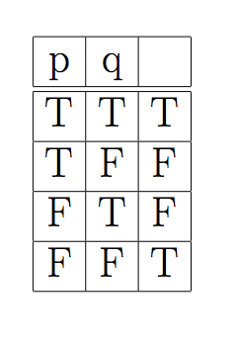
Find the proposition whose Truth Table column is give.

Slide 3
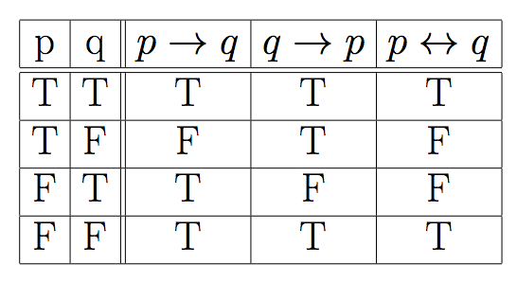
Another form

Slide 4
Some slides have been taken from the sites
http://cse.unl.edu/~choueiry/S13-235/
and
http://www.whitman.edu/mathematics/higher_math_online/section01.02.html

Slide 5
Predicate Logic (Propositional Function)
Propositional statements are not powerful enough to capture wide range of statements.
Consider the statement:
For every n ∈ Z, 2n is even
Consider the sentences
y has four sides
x has black hair
x+2 is an even integer
The above sentences involve variables.

Slide 6
Open sentences
A sentence whose truth value depends on the value of one or more variables is called an open sentence (predicate).
Examples of open statements
p(y) (read as “p of y”): y has four sides
p(x): x has black hair
p(x): x+2 is an even integer
Mother(x): propositional function with one variable.
Friend(x,y): function with two variables. (2-tuple)
P(x₁, x₂, …, x_{n}): function with n variables. (n-tuple)
An open statement p(x) is a proposition when x is assigned a value.

Slide 7
Universe of Discourse
Intuitively, universe (domain) of a variable x in a propositional function is the set of values x can take.
The domail of all variables in the following predicates is the set of positive integers.
P(x): x is a prime number
L(x,y): x < y
S(x,y,z) : x²+y² ≥ z²
Is P(11) true?
Is L(4,4) true?
Is S(3,4,5) true?

Slide 8
Universe of Discourse
Intuitively, universe (domain) of a variable x in a propositional function is the set of values x can take.
p(y): y has four sides.
Universe: set of polygons
p(x): x has black hair
Universe: humans
p(x): x + 2 is an even integer
Universe: set of integers

Slide 9
Quantifiers
We can use ∧, ∨, ¬, , , to deconstruct many English sentence to an equivalent symbolic form.

Slide 10
Quantifiers
We can use ∧, ∨, ¬, , to deconstruct many English sentence to an equivalent symbolic form.
These symbols are not enough.
For every n ∈ Z, 2n is even.

Slide 11
Quantifiers
These symbols are not enough.
For every n ∈ Z, 2n is even.
Consider the open statement p(x): x is an even integer. Since the universe is Z, the above proposition can be written as
[...∧ p(2.(-2)) ∧ p(2.(-1)) ∧ p(2(0)) ∧ p(2(1)) ∧ …].
This is not much of help.

Slide 12
Universal Quantifier: ∀ (for all)
∀ x p(x): a proposition which is true if p(x) is true for all values of x of the universe of discourse.
Consider : For every n ∈ Z, 2n is even
Let p(x): x is even be an open statement.
For every n ∈ Z, 2n is even can be written as ∀ x ∈ Z, p(2x).

Slide 13
Universal Quantifier: ∀ (for all)
∀ x p(x): a proposition which is true if p(x) is true for all values of x of the universe of discourse.
Consider : For every n ∈ Z, 2n is even
Let p(x): x is even be an open statement.
For every n ∈ Z, 2n is even can be written as ∀ x ∈ Z, p(2x).
If the Universe is finite, say {a₁, a₂, …, a_{n}}, then
∀ x p(x) p(a₁) ∧ p(a₂) ∧ … ∧p(a_{n}) .

Slide 14
Examples : universal quantifiers
Let p(x): x takes macm 101; q(x): x is a CS student.
Express the statements:
Every CS student must take macm101

Slide 15
Examples : universal quantifiers
Let p(x): x takes macm 101; q(x): x is a CS student.
Express the statements:
Every CS student must take macm101
∀ x (q(x) p(x))

Slide 16
Examples : universal quantifiers
Let p(x): x takes macm 101; q(x): x is a CS student.
Express the statements:
Every CS student must take macm101
∀ x (q(x) p(x))
Everybody must take macm101 or be a non CS student.

Slide 17
Examples : universal quantifiers
Let p(x): x takes macm 101; q(x): x is a CS student.
Express the statements:
Every CS student must take macm101
∀ x (q(x) p(x))
Everybody must take macm101 or be a non CS student.
∀ x (p(x) ∨ ¬q(x))

Slide 18
Examples : universal quantifiers
Express the statement
‘for every x and every y, x+y>10’
Answer:
Let P(x,y) be the statement x+y>10
Where the universe of discourse for x, y is the set of integers
The statement is: ∀x ∀y P(x,y)
Shorthand: ∀x,y P(x,y)

Slide 19
Existential Quantifier: ∃ (there exists)
∃ x p(x): a proposition which is true if p(x) is true for at least one values of x of the universe of discourse.
Consider : There is an integer that is not even
Let p(x): x is not even be an open statement.
The above proposition can be written as ∃ x ∈ Z, p(x).
If the Universe is finite, say {a₁, a₂, …, a_{n}}, then
∃ x p(x) p(a₁) ∨ p(a₂) ∨ …∨ p(a_{n}) .

Slide 20
Existential Quantifier: ∃ (there exists)
Example: What is the truth value of ∃x p(x) where p(x) is the statement ``x² > 10”? Suppose the universe of discourse is set of positive number not exceeding 4, i.e. the set {1,2,3,4}
Ans:

Slide 21
Existential Quantifier: ∃ (there exists)
Example: What is the truth value of ∃x p(x) where p(x) is the statement ``x² > 10”? Suppose the universe of discourse is set of positive number not exceeding 4, i.e. the set {1,2,3,4}
Ans:
In our case ∃x p(x) p(1)∨ p(2) ∨ p(3) ∨ p(4).
Since p(4) is true, ∃x p(x) is true.

Slide 22
Quantifiers: Truth values
The truth table for the quantified statements.

Slide 23
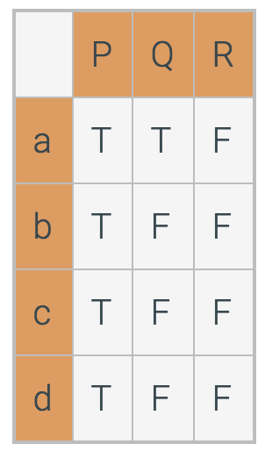
Truth values for quantified statements for a given set of predicates.
P, Q, and R are quantified statements.
The domain for this problem is {a, b, c, d}.
Consider the truth table:
Which statements are true?
∀x P(x)?
∃ x P(x)?
∀x Q(x)?
∃ x Q(x)?
∀x R(x)?
∃ x R(x)?

Slide 24
Example:
p(x): x > 0; q(x): x² ≥ 0; r(x): (x-4)(x+1) = 0 s(x): x² – 3 >0.

Slide 25
Example:
p(x): x > 0; q(x): x² ≥ 0; r(x): (x-4)(x+1) = 0 s(x): x² – 3 >0.

Slide 26
Precedence of Quantifiers
The quantifiers ∀ and ∃ have higher precedence than all logical connectives.
∀x (p(x) ∧ q(x)) is the conjunction of p(x) and q(x).

Slide 27
Precedence of Quantifiers
For example, ∀x P(x) ∨ Q(x) means (∀x P(x))∨ Q(x)
∀x (P(x) ∨ Q(x)) means something different.
Unfortunately, often people write ∀x P(x) ∨ Q(x) when they mean ∀ x (P(x) ∨ Q(x)).

Slide 28
Problems
Let p(x,y): xy =0; Universe is R.
∀x ∀y p(x,y) ∀y ∀x p(x,y) (?)
∀x ∃y p(x,y) ∃y ∀x p(x,y) (?)
Let q(x,y): x+y = 0; Universe is R
∃y ∀x q(x,y)
∀x ∃y q(x,y)

Slide 29
Problems
Let p(x,y): xy =0; Universe is R.
∀x ∀y p(x,y) ∀y ∀x p(x,y) (?) (T)
∀x ∃y p(x,y) ∃y ∀x p(x,y) (?) (T)
Let q(x,y): x+y = 0; Universe is R
∃y ∀x q(x,y) (F)
∀x ∃y q(x,y) (T)

Slide 30
Translating English to Symbolic Logic
Goldbach’s conjecture: Every even integer greater than 2 is the sum of two prime numbers.
Let P = { 2, 3, 5, 7, …} be the set of primes;
Let S= {4,6,8,10, …} be the set of even integers > 2.
∀x ∈ S, ∃p, q ∈ P, x = p + q.

Slide 31
Translating English to Symbolic Logic
Goldbach’s conjecture: Every even integer greater than 2 is the sum of two prime numbers.
Let P = { 2, 3, 5, 7, …} be the set of primes;
Let S= {4,6,8,10, …} be the set of even integers > 2.
∀x ∈ S, ∃p, q ∈ P, x = p + q.
We can also write the conjecture as
(x ∈ S) ∃p, q ∈ P, x = p + q.

Slide 32
Translating English to Symbolic Logic
Goldbach’s conjecture: Every even integer greater than 2 is the sum of two prime numbers.
Let P = { 2, 3, 5, 7, …} be the set of primes;
Let S= {4,6,8,10, …} be the set of even integers > 2.
∀x ∈ S, ∃p, q ∈ P, x = p + q.
We can also write the conjecture as
(x ∈ S) ∃p, q ∈ P, x = p + q.
Every universally quantified statement can be expressed as a conditional statement.

Slide 33
Translating English to Symbolic Logic
Every universally quantified statement can be expressed as a conditional statement.
The following statements mean the same thing.
∀x ∈ S, Q(x)
(x ∈ S) Q(x)
Sometimes a theorem will be expressed as a universally quantified statement, but it will be more convenient to think of it as a conditional statement.

Slide 34
Translating English to Symbolic Logic
Every universally quantified statement can be expressed as a conditional statement.
The following statements mean the same thing.
∀x ∈ S, Q(x)
(x ∈ S) Q(x)
Sometimes a theorem will be expressed as a universally quantified statement, but it will be more convenient to think of it as a conditional statement.
We should be able to switch between the two forms

Slide 35
Translating English to Symbolic Logic
If somebody is female and is a parent, this person is someone’s mother
f(x): x is female
p(x): x is a parent
m(x,y): x is the mother of y

Slide 36
Translating English to Symbolic Logic
If somebody is female and is a parent, this person is someone’s mother
f(x): x is female
p(x): x is a parent
m(x,y): x is the mother of y
∀x (f(x) ∧ p(x) ∃ y, m(x,y))

Slide 37
Translating English to Symbolic Logic
For every prime number p there is another prime number q with q > p.
The universe is the set of positive integers (N)
f(x): x ∈ N is a prime.
g(x,y): x > y, x, y ∈ N.

Slide 38
Translating English to Symbolic Logic
For every prime number p there is another prime number q with q > p.
f(x): x ∈ N is a prime.
g(x,y): x > y, x, y ∈ N.
∀p∈ N, f(p) ∃ q∈ N, (f(q) ∧ g(q, p))
∀p∈ N, ( f(p) ∧ (∃ q∈ N, (f(q) ∧ g(q, p))))

Slide 39
Translating English to Symbolic Logic
For every prime number p there is another prime number q with q > p.
f(x): x ∈ N is a prime.
g(x,y): x > y, x, y ∈ N.
∀p, f(p) ∃ q, (f(q) ∧ g(q, p))
∀p, ( f(p) ∧ (∃ q (f(q) ∧ g(q, p))))

Slide 40
Translating English to Symbolic Logic
P(x): x is a person; T(y): time is y; F(x,y): you can fool x in time y.
You can fool some of the people all of the time

Slide 41
Translating English to Symbolic Logic
P(x): x is a person; T(y): time is y; F(x,y): you can fool x in time y.
You can fool some of the people all of the time
∃p (∀t (P(p) ∧ (T(t) F(p,t))))

Slide 42
Translating English to Symbolic Logic
P(x): x is a person; T(y): time is y; F(x,y): you can fool x in time y.
You can fool some of the people all of the time
∃p (∀t (P(p) ∧ (T(t) F(p,t))))
You can fool all of the people some of the time

Slide 43
Translating English to Symbolic Logic
P(x): x is a person; T(y): time is y; F(x,y): you can fool x in time y.
You can fool some of the people all of the time
∃p (∀t (P(p) ∧ (T(t) F(p,t))))
You can fool all of the people some of the time
∃t (∀p (P(p) ∧ (T(t) F(p,t))))

Slide 44
Translating English to Symbolic Logic
P(x): x is a person; T(y): time is y; F(x,y): you can fool x in time y.
You can fool some of the people all of the time
∃p (∀t (P(p) ∧ (T(t) F(p,t))))
You can fool all of the people some of the time
∃t (∀p (P(p) ∧ (T(t) F(p,t))))
You can fool all of the people all of the time

Slide 45
Translating English to Symbolic Logic
P(x): x is a person; T(y): time is y; F(x,y): you can fool x in time y.
You can fool some of the people all of the time
∃p (∀t (P(p) ∧ (T(t) F(p,t))))
You can fool all of the people some of the time
∃t (∀p (P(p) ∧ (T(t) F(p,t))))
You can fool all of the people all of the time
∀p ∀t (P(p) ∧ (T(t) F(p,t))))

Slide 46
Negation
We can use negation with quantified expressions as we used them with propositions
Let P(x) be a predicate. Then the followings hold:
¬(∀x P(x)) ≡ ∃x ¬P(x)
(∃x P(x)) ≡ ∀x ¬P(x)
This is essentially the quantified version of De Morgan’s Law.

Slide 47
Negating Quantified Expressions
Consider ∀x J(x)
“Every student in cs1820 has taken a course in Java.”
Here J(x) is “x has taken a course in Java” and
the domain is students in cs1820.
Negating the original statement gives “It is not the case that every student in cs1820 has taken Java.” This implies that “There is a student in cs1820 who has not taken Java.”
Symbolically ¬∀x J(x) and ∃x ¬J(x) are equivalent

Slide 48
Negation: Truth
Truth Values of Negated Quantifiers
Statement | True when… | False when...
¬∃x P(x) ≡ ∀x ¬P(x) | P(x) is false for every x | There is an x for which P(x) is true
¬∀x P(x) ≡ ∃x ¬P(x) | There is an x for which P(x) is false | P(x) is true for every x

Slide 49
Negation: Example
Rewrite the following expression, pushing negation inward:
¬ ∀x (∃ y ∀z P(x,y,z) ∧ ∃ z ∀y P(x,y,z))
Answer:
∃x (∀y ∃z ¬P(x,y,z) ∨ ∀z ∃y ¬P(x,y,z))

Slide 50
Example
p(x): x is odd; q(x): x² – 1 is odd.
∀x (p(x) q(x))
¬ [∀x (p(x) q(x))]
∃x [ ¬(p(x) q(x))]
∃x [ ¬ (¬ p(x) ∨ q(x))]
∃x [ p(x) ∧ ¬ q(x) ]

Slide 51
Example
p(x): x is odd; q(x): x² – 1 is odd.
∀x (p(x) q(x)) True
¬ [∀x (p(x) q(x))]
∃x [ ¬(p(x) q(x))]
∃x [ ¬ (¬ p(x) ∨ q(x))]
∃x [ p(x) ∧ ¬ q(x) ] False

Slide 52
Definition:

Slide 53
Comments
Whenever you see a quantifier, ask what is the universe of discourse.
Should know the precedence rules. It is better to eliminate confusion by using the parentheses.
The order of quantifiers matters a lot. Most often ∀x ∃y q(x,y) is not equal to ∃x ∀y q(x,y).
De Morgan’s laws for quantifiers are very useful. It is important to be comfortable with De Morgan’s laws.
You don’t need to memorize the laws of logic. Just convince yourself that they are true.
One way to show logical equivalence is through truth tables, at least when they do not have quantifiers over variables.

Slide 54
Practice problems from the text:
Section 2.4: 1, 2, 4, 9, 10, 12

Slide 55
Solution Hints
2(a) (i) True, since p(3) is true. The rest of the statement can be ignored.
(ii) It is true since p(2), q(2) and r(2) are all true.
(iii) Easy
(iv) True
2(b) x is integer; x cannot be 0 since r(0) is false. x cannot be 1 or 3 since q(x) is false. The statement is true only when x=2

Slide 56
Solution Hints
4(a) All polygon is a quadrilateral or a triangle (but not both); (True)
(b) Every isosceles triangle is equilateral (false)
(c) There exists a triangle with interior angle greater than 180. (F)
(d) A triangle has all its interior angle equal if and only if it is an equilateral
triangle. (T)
(e) True
(f) There exists a quadrilateral that is not a rectangle. (T)
(g) If all the sides of a polygon are equal, the polygon is an equilateral
triangle. (False)
(h) No triangle has an interior angle that exceeds 180 degrees. (T)
A polygon (of three or four sides) is a square if and only if all its interior angles are equal and all of its sides are equal. (F) A parallelogram also satisfies these properties.
A triangle has all interior angles equal if and only if all of its sides are equal. (T)

Slide 57
Solution Hints
10. Solved in the class.
12.(a) Some of the questions are solved in the class.
(iv) False, if x=0
(v) False if x = 0.
(vii) False
(viii) False
(b) (iv), (v) and (viii) are now true.
(c) (1), (ii) and (ii) are true; (iv) is false. Easy.

Slide 58
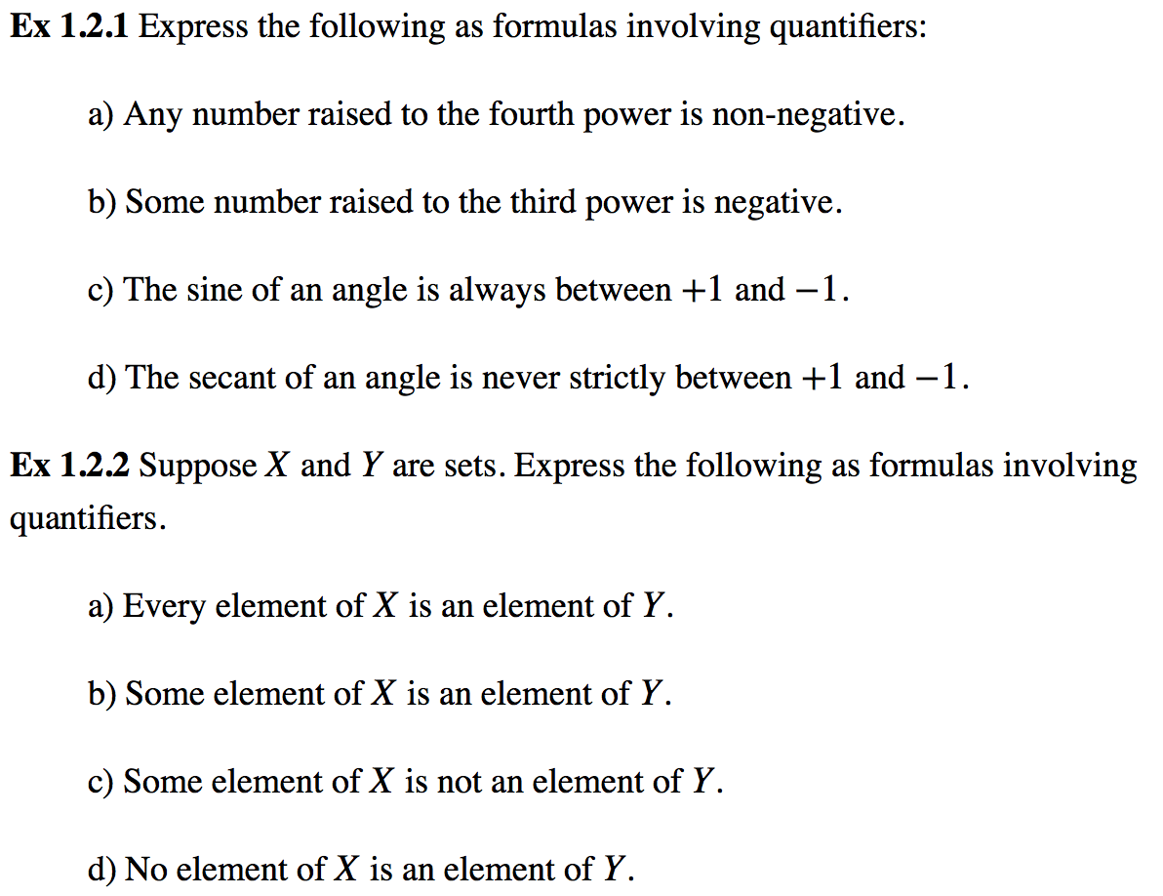
Some more practice problems (the universe is real)

Slide 59
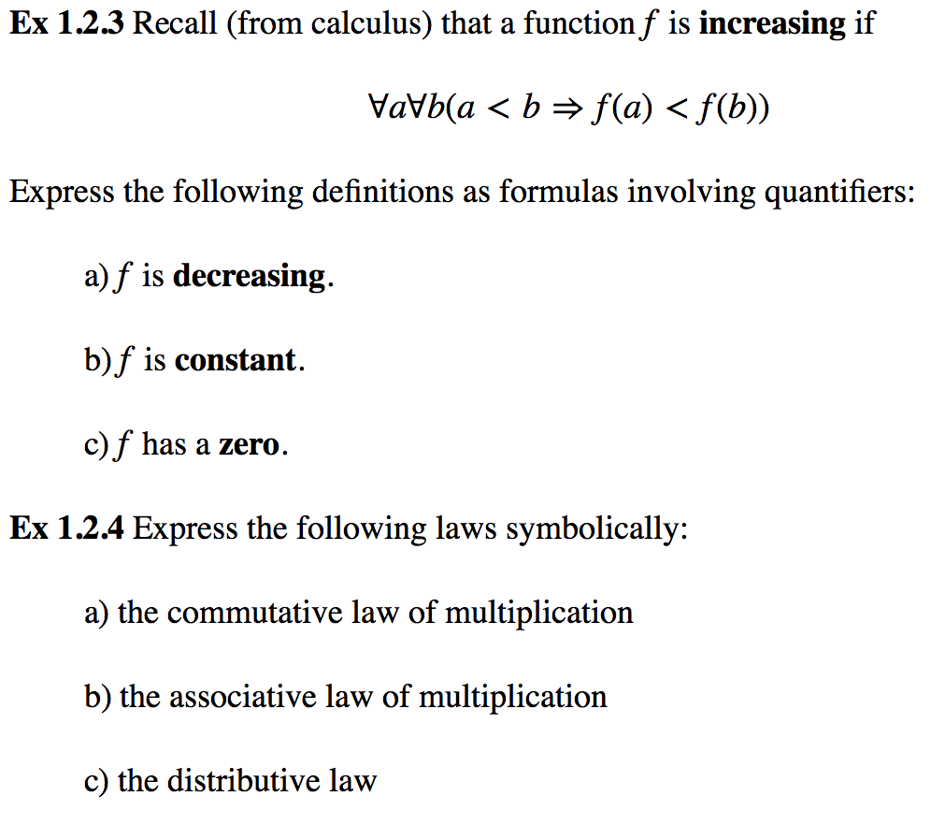
Some more practice problems (the universe is real)

Slide 60
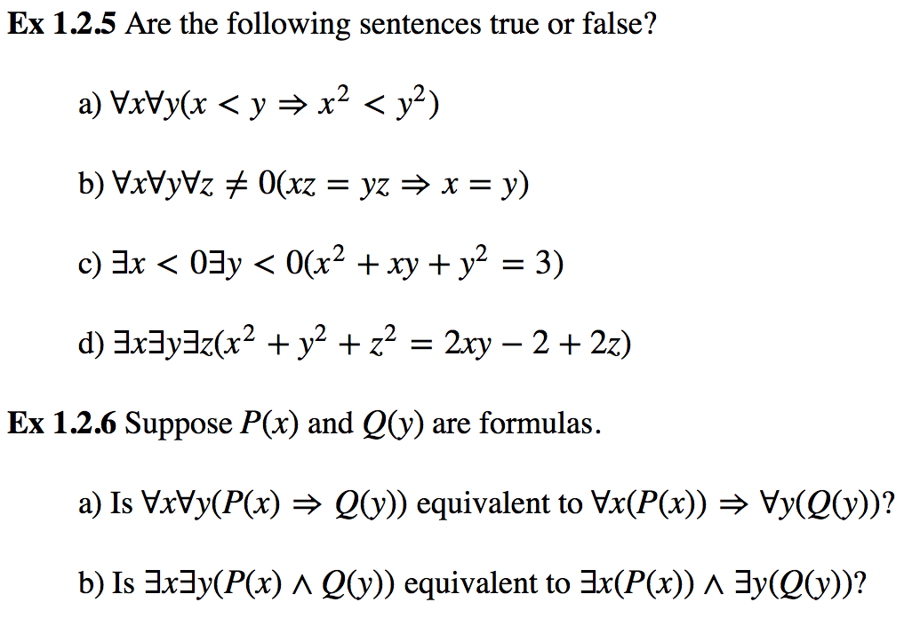
Some more practice problems (the universe is real)

