Slide 1
Rules of Inference
Section 2.3
Most of lecture slides are taken from
http://www.cs.sfu.ca/CourseCentral/101.MACM/abulatov/

Slide 2
Rules are used to distinguish between valid and invalid arguments

Slide 3
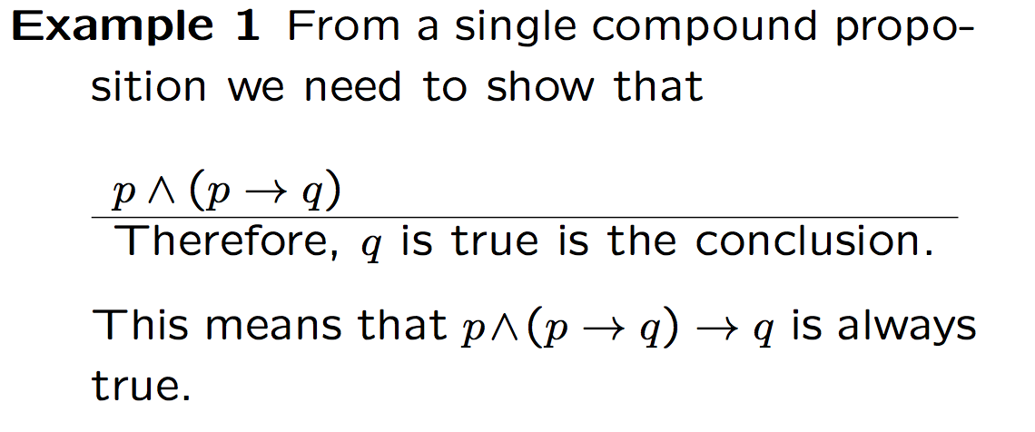

Slide 5
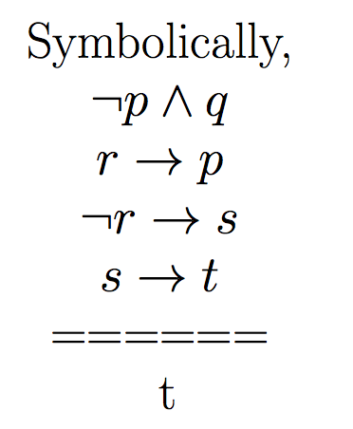

Slide 6
Logic Inference

Slide 7
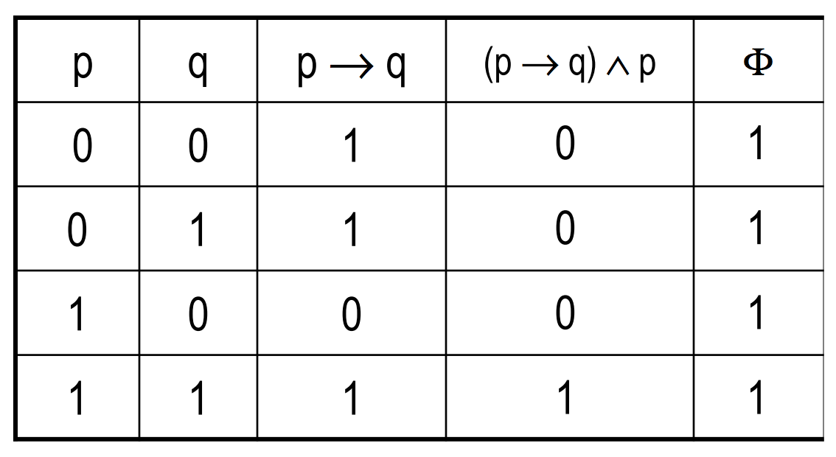

Slide 8
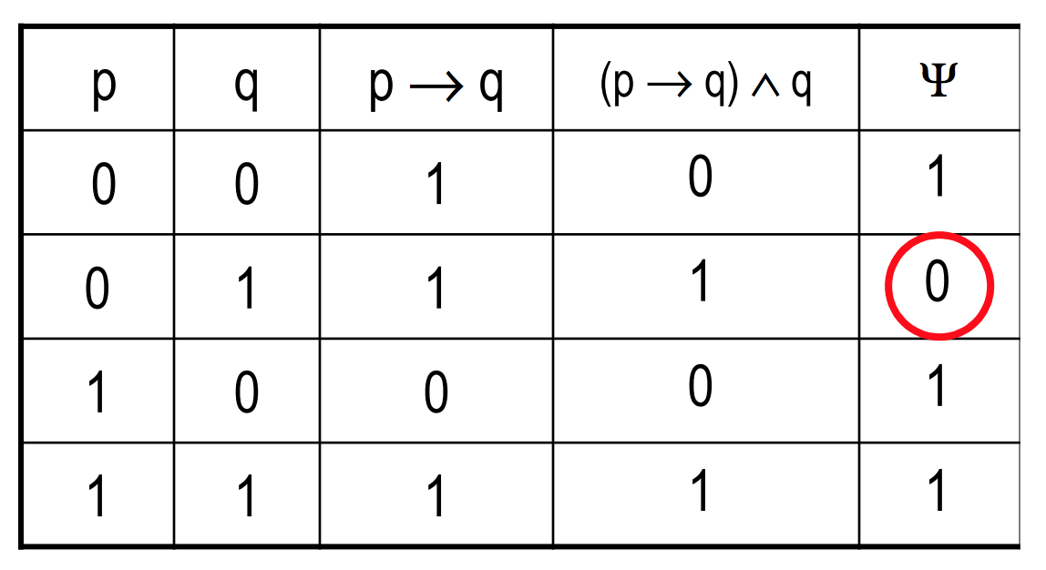

Slide 9
Example

Slide 10
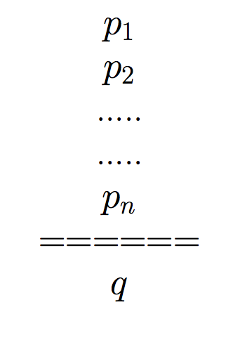
General definition of inference
Premises/ hypotheses
Conclusion

Slide 13
p: the number is divisible by 8
q: the number is divisible by 4

Slide 15
p: the number is divisible by 8
q: the number is divisible by 4
r: the number is divisible by 2

Slide 17
p: the number is divisible by 8
q: the number is divisible by 4

Slide 20
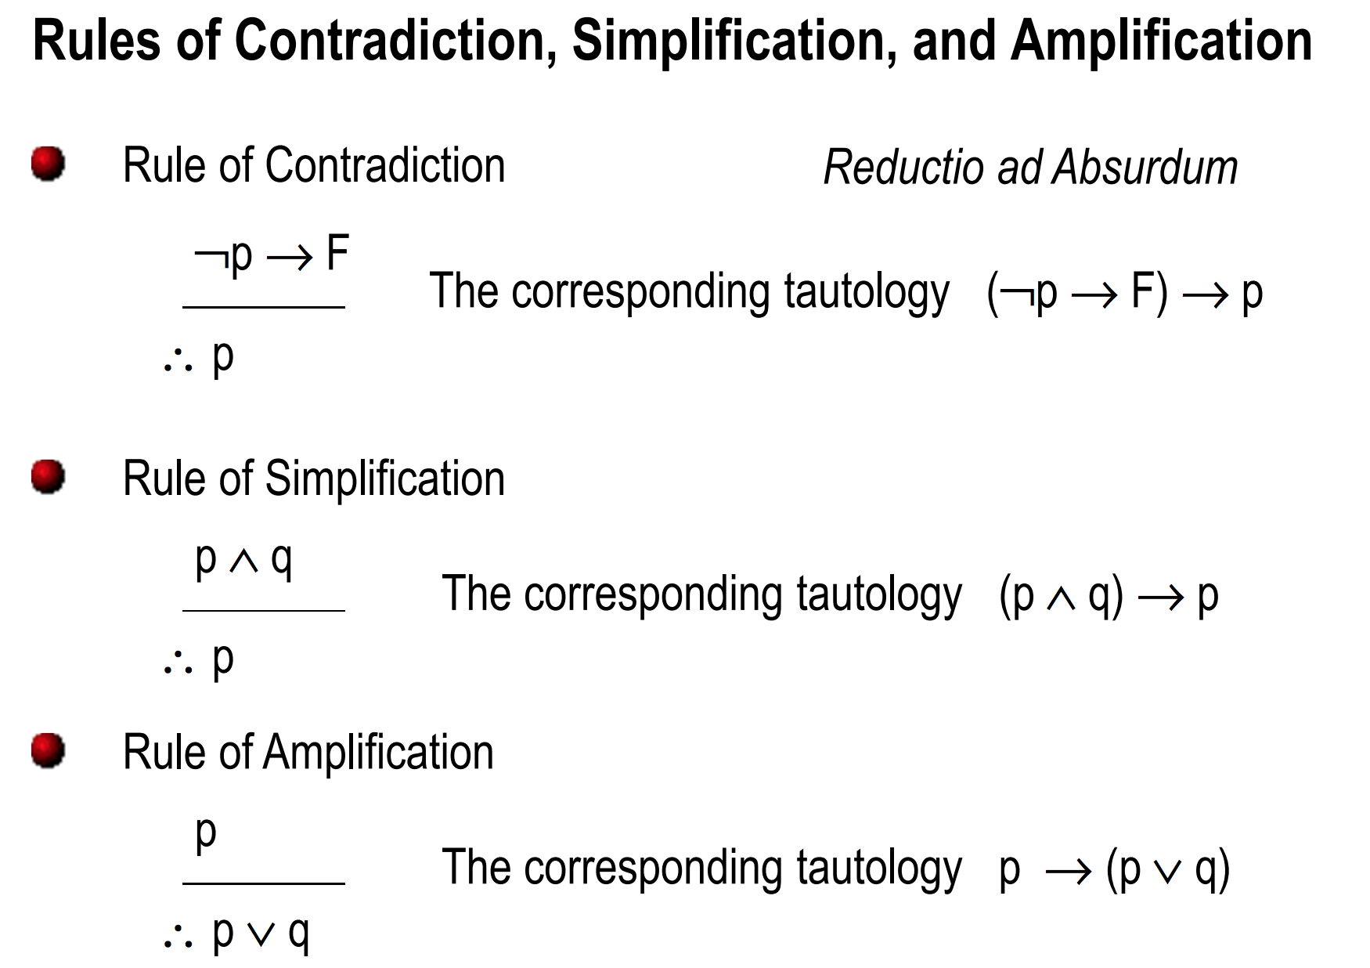

Slide 21
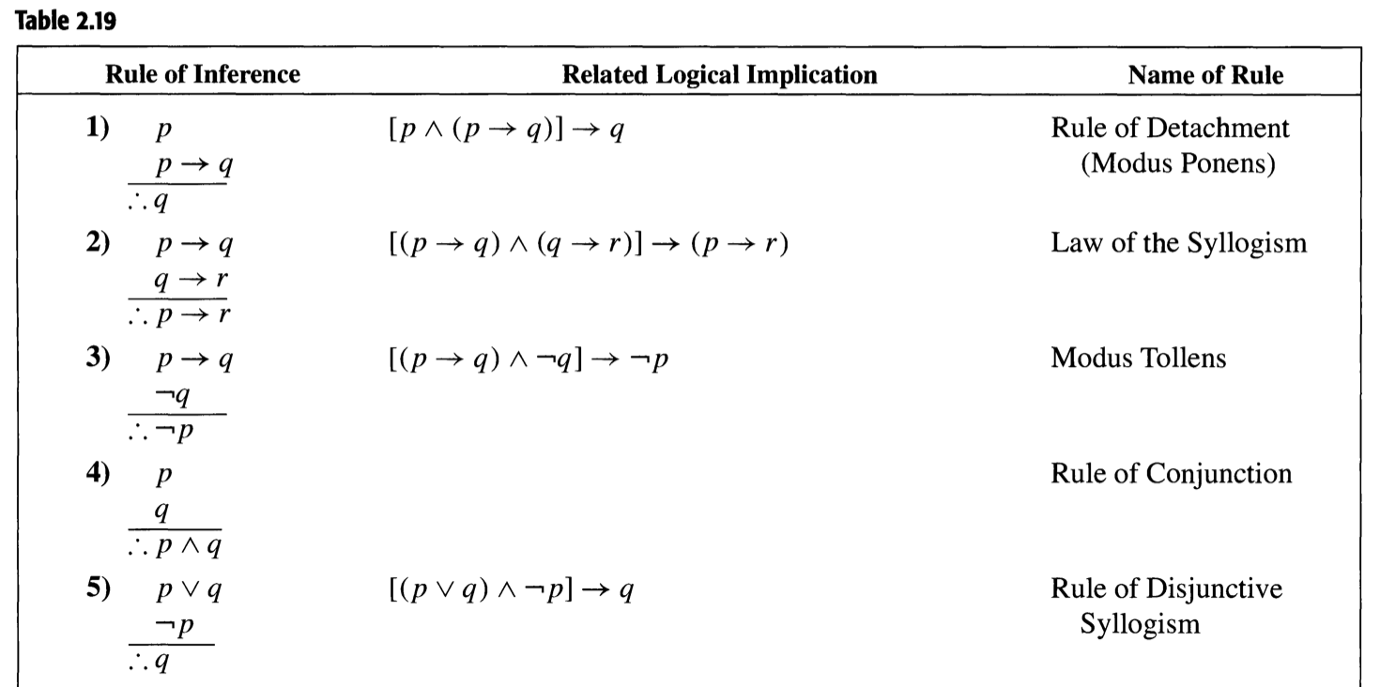

Slide 22
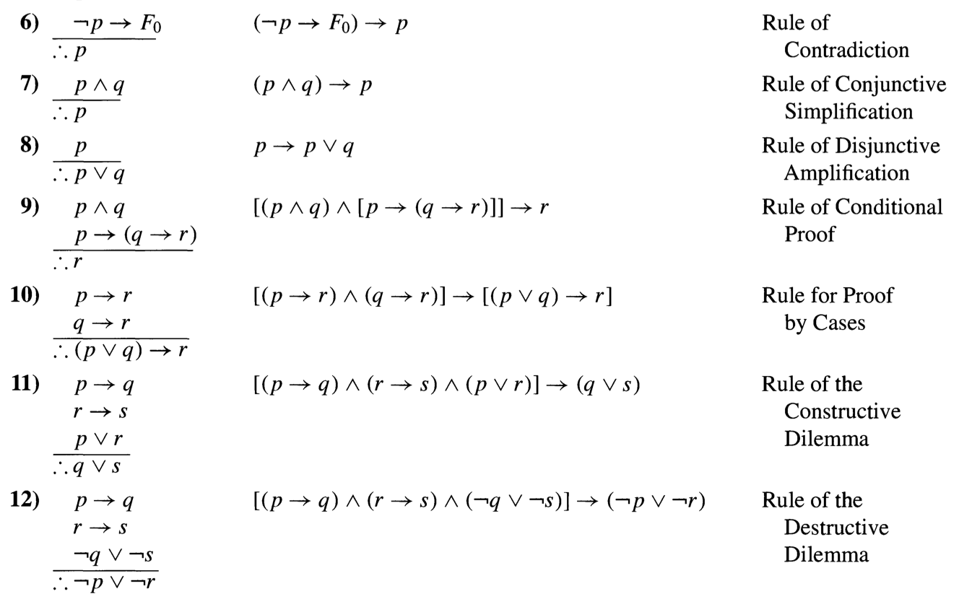

Slide 23
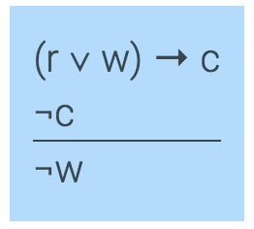
An example
Here is an argument expressed in English:
If it is raining or windy or both, the game will be cancelled
The game will not be cancelled.
_________________________________________
Therefore, it is not windy
w: it is windy; r: It is raining;
c: The game will be cancelled
Formulation in logic:

Slide 24
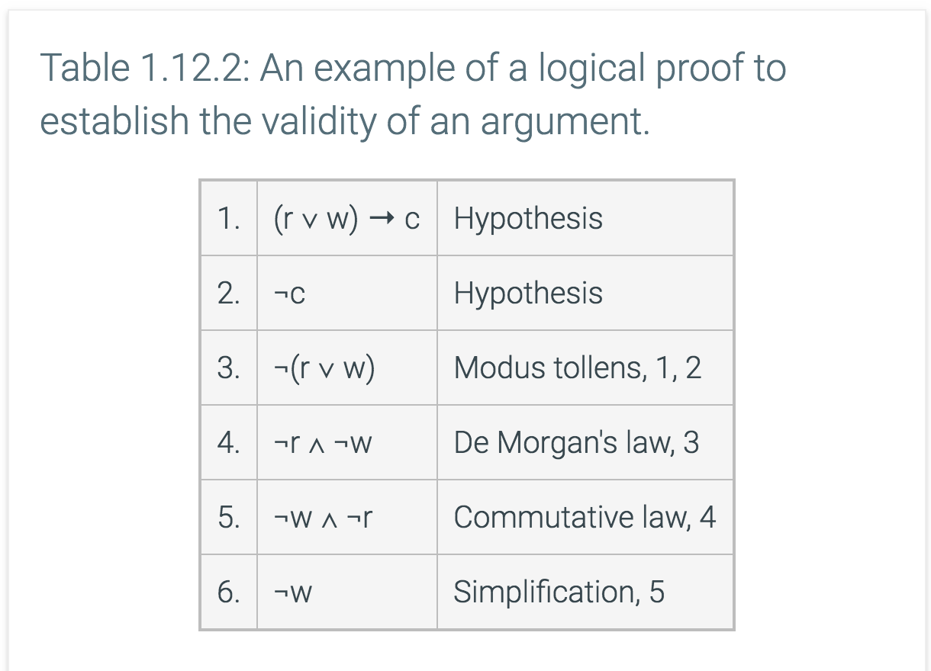

Slide 25
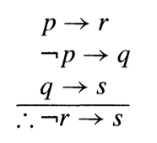
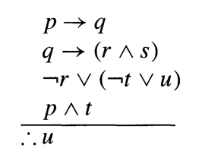
Following problems will be solved in the class
Show the validity of the following arguments:

Slide 26
Practice Problems
Example questions from the text 2.31 … 2.34
Problems (Exercises 2.3) 2, 4, 8, 10, 12

Slide 27
An example (incomplete)
Consider the following directed graph.
The graph has five cycles: (a,d,g,f,b), (a,e,f,b),(c,d,g,f), (c,e,f) and (g,I,h).
Remove minimum number of edges in order to destroy all the circuits.

