Slide 1
Chapter 2
Covers sections 2.1 and 2.2

Slide 2
Chapter 2 (Fundamental of Logic)
Basic connectives and truth table (2.1)
Logical equivalence (2.2)
Logical implication: rules of inference (2.3)
The use of quantifiers (2.4)
The proofs of theorems (2.5)

Slide 3
Logic and Arguments
Logic is the study of formal reasoning (arguments).
A statement in logic always has a well defined meaning (no room for confusion).
Logic is important in mathematics for proving theorems.
Used for designing electronic circuitry

Slide 4
Logic and Arguments
Here are some examples of the arguments:
If it is snowing, then it is cold outside.
It is snowing
--------------------------------------------------
Therefore, it is cold outside
If it is snowing, then it is cold outside.
It is cold outside
--------------------------------------------------
Therefore, it is snowing.

Slide 5
Logic and Arguments
Here are some examples of the arguments:
Either you are a Canucks fan or a Maple Leafs fan.
You are not a Maple Leafs fan
-----------------------------------------------------------------
Therefore, you are a Canucks fan.
Either you are neither a Canucks fan nor a Maple Leafs fan.
You are a Maple Leafs fan
-----------------------------------------------------------------
Therefore, you are not a Canucks fan.

Slide 6
Logic and Arguments
Here are some examples of the arguments:
All humans are green
Some green things are edible
-----------------------------------------------------------------
Therefore, some humans are edible
All humans are green.
Some green things are not edible
-----------------------------------------------------------------
Therefore, some humans are not green

Slide 7
Logic and Arguments
Some of these arguments are valid, and some are not valid. You may at the moment only have an intuitive understanding of which is which. After we are done with chapter 2, one should be able to correctly classify these arguments as either valid or invalid, and should be able to explain why.
one of the tasks of logic is provide a precise mathematical theory of validity of arguments.

Slide 8
Logic
(Propositional ) Logic is a system based on statements (also called propositions).
The most basic element in logic is a proposition.

Slide 9
Logic
A statement is a (declarative) sentence that is either true or false (not both).
We say that the truth value of a proposition is either true (T) or false (F).
Corresponds to 1 and 0 in digital circuits
We usually denote a proposition by a letter: p, q, r, s, …

Slide 10
Consider a sentence: The sun rises in the east
Is it a statement?
What is the truth value
of the proposition?

Slide 11
Consider a sentence: The sun rises in the east
Is it a statement? YES
What is the truth value
of the proposition? TRUE

Slide 12
Consider a sentence: {0,2,3} ∩ N = Φ
Is it a statement?
What is the truth value
of the proposition?

Slide 13
Consider a sentence: {0,2,3} ∩ N = Φ
Is it a statement? YES
What is the truth value
of the proposition? False

Slide 14
Consider a sentence: y > 21
Is it a statement?
What is the truth value
of the proposition?

Slide 15
Consider a sentence: y > 21
Is it a statement? No
What is the truth value
of the proposition? Its truth value
depends on unspecified y.
This statement is called an
open statement.

Slide 16
Consider a sentence: Please do not fall asleep.
Is it a statement?
What is the truth value
of the proposition?

Slide 17
Consider a sentence: Please do not fall asleep.
Is it a statement? No
What is the truth value It is neither true nor false
of the proposition
English statements are not in general propositions

Slide 18
Sentences that are not statements with similar expressions that are statements

Slide 19
Consider a sentence:
Every even integer greater than 2 is a sum of two prime numbers.
Goldbach conjecture
Is it a statement?
What is the truth value
of the proposition?

Slide 20
Consider a sentence:
Every even integer greater than 2 is a sum of two prime numbers.
Goldbach conjecture
Is it a statement? Yes
What is the truth value
of the proposition? Probably true

Slide 21
Consider a sentence:
Either x is a multiple of 7 or it is not
Is it a statement?
What is the truth value
of the proposition?

Slide 22
Consider a sentence:
Either x is a multiple of 7 or it is not
Is it a statement? Yes
What is the truth value
of the proposition? True since it is true
for all x.

Slide 23
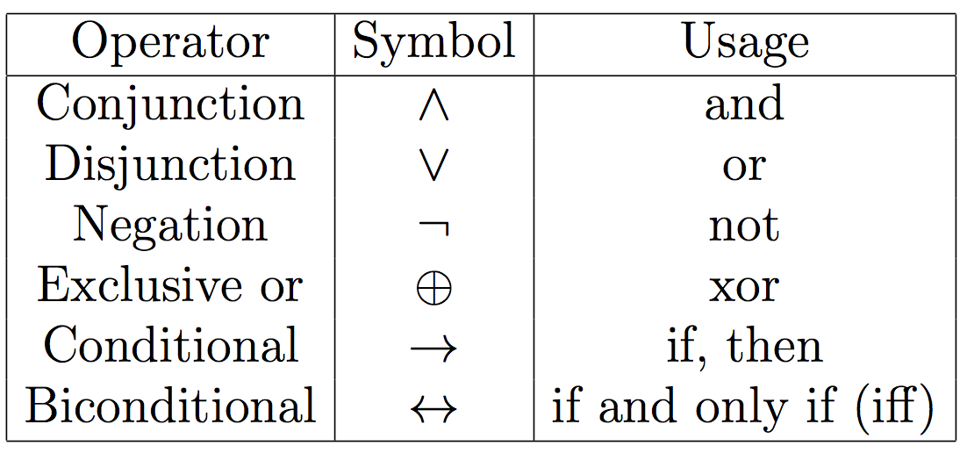
Logical Connectives (Operators)
Combining statements to make compound statements.
p, q, r, s, … represent statements/propositions.
Following connectives are considered now.

Slide 24
Logical Connective: Logical And ( )
The logical connective AND is true only when both of the propositions are true. It is also called a conjunction
Examples
It is raining and it is warm
(2+3=5) and (1<2).

Slide 25
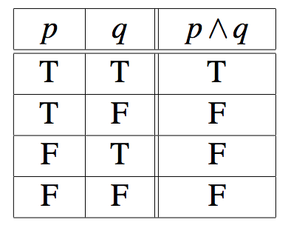
Logical Connective: Logical And ( )
Truth table
A truth table shows the truth value of a compound proposition for every possible combination of truth values for the variables contained in the compound proposition.
Every row in the truth table shows a particular truth value for each variable, along with the compound proposition's corresponding truth value.

Slide 26
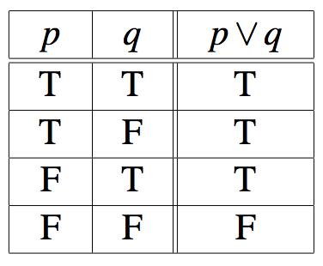
Logical Connective: Logical OR( )
The logical disjunction, or logical OR, is true if one or both of the propositions are true. This is also known as ‘inclusive OR’
Examples
It is raining or it is the second lecture
(2+2=5) ∨ (1<2)
Truth table

Slide 27
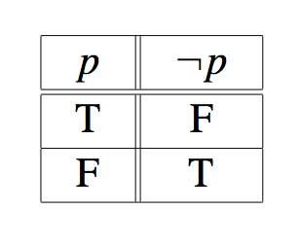
Logical Connective: Negation ( )
¬p, the negation of a proposition p, is also a proposition
p: Today is Monday
Examples:
Today is not Monday
It is not the case that today is Monday, etc.
Truth table

Slide 28
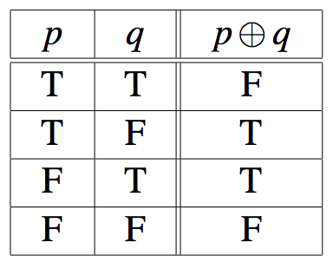
Logical Connective: Exclusive Or ( )
The exclusive OR, or XOR, of two propositions is true when exactly one of the propositions is true and the other one is false
Example
The circuit is either ON or OFF but not both
Let ab<0, then either a<0 or b<0 but not both
Truth table

Slide 29
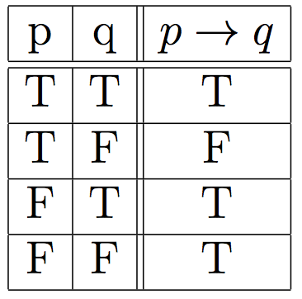
Logical Connective: Implication ( )
Definition: Let p and q be two propositions. The implication p→q is the proposition that is false when p is true and q is false and true otherwise
p is called the hypothesis, premise
q is called the conclusion, consequence
Truth table

Slide 31
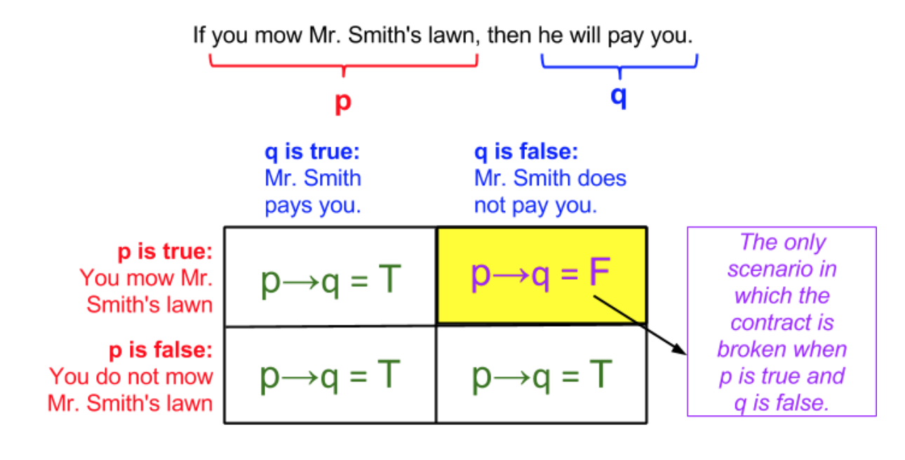
A conditional statement illustrated

Slide 32
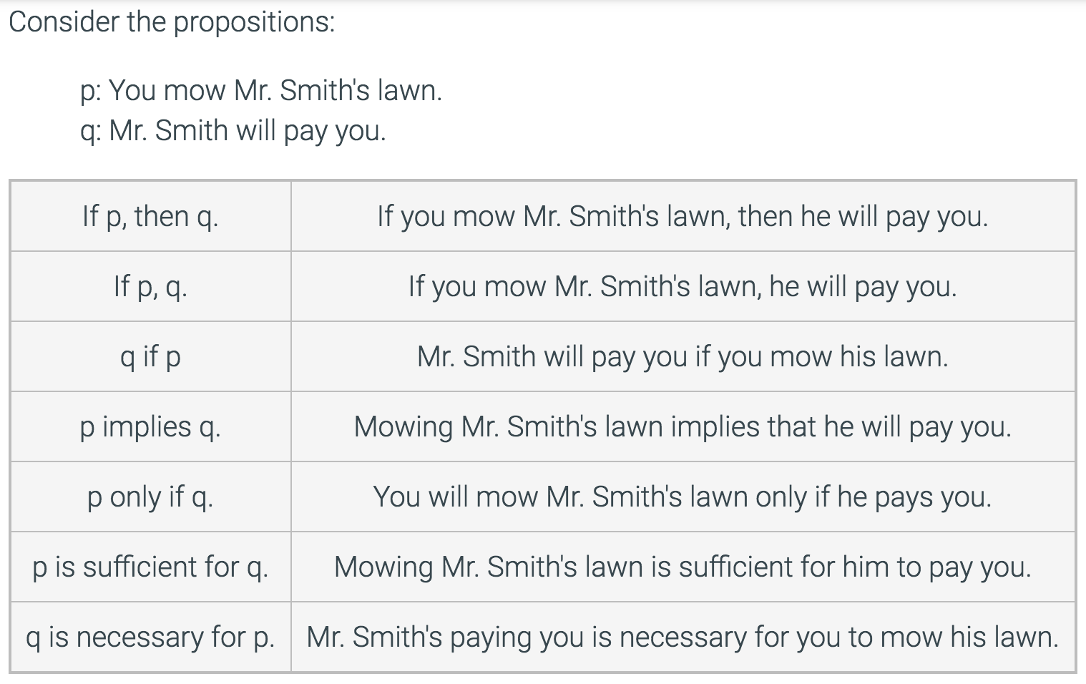
English expressions of the conditional operation

Slide 33
Logical Connective: Implication ( )
Consider the statements:
you pass the exam → you pass the course
Equivalent statements:
Passing the exam is sufficient for passing the course.
For you to pass this course, it is sufficient that you pass the exam.

Slide 34
Exercise: Which of the following implications is true?
If -1 is a positive number, then 2+2=5

Slide 35
Exercise: Which of the following implications is true?
If -1 is a positive number, then 2+2=5
True. The premise is obviously false, thus no matter what the conclusion is, the implication holds.

Slide 36
Exercise: Which of the following implications is true?
If -1 is a positive number, then 2+2=5
If -1 is a positive number, then 2+2=4
True. The premise is obviously false, thus no matter what the conclusion is, the implication holds.
True. Same as above.

Slide 37
Exercise: Which of the following implications is true?
If -1 is a positive number, then 2+2=5
If -1 is a positive number, then 2+2=4
If you get an 100% on your Midterm 1, then you will have an A⁺.
True. The premise is obviously false, thus no matter what the conclusion is, the implication holds.
True. Same as above.

Slide 38
Exercise: Which of the following implications is true?
If -1 is a positive number, then 2+2=5
If -1 is a positive number, then 2+2=4
If you get an 100% on your Midterm 1, then you will have an A⁺.
True. The premise is obviously false, thus no matter what the conclusion is, the implication holds.
True. Same as above.
False. Your grades homework, quizzes, Midterm 2, and Final, if they are bad, would prevent you from having an A⁺.

Slide 39
Note that logical (material) implication does not assume any casual connection.
`If black is white, then we live in Antartic’
`If pigs fly, then Paris is in France.

Slide 40
Exercises
To take discrete mathematics, you must have taken calculus or a course in computer science.
When you buy a new car from Acme Motor Company, you get $2000 back in cash or a 2% car loan.
School is closed if more than 2 feet of snow falls and if the wind chill is below -80.

Slide 41
Exercises
To take discrete mathematics, you must have taken calculus or a course in computer science.
Propositions
- p: take discrete math
- q: you have taken calculus
- r : you have taken a course in CS

Slide 42
Exercises
When you buy a new car from Acme Motor Company, you get $2000 back in cash or a 2% car loan.
Propositions
- p: you buy a car
- q: you you get $2000 back
- r : you get 2% car loan

Slide 43
Exercises
School is closed if more than 2 feet of snow falls and if the wind chill is below -80.
Propositions
- p: School is closed
- q: 2 feet of snow falls
- r : wind chill is below -80

Slide 44
Truth Tables
Logical operators/connectives are defined by truth tables:
Negation truth table (unary):
Binary truth tables:
p | ¬p
F T | T F
p | q | p∧q | p∨q | p ⊕q | p →q | p ↔ q
T T F F | T F T F | T F F F | T T T F | F T T F | T F T T | T F F T

Slide 45
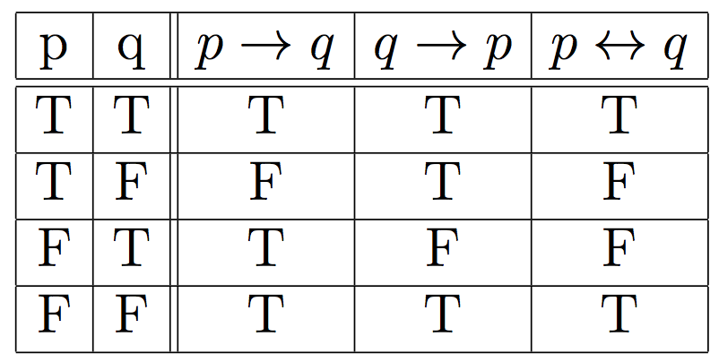
Logical Connective: Biconditional ( )
Definition: The biconditional is the proposition that is true when p and q have the same truth values. It is false otherwise.
Note that it is equivalent to
Truth table

Slide 46
Logical Connective: Biconditional ( )
The biconditional p↔q can be equivalently read as
p if and only if q
p is a necessary and sufficient condition for q
if p then q, and conversely
p iff q
Examples
x>0 if and only if x² is positive
The alarm goes off iff a burglar breaks in

Slide 48
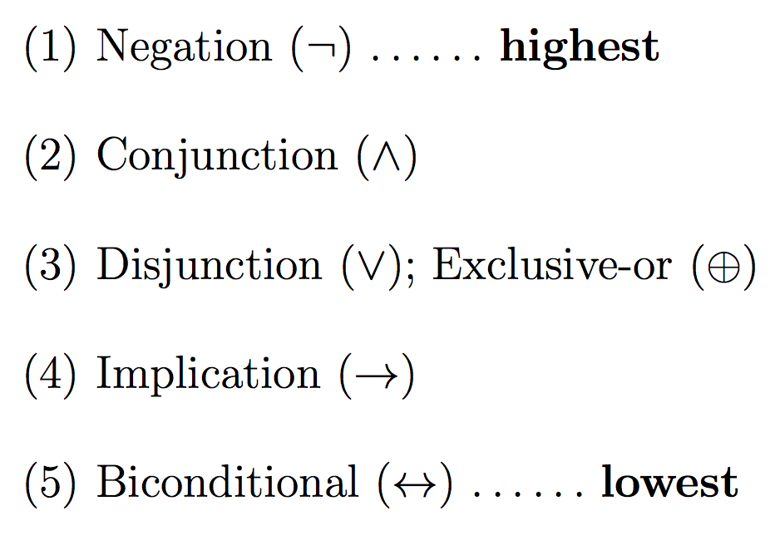
Precedence of Logical Operators
As in arithmetic, an ordering is imposed on the use of logical operators in compound propositions
However, it is preferable to use parentheses to disambiguate operators and facilitate readability
¬ p ∨ q ∧ ¬ r ≡ (¬p) ∨ (q ∧ (¬r))
To avoid unnecessary parenthesis, the following precedence hold:

Slide 49
Examples
Express each statement or open statement in one of the forms: p ∧ q, p ∨ q, or ¬p.
Today is cold but it is not cloudy
x ∈ A – B
At least one of the numbers x and y equals 0.

Slide 50
Examples
Express the following sentence in the form If P, then Q.
We will order pizza today if there are 100 students in the class.
We will order pizza today only if there are 100 students in the class.
You can use the lab if you are a cs major or not a freshman.
An integer is by 8 only if it is divisible by 4.

Slide 51
Examples
Express the following sentence in the form If P, then Q.
We will order pizza today if there are 100 students in the class.
(If there are 100 students, then we will order pizza today)
We will order pizza today only if there are 100 students in the class.
You can use the lab if you are a cs major or not a freshman.
An integer is divisible by 8 only if it is divisible by 4.

Slide 52
Examples
Express the following sentence in the form If P, then Q.
We will order pizza today if there are 100 students in the class.
(If there are 100 students, then we will order pizza today)
We will order pizza today only if there are 100 students in the class.
(If we order pizza today, there are 100 students in the class)
You can use the lab if you are a cs major or not a freshman.
An integer is divisible by 8 only if it is divisible by 4.

Slide 53
Examples
Express the following sentence in the form If P, then Q.
We will order pizza today if there are 100 students in the class.
(If there are 100 students, then we will order pizza today)
We will order pizza today only if there are 100 students in the class.
(If we order pizza today, there are 100 students in the class)
You can use the lab if you are a cs major or not a freshman.
(if you are a cs major or not a freshman, then you can use the lab.)
An integer is divisible by 8 only if it is divisible by 4.

Slide 54
Examples
Express the following sentence in the form If P, then Q.
We will order pizza today if there are 100 students in the class.
(If there are 100 students, then we will order pizza today)
We will order pizza today only if there are 100 students in the class.
(If we order pizza today, there are 100 students in the class)
You can use the lab if you are a cs major or not a freshman.
(if you are a cs major or not a freshman, then you can use the lab.)
An integer is divisible by 8 only if it is divisible by 4.
(If an integer is divisible by 8, then it is divisible by 4.)

Slide 55
Truth Tables
Logical operators/connectives are defined by truth tables:
Negation truth table (unary):
Binary truth tables:
p | ¬p
F T | T F
p | q | p∧q | p∨q | p ⊕q | p →q | p ↔ q
T T F F | T F T F | T F F F | T T T F | F T T F | T F T T | T F F T

Slide 56
Logical Equivalence
Definition: Two statements s₁ and s₂ are logically equivalent, , if their truth tables are the same
i.e. s₁ is true (respectively, false) if and only if the statement s₂ is true (respectively, false).

Slide 59
Example
True or False:

Slide 60
Example
Show that

Slide 61
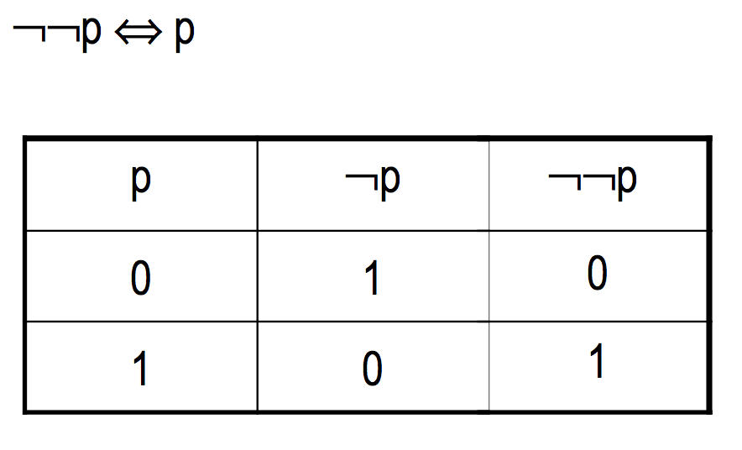
Laws of Logic
Double negation

Slide 62
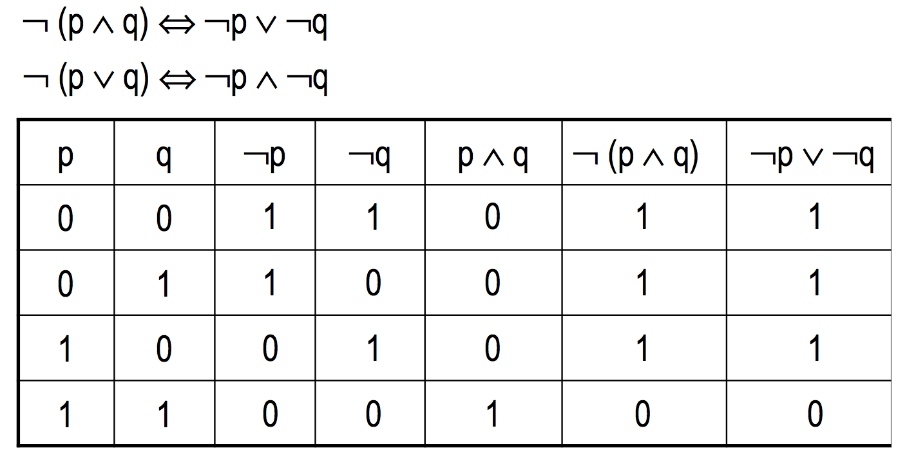
Laws of Logic
DeMorgan’s laws

Slide 63
Algebraic Laws of logic

Slide 64
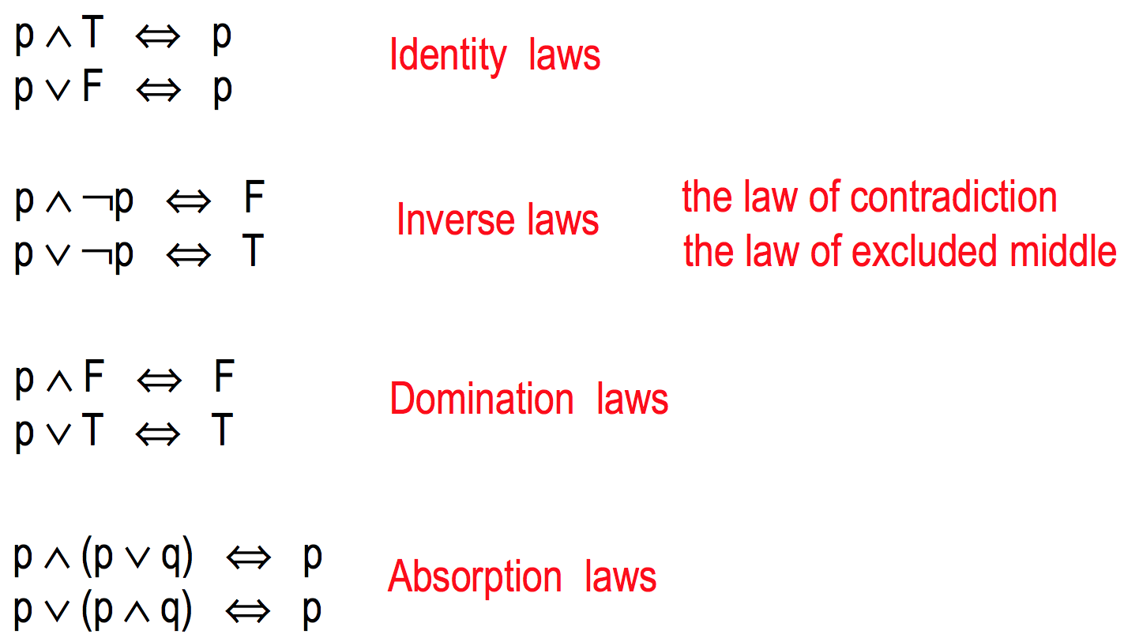
`Logic’ Laws of logic

Slide 65
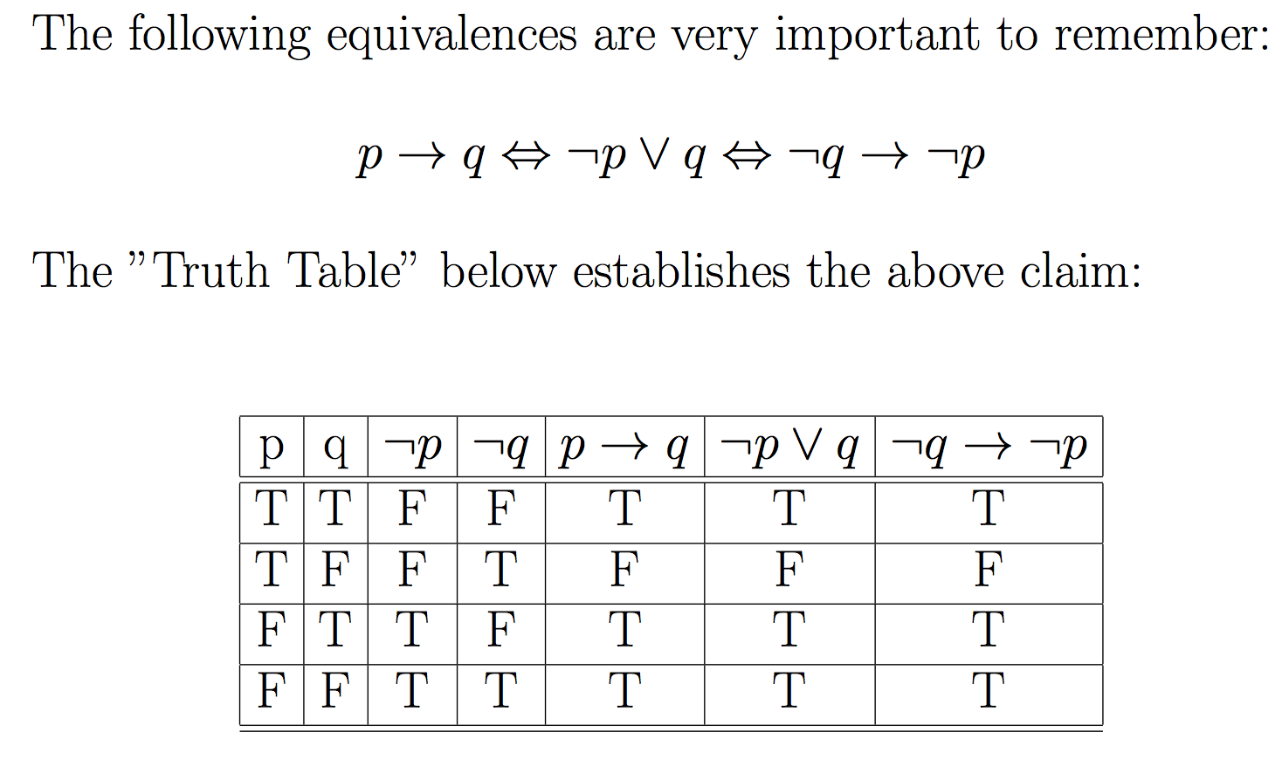
p implies q (p→q)

Slide 66
p implies q (p→q)
If p then q is logically equivalent to if not q then not p (contrapositive)

Slide 67
Examples
Express the following sentence in the form If p, then q and if not q, not p .
We will order pizza today if there are at least 100 students in the class.
(If there are at least 100 students, then we will order pizza today)
(if we don’t order any pizza today, there are less than 100 students

Slide 68
Examples
Express the following sentence in the form If p, then q and if not q, not p .
We will order pizza today if there are at least 100 students in the class.
(If there are at least 100 students, then we will order pizza today)
(if we don’t order any pizza today, there are less than 100 students
We will order pizza today only if there are at least 100 students in the class.
(If we order pizza today, there are at least 100 students in the class.)
(if there are less than 100 students in the class, we don’t order pizza today.)

Slide 69
Examples
Express the following sentence in the form If p, then q and if not q, not p .
You can use the lab if you are a cs major or not a freshman.
(if you are a cs major or not a freshman, then you can use the lab.)
(If you cannot use the lab, you are not a cs major and a freshman)

Slide 70
Examples
Express the following sentence in the form If p, then q and if not q, not p .
You can use the lab if you are a cs major or not a freshman.
(if you are a cs major or not a freshman, then you can use the lab.)
(If you cannot use the lab, you are not a cs major and a freshman)
An integer is divisible by 8 only if it is divisible by 4.
(If an integer is divisible by 8, then it is divisible by 4.)
(if an integer is not divisible by 4, it is not divisible by 8.)

Slide 71
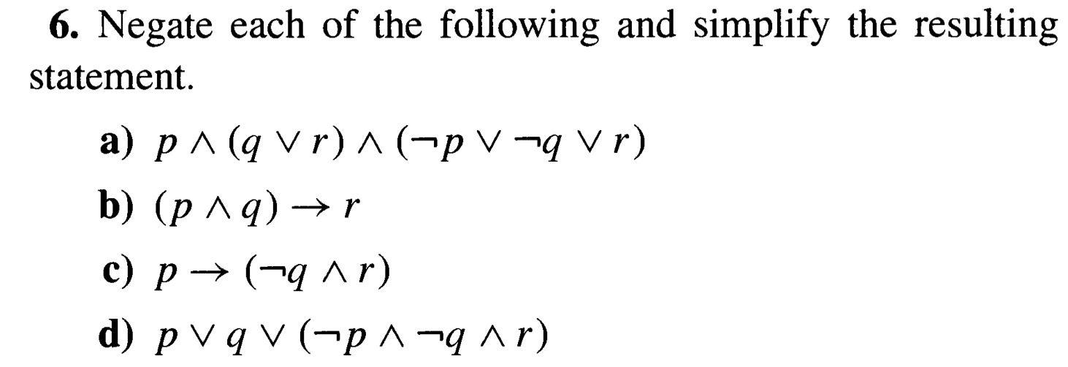

Slide 72
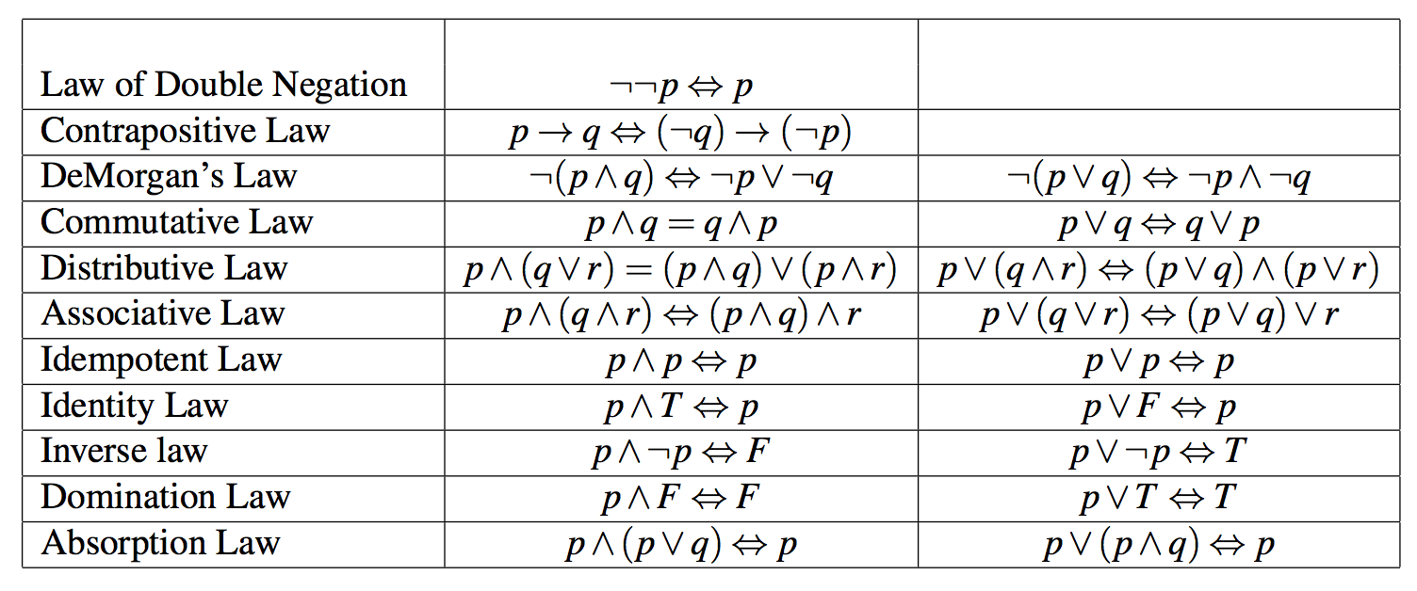
Laws of Logic

Slide 73
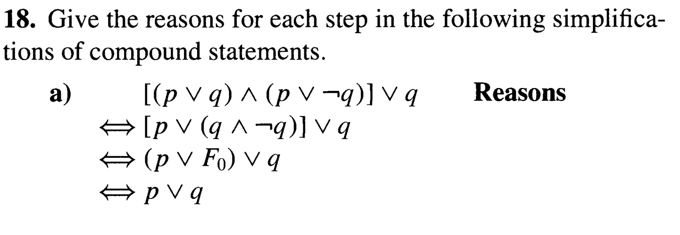

Slide 74
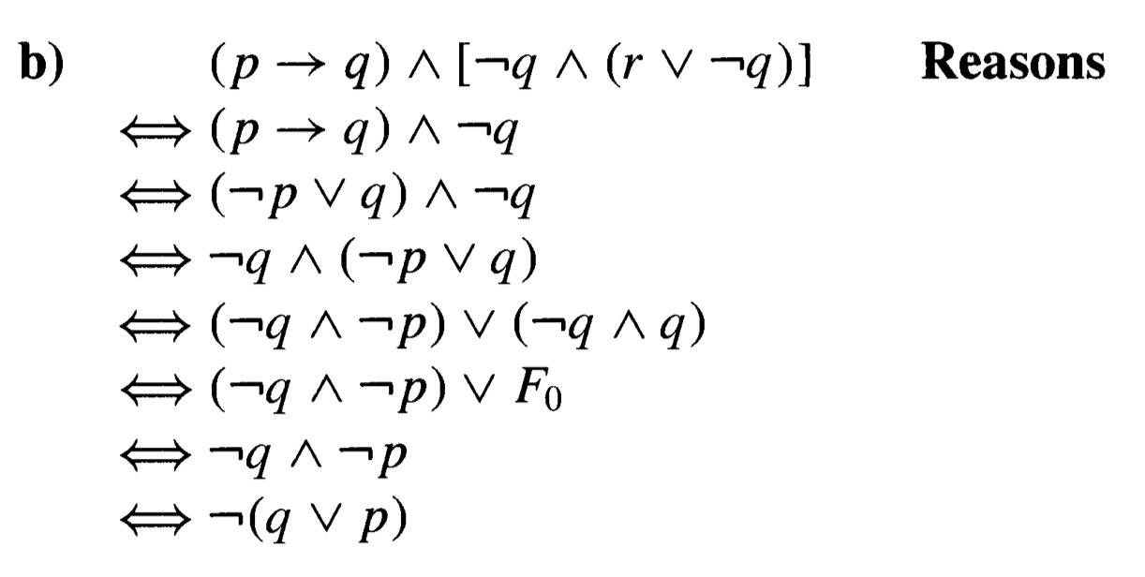

Slide 79
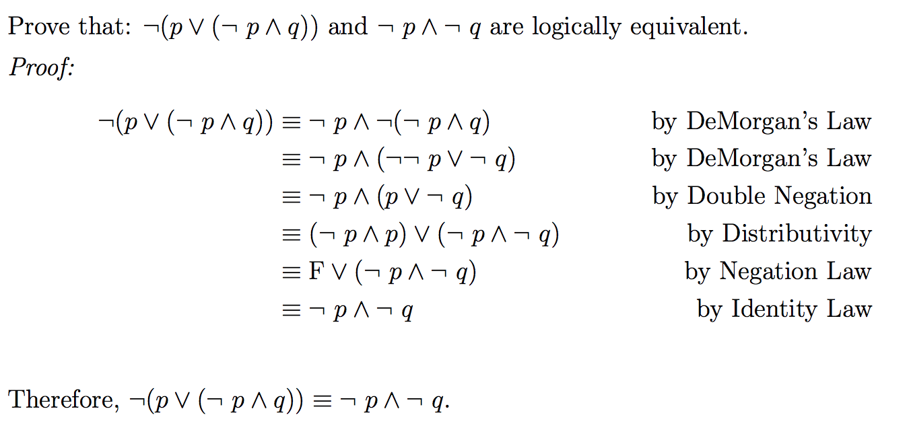

Slide 81
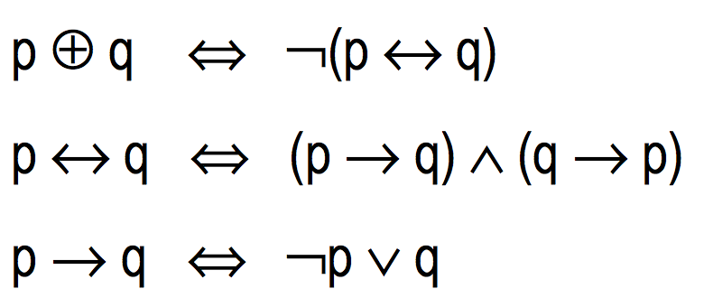
Expressing connectives
We have seen that connectives can be expressed through others:

Slide 82
Theorem
Every compound statement is logically equivalent to a statement that uses only conjunction, disjunction, and negation.

Slide 83
Practice Problems
Exercise Problems of sections 2.1 and 2.2
Problems (Exercises 2.1) 2, 4, 11, 12
Problems (Exercises 2.2) 4, 6, 8, 12, 15, 16, 18

