Slide 1
Chapter 1B
Section 1.2 and 1.3

Slide 2
Section 1.2 (Permutations)
Given a collection of n distinct (distinguishable) objects, any arrangements of these objects in a linear order is called a permutations.

Slide 3
Section 1.2 (Permutations)
Let a, b, c be three distinct objects.
abc is a permutation
abc, acb, bac, bca, cab,cba are the six permutations of thee object.
The permutations are like list arrangements. (a,b,c), (a,c,a), (b,a,c), (b,c,a), (c,a,b), (c,b,a)

Slide 4
Section 1.2 (Permutations)
Two key words we should be looking in the case of permutations or arrangements.
distinct (distinguishable objects) objects
order is important

Slide 5
Permutations
Definition: A permutation of a set of distinct objects is an ordered arrangement of these objects. An ordered arrangement of r elements of a set is called an r-permutation.

Slide 6
Permutations
Example: Let S = {1,2,3}.
The ordered arrangement (3,1,2) is a permutation of S.
The ordered arrangement (3,2) is a 2-permutation of S.
The number of r-permuations of a set with n elements is denoted by P(n,r).
The 2-permutations of S = {1,2,3} are (1,2); (1,3); (2,1); (2,3); (3,1); and (3,2). Hence, P(3,2) = 6.

Slide 7
Formula for the Number of Permutations
Theorem 1: If n is a positive integer and r is an integer with 1 ≤ r ≤ n, then there are
P(n, r) = n(n − 1)(n − 2) ∙∙∙ (n − r + 1)
r-permutations of a set with n distinct elements.

Slide 8
Formula for the Number of Permutations
Theorem 1: If n is a positive integer and r is an integer with 1 ≤ r ≤ n, then there are
P(n, r) = n(n − 1)(n − 2) ∙∙∙ (n − r + 1)
r-permutations of a set with n distinct elements.
Proof: Use the product rule. The first element can be chosen in n ways. The second in n − 1 ways, and so on until there are (n − ( r − 1)) ways to choose the last element.
Note that P(n,0) = 1, since there is only one way to order zero elements.

Slide 9
Factorial
For any positive integer n, n! means:
n(n-1)(n-2) ……. 3.2.1
0! is defined as equal to one.
Examples: 4! = 4.3.2.1 = 24.
Examples: 3.5! = 3.(5!)
Note that P(n,n) = n!

Slide 10
Examples
Using only pencil and paper, find the value of
There are two 0’s at the end of 10!=3,268,800. Using only paper and pencil, determine how many 0’s are at the end of 100!.

Slide 11
Solution
Using only pencil and paper, find the value of
Easy.
There are two 0’s at the end of 10!=3,268,800. Using only paper and pencil, determine how many 0’s are at the end of 100!.

Slide 12
Solution
Using only pencil and paper, find the value of
Easy.
There are two 0’s at the end of 10!=3,268,800. Using only paper and pencil, determine how many 0’s are at the end od 100!.
Ans: 10! = 10 x 9 x 8 x 7 x 6 x 5 x 4 x 3 x 2 x 1.
The two zeros in 10! come from the fact that
(1) The number is divisible by 10, and
(2) The number is divisible by both 5 and 2.

Slide 13
Solution
Now 100! is divisible by 100*(95*92)* 90*(85*82)*
…..10*(5*2).

Slide 14
Solution
Now 100! is divisible by 100*(95*92)* 90*(85*82)*
…..10*(5*2).
The number of trailing zeros in 100! is 21.
The answer is not correct. We have missed some trailing zeros.

Slide 15
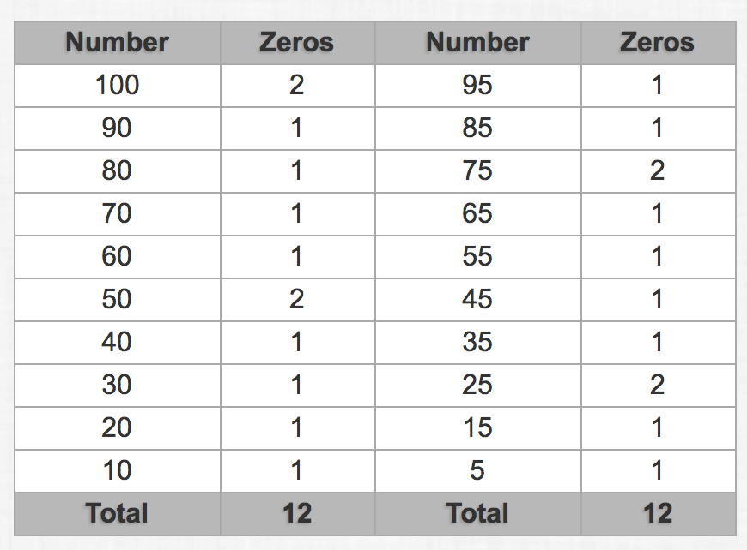
Correct answer is 24.
Each divisor of 10 is realized by the product of a 5 and a 2. 5 and 2 are factors of 10.
Let us count the number of 5s in the factorization of 100!. This is shown in the table.
100 = 5 x 5 x 4
90 = 5 x 18
= 5 x 12
= 5 x 5 x2
and so on

Slide 16
Correct answer is 24.
When a factor 5 is multiplied with an even number, we get a trailing zero in 100!
There are at least 50 even numbers in the factorization of 100!
Therefore, twenty four (24) 5s factorization of 100! will realize 24 trailing zeros in 100! when multiplied with even numbers.

Slide 17
Example
Compute how many 7-digit numbers can be made from the digits 1,2,3,4,5,6,7 if there is no repetition and the odd digits must appear in an unbroken sequence. (3571264, 2413576 are valid, but not 7234615)
Ans:

Slide 18
Solution
Compute how many 7-digit numbers can be made from the digits 1,2,3,4,5,6,7 if there is no repetition and the odd digits must appear in an unbroken sequence. (3571264, 2413576 are ok, but not 7234615)
Ans:
There are 4 odd digits. There are 4! length-4 lists of odd integers without repetition.
The 7-digit valid number can be visualized as a list of length 4 using symbols 2, 4, 6, and a length-4 list of odd integers. There are 4! different such lists.
The total number of valid 7-digit sequence is (4!)².

Slide 19
Solving Counting Problems by Counting Permutations
Example: How many ways are there to select a first-prize winner, a second prize winner, and a third-prize winner from 100 different people who have entered a contest?
Solution:
P(100,3) = 100 ∙ 99 ∙ 98 = 970,200

Slide 20
Solving Counting Problems by Counting Permutations
Example: Suppose that a saleswoman has to visit eight different cities. She must begin her trip in a specified city, but she can visit the other seven cities in any order she wishes. How many possible orders can the saleswoman use when visiting these cities?
Solution: The first city is chosen, and the rest are ordered arbitrarily. Hence the orders are:
7! = 7 ∙ 6 ∙ 5 ∙ 4 ∙ 3 ∙ 2 ∙ 1 = 5040
If she wants to find the tour with the shortest path that visits all the cities, she must consider 5040 paths!

Slide 21
Solving Counting Problems by Counting Permutations
Example: How many permutations of the letters ABCDEFGH contain the string ABC ?
Solution: count the permutations of six objects,
ABC, D, E, F, G, and H.
6! = 6 ∙ 5 ∙ 4 ∙ 3 ∙ 2 ∙ 1 = 720

Slide 22
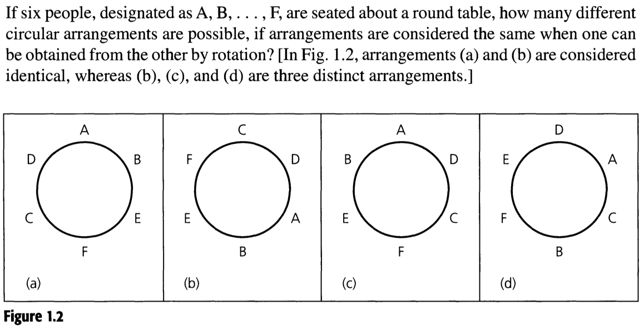
Example 1.16
ABEFCD; BEFCDA; EFCDAB; FCDABE; CDABEF, DABEFC are circularly identical (linearly not so).
Fix the starting object (say A). The remaining five objects are linearly ordered.
Ans:

Slide 23
Example 1.16
ABEFCD; BEFCDA; EFCDAB; FCDABE; CDABEF, DABEFC are circularly identical (linearly not so).
Fix the starting object (say A). The remaining five objects are linearly ordered.
Ans: 5! i.e. 5.4.3.2.1

Slide 24
P(n,r)
P(n,r) is the number of r-permutations (arrangements of r objects) of a given set of n distinct objects.
P(n,r) = n(n-1)(n-2)……….(n-(r-1))
= n(n-1)(n-2)……….(n-r+1)

Slide 25
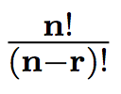
Permutation P(n,r)
We can rewrite P(n,r) =n.(n-1).(n-2). …. (n-r+1) as
P(n,r) =
Thus P(n,r) =

Slide 26
Permutations with Repetitions

Slide 27
Factors in 100!
We have seen that 5²⁴ divides 100!, but 5²⁵ doesn’t.
What can we say when it is 1000! ?
We have to have a method. Table-like solution is not practical

Slide 28
A formula
Notation: ⎣x⎦ = floor(x) and ⎡x⎤ = ceiling(x).
⎣x⎦ is the greatest integer less than or equal to x and ⎡x⎤ is the smallest integer greater than or equal to x.
e.g., ⎣2.6⎦= 2, ⎡2.6⎤ = 3, ⎣–2.1⎦ = –3 and ⎡–2.1⎤ = –2.

Slide 29
A formula
Number of 5’s in 100!
= ⎣100/5⎦ + ⎣100/5²⎦ + ⎣100/5³⎦
= 20 + 4 + 0 = 24
Number of 5’s in 1000!
= ⎣1000/5⎦ + ⎣1000/5²⎦ + ⎣1000/5³⎦ + ⎣1000/5⁴⎦
= 200 + 40 + 8 + 1 = 249

Slide 30
A formula
Number of 2’s in 100!
= ⎣100/2⎦ + ⎣100/2²⎦ + ⎣100/2³⎦ + ⎣100/2⁴⎦ + ⎣100/2⁵⎦ + ⎣100/2⁶⎦
= 50 + 25 + 12 + 6 + 3 + 1 = 97
This shows that 2⁹⁷ divides 100!, but 2⁹⁸ doesn’t.

Slide 31
Permutations with Repetitions

Slide 32
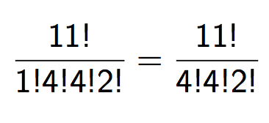
Permutations with Repetitions
How many ways can we permute the letters of MISSISSIPPI?
There are 11 characters.
M one time
I four times
S four times
P two time
Number of different arrangements:

Slide 33
Question 34 (page 14)
How many distinct 4-digit integers can one make for the digits 1, 3, 3, 7, 7, 8?
First attempt:
Make the digits distinct: 1, 3₁, 3₂, 7₁, 7₂, 8
Number of 4-permutations is P(6,4) since the digits are all distinct.
Factor in the duplicates: P(6,4)/(2! x 2!) = 90.
The correct answer is 102.

Slide 34
Correct Answer
We break the solution into many cases:
(no 7’s: 1, 3, 3, 8)
(one 7 and 3: 1, 3, 7, 8)
(one 7 and two 3’s: 1, 3, 3, 7)
(one 7 and two 3’s: 3, 3, 7, 8)
(two 7’s and no 3’s: 1, 7, 7, 8)
(two 7’s and one 3: 1, 3, 7, 7)
(two 7’s and one 3: 3, 7, 7, 8)
(two 7’s and two 3’s: 3, 3, 7, 7)

Slide 35
Correct Answer
We break the solution into many cases:
(no 7’s: 1, 3, 3, 8) 4!/2
(one 7 and 3: 1, 3, 7, 8) 4!
(one 7 and two 3’s: 1, 3, 3, 7) 4!/2!
(one 7 and two 3’s: 3, 3, 7, 8) 4!/2!
(two 7’s and no 3’s: 1, 7, 7, 8) 4!/2!
(two 7’s and one 3: 1, 3, 7, 7) 4!/2!
(two 7’s and one 3: 3, 7, 7, 8) 4!/2!
(two 7’s and two 3’s: 3, 3, 7, 7) 4!/(2!2!)
Total number = 102

Slide 36
Example

Slide 37
Combinations
How many committees of three students can be formed from a group of four students?
Solution: To answer this question, we need only to find the number of subsets with three elements from the set containing four elements. As is easily seen, there are four such subsets. Note that order in which these students are chosen does not matter.

Slide 38
Counting Subsets
In counting the number of length-k lists from a set of n possible objects, the order of the objects were very important.
What happens when the order is not important?
Now we select size-k subsets from a set of n possible objects.
How many such size-k subsets are there?

Slide 39
Counting Subsets
Suppose A = {a,b,c,d,e}
Size-2 subsets of A are: {a,b}, {a,c}, {a,d}, {a,e}, {b,c}, {b,d}, {b,e}, {c,d}, {c,e}, {d,e}.
Observe length-2 lists: (a,b), (b,a), (a,c), (c,a), (a,d), (d,a),(a,e), (e,a), (b,c), (c,b), (b,d), (d,b), (b,e), (e,b), (c,d), (d,c), (c,e), (e,c), (d,e), (e,d)

Slide 40
Counting Subsets
Suppose A = {a,b,c,d,e}
Size-2 subsets of A are: {a,b}, {a,c}, {a,d}, {a,e}, {b,c}, {b,d}, {b,e}, {c,d}, {c,e}, {d,e}.
Observe length-2 lists: (a,b), (b,a), (a,c), (c,a), (a,d), (d,a),(a,e), (e,a), (b,c), (c,b), (b,d), (d,b), (b,e), (e,b), (c,d), (d,c), (c,e), (e,c), (d,e), (e,d)
There is definitely some connection between the number of size-k subsets and the number of length-k lists.

Slide 41
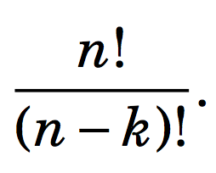
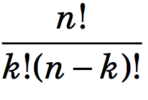
Counting Subsets
Consider a size-k subset {a₁,a₂, …, a_{k}}.
This size-k subsets generate k! length-k lists using the k symbols a₁,a₂, …, a_{k}.
These k! lists are present in length-k lists using n symbols.
Thus every size-k subset realizes k! length-k lists.
Therefore,
number of size-k subsets x k! = number of length-k lists
number of size-k subsets = C(n,k) =

Slide 42
Counting Subsets
In the text, C(n,k) is written as .
is read as ``n choose k’’
C(n,k) denotes the number of subsets that can be made by choosing k elements from a set of n elements.

Slide 43
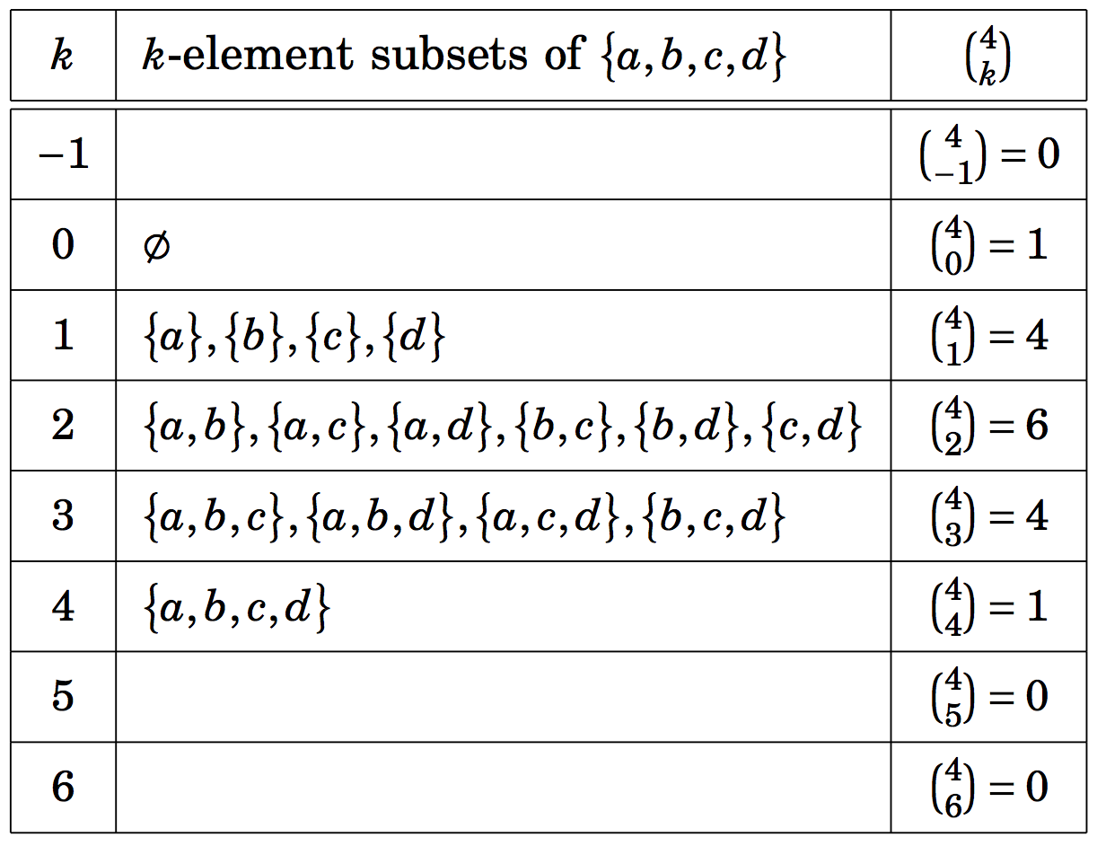
Counting Subsets

Slide 44
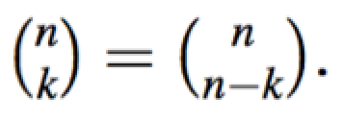
Example
Show that for any integer k, k <= n,

Slide 45
Example
Show that for any integer k, k <= n,

Slide 46
Example
How many 5-card hands are there in which two of the cards are clubs and three are hearts?
Ans: Note that order is not important.
How many ways can we select two club cards?
How many ways can we select three hearts?

Slide 47
Example
How many 5-card hands are there in which two of the cards are clubs and three are hearts?
Ans: Note that order is not important.
How many ways can we select two club cards?
The answer is: C(13,2) = =
How many ways can we select three hearts?

Slide 48
Example
How many 5-card hands are there in which two of the cards are clubs and three are hearts?
Ans: Note that order is not important.
How many ways can we select two club cards?
The answer is: C(13,2) = =
How many ways can we select three hearts?
The answer is: C(13,3)

Slide 49
Example
How many 5-card hands are there in which two of the cards are clubs and three are hearts?
Ans: Note that order is not important.
How many ways can we select two club cards?
The answer is: C(13,2) = =
How many ways can we select three hearts?
The answer is: C(13,3)
Total number = C(13,2). C(13,3) =

Slide 50
Example
In how many ways a gambler draw five cards from a standard deck and get
(a) a flush (five card of the same suit)?
(b) four aces?
(c) four of a kind?
(d) three aces and two jacks?
(e) three aces and a pair?
(f) a full house (three of a kind and a pair)?
(g) thee of a kind?
(h) two pairs?

Slide 51
Example
In how many ways a gambler draw five cards from a standard deck and get
(a) a flush (five card of the same suit)? C(4,1).C(13,5)
(b) four aces?
(c) four of a kind?
(d) three aces and two jacks?
(e) three aces and a pair?
(f) a full house (three of a kind and a pair)?
(g) three of a kind?
(h) two pairs?

Slide 52
Example
In how many ways a gambler draw five cards from a standard deck and get
(a) a flush (five card of the same suit)? C(4,1).C(13,5)
(b) four aces? C(4,4).C(48,1)
(c) four of a kind?
(d) three aces and two jacks?
(e) three aces and a pair?
(f) a full house (three of a kind and a pair)?
(g) three of a kind?
(h) two pairs?

Slide 53
Example
In how many ways a gambler draw five cards from a standard deck and get
(a) a flush (five card of the same suit)? C(4,1).C(13,5)
(b) four aces? C(4,4).C(48,1)
(c) four of a kind? C(13,1).C(48,1)
(d) three aces and two jacks?
(e) three aces and a pair?
(f) a full house (three of a kind and a pair)?
(g) three of a kind?
(h) two pairs?

Slide 54
Example
In how many ways a gambler draw five cards from a standard deck and get
(a) a flush (five card of the same suit)? C(4,1).C(13,5)
(b) four aces? C(4,4).C(48,1)
(c) four of a kind? C(13,1).C(48,1)
(d) three aces and two jacks? C(4,3).C(4,2)
(e) three aces and a pair?
(f) a full house (three of a kind and a pair)?
(g) three of a kind?
(h) two pairs?

Slide 55
Example
In how many ways a gambler draw five cards from a standard deck and get
(a) a flush (five card of the same suit)? C(4,1).C(13,5)
(b) four aces? C(4,4).C(48,1)
(c) four of a kind? C(13,1).C(48,1)
(d) three aces and two jacks? C(4,3).C(4,2)
(e) three aces and a pair? C(4,3).C(12,1).C(4,2)
(f) a full house (three of a kind and a pair)?
(g) three of a kind?
(h) two pairs?

Slide 56
Example
In how many ways a gambler draw five cards from a standard deck and get
(a) a flush (five card of the same suit)? C(4,1).C(13,5)
(b) four aces? C(4,4).C(48,1)
(c) four of a kind? C(13,1).C(48,1)
(d) three aces and two jacks? C(4,3).C(4,2)
(e) three aces and a pair? C(4,3).C(12,1).C(4,2)
(f) a full house (three of a kind and a pair)? C(13,1).C(4,3).C(12,1).C(4,2)
(g) three of a kind?
(h) two pairs?

Slide 57
Example
In how many ways a gambler draw five cards from a standard deck and get
(a) a flush (five card of the same suit)? C(4,1).C(13,5)
(b) four aces? C(4,4).C(48,1)
(c) four of a kind? C(13,1).C(48,1)
(d) three aces and two jacks? C(4,3).C(4,2)
(e) three aces and a pair? C(4,3).C(12,1).C(4,2)
(f) a full house (three of a kind and a pair)? C(13,1).C(4,3).C(12,1).C(4,2)
(g) three of a kind? C(13,1).C(4,3).C(12,2).C(4,1).C(4,1)
(h) two pairs?

Slide 58
Example
In how many ways a gambler draw five cards from a standard deck and get
(a) a flush (five card of the same suit)? C(4,1).C(13,5)
(b) four aces? C(4,4).C(48,1)
(c) four of a kind? C(13,1).C(48,1)
(d) three aces and two jacks? C(4,3).C(4,2)
(e) three aces and a pair? C(4,3).C(12,1).C(4,2)
(f) a full house (three of a kind and a pair)? C(13,1).C(4,3).C(12,1).C(4,2)
(g) three of a kind? C(13,1).C(4,3).C(12,2).C(4,1).C(4,1)
(h) two pairs? C(13,2).C(4,2).C(4,2).C(44,1)

Slide 59
Example
The problem concerns lists made from the symbols A,B,C,D,E,F,G,H,I.
How many length-5 lists can be made if repetition is not allowed and the list is in alphabetical order? (Example: BDEFI or ABCGH, but not BACGH)
How many length-5 lists can be made if repetition is not allowed and the list is not alphabetical order.

Slide 60
Example
The problem concerns lists made from the symbols A,B,C,D,E,F,G,H,I.
How many length-5 lists can be made if repetition is not allowed and the list is in alphabetical order? (Example: BDEFI or ABCGH, but not BACGH)
Observe that size-5 subset realizes one length-5 list in alphabetical order, and one length-5 list realizes one size-5 subset. Therefore, the number od length-5 alphabetically ordered list is the same as the number of size-5 subsets. Hence the number is C(9,5).
How many length-5 lists can be made if repetition is not allowed and the list is not alphabetical order.

Slide 61
Example
The problem concerns lists made from the symbols A,B,C,D,E,F,G,H,I.
How many length-5 lists can be made if repetition is not allowed and the list is in alphabetical order? (Example: BDEFI or ABCGH, but not BACGH)
Observe that size-5 subset realizes one length-5 list in alphabetical order, and one length-5 list realizes one size-5 subset. Therefore, the number od length-5 alphabetically ordered list is the same as the number of size-5 subsets. Hence the number is C(9,5).
How many length-5 lists can be made if repetition is not allowed and the list is not alphabetical order.
Ans: 9x8x7x6x5 – C(9,5).

Slide 62
Concise way to write

Slide 63
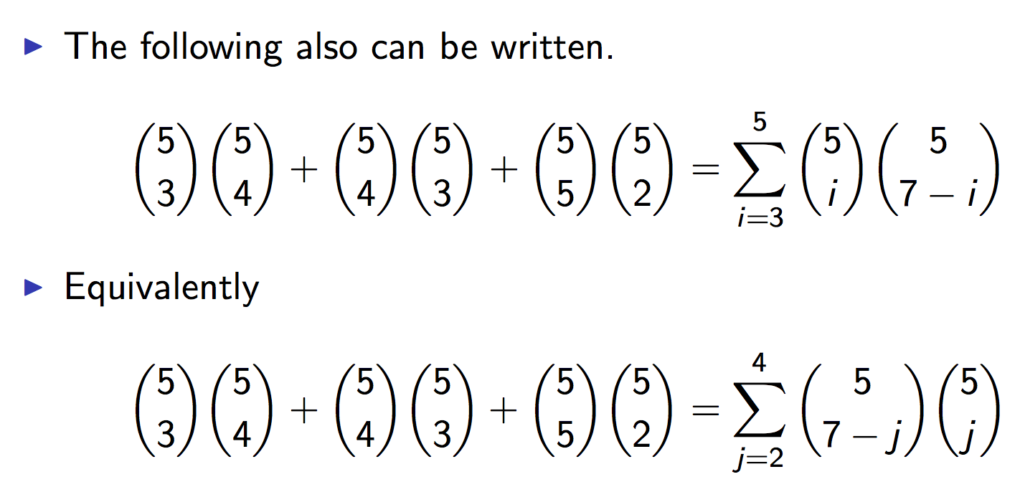
Concise way to write
We have substituted j = 7 – i in the second.
The range of j is now from 2 to 4.

Slide 64
Example

Slide 65
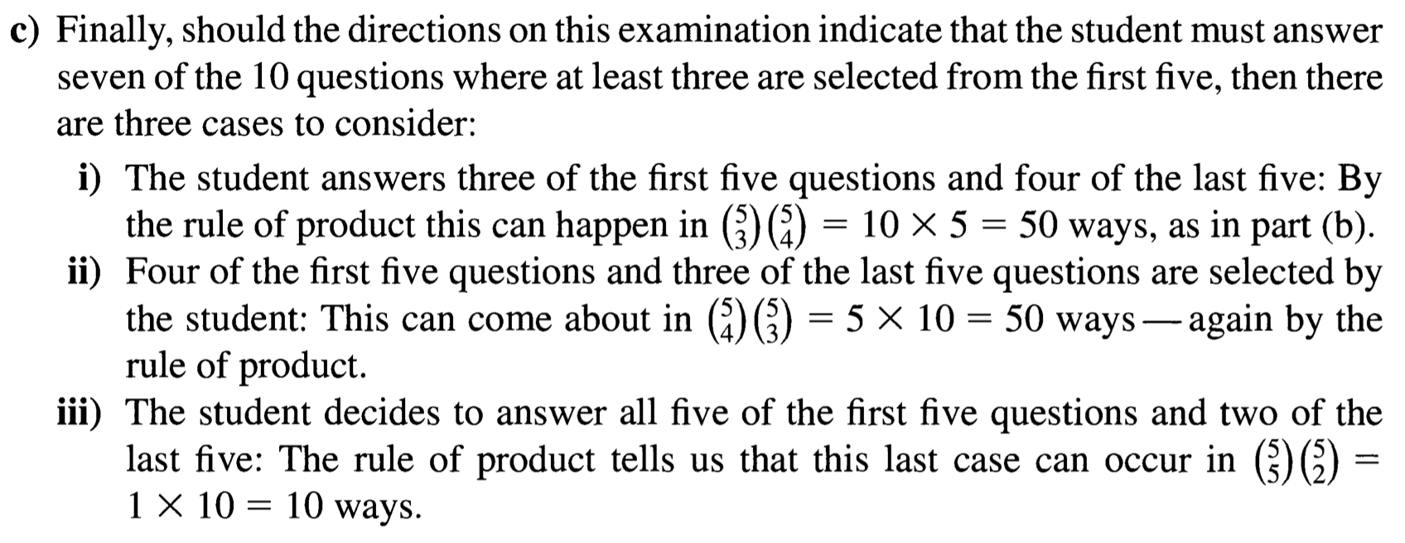
Example

Slide 66
Polynomial expansion
Consider (x + y)⁴ = x⁴ + 4 x³y + 6 x²y² + 4 xy³ + y⁴
To obtain the x⁴ term
Each time you multiple by (x+y), you select the x
Thus, of the 4 choices, you choose x 4 times
C(4,4) = 1
Alternatively, you choose y 0 times
C(4,0) = 1
To obtain the x³y term
Three of the times you multiply by (x+y), you select the x
The other time you select the y
Thus, of the 4 choices, you choose x 3 times
C(4,3) = 4
Alternatively, you choose y 1 time
C(4,1) = 4
To obtain the x²y² term
C(4,2) = 6

Slide 68
A binomial

Slide 69
The binomial Theorem

Slide 71
Binomial Theorem (Example)
Use the binomial theorem to find the coefficient of x⁶y³ in (3x-2y)⁹.
We can write (3x – 2y)⁹ as (a + b)⁹ where a = 3x and b = -2y. Now the coefficient of a⁶b³ is C(9,6).
Now C(9,6).a⁶b³ = C(9,6) (3x)⁶ (-2y)³ = - C(9,6)3⁶ 2³ x⁶y³.

Slide 72
For (a), set x = y = 1.
For (b), set x = 1, and y = -1.

Slide 73
Note that k is at least 1 and k cannot be greater than n.

Slide 74
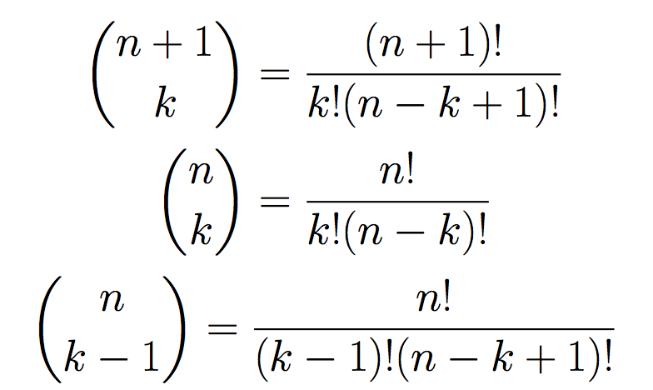
Proof 1 By definition
Important identity

Slide 75
Proof 2: Combinatorial
For any integers 1 ≤ k ≤ n,
C(n+1,k) = C(n,k-1) + C(n,k)
It says that number of size-k subset of a set with n+1 elements is equal to the sum of the number of size-(k-1) subset of a set of n elements and the number of size-k subset of a set of n elements.
Consider a set with n+1 elements.
A={0,1,2, …,n).
All subsets of A of size k
= All subsets of size k with element 0 in it
+ All subsets of size k with no element 0.
C(n+1,k) = C(n,k-1) + C(n,k).

Slide 76
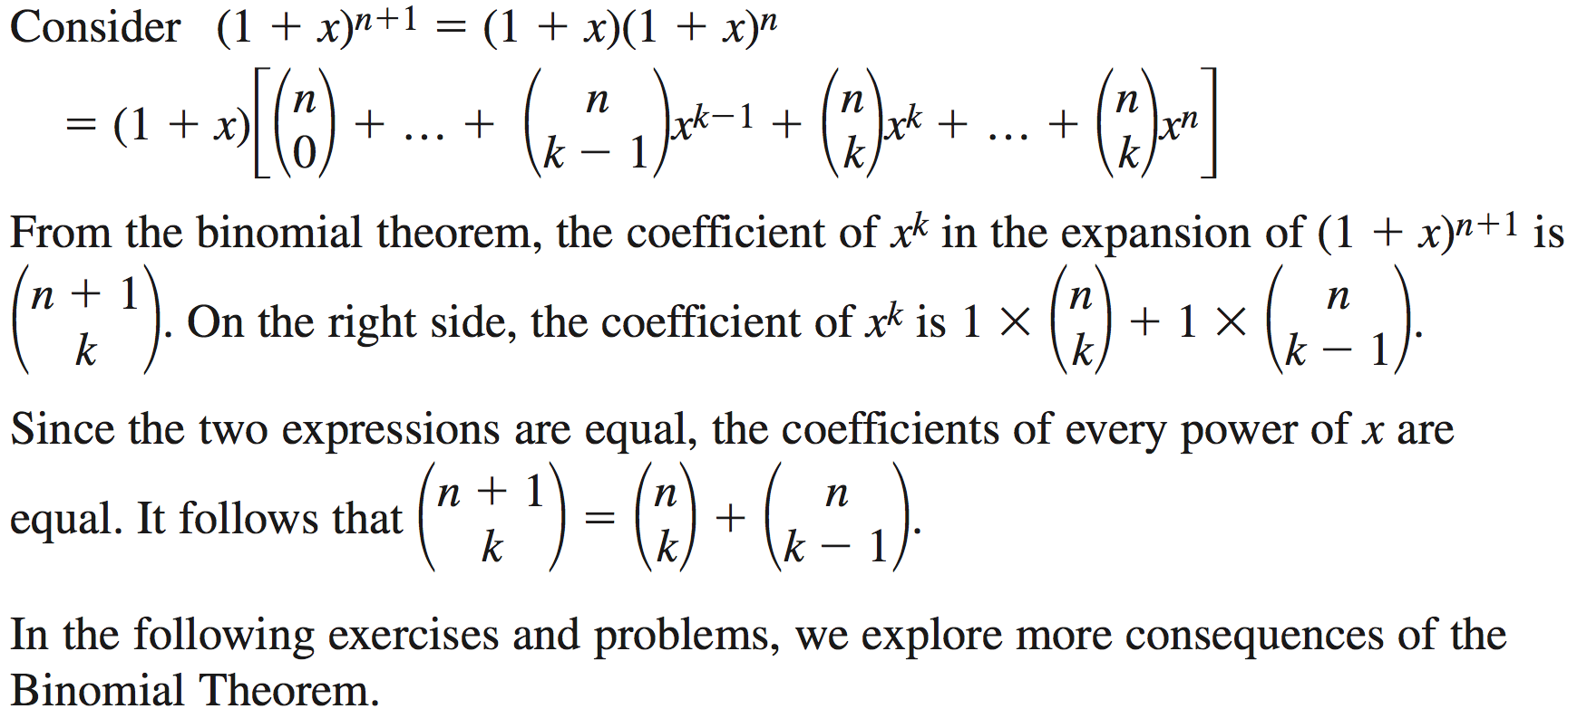
Proof 3: Combinatorial

Slide 77
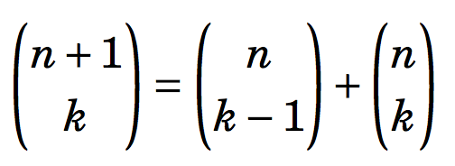
Pascal’s Triangle
We will focus on the pattern based on one equation (identity)
for any integers 1 ≤ n ≤ k.
For any integers 1 ≤ n ≤ k,
C(n+1,k) = C(n,k-1) + C(n,k)

Slide 78
Pascal’s Triangle
For any integers 1 ≤ k ≤ n,
C(n+1,k) = C(n,k-1) + C(n,k)
It says that number of size-k subset of a set with n+1 elements is equal to the sum of the number of size-(k-1) subset of a set of n elements and the number of size-k subset of a set of n elements.
Consider a set with n+1 elements.
A={0,1,2, …,n).
All subsets of A of size k
= All subsets of size k with element 0 in it
+ All subsets of size k with no element 0.
C(n+1,k) = C(n,k-1) + C(n,k).

Slide 79
Pascal’s Triangle and the Binomial Theorem
For any integers 1 ≤ k ≤ n,
C(n+1,k) = C(n,k-1) + C(n,k)
It says that number of size-k subset of a set with n+1 elements is equal to the sum of the number of size-(k-1) subset of a set of n elements and the number of size-k subset of a set of n elements.
Consider a set with n+1 elements.
A={0,1,2, …,n).
All subsets of A of size k
= All subsets of size k with element 0 in it
+ All subsets of size k with no element 0.
C(n+1,k) = C(n,k-1) + C(n,k).
Note that k is at least 1 and k cannot be greater than n.

Slide 81
Consequences of the Binomial Theorem
Write the binomial expansion of (x +2y)⁵ and (x – 2y)⁵.
How many terms are there in the expansion of (a +b)^{n}?
Determine the sum of the coefficients in the expansion of (1-4x)⁵.
In the expansion of (1-x)^{n}, the coefficient of x² is 15. Determine the value of n.
What is the middle term in the expansion of (x – 2x²)8?
Show that

