Slide 1
MACM 101 (Fall 2019)
Chapter 1
(Sections Covered: 1.1)

Slide 2
List of sections covered
Chapter 1 (Fundamental Principles of Counting)
  The rules of sum and product (1.1)

Slide 3
Combinatorics
Combinatorics, the study of arrangements of objects, is an important part of discrete mathematics.
Combinatorics are used in
  Discrete probability: What is the probability to guess a 6-symbols password in the first attempt?
  Analysis of algorithms:
    Why a comparison-based sorting algorithm cannot be more efficient than cnlogn for any constant c.
    What is the growth rate of the running time of an algorithm as the input size gets doubled? (We need to do this without writing a code!)

Slide 4
The Rule of Sum
If the first task can be performed in m ways, while a second task can be performed in n ways, and the two tasks cannot be performed simultaneously, performing either task can be accomplished in any one of m + n ways.

Slide 5
Example
A customer selects a drink. There are two categories of drinks: hot drinks and cold drinks. The hot drink selections are {coffee, tea, hot cocoa}. The cold drinks selections are {milk, orange juice}. How many possible ways can he order a drink?

Slide 6
Example
A customer selects a drink. There are two categories of drinks: hot drinks and cold drinks. The hot drink selections are {coffee, tea, hot cocoa}. The cold drinks selections are {milk, orange juice}. How many possible ways can he order a drink?
  Crucial observation: none of the drinks is categorized as both a hot drink or a cold drink.
  Ans: 3 + 2 = 5 (applying sum rule)

Slide 7
The Rule of Sum
Alternately
If a task can be done either in one of m ways and in one of n ways to do the second task, where none of the set of m ways is the same as any of the n ways, then there are m + n ways to do the task.

Slide 8
The Rule of Sum
Example
The mathematics department must choose either a student or a faculty member as a representative for a university committee. How many choices are there for this representative if there are 37 members of the mathematics faculty and 83 mathematics majors and no one is both a faculty member and a student.

Slide 9
The Rule of Sum
Example
The mathematics department must choose either a student or a faculty member as a representative for a university committee. How many choices are there for this representative if there are 37 members of the mathematics faculty and 83 mathematics majors and no one is both a faculty member and a student.
Solution: By the sum rule it follows that there are 37 + 83 = 120 possible ways to pick a representative.

Slide 10
The Rule of Sum
If the first task can be performed in m ways, while a second task can be performed in n ways, and the two tasks cannot be performed simultaneously, performing either task can be accomplished in any one of m + n ways.
Example: A deck of cards.
  How many ways can one draw a heart?
  How many ways can one draw a heart or a spade?
  .... a heart or a king of spade
  .... a king?
  .... a heart or a king?

Slide 11
The Rule of Sum
If the first task can be performed in m ways, while a second task can be performed in n ways, and the two tasks cannot be performed simultaneously, performing either task can be accomplished in any one of m + n ways.
Example: A deck of cards.
  How many ways can one draw a heart? (13 ways)
  How many ways can one draw a heart or a spade? (13 + 13 = 26 ways)
  .... a heart or a king of spade? (13 hearts or 1 king → 14 ways.)
  .... a king? (4 ways)
  .... a heart or a king? (13 hearts (includes 1 king) + 3 other kings = 14 ways)

Slide 12
The Rule of Product
If a task can be broken down into first stage and second stage, and if there are m possible outcomes for the first stage and if, for each of these outcomes, there are n possible outcomes, the total procedure can be carried out, in the designated order, in m.n ways.

Slide 13
Example
Consider a restaurant that has a breakfast special that includes a drink, a main course, and a side. The set of choices for each category are:
  drink: {coffee, orange juice}
  main course: {pancakes, eggs}
  side: {bacon, sausage, hash browns}
How many different breakfast choices are there?

Slide 14
Example
Consider a restaurant that has a breakfast special that includes a drink, a main course, and a side. The set of choices for each category are:
  drink: {coffee, orange juice}
  main course: {pancakes, eggs}
  side: {bacon, sausage, hash browns}
(coffee, pancakes, bacon) is one particular breakfast combination. (a triple is a breakfast choice)
Answer: 2 . 2. 3 = 12 (product rule)

Slide 15
The Rule of Product
Example: How many bit strings of length eight are there?
Solution:
10011101 is an 8-bit binary string.
Since each of the eight bits is either a 0 or a 1, the answer is 2⁸ = 256.

Slide 16
The Rule of Product
Example: How many different license plates can be made if each plate contains a sequence of three uppercase English letters followed by three digits?

Slide 17
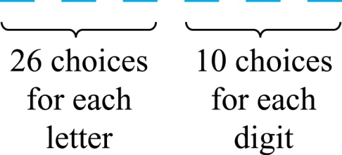
The Rule of Product
Example: How many different license plates can be made if each plate contains a sequence of three uppercase English letters followed by three digits?

Slide 18
The Rule of Product
Example: How many different license plates can be made if each plate contains a sequence of three uppercase English letters followed by three digits?
Solution: By the product rule,
there are 26 ∙ 26 ∙ 26 ∙ 10 ∙ 10 ∙ 10 = 17,576,000 different possible license plates.

Slide 19
The Rule of Product
Example: A new company with two employees rents a floor of a building with 12 offices. How many ways are there to assign different offices to these two employees?
  The office to the first employee can be done in 12 ways.
  After the first assignment, the office to the second employee can be assigned in 11 ways. By the product rule, there are 12.11 = 132 ways to assign 12 offices to two employees.
  A tuple (employee #1 office, employee #2 office) is an assignment.

Slide 20
Combining the sum and the product rule
Example: Suppose statement labels in a programming language can be either a single letter or a letter followed by a digit. Find the number of possible labels.
Solution: Use both the sum and the product rule.
26 + 26 ∙ 10 = 286

Slide 21
Basic Counting Principles: Subtraction Rule
Subtraction Rule: If a task can be done either in one of n₁ ways or in one of n₂ ways, then the total number of ways to do the task is n₁ + n₂ minus the number of ways to do the task that are common to the two different ways.

Slide 22
The Rule of Sum
Example: A deck of cards.
  How many ways can one draw a heart? (13 ways)
  How many ways can one draw a heart or a spade? (13 + 13 = 26 ways)
  .... a heart or a king of spade? (13 hearts or 1 king → 14 ways.)
  .... a king? (4 ways)
  .... a heart or a king? (13 hearts (includes 1 king) + 3 other kings)
  13 hearts + 4 Kings -1 King common

Slide 23
Combining the sum and the product rule
Combining the sum and product rule allows us to solve more complex problems.
Counting Passwords
Example: Each user on a computer system has a password, which is either seven or eight characters long, where each character is an uppercase letter or a digit. Each password must contain at least one digit. How many possible passwords are there?

Slide 24
Counting Passwords
Solution: Let P be the total number of passwords, and let P₇ and P₈ be the number of passwords of length 7 and 8 respectively.
  By the sum rule P = P₇ +P₈.

Slide 25
Counting Passwords
Solution: Let P be the total number of passwords, and let P₇ and P₈ be the number of passwords of length 7 and 8.
  By the sum rule P = P₇ +P₈.
  To find each of P₇ and P₈ , find the number of passwords of the specified length composed of letters and digits and subtract the number composed only of letters.

Slide 26
Counting Passwords
Solution: Let P be the total number of passwords, and let P₇ and P₈ be the number of passwords of length 7 and 8.
  By the sum rule P = P₇ +P₈.
  To find each of P₇ and P₈ , find the number of passwords of the specified length composed of letters and digits and subtract the number composed only of letters.
    .
  P₇ = 36⁷ − 26⁷ = 78,364,164,096 − 8,031,810,176 = 70,332,353,920.

Slide 27
Counting Passwords
Solution: Let P be the total number of passwords, and let P₇ and P₈ be the number of passwords of length 7 and 8.
  By the sum rule P = P₇ +P₈.
  To find each of P₇ and P₈ , find the number of passwords of the specified length composed of letters and digits and subtract the number composed only of letters.
    .
  P₇ = 36⁷ − 26⁷ = 78,364,164,096 − 8,031,810,176 = 70,332,353,920.
  P₈ = 36⁸ − 26⁸ = 2,821,109,907,456 − 208,827,064,576
  = 2,612,282,842,880.
  Consequently, P = P₇ +P₈ = 2,682,615,196,800.

Slide 28
Counting Passwords
    Why can we not compute P₇ as follows:
  P₇ = 36⁶ x 10 = 21,767,823,360

Slide 29
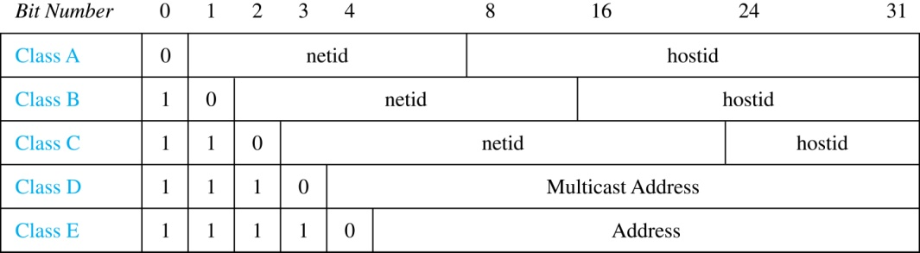
Internet Addresses
Version 4 of the Internet Protocol (IPv4) uses 32 bits.
Class A Addresses: used for the largest networks, a 0,followed by a 7-bit netid and a 24-bit hostid.
Class B Addresses: used for the medium-sized networks, a 10,followed by a 14-bit netid and a 16-bit hostid.
Class C Addresses: used for the smallest networks, a 110,followed by a 21-bit netid and a 8-bit hostid.
  Neither Class D nor Class E addresses are assigned as the address of a computer on the internet. Only Classes A, B, and C are available.
  1111111 is not available as the netid of a Class A network.
  Hostids consisting of all 0s and all 1s are not available in any network.

Slide 30
Counting Internet Addresses
Example: How many different IPv4 addresses are available for computers on the internet?

Slide 31
Counting Internet Addresses
Example: How many different IPv4 addresses are available for computers on the internet?
Solution: Use both the sum and the product rule. Let x be the number of available addresses, and let x_{A}, x_{B}, and x_{C} denote the number of addresses for the respective classes.
  To find, x_{A}: 2⁷ − 1 = 127 netids. 2²⁴ − 2 = 16,777,214 hostids.
  x_{A} = 127∙ 16,777,214 = 2,130,706,178.
  To find, x_{B}: 2¹⁴ = 16,384 netids. 2¹⁶ − 2 = 16,534 hostids.
  x_{B} = 16,384 ∙ 16, 534 = 1,073,709,056.
  To find, x_{C}: 2²¹ = 2,097,152 netids. 2⁸ − 2 = 254 hostids.
  x_{C} = 2,097,152 ∙ 254 = 532,676,608.
  Hence, the total number of available IPv4 addresses is
  x = x_{A} + x_{B} + x_{C}
  = 2,130,706,178 + 1,073,709,056 + 532,676,608
  = 3, 737,091,842.

Slide 32
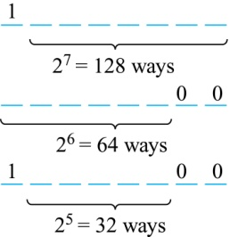
Counting Bit Strings
Example: How many bit strings of length eight either start with a 1 bit or end with the two bits 00?
Solution: Use the subtraction rule.
  Number of bit strings of length eight that start with a 1 bit: 2⁷ = 128
  Number of bit strings of length eight that end with bits 00: 2⁶ = 64
  Number of bit strings of length eight that start with a 1 bit and end with bits 00 : 2⁵ = 32
Hence, the number is 128 + 64 − 32 = 160.

Slide 33
Tree Diagrams
Tree Diagrams: We solve many counting problems through the use of tree diagrams, where a branch represents a possible choice and the leaves represent possible outcomes.
Example: Suppose that “I Love Discrete Math” T-shirts come in five different sizes: S,M,L,XL, and XXL. Each size comes in four colors (white, red, green, and black), except XL, which comes only in red, green, and black, and XXL, which comes only in green and black. What is the minimum number of shirts that the campus book store needs to stock to have one of each size and color available?

Slide 34
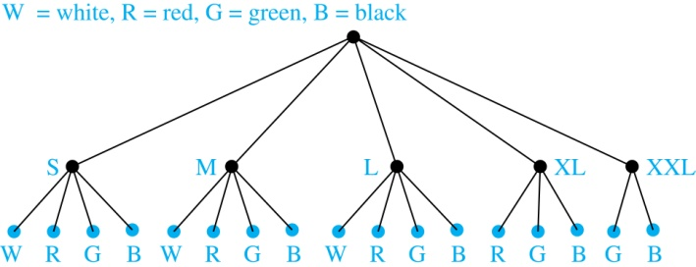
Tree Diagrams
Example: Suppose that “I Love Discrete Math” T-shirts come in five different sizes: S,M,L,XL, and XXL. Each size comes in four colors (white, red, green, and black), except XL, which comes only in red, green, and black, and XXL, which comes only in green and black. What is the minimum number of shirts that the campus book store needs to stock to have one of each size and color available?
Solution: Draw the tree diagram.
The store must stock 17 T-shirts.

Slide 35
What we know so far ….
Two sets of independent tasks
  task 1 has m choices (A)
  task 2 has n choices (B)
Rule of Sum
  How many ways to pick a task from A or a task from B? (m+n ways)
Rule of Product
  How many ways to pick a task from A and a task from B? (m.n ways)

Slide 36
Counting Lists
A list is an ordered sequence of objects.
  Top 10 movies: A list of 10 movies which can be represented as (name 1, name 2, …, name 10).
  The objects are ordered.
  i^{th} element of the list is the i^{th} object.
  (a,b) list different than (b,a).
  The number of elements in the list is called its length.

Slide 37
Counting Lists
Consider two sets:
  m = number of MACM 101 students in the class;
  n = number of possible grades ;
Consider a list with two objects: (name, grade) where the first object is name, and the second object is grade.
How many possible different 2-tuples are possible?
The number is mn.

Slide 38
Counting Lists
Suppose we want to make a list of length three having the property that
  the first entry must be an element of the set {a,b,c} (p = 3 choices),
  the second entry must be in {5,7} (q = 2 choices) and
  the third entry must be in C={a,x} (r = 2 choices).
How many such lists altogether?
Again it is p x q x r.
How do we generate these lists systematically?

Slide 39
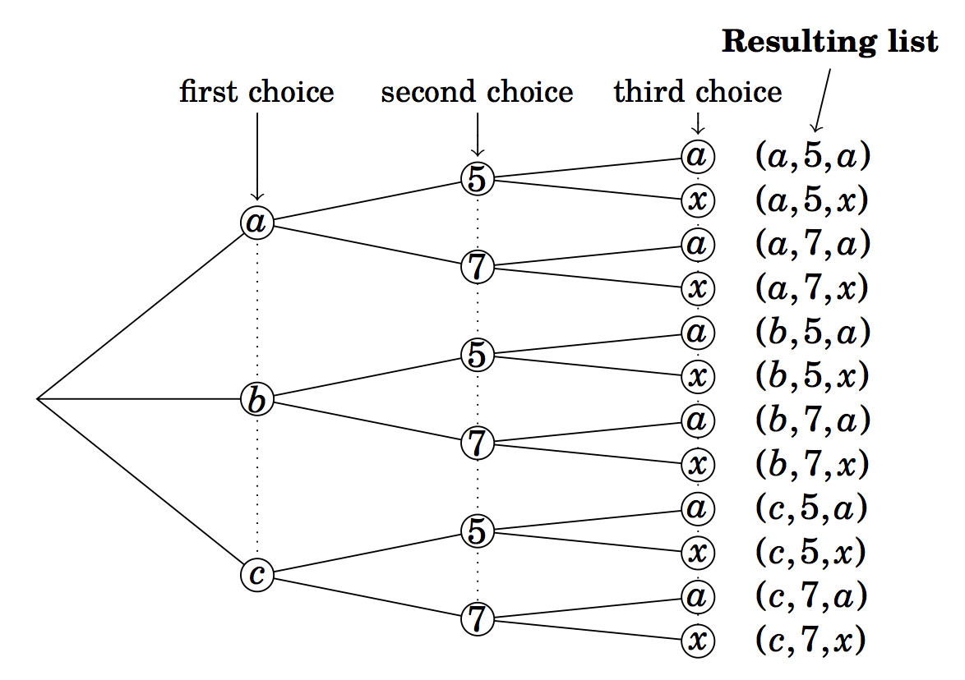
Counting Lists (tree diagram)
Constructing lists of length three:

Slide 40
Example
In BC, the license plate of a car has either three letters followed by three digits, or 3 digits followed by three letters. For example ABC007, 007ABC are two standard license plates. How many different license plates are possible?
  Note that any license plates such as ABC007 corresponds to a length-6 list (A, B, C, 0, 0, 7).
  # of license plates of the type (letter,letter,letter, digit,digit,digit) is 26 x 26 x 26 x 10 x 10 x 10

Slide 41
Example
In BC, the license plate of a car has either three letters followed by three digits, or 3 digits followed by three letters. For example ABC007, 007ABC are two standard license plates. How many different license plates are possible?
  Note that any license plates such as ABC007 corresponds to a length-6 list (A, B, C, 0, 0, 7).
  # of license plates of the type (letter,letter,letter, digit,digit,digit) is 26 x 26 x 26 x 10 x 10 x 10
  # of license plates of the type
  (digit,digit,digit,letter,letter,letter) is 10 x 10 x 10 x 26 x 26 x 26

Slide 42
Example
In BC, the license plate of a car has either three letters followed by three digits, or 3 digits followed by three letters. For example ABC007, 007ABC are two standard license plates. How many different license plates are possible?
  Note that any license plates such as ABC007 corresponds to a length-6 list (A, B, C, 0, 0, 7).
  # of license plates of the type (letter,letter,letter, digit,digit,digit) is 26 x 26 x 26 x 10 x 10 x 10
  # of license plates of the type
  (digit,digit,digit,letter,letter,letter) is 10 x 10 x 10 x 26 x 26 x 26
  Total = 2 x 26 x 26 x 26 x 10 x 10 x 10

Slide 43
Example
Consider making lists from the symbols A, B, C, D, E, F, G
  How many length-4 lists are possible if repetition is allowed (i.e. a symbol may appear more than once)?
  How many length-4 lists are possible if repetition is not allowed?
  How many length-4 lists are possible if repetition is not allowed and the list must contain an E?
  How many length-4 lists are possible if repetition is allowed and the list must contain an E?

Slide 44
Example
Consider making lists from the symbols A, B, C, D, E, F, G
  How many length-4 lists are possible if repetition is allowed (i.e. a symbol may appear more than once)?
  Ans:

Slide 45
Example
Consider making lists from the symbols A, B, C, D, E, F, G
  How many length-4 lists are possible if repetition is allowed (i.e. a symbol may appear more than once)?
  Ans:
  There are 7 choices for each position of the list. Therefore, the number of length-4 lists in this case is 7 x 7 x 7 x 7.

Slide 46
Example
Consider making lists from the symbols A, B, C, D, E, F, G
  (b) How many length-4 lists are possible if repetition is not allowed?
  Ans

Slide 47
Example
Consider making lists from the symbols A, B, C, D, E, F, G
  (b) How many length-4 lists are possible if repetition is not allowed?
  Ans
  Here repetition is not allowed.
  Note that once the letter for position one of the list is chosen, the same letter cannot be chosen again.
  Thus the choice for the first position is 7, and the choice for the second position is 6.
  Once the second position of the list is filled, there only 5 choices for the third position of the list.
  Therefore, the total number length-4 lists is 7 x 6 x 5 x 4

Slide 48
Example
Consider making lists from the symbols A, B, C, D, E, F, G
  (c) How many length-4 lists are possible if repetition is not allowed and the list must contain an E?
  Ans:

Slide 49
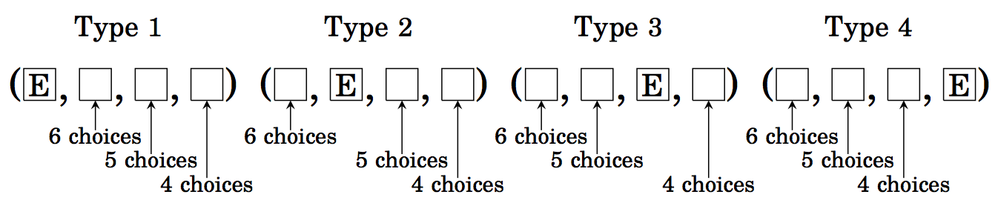
Example
Consider making lists from the symbols A, B, C, D, E, F, G
  (c) How many length-4 lists are possible if repetition is not allowed and the list must contain an E?
  Ans: There are four types of lists depending on whether E occurs as the first, second, third or fourth entry. These four types are shown below.

Slide 50
Example
Consider making lists from the symbols A, B, C, D, E, F, G
  (c) How many length-4 lists are possible if repetition is not allowed and the list must contain an E?
  Ans: There are four types of lists depending on whether E occurs as the first, second, third or fourth entry. These four types are shown below.
  Total # =(6 x 5 x 4) + (6 x 5 x 4) + (6 x 5 x 4) + (6 x 5 x 4)

Slide 51
Example
Consider making lists from the symbols A, B, C, D, E, F, G
  (d) How many length-4 lists are possible if repetition is allowed and the list must contain an E?
  Ans:

Slide 52
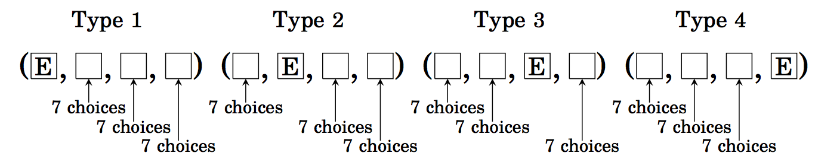
Example
Consider making lists from the symbols A, B, C, D, E, F, G
  (d) How many length-4 lists are possible if repetition is allowed and the list must contain an E?
  Ans: Again there are four types of lists.
  The total number of lists is 4 x 7⁴ = 1372.

Slide 53
Example
Consider making lists from the symbols A, B, C, D, E, F, G
  (d) How many length-4 lists are possible if repetition is allowed and the list must contain an E?
  Ans: Again there are four types of lists.
  The total number of lists is 4 x 7⁴ = 1372 which is substantially larger than the correct value of 1105.

Slide 54
Example
Consider making lists from the symbols A, B, C, D, E, F, G
  (d) How many length-4 lists are possible if repetition is allowed and the list must contain an E?
  Ans: Again there are four types of lists.
  The total number of lists is 4 x 7⁴ = 1372 which is substantially larger than the correct value of 1105.
  Note: The list (E,A,E,C,D) is counted twice, one as a type 1 and one as a type 3. Similarly (E,E,E,E) is counted 4 times.

Slide 55
Example
Consider making lists from the symbols A, B, C, D, E, F, G
  (d) How many length-4 lists are possible if repetition is allowed and the list must contain an E?
  Ans: Again there are four types of lists.
  The total number of lists is 4 x 7⁴ = 1372 which is substantially larger than the correct value of 1105.
  Note: The list (E,A,E,C,D) is counted twice, one as a type 1 and one as a type 3. Similarly (E,E,E,E) is counted 4 times.
Need to think it differently

Slide 56
Example
Consider making lists from the symbols A, B, C, D, E, F, G
  (d) How many length-4 lists are possible if repetition is allowed and the list must contain an E?
  Ans: Correct thinking:

Slide 57
Example
Consider making lists from the symbols A, B, C, D, E, F, G
  (d) How many length-4 lists are possible if repetition is allowed and the list must contain an E?
  Ans: Correct thinking:
  We know that the number of length-4 lists with repetitions is 7⁴.

Slide 58
Example
Consider making lists from the symbols A, B, C, D, E, F, G
  (d) How many length-4 lists are possible if repetition is allowed and the list must contain an E?
  Ans: Correct thinking:
  We know that the number of length-4 lists with repetitions is 7⁴.
  There are many lists which contain no E. We subtract these lists (containing no E) from 7⁴ to obtain the number of lists that contain at least one E.
  There are 6⁴ lists that do not have an E.

Slide 59
Example
Consider making lists from the symbols A, B, C, D, E, F, G
  (d) How many length-4 lists are possible if repetition is allowed and the list must contain an E?
  Ans: Correct thinking:
  We know that the number of length-4 lists with repetitions is 7⁴.
  There are many lists which contain no E. We subtract these lists (containing no E) from 7⁴ to obtain the number of lists that contain at least one E.
  There are 6⁴ lists that do not have an E.
  Therefore there are 7⁴ – 6⁴ = 1105 lists with repetition allowed that contain at least one E.

Slide 60
Example
Consider making lists from the symbols A, B, C, D, E, F, G
  (d) How many length-4 lists are possible if repetition is allowed and the list must contain an E?
  Ans: Correct thinking:
  We know that the number of length-4 lists with repetitions is 7⁴.
  There are many lists which contain no E. We subtract these lists (containing no E) from 7⁴ to obtain the number of lists that contain at least one E.
  There are 6⁴ lists that do not have an E.
  Therefore there are 7⁴ – 6⁴ = 1105 lists with repetition allowed that contain at least one E.
In solving counting problems, we must always be careful to avoid this kind of multiple counting.

Slide 61
Examples
Five cards are dealt off of a standard 52-card deck and lined up in a row. How many such line ups are there in which all 5 cards are of the same suit?
Ans:

Slide 62
Examples
Five cards are dealt off of a standard 52-card deck and lined up in a row. How many such line ups are there in which all 5 cards are of the same suit?
Ans: There are 4 suites: club, diamond, heart and spade. Each suite has 13 cards.
  how many rows (lists) of 5-card club suite?

Slide 63
Examples
Five cards are dealt off of a standard 52-card deck and lined up in a row. How many such line ups are there in which all 5 cards are of the same suit?
Ans: There are 4 suites: club, diamond, heart and spade. Each suite has 13 cards.
  how many rows (lists) of 5-card club suite?
    first element has 13 choices
    second element has 12 choices
    third element has 11 choices
    fourth element has 10 choices
    fifth element has 9 choices.

Slide 64
Examples
Five cards are dealt off of a standard 52-card deck and lined up in a row. How many such line ups are there in which all 5 cards are of the same suit?
Ans: There are 4 suites: club, diamond, heart and spade. Each suite has 13 cards.
  how many rows (lists) of 5-card club suite?
    first element has 13 choices
    second element has 12 choices
    third element has 11 choices
    fourth element has 10 choices
    fifth element has 9 choices.
  number of 5-card lists of club suites = 13.12.11.10.9
  number of 5-card lists of four suites= 4.13.12.11.10.9

Slide 65
Examples
This problem concerns list made from the letters A, B, C, D, E, F, G, H, I, J.
  How many length-5 lists can be made from these letters if repetition is not allowed, and the list must begin with a vowel?
  How many length-5 lists can be made from these letters if repetition is not allowed, and the list must begin and end with a vowel?
  How many length-5 lists can be made from these letters if repetition is not allowed, and the list must contain exactly one A.

Slide 66
Examples
This problem concerns list made from the letters A, B, C, D, E, F, G, H, I, J.
  How many length-5 lists can be made from these letters if repetition is not allowed, and the list must begin with a vowel?
  Ans: There are 3 vowels in the given letters: A, E and I.
    There are three types of lists we need to count. One type that starts with A, the other two types that start with E and I.
    Lists that start with A: Since no repetition is allowed, there are 9 choices for position 2, 8 choices for position 3, 7 choices for position 4 and 6 choices for position 5.
    Total number of lists for this type: 9.8.7.6
    Total number of lists of all types: 3x(9.8.7.6)

Slide 67
Examples
This problem concerns list made from the letters A, B, C, D, E, F, G, H, I, J.
  How many length-5 lists can be made from these letters if repetition is not allowed, and the list must begin and end with a vowel?

Slide 68
Example
This problem concerns list made from the letters A, B, C, D, E, F, G, H, I, J.
  How many length-5 lists can be made from these letters if repetition is not allowed, and the list must begin and end with a vowel?
  Ans: There are six types lists: one starts with A and ends with E.; one starts with A and ends in I; one starts with E and ends with A; one starts with E and ends with I; one starts with I and ends with A; and one starts with I and ends with E.
    Lists that starts with A and ends in E: the choices for positions 2, 3, 4 are 8, 7, 6 respectively. Total such lists is 8.7.6.
    Total number of lists of all types is 6x(8.7.6)
Note that 6 types of lists come from the fact there are 3 vowels enumerating lists with 2 positions.

Slide 69
Example
This problem concerns list made from the letters A, B, C, D, E, F, G, H, I, J.
  How many length-5 lists can be made from these letters if repetition is not allowed, and the list must contain exactly one A.
  Very similar to a problem solved earlier.

Slide 70
Acknowledgement
I have taken materials from the following sources:
  Textbook
  “Book of Proof” by Richard Hammock
    http://www.people.vcu.edu/~rhammack/BookOfProof/
  Lecture notes slides prepared by Prof. Bulatov.
  www.cs.sfu.ca/CC/101/101.MACM/abulatov/#lec
  Lecture notes slides prepared by Prof. Grunschlag
  www.cs.columbia.edu/~zeph/3203s04/lectures.html

