Slide 1
Placing balls in bins

Slide 2
Acknowledgement
I have used materials from the following sources:
Textbook
Lecture notes slides prepared by Prof. Bulatov.
www.cs.sfu.ca/CC/101/101.MACM/abulatov/#lec
Lecture notes slides prepared by Prof. Grunschlag
www.cs.columbia.edu/~zeph/3203s04/lectures.html
“Book of Proof” by Richard Hammock
http://www.people.vcu.edu/~rhammack/BookOfProof/

Slide 3
Problem of balls in bins
Count the number of ways to place a collection A of m ≥ 1 balls into a collection B of n bins, n ≥ 1.
Balls are labeled (distinguishable) or unlabeled (indistinguishable)
Bins are labeled (distinguishable) or unlabeled (indistinguishable)
Placement is either unrestricted, injective (one-to-one) or surjective (onto)
We thus have 12 cases. However, we will ignore the situation when both the balls and the bins are unlabeled. Thus, effectively we will consider the other 9 case.

Slide 4
Some questions to think about
Can you interpret the problem in another way?
Is there a closed formula?
Is there a recursive formula?
Over what values of m and n do these formula hold?
What are some related problems?

Slide 5
What do we know from our earlier studies?
The number of integer solutions to x₁+x₂+ …….. + x_{n} = m when
C(n+m-1,n-1) is also the number of combinations of selecting m elements with repetitions from a set of n objects.
This is the same problems as the problem of distributing m pennies to n kids.

Slide 6
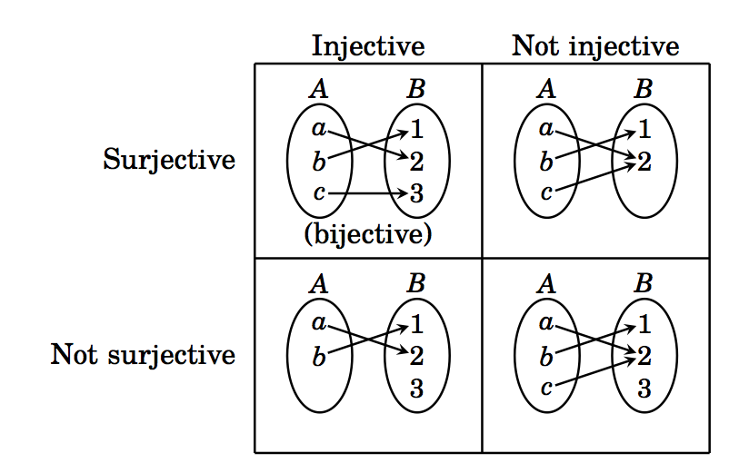
What do we know from our earlier studies?
The four types of functions f: A → B where |A|=m & |B|=n:
Figure 1

Slide 7
9 cases

Slide 8
A: m labeled balls; B: n labeled bins; Unrestricted placements
Interpretations:
Count the number of functions f: A → B.
We get one-to-one matching of ball placements and function f by placing ball i into bin j iff f(i)=j.
Formula
Let g(m,n) denote the number of placements. Then g(m,n)=n^{m}.
When n=2, g(m,n)=2^{m}. This number is the same as the number of binary strings of length m.
2^{m} is also the number of subsets of A.

Slide 9
A: m labeled balls; B: n labeled bins; one-to-one placements (injective)
Interpretations:
Counts the number of injective functions f: A → B.
Formula
Let g(m,n) denote the number of placements. Then g(m,n)=n(n-1)(n-2)….(n-m+1) = P(m,n).
When m > n, g(m,n)=0.
Additional comments:
g(m,n)=n! when |A|=|B|. This function g on A is called a permutation.
The Pigeonhole Principle states that there is no injection (one-to-one mapping) if m > n: for any function in such a case, there must be at least one bin (pigeonhole) with at least two balls (pigeons).

Slide 10
A: m labeled balls; B: n labeled bins; onto placements (surjective)
Interpretations:
Count the number of surjective (onto) functions f: A → B.
Formula
Let denote the number of placements. Then
Recursive formula:
Additional comments:
Why does this work? n^{m} is the number of functions. We then remove the number of onto functions whose range has n-1 elements; n-2 elements; etc.

Slide 11
A: m unlabeled balls; B: n labeled bins; unrestricted placements
Interpretations:
The number of integer solutions to x₁+ … +x_{n}=m, x_{i} ≥ 0.
Distributing n pennies to m kids, a kid may get 0 penny
Counts the number of ways of writing m as a sum of n nonnegative integers where different orderings are counted as different.
Let g(m,n) denote the number of placements. Then
Related problems:
Counts the number of multisets of {1, 2, …, n} of size m.

Slide 12
A: m unlabeled balls; B: n labeled bins; one-to-one placements
Interpretations:
Counts the number of subsets of {1,2, …, n} of size m.
Let g(m,n) denote the number of placements. Then
g(m,n) =
Recursive formula

Slide 13
A: m unlabeled balls; B: n labeled bins; onto placements
Interpretations:
The number of integer solutions to x₁+ … +x_{n}=m, x_{i} ≥ 1.
Distributing n pennies to m kids, a kid may get at least 1 penny
Counts the number of ways of writing m as a sum of n positive integers where different orderings are counted as different.
Let g(m,n) denote the number of placements. Then g(m,n) =

Slide 14
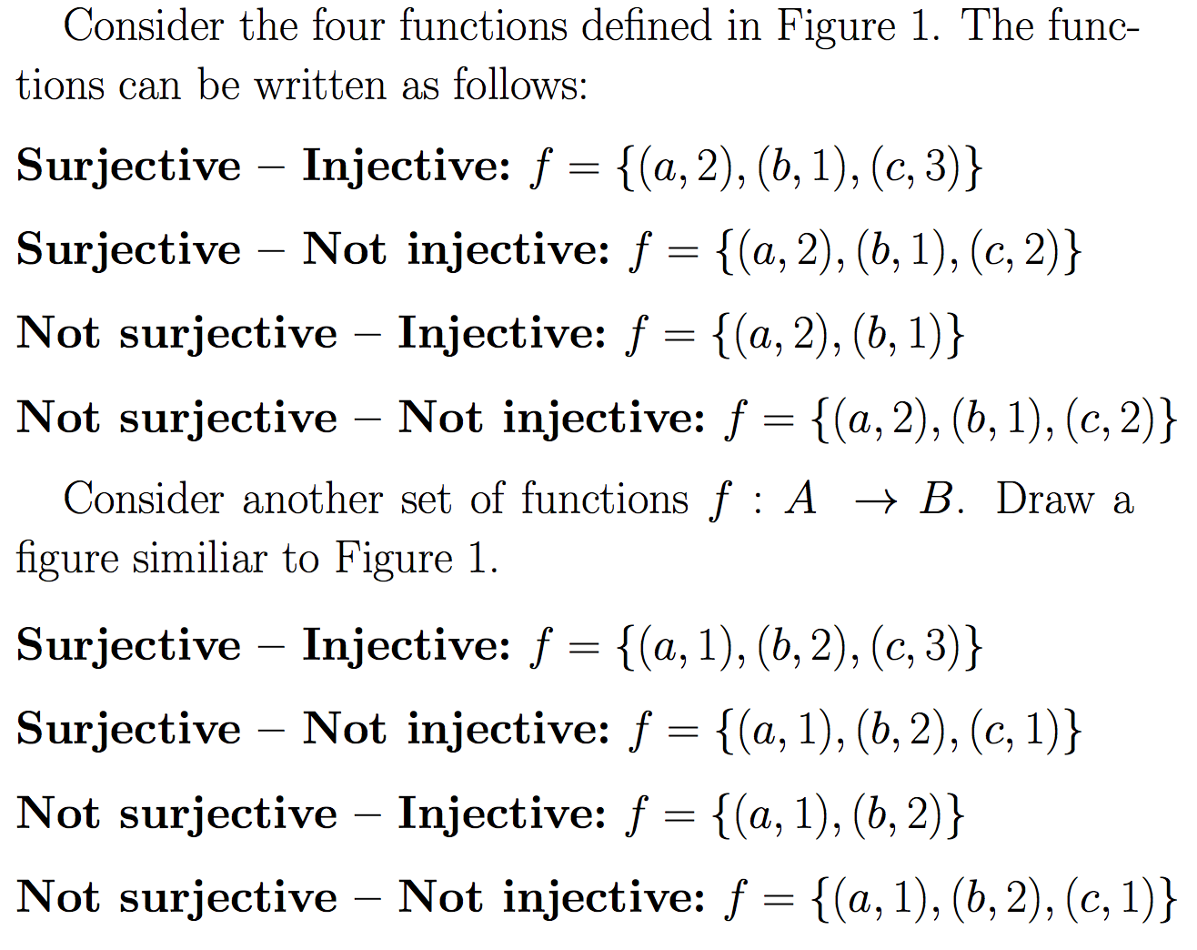
A: m labeled balls; B: n unlabeled bins; unrestricted placements
Interpretations:

Slide 15
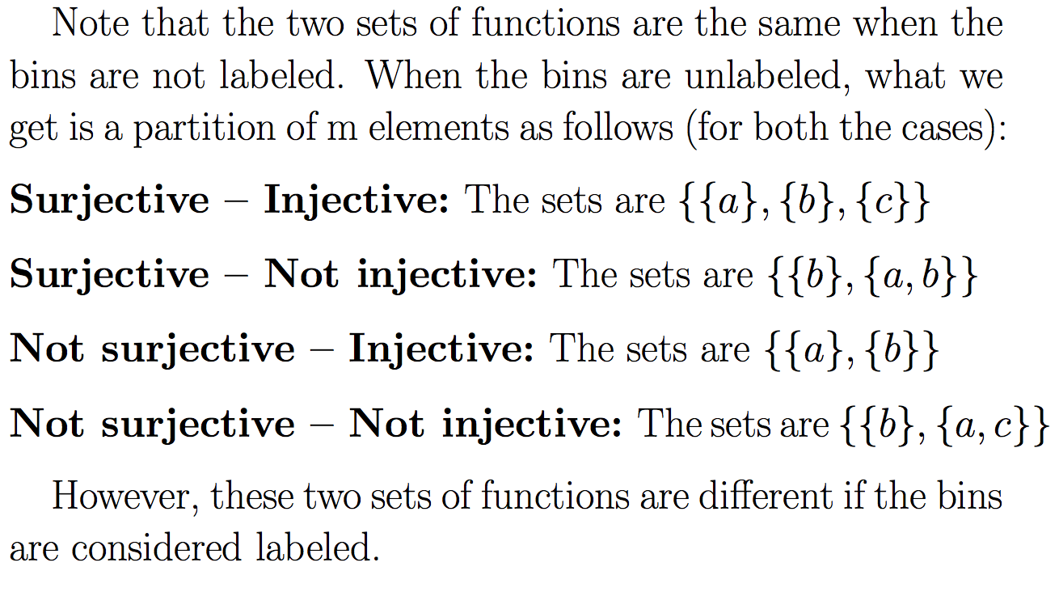
A: m labeled balls; B: n unlabeled bins; unrestricted placements (contd)
Interpretations (continued):
{a, c}

Slide 16
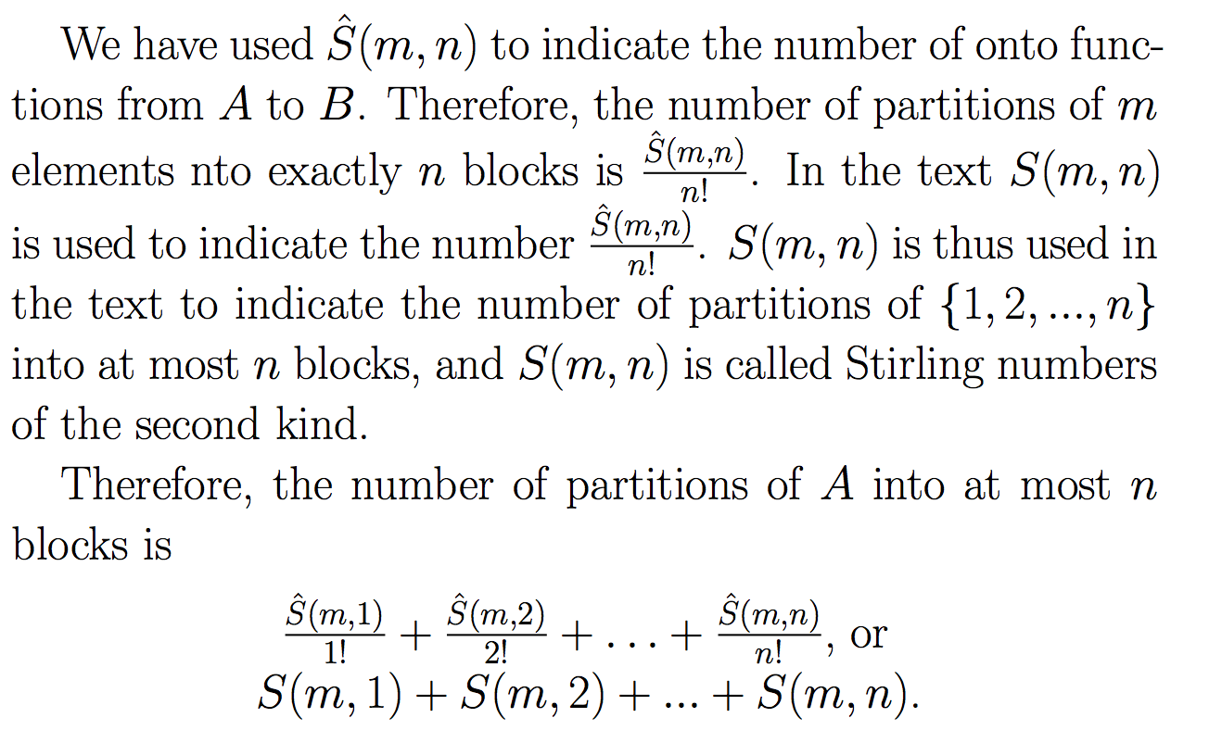
A: m labeled balls; B: n unlabeled bins; unrestricted placements (contd)
Formula:

Slide 17
A: m labeled balls; B: n unlabeled bins; one-to-one placements (contd)
Interpretation: Either you can do it (when m ≤ n) or you cannot do it when m > n.
Count = 1 when m ≤ n, otherwise it is zero

Slide 18
A: m labeled balls; B: n unlabeled bins; onto placements
Interpretations:
Counts the number of partitions of {1,2, …, m} into exactly n nonempty blocks.
Formula: S(m,n) =

