Slide 1
CMPT 307 Data Structures and Algorithms
Binay Bhattacharya
Introduction

Slide 2
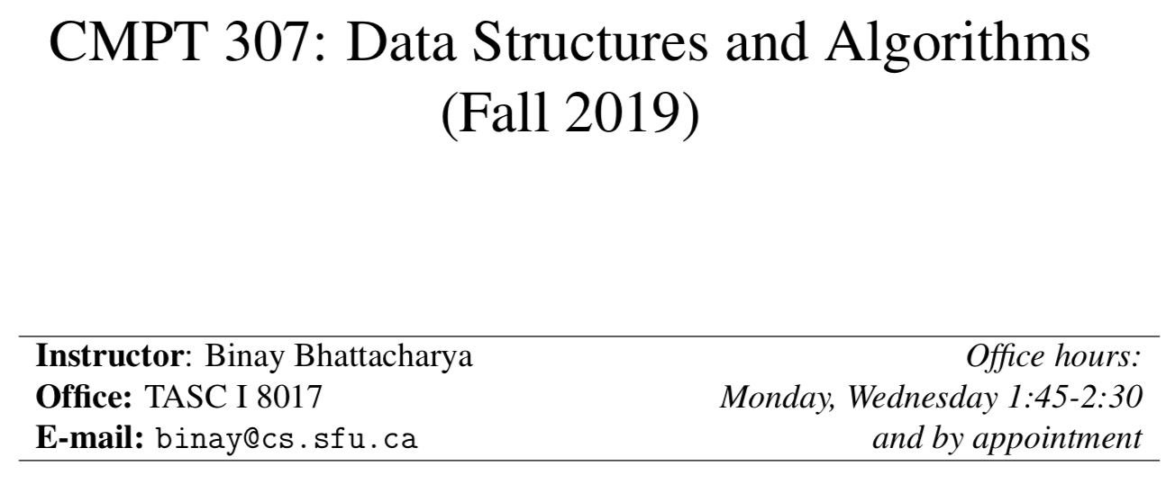

Slide 3
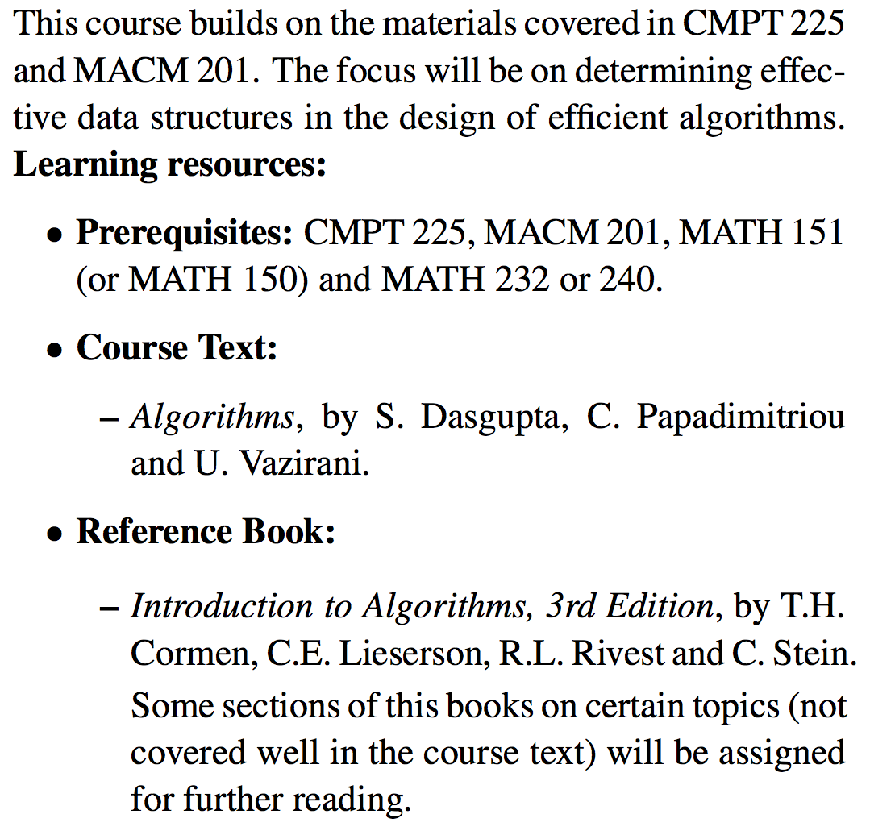

Slide 5
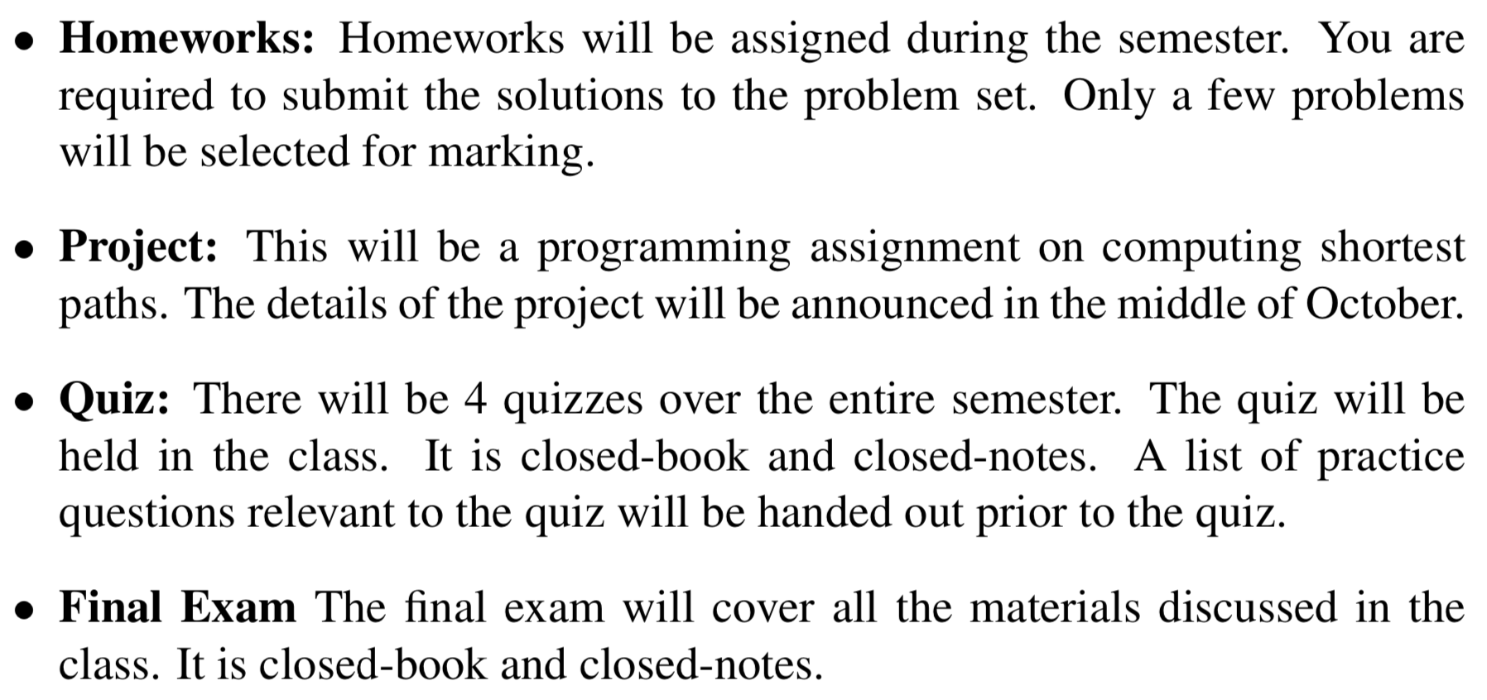
Activities

Slide 6
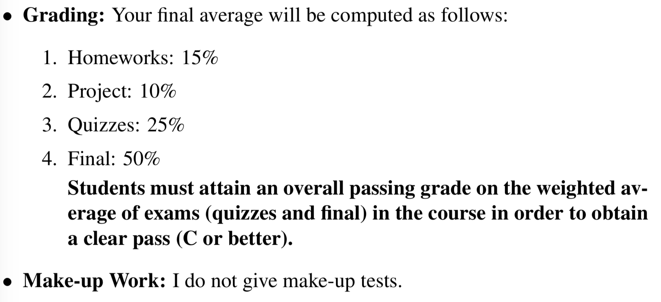

Slide 7
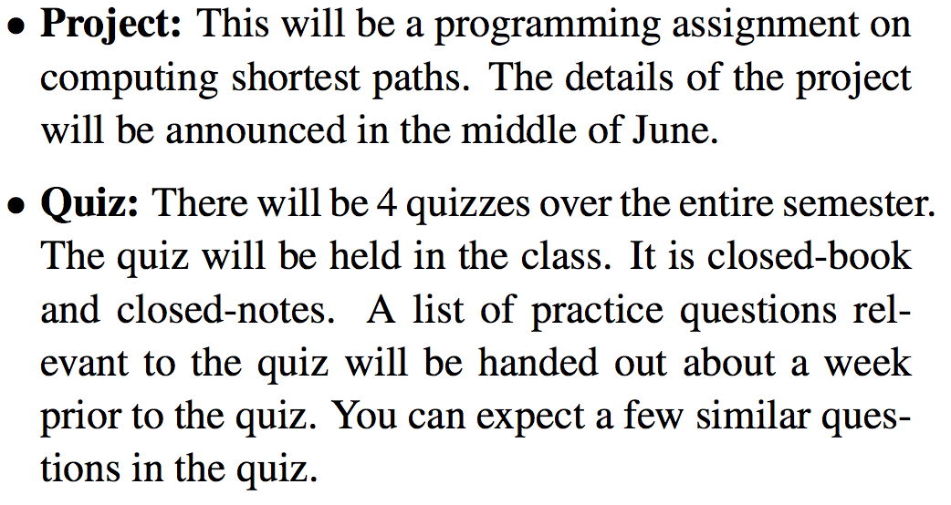

Slide 8
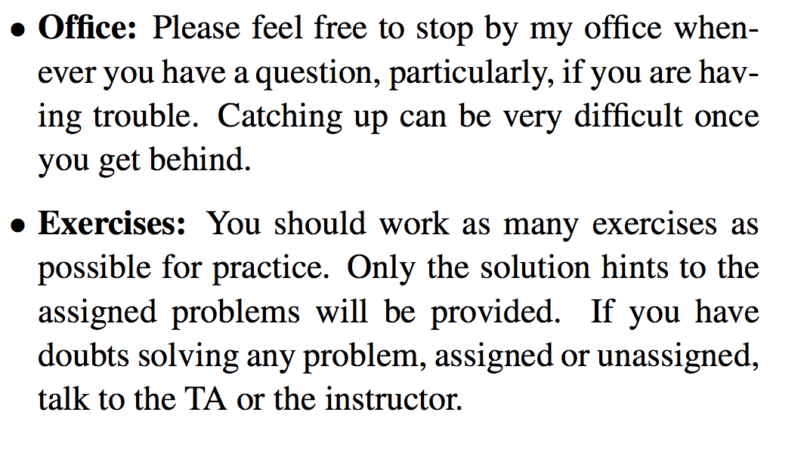

Slide 9
Topics Covered in CMPT 225
Stacks
allows items to be inserted and removed at one end.
the end is called top of the stack
the other end is called the bottom
elements other than the top element are not accessible
can be represented by an array or a linked list
last-in-first-out (LIFO) data structures
Queues
allows items to be inserted at the back and removed from the front
the front and the back elements are only accessible
other elements are not accessible
can be represented by an array or a linked list.
first-in-first-out (FIFO) data structures.

Slide 10
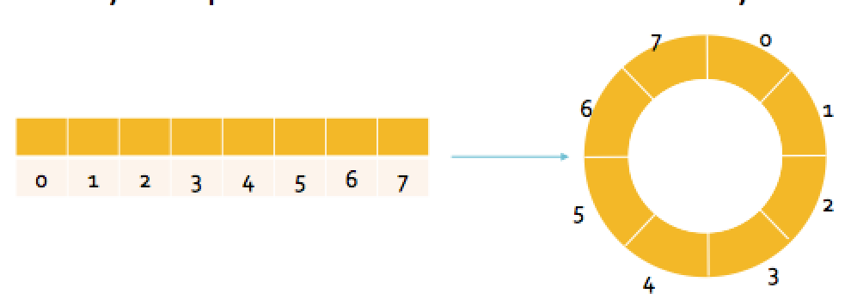
Some Generalizations of Queues
Circular array implementation
Dequeue
allows insertion and deletion from both ends.

Slide 11
Recursions
Recursion is similar to induction
Recursion solves a problem by
specifying a solution for the base case
using a recursive case to derive solutions of any size from solutions to smaller problems
Induction proves a property by
proving it is true for the base case
proving it is true for some number, n, if it is true for all numbers less than n

Slide 12
Recursions (contd.)
Identify recursive algorithms
Write simple recursive algorithms
Understand recursive function calling
With reference to the call stack
Compute the result of simple recursive algorithms
Understand the drawbacks of recursion
Analyze the running times of recursive functions
Covered in the O Notation section

Slide 13
Recursions (contd.)
Fibonacci sequence
Sorting
mergesort
quicksort
Binary search

Slide 14
Searching data sets
Would like to to store data items for frequent search
student id is used to locate a student
there are 25000 students currently enrolled
the ids are stored in a table
table size shouldn’t be too large, should be comparable to the size of the student body.
Store the table in an array
new items can be added quickly
look up needs linear time

Slide 15
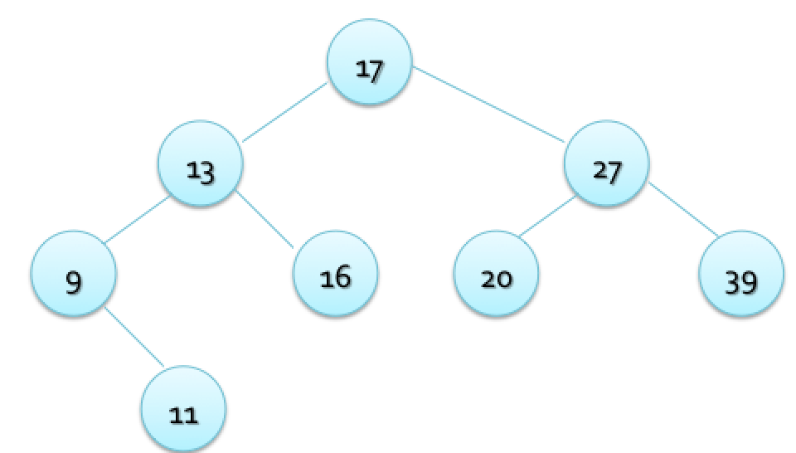
Binary Search Tree
Store the table in a binary search tree
lookup and insertion need time proportional to the height of the tree.

Slide 16
Hash Table
Hash table allows lookup and insertion in time not dependent on the size of the table (i.e. constant time) on an average.
a hash table consists of an array to store data
one attribute of the object is used as a table key
a hash function maps a key to an array index

Slide 17
Priority Queues
Items in a priority queue have a priority
The highest/lowest priority item is removed first
Priority queue operations
insert
remove in priority queue order

Slide 18
Heaps
Heaps are priority queues.
A heap is a binary tree with two properties
it is partially ordered
it has a heap structure
Cost of inserting an element of removing an element cost time proportional to the height of the tree
A heap can be implemented in an array (a very efficient representation)
Heapsort algorithm is designed to sort n elements use heaps

Slide 19
Introduction to graphs
Graph terminologies : vertex/nodes, edges
Representation of graphs
adjacency lists
adjacency matrices
Perform graph searches
depth first
breadth first
Perform shortest-path algorithm
Dijkstra’s algorithm

Slide 20
Four Representative Problems

Slide 21
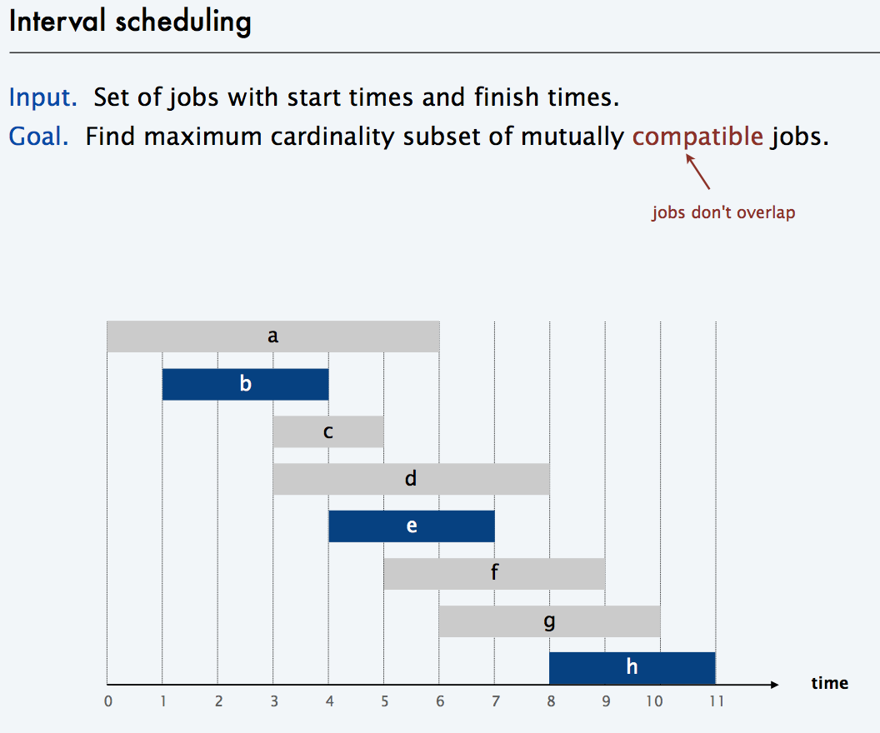

Slide 22
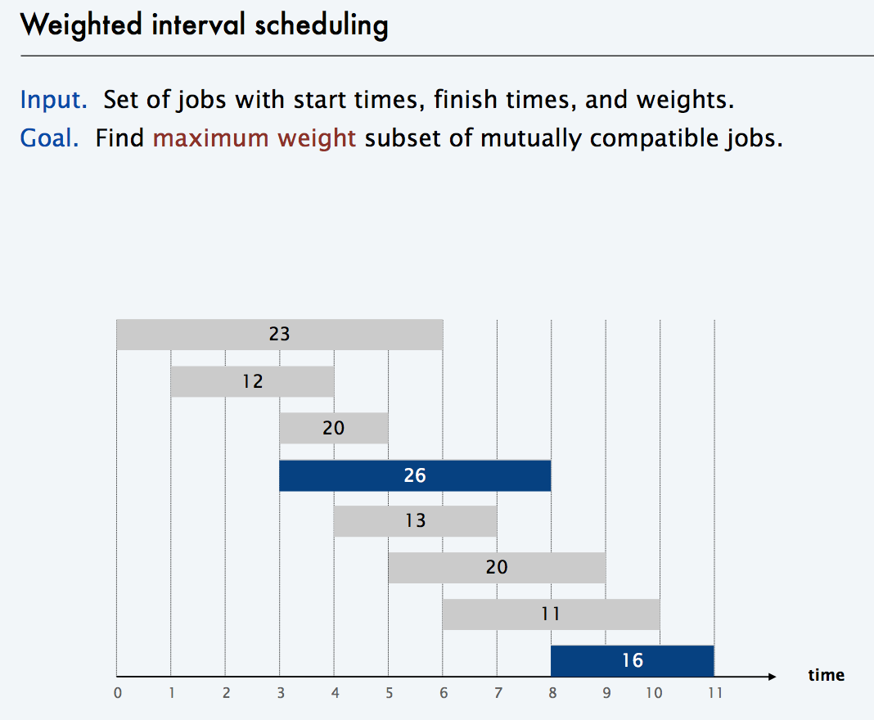

Slide 24
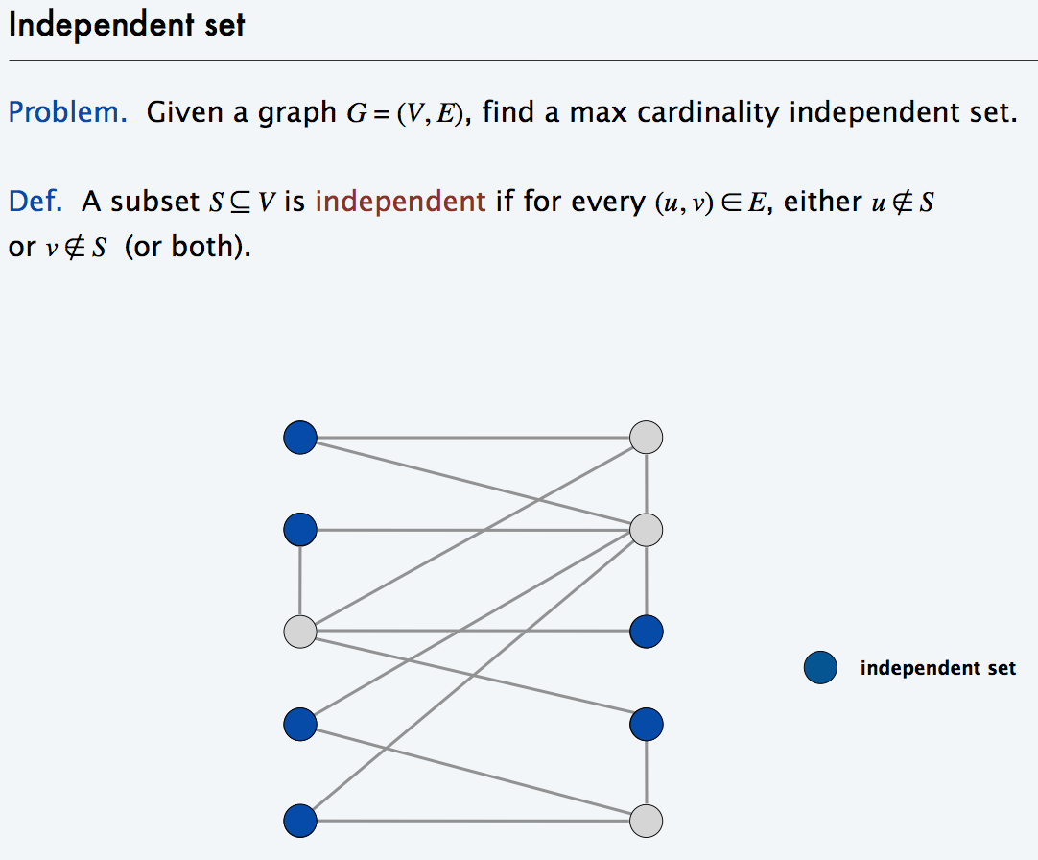

Slide 25
Four Representative Problems

Slide 26
Shortest Path Computation

Slide 27
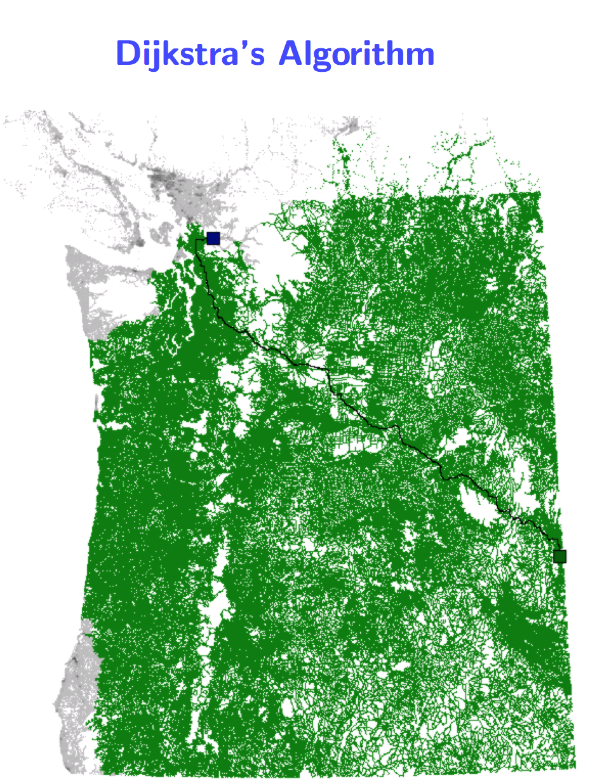

Slide 28
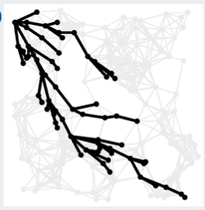
A* search

Slide 29
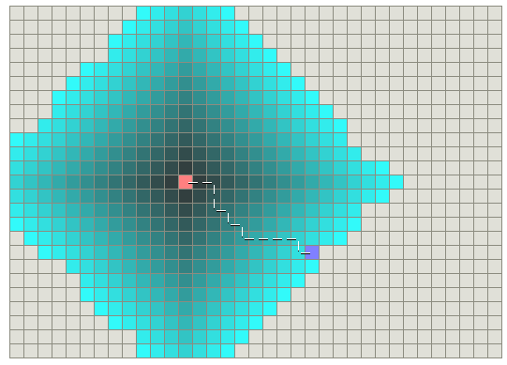
Classical Dijkstra

Slide 30
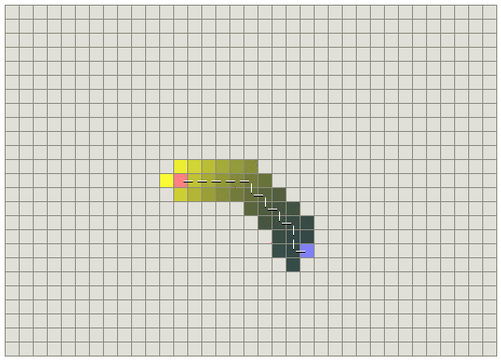
A* search

Slide 31
Maps with obstacles Classical Dijkstra

Slide 32
Maps with obstacles A* search

Slide 33
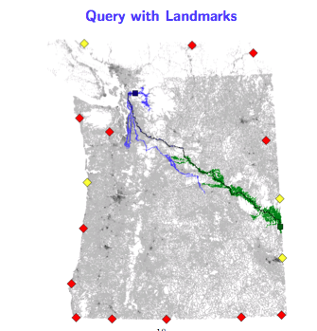
Landmark method

Slide 34
ACM Programming Competition
You should consider competing in ACM programming competition if you
love algorithms,
improve on your job interviews, or
enjoy writing codes.
The ACM competition is a two-tiered competition among teams representing institutions of higher education.

Slide 35
ACM Programming Competition
The teams are given several problems to solve in five hours. For each problem the task is to first design an algorithm, and then write a code for the algorithm in any standard programming language and make it work on provided test data.
The winning team then competes for the world final.

Slide 36
ACM Programming Competition
SFU is hosting this year’s Pacific Northwest Regional Programming Contest to be held in Nevember 9, 2019.
Multiple teams from Stanford, Berkeley, UBC, Washington etc will compete.
Top two teams will qualify for the final.
SFU is in the process of selecting its teams.
You are encouraged to participate in competition. Please let me know if you are interested.

Slide 37
ACM Programming Competition
You are encouraged to participate in the competition. Please let me know if you are interested. You will be notified of the activities.

Slide 38
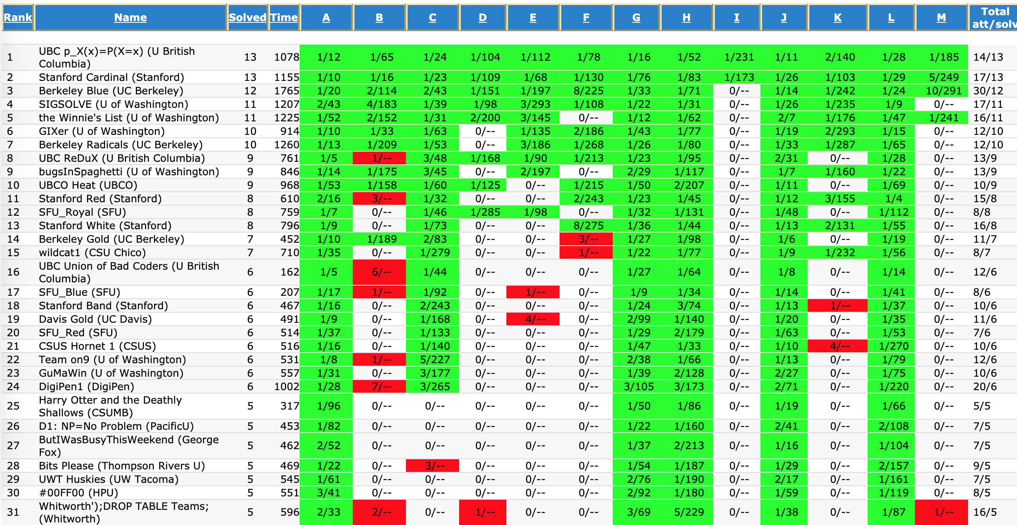

Slide 39
Acknowledgement
Used some slides from
http://cseweb.ucsd.edu/classes/sp14/cse202-a/
http://www.cs.sfu.ca/CourseCentral/225/johnwill/schedule.html

