Slide 1
Maintenance of dynamic set

Slide 2
Acknowledgements
CLRS text Chapters 10, 12
Design and analysis of computer algorithms by Aho, Hopcroft and Ullman.

Slide 3
Maintaining Dictionary
We are given a set S of objects.
Each object is a 2-tuple: (key, records)
The keys are used to identify the records.
The keys are totally ordered : given any two keys k and k’, either k < k’, k = k’ or k > k’.

Slide 4
Maintaining Dictionary
Objective is to maintain the set S under the following operations:
Search/ Find/ Lookup for a record
Insert a record
Delete a record.
Execute a sequence of operations: Insert, Insert …., Insert, Search, Search, Delete, Insert, …..
Our set of objects is a dynamic set.
How quickly can one perform these operations?

Slide 5
Elementary data structures
We can represent a dynamic set in a linear list.
array
linked list
doubly linked list
What is the cost of each operations?

Slide 6
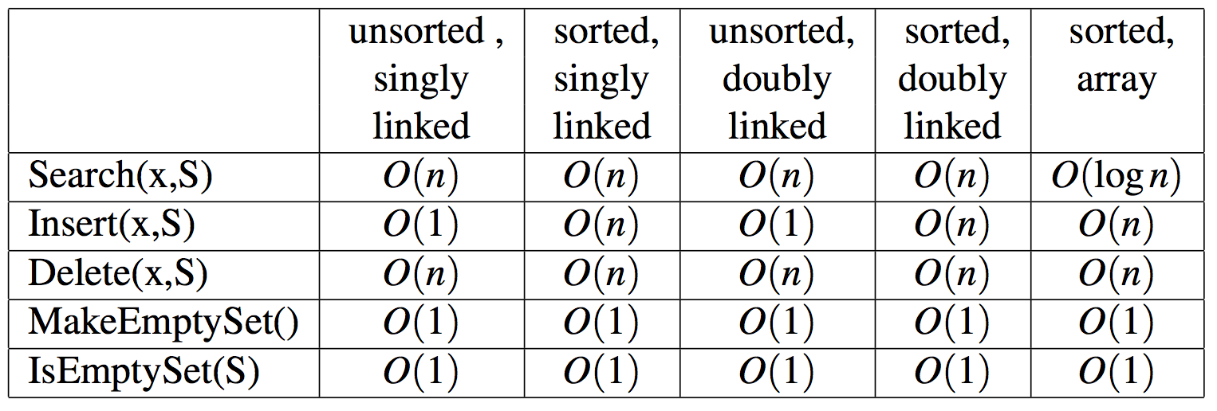
Linear lists

Slide 7
Non-linear list (tree data structures)
Binary Search trees:
A binary search tree is a binary tree with the following properties:
Each node in the BST stores a key, and optionally some auxiliary information.
The key of every node in a BST is strictly greater than all the keys to the left and strictly smaller than all the keys to the right.

Slide 8
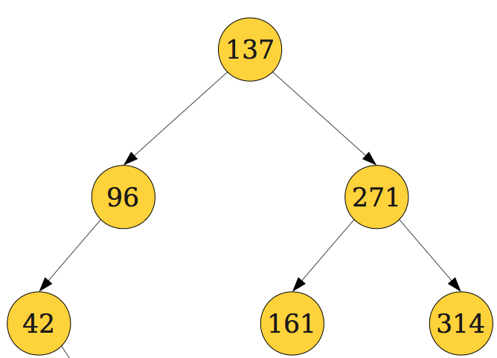
BST
Every vertex has two links or pointers: left child and right child.
Both the links of leaves are null.
Inorder traversal of a BST list the elements (keys) in sorted increasing order.

Slide 9
BST
The height of a BST is the length of a longest path from the root to a leaf, measured in the number of edges.
A tree with one vertex has height 0
An empty tree has height -1, by convention
The minimum element of S can be found by following the left pointer until a null link is encountered.
The maximum element of S can be found by following the right pointer until a null link is encountered.

Slide 10
BST
height = 2; minimum = 42; maximum = 314

Slide 11
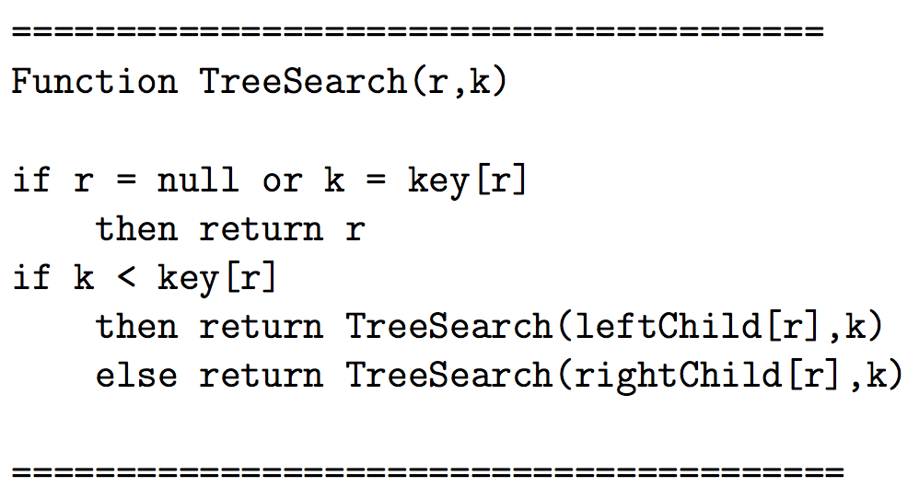
Querying a BST
Looking for an element in a BST
Starting from the root of the BST, and a key k, one can find the location of the key in BST as follows:

Slide 12
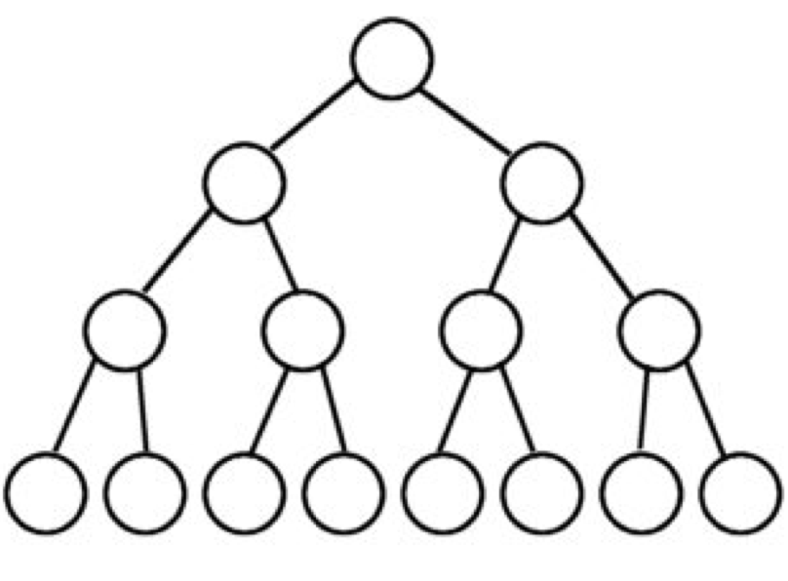
Querying a BST
The worst case running time is proportional to the height of the tree, say h.
In the worst case, h could be as large as n-1.
In the best case h is ⎣log₂n⎦.

Slide 13
Inserting a key into a BST
Insertions cause BST, representing a dynamic set, to change. We need to update the search tree.

Slide 14
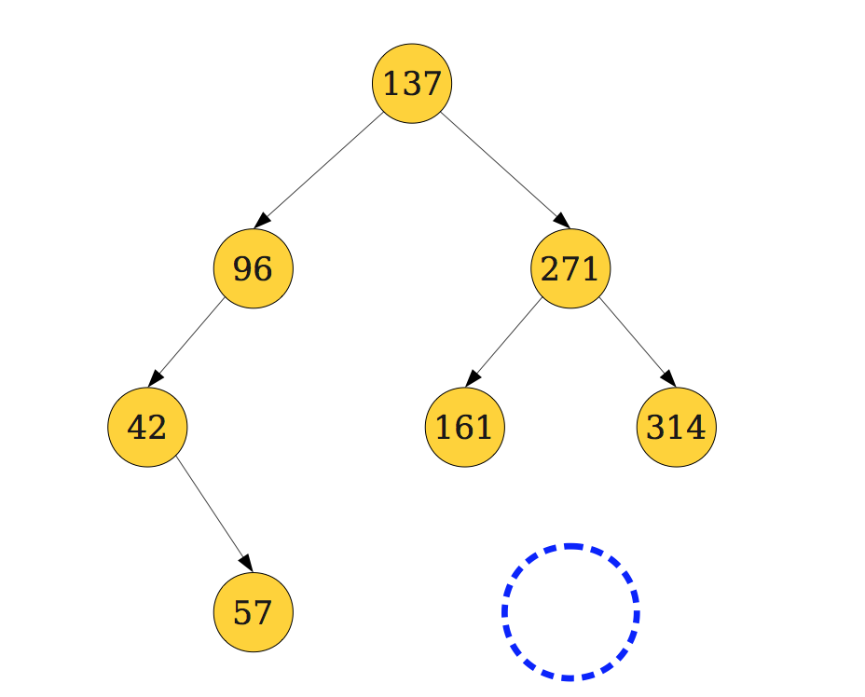
Inserting a key into a BST (Inserting 166)

Slide 15
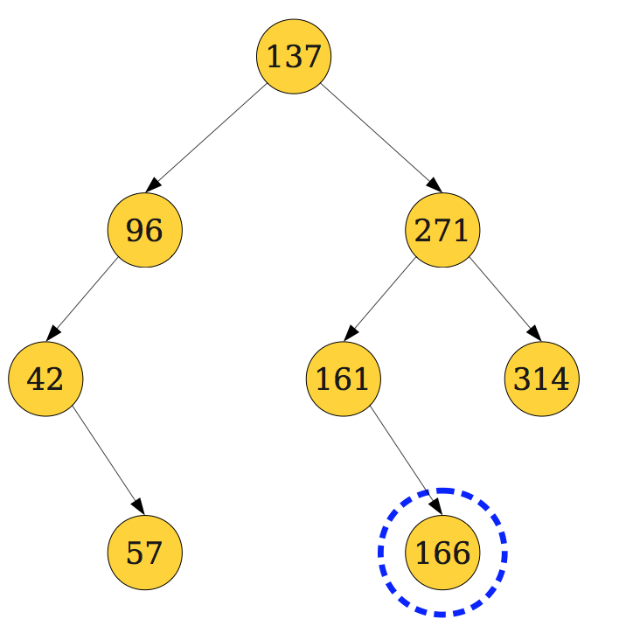
Inserting a key into a BST (Inserting 166)

Slide 16
Inserting a key into a BST
Insert(k, S) costs O(h) time.

Slide 17
Deleting a key from a BST
Deletions cause BST, representing a dynamic set, to change. We need to update the search tree.

Slide 18
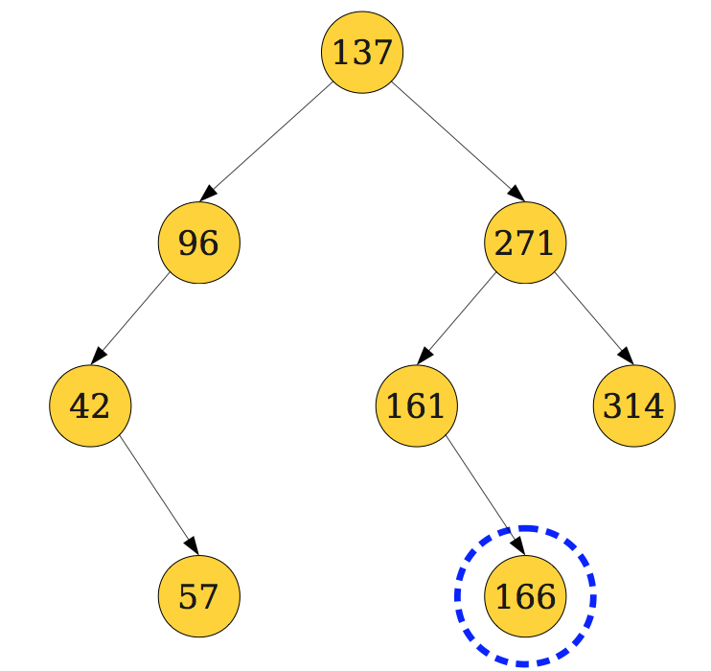
Deleting a key from a BST (deleting 57)

Slide 19
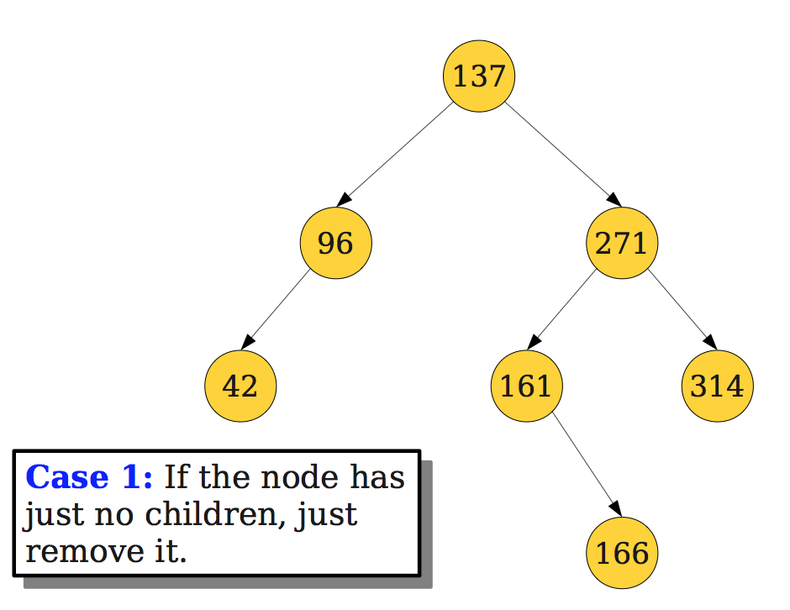
Deleting a key from a BST (deleting 57)

Slide 20
Deleting a key from a BST (deleting 96)

Slide 21
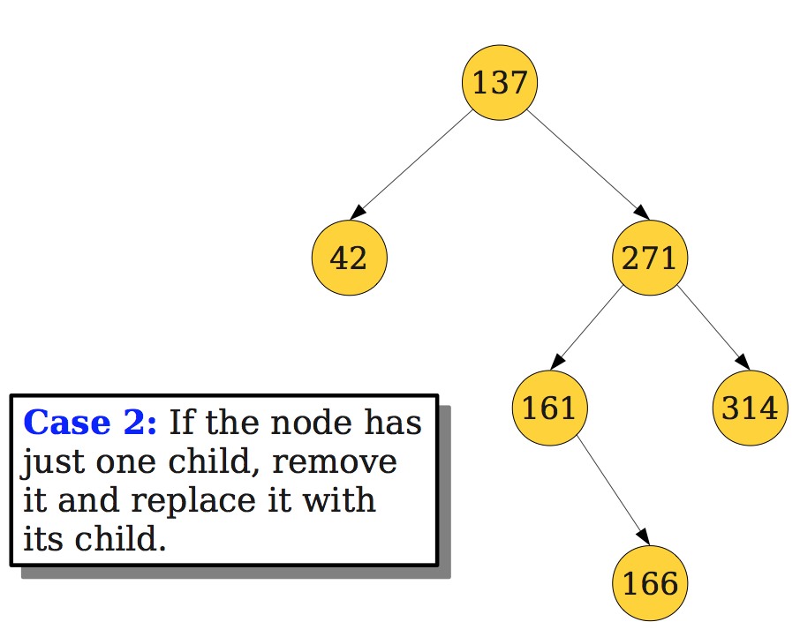
Deleting a key from a BST (deleting 96)

Slide 22
Deleting a key from a BST (deleting 137)

Slide 23
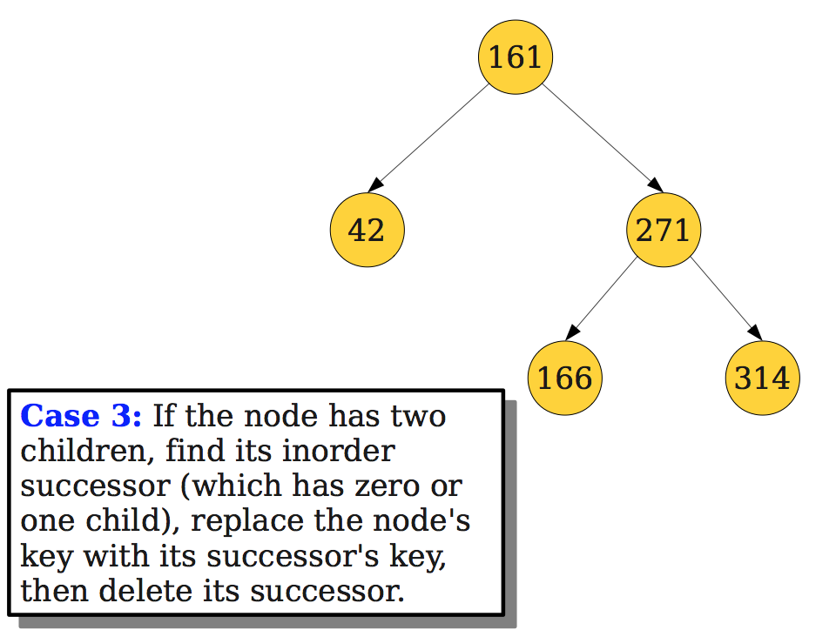
Deleting a key from a BST (deleting 137)

Slide 24
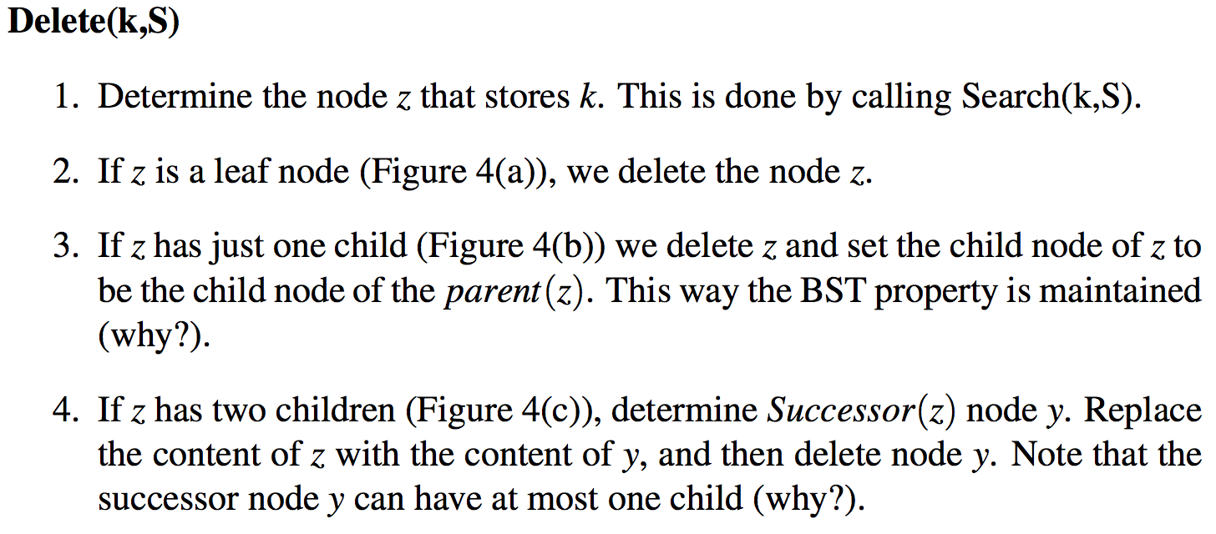
Deleting a key from a BST
The time complexity is O(h).
In the best case, h is O(logn).
In the worst case, h is O(n).

Slide 25
Linear lists and BST

Slide 26
Challenge
Keep the height of BST, under insertion and deletion, to O(logn) all the time.
If we insert elements in increasing order, the resulting BST has a skewed growth.
If the keys are inserted at random, the average picture is much more acceptable.

Slide 27
Balanced Search Trees 2-3 Trees
Controlling the height of the tree maintaining a dynamic set is important.
There are many types of balanced search trees
AVL tree
2-3 tree
Splay tree
2-3-4 tree
Red Black tree
B-trees

Slide 28
2-3 Trees
2-3 tree is a tree data structure with the following properties:
Every vertex which is not a leaf has 2 or 3 children
The children are labeled first, second and third from left to right.
Every path from the root to a leaf is of the same distance.
All elements of S are stored at the leaves.
The tree consisting of a single vertex is a 2-3 tree.

Slide 29
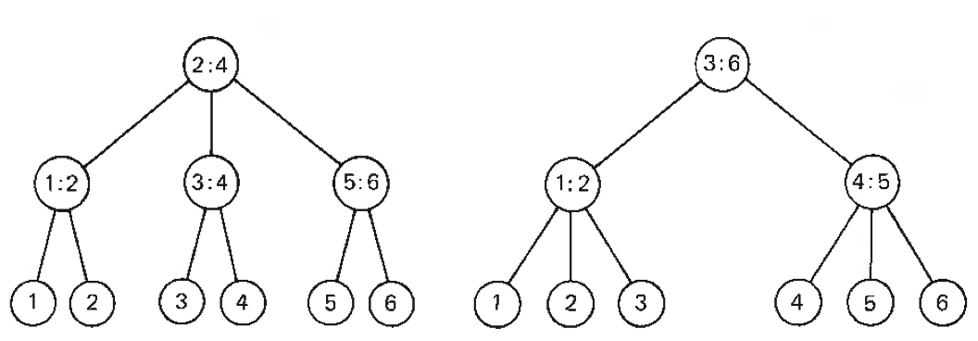
2-3 Tree
S = {1, 2, 3, 4, 5, 6}; elements at the leaves are sorted from left to right.
Internal vertices contain information to facilitate the search.
A 2-3 tree of height h can pack vertices between 2^{h+1}-1 and (3^{h+1} -1)/2.
Any 2-3 tree storing n elements at the leaves has O(logn) height.

Slide 30
2-3 Tree
Interior vertices are used to facilitate search.
For an interior vertex v
L[v] : largest element in the subtree whose root is the first child of v.
M[v]: largest element in the subtree whose root is the second child of v.

Slide 31
Notations
Notations : v is a vertex
f[v] : First child of v;
s[v]: Second child of v
t[v]: Third child of v
L[v]: Largest element of the subtree rooted at f[v].
M[v]: Largest element of the subtree rooted at s[v].
p[v]: Parent node of v. It is null if v is the root.

Slide 32
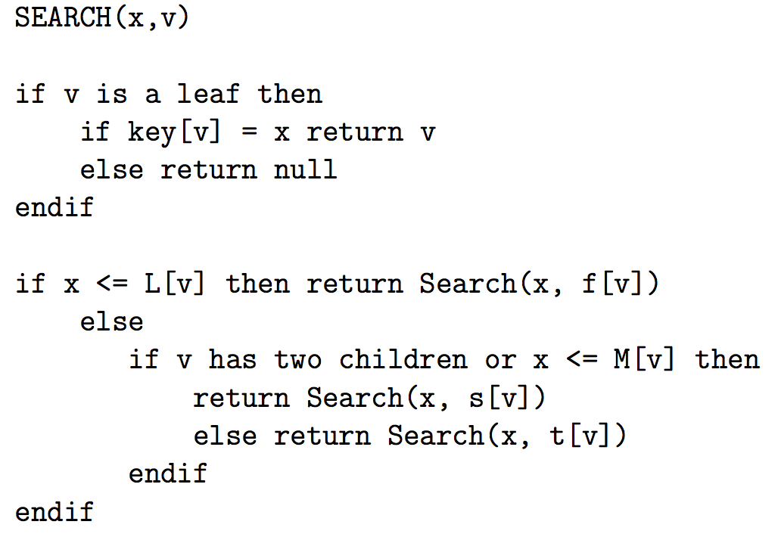
Search(x,v) (Search a 2-3 tree rooted at r for element x)

Slide 33
Search(x,v) (Search a 2-3 tree rooted at r for element x)
Runtime Cost: The cost of SEARCH(x,v) is O(logn)

Slide 34
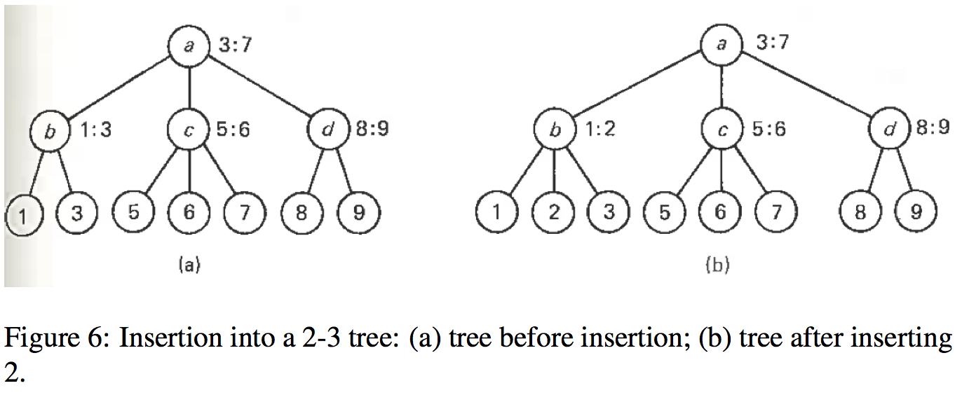
Insert(x,v) (Insert an element x into 2-3 tree rooted at v)

Slide 35
Insert(x,v) (Insert an element x into 2-3 tree rooted at v)
Locate where x goes: use SEARCH(x,v) and identify leaf z.
Attach a node u, containing x, to p[z].
Update the tree to make sure that the 2-3 tree properties are satisfied.

Slide 36
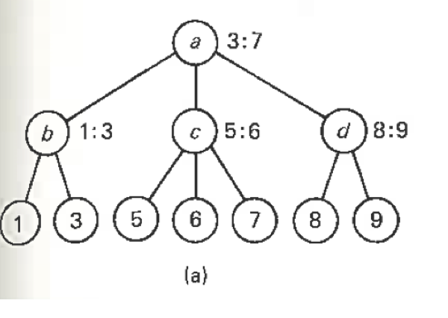
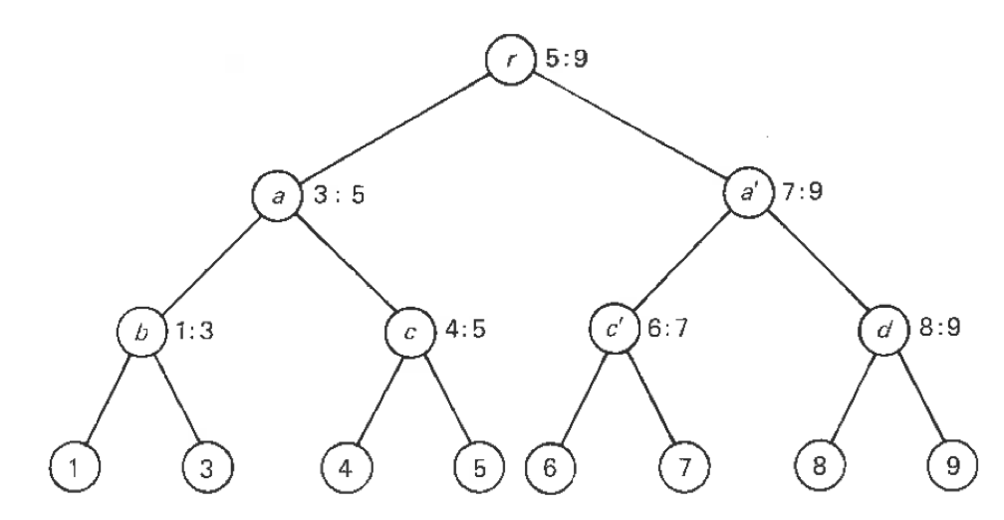
Insert(x,v) (Insert an element x into 2-3 tree rooted at v)
Inserting 4.

Slide 37
Insert(x,v) (Insert an element x into 2-3 tree rooted at v)
Inserting 4.
After 4 is inserted, the parent node has 4 children.
Split the parent node into two vertices, each getting two children.
Connect these two vertices to the node above. If it has three children, the process is repeated.

Slide 38
Conclusions
We have now seen that a SEARCH, INSERT, or DELETE operations can be executed in at most O(logn) steps on a 2-3 tree with n leaves.
The tree can be augmented to answer the following query in O(logn) time as well.
MINIMUM(S)
MAXIMUM(S)
SMALLEST(k,S)
For this case, we store , for every internal vertex v, the number of elements stored in its subtree.
This information can be maintained during insertion and deletion processes.

Slide 39
Non-trivial operations
CONCATENATE(S₁,S₂):
Two 2-3 trees S₁ and S₂ are concatenated where the elements at the leaves of S₂ are all larger than the elements at the leaves of S₁.
This is discussed in the notes.
An example will be shown in the class.

Slide 40
Hashing
Hash table efficiently performs dictionary operations on a dynamic set
average constant time for Search, Insert and Deletion operations
under simple uniform hashing assumption (a reasonable one)
bad worst case behavior (almost never happens)
Performs operations on the keys. This is different than just comparing keys.

Slide 41
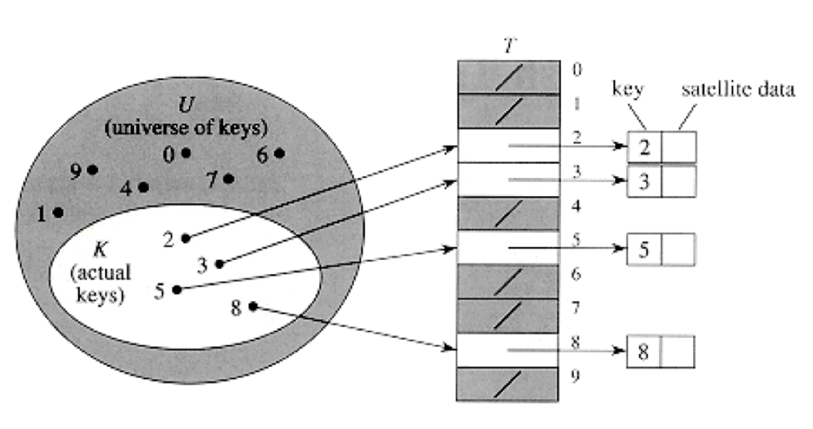
Hashing
Hashing describes a way to store the elements of a set in a hash table by breaking the universe of possible keys.
The position of the data element in the table is given by a function f : U → T.

Slide 42
Two requirements
Size of the hash table:
only a small subset of all possible keys of the universe we need to store.
Address calculation:
The keys are not necessarily integers.
The index of the table being computed depends on the size of the hash table.

Slide 43
What Makes A Good Hash Function?
Fast runtime
O(1) and fast in practical terms
Distributes the data evenly
hash(a) % size ≠ hash(b) % size
Uses the whole hash table
for all 0 ≤ i < size, ∃ k such that hash(k) % size = i

Slide 44
Formally
U: universe of possible keys.
{B₀, B₁, …., B_{m-1} }: set of buckets.
The hash function is a mapping
h: U → {0, 1, 2, …, m-1}
mapping each key s of the universe to a number h(s).
The respective key is stored in the bucket B_{h(s)}.
The bucket number h(s) is also called hash address.
The complete set of buckets is called hash table.

Slide 45
Division Method
The mapping is a simple one : h(k) = k mod m.
This is used when the keys are all integers.
The table size m should be chosen carefully.
if m is even and h(k) is even, the keys will be stored in even locations. It is not a good idea.
m = 2^{p} yields the bucket number using the lower p bits of k.
Select m to be a prime not too close to the exact power of 2 is often a good choice.

Slide 46
Division Method (Example)
Suppose we wish to allocate a hash table to hold roughly n=2000 character strings where a character has 8-bits.
Suppose we don’t mind examining an average of 3 elements in an unsuccessful search.
We allocate a hash table of size 701. This number is chosen because it is a prime near 2001/3, but not a power of 2.
Our hash function is h(k) = k mod 701.

Slide 47
Hash function for strings
Example:
public static int h (String s){ int k = 0, m = 13; for (int i=0; i < s.length(); i++) k += (int)s.charAt (i); return ( k%m );

Slide 48
Multiplicative method
Select A, 0 < A < 1.
A = 0.6180339887 is a good choice. This is (√5 -1)/2.
Multiply k.A where k is the key
Take p = logm significant bits from the fractional part of the product.
logm bits realize a table index.
Random numbers are generated in a similar manner.
Note that the selection of a specific m is not important any more.

Slide 49
Multiplicative method Example
m=16
p=logm = 4 bits
A = .101011₂
k = 011011₂
k.A = 010010.001001₂
Take 0010₂ (first p bits following the decimal point) as the index of the bucket where k is stored.
Note here that in multiplicative method, m need not be prime.

Slide 50
Possible ways of dealing collisions
There are two common methods for resolving collisions
Chaining: Each bucket is maintained as a linked list. All the objects whose keys are mapped to the same bucket are kept in a linked list.
Open addressing: Colliding elements are stored in other vacant buckets in the table. A collision resolution scheme assigns a sequence of addresses to the key. The insertion algorithm inspects the cell in the order indicated until it finds an empty slot in the table.

Slide 51
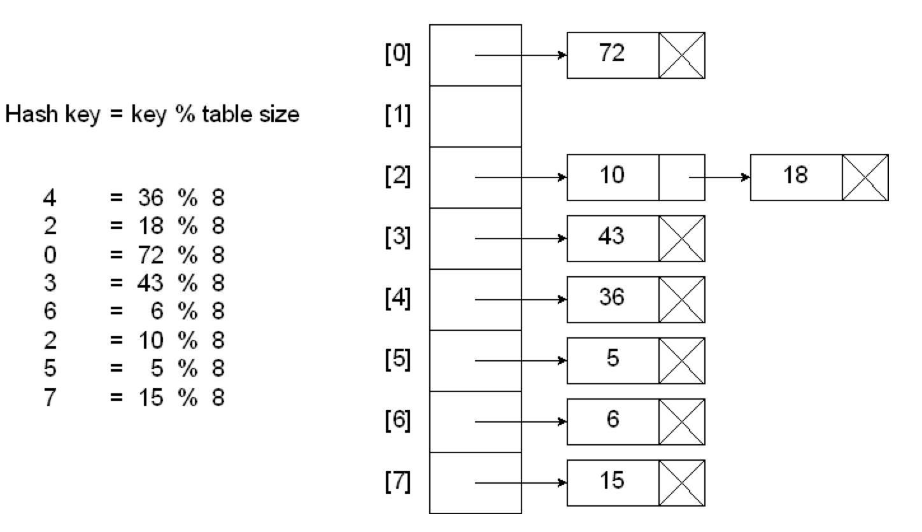
Hashing with chaining
Search, Insertion and Deletion are straight forward.

Slide 52
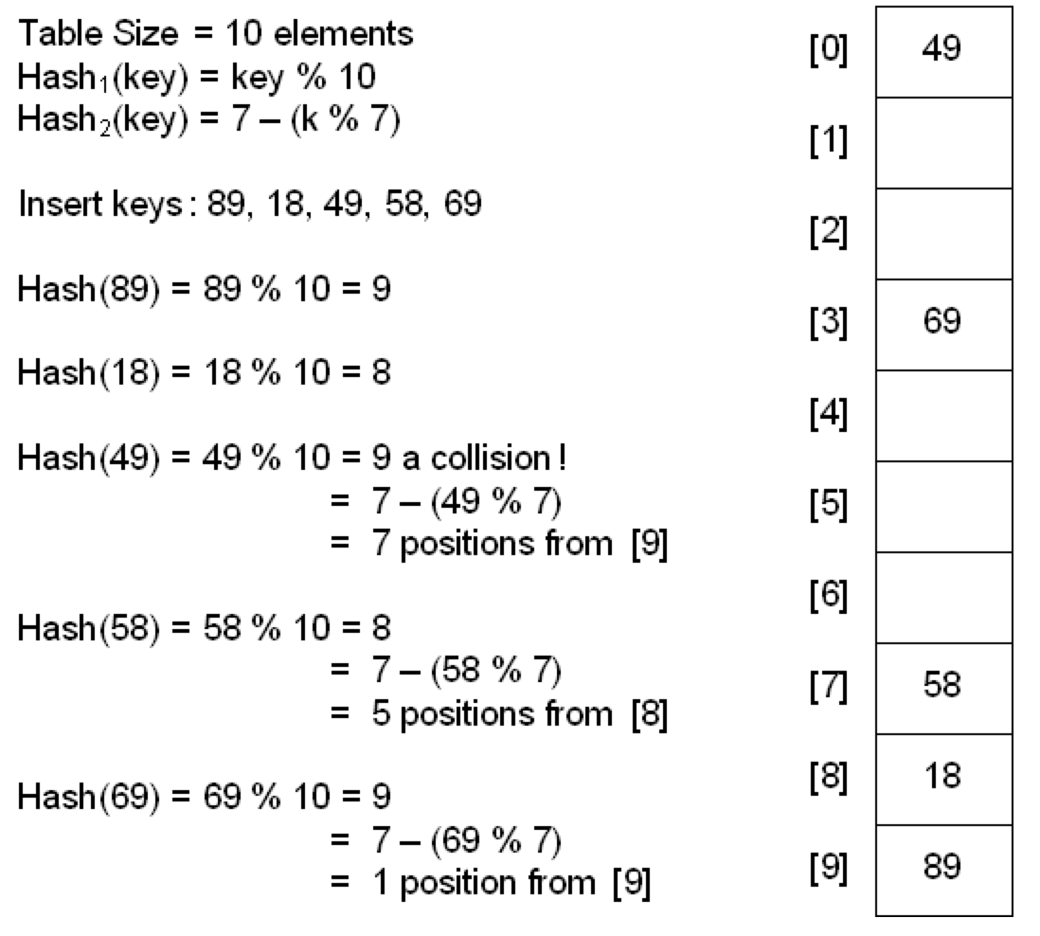
Hashing with double hashing
1
58
49

Slide 53
Hashing with double hashing
In this method two hashing functions h₁(x) and h₂(x).
Use h₁(x) to insert x.
In case of collision, use the second hash function to x and probe at a distance h₂(x), 2h₂(x), 3h₃(x), and so on.
In deleting an object, we cannot leave a hole in the table (why?).
Instead of deleting the element, just mark it.
We treat this bucket to be occupied for search and deletion steps. For insertion, this bucket is considered empty.

Slide 54
Deletions
Deletion from a separately chained hash table is easy.
Deletion from an open-addressed hash table is not simple.
A key to be deleted cannot simply be removed from the hash table leaving its position empty (why?).
The usual way is to add an extra bit (Deleted field) to each table entry.
When an entry is deleted, the Deleted field bit is set to 1.
Search proceed over both the occupied buckets and empty slots with Deleted bit set to 1.
Insertion occurs at the first position that is empty or has a Deleted bit 1.

Slide 55
Analysis
Uniform hashing assumption
any given key of the universe is equally likely to hash into any of the m slots, independently of where any other element has hashed to.
Load factor α for table B with m buckets containing n elements is n/m.

Slide 56
Analysis (Chaining) (CLRS section 11.4)
Let n_{j} denote the length of T[j].
E[n_{j}], the expected length of T[j], is α.
Theorem 1: For the chaining resolution scheme, the expected cost of an unsuccessful search is Θ(1 + α ) under the assumption of simple uniform hashing.
Theorem 2: Under the assumption of uniform hashing, the expected cost of each dictionary operation is Θ(1 + α ) for the chaining resolution scheme. This cost is constant if n ∈ O(m).

Slide 57
Analysis (Open address) (CLRS section 11.4)
Theorem 3: Given an open-address hash table with load factor α = n/m < 1, the expected cost for an unsuccessful search is at most 1/(1−α), assuming uniform hashing.
Theorem 4: Given an open-address hash table with load factor α < 1, the expected number of probes in a successful search is at most (1/α) log_{e}(1/(1-α)) assuming uniform hashing and assuming that each key in the table is equally likely to be searched.

Slide 58
A universal class of hash functions (uniform hashing)
|U| = p (p prime) and |U| = {0, …, p-1}, U: Universe
Let a ∈ {1, …, p-1}, b ∈ {0, …, p-1}
h_{a,b} : U → {0,…,m-1} be defined as follows
h_{a,b} = ((ax+b) mod p) mod m
The set H = {h_{a,b} | 1 ≤ a ≤ p, 0 ≤ b ≤ p}
is a universal class of hash functions.

