Slide 1
Data Structures

Slide 2
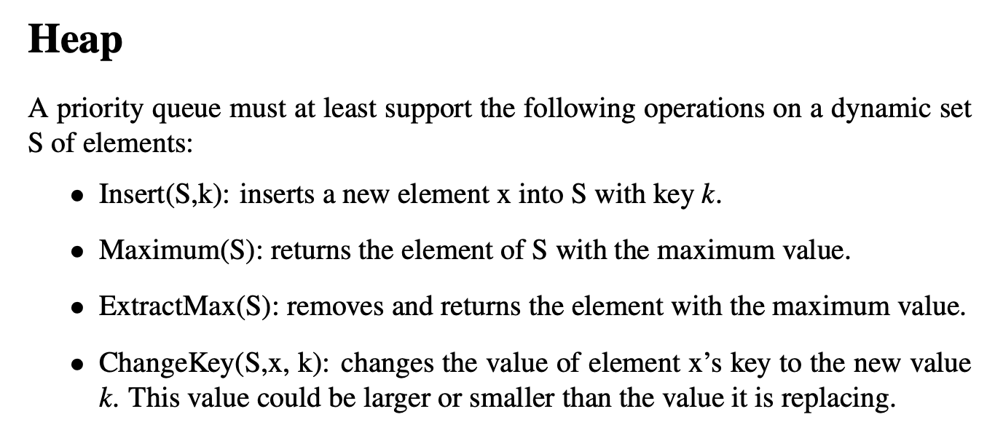

Slide 3
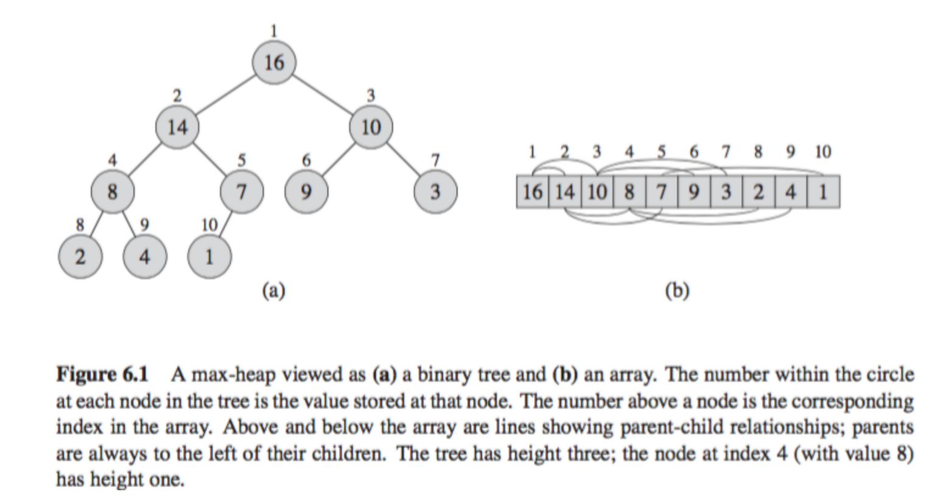

Slide 4
Sets and Dictionary

Slide 5
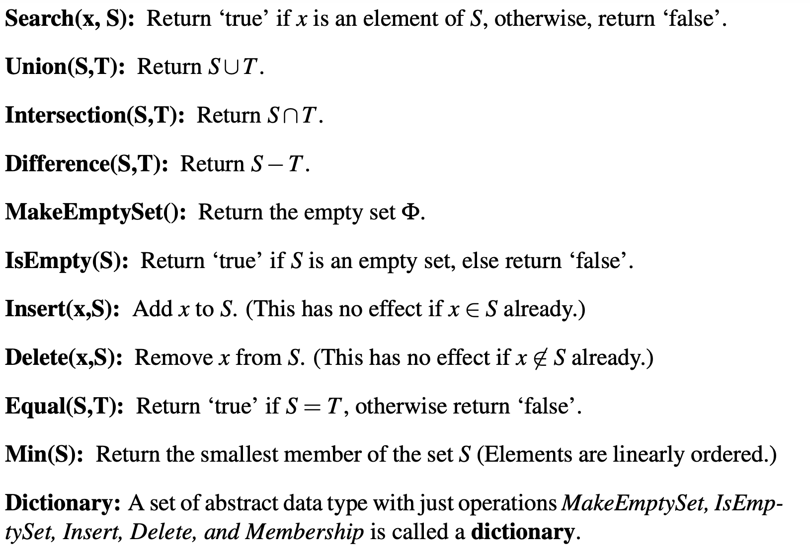

Slide 8
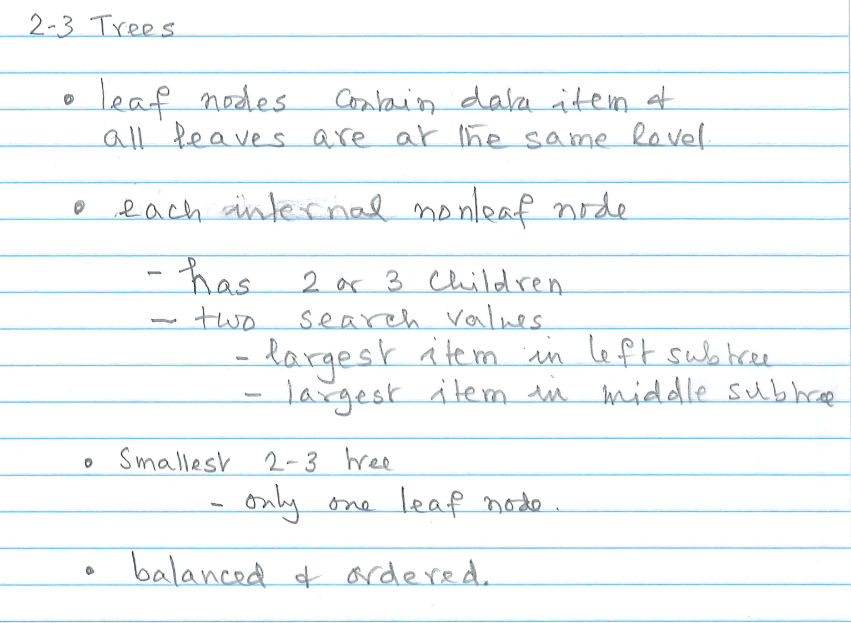

Slide 9
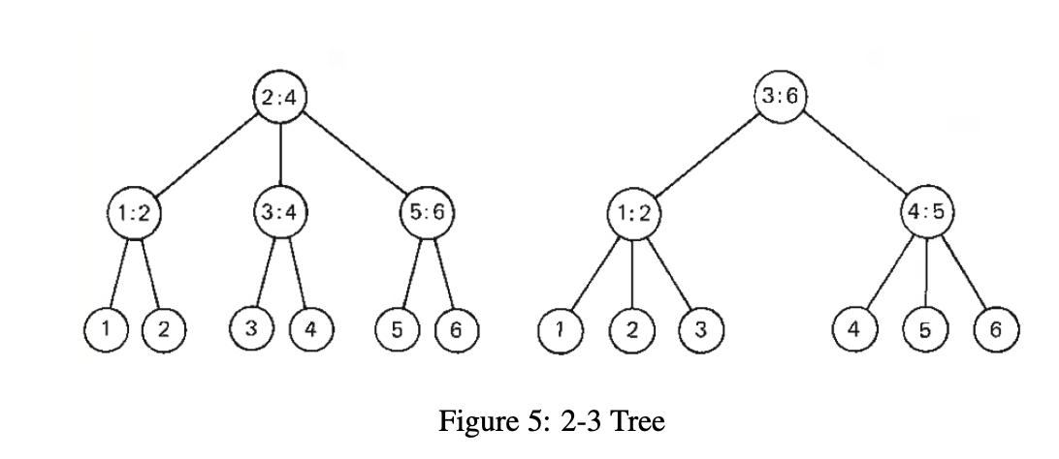

Slide 10
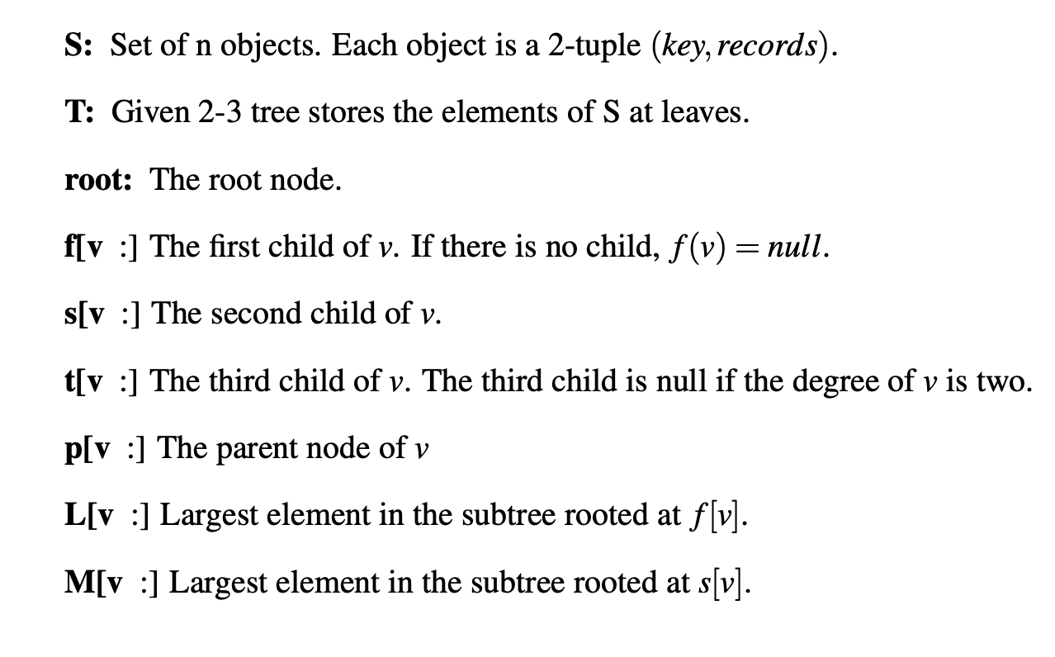
We can augment the tree with each internal node storing the number of leaf nodes.

Slide 11
Operations each costs O(logn) time
Search
Insert
Delete
Concatenate
Split
k^{th} smallest element

Slide 13
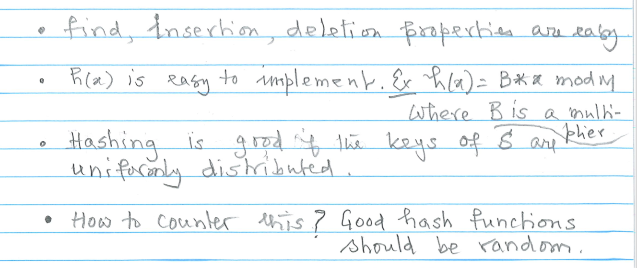

Slide 16
Another universal class of hash functions
Assumptions:
|U| = p (p prime) and |U| = {0, …, p-1}
Let a ∈ {1, …, p-1}, b ∈ {0, …, p-1} and h_{a,b} : U → {0,…,m-1} be defined as follows
h_{a,b} = ((ax+b) mod p) mod m
Then:
The set H = {h_{a,b} | 1 ≤ a ≤ p, 0 ≤ b ≤ p}
is a universal class of hash functions.

Slide 17
Disjoint Sets

Slide 18
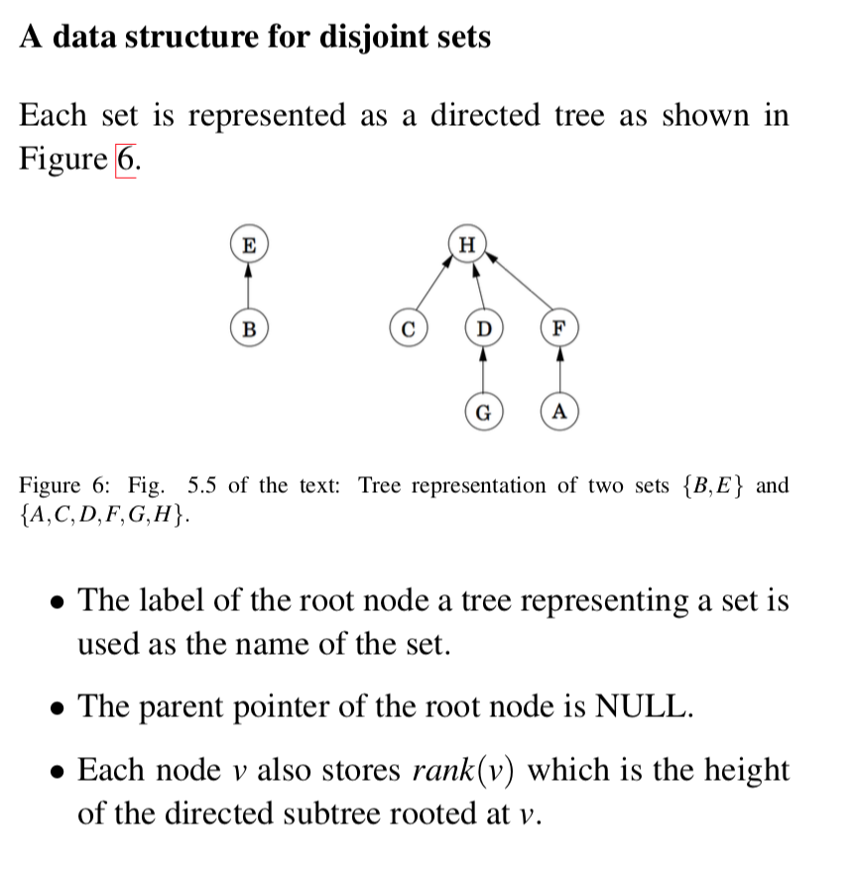

Slide 19
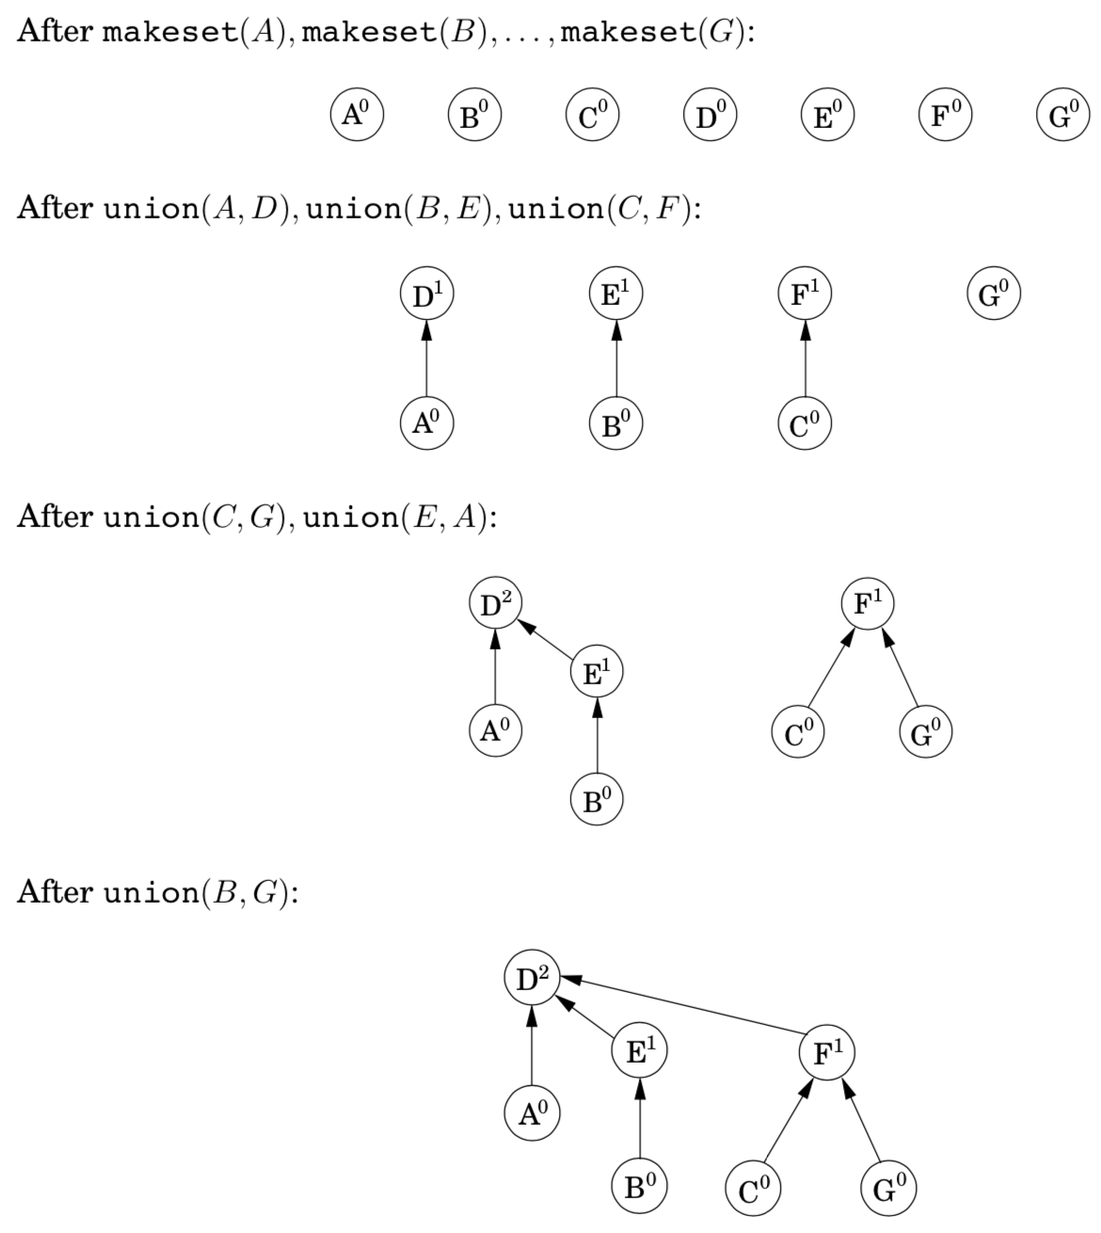

Slide 20
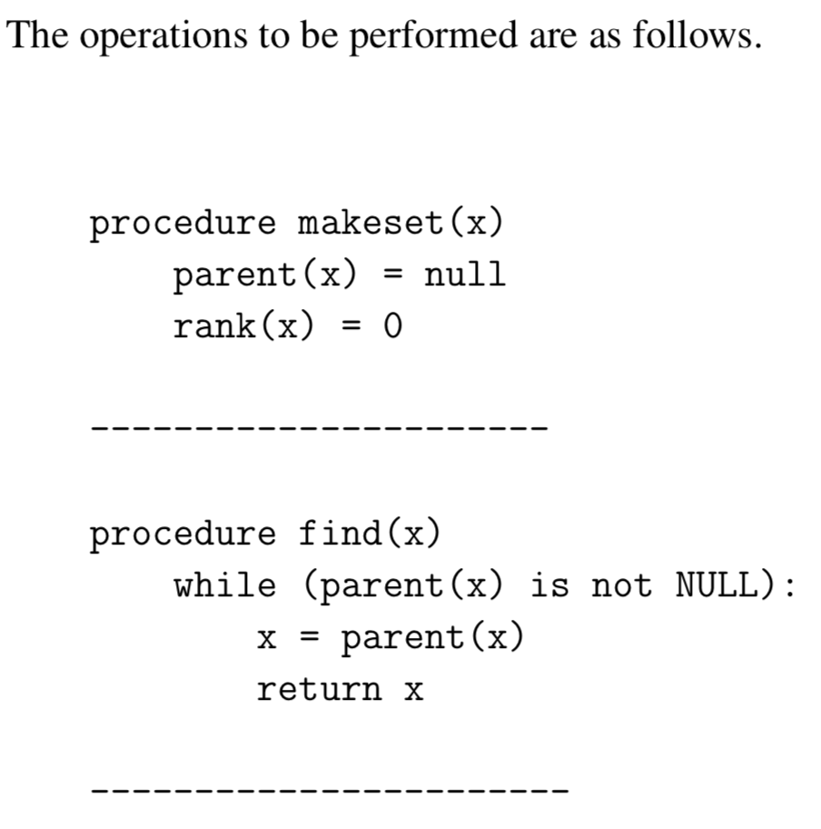
Constant time
Proportional to the height

Slide 21
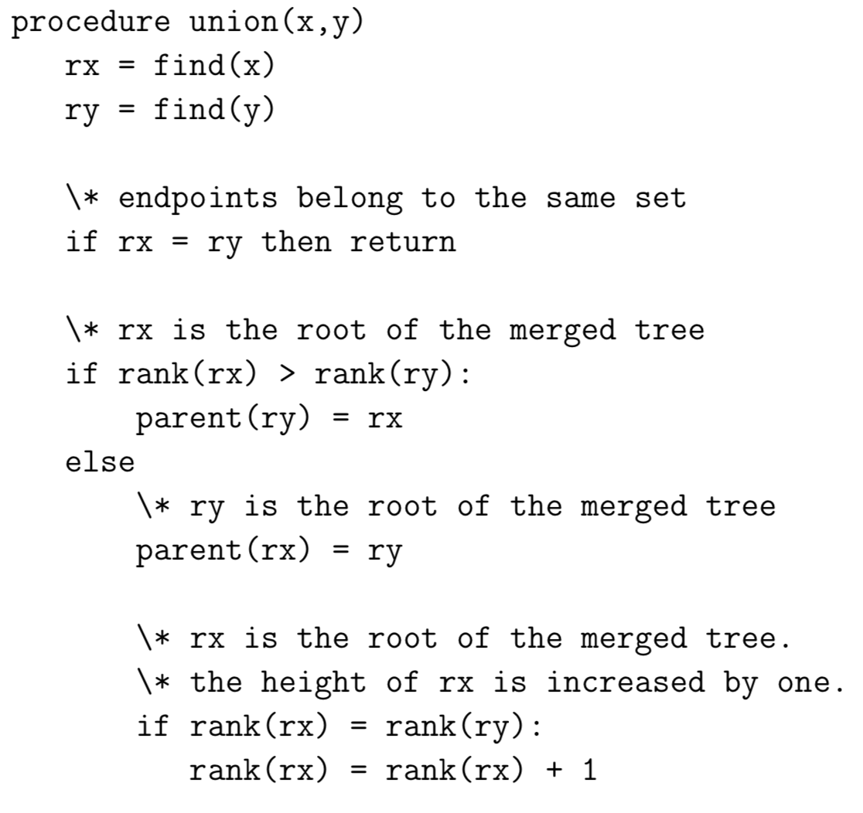
Proportional to the height

Slide 22
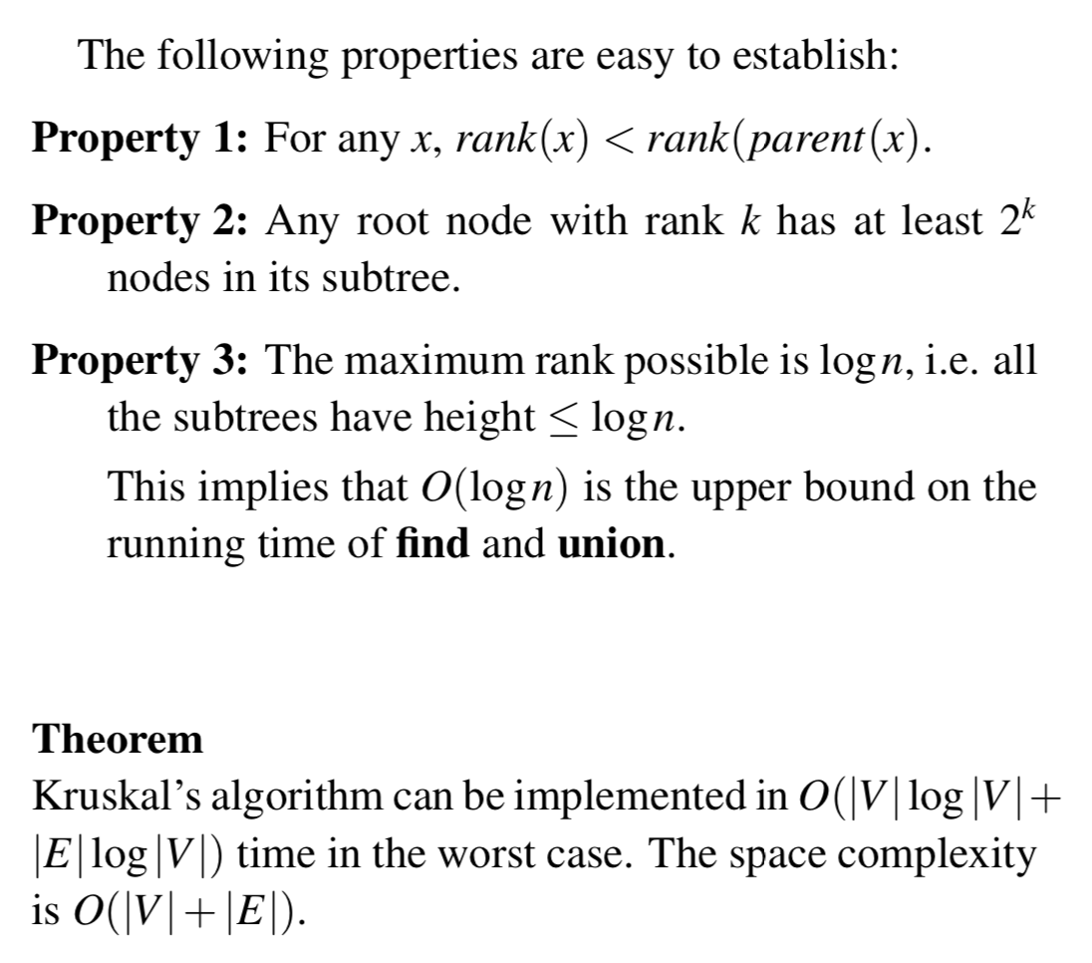

Slide 23
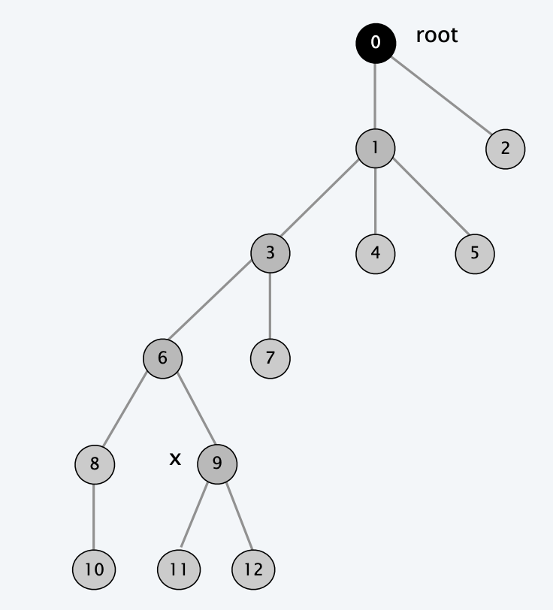
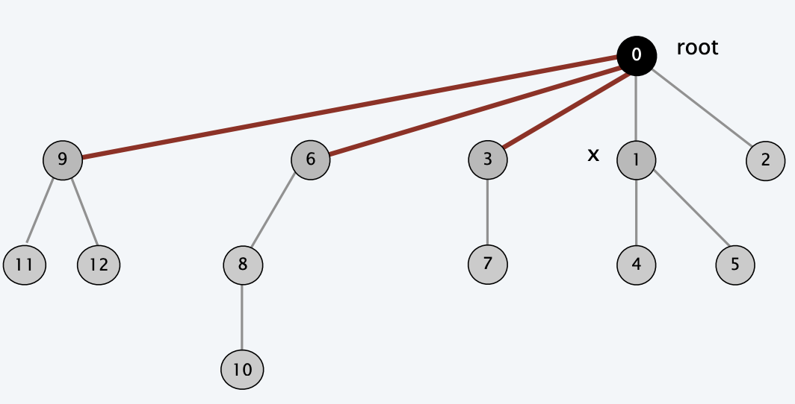
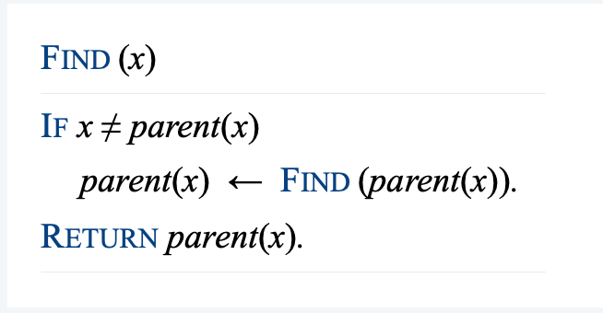

Slide 24
*
log* n ≤ 5 for n ≤ 2⁶⁵⁵³⁶

