Slide 1
Dynamic Programming (DP) Chapter 6

Slide 2
What is DP?
It is a ``method for solving complex problems by breaking them down into simpler subproblems’’.

Slide 3
Three steps for solving DP problems
Define subproblems
Formulate the recurrence that relates the subproblems
Recognize and solve the base cases.

Slide 4
Three steps for solving DP problems
Define subproblems
Formulate the recurrence that relates the subproblems
Recognize and solve the base cases.
Each step is very important

Slide 5
Weghted activity selection problem
Given a set S = {a₁, a₂, …, a_{n}} activities.
Activity a_{i} has a start time s_{i} and a finish time f_{i}.
Each activity a_{i} has a value, or weight v_{i}.
Two intervals are compatible if they do not overlap.
The problem is to select a subset of mutually compatible activities of largest total values.

Slide 6
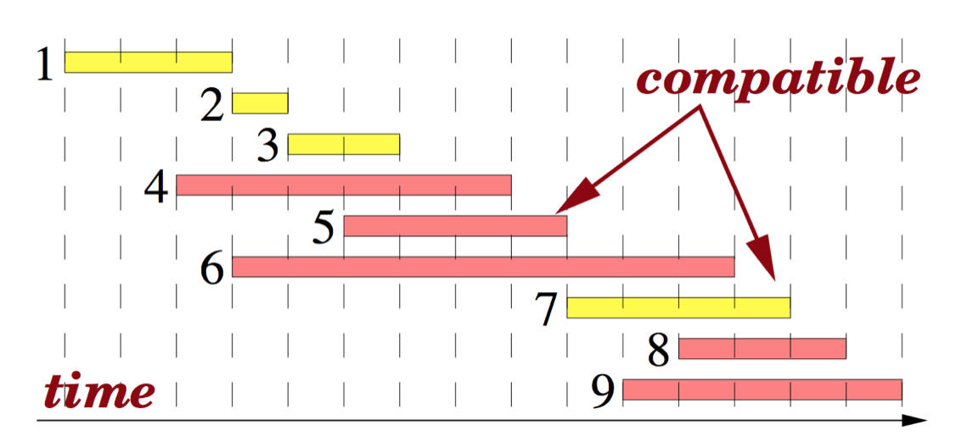
Greedy approach does always not work
If all the activities have the same value, then greedy strategy of selecting activities based on finish times is optimal.

Slide 7
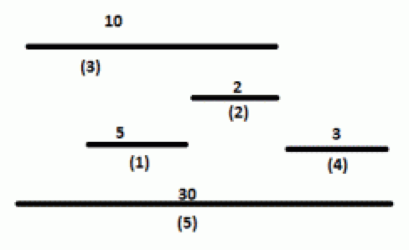
Greedy approach does always not work
If the activities have the different values, then any greedy solution is not optimal.

Slide 8
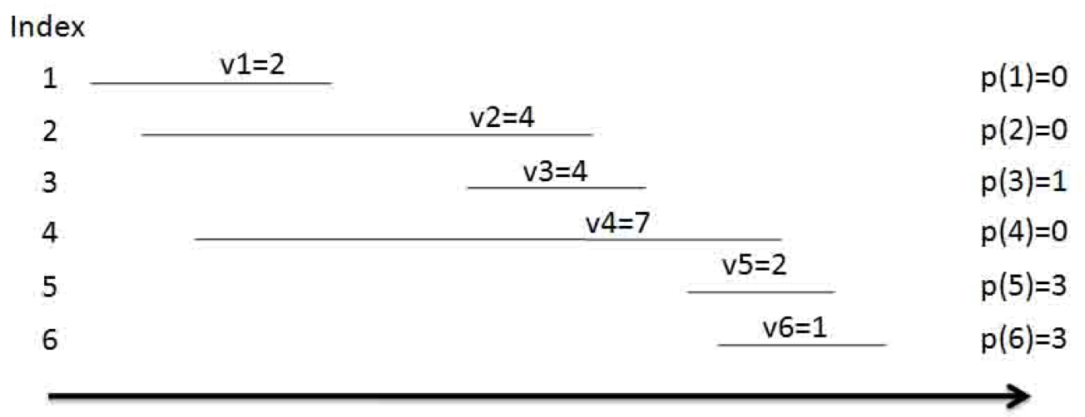
DP solution
We first relabel the activities by their finish times.

Slide 9
Define subproblems:
Let A_{i} = {a₁, a₂, …, a_{i}} be the set of first i activities.
Let Opt(i) be the total values of the optimal solution of the problem for the activities of A_{i}.

Slide 10
Define subproblems:
Let A_{i} = {a₁, a₂, …, a_{i}} be the set of first i activities.
Let Opt(i) be the total values of the optimal solution of the problem for the activities of A_{i}.
Opt(1) = 2; Opt(2) = 4; Opt(3) = 6; Opt(4) = 7; Opt(5) = 8; Opt(6) = 8.

Slide 11
Find the recurrence for Opt(i)
Define p(j), for an activity a_{j}, to be the largest index i < j such that activities a_{i} and a_{j} are compatible.

Slide 12
Find the recurrence for Opt(i)
Consider an optimal solution Opt(i) of A_{i}.
Opt(i) contains a_{i} : Opt(p(i))+ v_{i}
Note that a_{p(i)+1}, a_{p(i)+2}, …, a_{i-1} are not compatible with a_{i.}

Slide 13
Find the recurrence for Opt(i)
Consider an optimal solution Opt(i) of A_{i}.
Opt(i) contains a_{i} : Opt(i) = Opt(p(i)) + v_{i}
Note that a_{p(i)+1}, a_{p(i)+2}, …, a_{i-1} are not compatible with a_{i.}
Opt(i) does not contain a_{i} : Opt(i) = Opt(i-1)
We get the recurrence by combining both the possibilities:
Opt(i) = max{ Opt(p(i)) + v_{i} , Opt(i-1) }
Given Opt(i), how do we know whether a_{i} is in Opt(i)?

Slide 14
Find the recurrence for D_{i}
Consider an optimal solution Opt(i) of A_{i}.
Opt(i) contains a_{i} : Opt(i) = Opt(p(i)) + v_{i}
Note that a_{p(i)+1}, a_{p(i)+2}, …, a_{i-1} are not compatible with a_{i.}
Opt(i) does not contain a_{i} : Opt(i) = Opt(i-1)
We get the recurrence by combining both the possibilities:
Opt(i) = max{ Opt(p(i)) + v_{i} , Opt(i-1) }
Given Opt(i), how do we know whether a_{i} is in Opt(i)?
a_{i} is in Opt(i) if Opt(p(i)) + v_{j} ≥ Opt(i-1).

Slide 15
Solve the base cases
The base case is Opt(0) = 0
We can also say that Opt(1) = v₁.

Slide 16
Algorithm (Top Down)
Compute-Opt(j)
if j = 0 then
return 0
else
return max(v_{j} + Compute-Opt(p(j)),
Compute-Opt(j-1))
The correctness of the algorithm follows from induction arguments (why?)

Slide 17
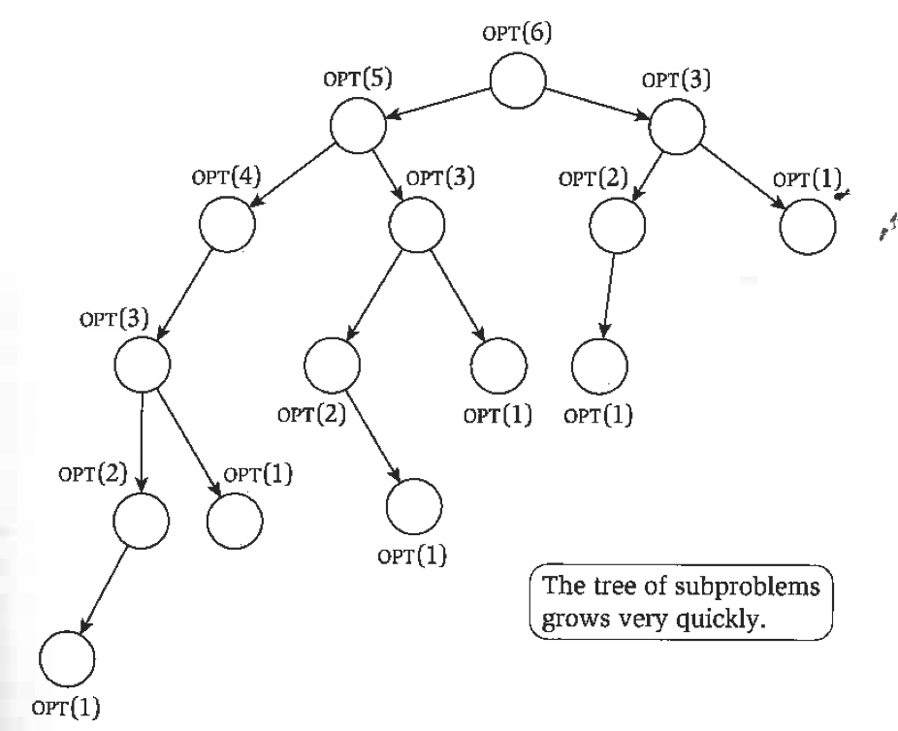
Recursion Tree
The same subproblem is solved many times.
The overall complexity of Compute-Opt(j) is exponential. (why?)

Slide 18
Modified (memoized) Compute-Opt(j) (linear time)
Initialize an array Opt[];
Opt[0] = 0; Opt[1..n] undefined
Compute-Opt(j){
if Opt[j] is computed before, return Opt[j];
else
Opt[j] = max(v_{j} + Compute-Opt(p(j)),
Compute-Opt(j-1));
return Opt[j];
}
The complexity of the algorithm is linear assuming that the intervals are already sorted by their finish times.

Slide 19
Iterated algorithm (bottom up)
Iterated-Compute-Opt(j)
Opt[0] = 0;
for (i = 1; I ≤ n; i++){
Opt[i] = max{ v_{i} + Opt[p(j)], Opt[i-1]}
}
Clearly, the algorithm is linear.
Memoized version is also linear.
Memoized version will take more time to compute due to the overhead cost of the recursion.
Memoized version is easier to code.

Slide 20
Finding the solution once Opt[.] is known.
Find-Solution(j){
If j=0
Output nothing;
else
if v_{j} + Opt[p(j)] ≥ Opt[j-1] {
output a_{j};
Find-Solution(p(j));
}
else
Find-Solution(j-1);
}

Slide 21
Shortest paths in DAGs
The graph G=(V,E) is directed, acyclic, weighted (possibly negative cost).
We can order the vertices (Using a DFS) on a line such that the directed edges can be drawn from the left to the right. (Topological ordering)
The leftmost vertex is a source and the rightmost vertex is a sink.

Slide 22
Shortest paths in DAGs
The shortest paths from the leftmost vertex to all the other nodes can be computed using Bellman-Ford algorithm.
The complexity is O(|V| + |E|) if the edges are ordered from left to right. Only two iterations are needed.

Slide 23
Shortest-Path DP solution
Define the subproblems:
Order the vertices on a line such that the source vertex S is the leftmost. Label the vertices as v₁,v₂,v₃, … from left to right.
dist(v_{i}) : distance of vertex v_{i} from the source vertex v_{1.}

Slide 24
DP solution
Find the recurrence:
In the figure, the preceding vertex of the shortest path to D is either B or C.
Therefore, dist(D) = min{ dist(C) + 3, dist(B) +1}
A similar relation can be written for every node.
In general: dist[(v)] = min_{∀e=(u,v)}{dist(u) + c_{e}}
c_{e} is the cost of edge e pointing to v.

Slide 25
DP solution
Solve the base case:
dist(v₁) = 0;

Slide 26
Memoized-Solution (Top down)
memoized-dist(v_{j})
if v_{j} = v₁ then
dist[v_{j}] = 0
return dist[v_{j}]
else
if dist[v_{j}] is computed before then
return dist[v_{j}];
else
if v_{j} has no incoming edge then dist[v_{j}] = infinity
else
dist[v_{j}] = (dist[v] + c_{e})
return dist[v_{j}]
The total cost is O(in-degree of v_{j})

Slide 27
Memoized-Solution (Top down)
The total cost of computing the shortest paths from the source vertex to all the other vertices in a DAG is O(|V|+|E|)
memoized-dist(v_{j})
if v_{j} = v₁ then
dist[v_{j}] = 0
return dist[v_{j}]
else
if list[v_{j}] is computed before then
return dist[v_{j}];
else
if v_{j} has no incoming edge then dist[v_{j}] = ∞
else
dist[v_{j}] = (dist[v] + c_{e})
return dist[v_{j}]
The total cost is O(in-degree of v_{j})

Slide 28
Iterated solution for the shortest path in a DAG
Determine the topological order of the DAG
dist[s] = 0; dist[v_{j}] = ∞, for all v_{j}.
for each v_{j} of V (other than s) in linearized order:
dist[v_{j}] = (dist[v] + c_{e})
The total cost is linear, i.e. (O(|V| + |E|).
Memoized version is also O(|V| + |E|).

Slide 29
Iterated solution for the shortest path in a DAG
Determine the topological order of the DAG
dist[s] = 0; dist[v_{j}] = ∞, for all v_{j}.
for each v_{j} of V (other than s) in linearized order:
dist[v_{j}] = (dist[v] + c_{e})
The total cost is linear, i.e. (O(|V| + |E|).
Bellman-Ford algorithm

Slide 30
The Knapsack Problem
Input
Capacity W
n items with weights w_{i} and values v_{i}
Output: a set of items S such that
the sum of weights of items in S is at most W
and the sum of values of items in S is maximized

Slide 31
Some Simplest Versions…
Fractional Knapsack Problem: Items be picked up partially.
The knapsack can hold 100 unit and has to choose from:
30 units of gold at Rs 1000 /unit
60 units of silver at Rs 500/unit
30 units of platinum at Rs 1500/unit
Notes:
Both of these examples can be solved with a greedy algorithm.
The thief breaks into a $M dollar art gallery where all of the pictures are worth $1M, but may be of radically different sizes. Which should you take?

Slide 32
Some Simplest Versions…
Fractional Knapsack Problem: Items be picked up partially.
The knapsack can hold 100 unit and has to choose from:
30 units of gold at Rs 1000 /unit
60 units of silver at Rs 500/unit
30 units of platinum at Rs 1500/unit
Note
Optimal fills the Knapsack up to full capacity.
Fills the items with increasing order of value per unit of item.
Notes:
Both of these examples can be solved with a greedy algorithm.
The thief breaks into a $M dollar art gallery where all of the pictures are worth $1M, but may be of radically different sizes. Which should you take?

Slide 33
Fractional Knapsack has greedy choice property
That is, if v₁/w₁ is maximum, then there exists an optimal solution that contains item x₁ up to the extent of min{w₁, W}.

Slide 34
Fractional Knapsack has greedy choice property
That is, if v₁/w₁ is maximum, then there exists an optimal solution that contains item x₁ up to the extent of min{w₁, W}.
Proof: Suppose not.
O be an optimal solution that does not contain x₁.
Let x_{t} be the item with maximum weight w_{t} in O.
If w_{t} > w₁, replacing w₁ amount of x_{t} by w₁ amount of x₁, the value of the solution will improve (since v₁/w₁ > v_{t}/w_{t}).

Slide 35
Fractional Knapsack has greedy choice property
That is, if v₁/w₁ is maximum, then there exists an optimal solution that contains item x₁ up to the extent of min{w₁, W}.
Proof: Suppose not.
O be an optimal solution that does not contain x₁.
Let x_{t} be the item with maximum weight w_{t} in O.
If w_{t} > w₁, replacing w₁ amount of x_{t} by w₁ amount of x₁, the value of the solution will improve (since v₁/w₁ > v_{t}/w_{t}).
Let S’ be a subset of items in O whose weight is > w₁. Replacing w₁ of this total weight by w₁ of x₁ will improve the value of the solution.
If no such set S’ exists then (sum of all the sets in O = W ≤ w₁.
Replace all the sets in O by W amount of x₁ and the value of the solution will improve.

Slide 36
Running Time
Sort the values/item costs. (Could use a max heap)
We finish the process in at most n iterations.
Total cost is O(nlogn)
Storage space is linear.

Slide 37
Running Time
Use a priority queue built on values/item costs.
We finish the process in at most n iterations.
Total cost is O(nlogn)
Storage space is linear.
Possible to reduce the running time to O(n).

Slide 38
0-1 Knapsack
An item can either be picked or left. It cannot be picked partially. For example gold coins, diamond rings, TV etc.

Slide 39
Greedy doesn’t work for 0-1 Knapsack
Capacity 200
Items :
X₁ : v₁/w₁ = 12, weight : 50
X₂ : v₂/w₂ = 10, weight : 55
X₃ : v₃/w₃ = 8, weight : 10
X₄ : v₄/w₄ = 7, weight : 100
Value of Greedy :
50 * 12 + 55 *10 + 8* 10= 1230
Optimal :
7 * 100 + 50*12 + 8*10= 1380

Slide 40
DP solution
Define subproblems:
K(w, j) = maximum value achievable using a knapsack of capacity w and items 1 … j
Number of subproblems = nW

Slide 41
DP solution
Define subproblems:
K(w, j) = maximum value achievable using a knapsack of capacity w and items 1 … j
Number of subproblems = nW
K(w,j), 0 ≤ w ≤ W, 0 ≤ j ≤ n

Slide 42
DP solution
Define subproblems:
K(w, j) = maximum value achievable using a knapsack of capacity w and items 1 … j
Number of subproblems = nW
K(w,j), 0 ≤ w ≤ W, 0 ≤ j ≤ n
Number of subproblems is exponential in the input length of W.

Slide 43
DP solution
Find recurrence relation:
building larger subproblems by combining smaller subproblems
Want to solve K(w, j)

Slide 44
DP solution
Find recurrence relation:
building larger subproblems by combining smaller subproblems
Want to solve K(w, j)
The optimal solution contains either item j or does not contain item j

Slide 45
DP solution
Find recurrence relation:
building larger subproblems by combining smaller subproblems
Want to solve K(w, j)
The optimal solution contains either item j or does not contain item j
If it contains item j, K(w,j) = v_{j} + K(w – w_{j}, j-1)
If it does not contain item j, K(w,j) = K(w, j-1)
Combining: K(w,j) = max {v_{j} + K(w – w_{j}, j-1), K(w, j-1)}

Slide 46
DP solution
Find recurrence relation:
building larger subproblems by combining smaller subproblems
Want to solve K(w, j)
The optimal solution contains either item j or does not contain item j
If it contains item j, K(w,j) = v_{j} + K(w – w_{j}, j-1)
If it does not contain item j, K(w,j) = K(w, j-1)
Combining: K(w,j) = max {v_{j} + K(w – w_{j}, j-1), K(w, j-1)}
The cost of the optimal solution to the knapsack problem is K(W, n)

Slide 47
DP solution
Find base cases
K(0, j) = 0 for all j
K(w, 0) = 0 for all w.

Slide 48
DP solution
We are done:
Recursive program:
function K(w,j)
if w = 0 then return 0;
if j = 0 then return 0;
if w_{j} > w then return K(w, j-1);
return max(K(w-w_{j}, j-1) + v_{j}, K(w, j-1));
Memoized version is easy.

Slide 49
Memoized-Solution (Top down)
memoized-K(w,j)
if w = 0 then return 0;
if j = 0 then return 0;
else
if w_{j} > w then return K(w, j-1);
if k[w,j] is computed before then return K[w,j];
else
return max(K(w-w_{j}, j-1) + v_{j}, K(w, j-1));
The total cost is # of subproblems which is O(nW).

Slide 50
DP solution
The running time of the algorithm is O(nW)
The running time is exponential in the input length of W, but not in the number of items.
The algorithm is a pseudo polynomial time algorithm.

Slide 51
DP solution
Iterative solution

Slide 52
DP solution
Iterative solution
The running time of the algorithm is O(nW)
The running time is exponential in the input length of W, but not in the number of items.
The algorithm is a pseudo polynomial time algorithm.

Slide 53
0-1 Knapsack Solution
Capacity 200
Items :
X₁ : v₁/w₁ = 12, weight : 50
X₂ : v₂/w₂ = 10, weight : 55
X₃ : v₃/w₃ = 8, weight : 10
X₄ : v₄/w₄ = 7, weight : 100
Optimal :
7 * 100 + 50*12 + 8*10= 1380

Slide 54
Example: Find optimal solution.
I = {1,2,3,4,5} be the set items.
Values :
v(1) = 1; v(2) = 6; v(3) =18; v(4) = 22; v(5) = 28
Weights
w(1) = 1; w(2) = 2; w(3) = 5; w(4) = 6; w(5) = 7
Knapsack size : W = 11

Slide 55
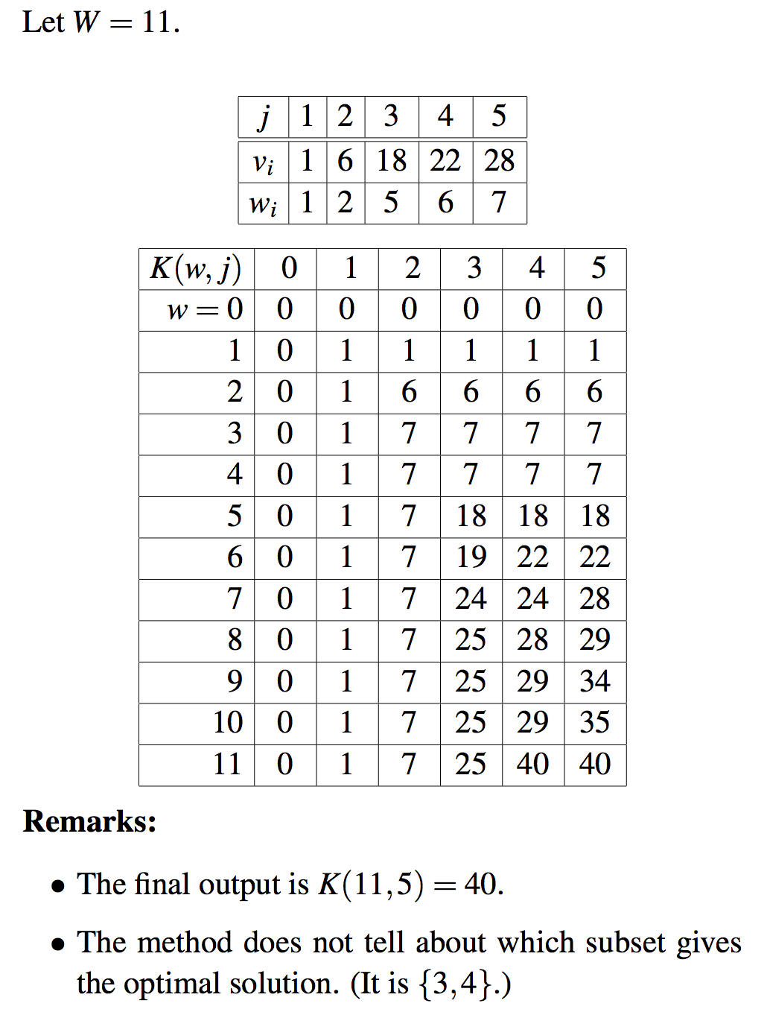

Slide 56
Constructing the optimal solution
The algorithm for computing K(w,j) described earlier does not keep record of which subset of items gives the optimal solution.
To compute the actual subset, we can add an auxiliary boolean array keep(w,j) which is 1 if we decide to take the j-th item in K(w,j) and 0 otherwise.
In this case can you retrieve the solution?

Slide 57
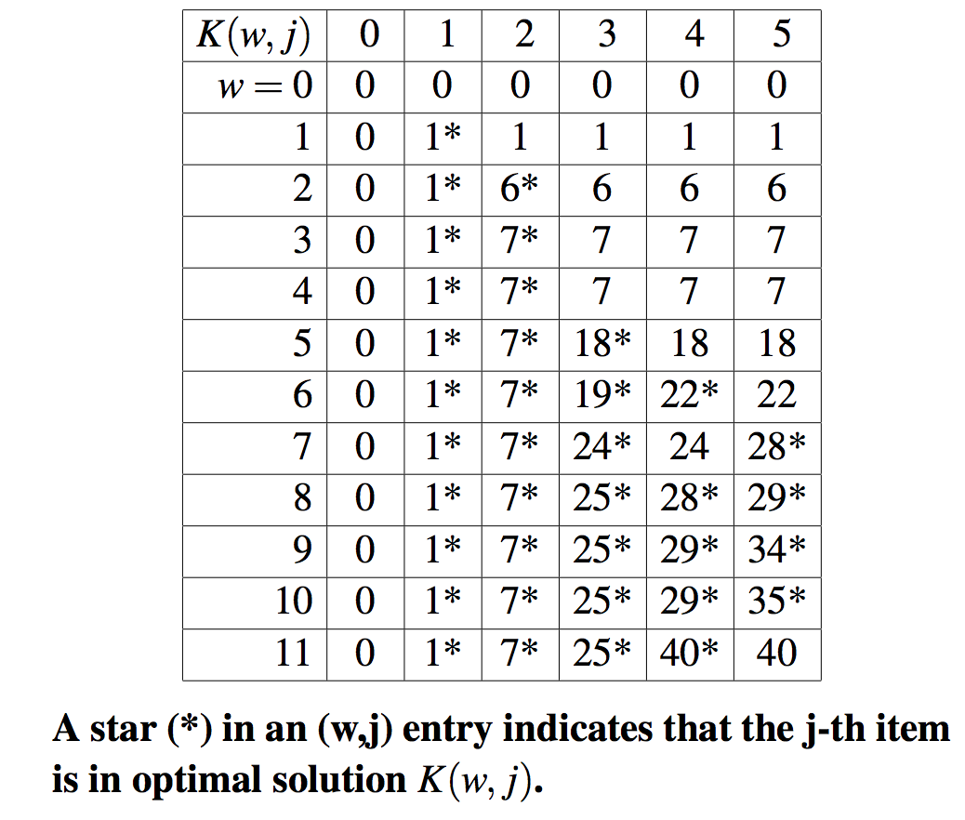

Slide 58
Memoized-Solution (Top down)
memoized-output(w,j)
if w ≤ 0 then return 0;
if j = 0 then return 0;
else
if K(w,j) = K(w,j-1) then memoized-output(w,j-1);
else
Print j;
memoized-output(w-w_{j}, j-1);
The total cost is O(n). (Why?)

Slide 59
Longest Increasing Subsequence
The input is a sequence of numbers: a₁, a₂, …, a_{n}.
A susequence is any subset of these numbers taken in order, of the form where 1 ≤ i₁ < i₂ < ….. ≤ n.
A subsequence is an increasing sequence if the numbers are getting strictly larger.
The largest increasing subsequence of 5, 2, 8, 6, 3, 6, 9, 7 is 2, 3, 6, 9.

Slide 60
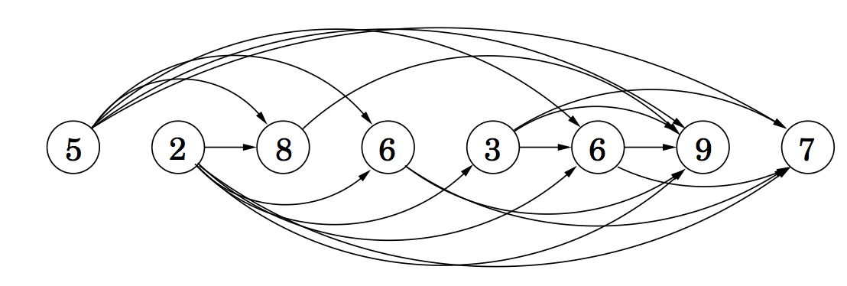
DAG of increasing sequence
For each pair (a_{i}, a_{j}), i < j, draw an arc from a_{i} to a_{j} if a_{i} < a_{j}.
The dag can be constructed in O(n²) time.

Slide 61
DAG of increasing sequence
For each pair (a_{i}, a_{j}), i < j, draw an arc from a_{i} to a_{j} if a_{i} < a_{j}.
The dag can be constructed in O(n²) time.
Need to find the longest path that ends in a vertex.

Slide 62
DP solution
Define subproblems:
L(i) : longest path through the vertices of {1,2,3, …, i} that ends at i.
There are n subproblems.

Slide 63
DP solution
Find the recurrence:
Building the solution of L(i) using the solutions of the subproblems L(j), j= 1, 2, …, i-1.
L(i) = 1 + max {L(j): (j,i) ε E}
Total number of subproblems is n.

Slide 64
DP solution
Base cases:
L(i) = 0 if node I has no incoming edge.

Slide 65
DP solution
Recursive solution:
function L(i)
if i has no incoming edge then return 0;
else
return (1 + max (L(j): (j,i) ε E))
Memoized version is easy

Slide 66
DP solution
Recursive memoized solution:
function memoized-L(i)
If i has no incoming edge, return 0;
else
if L(i) is already computed then return L(i);
else
return (1 + max (L(j): (j,i) ε E));

Slide 67
DP solution
Running time:
Building the DAG from the input data costs O(n²) time.
Can you build it in O(nlogn + |E|) time?
(|E| is the number of edges created)
Running DP on the DAG is O(n +|E|) time in the worst case.

Slide 68
Outputing the optimal subsequence
memoized-output-L(i)
/* Output the longest path that ends at i.
if i has no incoming edge then return 0;
for each j where the arc (j,i) ε E
if L(j) +1 = L(i) then set j*=j;
Print a_{j*};
memoized-output-L(j*);

Slide 69
Shortest paths (constraint)
Problem: Given a graph G, and s (source) and t (end) vertices, find the shortest path from s and t that uses at most k edges.

Slide 70
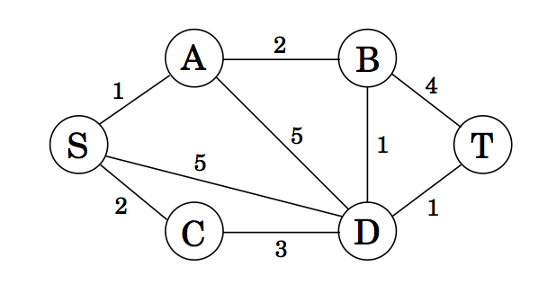
Shortest paths (constraint)
In the following,
the shortest path cost from s to t is 5 and has 4 edges.
the shortest path using only two or three edges is 6.

Slide 71
Shortest paths (constraint)
Dijkstra’s algorithm cannot be adapted.
DP solution is possible.

Slide 72
Shortest paths (constraint) (DP solution)
Subproblems

Slide 73
Shortest paths (constraint) (DP solution)
Subproblems
dist(v, i): shortest path distance to v using at most i edges.
There are O(n.k) subproblems. n vertices and path length of at most k.

Slide 74
Shortest paths (constraint) (DP solution)
Subproblems
dist(v, i): shortest path distance to v using exactly i edges.
There are O(n.k) subproblems. n vertices and path length of at most k.
Recurrence

Slide 75
Shortest paths (constraint) (DP solution)
Subproblems
dist(v, i): shortest path distance to v using at most i edges.
There are O(n.k) subproblems. n vertices and path length of at most k.
Recurrence
Base case
dist(v,0) = ∞ for all vertices v.
dist(s,0) = 0

Slide 76
DP solution
Recursive memoized solution:
function memoized-dist(v,i)
if i = 0 and v = s then return 0
else return ∞;
else
if dist(v,i) is already computed then return dist(v,i);
else
return (min{dist(u,i-1) + l_{e}(u,v) : (u,v) ε E});

Slide 77
Shortest paths (constraint) (DP solution)
Iterative algorithm:
Set dist(v,0) = ∞ for all vertices v of V.
dist (s,0) = 0
for (i = 1; j = k; i++) {
for each v of V
}
Output the vertex v with the smallest dist(v,j), j=1, 2, …, k.
Total cost is O(k(|V| + |E|)). (why?)

Slide 78
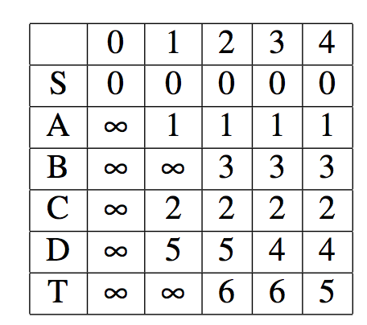
Shortest paths (constraint) (DP solution)
The values of dist(v,i) for all i and v for the following graph is:
Entries of the table is computed column-wise.
length
vertex
Distance Table

Slide 79
Constructing the optimal solution
The algorithm for computing dist(v,i) described earlier does not keep record of path of the optimal solution.
To compute the actual subset, we can add an auxiliary array prev(v,i) which records the prvious vertex.
In this case can you retrieve the solution?

Slide 80
All-pairs shortest paths
Dijkstra’s algorithm and the Bellman-Ford algorithm solve the single-source shortest paths problem in which we want shortest paths starting from a single node.
Dijkstra’s algorithm takes (O((|V| + |E|)log |V|)) time; edges have positive costs.
Bellman-Ford algorithm takes (O(|V|(|V| + |E|))) time; edges may have negative costs, but no cycles.

Slide 81
All-pairs shortest paths
The all-pairs shortest paths problem asks how to find the shortest paths between all possible pairs of nodes.
edges have positive costs; Dijkstra’s algorithm takes (O((|V| + |E|)log |V|) x |V|);
edges may have negative costs, but no cycles; Bellman-Ford algorithm takes (O(|V|²(|V| + |E|))) time;

Slide 82
Intermediate nodes
A path between u and v starts at u, passes through some set of intermediate nodes, and ends at v.
If there are no negative cycles, there is some shortest path from u to v where there is no intermediate nodes.

Slide 83
Intermediate nodes
Number all the nodes v₁, v₂, …, v_{n}.
What does a shortest path from u to v look like if no intermediate nodes are allowed?
What does a shortest path from u to v look like if only one node, say v₁, can be an intermediate node?
What does a shortest path from u to v look like if only the intermediate nodes are from v₁ and v₂?
What does a shortest path from u to v look like if only the intermediate nodes are from v₁, v₂ and v₃?

Slide 84
DP solution (Floyd-Warshall’s algorithm)
Find subproblems:
dist(i,j,k) is the subproblem fo computing the shortest path from v_{i} to v_{j} in which only nodes {v₁, v_{2,} …, v_{k}} can be used as intermediate nodes. (k ≠ i, j)
There are O(n³) subproblems:
1 ≤ i ≤ n; 0 ≤ j ≤ n; 0 ≤ k ≤ n.
The space complexity is O(n³)

Slide 85
DP solution (Floyd-Warshall’s algorithm)
Find recurrence relation
dist(i, j, k) contains v_{k} as an intermediate node
dist(i,j,k) does not contain v_{k} as an intermediate node
dist(i,j,k) = min{dist(i,k,k-1) + dist(k,j, k-1), dist(i,j,k-1)}

Slide 86
DP solution (Floyd-Warshall’s algorithm)
Basis
dist(i,j,0) = length of the direct edge between v_{i} and v_{j}, if it exists, and is ∞ otherwise.

Slide 87
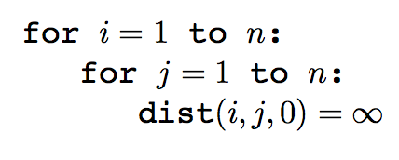
DP solution
Floyd-Warshall algorithm : Time is O(|V|³)

Slide 88
Example
dist(i,j,k) = min{dist(i,k,k-1) + dist(k,j, k-1), dist(i,j,k-1)}

Slide 89
Example
dist(i,j,k) = min{dist(i,k,k-1) + dist(k,j, k-1), dist(i,j,k-1)}

Slide 90
Step 4

Slide 91
Problems from the text
Problem 6.1
Subproblems D(j), 0 ≤ j ≤ n, largest sum of a contiguous subsequence ending exactly at position j.
Recurrence : D(j) = max {0, D(j-1) + a_{j}}
Base case: D(0) = 0;
For the sequence 5, 15, -30, 10, -5, 40, 10, -15:
D(0)=0; D(1)=5, D(2) = 20, D(3) = 0, D(4) = 10, D(5) = 5,
D(6)=45, D(7)=55, D(8) = 40.
Optimal solution is D(7) which is 55.
Show that the optimal can be computed in linear time.
How do you find the sequence?

Slide 92
Problems from the text
Problem 6.3
Subproblems D(j), 0 ≤ j ≤ n, maximum profit that can be obtained from locations 1 to j.
Recurrence : j-th hotel is included or not included
If j-th hotel is included, any hotel within k miles cannot be selected. Let j* < j denote the first hotel outside k mile range.
D(j) = max {D(j*) + p_{j} , D(j-1)}
Base case: D(0) = 0;
Since the locations are given in sorted order, j* can be computed for all j in linear time.
Show that the optimal can be computed in linear time.
How do you find the sequence?

Slide 93
Problems from the text
Problem 6.8
Subproblems L(i,j): gives the longest common subsequence of x₁x₂…x_{i} and y₁y₂…y_{j}, i=1, 2,…,n and j=1, 2, …, m. There are mn subproblems.
Recurrence : In the largest common substring of length L(i,j), either x_{i} = y_{j}, or x_{i} ≠ y_{j}.
L(i,j) = L(i-1,j-1) + 1 if x_{i} = y_{j}
L(i,j) = max { L(i,j-1), L(i-1,j)} if x_{i} ≠ y_{j}.
Base cases L(i,0) = 0, i=1,2, …,n, and L(0,j) = 0, j=1,2, …, m.
Provide an implementation
Show that the optimal can be computed in O(mn) time.
How do you find the sequence?

Slide 94
Problem 6.20 (Optimal binary search tree)
Binary search trees (bst) are used to store a set of keys for fast access.
A balanced bst achieves a worst-case time O(logn) for each key search, but fails to take advantage of the structure of the data.
For instance, a frequently appearing word, such as ‘the’, may be placed deep in the tree.
In practice, keys are accessed with different frequencies. Optimal Binary Search Tree exploits this non-uniformity of access patterns.
The input is a list of words (keys) w₁, w₂, …, w_{n} along with their access probabilities p₁,p₂, …,p_{n} which are known at the start.

Slide 95
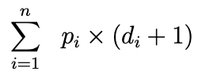
Problem 6.20 (Optimal binary search tree)
The input is a list of words (keys) w₁, w₂, …, w_{n} along with their access probabilities p₁,p₂, …,p_{n} which are known at the start.
In a bst, accessing a key at depth d incurs search cost d+1. If the word w_{i} is stored at depth d_{i} in the tree, the expected access cost is

Slide 96
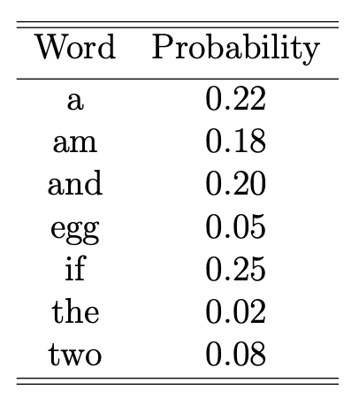
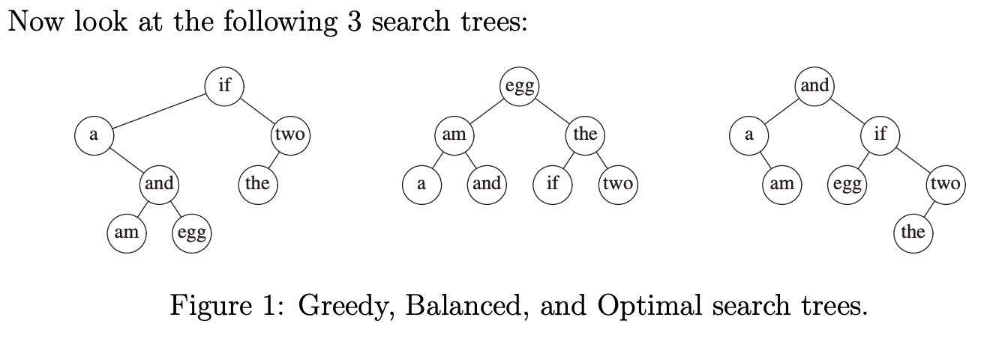
Problem 6.20 (Optimal binary search tree)
An example:

Slide 97
Problem 6.20 (Optimal binary search tree)
An example:
Greedy expected access cost: 2.43
Balanced expected cost: 2.70
Optimal expected cost: 2.13

Slide 98
DP solution
Sub-problem
Let S(i,j) be the total search cost for the optimal bst of the words w_{i,} w_{i+1}, …., w_{j}.
S(i,j) = 0 for i ≥ j.
If the optimal tree for subproblem has w_{r} as the root, we can write
Recurrence formula

Slide 99
DP solution
Sub-problem
Let S(i,j) be the total search cost for the optimal bst of the words w_{i,} w_{i+1}, …., w_{j}.
S(i,j) = 0 for i ≥ j.
If the optimal tree for subproblem has w_{r} as the root, we can write
Recurrence formula
The memoized running time is O(n³)

