Slide 1
Graphs (Chapter 3)

Slide 2
Acknowledgement
I have used some slides from:
http://web.stanford.edu/class/archive/cs/cs161/cs161.1138/

Slide 3
Why Graphs?
Graphs are commonly used to represent varieties of problems.

Slide 4
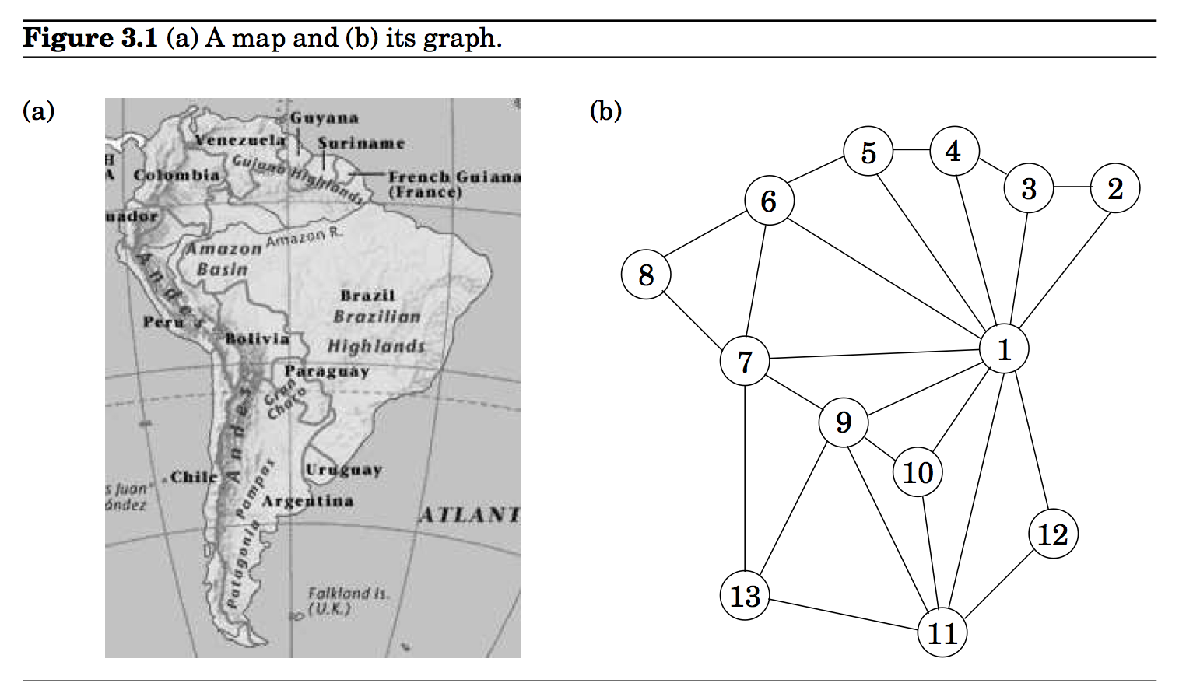

Slide 5
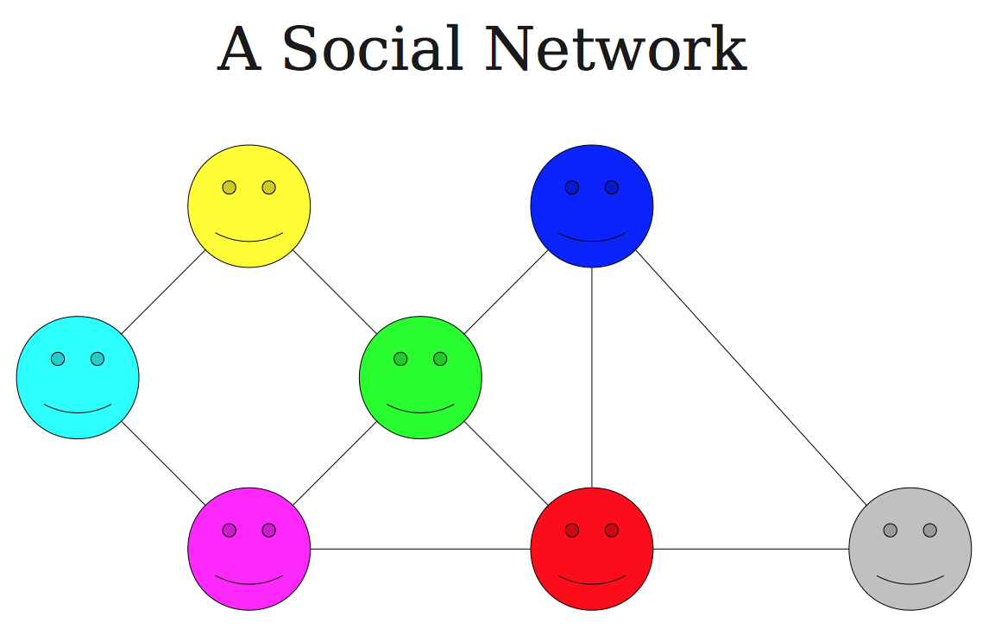

Slide 6
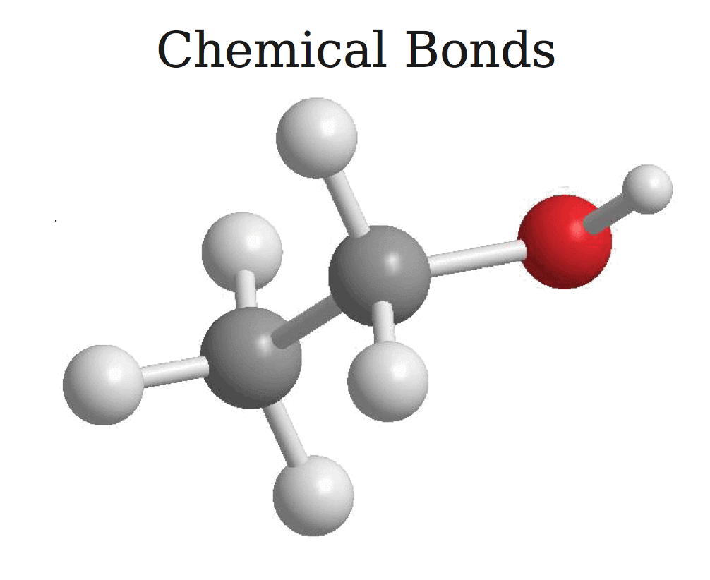

Slide 9
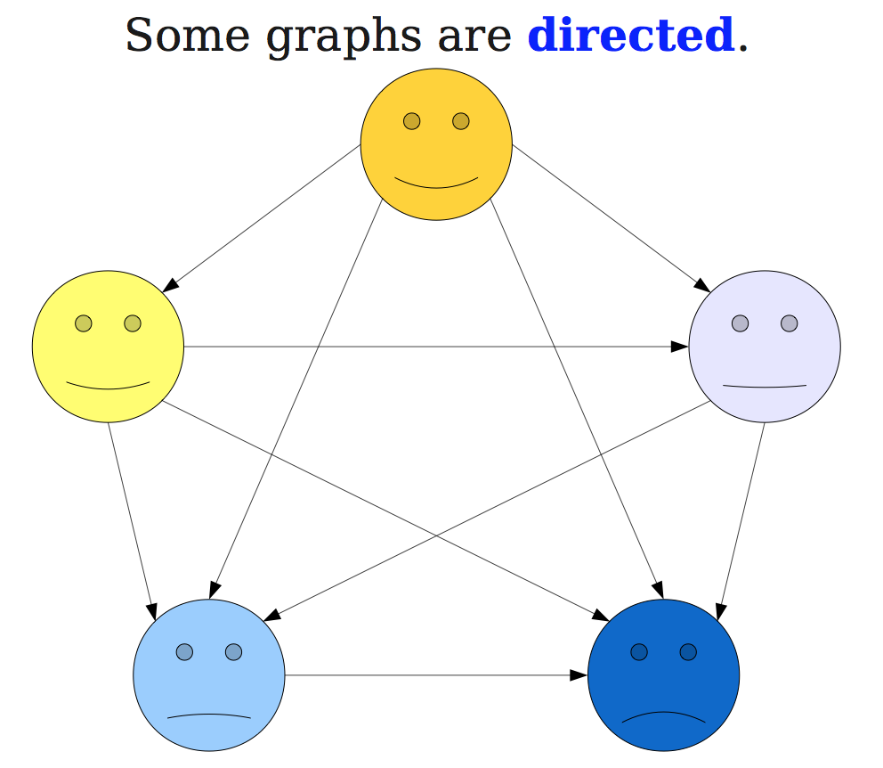

Slide 11
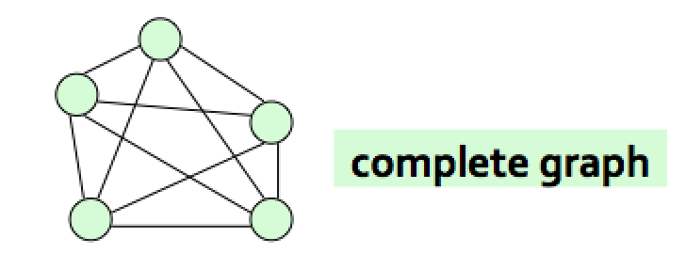
Some examples
Connected graph
Complete graph

Slide 12
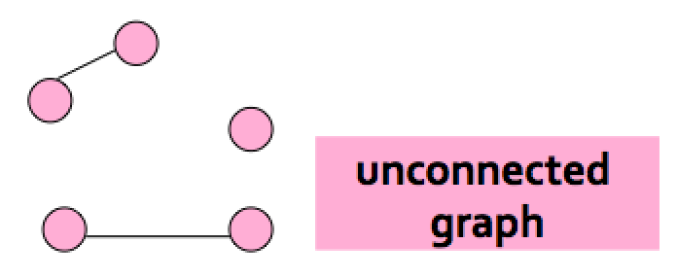
Some examples
Disconnected graph

Slide 13
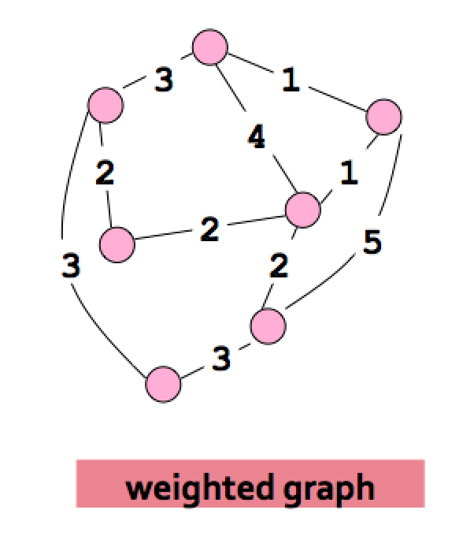
Some examples
Edge-weighted graph

Slide 14
Graph Terminology
A graph is an ordered pair G=(V,E) where
V is the set of vertices (nodes) of the graph
E is the set of edges of the graph
E can be a set of ordered or unordered pairs of vertices: e= {u,v} (undirected}; e=(u,v) (directed).
If E consists of unordered pairs, G is undirected.
If E consists of undirected pairs, G is directed.

Slide 15
Graph Terminology
When analyzing algorithms on a graph, there are usually two parameters we care about:
The number of nodes n. (n = |V|)
The number of edges m, (m = |E|)
Note that m = O(n²) .
A graph is dense if m = Θ(n²). A graph is called sparse if it is not dense.

Slide 16
Graph Terminilogy
In an undirected graph, the degree of a node (denoted deg(v)) is the number of edges incident to v.
In a directed graph, the indegree of a node (denoted deg⁻(v)) is the number of edges entering v and the outdegree of a node v (denoted deg⁺(v)) is the number of edges leaving v.

Slide 17
Some examples
Edge-weighted graph

Slide 19
How is a graph represented?
Adjacency matrix: If there are n = |V| vertices v₁ , v₂ , …, v_{n} , this is an n x n array whose (i,j)th entry is
For undirected graphs, the matrix is symmetric.
For directed graphs the matrix is not symmetric.

Slide 20
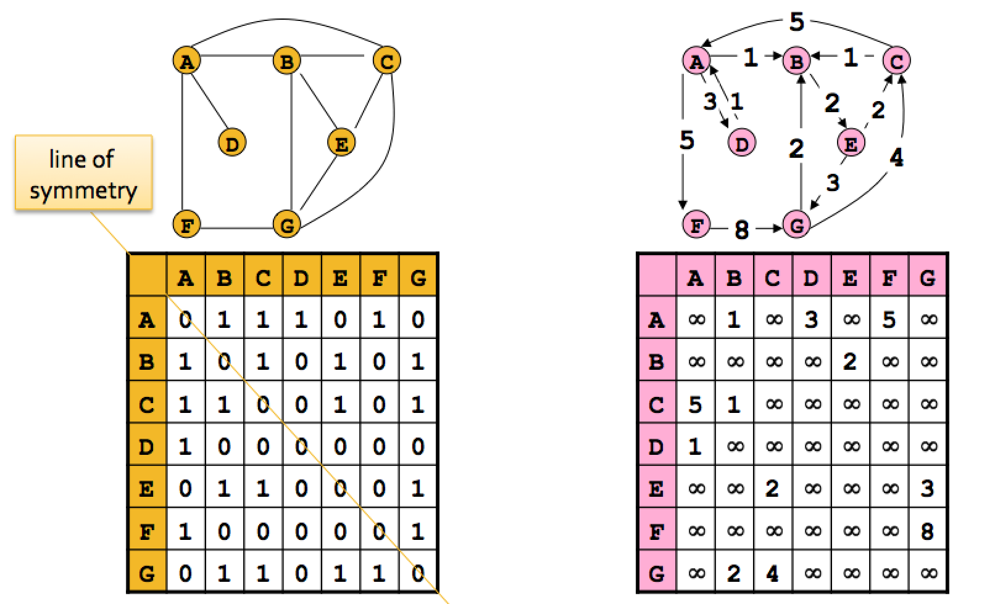
Storage space: O(n²)

Slide 21
Adjacency matrix benefit
The biggest convenience is that the presence of a particular edge can be checked in constant time.
Any algorithm that uses adjacency matrix structure to store a graph has Ω(n²) lower bound. This is true even if |E| is O(n).

Slide 22
Adjacency list representation
It consists of |V| linked lists, one per vertex.
The linked list for a vertex u holds the names of the vertices to which u has an edge of the type {u,v} or (u,v) of E.
Each edge appears in exactly one of the linked lists if the graph is directed, or two of the lists if the graph is undirected.

Slide 23
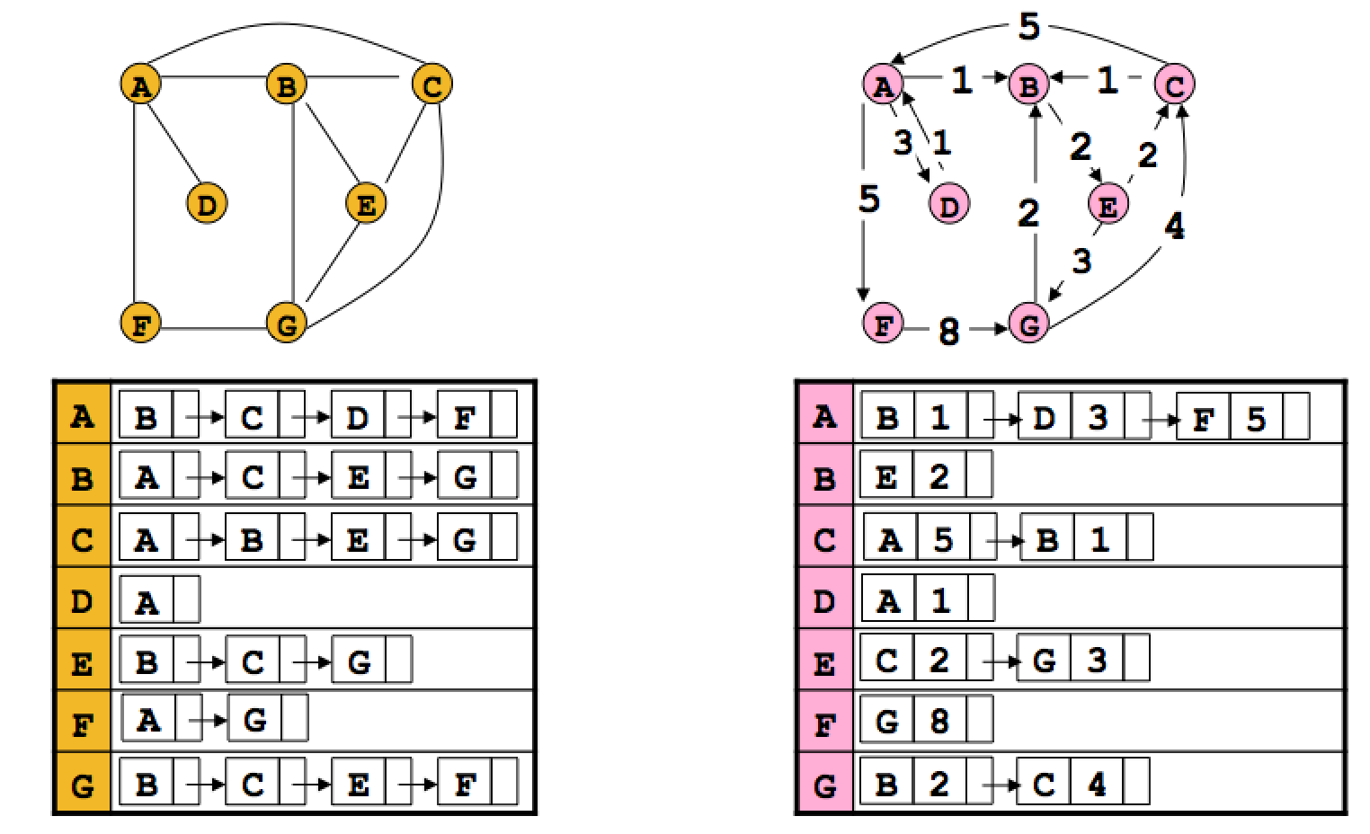
Storage space: O(n+m)

Slide 24
Adjacency lists benefits
The storage space requirement is O(n + m), which is optimal in the sense that no other representation taking less than this amount is possible.
Checking of for an edge is no longer a constant time operation.
Iterating through all the neighbors of a vertex is now easy.
An algorithm on a graph runs in linear time if the running time of the algorithm is O(n + m).

Slide 25
Relative advantages of adjacency lists and matrices (From the book: The Algorithm Design Manual by Skienna)

Slide 26
Depth-first search (DFS) in undirected graph
DFS is a versatile linear time procedure to traverse (explore) a graph.
The undirected graph G=(V,E) is represented by an adjacency list.
DFS traverses a graph G = (V,E) in a systematic manner revealing a wealth of information about a graph.

Slide 27
explore(G,v)
Visits the vertices of G, reachable from v.
Input: undirected graph G = (V,E); v ∈ V.
Output: visited(u) is set to true for all nodes reachable from v.
The graph is represented an adjacency list structure.
The algorithm is recursive.

Slide 28
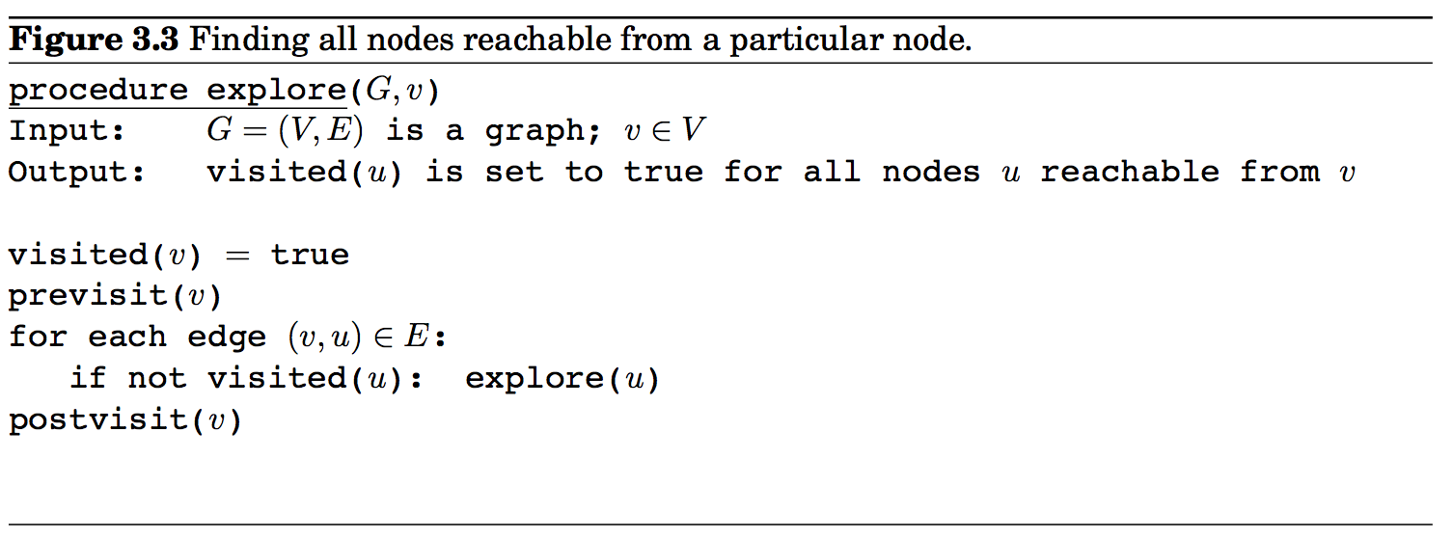
explore(G,v)
The algorithm given in the text follows.

Slide 29
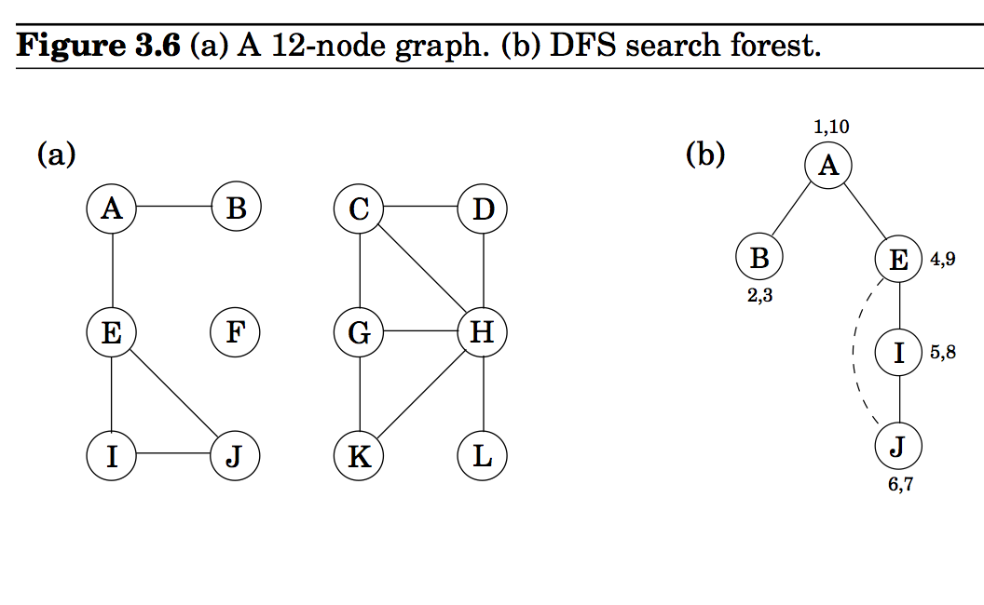
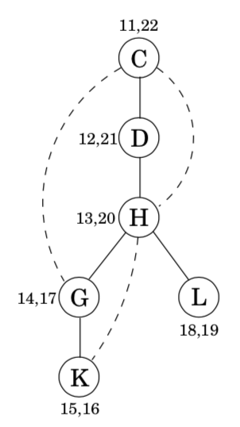
An example

Slide 30
explore(G,v)
The algorithm given in the text
The previsit(v) and postvisit(v) procedures are optional meant for performing other operations on the vertex v.

Slide 31
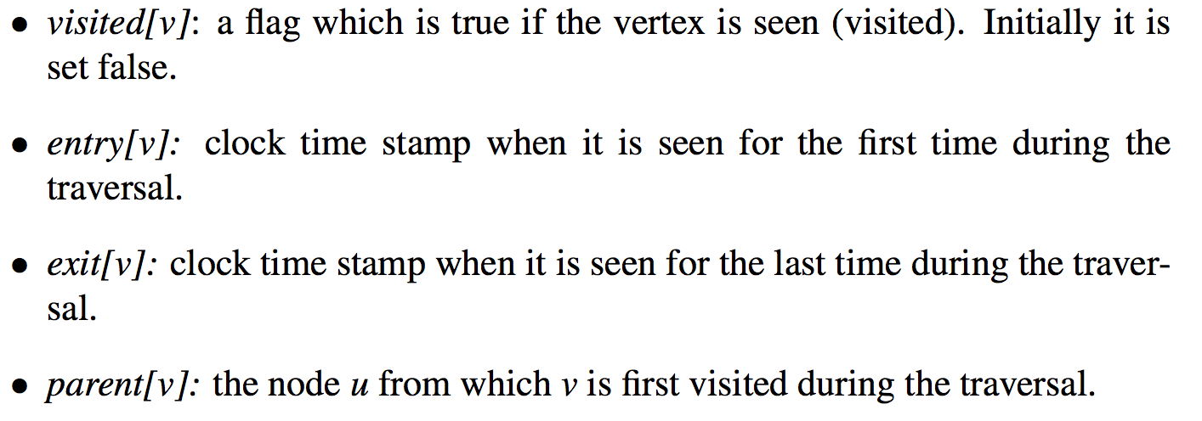
explore(G,v) A neat implementation

Slide 32
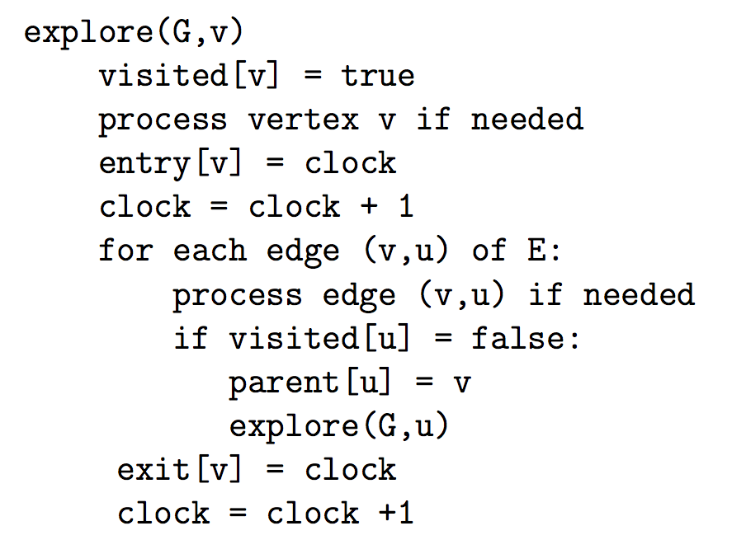
explore(G,v) A neat implementation

Slide 33
An example

Slide 34
An example
parent[A] = nil
parent[B] = A
parent[E] = A
parent[I] = E
parent[j] = I

Slide 35
An example
parent[A] = nil
parent[B] = A
parent[E] = A
parent[I] = E
parent[j] = I
The solid edges are actually those that are traversed, each of which is effected by a call to explore and led to the discovery of a new vertex. These edges form a tree. The edges are call DFS tree edges.
Tree edges are { (parent[u],u)| ∀ u, parent[u] is not nill}

Slide 36
dfs(G)
The explore procedure visits only the portion of the graph reachable from its starting point.
To examine the rest of the graph, we need to restart the procedure elsewhere, at some vertex that has not yet been visited.

Slide 37
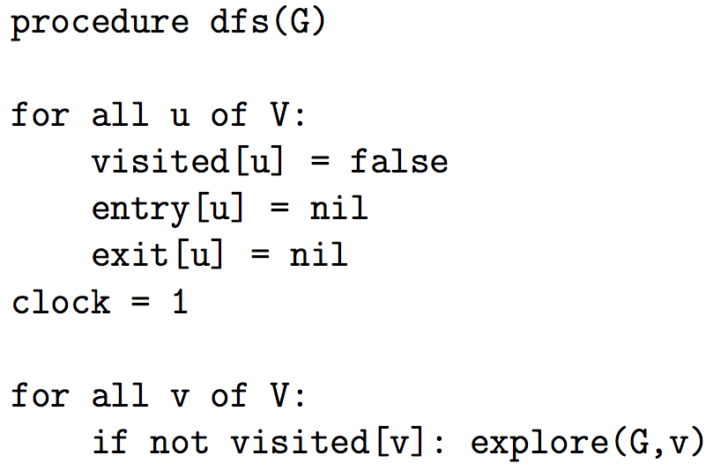
Procedure dfs(G)

Slide 38
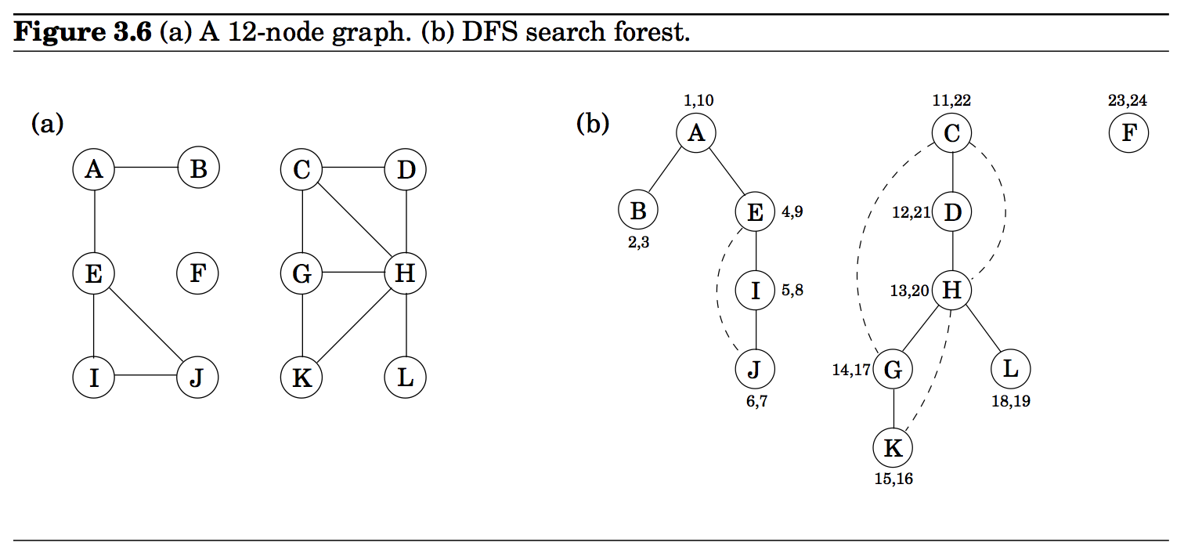
An example

Slide 39
Analysis of dfs(G)
Thanks to the ``visited” array, each vertex is explore’d exactly once.
During the exploration of a vertex, there are the following steps:
Some fixed amount of work – marking the spot as visited, assigning a value to entry, exit array (included in previsit /postvisit section; in the text they are called pre and post times) (O(1) total time per vertex)
A loop in which adjacent edges are scanned, to see if they lead to somewhere new.
Each edge connecting x and y is visited twice: once during explore(G, x) and once during explore(G,y).
The overall time for step 2 over the entire course of dfs(G) is O(|E|).
The worst case running time is O(|V|+|E|).
DFS algorithm is optimal.

Slide 40
Interesting observation of time intervals
The time intervals have interesting and useful properties with respect to a depth-first search.
Who is an ancestor in the DFS tree?
Suppose x is an ancestor of y in DFS tree. This implies that we must visit x before visiting y, and we must exit y before we exit x. Therefore, the time interval [entry[x], exit[x]] contains the time interval [entry[y], exit[y]].

Slide 41
An example

Slide 42
Interesting observation of time intervals
How many descendants?
The difference between the exit (post in the text) and the entry (pre in the text) times for v tells us how many descendants v has in the DFS tree. The clock gets incremented on each vertex entry and vertex exit, so half the time difference denotes the # of descendants of v.

Slide 43
An example

Slide 44
Connectivity in undirected graphs
An undirected graph is connected if there is a path between any pair of vertices.
A connected component of G is a subset C of V with the following properties:
C is nonempty.
For any u, v ∈ C: u and v are connected.
For any u ∈ C, v ∈ V – C: u and v are not connected.

Slide 45
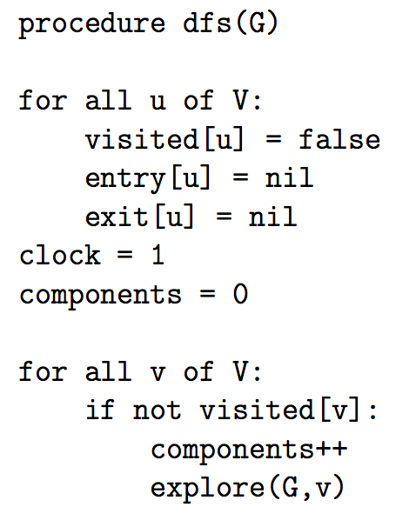
Connectivity in undirected graphs
The following modifications to dfs(G) compute the number of connected components of G.

Slide 46
Depth-first search in directed graphs
For directed graphs, algorithm explore(G,v), designed for undirected graphs earlier, can be used in verbatim.

Slide 47
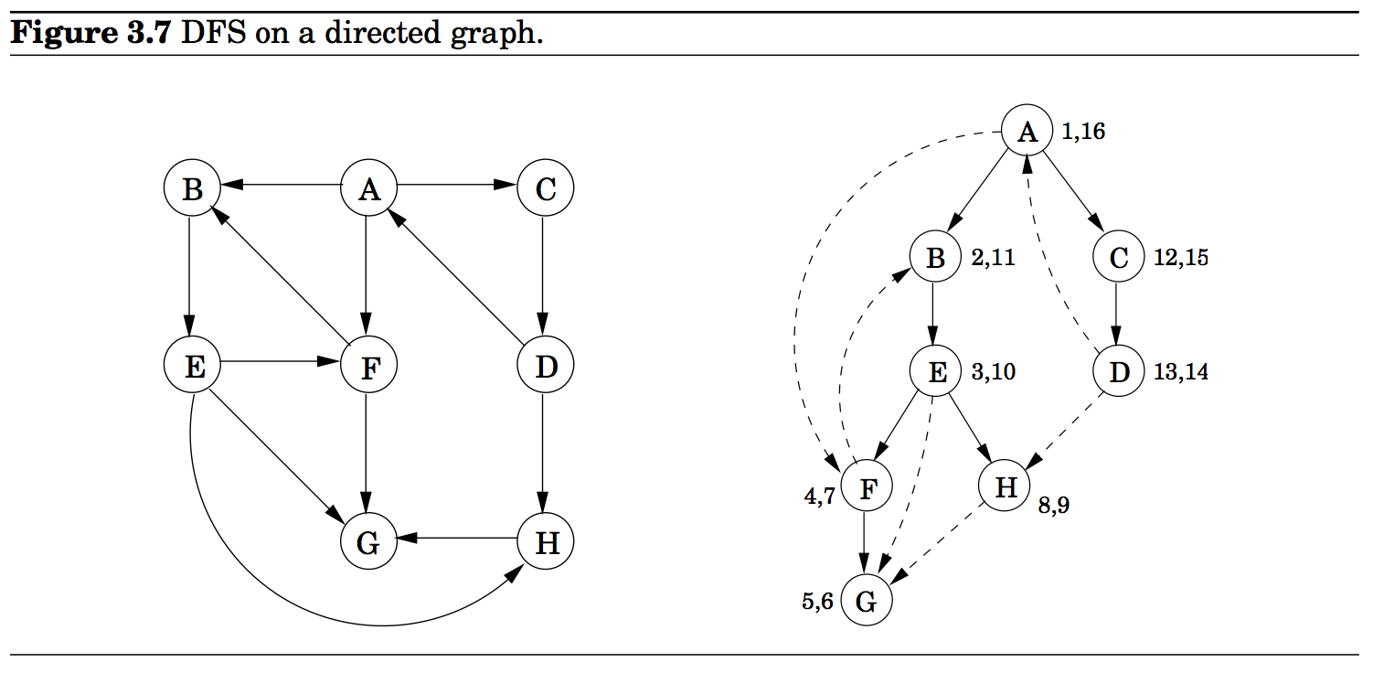
Vertices are picked in lexicographic order.
A is the root of the search tree; everything else is its descendants.
E has descendants F, H, G, and conversely, is an ancestor of these three nodes.
C is the parent of D

Slide 48
Types of edges
Tree edges: Edges lead from a node to its The resulting tree could be disconnected (forest).
Forward edges: Edges lead from a node to a nonchild descendant in DFS tree.
Back edges: Edges lead to an ancestor in the DFS tree
Cross edges: Edges lead to neither descendant nor ancestor.

Slide 49
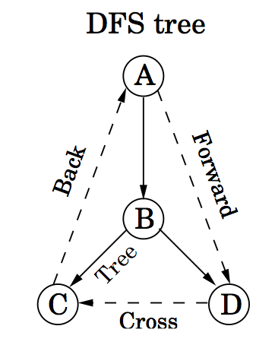
Types of edges
Tree edges: Edges lead from a node to its The resulting tree could be disconnected (forest).
Forward edges: Edges lead from a node to a nonchild descendant in DFS tree.
Back edges: Edges lead to an ancestor in the DFS tree
Cross edges: Edges lead to neither descendant nor ancestor.
Let u and v be two nodes. Ancestor or descendant relationships can be determined directly from entry (pre) and exit (post) numbers.
Let [_{u} …. ]_{u} denote the time interval for node u.
If the intervals of u and v look like [_{u} … [_{v} … ]_{v} … ]_{u}, u is the ancestor of v or v is the descendant of u.

Slide 50
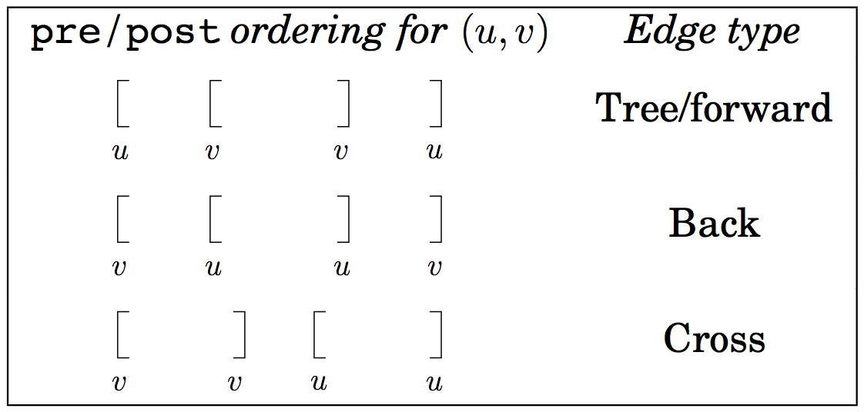
Summary of the various possibilities for an edge (u,v)

Slide 51
Directed acyclic graphs (DAGs)
A graph without a cycle is called acyclic.
G is a DAG if and only if its depth-first search reveals no back edge. This can therefore be tested in optimal O(|V| + |E|) time. In a DAG, every edge leads to a vertex with lower exit (post) number.
DAGs are good for modeling hierarchies and temporal dependencies: course prerequisites, task dependencies etc.

Slide 52
Strongly Connected Components
Directed Conectivity
In a directed graph, we say v is reachable from u if and only if there is a path from u to v.
In an undirected path, if there is a path from u to v, there is also a path from v to u.
In a directed graph, it is possible for v to be reachable from u, but u is not reachable from v.
Two nodes u and v of a directed graph are connected (or strongly connected) if there is a path from u to v and a path from v to u.

Slide 53
Strongly Connected Components
Let G = (V, E) be a directed graph.
A strongly connected component (or SCC) of G is a subset C of V with the following properties:
C is not empty.
For any u, v ∈ C: u and v are strongly connected.
For any u ∈ C, v ∈ V – C: u and v are not strongly connected.

Slide 54
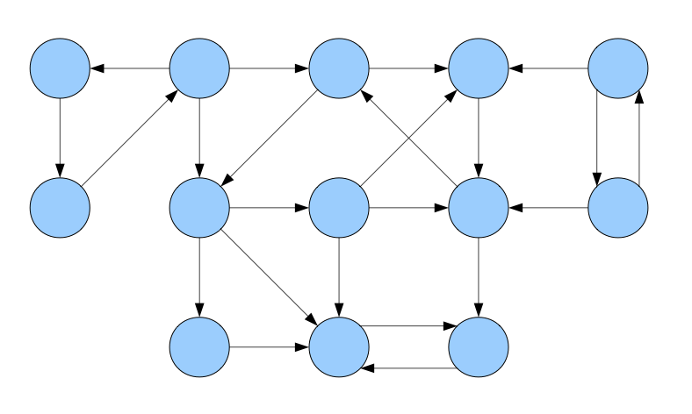
A directed graph

Slide 55
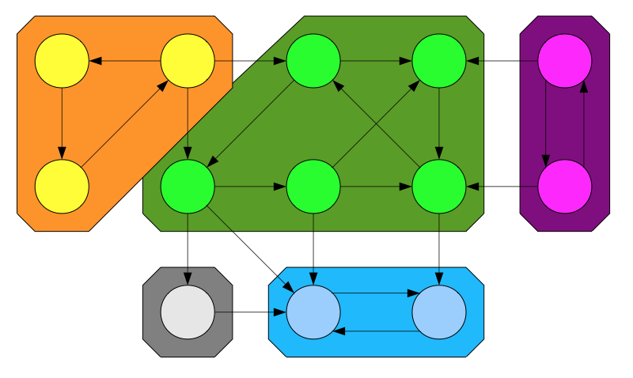
A directed graph and its strongly connected components

Slide 56
Properties of SCCs
The following properties of SCCs are true. (why?)
Two SCCs C₁ and C₂ are either equal or disjoint
Every node belongs to exactly one SCC
The SCCs of a graph form a partition of the nodes of the graph.

Slide 57
Condensation (meta) graphs
The condensation of a directed graph G is the directed graph G^{SCC} whose nodes are the the SCCs of G and whose edges are defined as follows:
(C₁, C₂) is an edge in G^{SCC} iff
∃u ∈ C₁, v ∈ C₂; (u, v) is an edge in G.
In other words, if there is an edge in G from any node in C₁ to any node in C₂, there is an edge in G^{SCC} from C₁ to C₂.

Slide 58
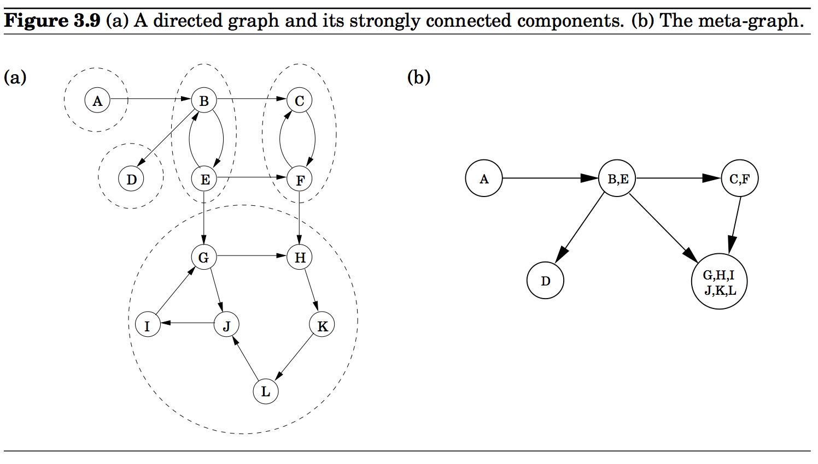

Slide 59
An important property
The condensation (meta) graph G^{SCC} of any directed graph G is a dag.
Every dag has at least one source node and at least one sink node.

Slide 60
An efficient algorithm to compute the SCCs of a directed graph.
The objective of the algorithm is to identify one of the source nodes in the condensation graph. Once it is identified, it will be removed from G. The process is repeated for the reduced graph.
The objective is to use the depth-first search algorithm which we know runs very fast.

Slide 61
Identify a source strongly connected component
Perform DFS(G)
Find the node with the largest exit (post) time stamp.

Slide 62
Identify a source strongly connected component
z lies in a strongly connected component which is a source node in the condensation graph G^{SCC.}
Perform DFS(G)
Find the node z with the largest exit (post) time stamp.

Slide 63
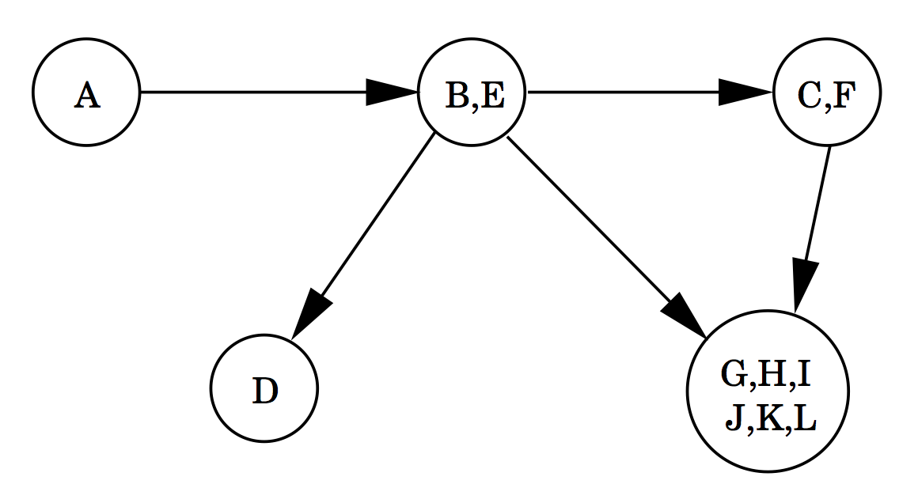
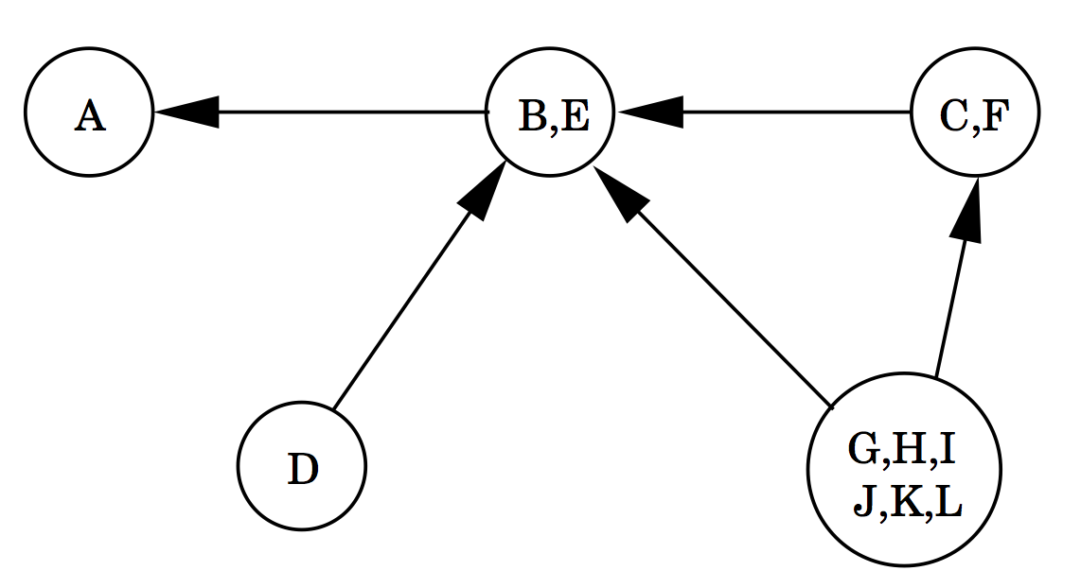
Determine the SCC that contains z
z
z
G^{SCC}
(G^{SCC}) ^{R}
Perform DFS on G^{R} from node z where G^{R} is obtained from G = (V, E) by reversing the direction of each edge of G.
The search ends after finding the component containing z.
The time spent to find this component is proportional to the size of the component.
Remove all the nodes from G, reachable from z. Let G’ be the reduced graph.

Slide 64
Repeat the process after removing a component
(G’)^{SCC}
((G’)^{SCC})^{R}
Select the next vertex z of G’ with the largest exit time stamp.
z now lies in the component which is a source node of (G’)^{SCC}. In the figure it is either B or E.
We find all the vertices reachable from z’. These vertices form a strongly connected component.

Slide 65
Algorithm to computing strongly connected components
G is the given directed graph.
Run DFS on G.
Record the exit (post) time stamp of each node.
Compute G^{R}
Run DFS on G^{R} always starting from the node with the largest exit time stamp.
Since G^{R} can be computed in linear time, the above algorithm runs in linear O(|V| + |E|) time.

Slide 67
Finding Cycles
In an undirected graph, the absence of nontree edges imply nonexistence of cycles. (why?)
This can be tested by the DFS of the graph.

Slide 68
Topological Sorting
Topological sorting is the most important operation on DAGs.
It orders the vertices on a line such that all directed edges go from left to right.
Such an ordering cannot exist if the graph contains a directed cycle.
The ordering gives us a sequence of processes which can be executed honoring the precedence relation.

Slide 69
Topological Sorting
Topological sorting can be performed efficiently using DFS.
During the DFS when a vertex receives an exit time stamp, append the vertex in the front of linear order linked list.
For exercise 3.3 of the text, suppose the search starts from A.
The linear order (in reverse order) is :
G, H, F, D, E, A, B.

Slide 70
Problems:
Most of the exercise problems in Chapter 3 in the text are interesting and should be solved. The following problems are designated as practice problems.
Chapter 3: 2, 3, 4, 5, 7*, 10, 11*, 12, 14, 16, 18, 21, 22*, 24, 26, 29

