Slide 1
Course Overview
cmpt 307

Slide 2
Two ancient problems
Factoring: Given a number N , express it as a product of its prime factors.
Primality: Given a number N, determine whether it is a prime.
Factoring is hard. Despite centuries of efforts the fastest methods for factoring a number N take time exponential in number of bits of N.
On the other hand, we can efficiently test whether N is prime!

Slide 3
Elementary Number Theory
Prime Numbers
building block of integers
every positive integer can be written uniquely as a product of prime numbers
difficult to write large integers as a product of primes.

Slide 4
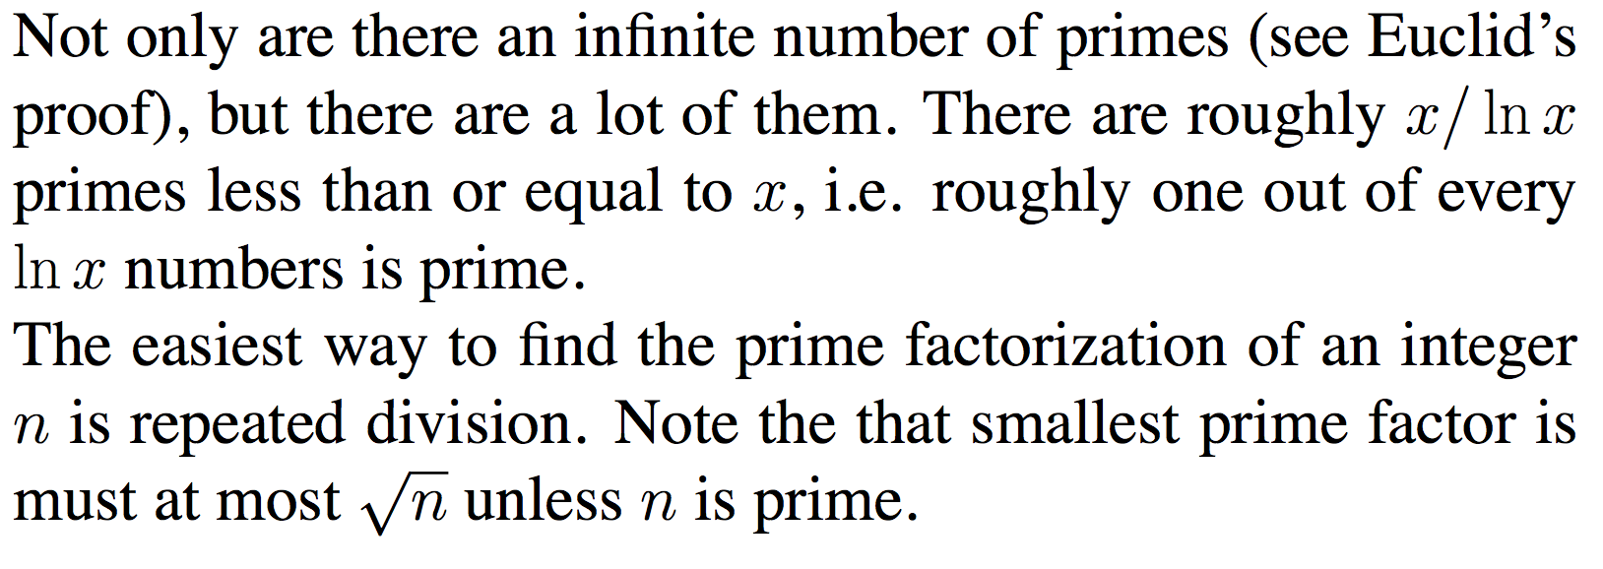
Primality Testing and Factorization

Slide 5
Basic arithmetic
Addition
The sum of any three single-digit numbers is at most two digit long.
The cost of each addition of two integers m and n is O(log m +log n).

Slide 6
Basic arithmetic
Multiplication and Division
multiplying two integers m and n cost O(log m.log n).
Can do better with divide-and-conquer.

Slide 7
Modular arithmetic
Repeated addition and multiplication can get the result cumbersomely large.
Modular arithmetic is a system for dealing with restricted range of numbers.

Slide 8
Exponentiation
In cryptosystem, it is necessary to compute x^{y} mod N for values of x, y, and N that are several hundred bits long.
Like to evaluate 2 ^{(19*(524288))} mod (N).

Slide 9
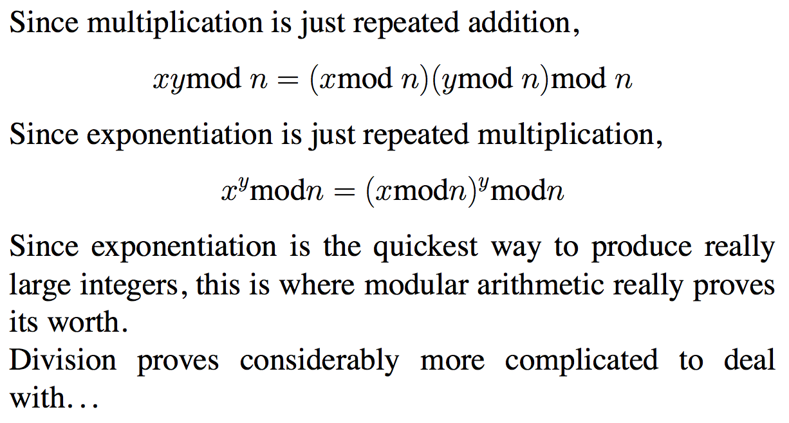
Exponentiation
xy mod n = (x mod n)(y mod n) mod n
x^{y} mod n = (x mod n)^{y} mod n

Slide 10
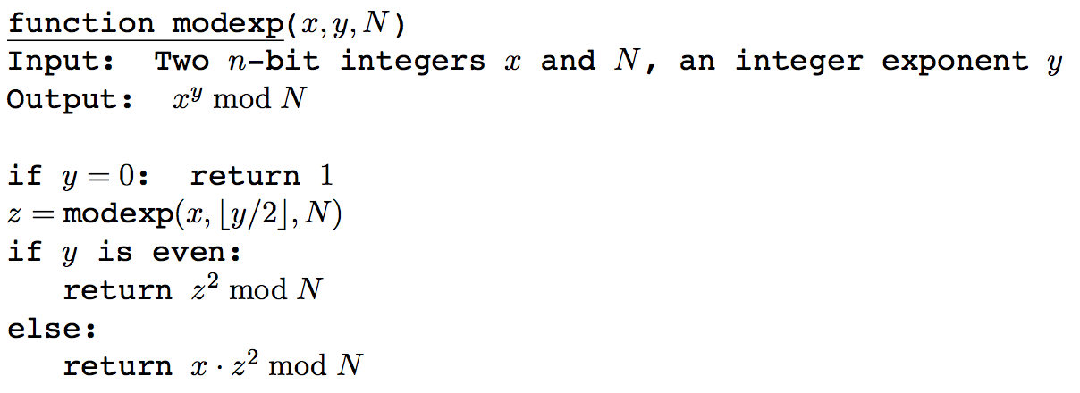
Modular exponentiation
number of bits to represent x^{y} = O(ylog x)
number of bits to represent x^{y} mod N is O(log N).

Slide 11
Euclid’s algorithm (discovered 2000 years ago)
gcd(a, b) // assume that a > b
If b=0 then return a.
Compute r = a mod b
return gcd(b, r)
This takes logarithmic time.
after every two iterations, the largest number gets reduced by a half at least.

Slide 12
Important Property
Given any two integers a and b, there exist integers x and y, such that ax + by = gcd(a,b).

Slide 13
Least Common Multiple (lcm)

Slide 14
Modular division
In real arithmetic, every number a (≠ 0) has an inverse, 1/a.
Multiplying by 1/a is the same as dividing by a.
In modular arithmetic we can make a similar definition:
x is a multiplicative inverse of “a modulo b” iff ax = 1 (mod b).
Theorem: The inverse of a modulo b exists and is unique iff a is relatively prime to b, i.e. gcd(a,b) = 1.
gcd(a,b) = 1 implies ax + by = 1 for some integer x and y
ax = 1 – by implies ax ≡ 1 (mod b).

Slide 15
Solve the equation 247x + 91y = 39
We need to find an x and y (integers)
We find that gcd(247,91) = 13.
Since 13 divides 39, we have a solution.
We can write
3 × 247 – 8 × 91 = 13
or 3 × 19 − 8 × 7 = 1
or 3 × 19 – 19 × 7 × t + 19 × 7 × t – 8 × 7 = 1
or 19 ( 3 – 7t) + 7 ( 19t -8) = 1 for any integer t
Therefore, x = 3 -7t and y = 19t – 8. (ans)

Slide 16
Analysis of algorithms
Chapter 2

Slide 17
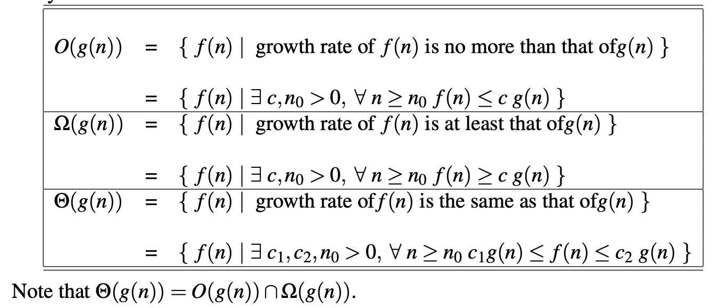

Slide 18
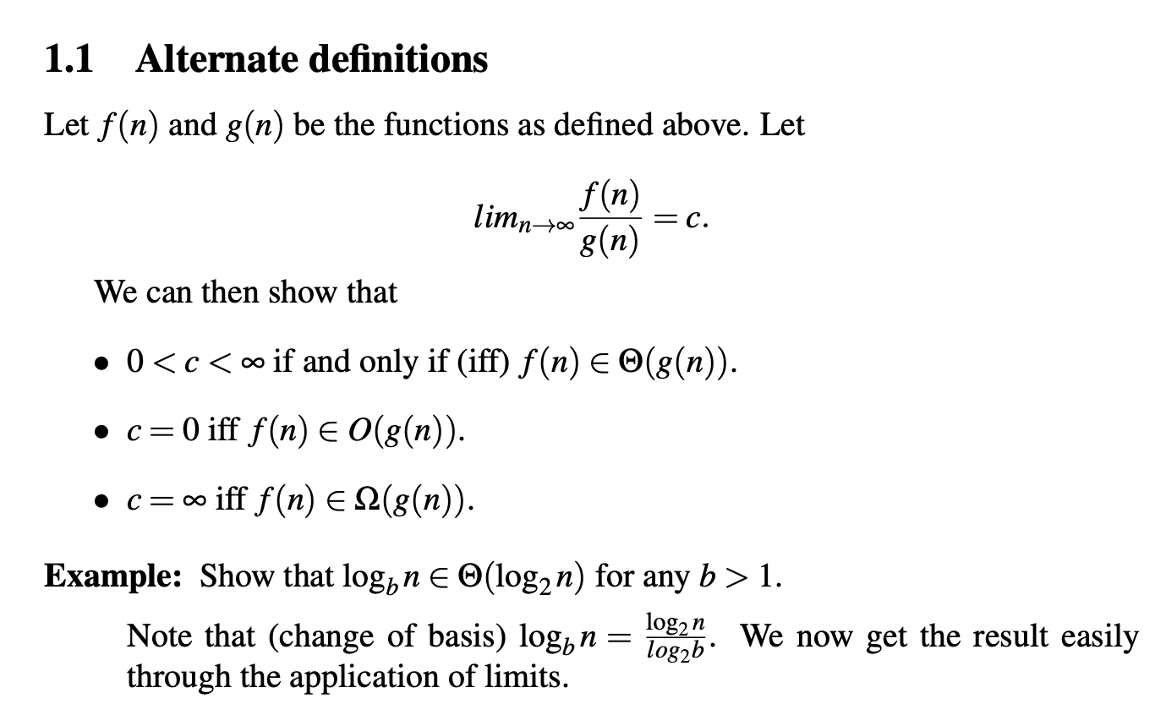

Slide 19
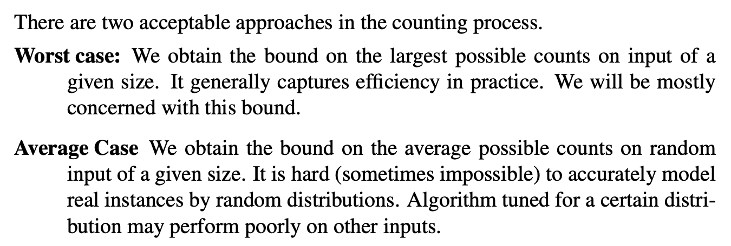

Slide 20
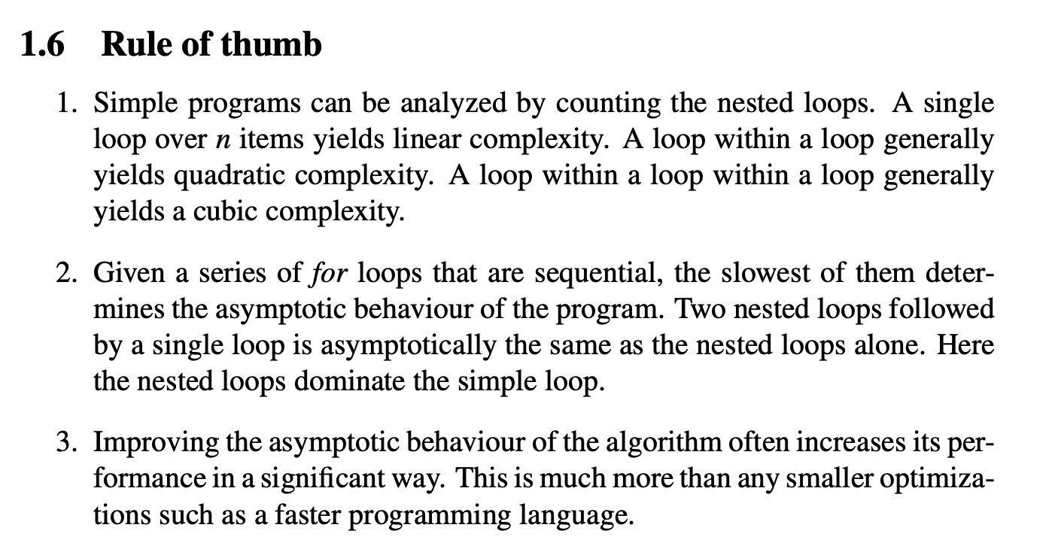

Slide 23
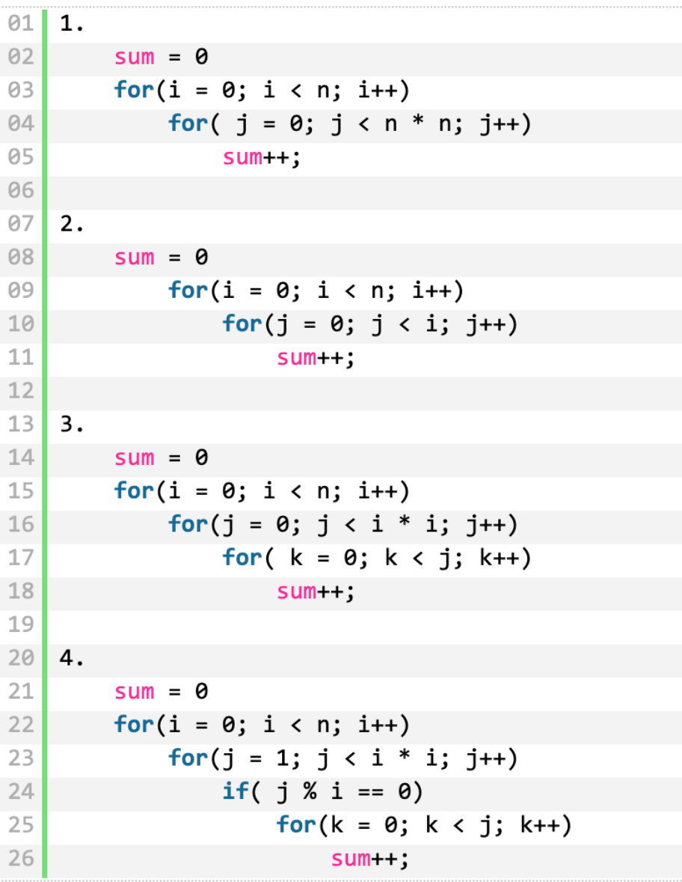

Slide 24
Divide-and-conquer
Chapter 2

Slide 26
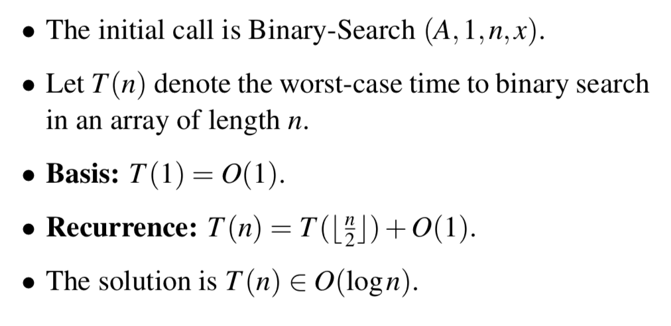

Slide 28
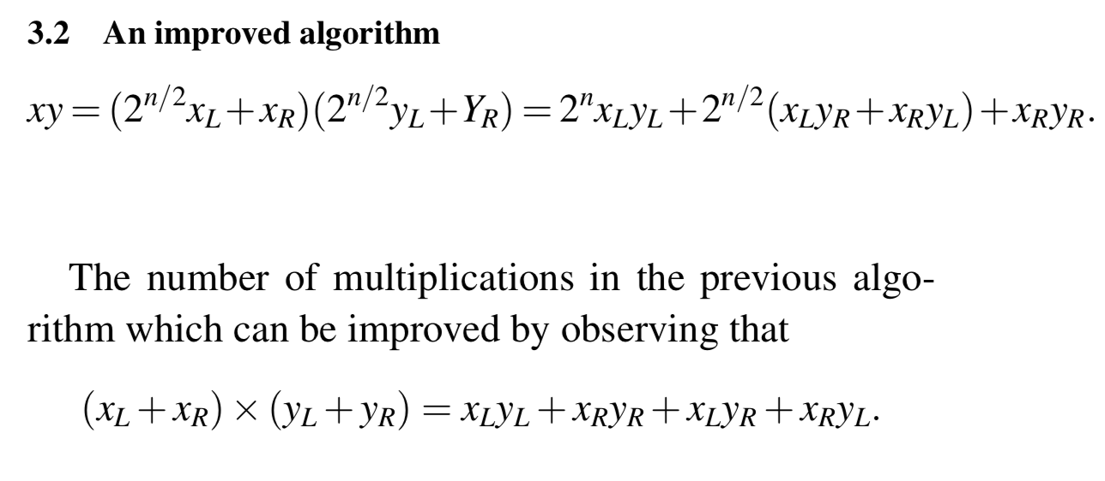

Slide 30
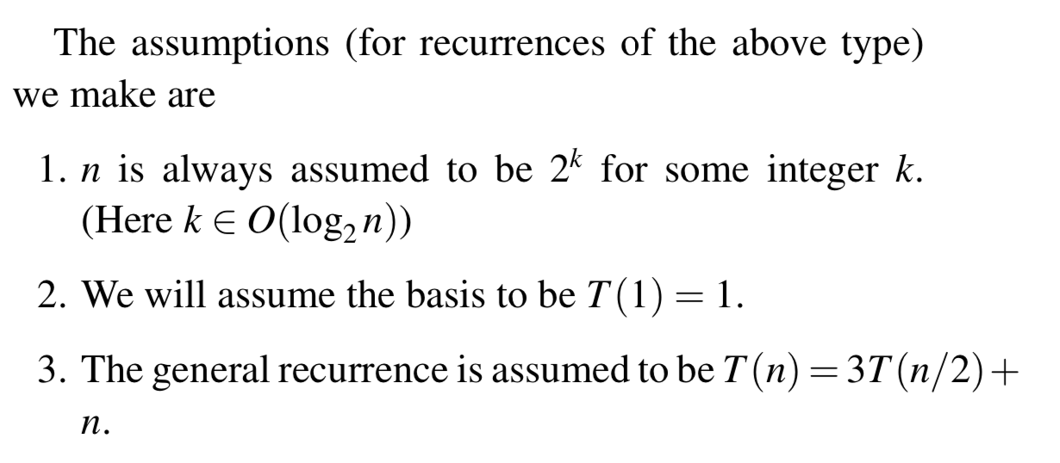

Slide 31
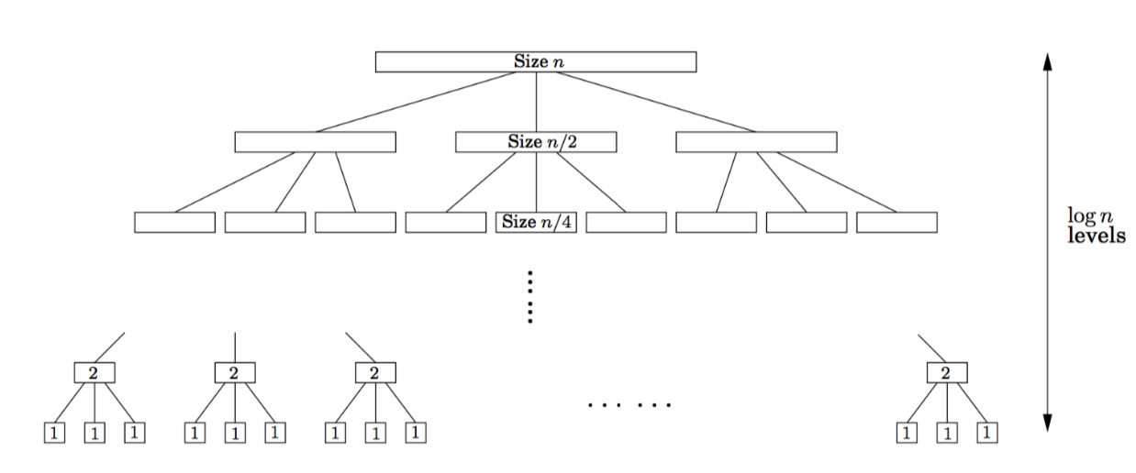
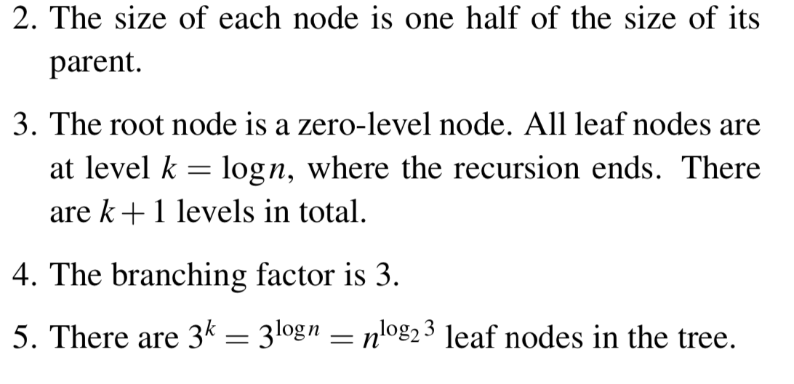

Slide 32
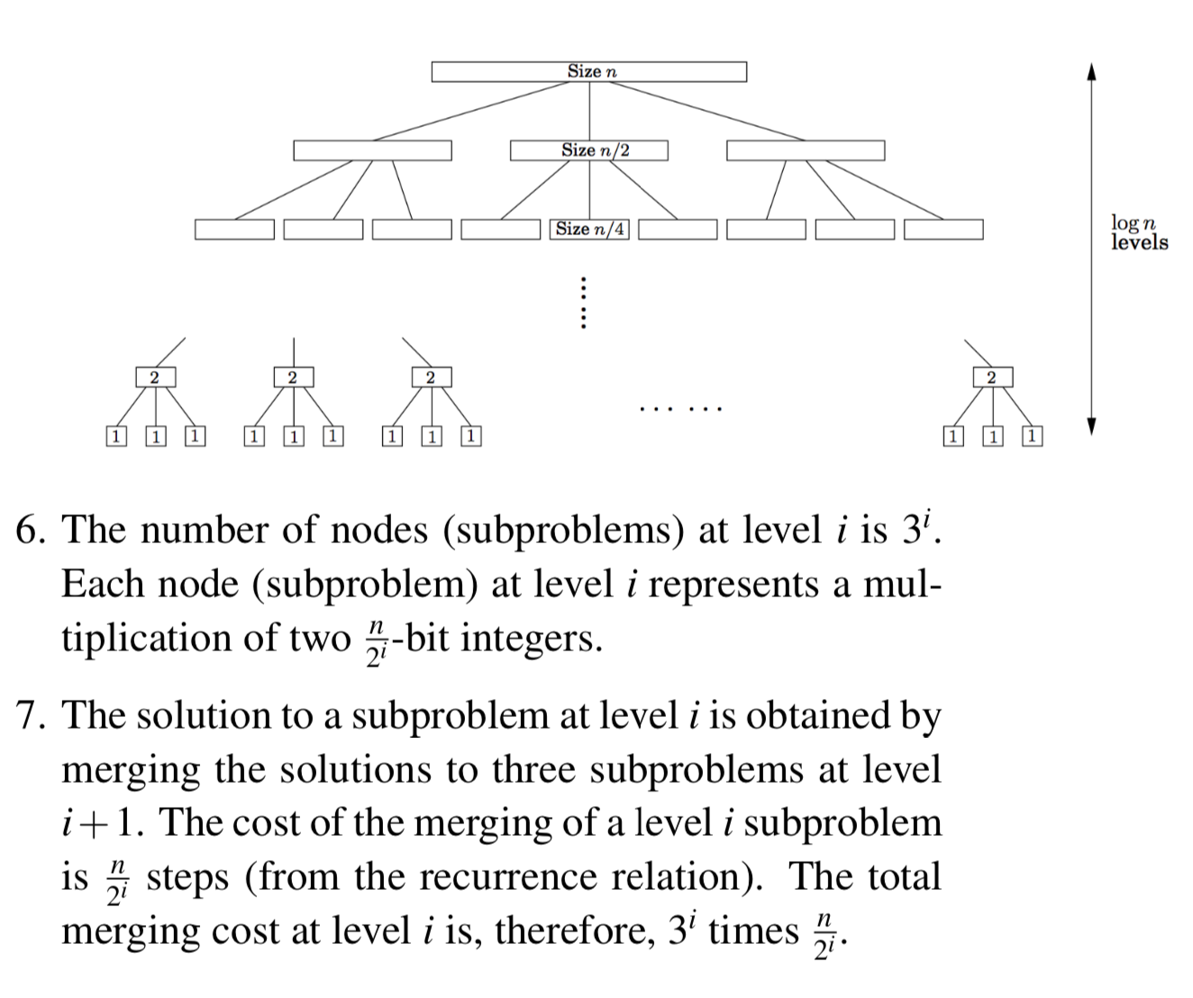

Slide 36
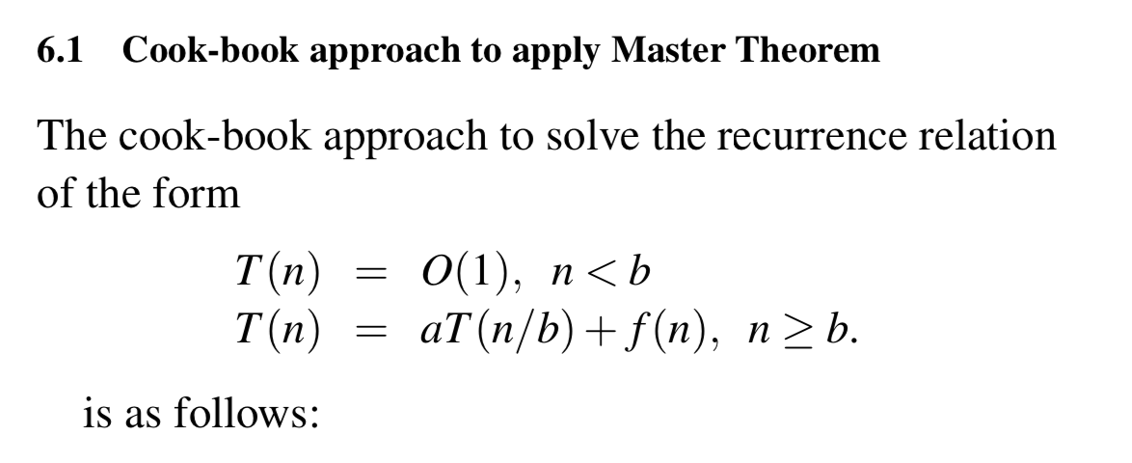

Slide 38
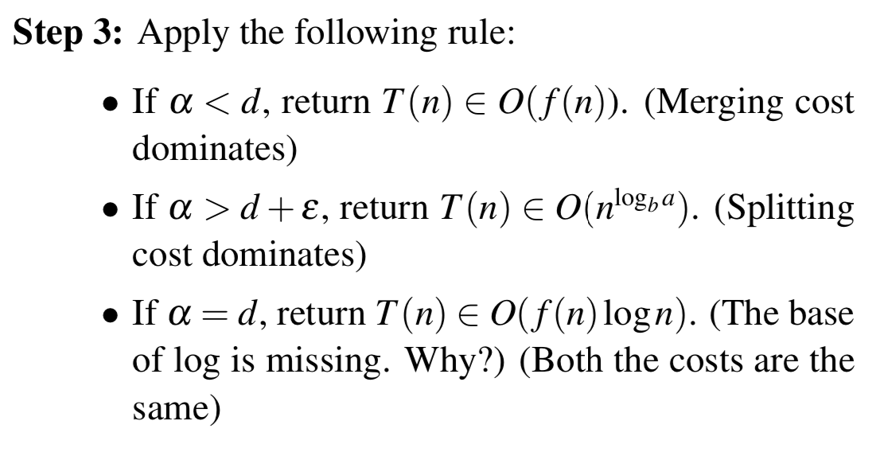

Slide 43
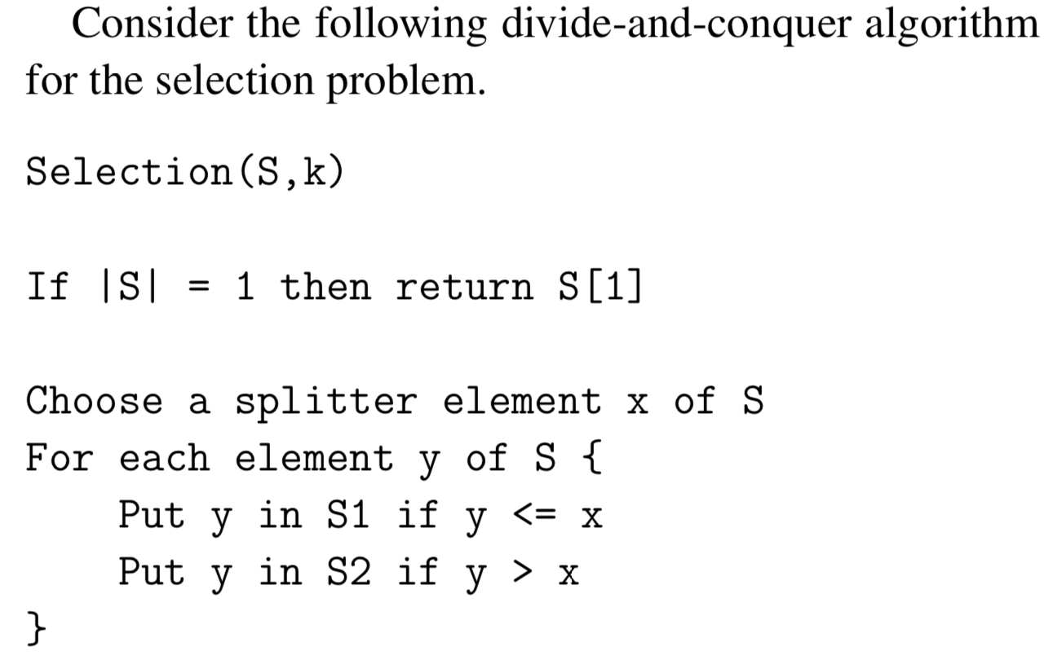
Part A

Slide 44
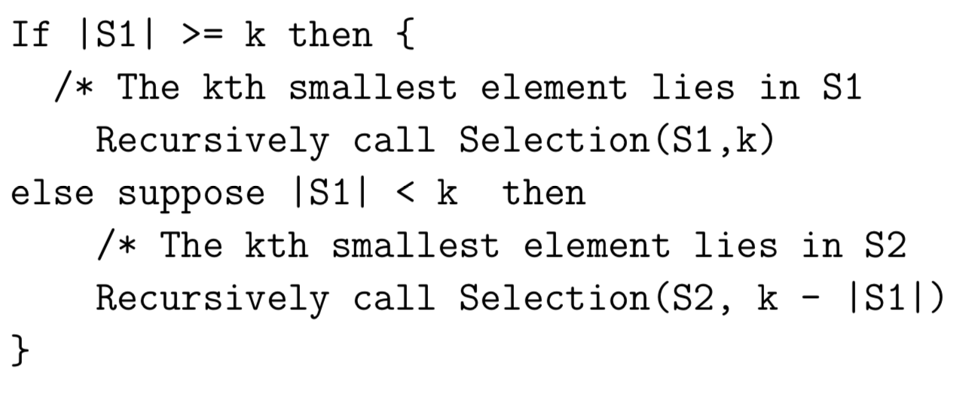
Part B

Slide 45
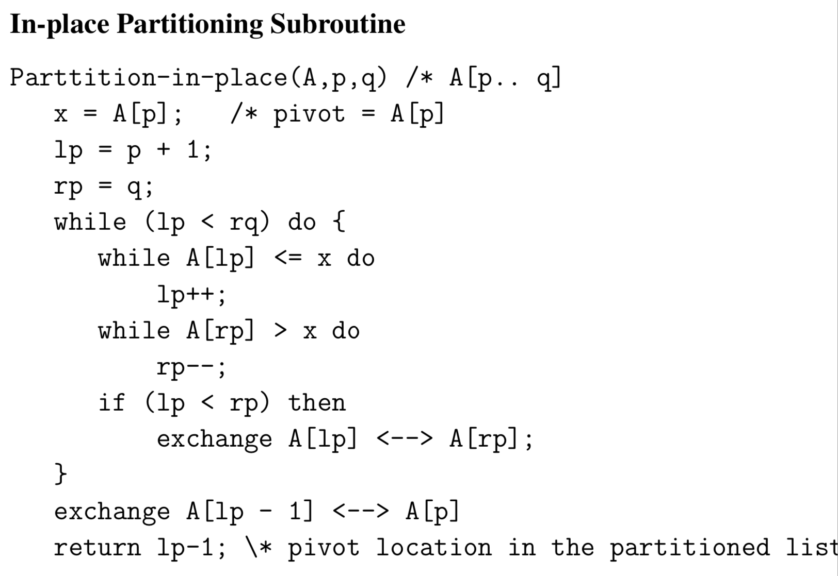

Slide 50
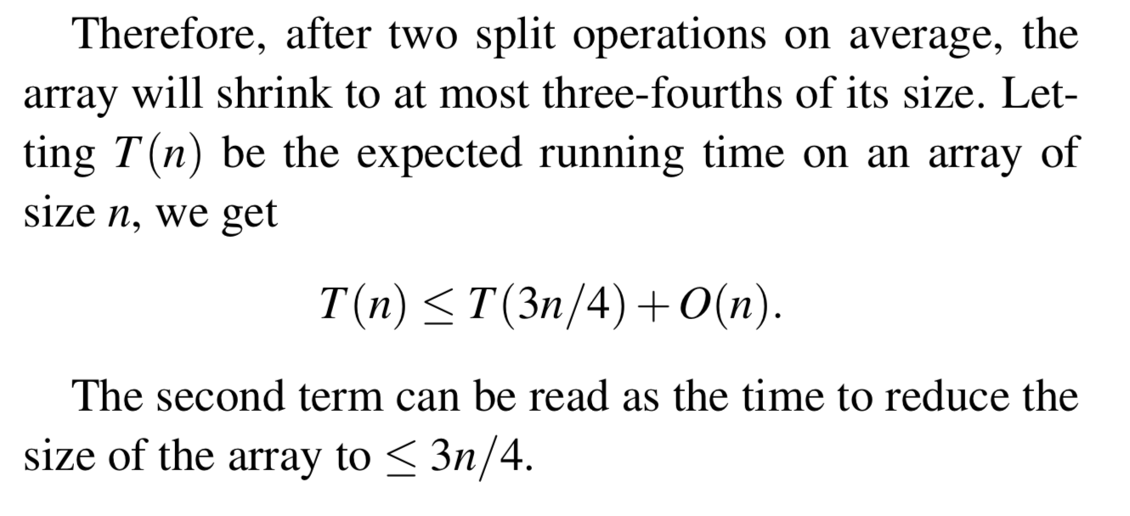

Slide 51
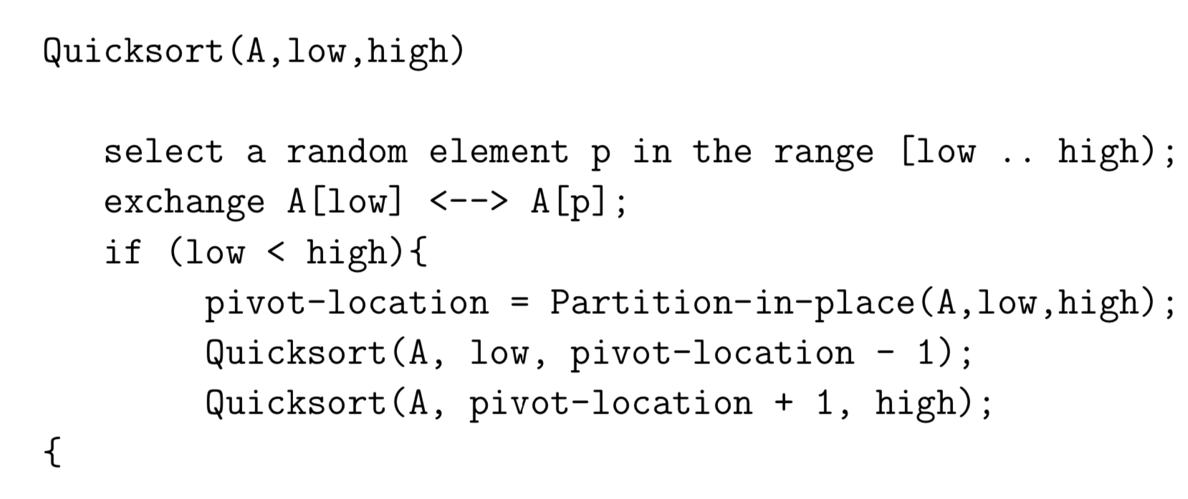

Slide 54
Graphs (Chapter 3)

Slide 55
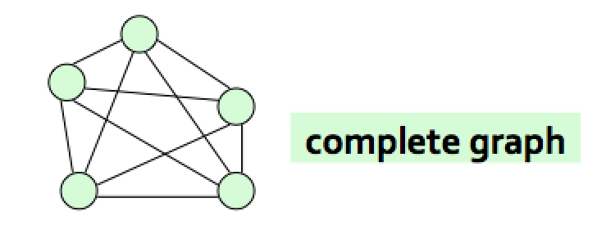
Some examples
Connected graph
Complete graph

Slide 56
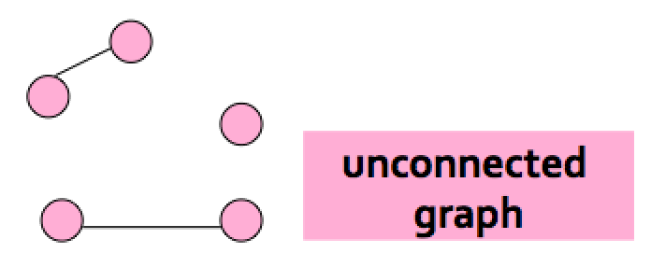
Some examples
Disconnected graph

Slide 57
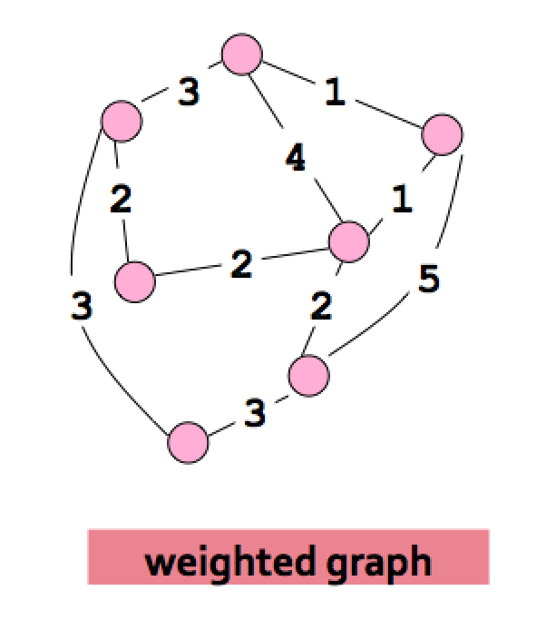
Some examples
Edge-weighted graph

Slide 58
Graph Terminology
When analyzing algorithms on a graph, there are usually two parameters we care about:
The number of nodes n. (n = |V|)
The number of edges m, (m = |E|)
Note that m = O(n²) .
A graph is dense if m = Θ(n²). A graph is called sparse if it is not dense.

Slide 59
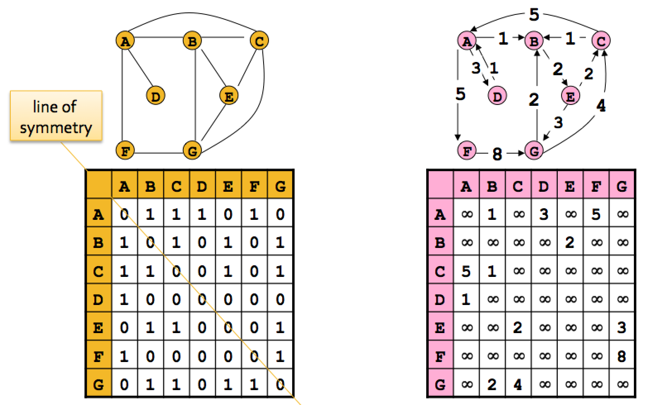
Storage space: O(n²)

Slide 60
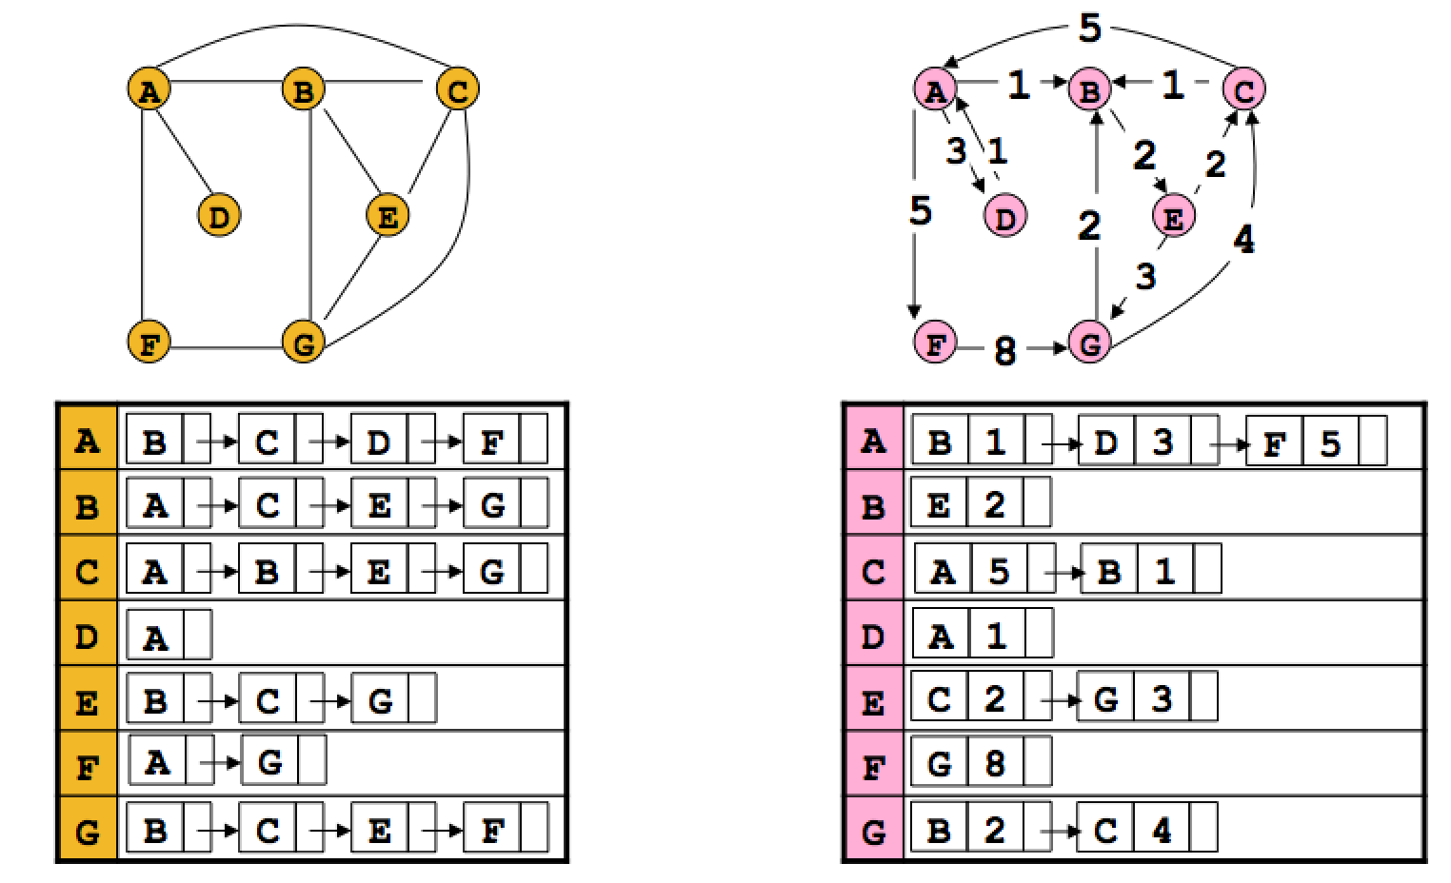
Storage space: O(n+m)

Slide 61
Adjacency matrix benefit
The biggest convenience is that the presence of a particular edge can be checked in constant time.
Any algorithm that uses adjacency matrix structure to store a graph has Ω(n²) lower bound. This is true even if |E| is O(n).

Slide 62
Adjacency lists benefits
The storage space requirement is O(n + m), which is optimal in the sense that no other representation taking less than this amount is possible.
Checking of for an edge is no longer a constant time operation.
Iterating through all the neighbors of a vertex is now easy.
An algorithm on a graph runs in linear time if the running time of the algorithm is O(n + m).

Slide 63
Relative advantages of adjacency lists and matrices (From the book: The Algorithm Design Manual by Skienna)

Slide 64
Depth-first search (DFS) in undirected graph
DFS is a versatile linear time procedure to traverse (explore) a graph.
The undirected graph G=(V,E) is represented by an adjacency list.
DFS traverses a graph G = (V,E) in a systematic manner revealing a wealth of information about a graph.

Slide 65
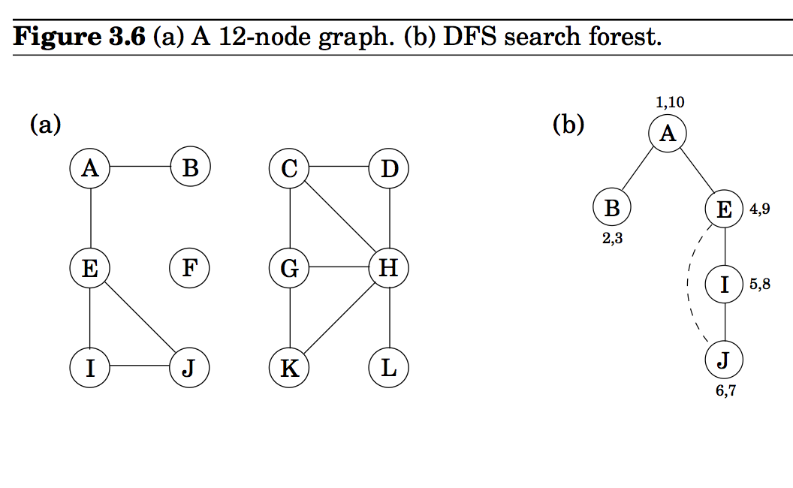
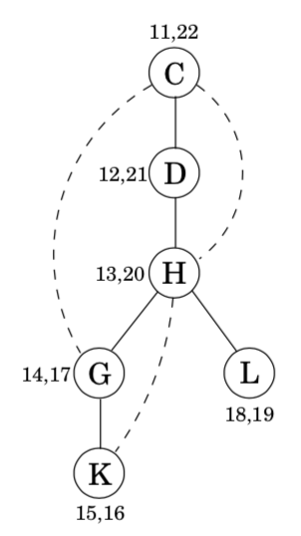
An example
parent[A] = nil
parent[B] = A
parent[E] = A
parent[I] = E
parent[j] = I
The solid edges are actually those that are traversed, each of which is effected by a call to explore and led to the discovery of a new vertex. These edges form a tree. The edges are call DFS tree edges.
Tree edges are { (parent[u],u)| ∀ u, parent[u] is not nill}

Slide 66
dfs(G)
The explore procedure visits only the portion of the graph reachable from its starting point.
To examine the rest of the graph, we need to restart the procedure elsewhere, at some vertex that has not yet been visited.

Slide 67
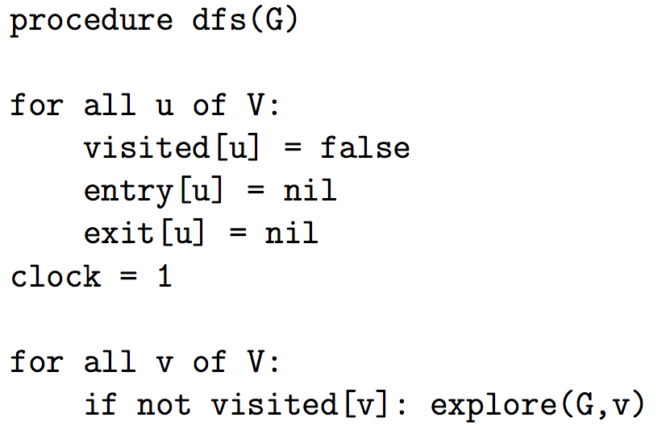
Procedure dfs(G)

Slide 68
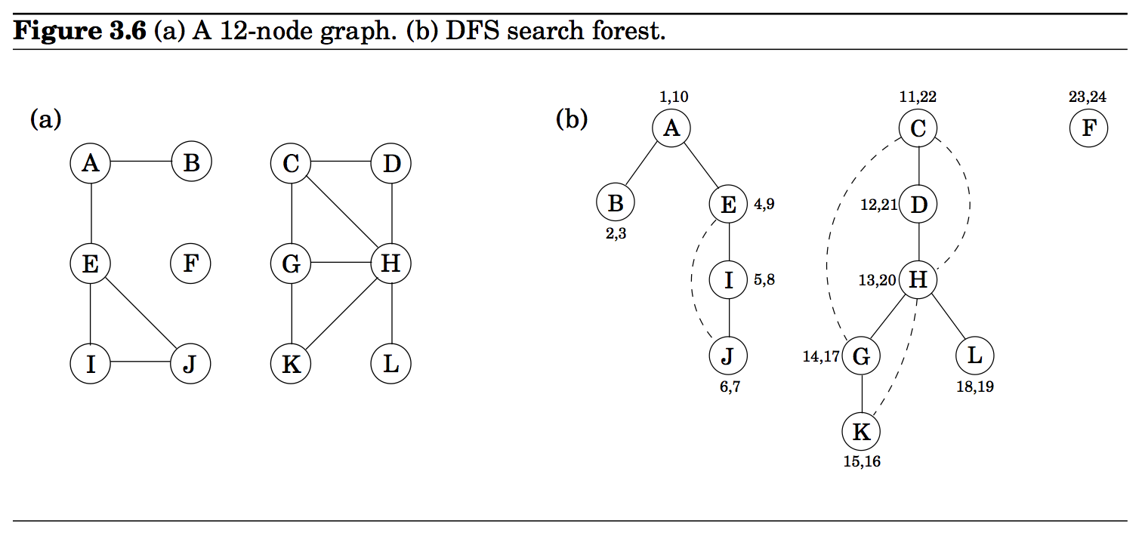
An example

Slide 69
Analysis of dfs(G)
The worst case running time is O(|V|+|E|).
DFS algorithm is optimal.

Slide 70
Interesting observation of time intervals
The time intervals have interesting and useful properties with respect to a depth-first search.
Who is an ancestor in the DFS tree?
How many descendants?
How many connected components in G?

Slide 71
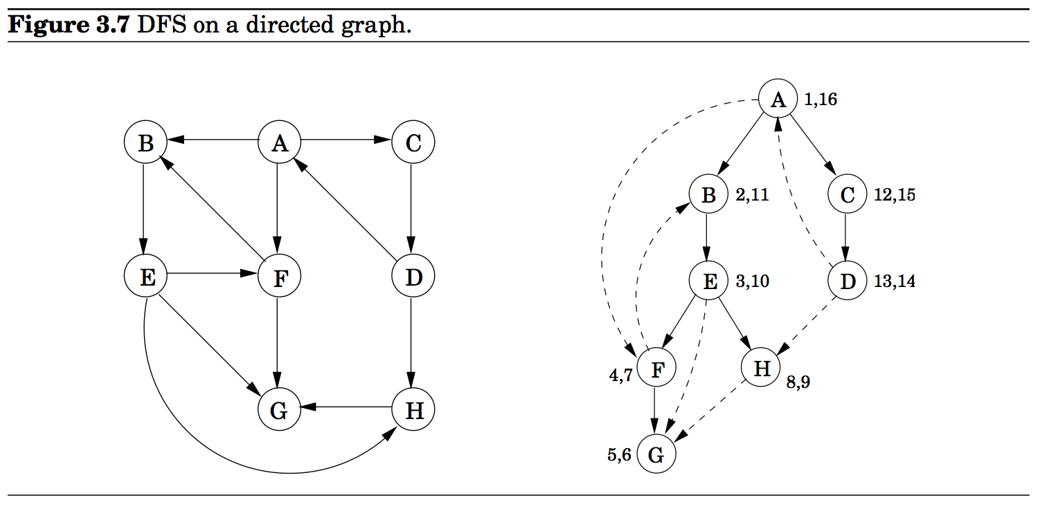
Vertices are picked in lexicographic order.
A is the root of the search tree; everything else is its descendants.
E has descendants F, H, G, and conversely, is an ancestor of these three nodes.
C is the parent of D

Slide 72
Types of edges
Tree edges: Edges lead from a node to visit its children. The resulting tree could be disconnected (forest).
Forward edges: Edges lead from a node to a nonchild descendant in DFS tree.
Back edges: Edges lead to an ancestor in the DFS tree
Cross edges: Edges lead to neither descendant nor ancestor.

Slide 73
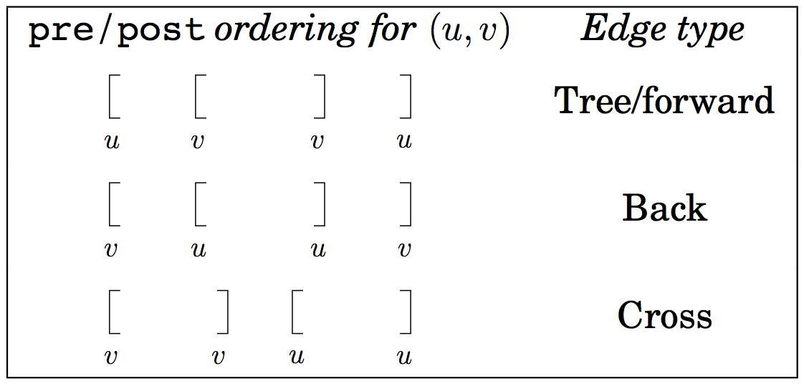
Summary of the various possibilities for an edge (u,v)

Slide 74
Directed acyclic graphs (DAGs)
A graph without a cycle is called acyclic.
G is a DAG if and only if its depth-first search reveals no back edge. This can therefore be tested in optimal O(|V| + |E|) time. In a DAG, every edge leads to a vertex with lower exit (post) number.
DAGs are good for modeling hierarchies and temporal dependencies: course prerequisites, task dependencies etc.

Slide 75
Strongly Connected Components
Let G = (V, E) be a directed graph.
A strongly connected component (or SCC) of G is a subset C of V with the following properties:
C is not empty.
For any u, v ∈ C: u and v are strongly connected.
For any u ∈ C, v ∈ V – C: u and v are not strongly connected.

Slide 76
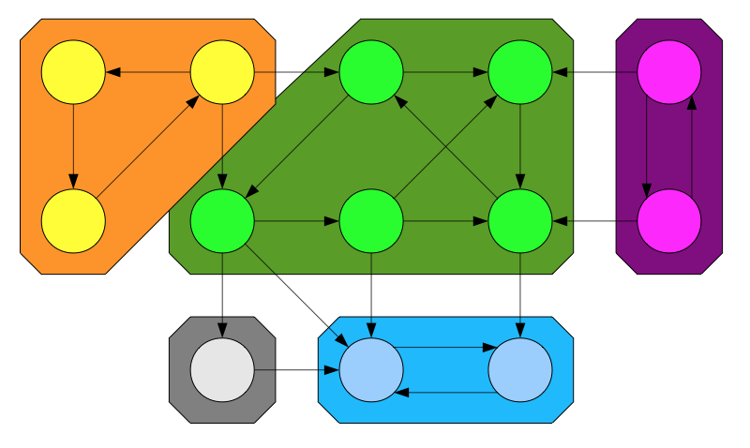
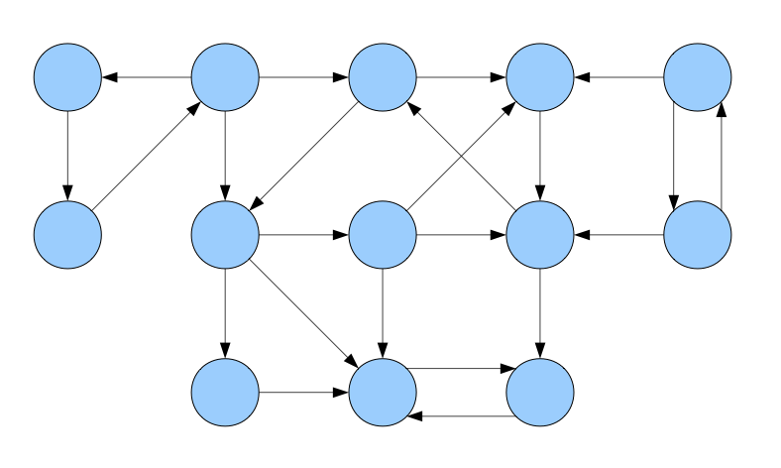
A directed graph and its strongly connected components

Slide 77
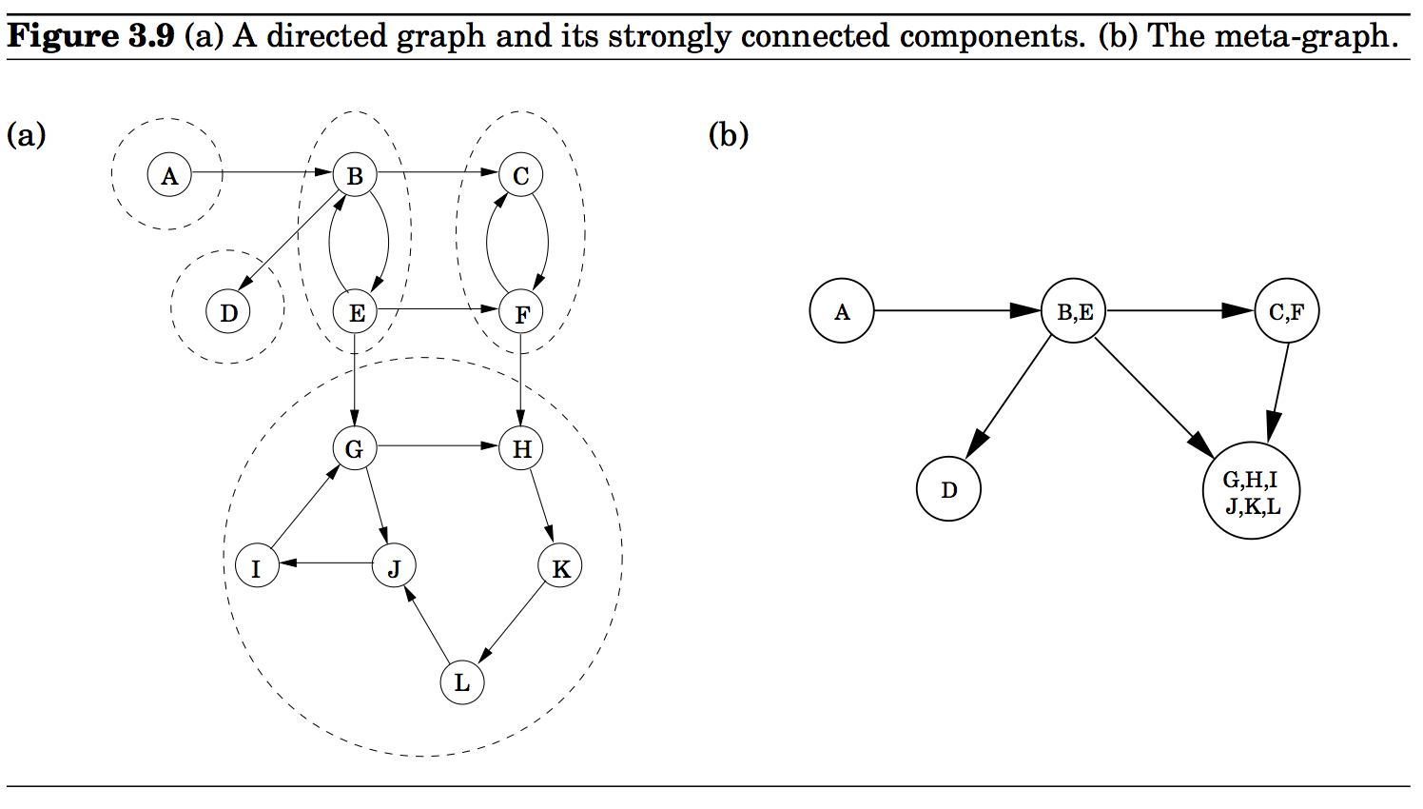

Slide 78
An important property
The condensation (meta) graph G^{SCC} of any directed graph G is a dag.
Every dag has at least one source node and at least one sink node.

Slide 79
Identify a source strongly connected component
Perform DFS(G)
Find the node with the largest exit (post) time stamp.

Slide 80
Identify a source strongly connected component
z lies in a strongly connected component which is a source node in the condensation graph G^{SCC.}
Perform DFS(G)
Find the node z with the largest exit (post) time stamp.

Slide 81
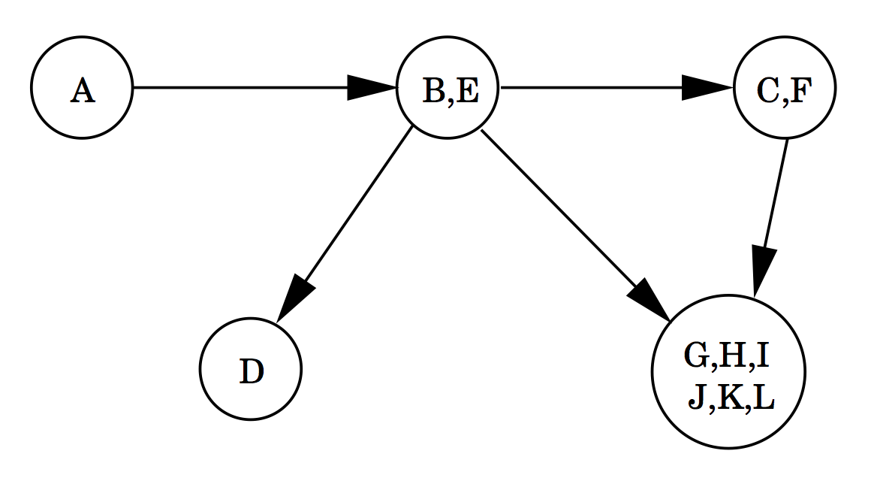
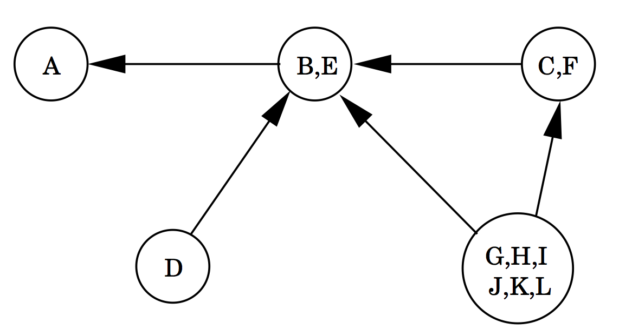
Determine the SCC that contains z
z
z
G^{SCC}
(G^{SCC}) ^{R}
Perform DFS on G^{R} from node z where G^{R} is obtained from G = (V, E) by reversing the direction of each edge of G.
The search ends after finding the component containing z.
The time spent to find this component is proportional to the size of the component.
Remove all the nodes from G, reachable from z. Let G’ be the reduced graph.

Slide 82
Repeat the process after removing a component
(G’)^{SCC}
((G’)^{SCC})^{R}
Select the next vertex z of G’ with the largest exit time stamp.
z now lies in the component which is a source node of (G’)^{SCC}. In the figure it is either B or E.
We find all the vertices reachable from z’. These vertices form a strongly connected component.

Slide 83
Algorithm to computing strongly connected components
G is the given directed graph.
Run DFS on G.
Record the exit (post) time stamp of each node.
Compute G^{R}
Run DFS on G^{R} always starting from the node with the largest exit time stamp.
Since G^{R} can be computed in linear time, the above algorithm runs in linear O(|V| + |E|) time.

Slide 85
Finding Cycles
In an undirected graph, the absence of nontree edges imply nonexistence of cycles. (why?)
This can be tested by the DFS of the graph.

Slide 86
Topological Sorting
Topological sorting is the most important operation on DAGs.
It orders the vertices on a line such that all directed edges go from left to right.
Such an ordering cannot exist if the graph contains a directed cycle.
The ordering gives us a sequence of processes which can be executed honoring the precedence relation.

Slide 87
Shortest Paths (Chapter 4)

Slide 88
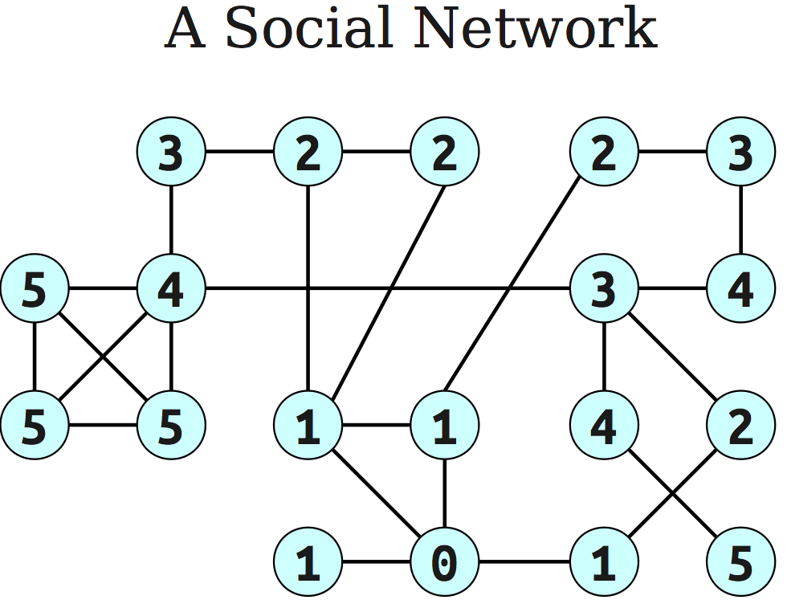
An application: Six degrees of separation
Source node
The numbers on nodes indicate the distances of the nodes from the source node.

Slide 89
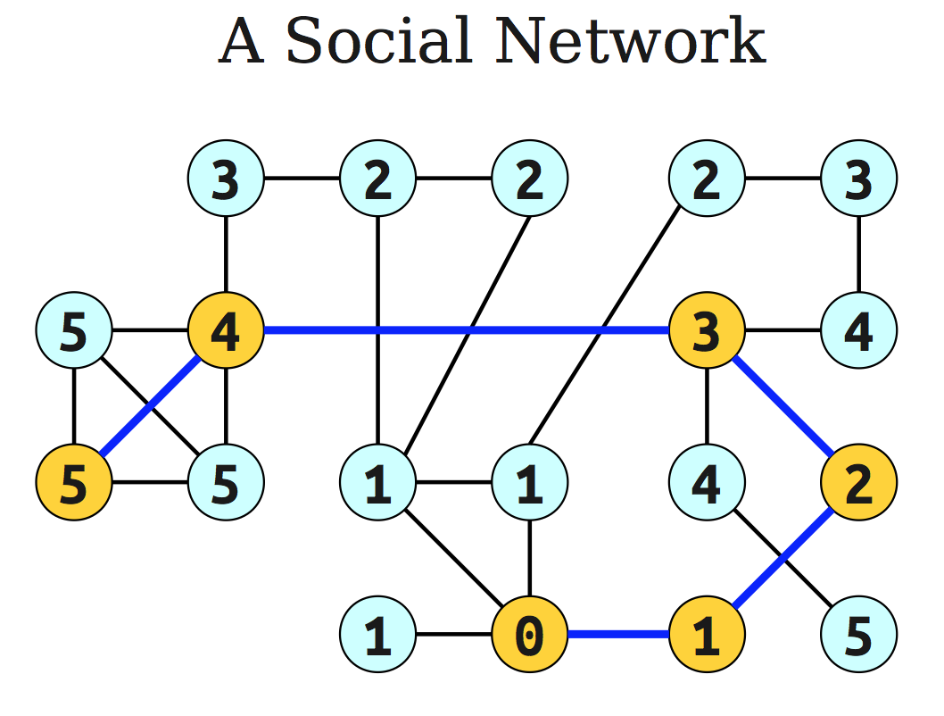
Source node

Slide 90
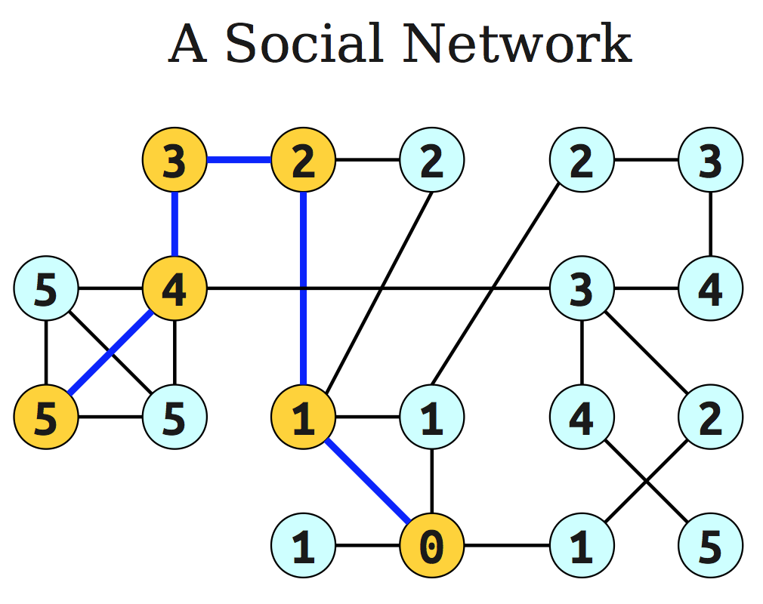
Source node
Principle of optimality: If node A lies on the shortest path from the source node S to B then
d (S,B) = d (S, A) + d ( A, B).

Slide 91
General Idea of BFS
Proceed outward from the source node s in ``layers’’.
The first layer is all nodes of distance 0.
The second layer is all nodes of distance 1.
The third layer is all nodes of distance 2.
etc.
This gives rise to breadth-first search.

Slide 92
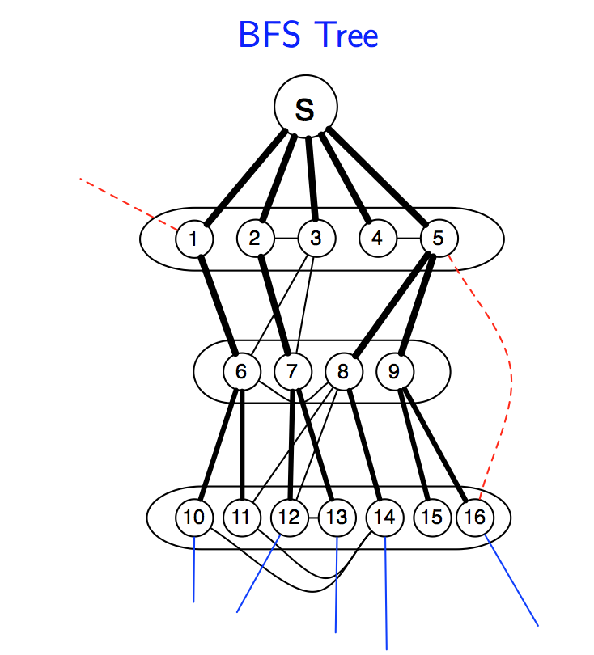
We keep only edges (thick ones) that correspond to parent field of some vertex.

Slide 93
DFS vs. BFS
DFS
BFS
Input:
A Graph G = (V, E) (directed or undirected)
No source vertex given!
Idea:
Explore the edges of G to “discover” every vertex in V starting at the most current visited node
Search may be repeated from multiple sources
Output:
2 timestamps on each vertex: pre[v], post[v]
DFS forest
O(|V|+|E|)
Input:
A graph G = (V, E) (directed or undirected)
A source vertex s ∈ V
Idea:
Explore the edges of G to “discover” every vertex reachable from s, taking the ones closest to s first
Output:
d[v] = distance (smallest # of edges, or shortest path) from s to v, for all v ∈ V
BFS tree
O(|V|+|E|)

Slide 94
Using Array Implementations
O(|V|(T_{ins} + T_{ex}) + |E|•T_{dec})
Implement priority queue with an unsorted array:
T_{ins} = O(1),
T_{ex} = O(|V|),
T_{dec} = O(1)
total time is O(|V|²)

Slide 95
Edges have (positive) lengths
Breadth-first search treats all edges as having the same length.
In reality the edges have lengths, and we are interested in computing shortest paths.
Our graph is a weighted graph G = (V,E) where each edge e = (u,v) of E has length l_{e} or we will sometime also write l(u,v) or l_{uv}.

Slide 96
An intuitive description of Dijkstra’s algorithm
We are given a weighted graph G = (V,E), and interested in computing the shortest paths from s (source node).
We drop a huge colony of ants on to the source node s time 0.
They move from there and follow all possible paths through the graph at a rate of one unit per second.
The first one to reach the node v will do so at time dist(s,v).
dist(s,v) is the shortest distance from s to v.

Slide 97
Three operations on the schedule
Remove the entry with earliest time (this happens once for each node).
Add a new entry (this happens once for each entry)
Decrease the time associated with an existing entry (this happens at most once for each edge)

Slide 98
Using Array Implementations
O(|V|(T_{ins} + T_{ex}) + |E|•T_{dec})
Implement priority queue with an unsorted array:
T_{ins} = O(1),
T_{ex} = O(|V|),
T_{dec} = O(1)
total time is O(|V|²)

Slide 99
Running Time using Binary Heaps
O(|V|(T_{ins} + T_{ex}) + E•T_{dec})
If priority queue is implemented with a binary heap, then
T_{ins} = T_{ex} = T_{dec} = O(log |V|)
total time is O(|E| log |V|)

Slide 100
Running Time using Fibonacci Heaps
O(|V|(T_{ins} + T_{ex}) + E•T_{dec})
If priority queue is implemented with a Fibonacci heap, then
T_{ex} = O(log |V|)
T_{ins} = T_{dec} = O(1)
total time is O(|V| log |V| + |E|)

Slide 101
Performance Summary
Choice of priority queue implementation directly affects performance.
2,000 vertices, 1 million edges: heap 2-3 times slower than array
100,000 vertices, 1 million edges: heap gives 500x speedup
1 million vertices, 2 million edges: heap gives 10,000x speedup.
array implementation is better for dense graph
heap is better for sparse graph

Slide 102
Shortest paths in the presence of negative edges
This property is no longer holds when edge length is allowed to be negative.
Dijkstra’s algorithm still returns the path <A, C, D> as the shortest path from source node to destination node. However, this is incorrect.
Negative edge weights present problems for Dijkstra’s algorithm.
Source
A
2
Destination
5
8
C
D
B
-7

Slide 103
Shortest paths in the presence of negative cycles
A bigger problem is negative cycles like the one below, since this means that there doesn’t exists a true shortest paths.
We can make the shortest paths as small as possible.
Source
A
-10
Destination
15
3
C
D
B
5

Slide 104
Bellman-Ford Algorithm
Handles graphs with negative edge weights.
It will return the same output as Dijkstra’s for any graphs with positive weights, but run slower.

Slide 105
Edge update
v
v
u
u
Update (relaxation) sets dist(v) to the length of a shorter path from s to v.

Slide 106
Bellman-Ford algorithm
Running time is O(|E||V|).
Invariant: At end of phase i, dist(v) ≤ length of any path from s to v using at most I edges.
Theorem: If there are no negative cycles, upon termination, dist(v) is the length of the shortest path from s to v.
Observation: If dist(v) doesn’t change during phase i, there is no need to relax any edge leaving v in phase i+1.

Slide 107
Negative cycles
It can be tested if a given graph has a negative cycle.
Check if Bellman-Ford algorithm updates dist(v) for any v in phase |V|. If it does, the graph has a negative cycle. (why?)

Slide 108
Shortest paths in dags
There is no cycle.
Edge weights could be negative.
We still cannot use Dijkstra’s algorithm.
We can use Bellman-Ford algorithm.
Running time is O(|E||V|)
For dense graphs this is O(|V|³).
We can reduce the complexity to O(|V| + |E|).

Slide 109
Shortest paths in dags
Use the topological order of the vertices of the dags. (Can be done in linear time)
dist(s) = 0
Determine the topological order of the vertices. (Also known as Linearize G)
for each vertex u of V, in linearized order
for all edges (u,v), radiating from u:
update(u,v)

Slide 110
Greedy Algorithm
Chapter 5

Slide 111
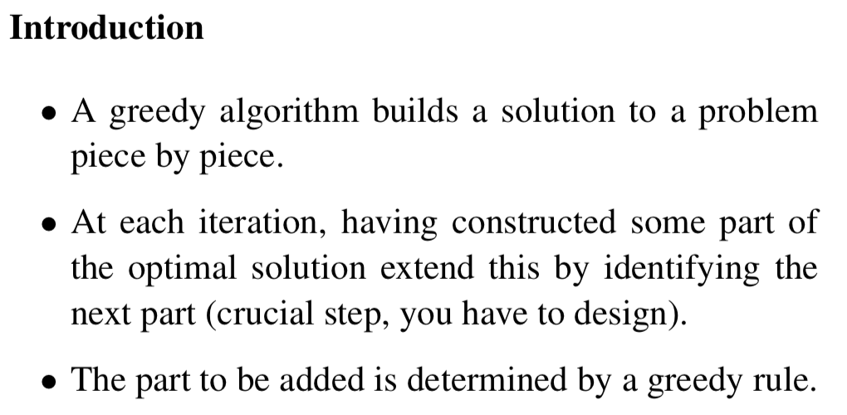

Slide 112
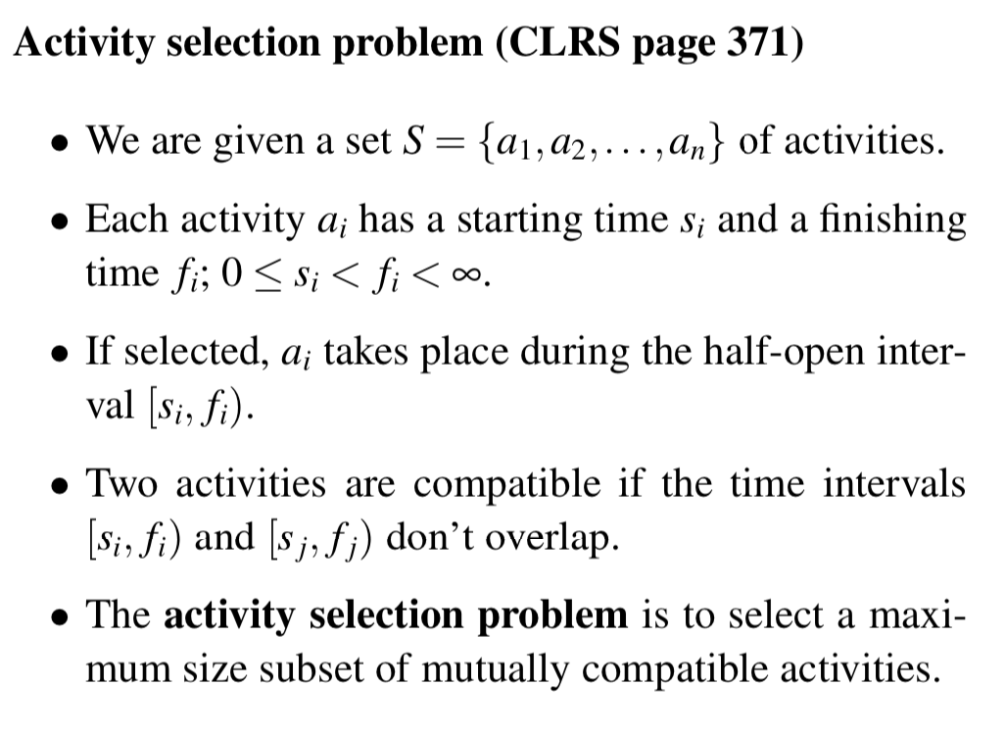

Slide 114
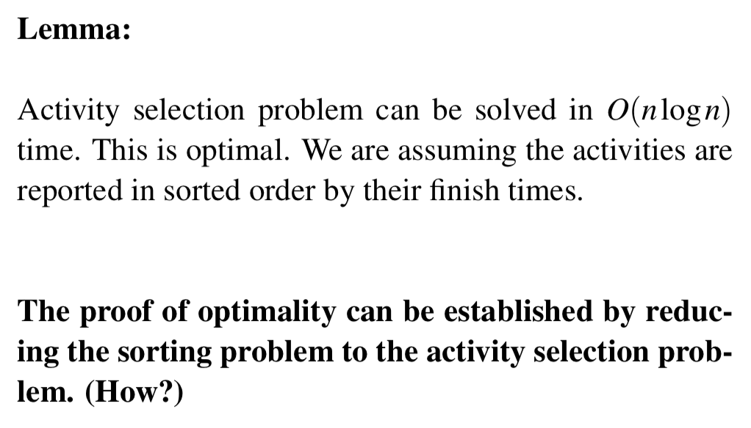

Slide 115
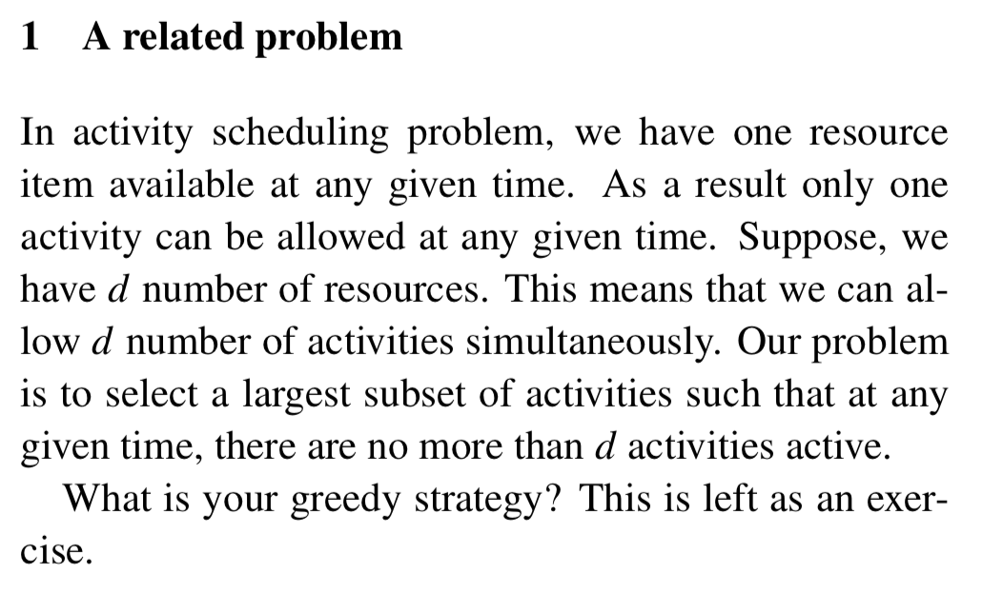

Slide 116
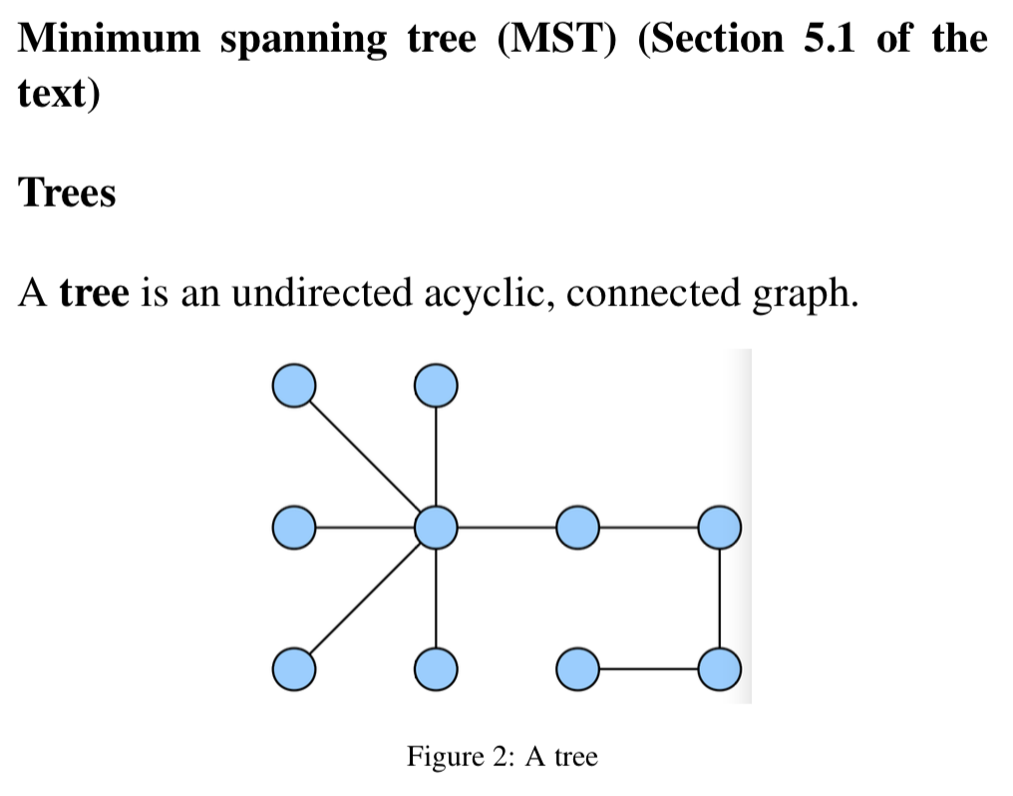

Slide 117
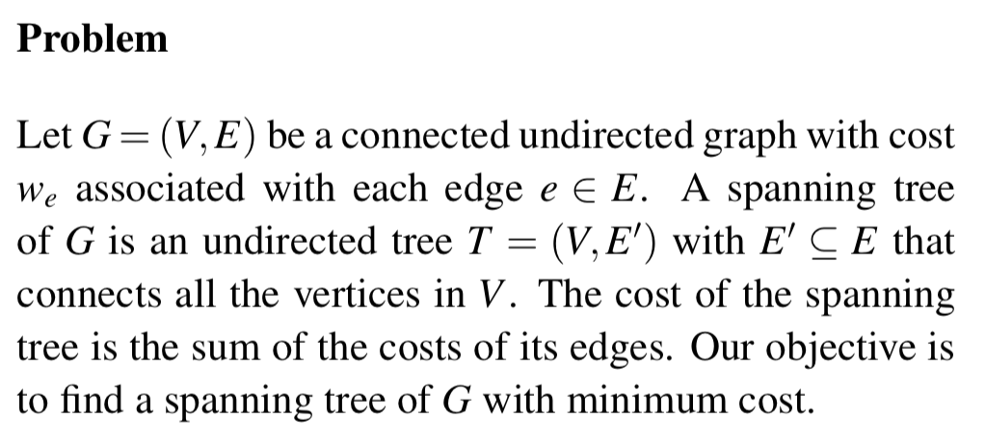

Slide 119
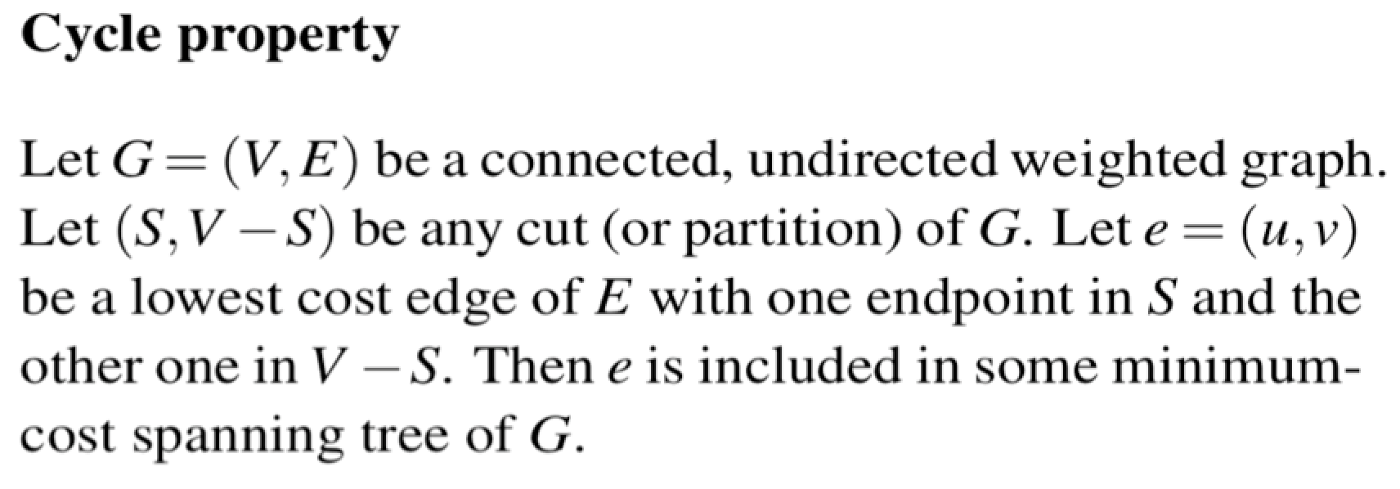
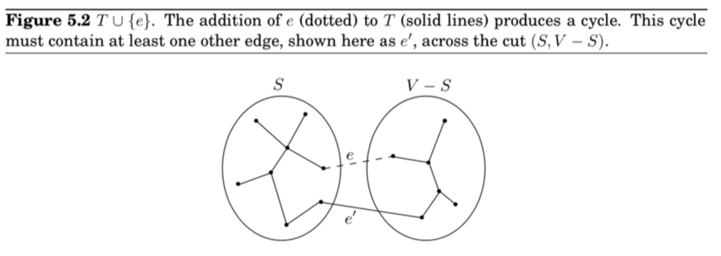

Slide 120
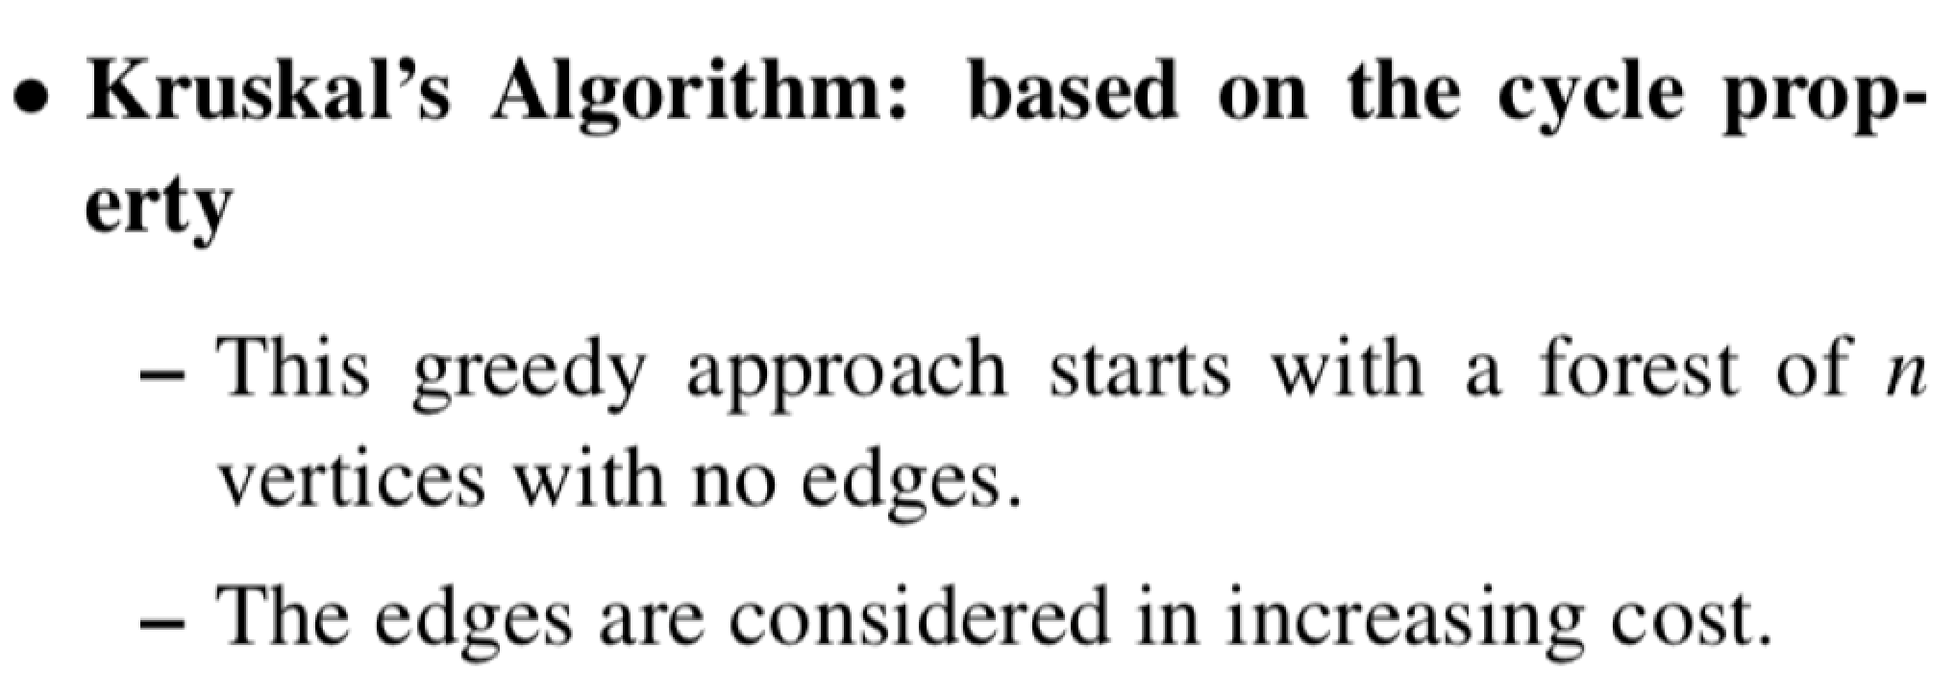

Slide 124
Dynamic Programming (DP) Chapter 6

Slide 125
What is DP?
It is a ``method for solving complex problems by breaking them down into simpler subproblems’’.

Slide 126
Three steps for solving DP problems
Define subproblems
Formulate the recurrence that relates the subproblems
Recognize and solve the base cases.
Each step is very important

Slide 127
Weghted activity selection problem
Given a set S = {a₁, a₂, …, a_{n}} activities.
Activity a_{i} has a start time s_{i} and a finish time f_{i}.
Each activity a_{i} has a value, or weight v_{i}.
Two intervals are compatible if they do not overlap.
The problem is to select a subset of mutually compatible activities of largest total values.

Slide 128
Find the recurrence for Opt(i)
Define p(j), for an activity a_{j}, to be the largest index i < j such that activities a_{i} and a_{j} are compatible.

Slide 129
Define subproblems:
Let A_{i} = {a₁, a₂, …, a_{i}} be the set of first i activities.
Let Opt(i) be the total values of the optimal solution of the problem for the activities of A_{i}.

Slide 130
Find the recurrence for Opt(i)
Consider an optimal solution Opt(i) of A_{i}.
Opt(i) contains a_{i} : Opt(i) = Opt(p(i)) + v_{i}
Opt(i) does not contain a_{i} : Opt(i) = Opt(i-1)
We get the recurrence by combining both the possibilities:
Opt(i) = max{ Opt(p(i)) + v_{i} , Opt(i-1) }
Given Opt(i), how do we know whether a_{i} is in Opt(i)?
a_{i} is in Opt(i) if Opt(p(i)) + v_{j} ≥ Opt(i-1).

Slide 131
Solve the base cases
The base case is Opt(0) = 0
We can also say that Opt(1) = v₁.

Slide 132
Modified (memoized) Compute-Opt(j) (linear time)
Initialize an array Opt[];
Opt[0] = 0; Opt[1..n] undefined
Compute-Opt(j){
if Opt[j] is computed before, return Opt[j];
else
Opt[j] = max(v_{j} + Compute-Opt(p(j)),
Compute-Opt(j-1));
return Opt[j];
}
The complexity of the algorithm is linear assuming that the intervals are already sorted by their finish times.

Slide 133
Iterated algorithm (bottom up)
Iterated-Compute-Opt(j)
Opt[0] = 0;
for (i = 1; I ≤ n; i++){
Opt[i] = max{ v_{i} + Opt[p(j)], Opt[i-1]}
}
Clearly, the algorithm is linear.
Memoized version is also linear.
Memoized version will take more time to compute due to the overhead cost of the recursion.
Memoized version is easier to code.

Slide 134
Finding the solution once Opt[.] is known.
Find-Solution(j){
If j=0
Print nothing;
else
if v_{j} + Opt[p(j)] ≥ Opt[j-1] {
Print a_{j};
Find-Solution(p(j));
}
else
Find-Solution(j-1);
}

Slide 135
Shortest paths in DAGs
The graph G=(V,E) is directed, acyclic, weighted (possibly negative cost).
We can order the vertices (Using a DFS) on a line such that the directed edges can be drawn from the left to the right. (Topological ordering)
The leftmost vertex is a source and the rightmost vertex is a sink.

Slide 136
Shortest paths in DAGs
The shortest paths from the leftmost vertex to all the other nodes can be computed using Bellman-Ford algorithm.
The complexity is O(|V| + |E|) if the edges are ordered from left to right. Only two iterations are needed.

Slide 137
DP solution
Find the recurrence:
In the figure, the preceding vertex of the shortest path to D is either B or C.
Therefore, dist(D) = min{ dist(C) + 3, dist(B) +1}
A similar relation can be written for every node.
In general: dist[(v)] = min_{∀e=(u,v)}{dist(u) + c_{e}}
c_{e} is the cost of edge e pointing to v.

Slide 138
DP solution
Solve the base case:
dist(v₁) = 0;

Slide 139
DP solution
Find the recurrence:
In the figure, the preceding vertex of the shortest path to D is either B or C.
Therefore, dist(D) = min{ dist(C) + 3, dist(B) +1}
A similar relation can be written for every node.
In general: dist[(v)] = min_{∀e=(u,v)}{dist(u) + c_{e}}
c_{e} is the cost of edge e pointing to v.

Slide 140
Memoized-Solution (Top down)
The total cost of computing the shortest paths from the source vertex to all the other vertices in a DAG is O(|V|+|E|)
memoized-dist(v_{j})
if v_{j} = v₁ then
dist[v_{j}] = 0
return dist[v_{j}]
else
if dist[v_{j}] is computed before then
return dist[v_{j}];
else
if v_{j} has no incoming edge then dist[v_{j}] = ∞
else
dist[v_{j}] = (dist[v] + c_{e})
return dist[v_{j}]
The total cost is O(in-degree of v_{j})

Slide 141
The Knapsack Problem
Input
Capacity W
n items with weights w_{i} and values v_{i}
Output: a set of items S such that
the sum of weights of items in S is at most W
and the sum of values of items in S is maximized

Slide 142
0-1 Knapsack
An item can either be picked or left. It cannot be picked partially. For example gold coins, diamond rings, TV etc.

Slide 143
DP solution
Define subproblems:
K(w, j) = maximum value achievable using a knapsack of capacity w and items 1 … j
Number of subproblems = nW
K(w,j), 0 ≤ w ≤ W, 0 ≤ j ≤ n
Number of subproblems is exponential in the input length of W.

Slide 144
DP solution
Find recurrence relation:
building larger subproblems by combining smaller subproblems
Want to solve K(w, j)
The optimal solution contains either item j or does not contain item j
If it contains item j, K(w,j) = v_{j} + K(w – w_{j}, j-1)
If it does not contain item j, K(w,j) = K(w, j-1)
Combining: K(w,j) = max {v_{j} + K(w – w_{j}, j-1), K(w, j-1)}
The cost of the optimal solution to the knapsack problem is K(W, n)

Slide 145
DP solution
Find base cases
K(0, j) = 0 for all j
K(w, 0) = 0 for all w.

Slide 146
Memoized-Solution (Top down)
memoized-K(w,j)
if w = 0 then return 0;
if j = 0 then return 0;
else
if w_{j} > w then return K(w, j-1);
if k[w,j] is computed before then return K[w,j];
else
return max(K(w-w_{j}, j-1) + v_{j}, K(w, j-1));
The total cost is # of subproblems which is O(nW).

Slide 147
DP solution
The running time of the algorithm is O(nW)
The running time is exponential in the input length of W, but not in the number of items.
The algorithm is a pseudo polynomial time algorithm.

Slide 148
Memoized-Solution (Top down)
memoized-output(w,j)
if w ≤ 0 then return;
if j = 0 then return;
else
if K(w,j) = K(w,j-1) then memoized-output(w,j-1);
else
Print j;
memoized-output(w-w_{j}, j-1);
The total cost is O(n). (Why?)

Slide 149
Longest Increasing Subsequence
The input is a sequence of numbers: a₁, a₂, …, a_{n}.
A susequence is any subset of these numbers taken in order, of the form where 1 ≤ i₁ < i₂ < ….. ≤ n.
A subsequence is an increasing sequence if the numbers are getting strictly larger.
The problem is to compute the largest increasing subsequence of the given sequence.
The largest increasing subsequence of 5, 2, 8, 6, 3, 6, 9, 7 is 2, 3, 6, 9.

Slide 150
DAG of increasing sequence
For each pair (a_{i}, a_{j}), i < j, draw an arc from a_{i} to a_{j} if a_{i} < a_{j}.
The dag can be constructed in O(n²) time.
Need to find the longest path that ends in a vertex.

Slide 151
Shortest paths (constraint)
Problem: Given a graph G, and s (source) and t (end) vertices, find the shortest path from s and t that uses at most k edges.

Slide 152
All-pairs shortest paths
Dijkstra’s algorithm and the Bellman-Ford algorithm solve the single-source shortest paths problem in which we want shortest paths starting from a single node.
Dijkstra’s algorithm takes (O((|V| + |E|)log |V|)) time; edges have positive costs.
Bellman-Ford algorithm takes (O(|V|(|V| + |E|))) time; edges may have negative costs, but no cycles.

Slide 153
All-pairs shortest paths
The all-pairs shortest paths problem asks how to find the shortest paths between all possible pairs of nodes.
edges have positive costs; Dijkstra’s algorithm takes (O((|V| + |E|)log |V|) x |V|);
edges may have negative costs, but no cycles; Bellman-Ford algorithm takes (O(|V|²(|V| + |E|))) time;

Slide 154
DP solution (Floyd-Warshall’s algorithm)
Find subproblems:
dist(i,j,k) is the subproblem fo computing the shortest path from v_{i} to v_{j} in which only nodes {v₁, v_{2,} …, v_{k}} can be used as intermediate nodes. (k ≠ i, j)
There are O(n³) subproblems:
1 ≤ i ≤ n; 0 ≤ j ≤ n; 0 ≤ k ≤ n.
The space complexity is O(n³)

Slide 155
DP solution (Floyd-Warshall’s algorithm)
Find recurrence relation
dist(i, j, k) contains v_{k} as an intermediate node
dist(i,j,k) does not contain v_{k} as an intermediate node
dist(i,j,k) = min{dist(i,k,k-1) + dist(k,j, k-1), dist(i,j,k-1)}

Slide 156
DP solution (Floyd-Warshall’s algorithm)
Basis
dist(i,j,0) = length of the direct edge between v_{i} and v_{j}, if it exists, and is ∞ otherwise.

Slide 157
Problem 6.20 (Optimal binary search tree)
An example:

