Slide 1
Shortest Paths (Chapter 4)

Slide 2
Acknowledgement
I have used some slides from:
http://web.stanford.edu/class/archive/cs/cs161/cs161.1138/
http://www.cs.sfu.ca/CourseCentral/225/johnwill/schedule.html

Slide 3
This chapter is about shortest paths.
The length of a path P (denoted |P|) in a graph is the number of edges in the graph.
A shortest path between u and v is a path P where |P| ≤ |P’| for any path P’ from u to v.
The distance between two nodes u and v in a graph is the length of the shortest path, denoted by d(u,v).

Slide 4
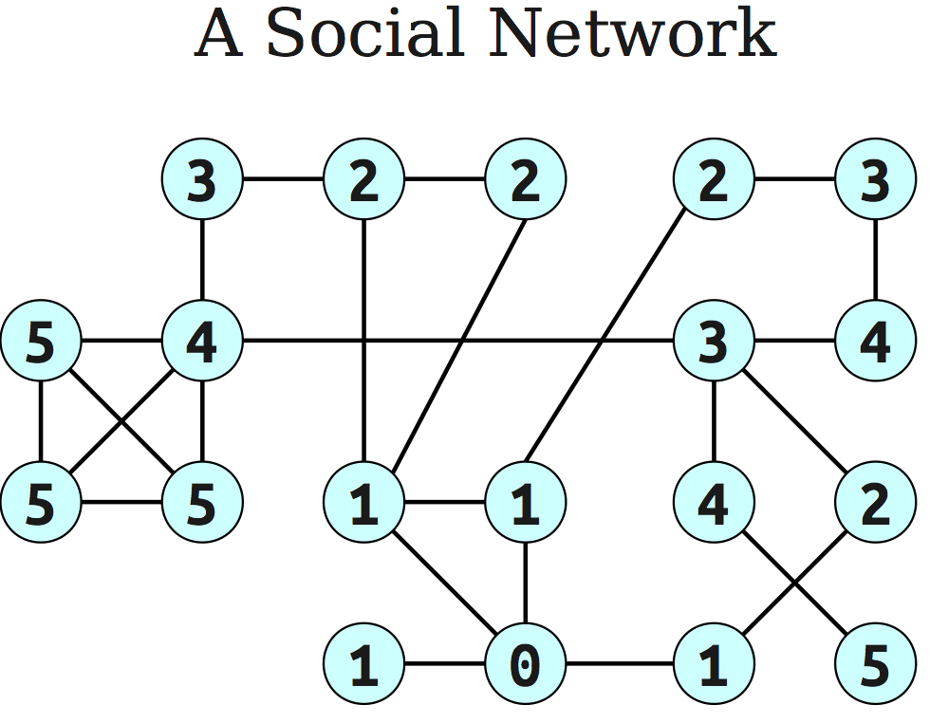
An application: Six degrees of separtion
Source node
The numbers on nodes indicate the distances of the nodes from the source node.

Slide 5
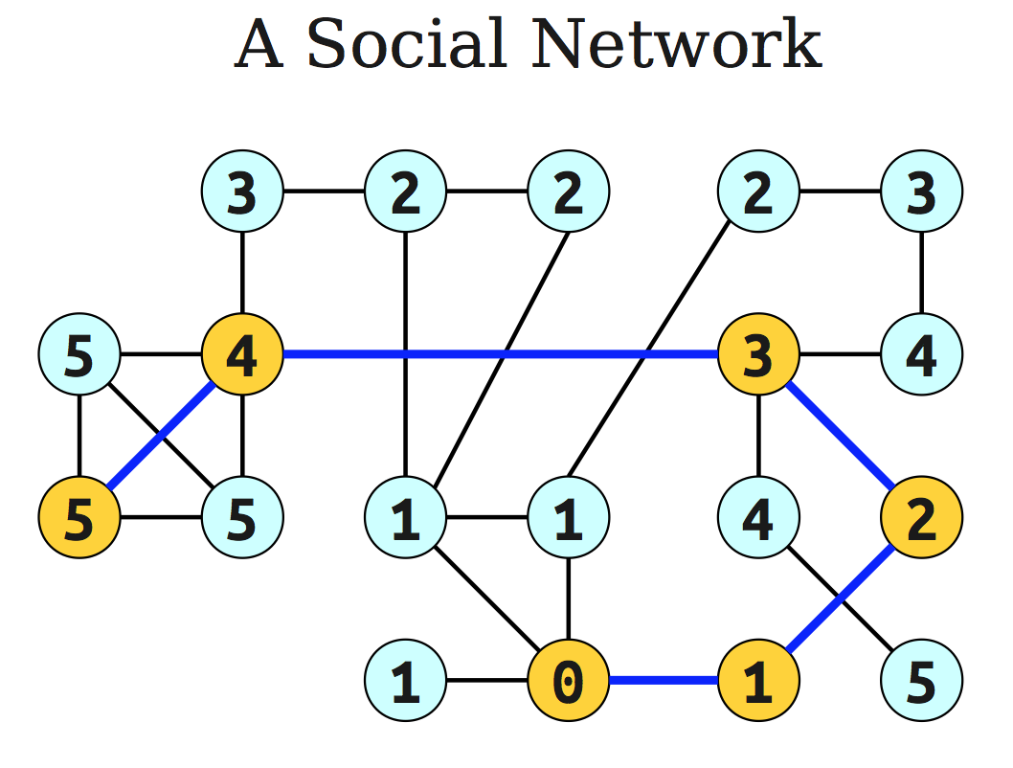
Source node

Slide 6
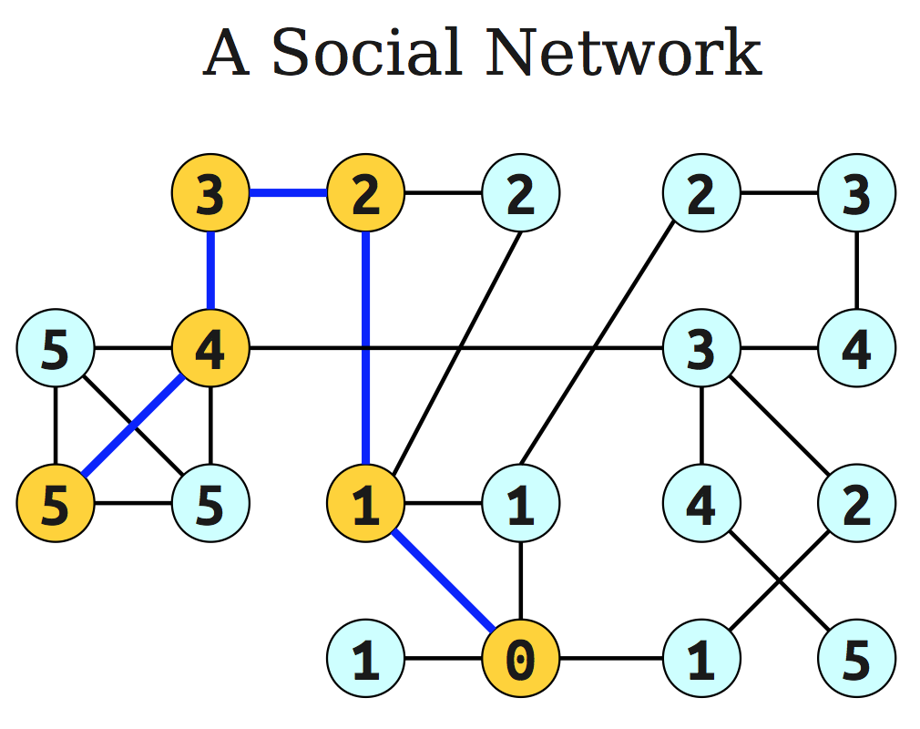
Source node
Principle of optimality: If node A lies on the shortest path from the source node S to B then
d (S,B) = d (S, A) + d ( A, B).

Slide 7
The shortest path problem
Input
A graph G=(V,E), which may be directed or undirected.
A start node s ∈ V.
Output
A table dist(v), where dist(v) = d(s,v) for any v ∈ V.

Slide 8
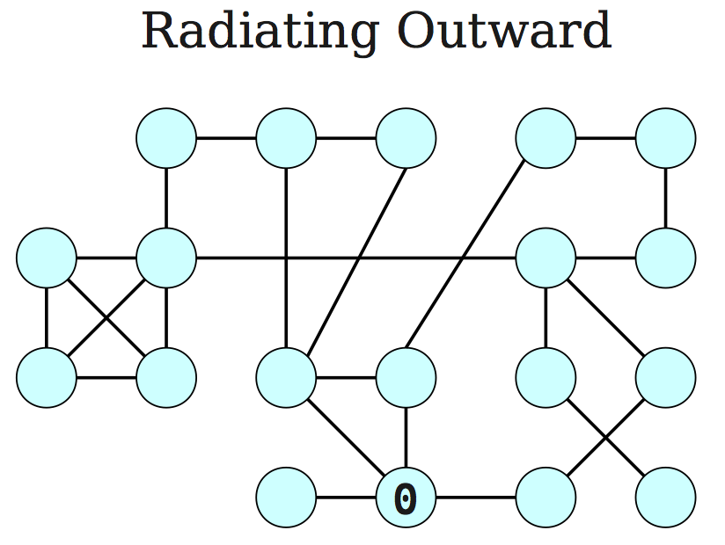

Slide 9
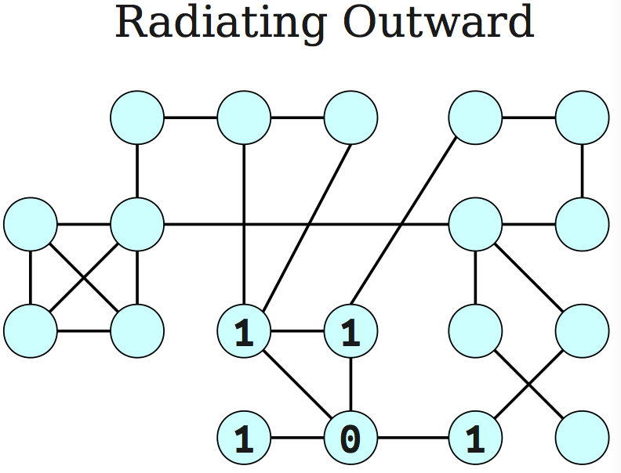

Slide 10
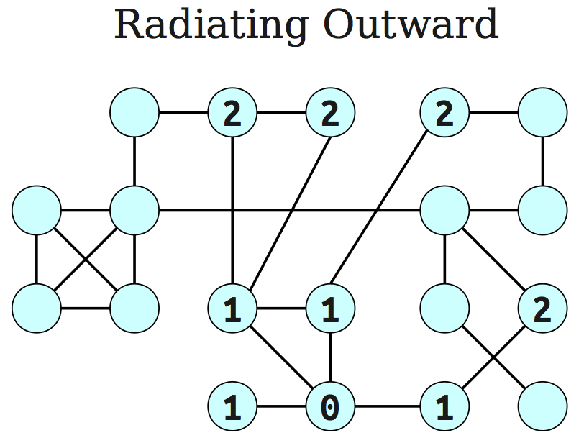

Slide 11
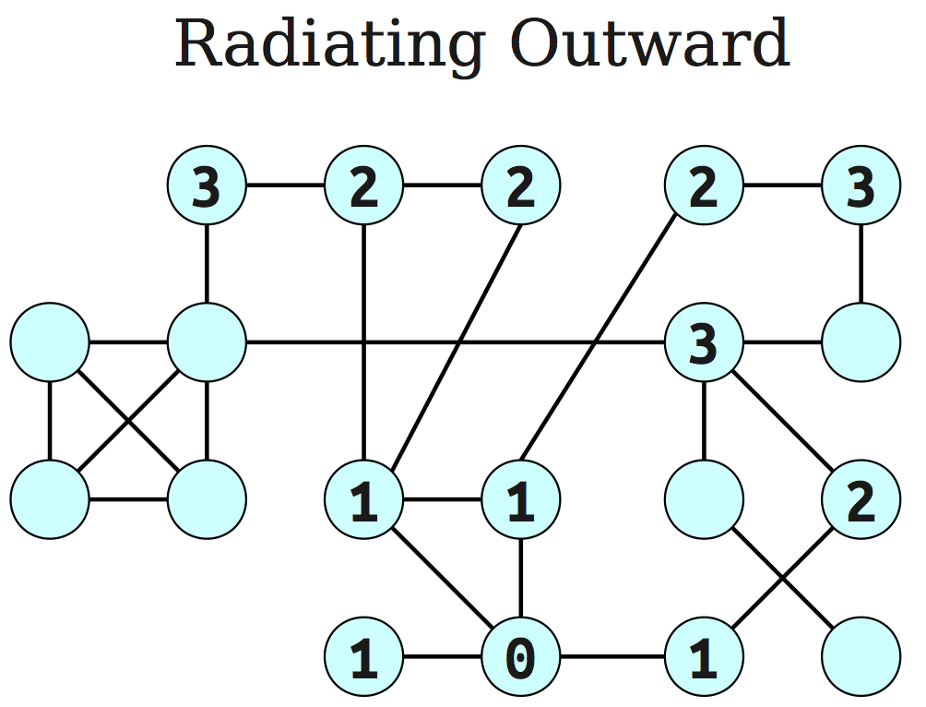

Slide 12
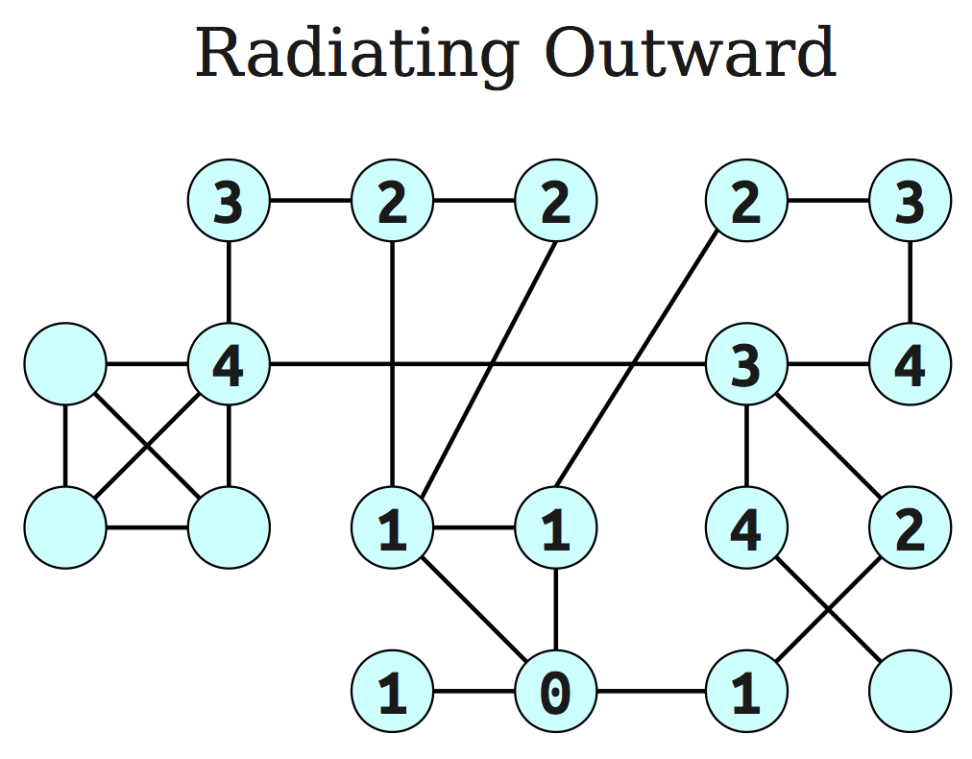

Slide 14
General Idea
Proceed outward from the source node s in ``layers’’.
The first layer is all nodes of distance 0.
The second layer is all nodes of distance 1.
The third layer is all nodes of distance 2.
etc.
This gives rise to breadth-first search.

Slide 15
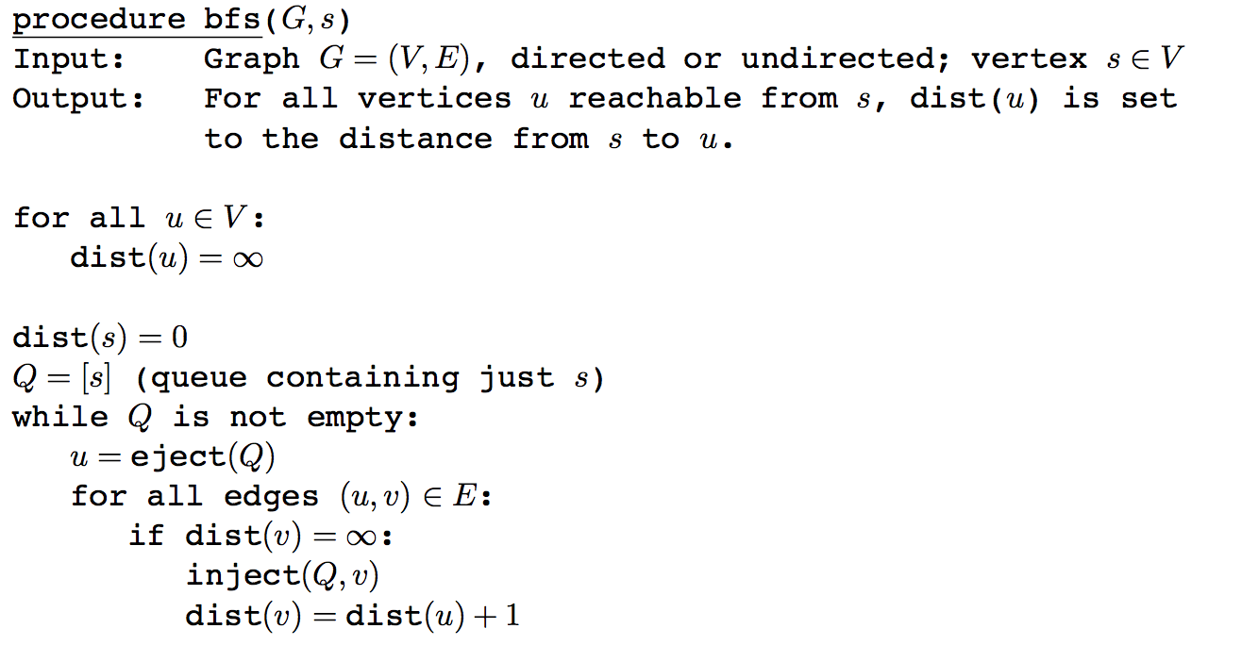
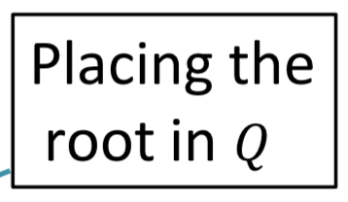
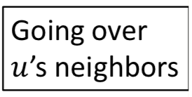
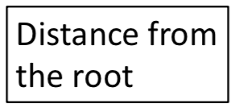
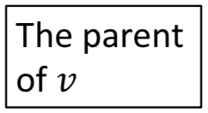
Breadth-first search
parent(v) = u

Slide 16
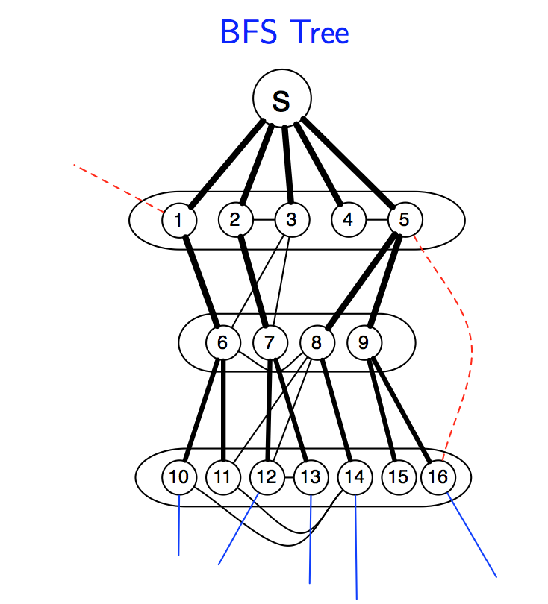
We keep only edges (thick ones) that correspond to parent field of some vertex.

Slide 17
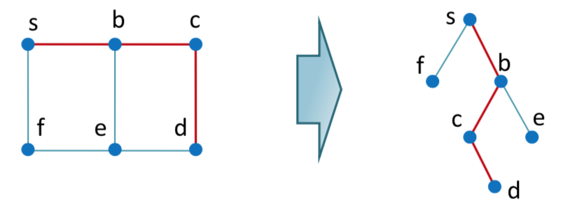
Using the parent values
Using the parent values (π), how can we find a shortest path between s and v?
v, π[v], π[π[v]], …, s

Slide 18
Correctness of BFS
We have developed the basic intuition behind BFS.
We need a proof that it faithfully executes the intuition.
Let S be the set of nodes whose distances from the source node s is known, i.e. dist[s,u] for all u in S is known.
Pick up a node v which is not an element of S, minimizing dist[s,v] + 1, where (u,v) is an edge of the graph and u is an element of S.

Slide 19
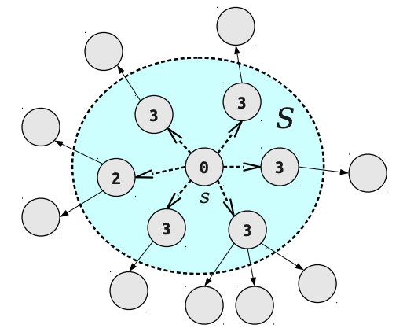
u
v
Lemma: Suppose we have shortest paths computed for nodes S ⊆ V,
where s ∈ S. Consider a node v, not in S, where (u, v) ∈ E, u ∈ S, and the quantity dist(s, u) + 1 is minimized. Then dist(s, v) = dist(s, u) + 1.

Slide 20
Running time analysis
The total running time is O(|V|+|E|) (why?)
Each vertex is put on the queue exactly once, when it is first encountered.
Therefore, there are 2|V| queue operations.
The rest of the work is done in the algorithm’s innermost loop. In this loop, each edge is being looked at exactly twice.
Over the course of execution, this loop takes O(|E|) time.

Slide 21
DFS vs. BFS
DFS
BFS
Input:
A Graph G = (V, E) (directed or undirected)
No source vertex given!
Idea:
Explore the edges of G to “discover” every vertex in V starting at the most current visited node
Search may be repeated from multiple sources
Output:
2 timestamps on each vertex: pre[v], post[v]
DFS forest
O(|V|+|E|)
Input:
A graph G = (V, E) (directed or undirected)
A source vertex s ∈ V
Idea:
Explore the edges of G to “discover” every vertex reachable from s, taking the ones closest to s first
Output:
d[v] = distance (smallest # of edges, or shortest path) from s to v, for all v ∈ V
BFS tree
O(|V|+|E|)

Slide 22
Modified BFS Algorithm Example
iteration
a
b
 | 0 | 1 | 2 | 3 | 4 | 5
Q | abcde | bcde | cde | de | e | Ø
d[a] | 0 | 0 | 0 | 0 | 0 | 0
d[b] | ∞ | 1 (a) | 1 (a) | 1(a) | 1(a) | 1(a)
d[c] | ∞ | 1 (a) | 1(a) | 1(a) | 1(a) | 1(a)
d[d] | ∞ | ∞ | ∞ | 2(c) | 2(c) | 2(c)
d[e] | ∞ | ∞ | 2(b) | 2(b) | 2(b) | 2(b)
c
d
e
a is source node

Slide 23
Modified BFS Algorithm
input: G = (V,E) and source node s and destination node t
// initialization
dist[s] = 0
dist[v] = infinity for all other nodes v
initialize priority queue Q to contain all nodes using dist values as keys. // T_{ins} : time per operation

Slide 24
Modified BFS Algorithm
while Q is not empty do
u = extract-min(Q) //T_{ex} : time per operation
if u = t, then return dist[t].
for each neighbor v of u do
if dist[v] > dist[u] + 1 then // T_{dec} : time per operation
dist[v] = dist[u] + 1
update-key(Q,v,dist[v])
parent(v) = u

Slide 25
Using Array Implementations
O(|V|(T_{ins} + T_{ex}) + |E|•T_{dec})
Implement priority queue with an unsorted array:
T_{ins} = O(1),
T_{ex} = O(|V|),
T_{dec} = O(1)
total time is O(|V|²)

Slide 26
Priority Queues
Priority queues is an abstract data structure that supports the following operations:
Find the minimum value.
Delete the element with the minimum value. If there are more than one element with the minimum value, just delete any one of them.
Insert an element.

Slide 27
Priority Queues
Heaps is the most efficient way to implement a priority queue
FindMin takes O(1) time
DeleteMin takes logarithmic time
Insert takes logarithmic time.

Slide 28
Running Time using Binary Heaps
O(|V|(T_{ins} + T_{ex}) + E•T_{dec})
If priority queue is implemented with a binary heap, then
T_{ins} = T_{ex} = T_{dec} = O(log |V|)
total time is O(|E| log |V|)

Slide 29
Edges have (positive) lengths
Breadth-first search treats all edges as having the same length.
In reality the edges have lengths, and we are interested in computing shortest paths.
Our graph is a weighted graph G = (V,E) where each edge e = (u,v) of E has length l_{e} or we will sometime also write l(u,v) or l_{uv}.

Slide 30
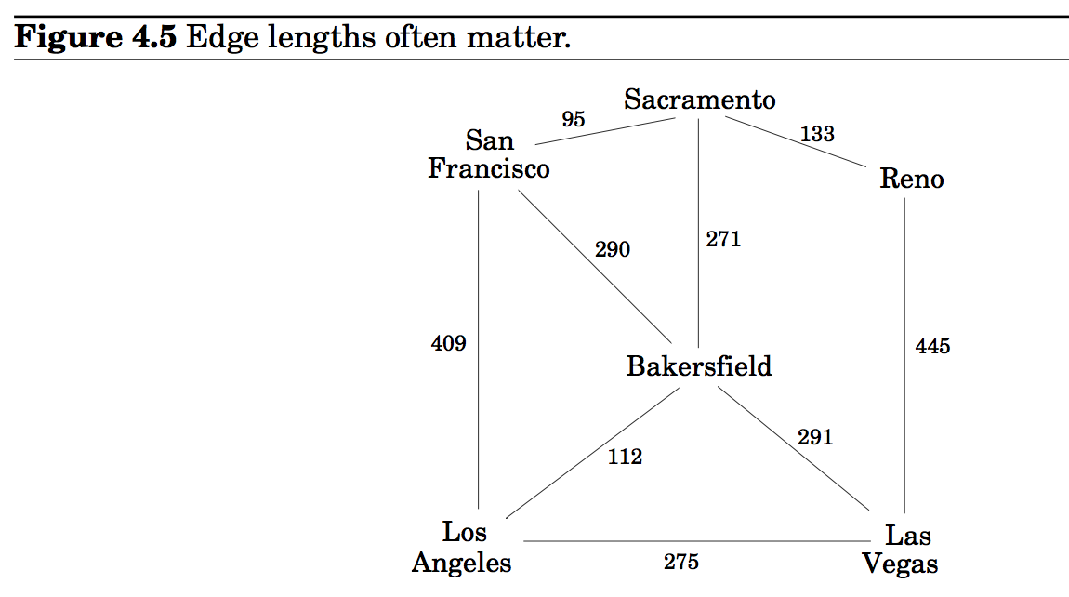

Slide 31
Dijkstra’s algorithm
An adaptation of breadth-first search.
Given a weighted graph G, we construct an unweighted graph G’ = (V’, E’) where
For any edge e = (u,v), replace it by l_{e} edges of length 1, by adding l_{e} -1 dummy nodes between u and v.

Slide 32
A problem with the adaptation
Running time is also dependent on the size of length parameter.

Slide 33
An intuitive description of Dijkstra’s algorithm
I have used the ideas described at:
http://www.quora.com/What-is-the-simplest-intuitive-proof-of-Dijkstra’s-shortest-path-algorithm

Slide 34
An intuitive description of Dijkstra’s algorithm
We are given a weighted graph G = (V,E), and interested in computing the shortest paths from s (source node).
We drop a huge colony of ants on to the source node s time 0.
They move from there and follow all possible paths through the graph at a rate of one unit per second.
The first one to reach the node v will do so at time dist(s,v).
dist(s,v) is the shortest distance from s to v.

Slide 35
Expanding wavefront of ants

Slide 36
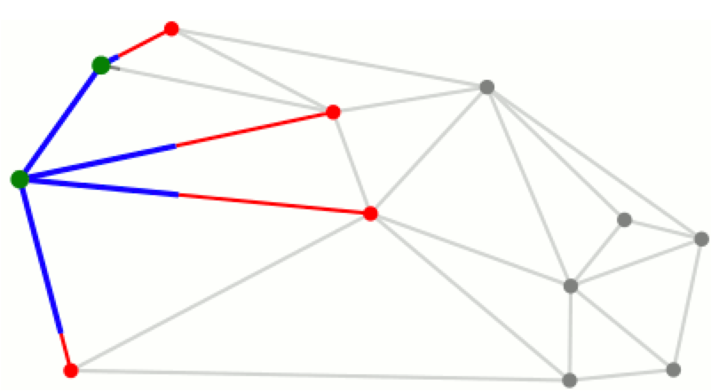
Expanding wavefront of ants

Slide 37
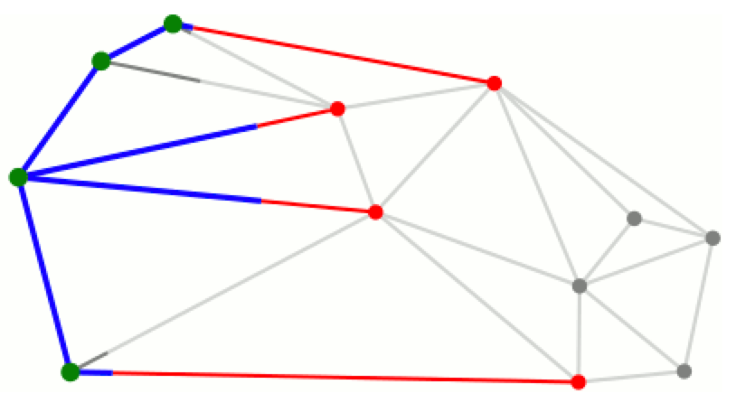
Expanding wavefront of ants

Slide 38
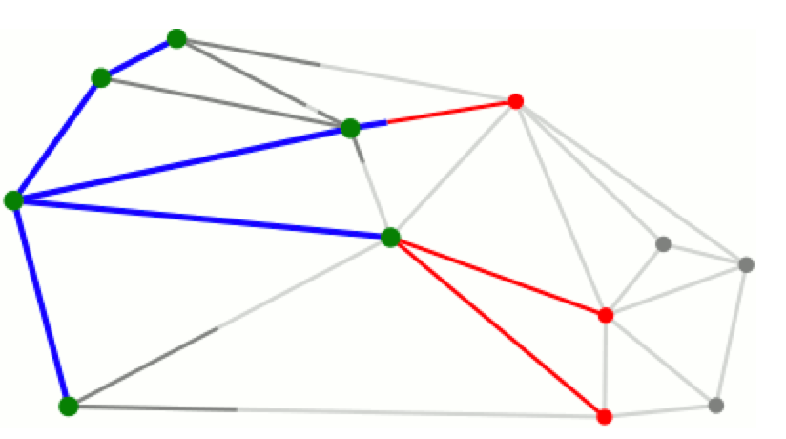
Expanding wavefront of ants

Slide 39
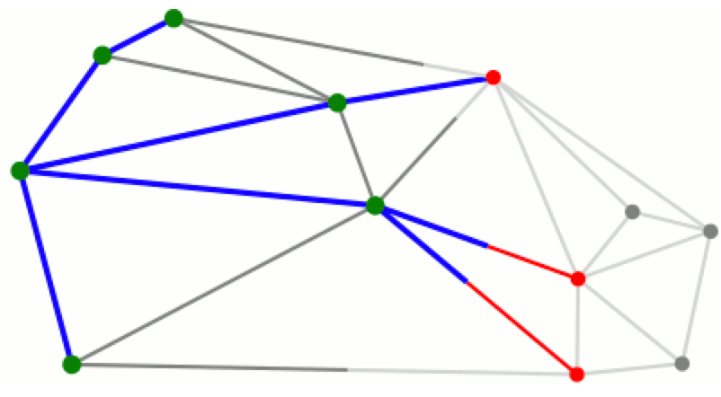
Expanding wavefront of ants

Slide 40
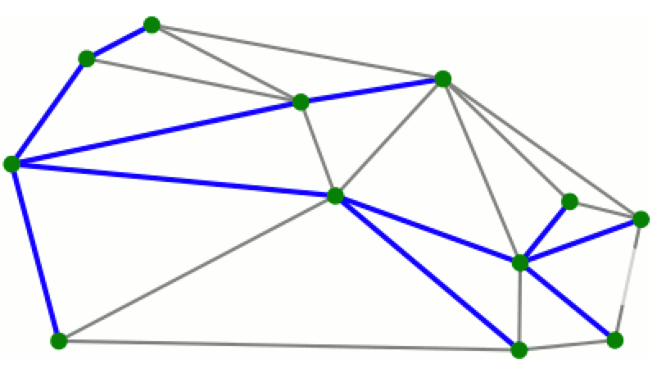
Expanding wavefront of ants

Slide 41
Information to maintain
Two information items we need to maintain:
A schedule to keep track of future arrival of the first ant en route to each node (shown in red in the animation). Initially, the ants are only scheduled to arrive at u at time 0.
A visited array to mark the nodes that ants have already reached (shown as greenish in the animation).

Slide 42
Data structure updates when an ant reach node i at time t.
We will mark node i as visited.
We will remove i from the schedule.
For each edge from i to an unvisited node j, the ants will move down that edge.
Ants are also moving back toward any visited nodes, but we don’t care about these ants since they will never find any new nodes.
We note that ants will arrive at j, from i, at time t + w where w is the length of the edge.
If j is already in the schedule, set dist(j) = min {dist(j), t + w}.
if j is not in the schedule, add j to the schedule with tentative arrival time as t + w, i.e. set dist(j) = t + w.

Slide 43
We repeat this process with the earliest arrival time of the vertex from the schedule.

Slide 44
// T_{ins} : time per operation
//T_{ex} : time per operation
// T_{dec} : time per operation

Slide 45
Three operations on the schedule
Remove the entry with earliest time (this happens once for each node).
Add a new entry (this happens once for each entry)
Decrease the time associated with an existing entry (this happens at most once for each edge)

Slide 46
Using Array Implementations
O(|V|(T_{ins} + T_{ex}) + |E|•T_{dec})
Implement priority queue with an unsorted array:
T_{ins} = O(1),
T_{ex} = O(|V|),
T_{dec} = O(1)
total time is O(|V|²)

Slide 47
Running Time using Binary Heaps
O(|V|(T_{ins} + T_{ex}) + E•T_{dec})
If priority queue is implemented with a binary heap, then
T_{ins} = T_{ex} = T_{dec} = O(log |V|)
total time is O(|E| log |V|)

Slide 48
Running Time using Fibonacci Heaps
O(|V|(T_{ins} + T_{ex}) + E•T_{dec})
If priority queue is implemented with a Fibonacci heap, then
T_{ex} = O(log |V|)
T_{ins} = T_{dec} = O(1)
total time is O(|V| log |V| + |E|)

Slide 49
Dijkstra's Algorithm Example
2
iteration
a
b
 | 0 | 1 | 2 | 3 | 4 | 5
Q | abcde | bcde | cde | de | d | Ø
d[a] | 0 | 0 | 0 | 0 | 0 | 0
d[b] | ∞ | 2 | 2 | 2 | 2 | 2
d[c] | ∞ | 12 | 10 | 10 | 10 | 10
d[d] | ∞ | ∞ | ∞ | 16 | 13 | 13
d[e] | ∞ | ∞ | 11 | 11 | 11 | 11
12
8
c
4
10
9
6
3
2
d
e
4
a is source node

Slide 50
Example
Will be completed in the class.

Slide 52
Performance Summary
Choice of priority queue implementation directly affects performance.
2,000 vertices, 1 million edges: heap 2-3 times slower than array
100,000 vertices, 1 million edges: heap gives 500x speedup
1 million vertices, 2 million edges: heap gives 10,000x speedup.

Slide 53
Performance Summary
Choice of priority queue implementation directly affects performance.
2,000 vertices, 1 million edges: heap 2-3 times slower than array
100,000 vertices, 1 million edges: heap gives 500x speedup
1 million vertices, 2 million edges: heap gives 10,000x speedup.
array implementation is better for dense graph
heap is better for sparse graph

Slide 54
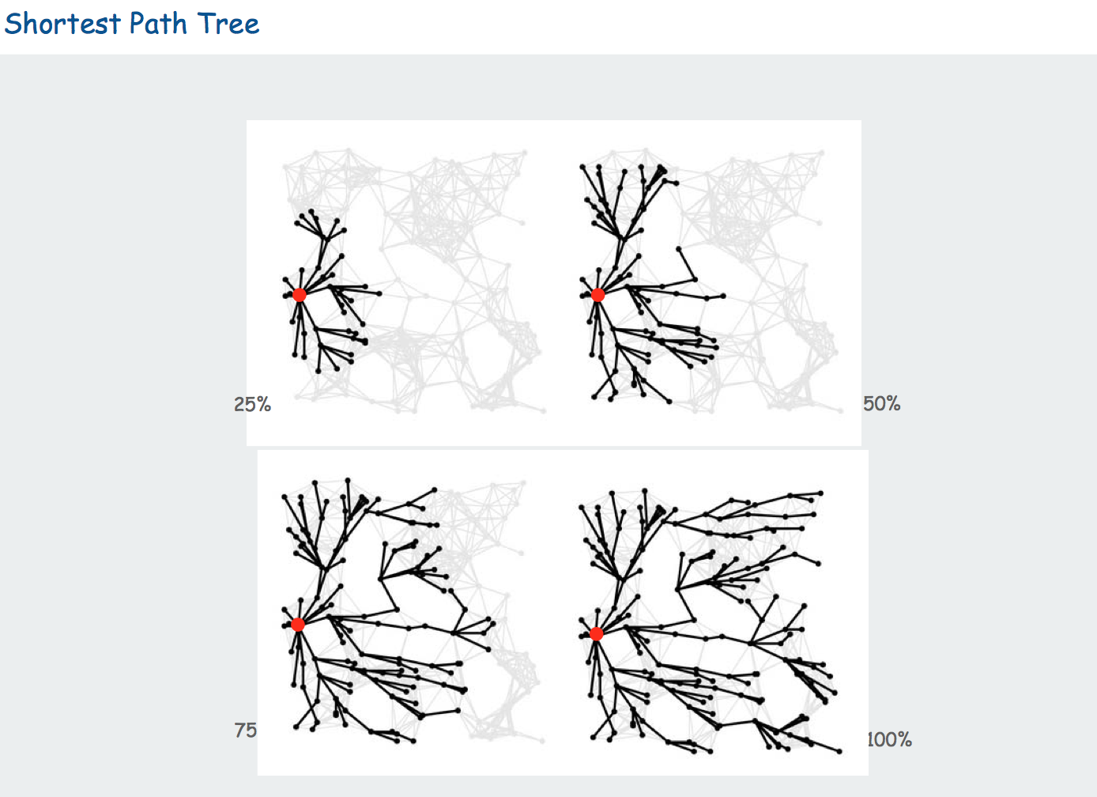

Slide 55
Shortest paths in the presence of negative cycles
We have implicitly assumed that the shortest path from the starting point s to any node v must pass exclusively through nodes that are close to v.
Dijkstra’s algorithm returns the path <A, C, D> as the shortest path from source node to destination node.
Source
A
2
Destination
5
8
C
D
B
7

Slide 56
Shortest paths in the presence of negative cycles
This property is no longer holds when edge length is allowed to be negative.
Dijkstra’s algorithm still returns the path <A, C, D> as the shortest path from source node to destination node. However, this is incorrect.
Negative edge weights present problems for Dijkstra’s algorithm.
Source
A
2
Destination
5
8
C
D
B
-7

Slide 57
Shortest paths in the presence of negative cycles
A bigger problem is negative cycles like the one below, since this means that there doesn’t exists a true shortest paths.
We can make the shortest paths as small as possible.
Source
A
-10
Destination
15
3
C
D
B
5

Slide 58
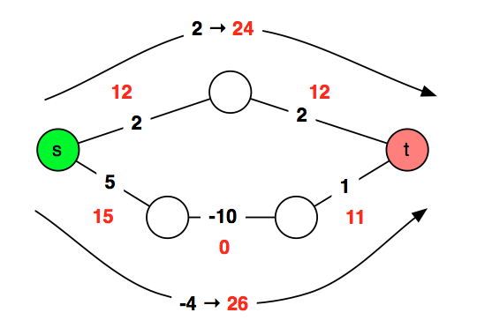
Just add a big number to each edge
Adding a large number M to each edge doesn’t work.

Slide 59
Bellman-Ford Algorithm
Handles graphs with negative edge weights.
It will return the same output as Dijkstra’s for any graphs with positive weights, but run slower.

Slide 60
Edge update
v
v
u
u
Update (relaxation) sets dist(v) to the length of a shorter path from s to v.

Slide 61
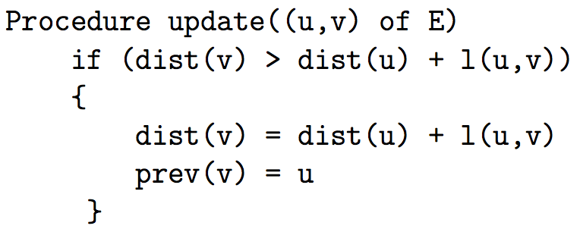
Edge update
dist(v) is the length of some path from source vertex s to v.
Relaxation (update) along edge e from v to w.
dist(v) is the length of some path from s to v
dist(w) is the length of some path to w

Slide 62
Bellman-Ford Example
B
2
D
4
4
A
-5
3
1
3
2
C
E
5
A | B | C | D | E
0 | ∞ | ∞ | ∞ | ∞

Slide 63
Bellman-Ford Example
B
2
D
4
4
A
-5
3
1
3
2
C
E
5
A | B | C | D | E
0 | 4 | 2 | ∞ | ∞

Slide 64
Bellman-Ford Example
B
2
D
4
4
A
-5
3
1
3
2
C
E
5
A | B | C | D | E
0 | 3 | 2 | 6 | 6

Slide 65
Bellman-Ford Example
B
2
D
4
4
A
-5
3
1
3
2
C
E
5
A | B | C | D | E
0 | 3 | 2 | 1 | 6

Slide 66
Bellman-Ford Example
B
2
D
4
4
A
3
1
-5
3
2
C
E
5
A | B | C | D | E
0 | ∞ | ∞ | ∞ | ∞
0 | 4 | 2 | ∞ | ∞
0 | 3 | 2 | 6 | 6
0 | 3 | 2 | 1 | 6
0 | 3 | 2 | 1 | 6
Each row is one of V-1 iterations
Each vertex is updating using values from the previous iteration
Notes:
Go through each row.
update all vertices using the values from the last pass
(values don’t change during a pass – all reset at the end)

Slide 68
Bellman-Ford algorithm
Running time is O(|E||V|).
Invariant: At end of phase i, dist(v) ≤ length of any path from s to v using at most i edges.
Theorem: If there are no negative cycles, upon termination, dist(v) is the length of the shortest path from s to v.

Slide 69
Bellman-Ford algorithm
Running time is O(|E||V|).
Invariant: At end of phase i, dist(v) ≤ length of any path from s to v using at most I edges.
Theorem: If there are no negative cycles, upon termination, dist(v) is the length of the shortest path from s to v.
Observation: If dist(v) doesn’t change during phase i, there is no need to relax any edge leaving v in phase i+1.

Slide 70
Negative cycles
It can be tested if a given graph has a negative cycle.
Check if Bellman-Ford algorithm updates dist(v) for any v in phase |V|. If it does, the graph has a negative cycle. (why?

Slide 71
Shortest paths in dags
There is no cycle.
Edge weights could be negative.
We still cannot use Dijkstra’s algorithm.
We can use Bellman-Ford algorithm.
Running time is O(|E||V|)
For dense graphs this is O(|V|³).
We can reduce the complexity to O(|V| + |E|).

Slide 72
Shortest paths in dags
Use the topological order of the vertices of the dags. (Can be done in linear time)
dist(s) = 0
Determine the topological order of the vertices. (Also known as Linearize G)
for each vertex u of V, in linearized order
for all edges (u,v), radiating from u:
update(u,v)

Slide 73
Problems from the text
Practice problems (Chapter 4)
1, 2, 4, 6, 7, 8, 9*, 10, 12, 13, 17, 19, 20

