Slide 1
Set Theory – Part I
Chapter 3.1, 3.2, 3.3

Slide 2
Introduction
Sets are one of the basic building blocks for the types of objects considered in discrete mathematics.
  Important for counting.
  Programming languages have set operations.

Slide 3
Introduction
Sets are one of the basic building blocks for the types of objects considered in discrete mathematics.
  Important for counting.
  Programming languages have set operations.
Set theory is an important branch of mathematics.
  Many different systems of axioms have been used to develop set theory.
  Here we are not concerned with a formal set of axioms for set theory. Instead, we will use what is called naïve set theory.

Slide 4
Sets
A set is an unordered collection of objects.
  the students in this class
  the chairs in this room
The objects in a set are called the elements, items or members of the set.
  A set is said to contain its elements.

Slide 5
Sets
A set is an unordered collection of objects.
  the students in this class
  the chairs in this room
The objects in a set are called the elements, items or members of the set.
  A set is said to contain its elements.
The notation a ∈ A denotes that a is an element of the set A.
If a is not a member of A, write a ∉ A

Slide 6
Describing a Set: Roster Method
S = {a,b,c,d}
Order not important
S = {a,b,c,d} = {b,c,a,d}

Slide 7
Describing a Set: Roster Method
Each distinct object is either a member or not; listing more than once does not change the set.
S = {a,b,c,d} = {a,b,c,b,c,d}

Slide 8
Describing a Set: Roster Method
Elipses (…) may be used to describe a set without listing all of the members when the pattern is clear.
S = {a,b,c,d, ……,z }

Slide 9
Roster Method
Set of all vowels in the English alphabet:
V = {a,e,i,o,u}
Set of all odd positive integers less than 10:
O = {1,3,5,7,9}
Set of all positive integers less than 100:
S = {1,2,3,……..,99}
Set of all integers less than 0:
S = {…., -3,-2,-1}

Slide 10
Some Important Sets
N = natural numbers = {0,1,2,3….}
Z = integers = {…,-3,-2,-1,0,1,2,3,…}
Z⁺ = positive integers = {1,2,3,…..} = {x ε Z | x > 0}
Q = set of rational numbers
Q⁺ = set of positive rational numbers
Q* = set of rational numbers
R = set of real numbers

Slide 11
Interval Notation
[a,b] = {x | a ≤ x ≤ b}
[a,b) = {x | a ≤ x < b}
(a,b] = {x | a < x ≤ b}
(a,b) = {x | a < x < b}
closed interval [a,b]
open interval (a,b)

Slide 12
Special types of sets that come up often
The empty set: Φ ={}
The natural numbers: N = {1, 2, 3, 4, ….}
The integers: Z = {…., -3, -2, -1, 0, 1, 2, 3, ….}
The rational numbers:
Q = {1, ½, 1/3, …, -1, -1/2,…, 2, 2/3, …, -2,-2/3,…}
The real numbers:
R ={all real numbers on a number line}

Slide 13
Representation of a set
A set can be expressed by listing its elements between commas, enclosed by braces.
  {2, 4, 6, 8} (finite set)
  {……., -4, -3, -2, -1, 0, 1, 2, 3, 4, …..} (infinite set)
  {{a,b, ...}, {0,1,2, ...., 9}, ... ,{α, β, ....}, ....}

Slide 14
Representation of a set
A set-builder notation is used to describe sets that are too complex to enumerate them.
  Suppose E={…., -6, -4, -2, 0, 2, 4, 6, ….}
  Set-builder notation
  E={n : n is an even integer} or
  E={n | n is an even integer}
  Other examples
  A = {x : x is an integer |x| < 4} = {-3, -2, -1, 0, 1, 2, 3}
  The rational numbers: Q={x : x = m/n, m,n ∈ Z, n ≠ 0}

Slide 15
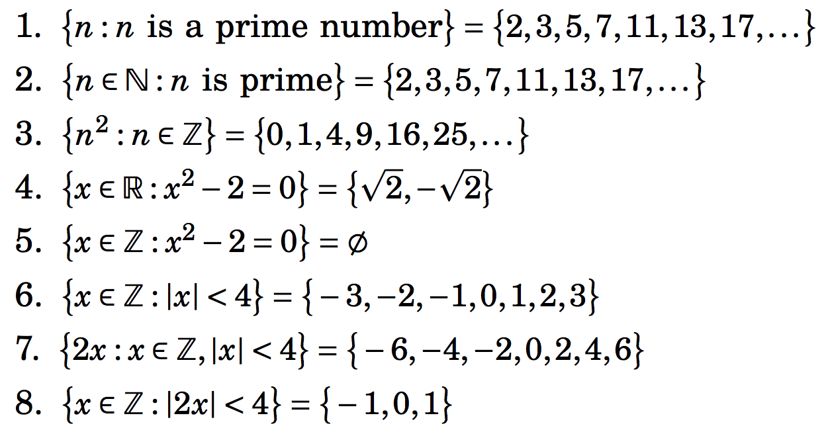
Some illustrations of set-builder notation

Slide 16
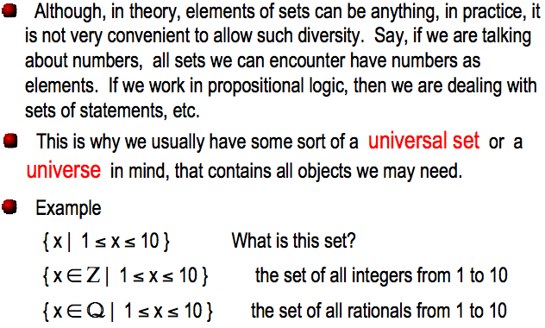
Universe

Slide 17
Conceptually:
Conceptually, a set is like a bag containing objects. This bag can contain another bag containing other objects.
Example: A= {1, {1}, {2}, {1,2}}
  How many elements are in A?
  1 ∈ A? 2 ∈ A? {2} ∈ A? {{2}} ∈ A?

Slide 18
Equality of Sets, Subsets
If B is a subset of A, every element of B is an element of A. We write B ⊆ A.
Two sets are equal if they have the same elements.
To show that two sets are equal, it is sufficient to show separately that
  A ⊆ B and
  B ⊆ A

Slide 19
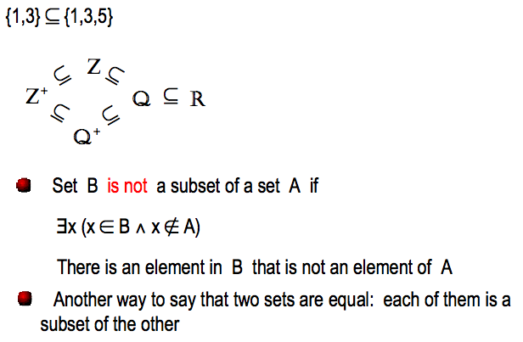
Equality of Sets, Subsets (contd.)
Z⁺ is N, the set of natural numbers
Q⁺ is the set of all positive rational numbers

Slide 20
Subsets (contd.)
A set B is a proper subset of a set A, if it is a subset A and is not equal to A ( ).
If A is a subset of B and B is a subset of C, A is a subset of C. (Transitive relation)
Note that if A has at least one element, ∅ is a proper subset of A.

Slide 21
Cardinality of a set
Cardinality of a set A, denoted by |A|:
  It is the number of elements in the set
  A set with finite number of elements is called a finite set.
  A set with infinite number of elements is called an infinite set.
  Sets N, Z, Q, R are all infinite.
Empty set has no element, denoted by ∅
  How many elements does the set {∅} contain?

Slide 22
Power set
Given a set A, the power set of A, P(A), is the set of all subsets of A.
Examples
  Let A={a,b,c}, P(A)={∅,{a},{b},{c},{a,b},{b,c},{a,c},{a,b,c}}
  Let A={{a,b},c}, P(A)={∅,{{a,b}},{c},{{a,b},c}}
Note: the empty set ∅ and the set itself are always elements of the power set.

Slide 23
Power set
The power set is a fundamental combinatorial object useful when considering all possible combinations of elements of a set
Fact: Let S be a set such that |S|=n, then
|P(S)| = 2^{n}
  Some intuition?

Slide 24
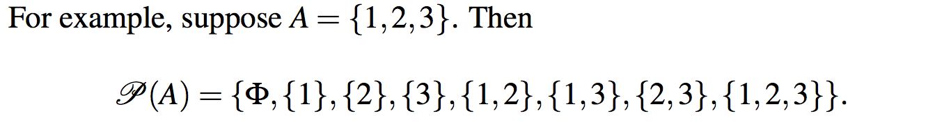
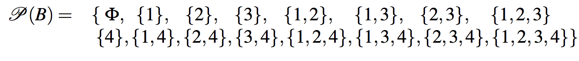
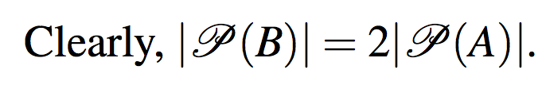
Power set
For B={1,2,3,4}

Slide 25
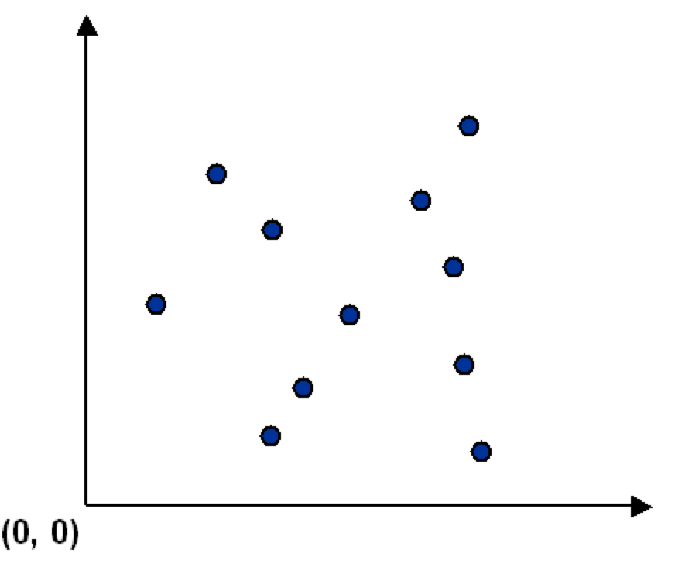
Ordered collection of objects
Sometimes we need to consider ordered collection of objects.
Consider a set S of points in the plane.

Slide 26
Ordered collection of objects
Sometimes we need to consider ordered collection of objects.
Consider a set S of points in the plane.
p_{i} =(x_{i},y_{i}) is the x-y coordinate of the i^{th} point.
S={(x₁,y₁), (x₂,y₂), ……, (x_{m},y_{m})} represents a set of m ordered objects.
Each object is an ordered collection of two elements.
S = {p₁,p₂, …, p_{m}} is also fine.

Slide 27
Tuples
Definition: The ordered n-tuple (a₁,a₂,…,a_{n}) is the ordered collection with the element a_{i} being the i^{th} element for i=1,2,…,n.
Two ordered n-tuples (a₁,a₂,…,a_{n}) and (b₁,b₂,…,b_{n}) are equal iff for every i=1,2,…,n we have a_{i}=b_{i}.
A 2-tuple (n=2) is called an ordered pair.

Slide 28
Section Summary
Set Operations
  Union
  Intersection
  Complementation
  Difference

Slide 29
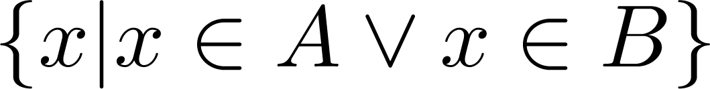
Union
Definition: Let A and B be sets. The union of the sets A and B, denoted by A ∪ B, is the set:
Example: What is {1,2,3} ∪ {3, 4, 5}?
Solution: ?
Venn Diagram for A ∪ B
U
A
B

Slide 30
Union
Definition: Let A and B be sets. The union of the sets A and B, denoted by A ∪ B, is the set:
Example: What is {1,2,3} ∪ {3, 4, 5}?
Solution: {1,2,4,5}
Venn Diagram for A ∪ B
U
A
B

Slide 31

Operations on Sets
Let A and B be two arbitrary sets. Let U be the universal set, (i.e. A ⊆ U and B ⊆ U).
Union: A ∪ B = {x: x ∈ A or x ∈ B}
Intersection: A ∩ B = {x: x ∈ A and x ∈ B}
Difference: A – B = { x: x ∈ A and x ∉ B}
Symmetric Difference:
A △ B = {x: (x ∈ A and x ∉ B) or (x ∉ A and x ∈ B)}
= (A – B) ∪ (B – A)
Complement: U – A = {x : x ∉ A}

Slide 32
Review Question
Example: U = {0,1,2,3,4,5,6,7,8,9,10} A = {1,2,3,4,5}, B ={4,5,6,7,8}
  A ∪ B
    Solution:
  A ∩ B
    Solution:
  Ā
    Solution:
    Solution:
  A – B
    Solution:
  B – A
    Solution:

Slide 33
Review Question
Example: U = {0,1,2,3,4,5,6,7,8,9,10} A = {1,2,3,4,5}, B ={4,5,6,7,8}
  A ∪ B
    Solution: {1,2,3,4,5,6,7,8}
  A ∩ B
    Solution: {4,5}
  Ā
    Solution: {0,6,7,8,9,10}
    Solution: {0,1,2,3,9,10}
  A – B
    Solution: {1,2,3}
  B – A
    Solution: {6,7,8}

Slide 34
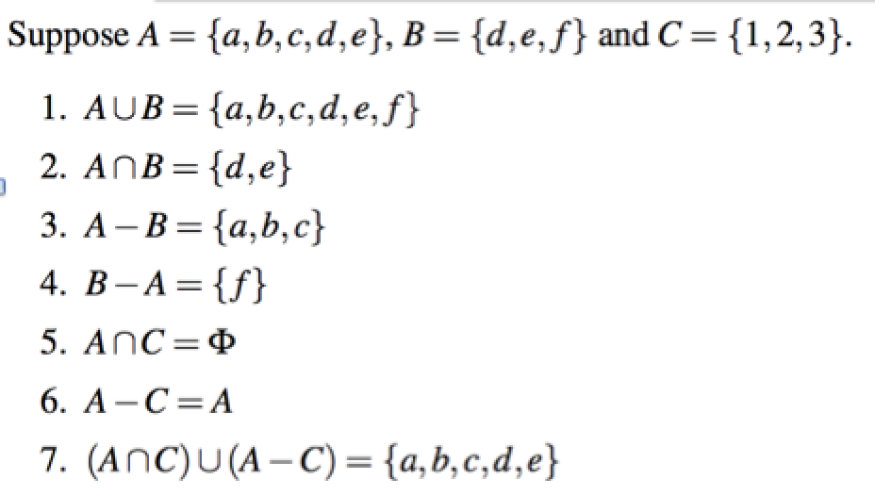
Operations on Sets

Slide 35
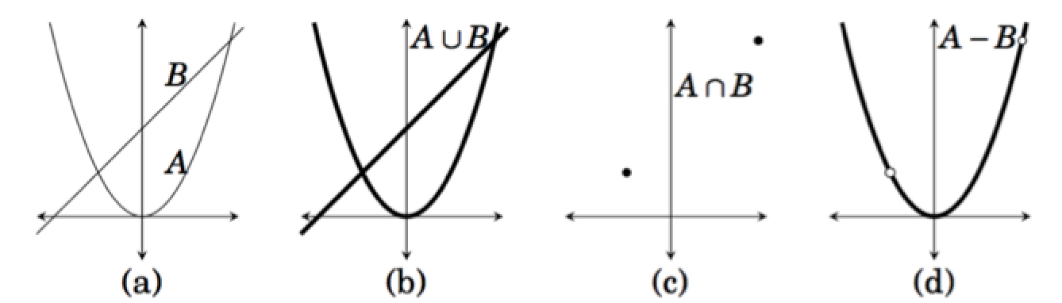
Operations on Sets
A={(x,x²) : x ∈ R} B={(x,ax + b) : x ∈ R and a,b ∈ R}

Slide 36
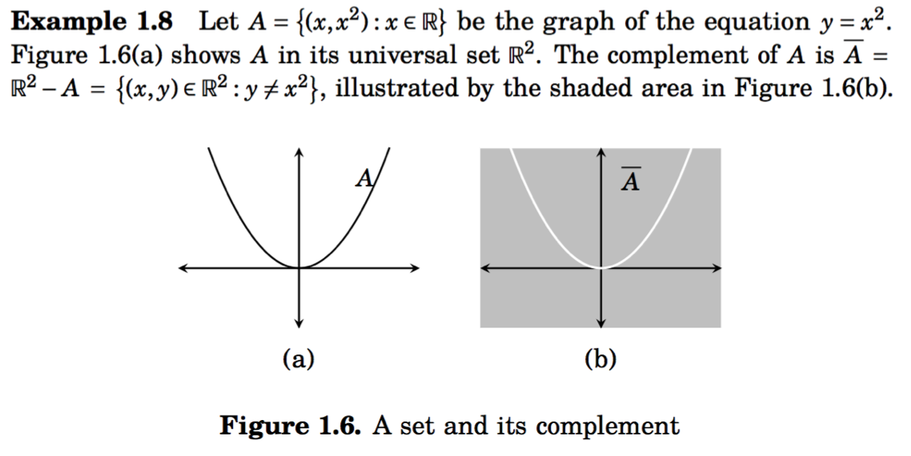
Operations on Sets

Slide 37
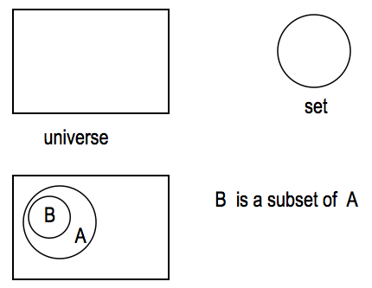
Venn Diagram
It is often used to visualize the various relations between the sets.

Slide 38
Intersection
The intersection of sets A and B, denoted by A B, is the set that contains those elements in both A and B.
U
A
B

Slide 39
Union
The union of sets A and B, denoted by A B, is the set that contains those elements that are in either A or B.
U
A
B

Slide 40
Set Difference
Definition: The difference of two sets A and B, denoted A−B, is the set containing those elements that are in A but not in B
U
A
B

Slide 41
Set Complement
Definition: The complement of a set A, denoted A, consists of all elements not in A. That is the difference of the universal set U and A.
A = {x | x ∉ A }
U
A
A

Slide 42
Disjoint Sets
Definition: Two sets are said to be disjoint if their intersection is the empty set: A ∩ B = ∅
U
A
B

Slide 43
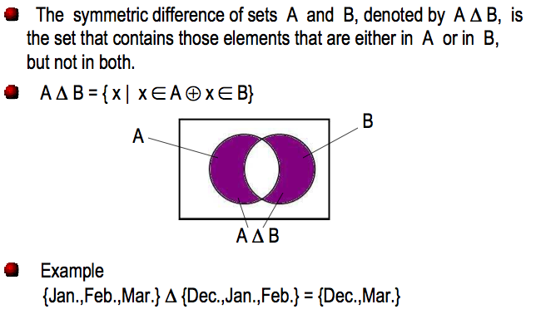
Symmetric Difference

Slide 44
Set identities
Set identities are basic laws on how set operations work
  Many have already been introduced on previous slides
Just like logical equivalences!
  Replace U with ∨
  Replace ∩ with ∧
  Replace ∅ with F
  Replace U with T

Slide 45
Set identities: DeMorgan again
These should look
very familiar…

Slide 46
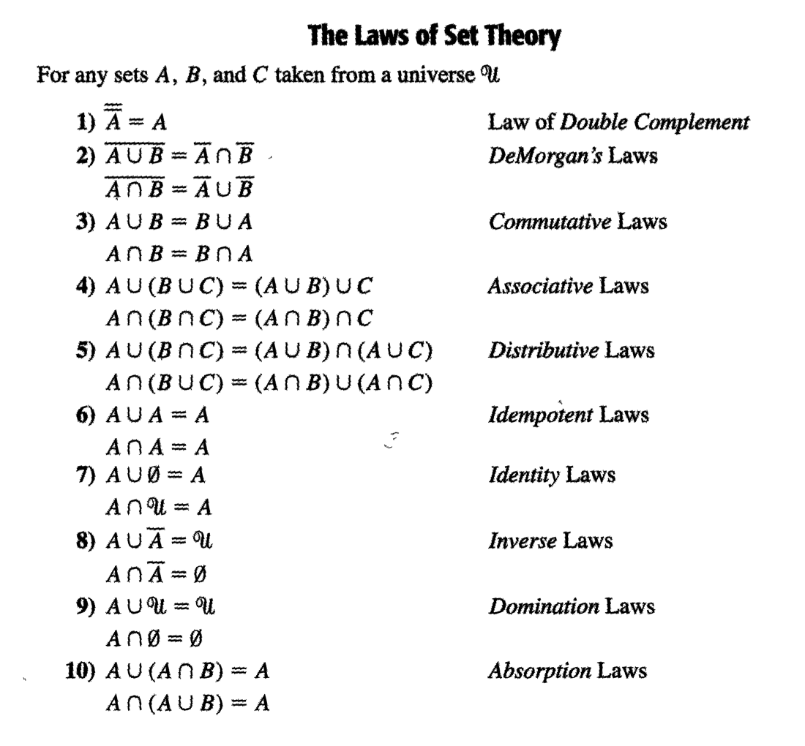

Slide 47
Proof by using basic set identities
Prove that A∩B=B-(B-A)
Definition of difference
Definition of difference
DeMorgan’s law
Complementation law
Distributive law
Complement law
Identity law
Commutative law

Slide 48
What is a membership table ?
Membership tables show all the combinations of sets an element can belong to
  1 means the element belongs, 0 means it does not
Consider the following membership table:
The top row is all elements that belong to both sets A and B
  Thus, these elements are in the union and intersection, but not the difference

Slide 49
What is a membership table ?
Membership tables show all the combinations of sets an element can belong to
  1 means the element belongs, 0 means it does not
Consider the following membership table:
The second row is all elements that belong to set A but not set B
  Thus, these elements are in the union and difference, but not the intersection

Slide 50
What is a membership table ?
Membership tables show all the combinations of sets an element can belong to
  1 means the element belongs, 0 means it does not
Consider the following membership table:
The third row is all elements that belong to set B but not set A
  Thus, these elements are in the union, but not the intersection or difference

Slide 51
What is a membership table ?
Membership tables show all the combinations of sets an element can belong to
  1 means the element belongs, 0 means it does not
Consider the following membership table:
The bottom row is all elements that belong to neither set A or set B
  Thus, these elements are neither the union, the intersection, nor difference

Slide 52
Proof by membership tables ?
The following membership table shows that A∩B=B-(B-A)
Because the two indicated columns have the same values, the two expressions are identical
This is similar to Boolean logic!

Slide 53
Proof by showing each set is a subset of the other
Assume that x∈B-(B-A)
  By definition of difference, we know that x∈B and x∉B-A
Consider x∉B-A
  If x∈B-A, then (by definition of difference) x∈B and x∉A
  Since x∉B-A, then only one of the inverses has to be true (DeMorgan’s law): x∉B or x∈A
So we have that x∈B and (x∉B or x∈A)
  It cannot be the case where x∈B and x∉B
  Thus, x∈B and x∈A
  This is the definition of intersection
Thus, if x∈B-(B-A) then x∈A∩B
Therefore, B – (B-A) ⊆ A∩B

Slide 54
Proof by showing each set is a subset of the other
Assume that x∈A∩B
  By definition of intersection, x∈A and x∈B
Thus, we know that x∉B-A
  B-A includes all the elements in B that are also not in A not include any of the elements of A (by definition of difference)
Consider B-(B-A)
  We know that x∉B-A
  We also know that if x∈A∩B then x∈B (by definition of intersection)
  Thus, if x∈B and x∉B-A, we can restate that (using the definition of difference) as x∈B-(B-A)
Thus, if x∈A∩B then x∈B-(B-A)
Therefore, A∩B ⊆ B - (B-A).
This completes the proof of A∩B = B - (B-A).

Slide 55
Proof by set builder notation and logical equivalences
First, translate both sides of the set identity into set builder notation
Then massage one side (or both) to make it identical to the other
  Do this using logical equivalences

Slide 56
Proof by set builder notation and logical equivalences
Original statement
Definition of difference
Negating “element of”
Definition of difference
DeMorgan’s Law
Distributive Law
Negating “element of”
Negation Law
Identity Law
Definition of intersection

Slide 57
Subset problems
Let A, B, and C be sets. Show that:
(AUB) ⊆ (AUBUC)
(A∩B∩C) ⊆ (A∩B)
(A-B)-C ⊆ A-C
(A-C) ∩ (C-B) = ∅

Slide 58
Practice Problems
Problems (Exercises 3.1) 2, 3, 4, 6, 7, 8, 15, 22
Problems (Exercises 3.2) 5, 6, 7, 8, 16, 17, 18
Problems (Exercises 3.3) 2, 4, 6, 7

