Slide 1
Set Theory (Part II)
Chapter 1

Slide 2
Indexed Sets
Generalized Union and Intersection of sets
Suppose A₁, A₂, …., A_{n} are sets. We can use A_{i} to indicate the i^{th} set where i is called the index of the set.

Slide 3
Indexed Sets
Other equivalent expressions:

Slide 4
Indexed Sets
Consider the set B_{j} = {kj | k=2,3,4, …}
= {2j, 3j, 4j, …..}
B_{j} is the set all the positive numbers divisible by j except by itself.
The set of all composite numbers, numbers which can be expressed as the product of two integers (≠ 1)

Slide 5
Proving Set Equivalences: Example 1
Let
A={x|x is even}
B={x|x is a multiple of 3}
C={x|x is a multiple of 6}
Show that A∩B=C

Slide 6
Proving Set Equivalences: Example 1
A∩B ⊆ C: Consider an arbitrary element x ∈ A∩B
x is a multiple of 2 and x is a multiple of 3
we can write x=2.3.k for some integer k
x=6k for some integer k ⇒ x is a multiple of 6
x ∈ C
C ⊆A∩B: Consider an arbitrary element x∈ C
x is a multiple of 6 ⇒ x=6k for some integer k
x=2(3k)=3(2k) ⇒ x is a multiple of 2 and of 3
x ∈ A∩B

Slide 7
Proving Set Equivalences: Example 1
A∩B ⊆ C: Consider an arbitrary element x ∈ A∩B
x is a multiple of 2 and x is a multiple of 3
we can write x=2.3.k for some integer k
x=6k for some integer k ⇒ x is a multiple of 6
x ∈ C
C ⊆A∩B: Consider an arbitrary element x∈ C
x is a multiple of 6 ⇒ x=6k for some integer k
x=2(3k)=3(2k) ⇒ x is a multiple of 2 and of 3
x ∈ A∩B
: to be read as ‘this implies’

Slide 8
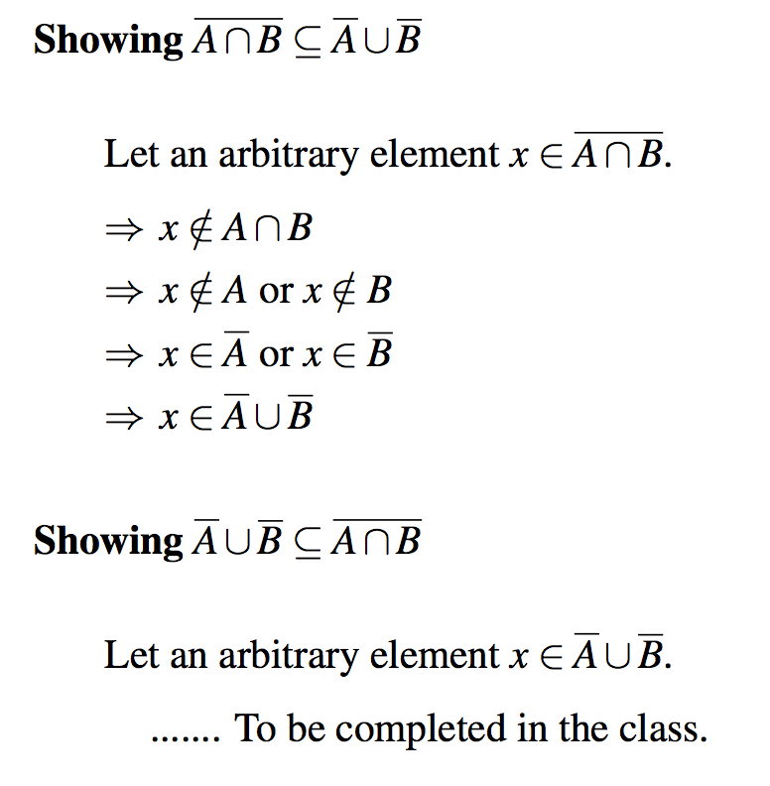
: Example 2

Slide 9
Example 3
Prove or disprove

Slide 10
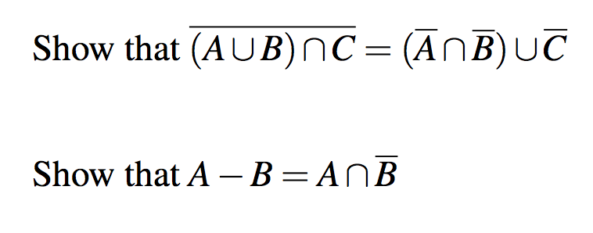
Example

Slide 11
Membership Table (Rosen, page 131)
Set identities can also be proved using membership table.
Consider each combination of sets that an element can belong to.
for A∩B=C : an element can belong to any subset of {A,B,C}
Verify that the elements of the same combination of sets belong to both the sets in the identity.
Consider DeMorgan’s Law

Slide 12
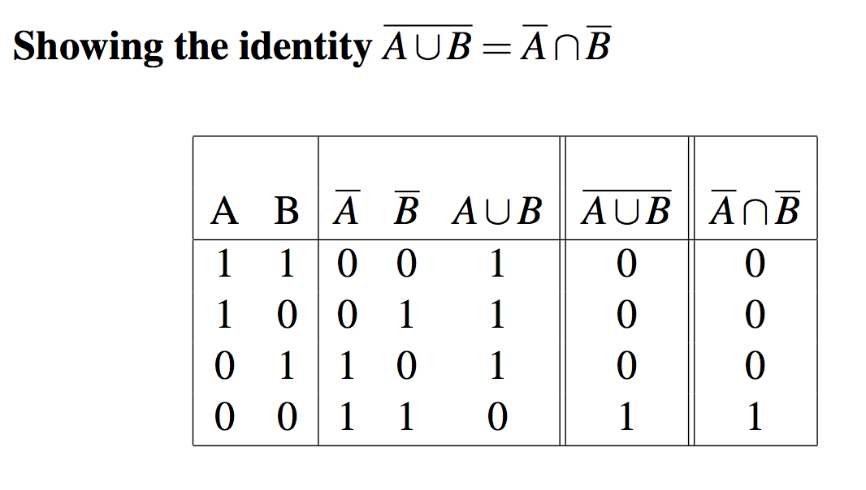
Membership Table (Rosen, page 131)
To indicate that an element is in a set, a 1 is used.
To indicate that an element is not in a set, a 0 is used.

Slide 13
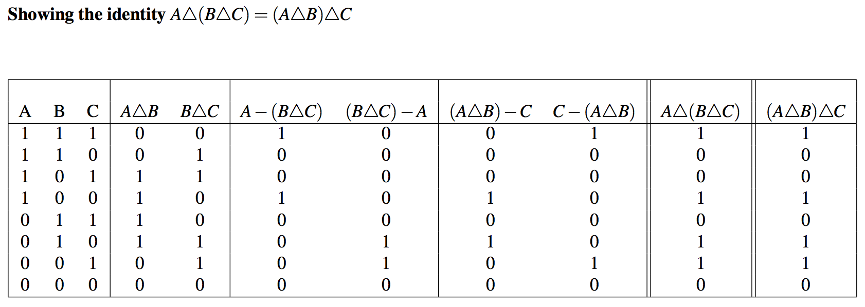
Membership Table (Rosen, page 131)

Slide 14
Membership Table (Rosen, page 131)
The identity of the last two columns is established.

Slide 15
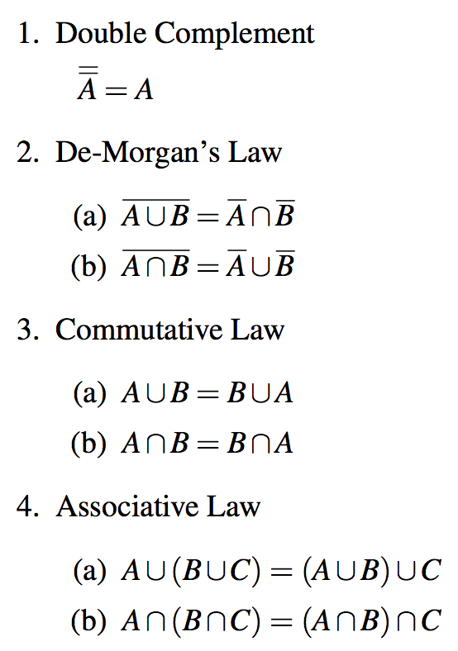
Laws of Set Theory

Slide 16
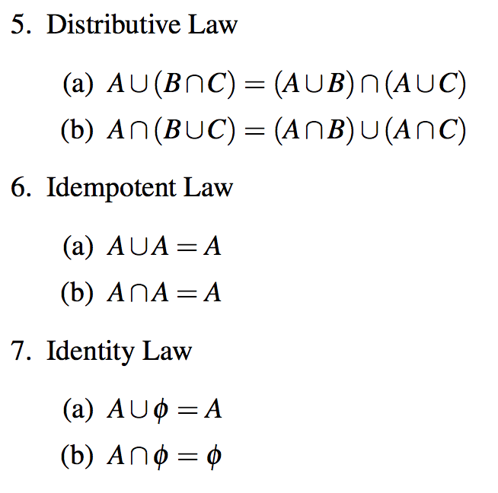
Laws of Set Theory

Slide 17
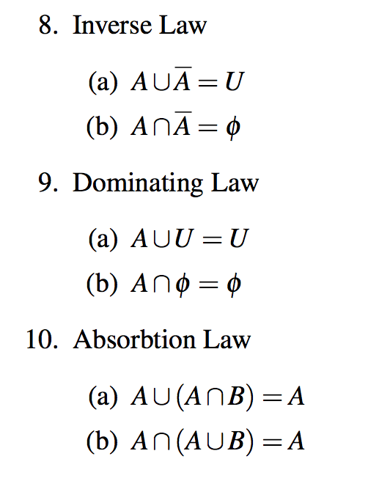
Laws of Set Theory

Slide 18
Practice problems from the text
Section 1.1
1, 3, 8, 9, 10, 21, 23, 28, 29, 37, 38, 39, 41, 48
Section 1.2
1, 3, 6, 8, 9,19, 20
Section 1.3
1, 2, 4, 9, 11, 14, 15, 16
Section 1.4
5, 6, 11
Section 1.5
1, 3, 5, 6, 8, 9

Slide 19
Practice problems from the text (2)
Section 1.6
1, 3, 4
Section 1.7
3, 5, 6, 9
Section 1.8
1, 3, 5, 12, 13

