Slide 1
Set Theory – Part I
Chapter 1

Slide 2
Set Theory
Sets are fundamental discrete structures and for the basis of more complex discrete structures like graphs
We will develop more fully
The definitions of sets
The properties of sets
The operations on sets

Slide 3
Set Theory
(Def:) A set is an (unordered) collection of unique objects.
The objects in a set are called elements.
One way to describe a set is to list its elements
{0, 1, 2, 3, 4, 5, 6, 7, 8, 9} – the set of digits
{a, b, ...., x, y, z} – the lower case alphabet set
A set can be element of another set
{{a,b, ...}, {0,1,2, ...., 9}, ... ,{α, β, ....}, ....} – set of all alphabets

Slide 4
Set Theory
Notation, for a set A:
x ∈ A: x is an element of A
x ∉ A: x is not an element of A
Conceptually, a set is like a bag containing objects. This bag can contain another bag containing other objects.
Example: A= {1, {1}, {2}, {1,2}}
How many elements are in A?
1 ∈ A? 2 ∈ A? {2} ∈ A? {{2}} ∈ A?

Slide 5
Set Theory
Definition: Two sets, A and B, are equal if they contain the same elements. We write A=B.
Example:
{2,3,5,7}={3,2,7,5}, because a set is unordered
Also, {2,3,5,7}={2,2,3,5,3,7} because a set contains unique elements
However, {2,3,5,7} ≠{2,3}

Slide 6
Special types of sets that come up often
The empty set: Φ ={}
The natural numbers: N = {1, 2, 3, 4, ….}
The integers: Z = {…., -3, -2, -1, 0, 1, 2, 3, ….}
The rational numbers:
Q = {1, ½, 1/3, …, -1, -1/2,…, 2, 2/3, …, -2,-2/3,…}
The real numbers:
R ={all real numbers on a number line}
π ∈ R

Slide 7
Representation of a set
A set can be expressed by listing its elements between commas, enclosed by braces.
{2, 4, 6, 8} (finite set)
{……., -4, -3, -2, -1, 0, 1, 2, 3, 4, …..} (infinite set)
{{a,b, ...}, {0,1,2, ...., 9}, ... ,{α, β, ....}, ....}

Slide 8
Representation of a set
A set-builder notation is used to describe sets that are too complex to enumerate them.
Suppose E={…., -6, -4, -2, 0, 2, 4, 6, ….}
Set-builder notation
E={n : n is an even integer} or
E={n | n is an even integer}
Other examples
A = {x : x is an integer |x| < 4} = {-3, -2, -1, 0, 1, 2, 3}
The rational numbers: Q={x : x = m/n, m,n ∈ Z, n ≠ 0}

Slide 9
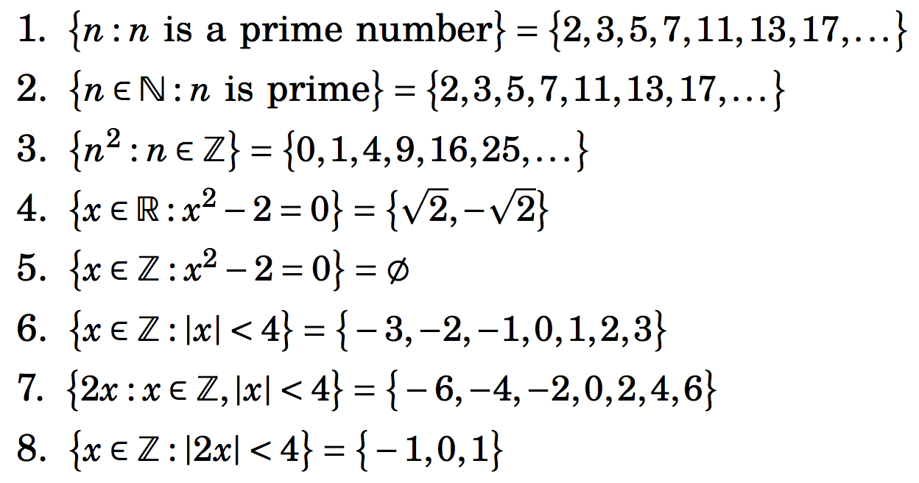
Some illustrations of set-builder notation

Slide 10
Universe

Slide 11
Equality of Sets, Subsets
If B is a subset of A, every element of B is an element of A. We write B ⊆ A.
Two sets are equal if they have the same elements.
To show that two sets are equal, it is sufficient to show separately that
A ⊆ B and
B ⊆ A

Slide 12
Equality of Sets, Subsets (contd.)
Z⁺ is N, the set of natural numbers
Q⁺ is the set of all positive rational numbers

Slide 13
Subsets (contd.)
A set B is a proper subset of a set A, if it is a subset A and is not equal to A ( ).
If A is a subset of B and B is a subset of C, A is a subset of C. (Transitive relation)
Note that if A has at least one element, ∅ is a proper subset of A.

Slide 14
Cardinality of a set
Cardinality of a set A, denoted by |A|:
It is the number of elements in the set
A set with finite number of elements is called a finite set.
A set with infinite number of elements is called an infinite set.
Sets N, Z, Q, R are all infinite.
Empty set has no element, denoted by ∅
How many elements does the set {∅} contain?

Slide 15
Power set
Given a set A, the power set of A, P(A), is the set of all subsets of A.
Examples
Let A={a,b,c}, P(A)={∅,{a},{b},{c},{a,b},{b,c},{a,c},{a,b,c}}
Let A={{a,b},c}, P(A)={∅,{{a,b}},{c},{{a,b},c}}
Note: the empty set ∅ and the set itself are always elements of the power set.

Slide 16
Power set
The power set is a fundamental combinatorial object useful when considering all possible combinations of elements of a set
Fact: Let S be a set such that |S|=n, then
|P(S)| = 2^{n}
Some intuition?

Slide 17
Power set
For B={1,2,3,4}

Slide 18
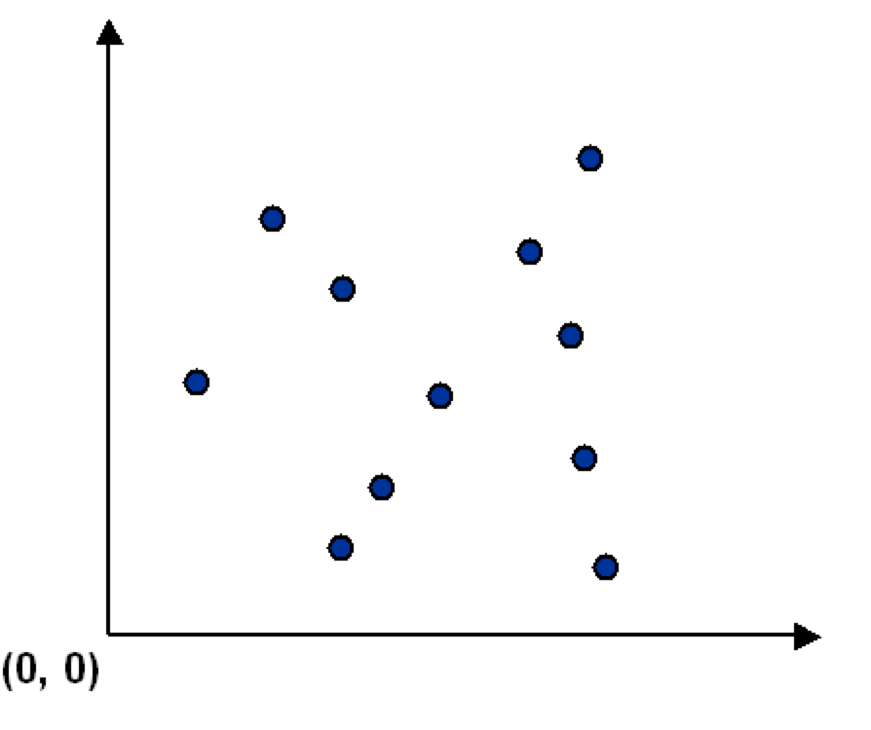
Ordered collection of objects
Sometimes we need to consider ordered collection of objects.
Consider a set S of points in the plane.

Slide 19
Ordered collection of objects
Sometimes we need to consider ordered collection of objects.
Consider a set S of points in the plane.
p_{i} =(x_{i},y_{i}) is the x-y coordinate of the i^{th} point.
S={(x₁,y₁), (x₂,y₂), ……, (x_{m},y_{m})} represents a set of m ordered objects.
Each object is an ordered collection of two elements.
S = {p₁,p₂, …, p_{m}} is also fine.

Slide 20
Tuples
Definition: The ordered n-tuple (a₁,a₂,…,a_{n}) is the ordered collection with the element a_{i} being the i^{th} element for i=1,2,…,n.
Two ordered n-tuples (a₁,a₂,…,a_{n}) and (b₁,b₂,…,b_{n}) are equal iff for every i=1,2,…,n we have a_{i}=b_{i}.
A 2-tuple (n=2) is called an ordered pair.

Slide 21
Cartesian Product
Definition: Let A and B be two sets. The Cartesian product of A and B, denoted AxB, is the set of all ordered pairs (a,b) where a∈A and b∈B
AxB = { (a,b) | (a∈A) and (b ∈ B) }
The Cartesian product is also known as the cross product.
The name `Cartesian product’ comes from a geometric interpretation.

Slide 22
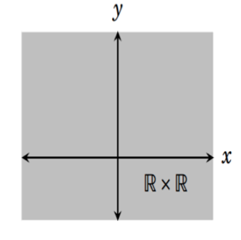
Cartesian Product
A = B = R (the set of reals)
R x R can also be written as R².

Slide 23
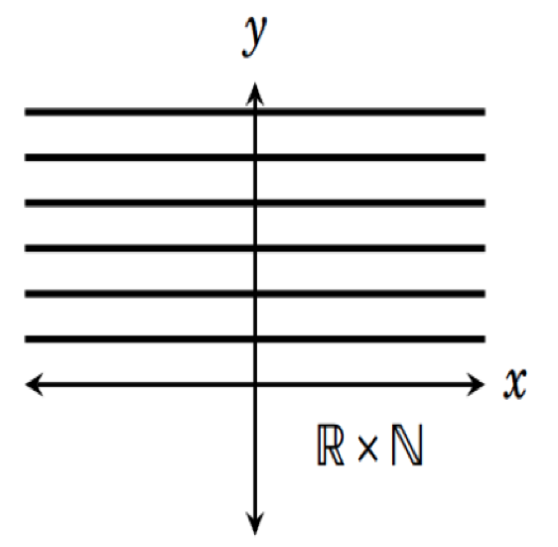
Cartesian Product
A = R (the set of reals),
B = N (the set positive integers) = {1, 2, 3, …}

Slide 24
Cartesian Product
A = R (the set of reals),
B = N (the set positive integers) = {1, 2, 3, …}
Note that A x B ≠ B x A, if A and B are not equal.

Slide 25
Cartesian Product
A = B = N (the set positive integers) = {1, 2, 3, …}

Slide 26
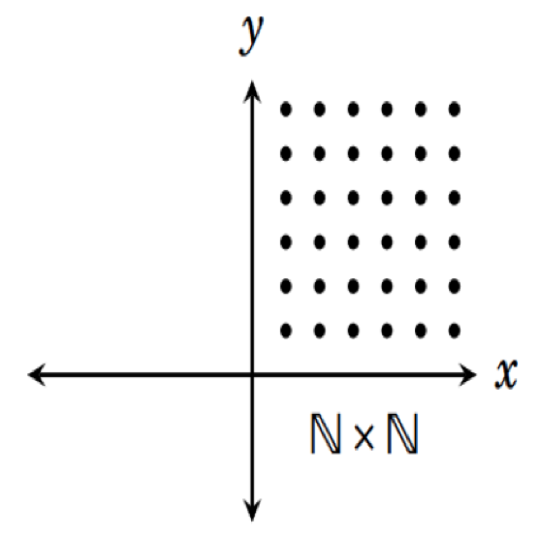
Cartesian Product
A = B = N (the set positive integers) = {1, 2, 3, …}

Slide 27
Cartesian Product
Cartesian Products can be generalized for any n-tuple
Definition: The Cartesian product of n sets, A₁,A₂, …, A_{n}, denoted A₁×A₂×… ×A_{n}, is
A₁×A₂×… ×A_{n} ={ (a₁,a₂,…,a_{n}) | a_{i} ∈ A_{i} for i=1,2,…,n}
Example: A set of points in three dimension with x-y-z coordinates. Each element of the set is an ordered 3-tuple.

Slide 28
Operations on Sets
Let A and B be two arbitrary sets. Let U be the universal set, (i.e. A ⊆ U and B ⊆ U).
Union: A ∪ B = {x: x ∈ A or x ∈ B}
Intersection: A ∩ B = {x: x ∈ A and x ∈ B}
Difference: A – B = { x: x ∈ A and x ∉ B}
Symmetric Difference:
A △ B = {x: (x ∈ A and x ∉ B) or (x ∉ A and x ∈ B)}
= (A – B) ∪ (B – A)
Complement: U – A = {x : x ∉ A}

Slide 29
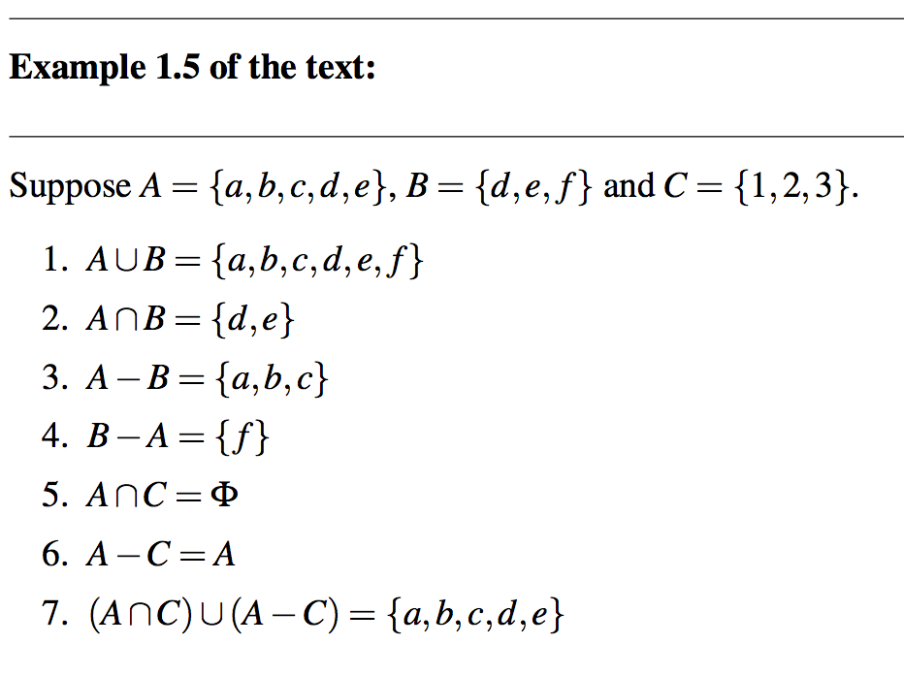
Operations on Sets

Slide 30
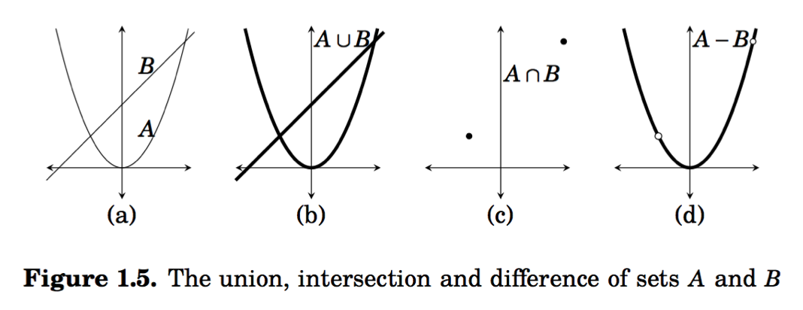
Operations on Sets
A={x² : x ∈ R} B={ax + b : x ∈ R and a,b ∈ R}

Slide 31
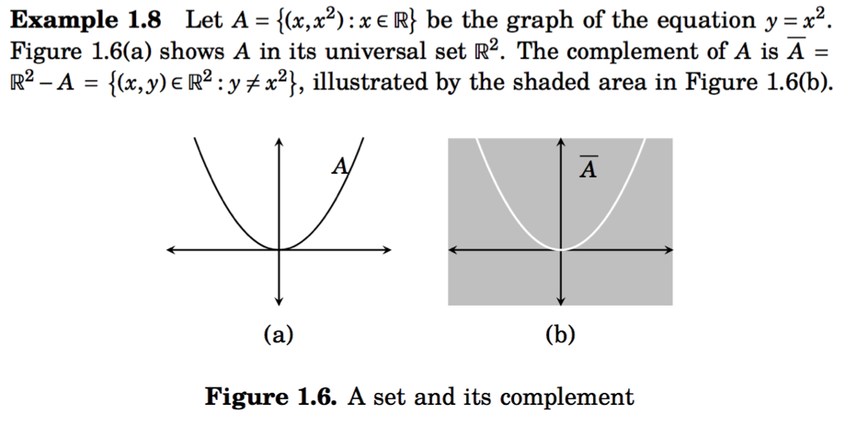
Operations on Sets

Slide 32
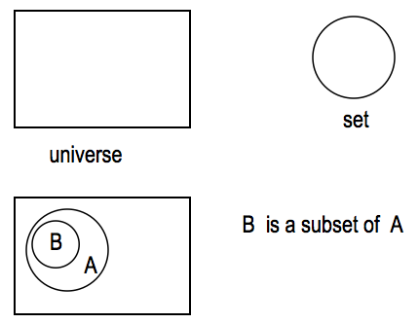
Venn Diagram
It is often used to visualize the various relations between the sets.

Slide 33
Intersection
The intersection of sets A and B, denoted by A B, is the set that contains those elements in both A and B.
U
A
B

Slide 34
Union
The union of sets A and B, denoted by A B, is the set that contains those elements that are in either A or B.
U
A
B

Slide 35
Set Difference
Definition: The difference of two sets A and B, denoted A−B, is the set containing those elements that are in A but not in B
U
A
B

Slide 36
Set Complement
Definition: The complement of a set A, denoted A, consists of all elements not in A. That is the difference of the universal set U and A.
A = {x | x ∉ A }
U
A
A

Slide 37
Disjoint Sets
Definition: Two sets are said to be disjoint if their intersection is the empty set: A ∩ B = ∅
U
A
B

Slide 38
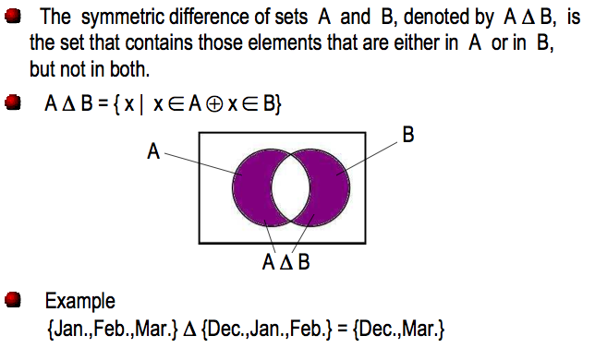
Symmetric Difference

