Slide 1
Proofs (Chapters 7, 8 and 9)

Slide 2
Proof Techniques of P ⇒ Q

Slide 3
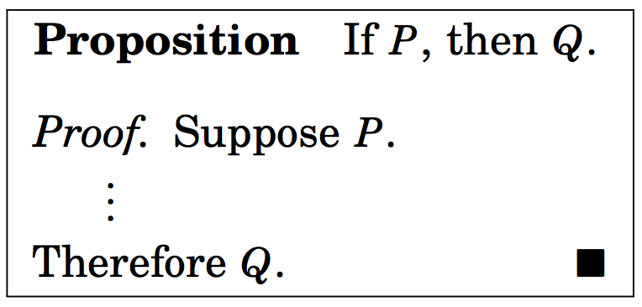
Proof Techniques of P ⇒ Q
Direct proof:

Slide 4
Proof Techniques of P ⇒ Q
Proof by cases:
It is a direct method of proving statements like
P₁ ∨ P₂ ∨ …. ∨ P_{n} ⇒ Q
which is equivalent to proving
(P₁ ⇒ Q) ∧ (P₂ ⇒ Q) ∧ (P₃ ⇒ Q) ∧ …. ∧ (P_{n} ⇒ Q).

Slide 5
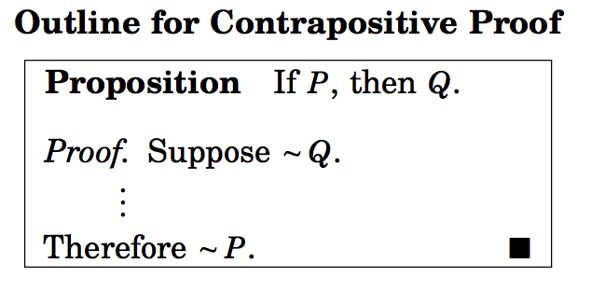
Proof Techniques of P ⇒ Q (contd.)
Contrapositive proof (Indirect proof)
Proving ¬Q ⇒ ¬P

Slide 6
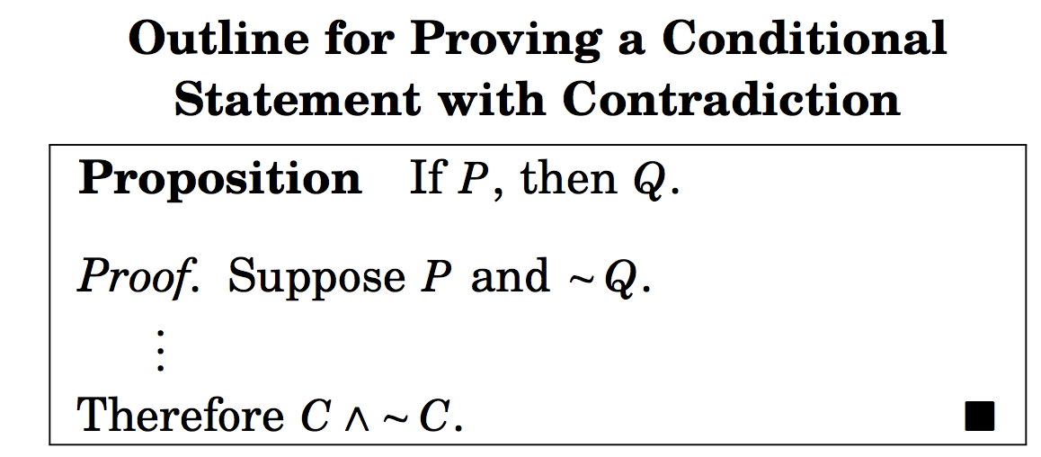
Proof Techniques of P ⇒ Q (contd.)
Contradiction proof.

Slide 7
If-and-Only-If-Proof: P ⇔ Q

Slide 8
If-and-Only-If-Proof: P ⇔ Q
It is equivalent to proving (P ⇒ Q) ∧ (Q ⇒ P)

Slide 9
If-and-Only-If-Proof: P ⇔ Q
It is equivalent to proving (P ⇒ Q) ∧ (Q ⇒ P)

Slide 10
Example
Suppose a and b are integers. Prove that
(a ≡ b (mod 6)) ⇔ (a ≡ b (mod 2))∧ (a ≡ b (mod 3))

Slide 11
Example
Suppose a and b are integers. Prove that
(a ≡ b (mod 6)) ⇔ (a ≡ b (mod 2))∧ (a ≡ b (mod 3))
We first prove that
a ≡ b (mod 6) ⇒ (a ≡ b (mod 2))∧ (a ≡ b (mod 3))

Slide 12
Example
Suppose a and b are integers. Prove that
(a ≡ b (mod 6)) ⇔ (a ≡ b (mod 2))∧ (a ≡ b (mod 3))
We first prove that
a ≡ b (mod 6) ⇒ (a ≡ b (mod 2))∧ (a ≡ b (mod 3))
This follows from the fact that if (a-b) is divisible by 6, (a-b) is also divisible by 2 and 3.

Slide 13
Example
Suppose a and b are integers. Prove that
(a ≡ b (mod 6)) ⇔ (a ≡ b (mod 2))∧ (a ≡ b (mod 3))
We first prove that
a ≡ b (mod 6) ⇒ (a ≡ b (mod 2))∧ (a ≡ b (mod 3))
This follows from the fact that if (a-b) is divisible by 6, (a-b) is divisible by 2 and 3.
Next we prove that
(a ≡ b (mod 2))∧ (a ≡ b (mod 3)) ⇒ a ≡ b (mod 6).

Slide 14
Example
Suppose a and b are integers. Prove that
(a ≡ b (mod 6)) ⇔ (a ≡ b (mod 2))∧ (a ≡ b (mod 3))
We first prove that
a ≡ b (mod 6) ⇒ (a ≡ b (mod 2))∧ (a ≡ b (mod 3))
This follows from the fact that if (a-b) is divisible by 6, (a-b) is divisible by 2 and 3.
Next we prove that
(a ≡ b (mod 2))∧ (a ≡ b (mod 3)) ⇒ a ≡ b (mod 6).
This again follows from the fact that if (a-b) is divisible by 2 and 3, (a-b) is divisible by 6.

Slide 15
Example
For any integer n, n is odd if and only if n² is odd.

Slide 16
Example
For any integer n, n is odd if and only if n² is odd.
In order to prove this statement we must prove two implications:
if n is odd, n² is odd.
if n² is odd, n is odd.
Direct proof is easy to design.

Slide 17
Equivalent Statements
Prove that the following statements are equivalent.
n – 5 is odd.
3n+2 is even.
n² – 1 is odd.

Slide 18
Equivalent Statements
Prove that the following statements are equivalent.
n – 5 is odd.
3n+2 is even.
n² – 1 is odd.
The above asserts that either the statements are all true or the statements are all false.

Slide 19
Equivalent Statements
Prove that the following statements are equivalent.
n – 5 is odd.
3n+2 is even.
n² – 1 is odd.
The above asserts that either the statements are all true or the statements are all false.
The above theorem is equivalent to proving the following implications:
(1) ⇒ (2)
(2) ⇒ (3)
(3) ⇒ (1)

Slide 20
Equivalent Statements
Prove that the following statements are equivalent.
n – 5 is odd.
3n+2 is even.
n² – 1 is odd.
The above asserts that either the statements are all true or the statements are all false.
The above theorem is equivalent to proving the following implications:
(1) ⇒ (2)
(2) ⇒ (3)
(3) ⇒ (1)
The above statements are all true. Direct proof technique can be used to prove the implications.

Slide 21
Proving ∃x R(x)
An existence proof is a proof of a statement of the form ∃x R(x).

Slide 22
Proving ∃x R(x)
An existence proof is a proof of a statement of the form ∃x R(x).
Constructive proof:
Establish R(c) for some c in the universe of x.

Slide 23
Proving ∃x R(x)
An existence proof is a proof of a statement of the form ∃x R(x).
Constructive proof:
Establish R(c) for some c in the universe of x.
Nonconstructive proof
Assume no c exists that makes R(c) true, and derive a contradiction. In other words use a proof by contradiction.

Slide 24
Proving ∃x R(x)
Example: Prove that if f(x) = x³ + x – 5, there exists a positive real number c such that f ‘(c) = 7.
In symbols: ∃x ∈ R, f’(x) = 7.

Slide 25
Proving ∃x R(x)
Example: Prove that if f(x) = x³ + x – 5, there exists a positive real number c such that f ‘(c) = 7.
In symbols: ∃x ∈ R, f’(x) = 7.
f’(x) = 3x² +1.
Now f’(x) = 7 implies x =
c =
f’( ) = 7.

Slide 26
Example
Prove

Slide 27
Example
Prove
Direct proof:
Given a and b, as stated, let A = { ax + by : x, y ∈ Z }.
This set has both positive and negative integers, as well as zero.
Let d be the smallest positive number of A.
Since d ∈ A, d is in the form d = ak +bl for some specific k, l ∈ Z.
d divides a and b. (why?)
We can now show that d = gcd(a,b). (see the text, page 126)

Slide 28
Practice Problems from Chapter 7
3, 4, 6, 7, 10, 13, 14, 17, 20, 22, 25, 28

Slide 29
Proofs Involving Sets (Chapter 8)
Generally, a set A will be expressed in set-builder notation A = {x:P(x)} where P(x) is some statement about x.
{x: x is an odd integer}
{n ∈ Z: n is odd}
{(a,b) ∈ Z x Z: b=a+5}
{X ∈ PowerSet(Z) : |X|=1}

Slide 30
How to show a ∈ {x: P(x)}?

Slide 31
How to show a ∈ {x: P(x)}?
Show that P(a) is true.

Slide 32
How to show a ∈ {x: P(x)}?
Show that P(a) is true.
How to show that a ∈ {x ∈ S: P(x)}?
Verify that a ∈ S
Show that P(a) is true.

Slide 33
How to show a ∈ {x: P(x)}?
Show that P(a) is true.
How to show that a ∈ {x ∈ S: P(x)}?
Verify that a ∈ S
Show that P(a) is true.
Example: Suppose A = {x: x ∈ N ∧ 7 | x}.
Show that 14 ∈ A.
Show that -14 ∉ A.

Slide 34
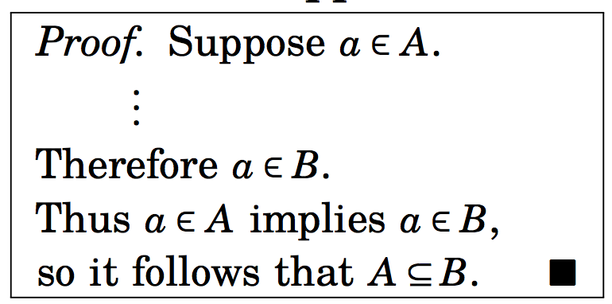
How to prove A ⊆ B
Direct approach: if a ∈ A, a ∈ B.

Slide 35
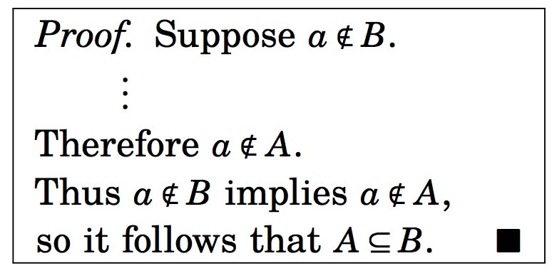
How to prove A ⊆ B
Contrapositive approach: if a ∉ B, a ∉ A.

Slide 36
Example

Slide 37
Example
Will be shown in the class.

Slide 38
Example 8.9
Solved in the text.

Slide 39
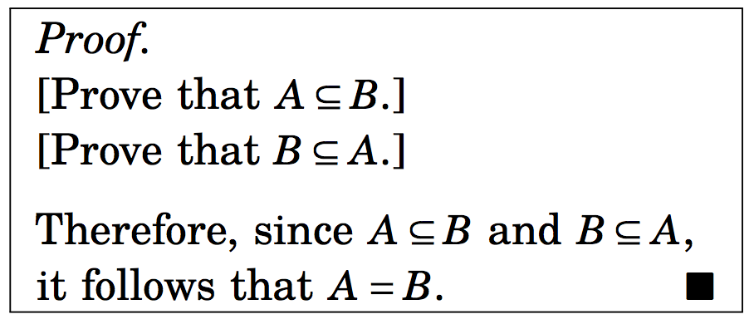
How to prove A = B

Slide 40
Example
Given sets A, B and C, prove that A x (B ∩ C) = (A x B) ∩ (A x C).
We should be able to show that
A x (B ∩ C) ⊆ (A x B) ∩ (A x C), and
(A x B) ∩ (A x C) ⊆ A x (B ∩ C) .

Slide 41
An alternate solution
Given sets A, B and C, prove that
A x (B ∩ C) = (A x B) ∩ (A x C).
A x (B ∩ C) =
= {(x,y): (x ∈ A) ∧ (y ∈ B ∩ C)} (def. of x)
= {(x,y): (x ∈ A) ∧ ((y ∈ B ) ∧(y ∈ C))} (def. of ∩)
= {(x,y): ((x ∈ A) ∧ (y ∈ B )) ∧ ((x ∈ A) ∧ (y ∈ C))} (rearranging)
= (A x B) ∩ (A x C)
The proof is complete

Slide 42
Perfect Numbers
Very old number theory topic.
The problem involves adding up the positive divisors of natural numbers.

Slide 43
Perfect Numbers
Very old number theory topic.
The problem involves adding up the positive divisors of natural numbers.
Positive divisors of 12 that are less than 12:
1,2,3,4,6
They add up to 16 which is greater than 12.
Positive divisors of 15 are
1,3,5
They add up to 9 which is less than 15.
Positive divisors of 6 are
1, 2, 3
They add up to 6!

Slide 44
Perfect Numbers
Very old number theory topic.
The problem involves adding up the positive divisors of natural numbers.
Positive divisors of 12 that are less than 12:
1,2,3,4,6
They add up to 16 which is greater than 12.
Positive divisors of 15 are
1,3,5
They add up to 9 which is less than 15.
Positive divisors of 6 are
1, 2, 3
They add up to 6!
6 is called a perfect number.

Slide 45
Definition of Perfect Numbers
A number p ∈ N is perfect if it equals the sum of the positive divisors less than it self.
6 is perfect since 6 = 1 + 2 + 3.
28 is perfect since28 = 1 + 2 + 4 +7 + 14.
496 is perfect since 496 = 1+2+4+8+16+31+62+124+248
What is the next number?
8128, then ?
Euclid (323–283 BC) looked at this problem first.

Slide 46
Perfect Numbers
Let P be the set containing the perfect numbers.
P= {p ∈ N: p is perfect}.
Let A = {2^{n-1}(2^{n}-1): n ∈ N, and 2^{n}-1 is a prime number}

Slide 47
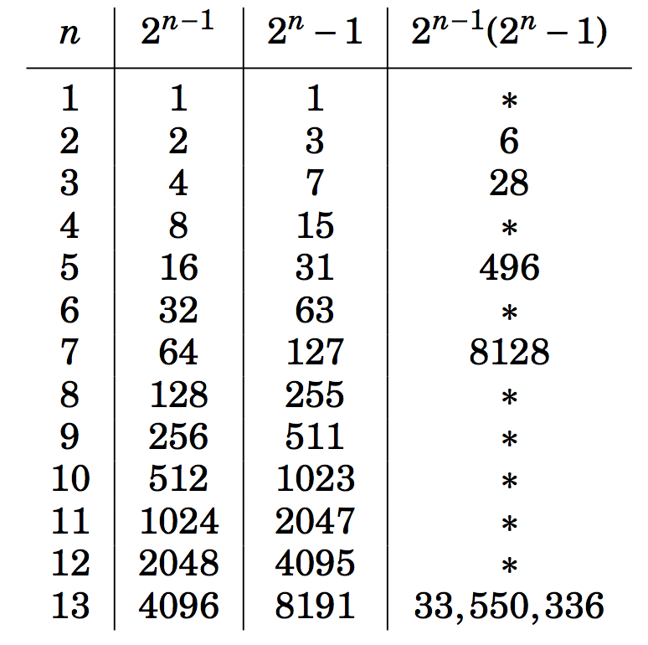
First few entries of A

Slide 48
A Theorem on Perfect Numbers
Theorem 8.1: If
A = {2^{n-1}(2^{n}-1): n ∈ N, and 2^{n}-1 is a prime number} and
P= {p ∈ N: p is perfect },
then A ⊆ P.
Set theory was invented over 2000 years after Euclid died.

Slide 49
Practice problems from Chapter 8
1, 2, 6, 7, 13, 15, 19, 20, 27, 29

Slide 50
Disproof
We considered so far: given statement, prove that it is true.
How do you prove that a statement is false?
There is a very simple procedure that proves a statement is false.
The procedure is called disproof.

Slide 51
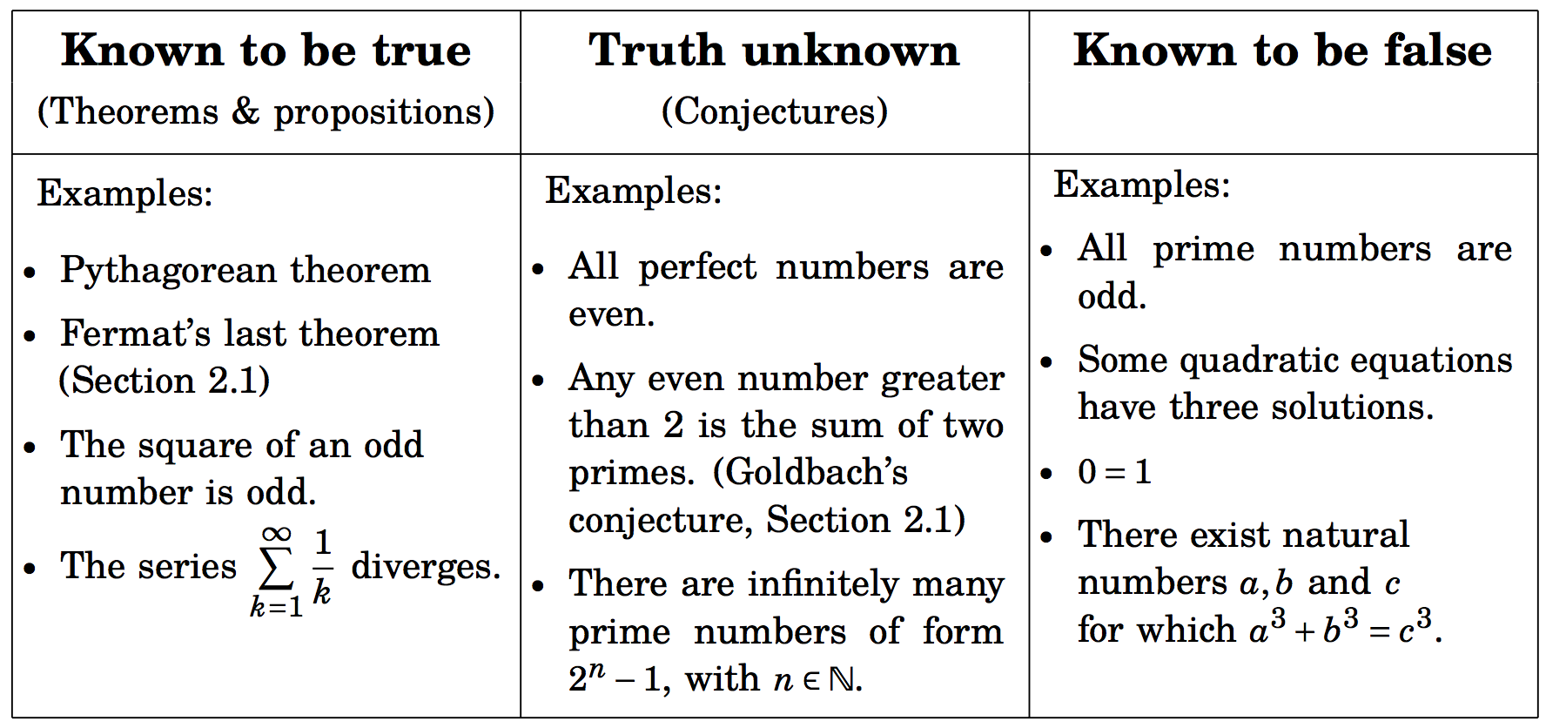
There are three types of statements.

Slide 52
How to disprove P?

Slide 53
How to disprove P?
Prove ¬P.
Now we can use the standard proof methods: direct proof, contrapositive proof, proof by contradiction.

Slide 54
Disproving Universal Statements: Counterexamples
Universally quantified statement ∀x ∈ S, P(x)
Its negation is ¬(∀x ∈ S, P(x)) ≡ ∃x ∈ S, ¬P(x).

Slide 55
Disproving Universal Statements: Counterexamples
Universally quantified statement ∀x ∈ S, P(x)
Its negation is ¬(∀x ∈ S, P(x)) ≡ ∃x ∈ S, ¬P(x).
We just need an element x ∈ S that makes ¬P(x) true.
i.e. an x that makes P(x) false.

Slide 56
Disproving Universal Statements: Counterexamples
Universally quantified statement ∀x ∈ S, P(x)
Its negation is ¬(∀x ∈ S, P(x)) ≡ ∃x ∈ S, ¬P(x).
We just need an element x ∈ S that makes ¬P(x) true.
i.e. an x that makes P(x) false.
The outline of proof:

Slide 57
Disproving Universal Statements: Counterexamples
The outline of proof:

Slide 58
Disproving Universal Statements: Counterexamples
In both the outlines, the statement is disproved simply by citing an example that shows that the statement is not true.
The special name for this example is called a counterexample.

Slide 59
Example:
Conjecture: For every n ∈, the integer f(n) = n²-n+11 is prime.

Slide 60
Example:
Conjecture: For every n ∈, the integer f(n) = n²-n+11 is prime.
Disproof: The statement “For every n ∈, the integer f(n) = n²-n+11 is prime” is false since f(11) = 121 = 11.11 is not a prime.

Slide 61
Disproving Existence Statements
Disproving an existence statement: ∃x ∈ S, P(x)

Slide 62
Disproving Existence Statements
Disproving an existence statement: ∃x ∈ S, P(x)
To disprove it, we have to prove its negation.
The negation is ¬(∃x ∈ S, P(x)) ≡ ∀x ∈ S, ¬P(x).

Slide 63
Disproving Existence Statements
Disproving an existence statement: ∃x ∈ S, P(x)
To disprove it, we have to prove its negation.
The negation is ¬(∃x ∈ S, P(x)) ≡ ∀x ∈ S, ¬P(x).
This negation is universally quantified. An example does not suffice.
We must use direct, contrapositive or contradiction proof to prove the conditional statement
If ∀x ∈ S, then ¬P(x)

Slide 64
Disproof by Contradiction
To disprove P, we must prove ¬P.
To prove ¬P with contradiction, we assume that ¬¬P ≡ P is true and deduce a contradiction.

Slide 65
Example
Disprove the conjecture:
(Example 9.5): There is a real number x for which x⁴ < x < x² .
(9(11)): If a, b ∈ N, then a+b < ab.
True or false:
(9(12)) If a, b, c ∈ N and ab, bc and ac all have the same parity, then a, b and c all have the same parity.

Slide 66
Practice problems of Chapter 9
1, 2, 3, 18, 19, 22, 23, 29, 34.

Slide 67
Congruence of Integers
Definition: Given integers a and b and an n ∈ N, we say that a and b are congruent modulo n if a and b have the same remainders when a and b are divided by n.
In other words, n | (a-b).
We express a ≡ b (mod n)
9 ≡ 1 (mod 4)
109 ≡ 4 (mod 3)
14 ≠ 8 (mod 4)

Slide 68
Some properties of congruent modulo n
For all integers a, a ≡ a (mod n).

Slide 69
Some properties of congruent modulo n
For all integers a, a ≡ a (mod n).
Follows easily since a – a = 0 = n x 0.
If a and b are integers such that a ≡ b (mod n), b ≡ a (mod n).

Slide 70
Some properties of congruent modulo n
For all integers a, a ≡ a (mod n).
Follows easily since a – a = 0 = n x 0.
If a and b are integers such that a ≡ b (mod n), b ≡ a (mod n).
If n|(b-a), n|(a-b), vice versa.
If a, b and c are integers such that a ≡ b (mod n) and b ≡ c (mod n), then a ≡ c (nod n).

Slide 71
Some properties of congruent modulo n
For all integers a, a ≡ a (mod n).
Follows easily since a – a = 0 = n x 0.
If a and b are integers such that a ≡ b (mod n), b ≡ a (mod n).
If n|(b-a), n|(a-b), vice versa.
If a, b and c are integers such that a ≡ b (mod n) and b ≡ c (mod n), then a ≡ c (nod n).
Given n|(a-b) and n|(b-c). Now (a-c) = (a-b) + (b-c). Therefore, n|(a-c).

Slide 72
Modular arithmetic
(5(24))Suppose that a, b and c, d are integers such that a ≡ b (mod n) and c ≡ d (mod n). Then
(a + c) ≡ b + d (mod n)

Slide 73
Modular arithmetic
(5(24))Suppose that a, b and c, d are integers such that a ≡ b (mod n) and c ≡ d (mod n). Then
(a + c) ≡ b + d (mod n) (easy)
a – c ≡ b – d (mod n)

Slide 74
Modular arithmetic
(5(24))Suppose that a, b and c, d are integers such that a ≡ b (mod n) and c ≡ d (mod n). Then
(a + c) ≡ b + d (mod n) (easy)
a – c ≡ b – d (mod n)
(Easy) since (a – c ) - (b – d ) = (a– b) + (d – c)
ac ≡ bd (mod n)

Slide 75
Modular arithmetic
(5(24))Suppose that a, b and c, d are integers such that a ≡ b (mod n) and c ≡ d (mod n). Then
(a + c) ≡ b + d (mod n) (easy)
a – c ≡ b – d (mod n)
(Easy) since (a – c ) - (b – d ) = (a– b) + (d – c)
ac ≡ bd (mod n)
Given a-b = t.n and c – d = t’.n
Therefore, a = b+ t.n, and c = d + t’n
Hence ac = bd + n(bt’ + dt + tt’n).
This implies that (ac –bd) is divisible by n.
ac ≡ bd (mod n)

