Slide 1
Proofs (Chapter 4, 5 and 6)

Slide 2
Proofs
A proof of a mathematical statement is logical argument which establishes the truth of a statement.
We will cover a variety of methods of proofs.
There are terms which we should know while proving things.

Slide 3
Terminology
A theorem is a statement that can be shown to be true (via a proof).
A proof is a sequence of statements that form an argument.
Axioms or postulates are statements taken to be self evident or assumed to be true.
A lemma (plural lemmas or lemmata) is a theorem useful within the proof of a theorem.
A corollary is a theorem that can be established from theorem that has just been proven.
A proposition that is true is usually a ‘less’ important theorem.
A conjecture is a statement whose truth value is unknown.
The rules of inference are the means used to draw conclusions from other assertions, and to derive an argument or a proof.

Slide 4
Theorems: Example
Theorem (Divisor theorem)
Let a, b, and c be integers. Then
If a|b and a|c then a|(b+c)
If a|b then a|bc for all integers c
If a|b and b|c, then a|c
Corrollary:
If a, b, and c are integers such that a|b and a|c, then a|mb+nc whenever m and n are integers
By part 2 it follows that a|mb and a|nc.
By part 1 it follows that a|(mb+nc).
What is the assumption? What is the conclusion?

Slide 5
Definitions
An integer n is even if n=2a for some integer a ∈ Z.
A.n integer n is odd if n= 2a + 1 for some integer a ∈ Z.
Two integers have the same parity if they are both even or they are both odd. Otherwise, they have opposite parity.
Other definitions…

Slide 6
Divisors
Consider three integers a, b and c, a ≠ 0, such that b = ac. In this case we say that a divides b.
We write a | b.
We also say that b is a multiple of a.

Slide 7
Divisors (Examples)
Which of the following is true?
12 | 12
13 | 0
0 |13
121 | 11
11 | 121

Slide 8
Accepted facts we will use as obvious (axioms):
In algebra, a + b = b + a
Laws of algebra
Laws of set theory
Laws of inference

Slide 9
Euclidean Geometry
Points and lines are our universe.
Definition: Two angles are supplementary if the sum of the angles is 180 degrees.
Axiom: Given two points, there is exactly one line.
Theorem: If the two sides of a triangle are equal, the angles opposite them are equal.
Corollary: If a triangle is equilateral, it is equiangular.

Slide 10
Multiples of an integer
How many positive multiples of 12 are less than 100,000?
The number of such multiples is ⎣100,000/12⎦ which is 8333.
In general, the number of t-multiples less than N is given by:
|{m ∈ Z⁺ | t |m and m ≤ N }| = ⎣N/t⎦.

Slide 11
The Division Algorithm
Theorem: Let a be an integer and d a positive integer. Then there are unique integers q and r, with 0 ≤ r < d, such that a = qd + r.
a is called dividend,
d is called divisor,
q is called the quotient, and
r is called the remainder

Slide 12
Prime numbers
Definition:
A number n ≥ 2, is prime if it is only divisible by 1 and itself. A number n ≥ 2 which is not a prime is called composite.
Numbers 2,3,5,7,11, … are examples of prime numbers.

Slide 13
Greatest Common Divisor (gcd)
Definition:
The gcd of integers a and b, denoted gcd(a,b), is the largest integer that divides both a and b.
gcd(18,24) = 6; gcd(10,9)=1; gcd(6,0) =6

Slide 14
Least Common Multiple (lcm)
Definition:
The lcm of non-zero integers a and b, denoted lcm(a,b), is the smallest positive integer that is multiple of both a and b.
lcm(4,6) = 12; lcm(7,7)=7.

Slide 15
Comments
Not all terms can be defined.
We accept some ideas as being so intuitively clear that they require no definitions or verifications.
We accept natural ordering of the elements of N, Z, Q and R. We also accept that for integers a and b,
a + b ∈ Z
a – b ∈ Z
ab ∈ Z.

Slide 16
Direct Proofs
We are interested in proving an implication:
P ⇒ Q, i.e. if P, then Q.

Slide 17
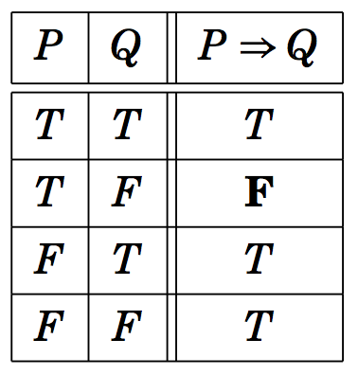
Direct Proofs
We are interested in proving an implication:
P ⇒ Q, i.e. if P, then Q.
Consider the truth table of P ⇒ Q:
Our goal is to show that this conditional statement P ⇒ Q is true.

Slide 18
Direct Proofs
We are interested in proving an implication:
P ⇒ Q, i.e. if P, then Q.
Consider the truth table of P ⇒ Q:
Our goal is to show that this conditional statement P ⇒ Q is true.
Since P ⇒ Q is true, if P is false. Therefore, we need to show that P ⇒ Q is true when P is true.

Slide 19
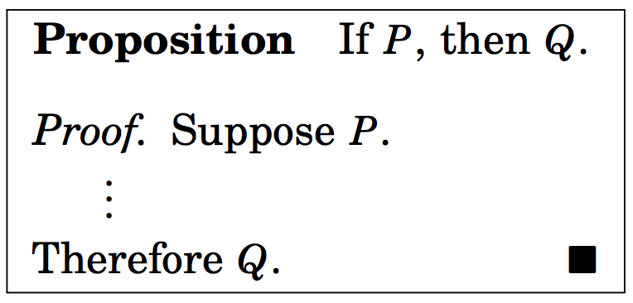
Direct Proof of P ⇒ Q
Outline of direct proof
We use the rules of inference, axioms, definitions, and logical equivalences to prove Q.

Slide 20
Direct Proofs

Slide 21
Problem:
Consider the following hypotheses (premises)
More I study, more I know
More I know, more I forget
More I forget, less I know.
Conclusion: Everyone who studies more knows less.
s(x): x studies more; m(x): x knows more;
f(x) : x forgets more ; l(x): x knows less
In symbols
∀x, [(s(x) ⇒ m(x)) ∧ (m(x) ⇒ f(x)) ∧ (f(x) ⇒ l(x)) ⇒ (s(x) ⇒ l(x)]

Slide 22
Problem (contd.):
Conclusion: Everyone who studies more knows less.
s(x): x studies more; m(x): x knows more;
f(x) : x forgets more ; l(x): x knows less
In symbols
∀x, [(s(x) ⇒ m(x)) ∧ (m(x) ⇒ f(x)) ∧ (f(x) ⇒ l(x)) ⇒ (s(x) ⇒ l(x)]
Direct Proof: Let c be an arbitrary element of the universe
(population). We need to show that s(c) ⇒ l(c).
s(c) is true.

Slide 23
Problem (contd.):
Conclusion: Everyone who studies more knows less.
s(x): x studies more; m(x): x knows more;
f(x) : x forgets more ; l(x): x knows less
In symbols
∀x, [(s(x) ⇒ m(x)) ∧ (m(x) ⇒ f(x)) ∧ (f(x) ⇒ l(x)) ⇒ (s(x) ⇒ l(x)]
Direct Proof: Let c be an arbitrary element of the universe
(population). We need to show that s(c) ⇒ l(c).
s(c) is true.
s(c) ⇒ m(c); m(c) ⇒ f(c); f(c) ⇒ l(c)

Slide 24
Problem (contd.):
Conclusion: Everyone who studies more knows less.
s(x): x studies more; m(x): x knows more;
f(x) : x forgets more ; l(x): x knows less
In symbols
∀x, [(s(x) ⇒ m(x)) ∧ (m(x) ⇒ f(x)) ∧ (f(x) ⇒ l(x)) ⇒ (s(x) ⇒ l(x)]
Direct Proof: Let c be an arbitrary element of the universe
(population). We need to show that s(c) ⇒ l(c).
s(c) is true.
s(c) ⇒ m(c); m(c) ⇒ f(c); f(c) ⇒ l(c)
s(c) ⇒ l(c) by the transitivity

Slide 25
Problem (contd.):
Conclusion: Everyone who studies more knows less.
s(x): x studies more; m(x): x knows more;
f(x) : x forgets more ; l(x): x knows less
In symbols
∀x, [(s(x) ⇒ m(x)) ∧ (m(x) ⇒ f(x)) ∧ (f(x) ⇒ l(x)) ⇒ (s(x) ⇒ l(x))]
Direct Proof: Let c be an arbitrary element of the universe
(population). We need to show that s(c) ⇒ l(c).
s(c) is true.
s(c) ⇒ m(c); m(c) ⇒ f(c); f(c) ⇒ l(c)
s(c) ⇒ l(c) by the transitivity
∀x (s(x) ⇒ l(x)) Universal generalization

Slide 26
Proposition: ∀x, if x is odd, x² is odd.

Slide 27
Proposition: ∀x, if x is odd, x² is odd.
We have the starting structure for an arbitrary element x of the universe:
indicates the end of the proof

Slide 28
Proposition: ∀x, if x is odd, x² is odd.
Using the definition of odd numbers we get

Slide 29
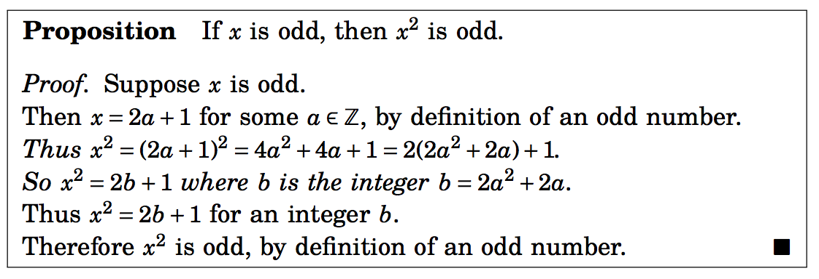
Proposition: ∀x, if x is odd, x² is odd.
We are almost there:

Slide 30
Proposition: ∀x, if x is odd, x² is odd.
The above proof can also be written as follows (x is an arbitrary element of the universe):
P(x): x is odd ⇒ (x=2a+1)
(x=2a+1) ⇒ (x² =2(2a²+2a+1) +1)
(x²=2b +1) ⇒ Q(x²): x² is odd
Thus P(x) ⇒ Q(x²) is true for an arbitrary x.

Slide 31
Show that 1+2+3+ …+ n =n(n+1)/2
We assume that n ∈ N.
We write
x = 1 + 2 + … + n.

Slide 32
Show that 1+2+3+ …+ n =n(n+1)/2
We assume that n ∈ N.
We write
x = 1 + 2 + … + n.
⇒ x = n + (n-1) + … + 1. (Commutative property)

Slide 33
Show that 1+2+3+ …+ n =n(n+1)/2
We assume that n ∈ N.
We write
x = 1 + 2 + … + n.
x = n + (n-1) + … + 1. (Commutative property)
2x = n(n+1) (adding both the rows)
⇒ x = n(n+1)/2

Slide 34
Q. 4(4):
Suppose x, y are integers. If x and y are odd, xy is odd.
Assume x and y are odd integers.
Then x=2a + 1, and y=2b+1 for some integers a and b.

Slide 35
Q. 4(4):
Suppose x, y are integers. If x and y are odd, xy is odd.
Assume x and y are odd integers.
Then x=2a + 1, and y=2b+1 for some integers a and b.
As a result xy = (2a+1).(2b+1)=4ab + 2a +2b +1 = 2(2ab+a+b) +1 =2t+1 where t is an integer.
Therefore, if x and y are odd integers, xy is odd.
This completes the proof.

Slide 36
Q. 4(6):
Suppose a,b,c are integers. If a|b and a|c, the a|(b+c).
by definitions, a|b implies b=ad for some integer d.
Similarly a|c imples c= af for some integer f.

Slide 37
Q. 4(6):
Suppose a,b,c are integers. If a|b and a|c, the a|(b+c).
by definitions, a|b implies b=ad for some integer d.
Similarly a|c imples c= af for some integer f.
We can now write b + c =a(f+d) = a.t, for some integer t. Therefore, by definition, a | (b+c).

Slide 38
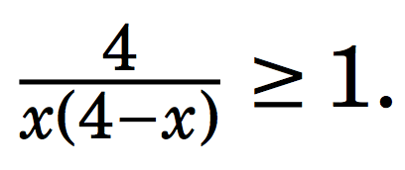
Q. 4(12):
If x ∈ R, and 0 < x < 4,

Slide 39
Q. 4(12):
If x ∈ R, and 0 < x < 4,
We can rewrite the above equation as 4 ≥ x(4-x). This is only possible if x(4-x) > 0. This is true since 0 < x < 4.

Slide 40
Q. 4(12):
If x ∈ R, and 0 < x < 4,
We can rewrite the above equation as 4 ≥ x(4-x). This is only possible if x(4-x) > 0. This is true since 0 < x < 4.
Upon further simplification we get (x-2)² ≥ 0.
Thus the above statement is true.

Slide 41
Proof by cases
Sometimes it is easier to prove a theorem by
breaking it down into cases and
proving each case separately.
It is a direct method of proving statements like p₁ ∨ p₂ ∨ …. ∨ p_{n} ⇒ q is equivalent to proving (p₁ ⇒ q) ∧ (p₂ ⇒ q) ∧ (p₃ ⇒ q) ∧ …. ∧ (p_{n} ⇒ q).

Slide 42
Example
For any two reals x and y, show that|x+y| ≤ |x| + |y|.
Proof by cases:

Slide 43
Example
For any two reals x and y, show that|x+y| ≤ |x| + |y|.
Proof by cases:
(Case 1) x ≥ 0, y ≥ 0
Theorem is true since (x+y) = x + y.

Slide 44
Example
For any two reals x and y, show that|x+y| ≤ |x| + |y|.
Proof by cases:
(Case 1) x ≥ 0, y ≥ 0
Theorem is true since (x+y) = x + y.
(Case 2) x < 0, y ≥ 0
Theorem is true since |x+y| < max{|x|,|y|} < |x| + |y|

Slide 45
Example
For any two reals x and y, show that|x+y| ≤ |x| + |y|.
Proof by cases:
(Case 1) x ≥ 0, y ≥ 0
Theorem is true since (x+y) = x + y.
(Case 2) x < 0, y ≥ 0
Theorem is true since |x+y| < |y| < |x| + |y|
(Case 3) x ≥ 0, y < 0
Very similar to the second case
(Case 4) x < 0, y < 0
In this case |x+y| = |x| + |y|.

Slide 46
Example
Problem: Let n ∈ Z. Prove that 9n²+3n-2 is even.

Slide 47
Example
Problem: Let n ∈ Z. Prove that 9n²+3n-2 is even.
Observe that 9n²+3n-2=(3n+2)(3n-1)
n is an integer →(3n+2)(3n-1) is the product of two integers
Case 1: Assume 3n+2 is even
→ 9n²+3n-2 is trivially even because it is the product of two integers, one of which is even
Case 2: Assume 3n+2 is odd
→ 3n+2-3 is even → 3n-1 is even → 9n²+3n-2 is even because one of its factors is even

Slide 48
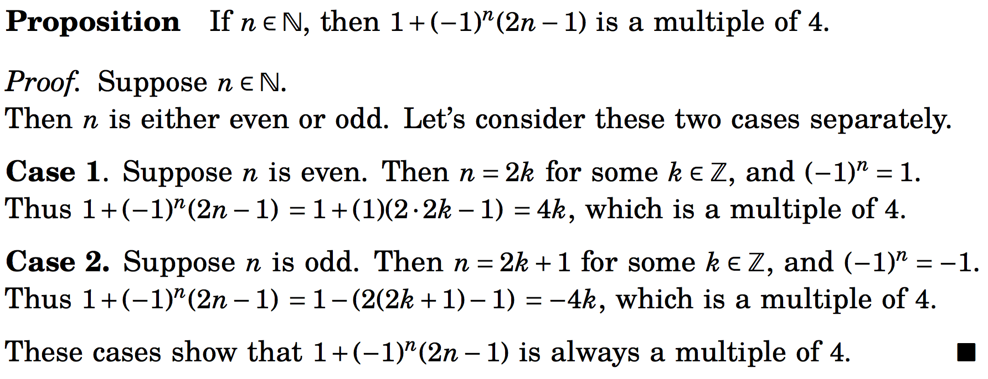
Proof by cases
In proving a statement is true, we sometimes have to examine multiple case before showing the statement is true in all possible scenarios.

Slide 49
Practice problems from the text:
Chapter 4
3,5, 7, 9, 14, 18, 19, 20, 21, 22, 26

Slide 50
Congruence of Integers
Definition: Given integers a and b and an n ∈ N, we say that a and b are congruent modulo n if a and b have the same remainders when a and b are divided by n.
In other words, n | (a-b).
We express a ≡ b (mod n)
9 ≡ 1 (mod 4)
109 ≡ 4 (mod 3)
14 ≠ 8 (mod 4)

Slide 51
Problem
Proposition: Given integers a and b and an n ∈ N. If a ≡ b (mod n), then a² ≡ b² (mod n).
Direct Proof: Suppose a ≡ b (mod n).
By definition, n|(a-b).
This means (a-b) = nc for some integer c.
Multiplying both sides by (a+b) we get a² –b² = nc(a+b).
Since c(a+b) is an integer, the above equation tells us that n|(a² –b²).
From the definition it follows that a² ≡ b² (mod n).

Slide 52
Example
Show that ∀k ∈ Z k ≡1(mod 3) ⇒ k ³ ≡1(mod 9)

Slide 53
Example
Show that ∀k ∈ Z k ≡1(mod 3) ⇒ k ³ ≡1(mod 9)
k ≡ 1(mod 3)
∃n k-1 = 3n

Slide 54
Example
Show that ∀k ∈ Z k ≡1(mod 3) ⇒ k ³ ≡1(mod 9)
k ≡ 1(mod 3)
∃n k-1 = 3n
∃n k = 3n + 1
∃n k ³ = (3n + 1)³
∃n k ³ = 27n ³ + 27n ² + 9n + 1
∃n k ³-1 = 27n ³ + 27n ² + 9n
∃n k ³-1 = (3n ³ + 3n ² + n)·9

Slide 55
Example
Show that ∀k ∈ Z k ≡1(mod 3) ⇒ k ³ ≡1(mod 9)
k ≡ 1(mod 3)
∃n k-1 = 3n
∃n k = 3n + 1
∃n k ³ = (3n + 1)³
∃n k ³ = 27n ³ + 27n ² + 9n + 1
∃n k ³-1 = 27n ³ + 27n ² + 9n
∃n k ³-1 = (3n ³ + 3n ² + n)·9
∃m k ³-1 = m·9
k ³≡1(mod 9)

Slide 56
Discussion
The first strategy you should try to prove an assertion is the direct proof method.
Don’t try to do too much at once. Be patient: take small steps using the appropriate definitions and previously proven facts.

Slide 57
Contrapositive Proof (Chapter 5)
We use the fact that P ⇒ Q and ¬Q ⇒ ¬P are logically equivalent.
The expression ¬Q ⇒ ¬P is called the contrapositive form of P ⇒ Q .

Slide 58
Contrapositive Proof (Chapter 5)
We use the fact that P ⇒ Q and ¬Q ⇒ ¬P are logically equivalent.
The expression ¬Q ⇒ ¬P is called the contrapositive form of P ⇒ Q .
In order to prove P ⇒ Q is true, it suffices to instead prove that ¬Q ⇒ ¬P is true.
In order to use direct proof to show ¬Q ⇒ ¬P is true, we would assume that ¬Q is true, and use this to deduce that ¬P is true.

Slide 59
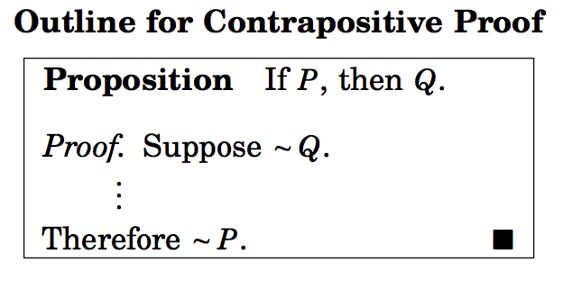

Slide 60
Example
Prove that for any sets A, B and C that if A-C A-B, then B C
Proof: The contrapositive statement of the above is

Slide 61
Example
Prove that for any sets A, B and C that if A-C A-B, then B C
Proof: The contrapositive statement of the above is if B ⊆ C , A-C ⊆ A-B.
To conclude that A-C ⊆ A-B, we must show that if x ∈ A-C, then x ∈ A – B.

Slide 62
Example
Prove that for any sets A, B and C that if A-C A-B, then B C
Proof: The contrapositive statement of the above is if B ⊆ C , A-C ⊆ A-B.
To conclude that A-C ⊆ A-B, we must show that if x ∈ A-C, then x ∈ A – B.
Suppose x ∈ A –C. This means that x ∈ A and x ∉ C
However, we are given that B ⊆ C.
Because x ∉ C, we deduce that x ∉ B either.
Thus we have x ∈ A and x ∉ B.
This implies that x ∈ A-B.

Slide 63
Example
Prove that for any sets A, B and C that if A-C A-B, then B C
Proof: The contrapositive statement of the above is if B ⊆ C , A-C ⊆ A-B.
To conclude that A-C ⊆ A-B, we must show that if x ∈ A-C, then x ∈ A – B.
Suppose x ∈ A –C. This means that x ∈ A and x ∉ C
However, we are given that B ⊆ C.
Because x ∉ C, we deduce that x ∉ B either.
Thus we have x ∈ A and x ∉ B.
This implies that x ∈ A-B.
Contrapositive statement is true.
Original statement is also true

Slide 64
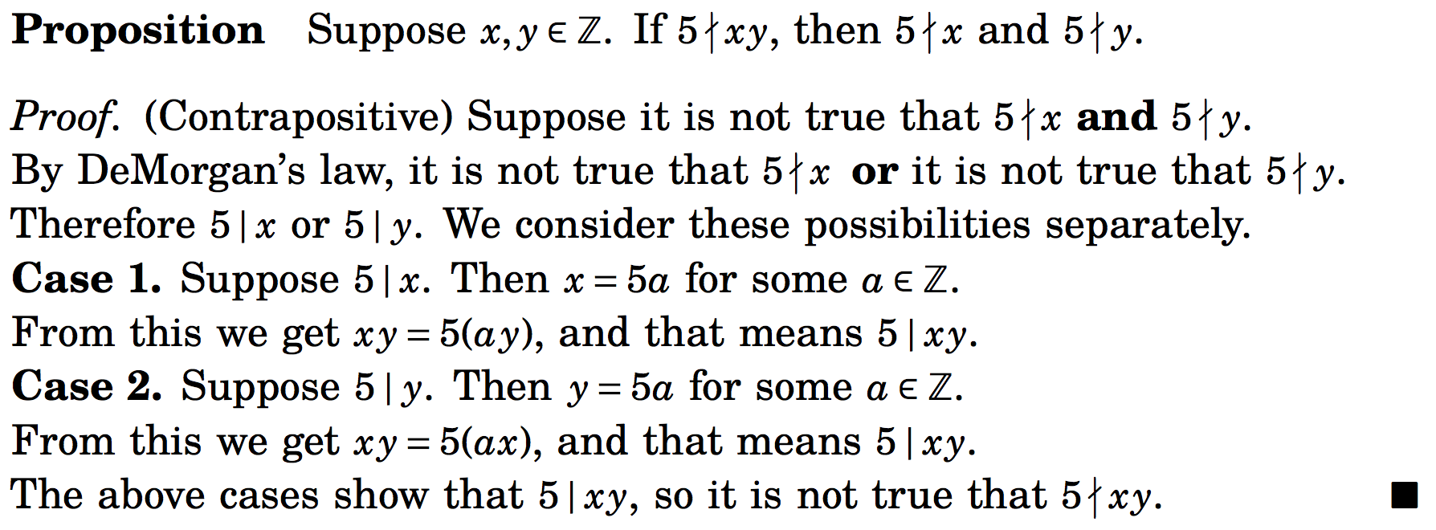
Example

Slide 65
Example 5(11)
Suppose x, y are integers. If x²(y+3) is even, the x is even or y is odd.
The equivalent contrapositive statement is:
if x is odd and y is even, x²(y+3) is odd.

Slide 66
Practice Problems of Chapter 5
4, 5, 12, 13, 17, 24, 25, 27, 28

Slide 67
Proof by Contradiction (Chapter 6)
This method is not just limited to conditional statements.
Show that the number is irrational. (Note: A number is irrational if it cannot be expressed as where a and b are integers, and b is non-zero.)

Slide 68
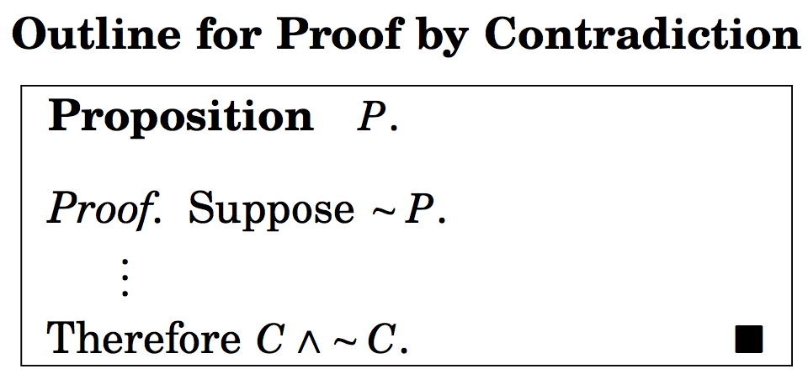
Proof by Contradiction (Chapter 6)
C is some statement.

Slide 69
Proof by Contradiction (Chapter 6)
¬P ⇒ (C ∧ ¬C)
C is some statement.

Slide 70
Show that the number is irrational.
Suppose ¬P : is rational.

Slide 71
Show that the number is irrational.
Suppose ¬ P : is rational.
Then by definition = where a and b are integers and a and non-zero b have no common factors, i.e. gcd(a,b) = 1.

Slide 72
Show that the number is irrational.
Suppose ¬ P : is rational.
Then by definition = where a and b are integers and a and non-zero b have no common factors, i.e. gcd(a,b) = 1.
Squaring we get 2b² = a². This implies that a is even. Therefore, a=2k, for some k.

Slide 73
Show that the number is irrational.
Suppose ¬ P : is rational.
Then by definition = where a and b are integers and a and non-zero b have no common factors, i.e. gcd(a,b) = 1.
Squaring we get 2b² = a². This implies that a is even. Therefore, a=2k, for some k.
We can write 2b² = 4k^{2,} i.e. b² = 2k² .
Hence b is also even.

Slide 74
Show that the number is irrational.
Suppose ¬ P : is rational.
Then by definition = where a and b are integers and a and non-zero b have no common factors, i.e. gcd(a,b) = 1.
Squaring we get 2b² = a². This implies that a is even. Therefore, a=2k, for some k.
We can write 2b² = 4k^{2,} i.e. b² = 2k² .
Hence b is also even.
This means that a and b have 2 as a common factor.
We arrive at a contradiction.
¬ P ⇒ F
P is true.

Slide 75
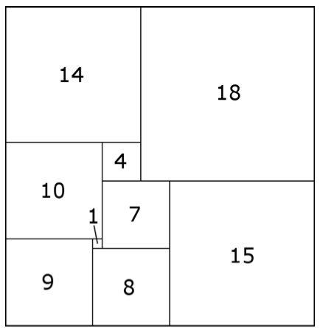
Arrangement of squares
Consider a 32 x 33 rectangle partitioned into nine squares:
Claim: Smallest square in the partition must always lie in the middle.

Slide 76
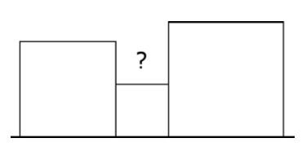
Proof by Contradiction.
Suppose it is possible to place the smallest square on the boundary.

Slide 77
Proof by Contradiction.
Suppose it is possible to place the smallest square on the boundary.
Observe that the squares immediately adjacent to the smallest square are larger.

Slide 78
Proof by Contradiction.
Suppose it is possible to place the smallest square on the boundary.
Observe that the squares immediately adjacent to the smallest square are larger.
The area marked ? cannot be covered by larger size squares.

Slide 79
Proof by Contradiction.
Suppose it is possible to place the smallest square on the boundary.
Observe that the squares immediately adjacent to the smallest square are larger.
The area marked ? cannot be covered by larger size squares.
The starting assumption leads to a contradiction.
The starting assumption is wrong.
Therefore, the smallest square must appear in the middle of the configuration of squares.

Slide 80
There are infinitely many primes.

Slide 81
There are infinitely many primes.
Suppose there are finite number of primes, and they are, say, p₁, p₂, ….., p_{n}.
Let p_{n} is the largest prime number in the list.

Slide 82
There are infinitely many primes.
Suppose there are finite number of primes, and they are, say, p₁, p₂, ….., p_{n}.
Let p_{n} is the largest prime number in the list.
Consider the number a = p₁x p₂x …..x p_{n} + 1.

Slide 83
There are infinitely many primes.
Suppose there are finite number of primes, and they are, say, p₁, p₂, ….., p_{n}.
Let p_{n} is the largest prime number in the list.
Consider the number a = p₁x p₂x …..x p_{n} + 1.
Since a is not divisible by a_{i} for any i, a is also a prime number.

Slide 84
There are infinitely many primes.
Suppose there are finite number of primes, and they are, say, p₁, p₂, ….., p_{n}.
Let p_{n} is the largest prime number in the list.
Consider the number a = p₁x p₂x …..x p_{n} + 1.
Since a is not divisible by a_{i} for any i, a is also a prime number.
Thus a is a prime number larger that p_{n}.
The starting assumption leads to a contradiction.
This proves that there are infinitely many prime.

Slide 85
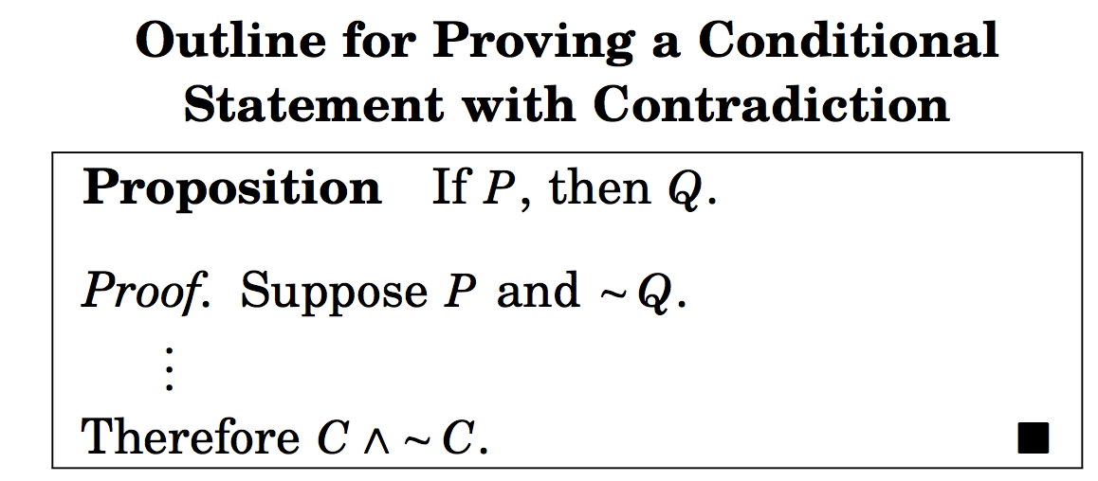
Proving conditional statements by contradiction

Slide 86
Proving conditional statements by contradiction
¬P ∧ ¬Q ⇒ F

Slide 87
Example
Let x and y be real numbers. If 5x+25y = 1723, then x or y is not an integer.

Slide 88
Example
Let x and y be real numbers. If 5x+25y = 1723, then x or y is not an integer.
Here P(x,y): 5x + 25 y =1723;
Q(x,y): (x is not an integer) ∨ (y is not an integer)

Slide 89
Example
Let x and y be real numbers. If 5x+25y = 1723, then x or y is not an integer.
Here P(x,y): 5x + 25 y =1723;
Q(x,y): (x is not an integer) ∨ (y is not an integer)
Suppose ∀x,y (P(x,y) ∧¬ Q(x,y))
¬ Q(x,y) : x and y are integers.

Slide 90
Example
Let x and y be real numbers. If 5x+25y = 1723, then x or y is not an integer.
Here P(x,y): 5x + 25 y =1723;
Q(x,y): (x is not an integer) ∨ (y is not an integer)
Suppose ∀x,y (P(x,y) ∧¬ Q(x,y))
¬ Q(x,y) : x and y are integers.
Note that 5x + 25 y =1723 is 5(x+5y) =1723.
Since x+5y is an integer, therefore 5 divides 1723, a contradiction.

Slide 91
Example
Consider the statement: For all nonnegative real numbers a, b, and c, if a² + b² = c², then a + b ≥ c.
Solve in the class.

Slide 92
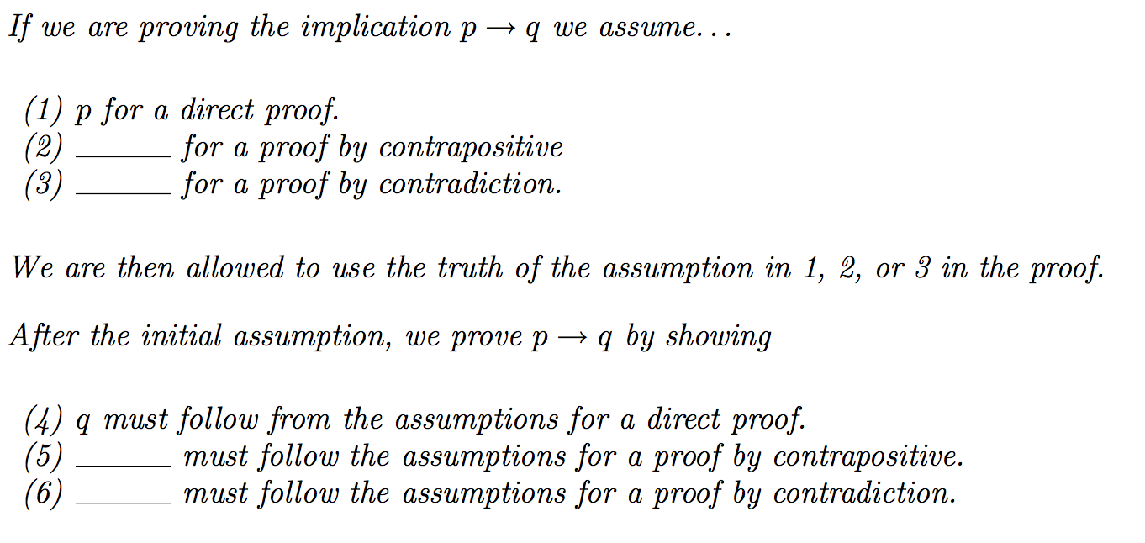
Fill in the blanks

Slide 93
Practice problems from Chapter 6.
3, 4, 5, 8, 14, 19, 21.

Slide 94
Some properties of congruent modulo n
For all integers a, a ≡ a (mod n).

Slide 95
Some properties of congruent modulo n
For all integers a, a ≡ a (mod n).
Follows easily since a – a = 0 = n x 0.
If a and b are integers such that a ≡ b (mod n), b ≡ a (mod n).

Slide 96
Some properties of congruent modulo n
For all integers a, a ≡ a (mod n).
Follows easily since a – a = 0 = n x 0.
If a and b are integers such that a ≡ b (mod n), b ≡ a (mod n).
If n|(b-a), n|(a-b), vice versa.
If a, b and c are integers such that a ≡ b (mod n) and b ≡ c (mod n), then a ≡ c (nod n).

Slide 97
Some properties of congruent modulo n
For all integers a, a ≡ a (mod n).
Follows easily since a – a = 0 = n x 0.
If a and b are integers such that a ≡ b (mod n), b ≡ a (mod n).
If n|(b-a), n|(a-b), vice versa.
If a, b and c are integers such that a ≡ b (mod n) and b ≡ c (mod n), then a ≡ c (nod n).
Given n|(a-b) and n|(b-c). Now (a-c) = (a-b) + (b-c). Therefore, n|(a-c).

Slide 98
Modular arithmetic
(5(24))Suppose that a, b and c, d are integers such that a ≡ b (mod n) and c ≡ d (mod n). Then
(a + c) ≡ b + d (mod n)

Slide 99
Modular arithmetic
(5(24))Suppose that a, b and c, d are integers such that a ≡ b (mod n) and c ≡ d (mod n). Then
(a + c) ≡ b + d (mod n) (easy)
a – c ≡ b – d (mod n)

Slide 100
Modular arithmetic
(5(24))Suppose that a, b and c, d are integers such that a ≡ b (mod n) and c ≡ d (mod n). Then
(a + c) ≡ b + d (mod n) (easy)
a – c ≡ b – d (mod n)
(Easy) since (a – c ) - (b – d ) = (a– b) + (d – c)
ac ≡ bd (mod n)

Slide 101
Modular arithmetic
(5(24))Suppose that a, b and c, d are integers such that a ≡ b (mod n) and c ≡ d (mod n). Then
(a + c) ≡ b + d (mod n) (easy)
a – c ≡ b – d (mod n)
(Easy) since (a – c ) - (b – d ) = (a– b) + (d – c)
ac ≡ bd (mod n)
Given a-b = t.n and c – d = t’.n
Therefore, a = b+ t.n, and c = d + t’n
Hence ac = bd + n(bt’ + dt + tt’n).
This implies that (ac –bd) is divisible by n.
ac ≡ bd (mod n)

