Slide 1
Probability Theory
Section 3.4 and 3.5
of
Grimaldi’s book

Slide 2
Acknowledgement
I have used materials from the following sources:
Textbook
Lecture notes slides prepared by Prof. Bulatov.

Slide 3
Sample space
Experiment: tossing a coin, rolling a die, selecting subjects from a group at random
The set of all possible outcomes of an experiment is called a sample space.

Slide 8
A: event of subset of size 4 where 47 is included and 73 is not included.
|A|= 1 x 98 x 97 x 96.
Sample space size = C(100,4).

Slide 9
Sample space
Under the assumption of equal likelihood, let S be the sample space for an experiment E. Each subset of S, including empty set, is called an event. Each element of S determines an outcome, so if |S| =n and a ε S and A ⊆ S, then
Pr({a}) = Pr(a) = |{a}|/|S| = 1/n
Pr(A) = |A|/n

Slide 10
Axioms of Probability
Let S be the sample space for an experiment E. Let A be any event (i.e. A ⊆ S).
Pr(A) ≥ 0
Pr(S)= 1
Rule of Complement: Pr(A)=1-Pr(A^{c}) where A^{c} is the complement of event A.

Slide 12
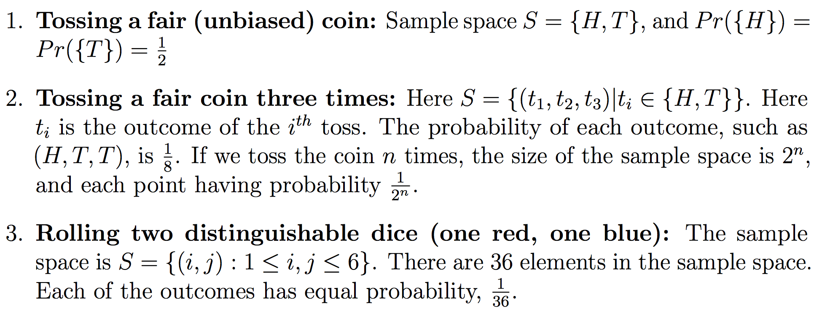
Examples of sample space

Slide 13
Examples of sample space

Slide 14
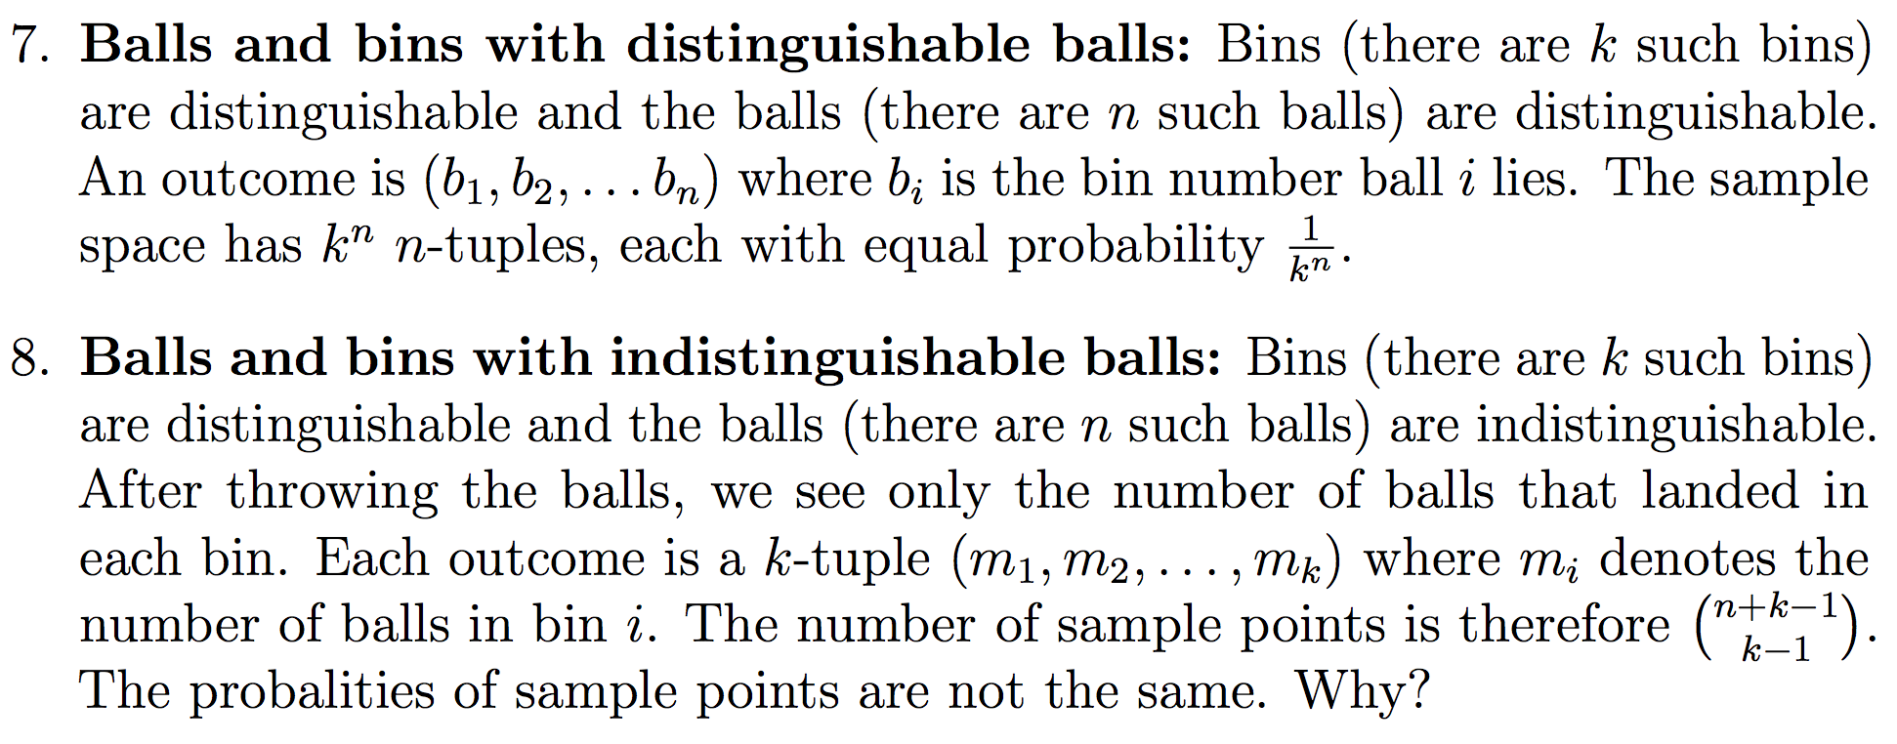
Examples of sample space

Slide 15
Examples of sample space

Slide 16
Probabilities do not depend on the order

Slide 18
Monty Hall Game (1970s)
A contestant is shown three doors; behind one of the doors was a prize (car), and behind the other two were goats.
The contestant picks a door (but doesn’t open it)
Monty’s assistant opens one of the other two doors, revealing a goat. (This is easy since the assistant knows where the prize is.)
The contestant is then given the option of sticking with his current door, or switching to the other unopened one.
Question is: Does the contestant have a better chance of winning if he/she switches it?

Slide 19
The Monty Hall Game (1970s) (contd.)
Intuitively, it seems obvious that there are only two remaining doors; they must have equal probability.
You are better off switching. Why?

Slide 20
The Monty Hall Game (1970s) (contd.)
Intuitively, it seems obvious that there are only two remaining doors; they must have equal probability.
You are better off switching. Why?
First write the sample space, and then assign probability to the sample space.
The sample space: S = {(car, goat, goat), (goat, car, goat), (goat, goat, car)}.
The probability of each sample point is 1/3. (equal likelihood, uniform probability)

Slide 21
The Monty Hall Game (1970s) (contd.)
Intuitively, it seems obvious that there are only two remaining doors; they must have equal probability.
You are better off switching. Why?
First write the sample space, and then assign probability to the sample space.
The sample space: S = {(car, goat, goat), (goat, car, goat), (goat, goat, car)}.
The probability of each sample point is 1/3. (equal likelihood, uniform probability)
If you don’t switch, Pr(winning) = 1/3.
If you switch, you always win if your initial selection was wrong.
If you switch, Pr(winning) = 2/3.

Slide 22
Birthday Paradox
Examine the chances that two people in a group have the same birthday.
Suppose U={1,2, …, 365}, is the number of days in a year.
The experiment consists of drawing a sample of n elements from U.
The size of the sample space : |S| = 365^{n}.

Slide 23
Birthday Paradox
Examine the chances that two people in a group have the same birthday.
Suppose U={1,2, …, 365}, is the number of days in a year.
The experiment consists of drawing a sample of n elements from U.
The size of the sample space : |S| = 365^{n}.
Let A be the event that at least two people have the same birthday.
Let A^{c} be the complement of A, i.e. it is the event of no two people have the same birthday.
|A^{c}| = 365 x 364 x … x (365 – n + 1).
Pr(A^{c}) = (365 x 364 x … x (365 – n + 1))/(365)^{n}
Pr(A) = 1 – P(A^{c})

Slide 24
Birthday Paradox
Examine the chances that two people in a group have the same birthday.
Suppose U={1,2, …, 365}, is the number of days in a year.
The experiment consists of drawing a sample of n elements from U.
The size of the sample space : |S| = 365^{n}.
Let A be the event that at least two people have the same birthday.
Let A^{c} be the complement of A, i.e. it is the event of no two people have the same birthday.
|A^{c}| = 365 x 364 x … x (365 – n + 1).
Pr(A^{c}) = (365 x 364 x … x (365 – n + 1))/(365)^{n}
Pr(A) = 1 – P(A^{c})
As n increase, Pr(A) increases.
When n = 23, Pr(A) is larger than 50%.
When n= 60 people, Pr(A) is over 99%.

Slide 25
Tossing with a biased coin
A coin is biased if Pr({head}) ≠ Pr({tail}).
Is it possible to toss a coin whose outcome is unbiased, even when you are tossing with a biased coin?
Let Pr({head}) = p, p is unknown.
Pr({tail}) = 1-p.
A simple experiment:
flip the coin twice : events A = {head}; B = {tail}
if event A is followed by event B, output unbiased-head
if event B is followed by event A, output unbiased-tail
Otherwise, repeat the experiment.

Slide 26
Example
Example: (6, Exercise 3.4) If two integers are selected, at random and without replacement, from {1, 2, 3, …, 100}, what is the probability the integers are consecutive.

Slide 27
Summary
It is important to do probability calculations systematically.
The key steps are:
what is the sample space?
what is the probability of each outcome?
what is the event we are interested in?
Finally, compute the probability of the event by adding up the probabilities of the sample points inside it
Be careful, there are many pitfalls if you are not careful.

Slide 28
Practice Problems from Grimaldi’s book (fifth edition)
Example 3.31 (page 151), 3.33 (page 152), 3.34 (page 153), 3.37 (page 155).
Example 3.39 (page 157), 3.40 (page 159).
Exercises 3.4: 4, 7, 9
Exercises 3.5: 3, 4, 7

