Slide 1
Pigeonhole Principle Section 12.3

Slide 2
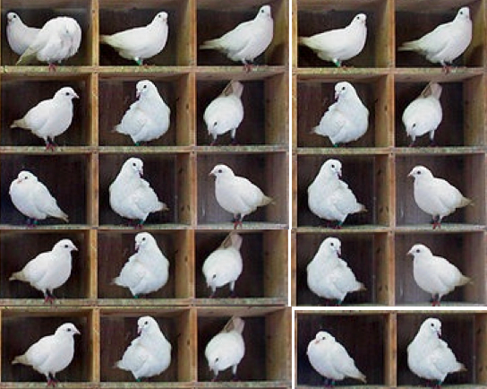
The Pigeonhole Principle
In words:
If n pigeons are in fewer than n pigeonholes, some pigeonhole must contain at least two pigeons

Slide 3
The Pigeonhole Principle
In math:

Slide 4
The Pigeonhole Principle
What is a set?
a finite set?
What is |A|?
What is a function?
the domain of a function?
the codomain of a function?
Why say “distinct”?

Slide 5
Other principles related to the pigeonhole principle:
If n objects are put into n boxes and no box is empty, each box has exactly one object.
If n objects are put into n boxes and no box gets more than one object, each box has an object.

Slide 6
Abstract formulation
Let X and Y be finite sets and let f: X → Y be a function.
If X has more elements than Y, then f is not one-to-one.
If X and Y have the same number of elements and f is onto, then f is one-to-one.
If X and Y have the same number of elements and f is one-to-one, then f is onto.

Slide 7
Applications of The Pigeonhole Principle
In any group of 8 people, two were born on the same day of the week
What are the “pigeons” and what are the “pigeonholes”?
A = the set of people, B = {Sun, … Sat}, f(a) = the day of the week on which a was born

Slide 8
Generalized pigeonhole principle
If m objects are placed into n boxes, then there is at least one box containing ⎡m/n⎤ objects
Proof by contradiction. Suppose each box contains less than ⎡m/n⎤ objects, and there are m objects in total in n boxes. In this case the total number of objects n boxes can hold is at most (⎡m/n⎤ -1)*n which is less than (((m/n)+1)-1)*n, since ⎡x⎤ < x+1 always. This implies that there are less than m pigeons in n boxes. This is a contradiction.

Slide 9
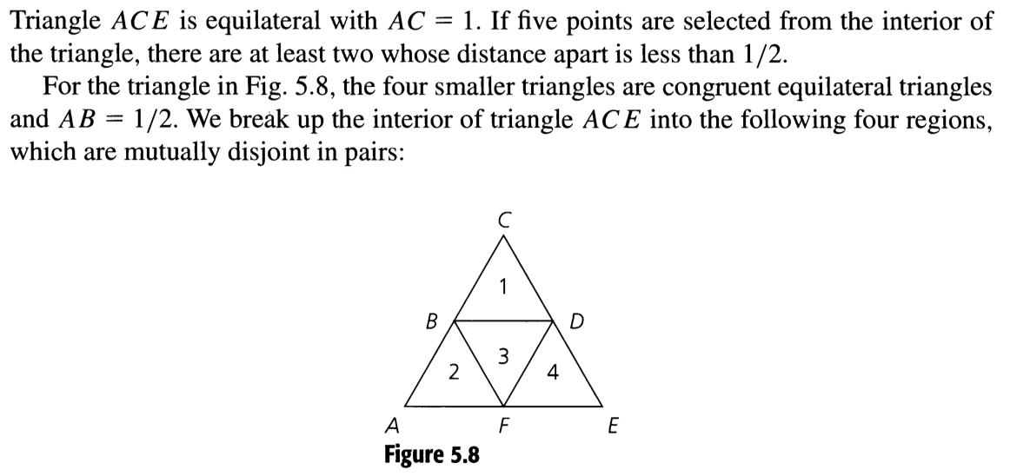
Problems
Let S ⊂ Z⁺, where |S|=12. Then S contains two elements that have the same remainder upon division by 11.
For any element a of S, (a mod 10} ∈ {0, 1, 2, 3, …, 10}. We define the function f: X → Y as follows: X = S; Y = {0,1,2,3,4,5,6,7,8,9}; f(a) = a mod 10. Now apply PHP.
Example 5.45 of Grimaldi’s Text
Define a function f: X → Y
where X contains 5 points (pigeon) and Y contains 4 triangles (hole)

Slide 10
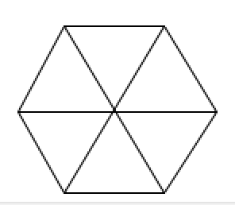
Problems (contd.)
19 darts are thrown onto a dartboard which is shaped as a regular hexagon with side length of 1 unit. Show that there are 4 darts within distance 1.
Each triangle is an equilateral triangle. Each side is of length 1.
Show that among 200 people, there are at least 17 people who are born on the same month. How many pigeons? How many holes?
How many students in a class must there be (smallest size) to ensure that 10 students get the same grade (one of A, B, C, D, F, or N)?

Slide 11
Problems (contd.)
Suppose that there are 50 people in the room. Some of them are acquainted with each other, while some are not. Assume that each person has at least one acquaintance. Show that there are two persons in the room who have equal number of acquaintances.
(Hints: Each individual can have acquaintances in the range [1 .. 49]. Why?)

Slide 12
Problems (contd.)
Consider n distinct numbers a₁, a₂, …, a_{m}. Let m = min {a₁, a₂, …, a_{n}} and M = max {a₁, a₂, …, a_{n}}. We define the gap of of two elements a_{i} and a_{j} to be |a_{i} – a_{j}| if there does not exist any other element a_{k} with a_{i} < a_{k} < a_{j}, otherwise it is 0. Show that there exist two elements in {a₁, a₂, …, a_{n}} whose gap is at least (M-m)/(n+1).
The gap between a₂ and a₆ is the largest; the gap between a₄ and a₆ is zero, since a₂ lies in between a₄ and a₆.
(Hint: Partition the interval [m .. M] into n+1 small sub-intervals (holes), each of length (M-m)/(n+1). When n points (pigeons) are placed in the holes, there exists at least one empty hole. )
m
M
a₄
a₂
a₆
a₃
a₅
a₁

Slide 13
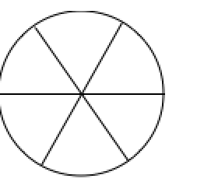
Problems (contd.)
Seven darts are thrown onto a circular dartboard of radius 10 units. Show that there will be two darts which are at most 10 units apart.
6 computers on a network are connected to at least 1 other computer. Show there are at least two computers that have the same number of connections
Given m positive integers a₁, a₂, …, a_{m}, show that there exists k and l with 0 ≤ k <l ≤ m such that a_{k+1} + a_{k+2} + … + a_{l} is divisible by m.
(Hints: Let A_{i} = a₁ + a₂ + … + a_{i}. Let B_{i} = A_{i} mod m.
Define f: X → Y where X= {A₁, A₂, …, A_{m}} and Y = {B₁, B₂, …, B_{m}}, and
|X| > |Y|. This implies that there exist indices j and j’ such that
A_{j} mod m = A_{j’} mod m. i.e. a_{j+1} + a_{j+2} + … + a_{j’} is divisible by m.)

Slide 14
Problems (contd.)
Problems from the text (Section 12.3): 1, 2, 3, 5. 6.

Slide 15
A nontrivial example:
A chess master who has 11 weeks to prepare for a tournament decides to play at least one game every day, but he decides not to play more than 12 games during any calendar week. Show that there exists a succession of consecutive days during which the chess master will have played exactly 21 games.
Ans:
Let a_{j} = number of games played on the first j days.
Therefore, 1 < a₁ < a₂ < … < a₇₇ ≤ 12 x 11 (why?)

Slide 16
A nontrivial example:
Let a_{j} = number of games played on the first j days.
Therefore, 1 < a₁ < a₂ < … < a₇₇ ≤ 12 x 11 (why?)
Let b_{j} = a_{j} + 21, j= 1, 2, …, 77.
Therefore, 21 < b₁ < b₂ < … < b₇₇ ≤ 132+21 (why?)
Define a function f : X → Y where
X = {a₁, a₂, …, a₇₇, b₁, b₂, …, b₇₇}
Y = {1,2,3, …, 153} (the value each a_{j} or b_{j} is at most 153)
f(x) = the value of x
There are 154 pigeons and 153 holes.
Hence there exists j and j’ such that a_{j} = b_{j’}.
Thus during days j’+1, j’ +2, …, j the chess player played exactly 21 games.

