Slide 1
Logic- Part-II
Some slides have been taken from the sites
http://cse.unl.edu/~choueiry/S13-235/
and
http://www.whitman.edu/mathematics/higher_math_online/section01.02.html

Slide 2
Predicate Logic (Propositional Function)
Propositional statements are not powerful enough to capture wide range of statements.
Consider the statement:
For every n ∈ Z, 2n is even
Consider the sentences
y has four sides
x has black hair
x+2 is an even integer
The above sentences involve variables.

Slide 3
Open sentences
A sentence whose truth value depends on the value of one or more variables is called an open sentence.
Examples of open statements
p(y): y has four sides
p(x): x has black hair
p(x): x+2 is an even integer
Mother(x): propositional function with one variable.
Friend(x,y): function with two variables. (2-tuple)
P(x₁, x₂, …, x_{n}): function with n variables. (n-tuple)
An open statement p(x) is a proposition when x is assigned a value.

Slide 4
Universe of Discourse
Intuitively, universe of discourse of a variable x in a propositional function is the set of values x can take.
p(y): y has four sides.
Universe: set of polygons
p(x): x has black hair
Universe: humans
p(x): x + 2 is an even integer
Universe: set of integers

Slide 5
Quantifiers
We can use ∧, ∨, ¬, , to deconstruct many English sentence to an equivalent symbolic form.
These symbols are not enough.
For every n ∈ Z, 2n is even
Consider the open statement p(x): x is an even integer. Since the universe is Z, the above proposition can be written as
[...∧ p(2.(-2)) ∧ p(2.(-1)) ∧ p(2(0)) ∧ p(2(1)) ∧ …].
This is not much of help.

Slide 6
Universal Quantifier: ∀ (for all)
∀ x p(x): a proposition which is true if p(x) is true for all values of x of the universe of discourse.
Consider : For every n ∈ Z, 2n is even
Let p(x): x is even be an open statement.
For every n ∈ Z, 2n is even can be wriiten as ∀ x ∈ Z, p(2x).
If the Universe is finite, say {a₁, a₂, …, a_{n}}, then
∀ x p(x) p(a₁) ∧ p(a₂) ∧ … ∧p(a_{n}) .

Slide 7
Universal Quantifier: ∀ (for all)
∀ x p(x): a proposition which is true if p(x) is true for all values of x of the universe of discourse.
Consider : For every n ∈ Z, 2n is even
Let p(x): x is even be an open statement.
For every n ∈ Z, 2n is even can be written as ∀ x ∈ Z, p(2x).

Slide 8
Examples : universal quantifiers
Let p(x): x takes macm 101; q(x): x is a CS student.
Express the statements:
Every CS student must take macm101

Slide 9
Examples : universal quantifiers
Let p(x): x takes macm 101; q(x): x is a CS student.
Express the statements:
Every CS student must take macm101
∀ x (q(x) p(x))

Slide 10
Examples : universal quantifiers
Let p(x): x takes macm 101; q(x): x is a CS student.
Express the statements:
Every CS student must take macm101
∀ x (q(x) p(x))
Everybody must take macm101 or be a non CS student.

Slide 11
Examples : universal quantifiers
Let p(x): x takes macm 101; q(x): x is a CS student.
Express the statements:
Every CS student must take macm101
∀ x (q(x) p(x))
Everybody must take macm101 or be a non CS student.
∀ x (p(x) ∨ ¬q(x))

Slide 12
Examples : universal quantifiers
Express the statement
‘for every x and every y, x+y>10’
Answer:
Let P(x,y) be the statement x+y>10
Where the universe of discourse for x, y is the set of integers
The statement is: ∀x ∀y P(x,y)
Shorthand: ∀x,y P(x,y)

Slide 13
Existential Quantifier: ∃ (there exists)
∃ x p(x): a proposition which is true if p(x) is true for at least one values of x of the universe of discourse.
Consider : There is an integer that is not even
Let p(x): x is even be an open statement.
The above proposition can be wriiten as ∃ x ∈ Z, ¬ p(x).
If the Universe is finite, say {a₁, a₂, …, a_{n}}, then
∃ x p(x) p(a₁) ∨ p(a₂) ∨ …∨ p(a_{n}) .

Slide 14
Existential Quantifier: ∃ (there exists)
Example: What is the truth value of ∃x p(x) where p(x) is the statement ``x² > 10”? Suppose the universe of discourse is set of positive number not exceedin 4, i.e. the set {1,2,3,4}
Ans:

Slide 15
Existential Quantifier: ∃ (there exists)
Example: What is the truth value of ∃x p(x) where p(x) is the statement ``x² > 10”? Suppose the universe of discourse is set of positive number not exceeding 4, i.e. the set {1,2,3,4}
Ans:
In our case ∃x p(x) p(1)∨ p(2) ∨ p(3) ∨ p(4).
Since p(4) is true, ∃x p(x) is true.

Slide 16
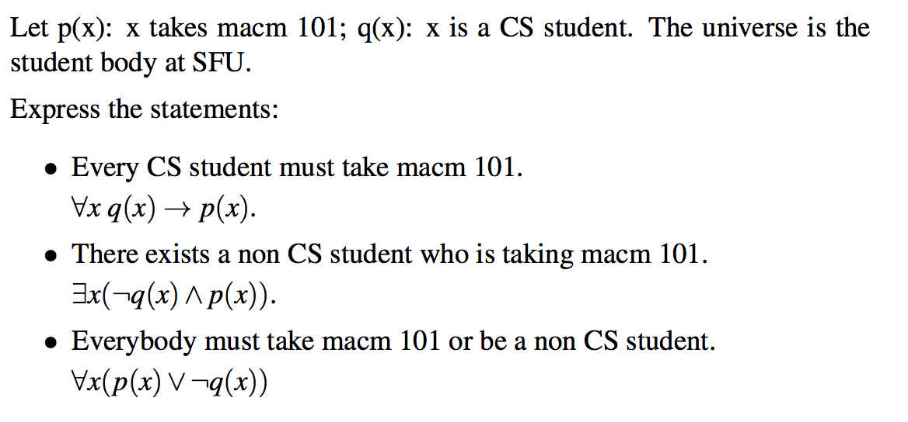
Existential Quantifier: Examples

Slide 17
Quantifiers: Truth values
The truth table for the quantified statements.

Slide 18
Example:
p(x): x > 0; q(x): x² ≥ 0; r(x): x² – 3x -4 =0 s(x): x² – 3 >0.

Slide 19
Example:
p(x): x > 0; q(x): x² ≥ 0; r(x): x² – 3x -4 =0 s(x): x² – 3 >0.

Slide 20
Precedence of Quantifiers
The quatifiers ∀ and ∃ have higher precedence than all logical connectives.
∀x p(x) ∧ q(x) is the conjunction of ∀x p(x) and q(x).
it is equivalent to (∀x p(x)) ∧ q(x)
but not equivalent to ∀x (p(x) ∧ q(x) )

Slide 21
Problems
Let p(x,y): xy =0; Universe is R.
∀x ∀y p(x,y) ∀y ∀x p(x,y) (?)
∀x ∃y p(x,y) ∃y ∀x p(x,y) (?)
Let q(x,y): x+y = 0; Universe is R
∃y ∀x q(x,y)
∀x ∃y q(x,y)

Slide 22
Problems
Let p(x,y): xy =0; Universe is R.
∀x ∀y p(x,y) ∀y ∀x p(x,y) (?) (T)
∀x ∃y p(x,y) ∃y ∀x p(x,y) (?) (T)
Let q(x,y): x+y = 0; Universe is R
∃y ∀x q(x,y) (F)
∀x ∃y q(x,y) (T)

Slide 23
Translating English to Symbolic Logic
Goldbach’s conjecture: Every even integer greater than 2 is the sum of two prime numbers.
Let P = { 2, 3, 5, 7, …} be the set of primes;
Let S= {4,6,8,10, …} be the set of even integers > 2.
∀x ∈ S, ∃p, q ∈ P, x = p + q.

Slide 24
Translating English to Symbolic Logic
Goldbach’s conjecture: Every even integer greater than 2 is the sum of two prime numbers.
Let P = { 2, 3, 5, 7, …} be the set of primes;
Let S= {4,6,8,10, …} be the set of even integers > 2.
∀x ∈ S, ∃p, q ∈ P, x = p + q.
We can also write the conjecture as
(x ∈ S) ∃p, q ∈ P, x = p + q.

Slide 25
Translating English to Symbolic Logic
Goldbach’s conjecture: Every even integer greater than 2 is the sum of two prime numbers.
Let P = { 2, 3, 5, 7, …} be the set of primes;
Let S= {4,6,8,10, …} be the set of even integers > 2.
∀x ∈ S, ∃p, q ∈ P, x = p + q.
We can also write the conjecture as
(x ∈ S) ∃p, q ∈ P, x = p + q.
Every universally quantified statement can be expressed as a conditional statement.

Slide 26
Translating English to Symbolic Logic
Every universally quantified statement can be expressed as a conditional statement.
The following statements mean the same thing.
∀x ∈ S, Q(x)
(x ∈ S) Q(x)
Sometimes a theorem will be expressed as a universally quantified statement, but it will be more convenient to think of it as a conditional statement.

Slide 27
Translating English to Symbolic Logic
Every universally quantified statement can be expressed as a conditional statement.
The following statements mean the same thing.
∀x ∈ S, Q(x)
(x ∈ S) Q(x)
Sometimes a theorem will be expressed as a universally quantified statement, but it will be more convenient to think of it as a conditional statement.
We should be able to switch between the two forms

Slide 28
Translating English to Symbolic Logic
If somebody is female and is a parent, this person is someone’s mother
f(x): x is female
p(x): x is a parent
m(x,y): x is the mother of y

Slide 29
Translating English to Symbolic Logic
If somebody is female and is a parent, this person is someone’s mother
f(x): x is female
p(x): x is a parent
m(x,y): x is the mother of y
∀x (f(x) ∧ p(x) ∃ y m(x,y))

Slide 30
Translating English to Symbolic Logic
For every prime number p there is another prime number q with q > p.
f(x): x ∈ N is a prime.
g(x,y): x > y, x, y ∈ N.

Slide 31
Translating English to Symbolic Logic
For every prime number p there is another prime number q with q > p.
f(x): x ∈ N is a prime.
g(x,y): x > y, x, y ∈ N.
∀p∈ N, f(x) ∃ q∈ N, f(q) ∧ g(q, p))
∀p∈ N, ( f(x) ∧ (∃ q∈ N, f(q) ∧ g(q, p)))

Slide 32
Translating English to Symbolic Logic
For every prime number p there is another prime number q with q > p.
f(x): x ∈ N is a prime.
g(x,y): x > y, x, y ∈ N.
∀p, f(x) ∃ q, f(q) ∧ g(q, p))
∀p, ( f(x) ∧ (∃ q, f(q) ∧ g(q, p)))

Slide 33
Translating English to Symbolic Logic
P(x): x is a person; T(y): time is y; F(x,y): you can fool x in time y.
You can fool some of the people all of the time

Slide 34
Translating English to Symbolic Logic
P(x): x is a person; T(y): time is y; F(x,y): you can fool x in time y.
You can fool some of the people all of the time
∃p (∀t (P(p) ∧ (T(t) F(p,t))))

Slide 35
Translating English to Symbolic Logic
P(x): x is a person; T(y): time is y; F(x,y): you can fool x in time y.
You can fool some of the people all of the time
∃p (∀t (P(p) ∧ (T(t) F(p,t))))
You can fool all of the people some of the time

Slide 36
Translating English to Symbolic Logic
P(x): x is a person; T(y): time is y; F(x,y): you can fool x in time y.
You can fool some of the people all of the time
∃p (∀t (P(p) ∧ (T(t) F(p,t))))
You can fool all of the people some of the time
∃t (∀p (P(p) ∧ (T(t) F(p,t))))

Slide 37
Translating English to Symbolic Logic
P(x): x is a person; T(y): time is y; F(x,y): you can fool x in time y.
You can fool some of the people all of the time
∃p (∀t (P(p) ∧ (T(t) F(p,t))))
You can fool all of the people some of the time
∃t (∀p (P(p) ∧ (T(t) F(p,t))))
You can fool all of the people all of the time

Slide 38
Translating English to Symbolic Logic
P(x): x is a person; T(y): time is y; F(x,y): you can fool x in time y.
You can fool some of the people all of the time
∃p (∀t (P(p) ∧ (T(t) F(p,t))))
You can fool all of the people some of the time
∃t (∀p (P(p) ∧ (T(t) F(p,t))))
You can fool all of the people all of the time
∀p ∀t (P(p) ∧ (T(t) F(p,t))))

Slide 39
Negation
We can use negation with quantified expressions as we used them with propositions
Let P(x) be a predicate. Then the followings hold:
¬(∀x P(x)) ≡ ∃x ¬P(x)
(∃x P(x)) ≡ ∀x ¬P(x)
This is essentially the quantified version of De Morgan’s Law.

Slide 40
Negation: Truth
Truth Values of Negated Quantifiers
Statement | True when… | False when...
¬∃x P(x) ≡ ∀x ¬P(x) | P(x) is false for every x | There is an x for which P(x) is true
¬∀x P(x) ≡ ∃x ¬P(x) | There is an x for which P(x) is false | P(x) is true for every x

Slide 41
Negation: Example
Rewrite the following expression, pushing negation inward:
¬ ∀x (∃ y ∀z P(x,y,z) ∧ ∃ z ∀y P(x,y,z))
Answer:
∃x (∀y ∃z ¬P(x,y,z) ∨ ∀z ∃y ¬P(x,y,z))

Slide 42
Example
p(x): x is odd; q(x): x² – 1 is odd.
∀x (p(x) q(x))
¬ [∀x (p(x) q(x))]
∃x [ ¬(p(x) q(x))]
∃x [ ¬ (¬ p(x) ∨ q(x))]
∃x [ p(x) ∧ ¬ q(x) ]

Slide 43
Example
p(x): x is odd; q(x): x² – 1 is odd.
∀x (p(x) q(x)) True
¬ [∀x (p(x) q(x))]
∃x [ ¬(p(x) q(x))]
∃x [ ¬ (¬ p(x) ∨ q(x))]
∃x [ p(x) ∧ ¬ q(x) ] False

Slide 44
Comments
Whenever you see a quantifier, ask what is the universe of discourse.
Should know the precedence rules. It is better to eliminate confusion by using the parentheses.
The order of quantifiers matters a lot. Most often ∀x ∃y q(x,y) is not equal to ∃x ∀y q(x,y).
DeMorgan’s laws for quantifiers are very useful. It is important to be comfortable with DeMorgan’s laws.
You don’t need to memorize the laws of logic. Just convince yourself that they are true.
One way to show logical equivalence is through truth tables, at least when they do not have quantifiers over variables.

Slide 45
Practice problems from the text:
Section 2.7
1, 2, 4, 5, 7, 8
Section 2.9
5, 6, 8, 11
Section 2.10
3, 4, 5, 6

Slide 46
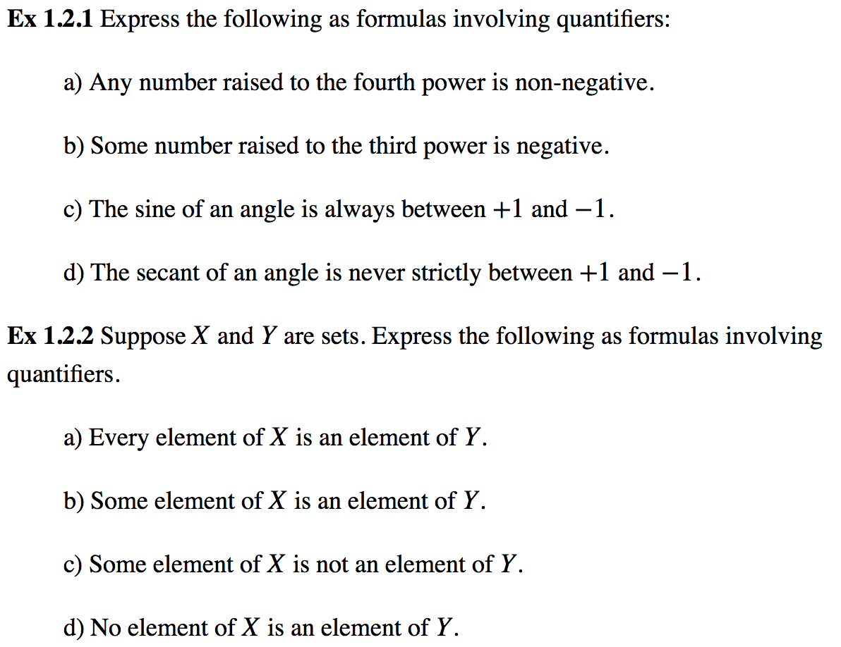
Some more practice problems (the universe is real)

Slide 47
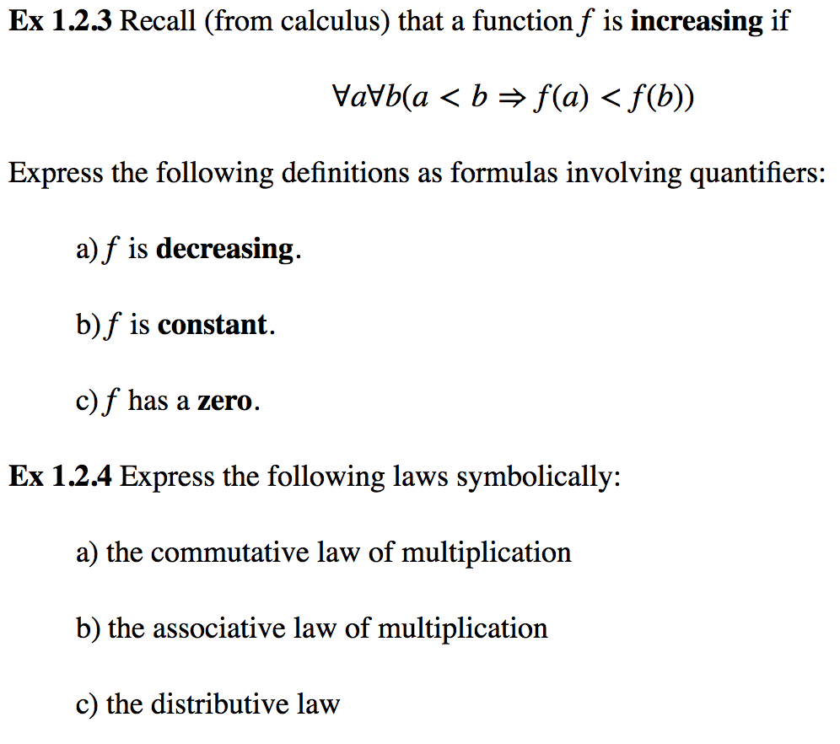
Some more practice problems (the universe is real)

Slide 48
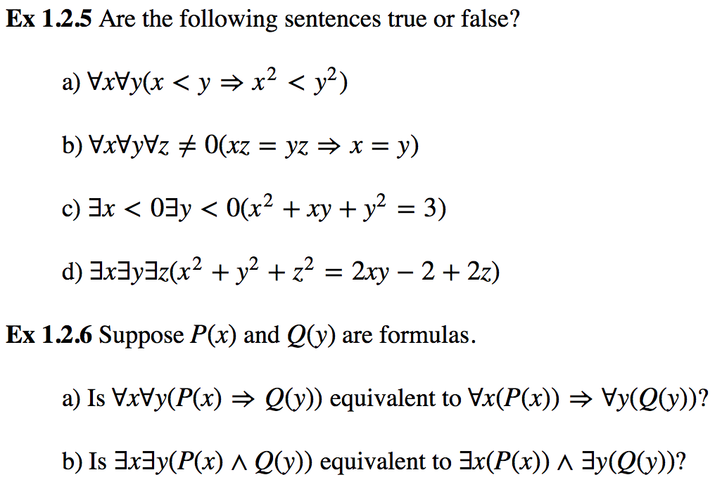
Some more practice problems (the universe is real)

